Slide 1
Agile Software Development and Testing
Portnov Computer
School

Slide 2
Ground Rules for this class
Start on time, end on time
Electronics use – only by exception (isn’t it surprising?)
One conversation at a time
No cell phones, please

Slide 3
Agile Software Engineering
Different names…
  SCRUM
  XP (extreme programming)
  Lean development

Slide 4
Agile Software Engineering
…similar methodology:
  Incremental framework for software project development
  Introduced to accommodate rapid product changes
  Frequent releases in short development cycles (sprints, timeboxing etc)
  Minimal requirement, spec and test documentation (if at all)
  Often – no formal test cases

Slide 5
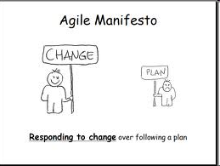
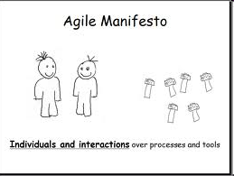
Agile Software Engineering

Slide 6



Agile Software Engineering
Traditional software development models:
Pre-defined set of features, low requirements churn
Delivering large pieces of software (incremental development) or entire product (waterfall) at once → longer development periods → less defined quality during development period, quality is assessed at testing phase
Start
Traditional
Release
Patch Releases
Development
Testing / Stabilization
Agile software development model:
Dynamically defined/prioritized set(s) of features
Delivering smaller pieces, one by one→ shorter development periods → more defined quality during development/testing period
First Release
Last Release
Always Stable

Slide 7
Agile Software Development vs Testing
Traditional software development models:
Front loaded development
Dev
Dev
Dev
Dev
Dev
Dev
Dev
Dev
QA
QA
QA
QA
Month 1
Month 2
Month 3
Agile software development model:
This point could slide either way
Continuous development in sprint
Dev
Dev
QA
Dev
Dev
QA
Dev
Dev
Dev
Dev
QA
QA
Month 1
Month 2
Month 3

Slide 8
SCRUM
What is Scrum?

Slide 9

SCRUM
What is Scrum?

Slide 10
SCRUM
What is Scrum?

Slide 11
SCRUM
What is Scrum?
= Type of Agile software engineering
= Iterative and incremental framework for software engineering
= Process with pre-defined set of practices and roles

Slide 12
SCRUM
Why?
To maximize team’s ability to deliver quickly and respond to evolving and changing requirements.
To develop functionality in smaller and stable increments (as opposite to one large unstable bundle) – have potentially deliverable product in shorter periods of time

Slide 13
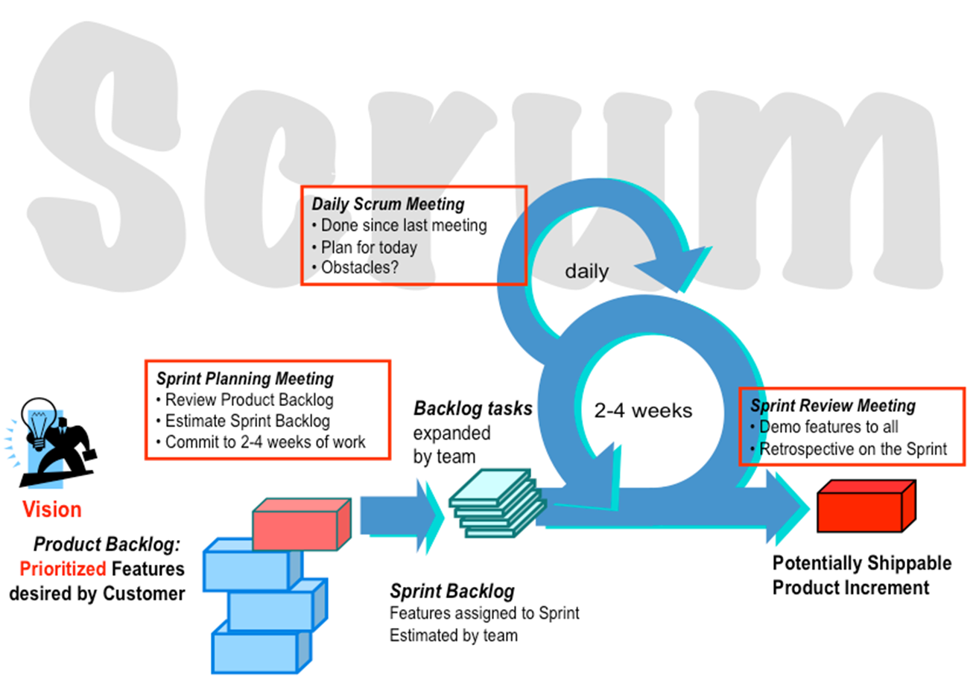
SCRUM – How?
By short development cycles (Sprints):

Slide 14
SCRUM – Team
Form a Scrum team:
  Scrum Master (maintains the process)
  Product Owner (represents the stakeholders and the business)
  Team (cross-functional group – Dev, QA, Architects, Business Analysts etc)
  Team size: 5-9, co-located
  If need to scale – add more Scrum teams

Slide 15
SCRUM – Team
Scrum Master:
  Leads the team
  Facilitates and coordinates everything
  Helps removing the obstacles
  Safeguards the process
  Acts as “sheepdog” for the team
  Can be anyone with necessary skills

Slide 16
SCRUM – Team
Product Owner:
  Business-oriented, defines product backlog
  Prioritizes features
  Owns vision of the product
  Owns release dates/costs
  Open to negotiations with the Team
  Can be Product/Project/Marketing Manager

Slide 17
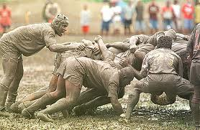
SCRUM – Team
Team:
  Developers, QAs, Architects, Analysts, Tech Writers, Subject matter experts etc.
  Actually does the work
  Responsible for estimates and planning the work/risks
  Do all the needful to deliver on schedule

Slide 18
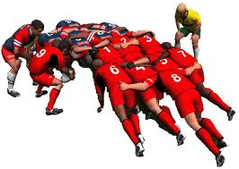
SCRUM – Team
Basic Team building principles:
  Trust
  Commitment
  Reliability
  Honesty
  Professionalism
  Effective Communications
  Self-organized and self-led

Slide 19
SCRUM – Process
Sprint
  Basic unit of development in Scrum
  Timeboxed (restricted to a specific duration) effort of a constant length
  Team decides the duration
  Typically - 1 to 4 weeks
  Before Sprint: planning meeting
  After Sprint: review/demo and retrospective

Slide 20
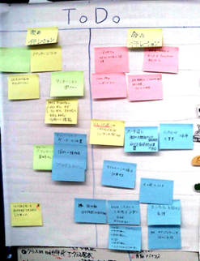
SCRUM – Process
Product Backlog:
  Defined by Product Owner/Team
  Prioritized by Product Owner
  Reviewed and re-prioritized before project starts and before each Sprint

Slide 21
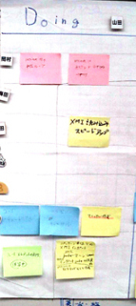
SCRUM – Process
Sprint Backlog:
  Defined/Prioritized by Product Owner/Team
  List of items to be done within next sprint
  Each feature is broken down into tasks
  Each task is 4-16 hrs of work

Slide 22
SCRUM – Process
Burn Down chart:
Tracks the progress in labor or work units – done, total, left
In class, we use topics/slides covered

Slide 23
SCRUM – Process
Sprint Planning Meeting:
Held at the beginning of the sprint (every 7-28 days)
Select what work is to be done
Prepare the Sprint Backlog that details the time it will take to do that work, with the entire team Identify and communicate how much of the work is likely to be done during the current sprint
Eight hours limit
  (1st four hours) Product Owner + Team: dialog for prioritizing the Product Backlog
  (2nd four hours) Team only: hashing out a plan for the Sprint, resulting in the Sprint Backlog

Slide 24
SCRUM – Process
Sprint Review Meeting:
Held at the end of each Sprint cycle
Review the work that was completed and not completed
Present the completed work to the stakeholders (a.k.a. “the demo”)
Incomplete work cannot be demonstrated
Four hour time limit

Slide 25
SCRUM – Process
Sprint Retrospective:
Held at the end of each Sprint cycle
All team members reflect on the past Sprint
Make continuous process improvements
Two main questions are asked in the sprint retrospective:
  What went well during the sprint?
  What could be improved in the next sprint?
Three hours limit

Slide 26
SCRUM – Process
Daily Scrum/Standup:
Held daily, same location and same time every day
The meeting starts precisely on time.
All are welcome, but normally only the core roles speak
The meeting is timeboxed to 15 minutes
Each team member answers three questions:
  What have you done since yesterday?
  What are you planning to do today?
  Any impediments/stumbling blocks?
Scrum Master facilitates resolution of impediments, although the resolution should occur outside the Daily Scrum itself to keep it under 15 minutes.

Slide 27
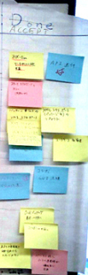
SCRUM – Process
Definition of DONE (DoD):
What “Done” means should be defined BEFORE Sprint starts
Individual for each Sprint team
All Sprint team members should agree
Cannot be changed once Sprint starts
Should be concrete and measurable
Defines deliverables for each Product Backlog item
“Sashimi” – a report that something is DONE.

Slide 28

SCRUM – Process
Sprint results:
If at the Sprint Review Meeting the acceptance criteria of “Done” are not met – the item(s) is NOT DONE and Sprint failed.
There are no “Partially Done” Sprints.

Slide 29
SCRUM – Process
Abnormally terminated Sprint:
The Product Owner can cancel a Sprint if necessary with input from the team, scrum master or management.
Management may wish to cancel a sprint if external circumstances negate the value of the sprint goal.
If a sprint is abnormally terminated, the next step is to conduct a new Sprint planning meeting, where the reason for the termination is reviewed.

Slide 30
SCRUM – Process
Inside the Sprint:
The development/testing done by delivery team
Daily scrums held to report progress/impediments
Product owner monitors the progress and backlog priorities
Scrum Master facilitates everything
Days are busy!

Slide 31
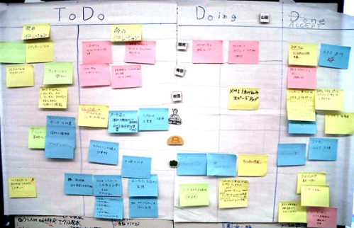
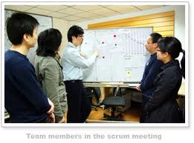
SCRUM – Process
Sprint at a glance:

Slide 32

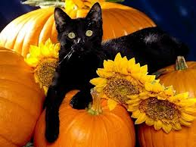

SCRUM - Exercise
Run one Sprint for a project:
Website “How to decorate a House for Halloween”
Site is informational, we are not selling anything!

Slide 33
SCRUM - Exercise
3-4 teams (5-9 people each)
Within each team, define roles:
  Scrum Master (1)
  Product Owner (1)
  Team (3-7)

Slide 34
SCRUM – Exercise
Select a page topic from Product backlog :
  Decoration materials (types, colors, where to get the supplies)
  Decorating with flowers
  Decorating with lights and toys
  Decorating with food
  Decorating with household items
  Last-minute decoration ideas
  “Green” decoration practices
  Safety measures

Slide 35
SCRUM – Exercise
Task: create ONE web site with multiple pages (each team should do ONE page, all pages should belong to ONE site):
Main Site/Page: “How to Decorate” (pick a team that will do the main page_
Main Site should have links to individual pages done by different teams.

Slide 36
SCRUM – Exercise
What to do in each team:
  Create a page (set of pages) on assigned topic
  Represent graphics and UI controls
  Can contain pictures/graphics (can you draw?)
  “Daily” Scrums! (every 15 mins)
  All pages should have consistent look and feel
  All pages should represent ONE site (→ Scrum Masters/Product Owners should coordinate between the teams on how pages are integrated and who is doing the Main Page)
  DO NOT FORGET TO TEST!

Slide 37
SCRUM – Exercise
Definition of DONE:
  Each page should represent the topic
  Each UI control (button, link) should be outlined and functional when clicked
  Demo – each team represents its module; Iana (=customer) to accept the work

Slide 38
SCRUM – Exercise
One..
  Two…
    Three…
      GO!

Slide 39
SCRUM – Exercise
Sprint Retrospective:
  Did we make the Sprint?
  What went well
  What went not so well
  How to improve
  What to do in the next Sprint

Slide 40
SCRUM – Why it can fail
Lack of commitment and reliability
Incorrect time/work estimates
Ineffective use of the retrospective
Inability to get everyone on planning and daily meetings
Bad Scrum Masters or Product Owners
Lack of team authority and decision-making skills
Team’s inability to learn
State of denial

Slide 41
SCRUM – Limitations
Project Scope: Scrum is challenging for large complex projects with geographically distributed teams and different time zones
Cannot be done in large teams and huge features (everything needs to be broken down)
Requires good Scrum Masters and Product Owners – do we have those?
Some organizations require audit trail on everything done (military, medical) – need paperwork trail and proof

Slide 42

SCRUM – Conclusion
Scrum:
Is doable and viable form of software development
Is getting more and more popular in the fast pacing markets
Doesn’t require specific skills that could not be found or developed within the team
Produces stable product increments in short periods of time
Makes everyone in the team accountable for success or failure
Develops great team spirit!

Slide 43
Backup slides

Slide 44
SCRUM - Exercise
3-4 teams (5-6 people each)
Within each team, define roles:
  Scrum Master (1)
  Product Owner (1)
  Team (3-4)

Slide 45
SCRUM – Exercise
Select a page topic from Product backlog :
  Types of trees
  Where to get the tree
  Decorating with lights and toys
  Decorating with food
  Decorating with household items
  Last-minute decoration ideas
  Safety measures
  Do’s and Don’t’s in Christmas tree decorating

Slide 46
SCRUM – Exercise
What to do in each team:
  Create a page (set of pages) on assigned topic
  Represent graphics and UI controls
  Can contain pictures/graphics (can you draw?)
  “Daily” Scrums! (every 15 mins)
  All pages should have consistent look and feel
  All pages should represent ONE site (→ Scrum Masters/Product Owners should coordinate between the teams on how pages are integrated and who is doing the Main Page)

Slide 47
SCRUM – Exercise
Definition of DONE:
  Each page should represent the topic
  Each UI control (button, link) should be outlined and functional when clicked
  Demo – each team represents its module; Iana (=customer) to accept the work

Slide 48


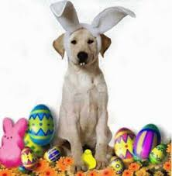
SCRUM - Exercise
Run one Sprint for a project:
Website “How to decorate a House for Easter”
Site is informational, we are not selling anything!

Slide 49


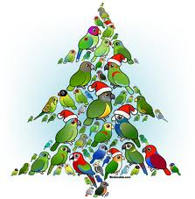
SCRUM - Exercise
Run one Sprint for a project:
“How to decorate a Christmas Tree”

Slide 50

SCRUM - Exercise
Run one Sprint for a project:
Website “How to decorate a House for Independence Day”
Site is informational, we are not selling anything!

Slide 51



SCRUM - Exercise
Run one Sprint for a project:
Website “How to decorate a House for Labor day”
Site is informational, we are not selling anything!

