Slide 1
Testing REST IPA using POSTMAN
Postman is a powerful HTTP client for testing web services. Created by Abhinav Asthana, a programmer and designer based in Bangalore, India, Postman makes it easy to test, develop and document APIs by allowing users to quickly put together both simple and complex HTTP requests.
Postman is available as a native app for Mac, Windows, and Linux operating systems.

Slide 2
Installing the Postman app
To install Postman, go to the https://www.getpostman.com/apps
Click Download for Mac / Windows / Linux depending on your platform.
macOS installation
Once you’ve downloaded app, you can drag the file to the “Applications” folder. Double click on Postman to open the application.
Windows installation
Download the setup file
Run the installer

Slide 3
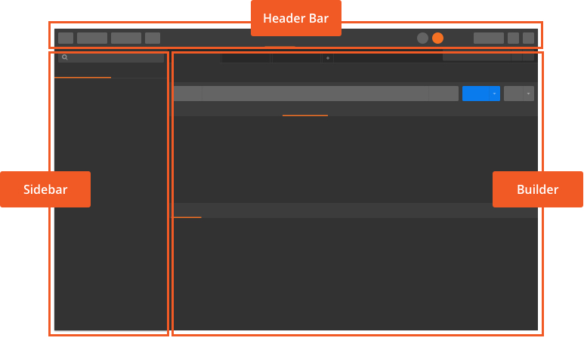
Navigating Postman
Postman provides a multi-window and multi-tab interface for you to work on APIs.
This interface design gives you as much space as possible for your APIs.

Slide 4
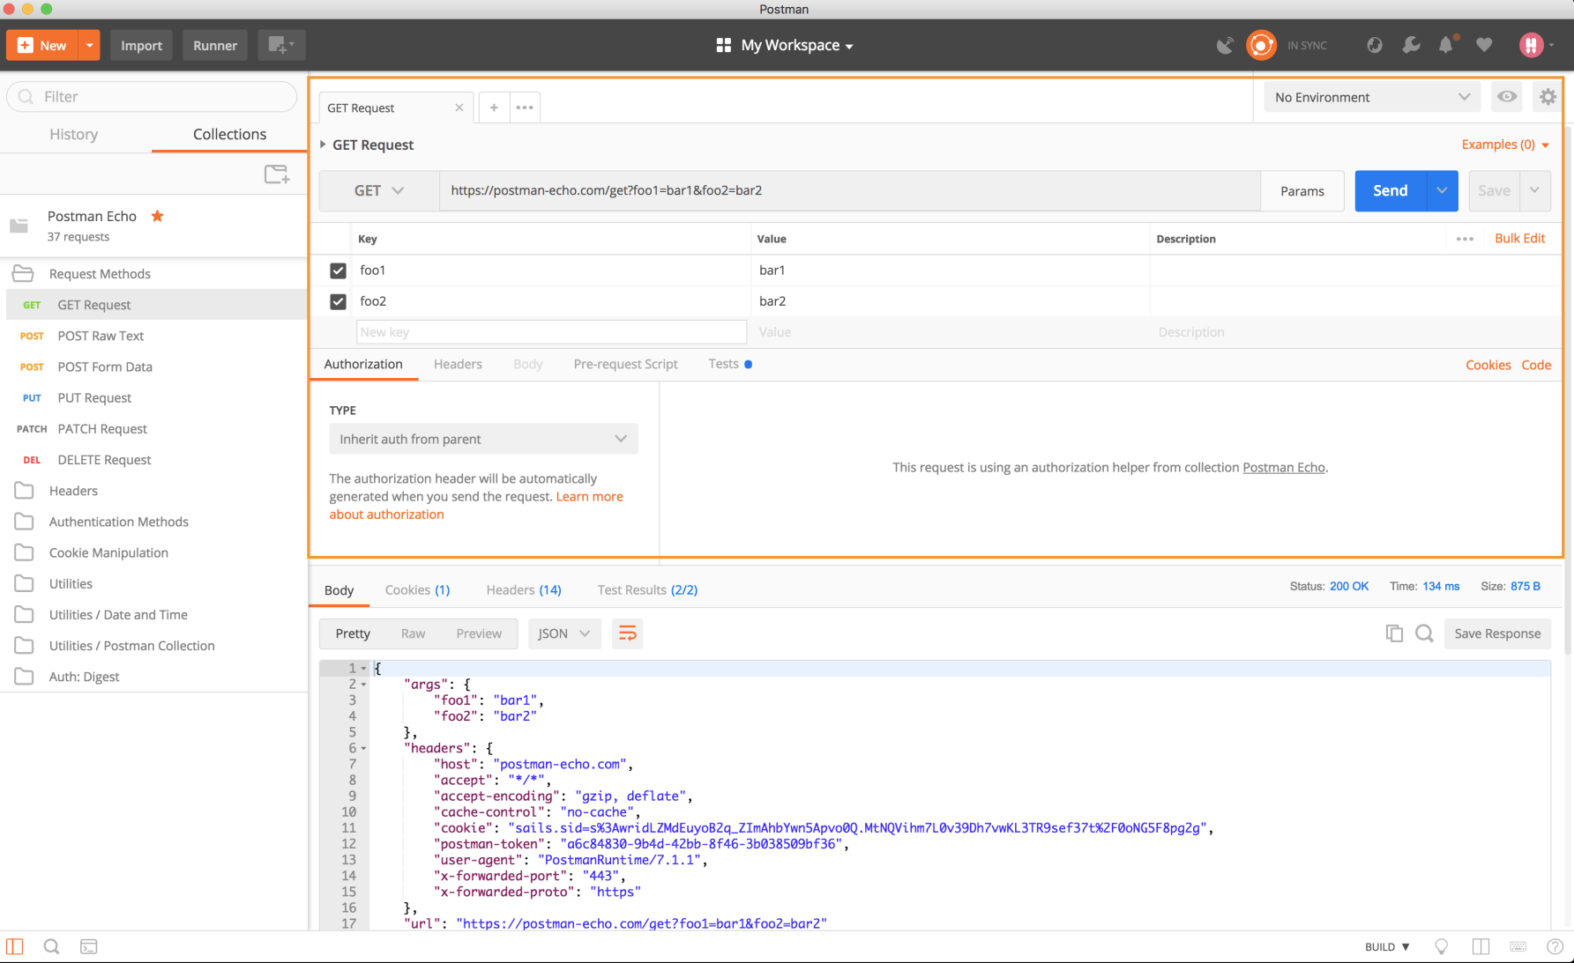
Requests
In Workspaces, you can create any kind of HTTP request. The four parts of an HTTP request are the URL, method, headers, and the body.

Slide 5
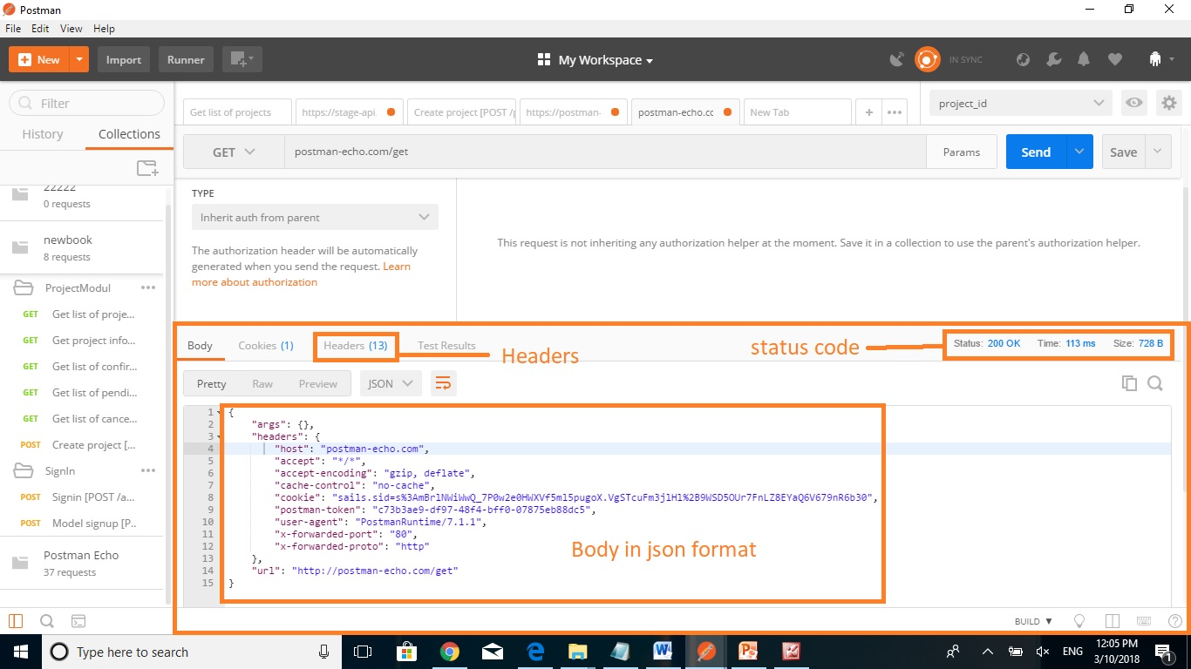
Responses
The Postman response viewer helps to ensure the correctness of API responses. An API response consists of the body, headers, and the status code.

Slide 6
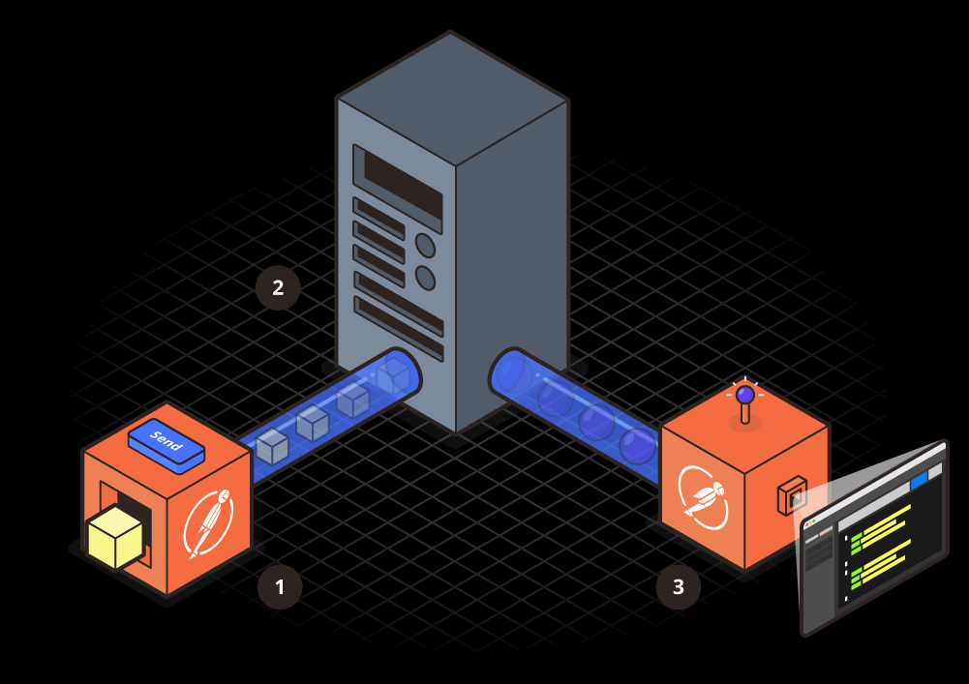
How does this work?
1. Enter your request details (URL: postman-echo.com/get) in Postman, and hit the Send button.
2. The request is received by the API server (postman-echo.com), and it returns a response.
3. The response is received by Postman, and the response is visualized in the interface.

Slide 7
CONSIDERATIONS OF TESTING WEB SERVICE
A well-constructed API test suite answers questions such as:
Does the service respond quickly enough for the intended
users?
Will the server respond with the correct values?(Positive
Testing)
How will the service handle exceptions and illegal
values?(Negative Testing)
Is the service stable under expected and unexpected user
loads?(JMETER,LoadRunner)

Slide 8
Example of testing IPA of newbook
API documentation for newbook: http://newbookalliance.github.io/API/
Base URL: https://stage-api.newbookmodels.com

Slide 9
Policies for all calls
Clients should add following headers to all requests:
X-Newbook-Client: '<client>'
X-Newbook-Version: '<version>'
API supports content negotiation
Via Accept header: Accept: application/json
Authorization
API uses token-based authorization via Authorization header:
authorization: '<token>‘
API Versioning
API uses url-path versioning. That means, you have to add version prefix (e.g. /api/v1/) to each API url.

Slide 10
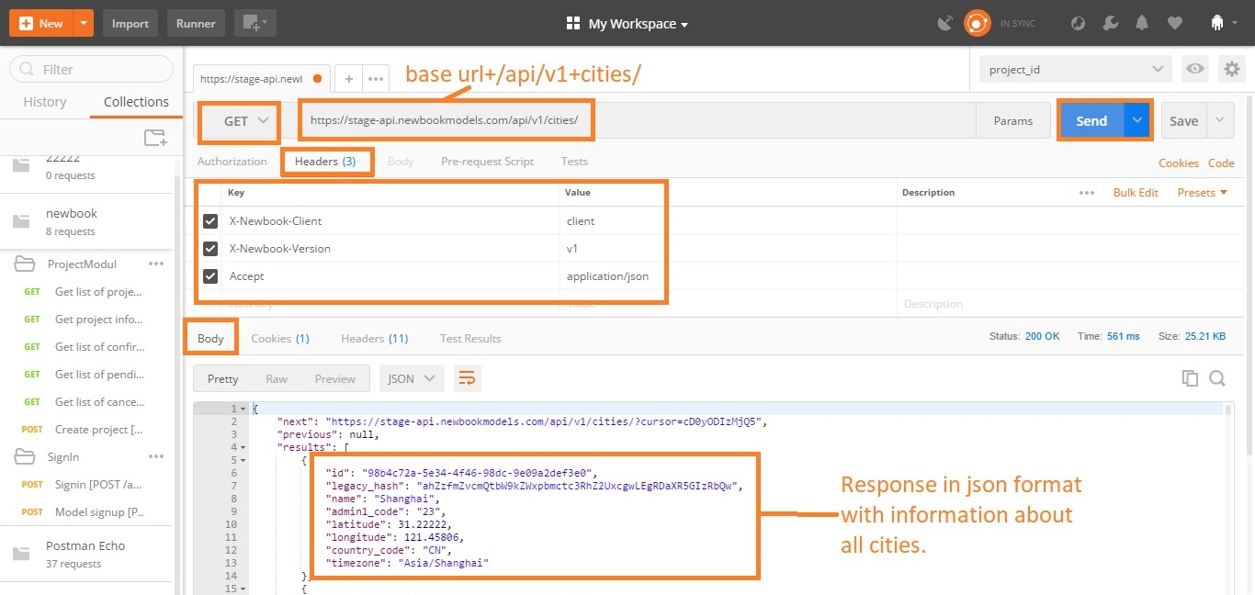
GET list of cities [GET /cities/]

Slide 11
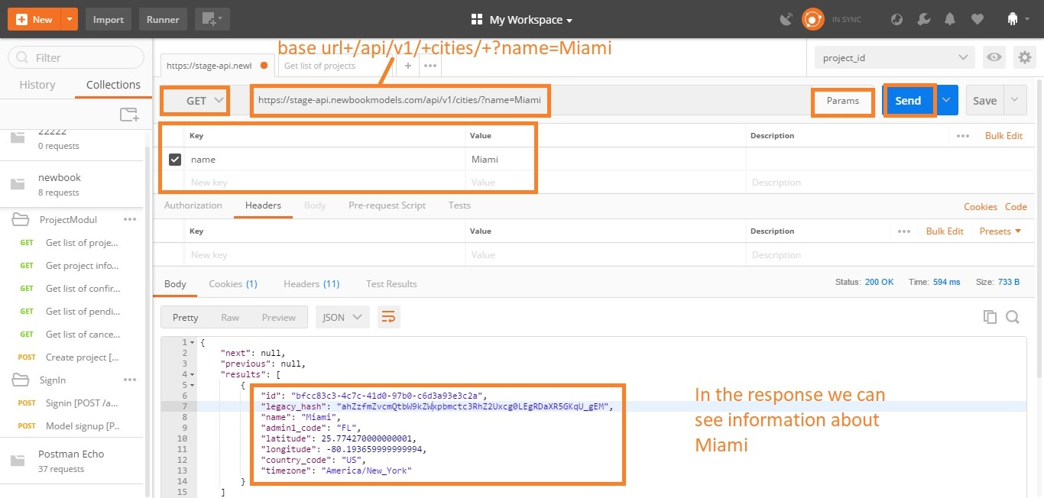
GET with parameters
A Get request can pass parameters to the server using "Query String Parameters".
For example, in the following request, https://stage-api.newbookmodels.com/api/v1/cities/?name=Miami
the parameter “name" has the value “Miami".

Slide 12
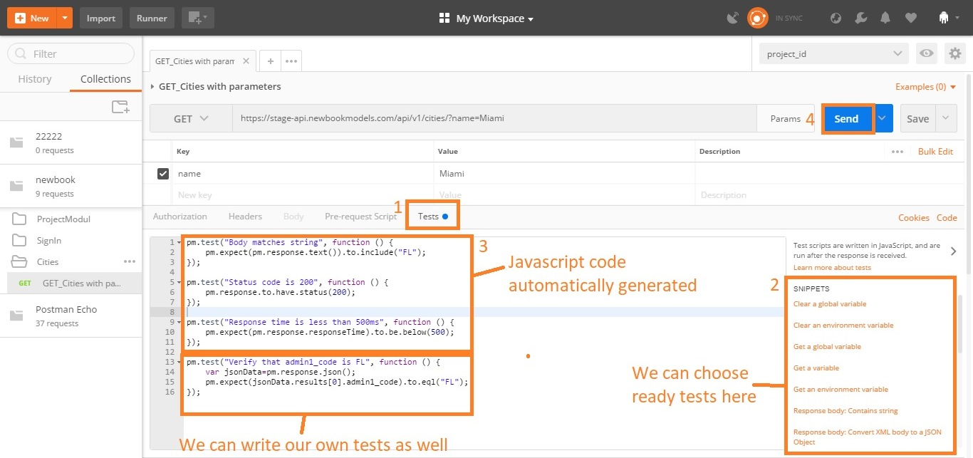
Test scripts
With Postman you can write and run tests for each request using the JavaScript language.
A Postman test is essentially JavaScript code executed after the request is sent, allowing access to the pm.response object.

Slide 13
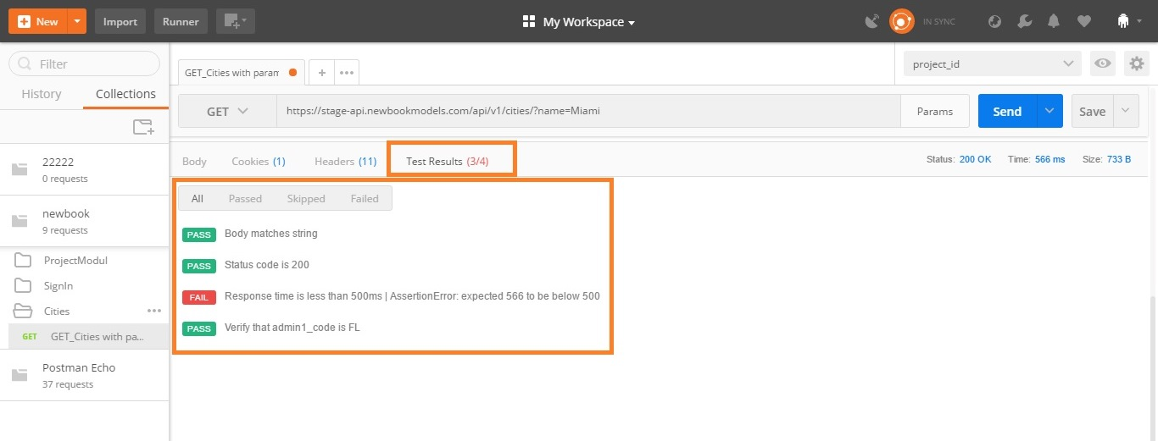
Test results
Postman runs tests every time you run a request.
Results are displayed in a Tests tab under the response viewer. The tab header shows how many tests passed, and the test results are listed here. If the test evaluates to true, the test passed.

Slide 14
Signin [POST /auth/signin/]
The HTTP POST request method is meant to transfer data to a server (and elicit a response). What data is returned depends on the implementation of the server.
To send POST request we need:
URL: https://stage-api.newbookmodels.com/api/v1/auth/signin/
Body: example of request body provided in documentation
{
"email": "a@a.aa",
"password": "qwer1234"
}

Slide 15
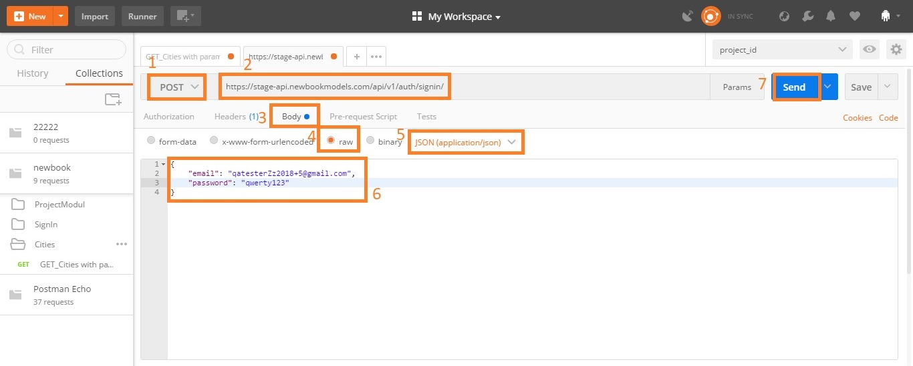
POST request structure
Choose POST method
URL is https://stage-api.newbookmodels.com/api/v1/auth/signin/
Go to “Body” tab to configure body
4 and 5 configure content-type.
6. Body in json format

Slide 16
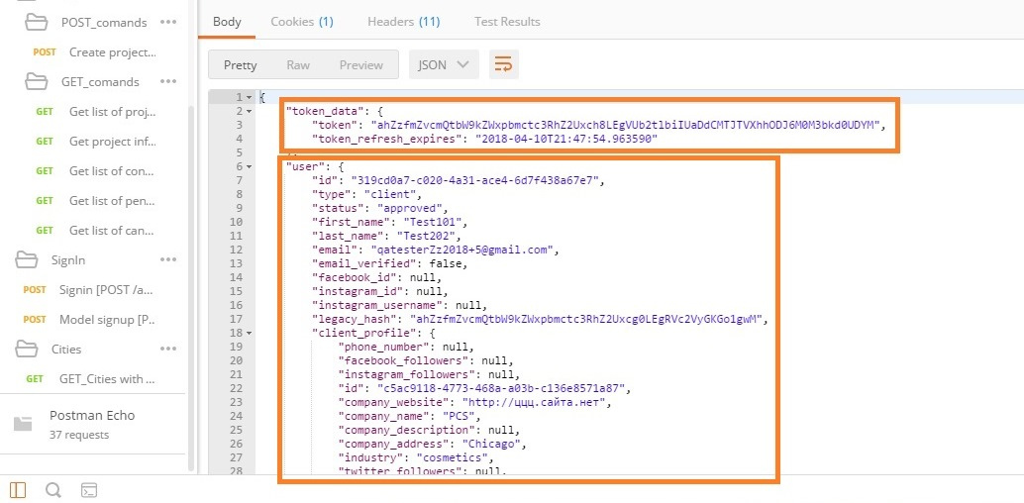
Response
The response returns us "token" (unique key) for clients account.
In all clients requests(Permissions: IsClient), we have to assign token to the header.

Slide 17
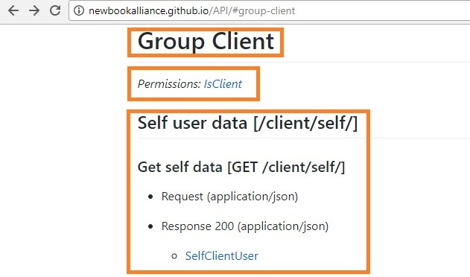
Get self data [GET /client/self/]
URL: https://stage-api.newbookmodels.com/api/v1/client/self/
For authorization will use token generated from Signin request.

Slide 18
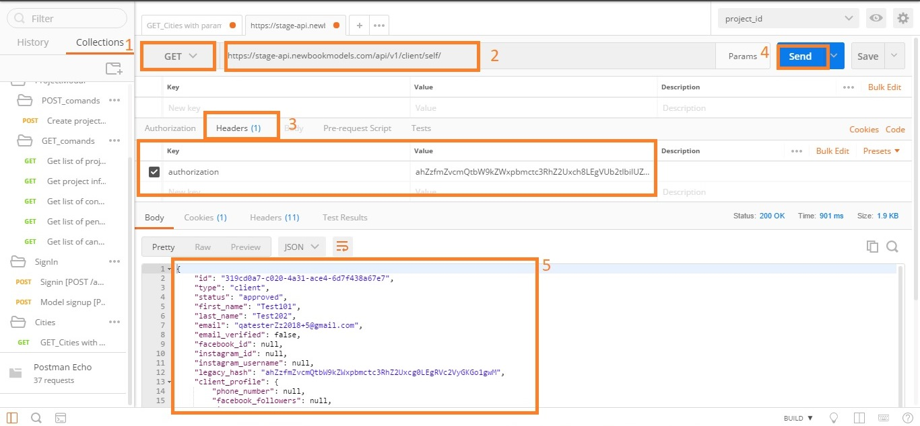
Request structure
URL: https://stage-api.newbookmodels.com/api/v1/client/self/
For authorization will use token generated from Signin request.
Response return information about client account

Slide 19
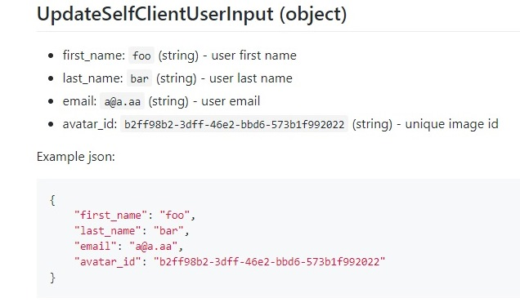
Update self user data
[PATCH /client/self/]
URL: https://stage-api.newbookmodels.com/api/v1/client/self/
For authorization will use token generated from Signin request.

Slide 20
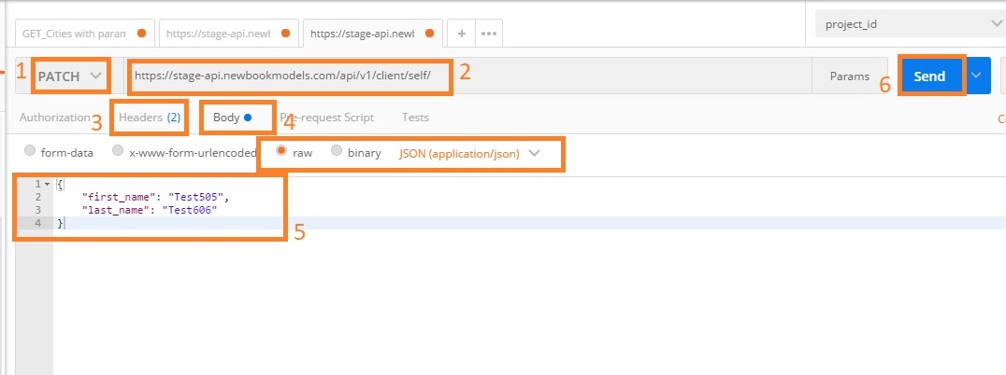
Request structure
URL: https://stage-api.newbookmodels.com/api/v1/client/self/
For authorization will use token generated from Signin request.

Slide 21
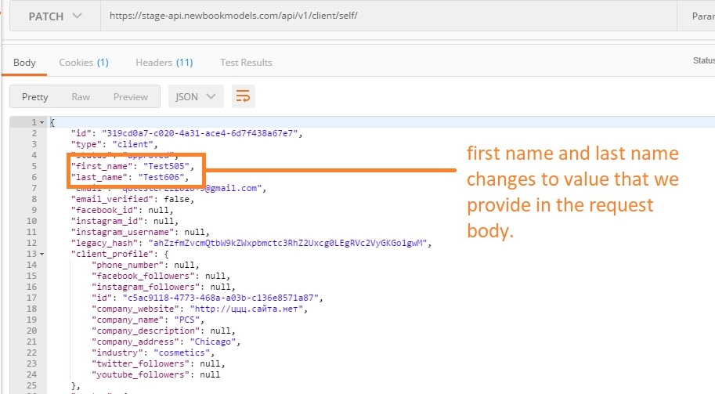
Response

Slide 22
Variables
Variables allow you to reuse values in multiple places so you can keep your code DRY (Don’t Repeat Yourself).
Also, if you want to change the value, you can change the variable once with the impact cascading through the rest of your code.
Variables can be used in the following form in the Postman user interface - {{variableName}} .
The string {{variableName}} will be replaced with its corresponding value when Postman resolves the variable.
For example, for an environment variable url with the value http://localhost , you will have to use {{url}} in the request URL field.

Slide 23
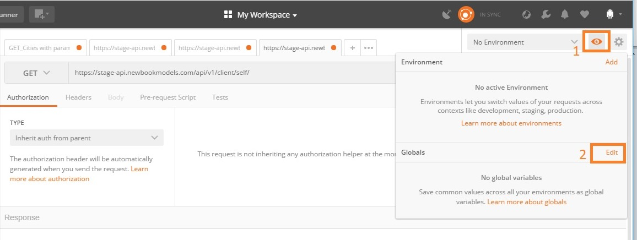
Add variables

Slide 24
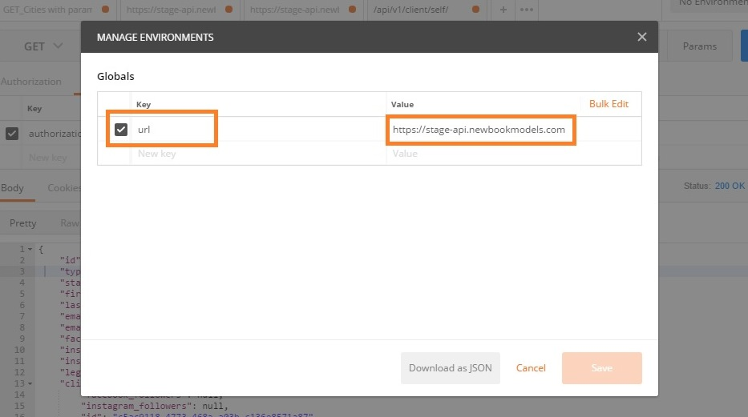
Add variables
In the table we providing variable name and value.
After that click save and close the window.

Slide 25
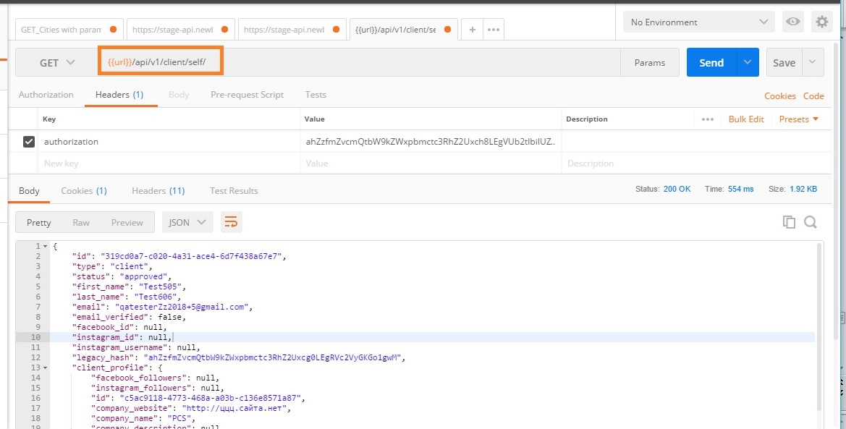
Use variables
Variables inside the Postman UI are enclosed inside curly braces.

Slide 26
Links for more information
https://www.getpostman.com/docs/v6/
https://docs.postman-echo.com/

Slide 27
TYPES OF HTTP REQUESTS
GET – Retrieves the data from a specified source
POST- Sends new data to a specified source
PATCH- Updates info for a specified source
DELETE- Removes data from a specified source

Slide 28
HTTP STATUS CODE
1XX- Codes between 100-199 mean that the server is working on the request. Not so common
2XX- Codes between 200-299 mean that the request was
successful.
3XX- Codes between 300-399 mean that the request was not performed.
4XX- Codes between 400-499 mean that the request is
incomplete and may need more info
5XX- Codes between 500-599 mean that the server
encountered an error.

