Slide 1

Basics of WEB Design - Elements

Slide 2


Slide 3
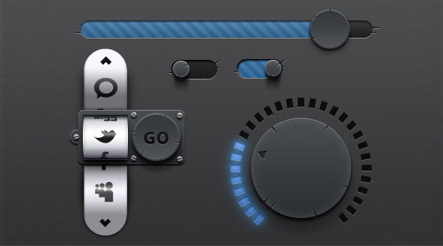
Mobile UI terminology
http://www.goshen.edu/physix/385/pub/css2.php
http://designinginterfaces.com/firstedition/index.php?page=About_the_Book

Slide 4
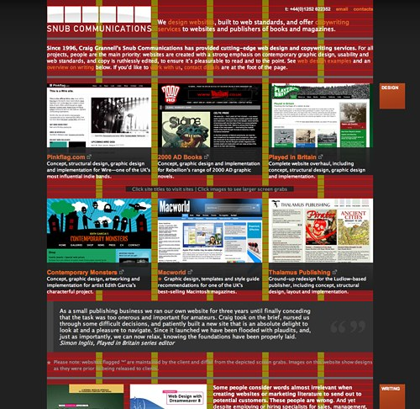
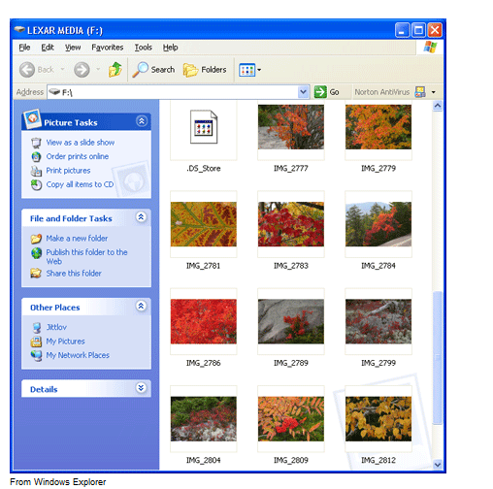
Grid
http://dev.opera.com/articles/view/grid-design-basics-grids-for-web-page-l/

Slide 5
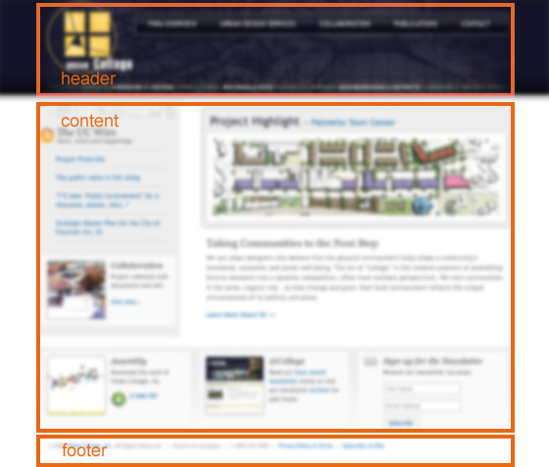
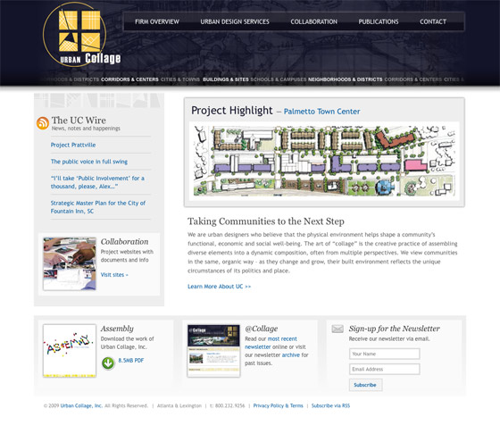
Content vs. Container
Web content is the textual, visual or aural content that is encountered as part of the user experience on websites. It may include, among other things: text, images, sounds, videos and animation.
A Web page is a series of containers, the most inclusive one being the <html> element that contains the entire Web page.
A container element is defined as an element that contains other HTML elements (including text).

Slide 6
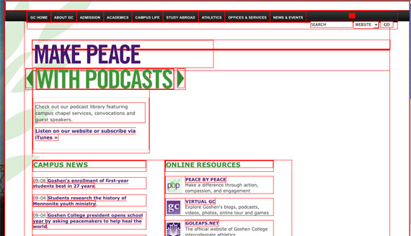
Building Web page

Slide 7
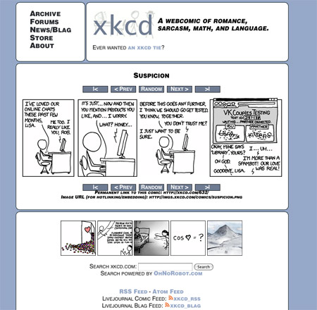
Body Content in different containers
Most pages look like there's some higher level of grouping going on.
Sometimes you can easily see at a glance where there are boxes being used to group content:

Slide 8
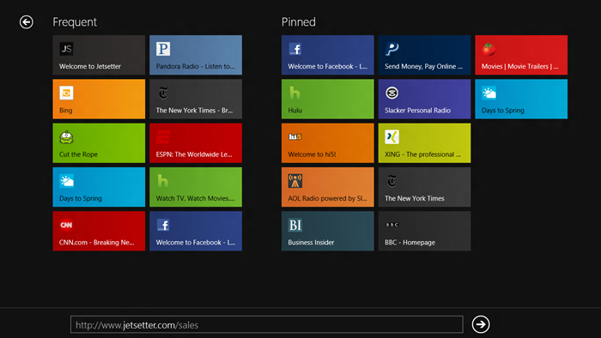
Tile Images/Content

Slide 9
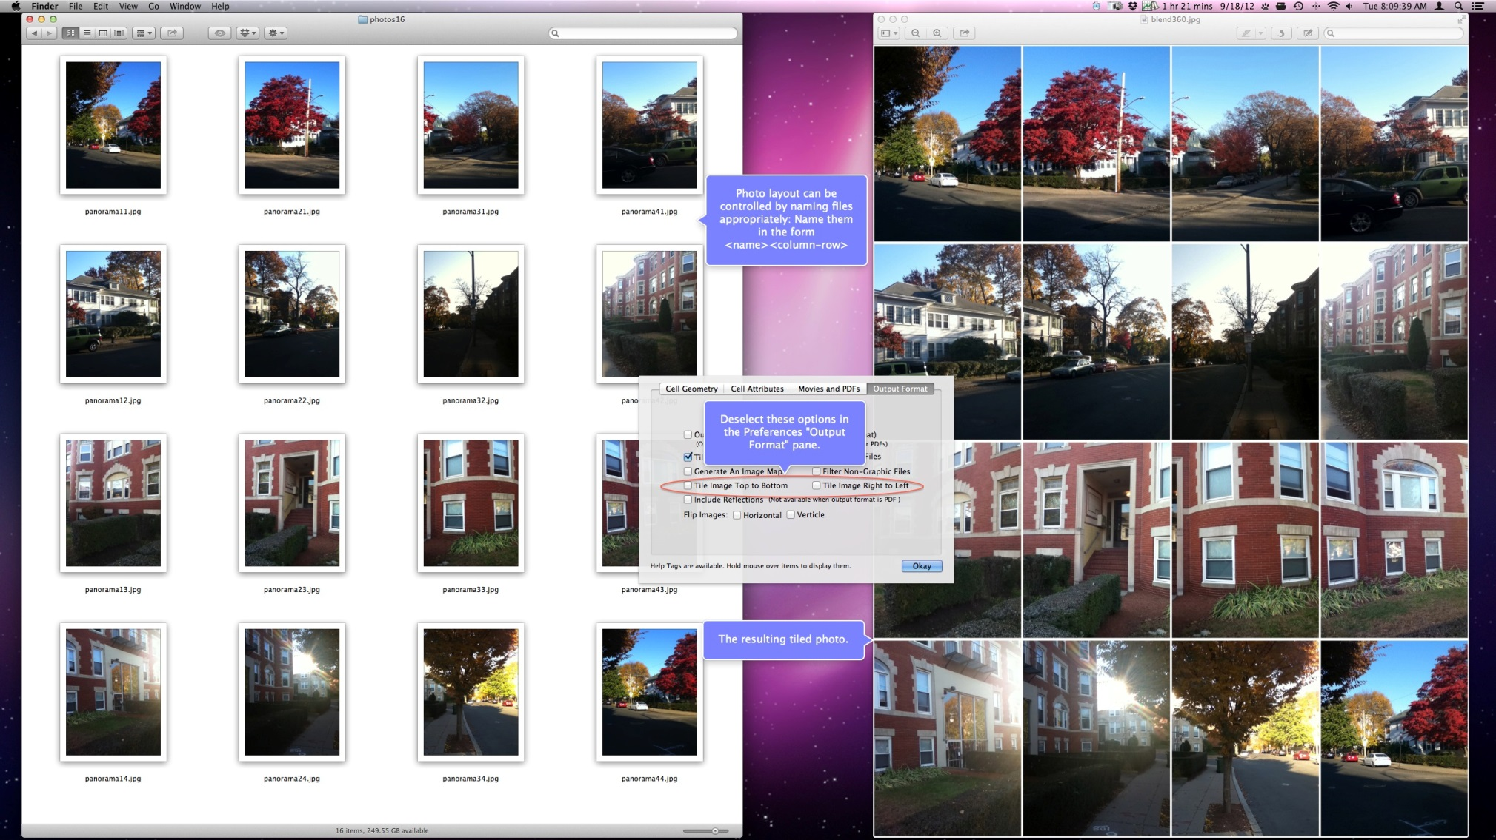
Tile Images/Content

Slide 10
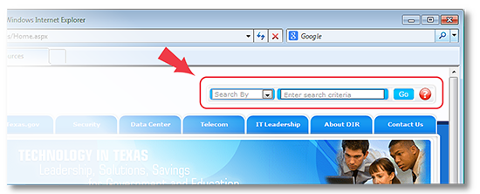
Build Professional Dictionary
Search Bar

Slide 11
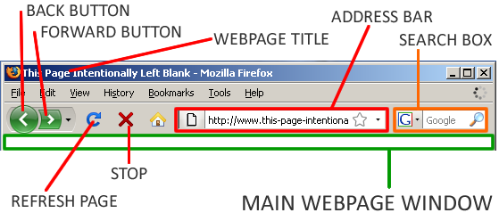
Build Professional Language

Slide 12
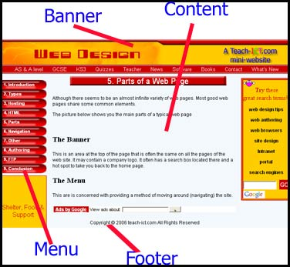
Build Professional Language

Slide 13
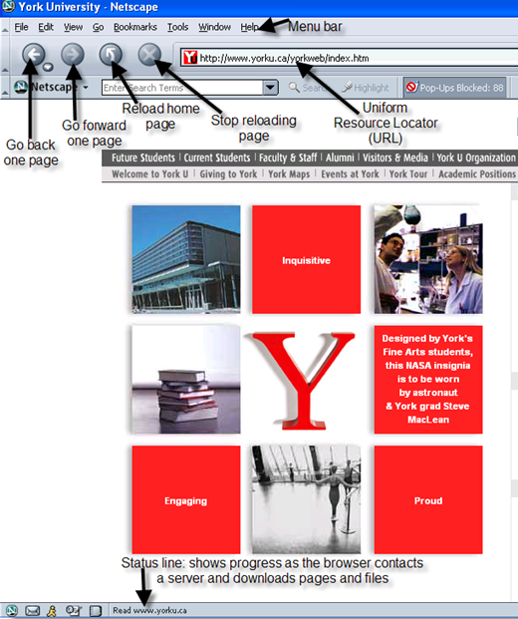
Build Professional Language

Slide 14
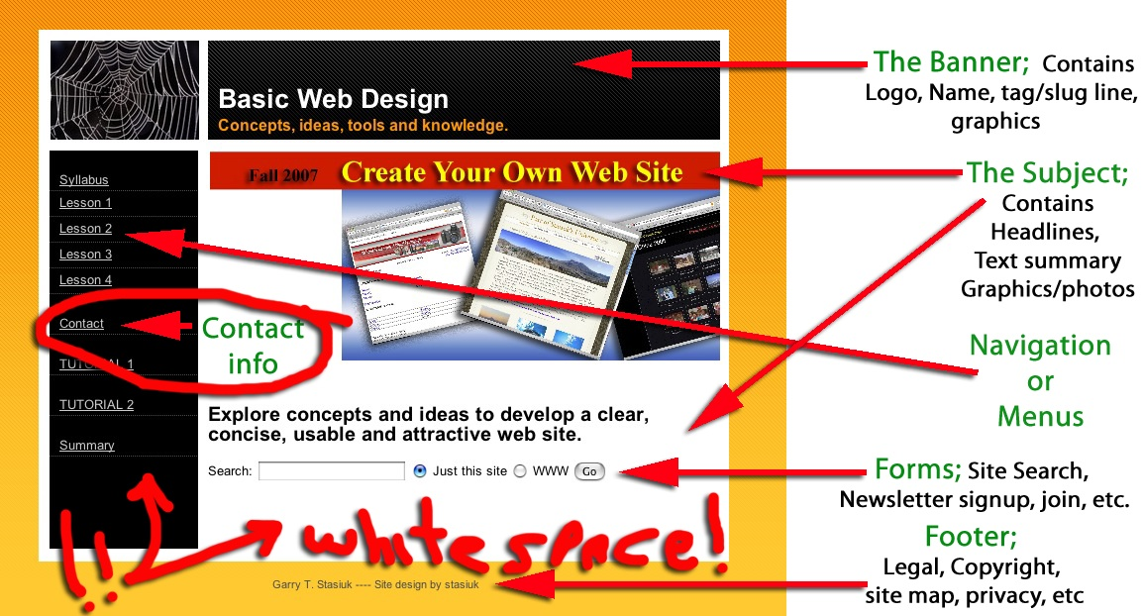

Slide 15
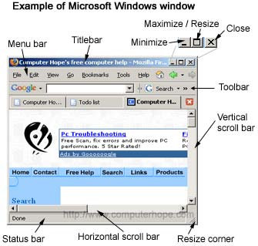

Slide 16
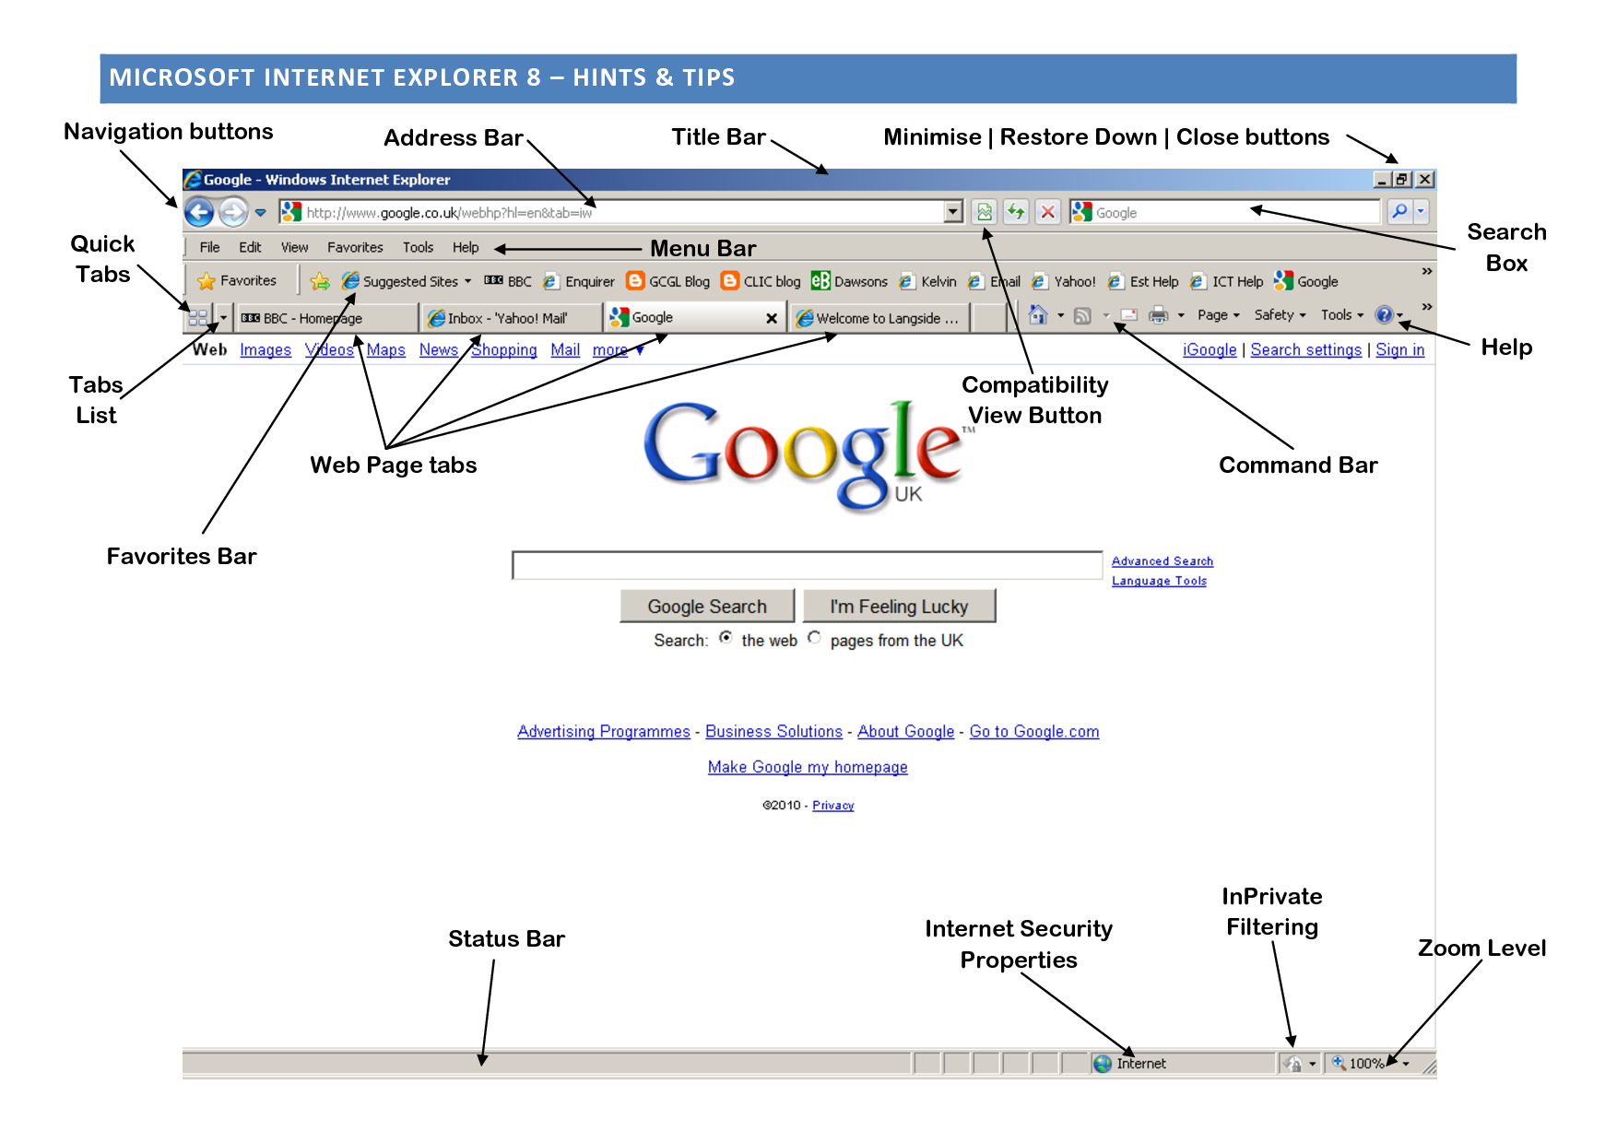

Slide 17
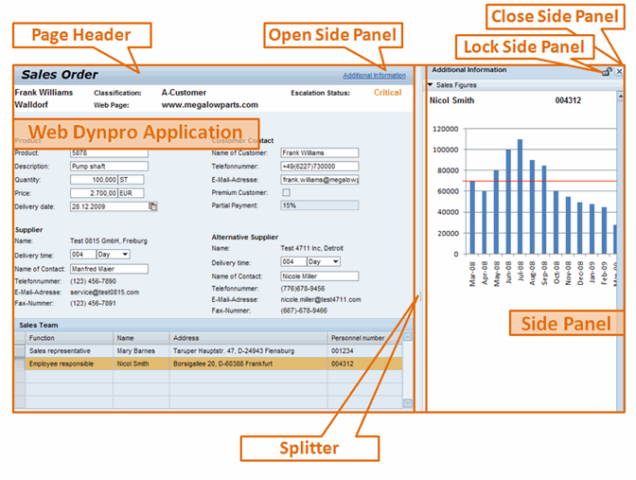

Slide 18
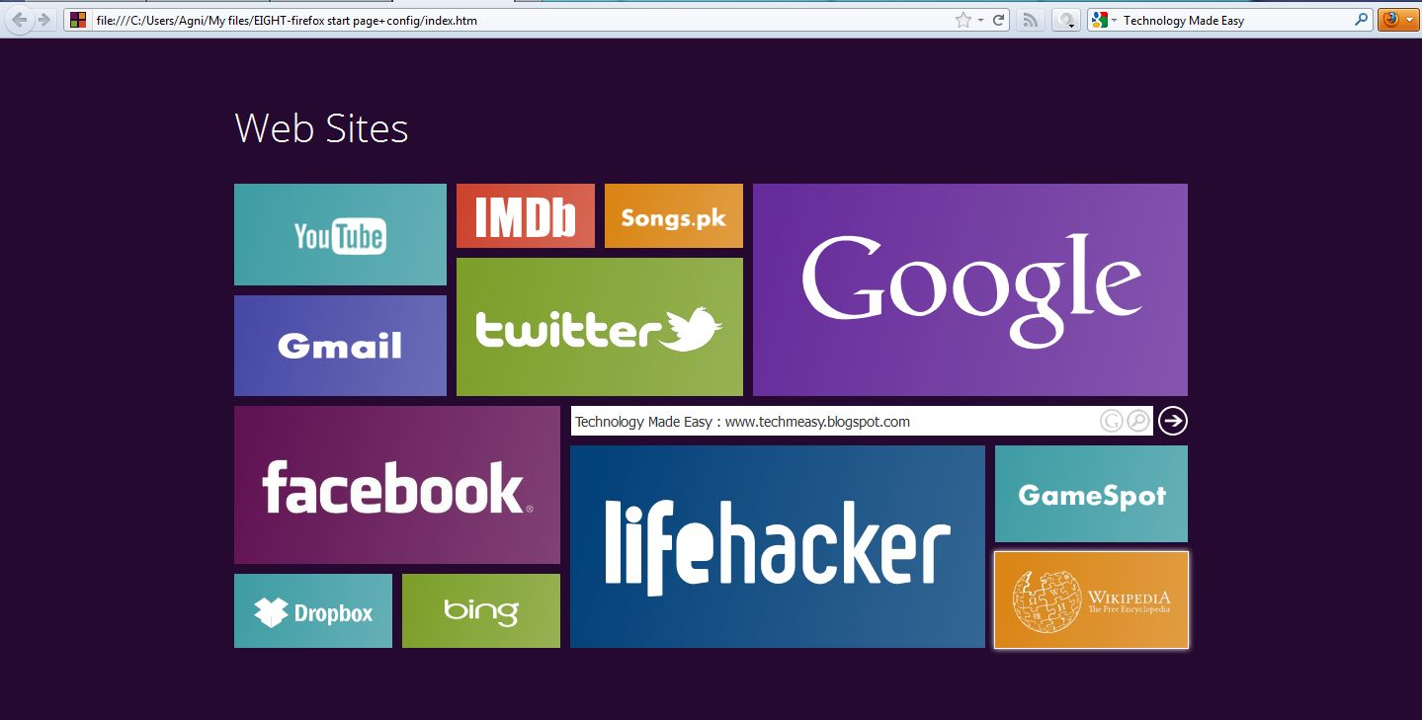
Alternate Design

Slide 19
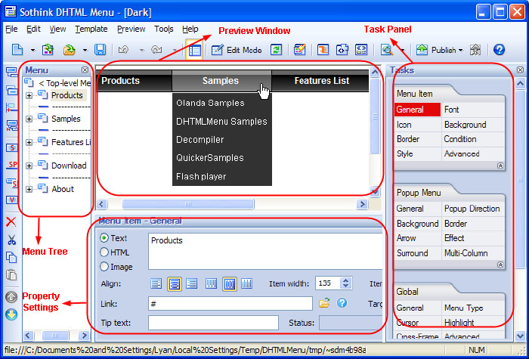

Slide 20
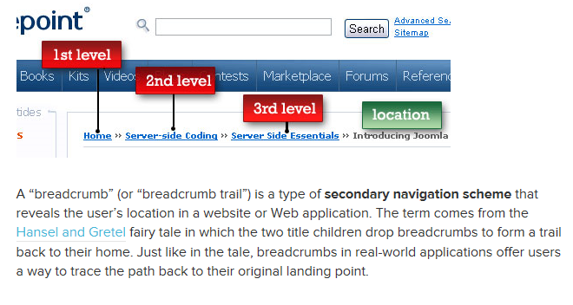
Breadcrumbs
Breadcrumbs are a type of web navigation where current location within the website is indicated by a list of pages above the current page in the hierarchy, up to the main page.
It not only shows users where they are currently located in the site's architecture, but it also lets them back up levels one at a time.

Slide 21
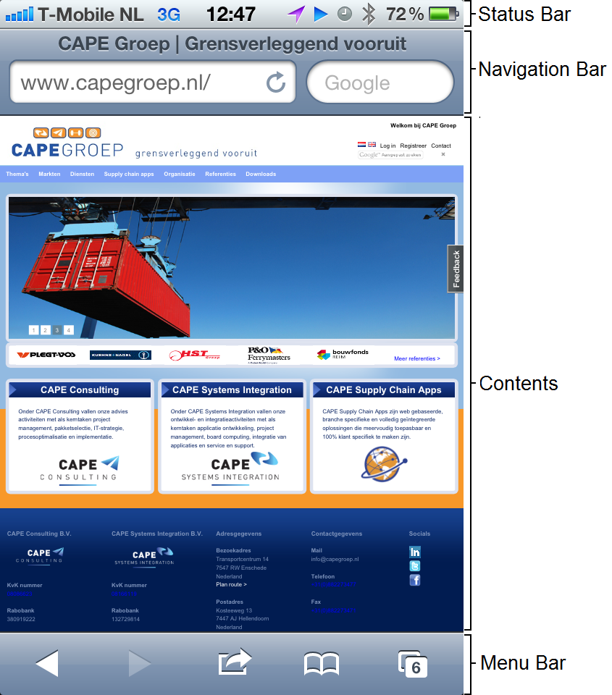
Installation of Application:
Splash Screen
Sync view loading, view transitions, and view installation.
View of Home/Content Page:
General Look – Image & Text Alignments
Layout:
Fit well the Form Factor
Resolution
Screen Size alignments
Truncation
Invalid/Garbage Symbols
Orientation: Portrait vs. Landscape
Buttons:
Functionality
Place on the screen, color and size adjustments
Customized style
Active vs. none-active mode
Alignment with the Naming
Links
http://www.quora.com/User-Interfaces/Which-are-the-best-iPhone-iPad-apps-from-a-UI-design-perspective

Slide 22
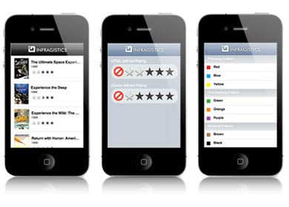
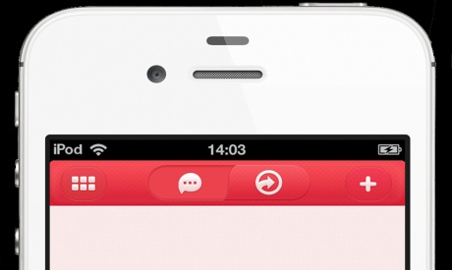
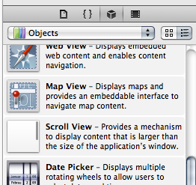
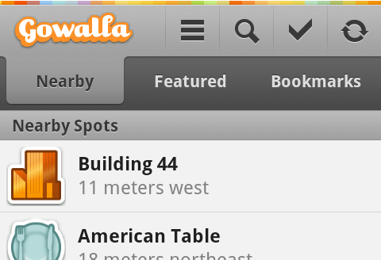

ListView:
Backbone of App
Grids of Mobile app
NavBar/ActionBar:
Title NavBar (example: on the top of iOS apps and on the bottom of Android apps.)
ScrollView:
“Swipe” through a list of items left-right and top-bottom
Switch
TabStrip
List View
Navigation Bars
Scroll View
Tab Strip
Switch

Slide 23
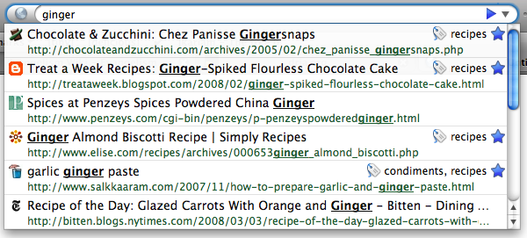
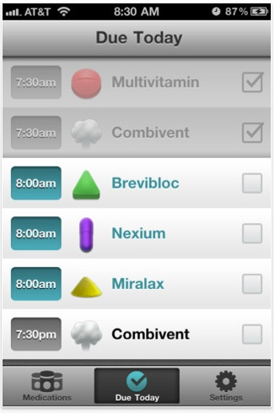
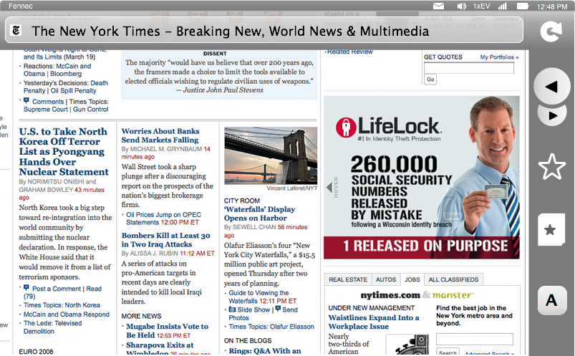
TouchScreen UI:
Panning and Zooming
Controls: Dragging horizontally beyond the page edge reveals the control strip
Navigation/Searching to a new page
Tabs
Notifications: New,
Preferences, Geolocation
Downloads
Add-ons
Identity: Authentication
Client Certificates, Username/Password
awesomebar
ControlStrip
Tabs
https://wiki.mozilla.org/Mobile/UI/Designs/TouchScreen/workingUI

Slide 24
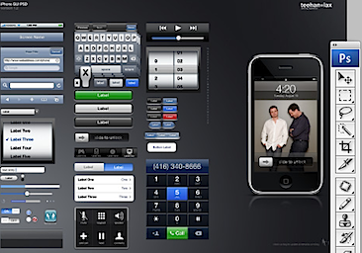
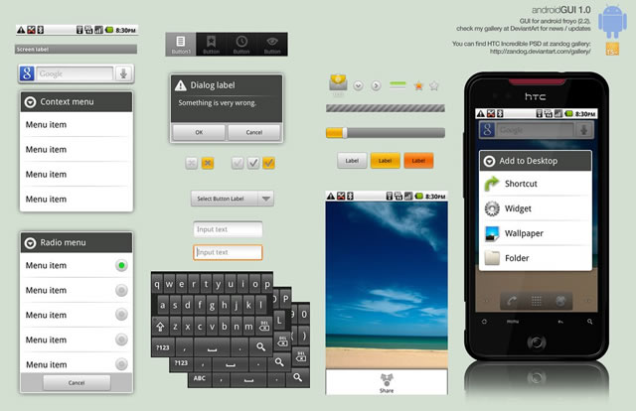
Self-Learning
ANDROIDs Popular UI:
Android GUI PSD
Stock (Droid 1, Nexus1)
Sense UI (Eris, Incredible, Evo)
Motoblur(*new* Droid X, Droid 2)
Touchwiz(Galaxy S devices)
iPhone Popular UI:
iPhone GUI PSD (Photoshop file)
iPhone GUI stencil for Omnigraffle
Favorites UI Design Walkthrough
Edward Tufte on iPhone interface design
iida A02 infobar
http://www.youtube.com/watch?v=ass2rWIqd8I&feature=player_embedded&list=PLS7azqUNoh8szi0WyRZPE4CSxfxH1L7cF#!
http://mobileorchard.com/7-iphone-ui-user-interface-design-resources/
http://speckyboy.com/2010/10/27/30-fresh-web-ui-mobile-ui-and-wireframe-kits/

Slide 25
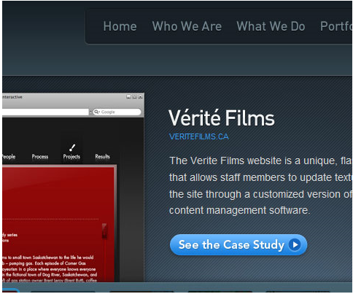
“Call in Action” button
Call to action in web design — and in user experience (UX) in particular — is a term used for elements in a web page that solicit an action from the user. The most popular manifestation of call to action in web interfaces comes in the form of clickable buttons that when clicked, perform an action (e.g. "Buy this now!") or lead to a web page with additional information (e.g. "Learn more…") that asks the user to take action

Slide 26
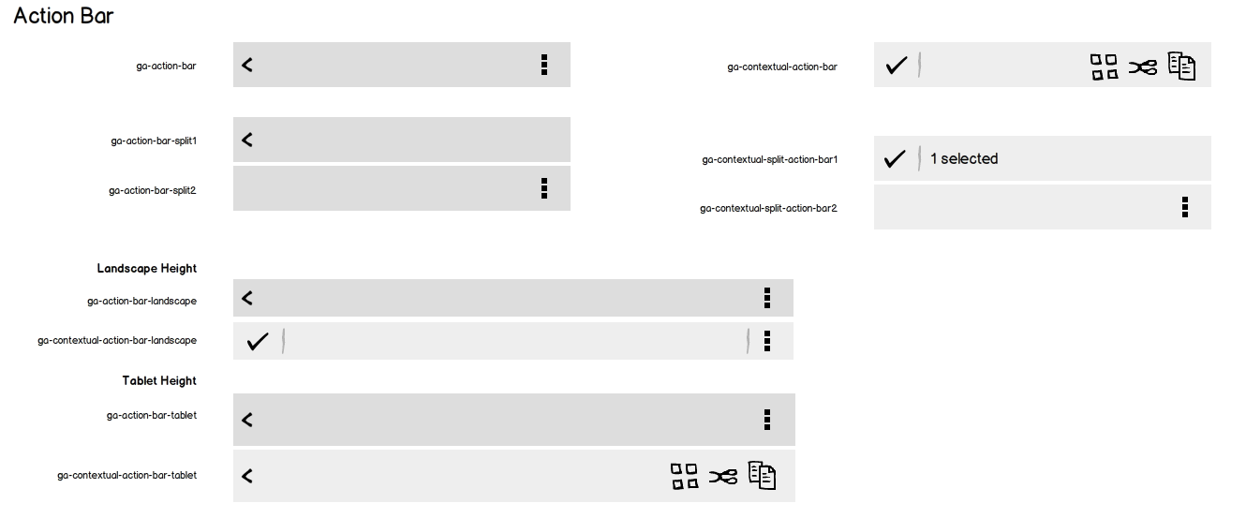
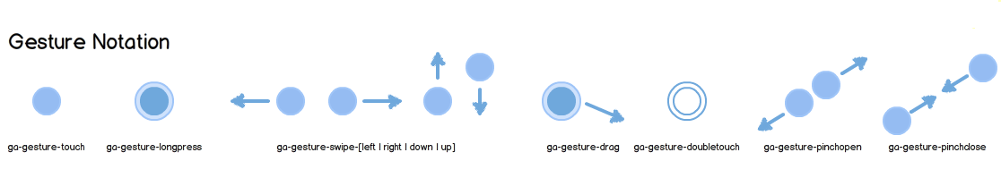

Slide 27
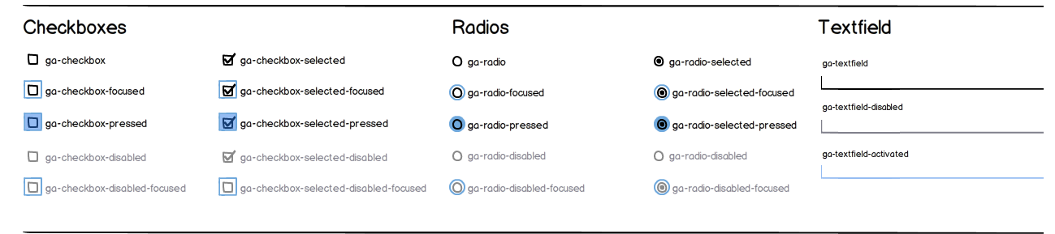
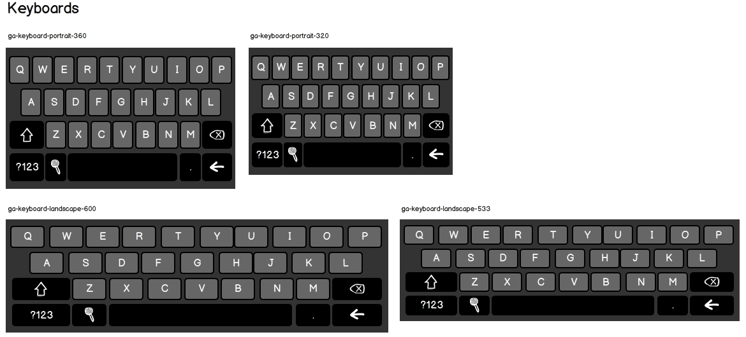

Slide 28
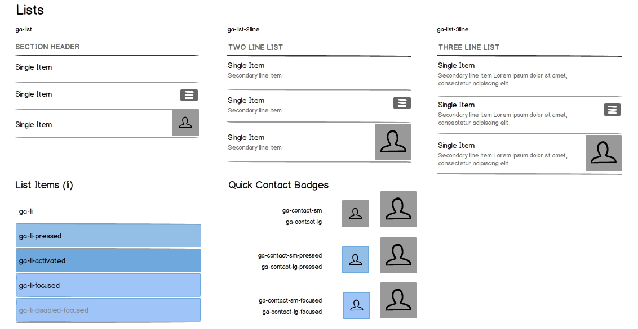

Slide 29
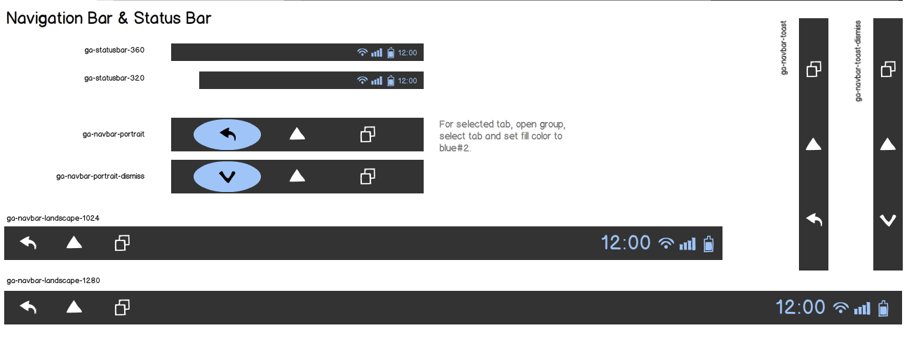
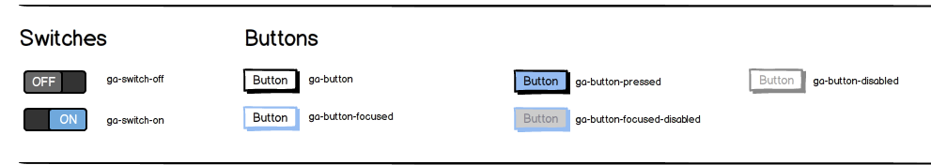
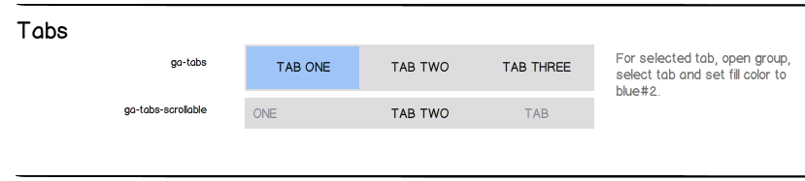

Slide 30
Terminology
Page notifications
(general)
Pop-up blocking
File Install
Geolocation
Control Strip
back/forward
create bookmark
Actions
All other operations
Titlebar of the page
Tab switching
local tabs
weave integration
Location Bar
bar with controls
Awesome-bar

Slide 31
Panning
Panning, on a touchscreen device, is achieved through direct manipulation -- a finger placed on the screen and "dragging" what's visible as if it were a continuous plane.
Some details:
• linear panning when the user is in contact with the screen
• when the user "flicks" or "swipes" the screen pans kinetically ◦ distance and speed traveled corresponds to the vigor of the flick
◦ a flick at the most-vigorous end of the spectrum should allow the user to reach the left or right side of the page in one flick
◦ when the page is scrolling by with the user _not_ in contact with the screen (ie. during a flick), the user should be able to stop page movement by tapping the screen (pinning the page down, essentially)
• we should constrain movement so that minor variances from an otherwise straight-line pan do not cause much jitter

Slide 32
Zooming
Structured Zoom
The primary zooming mechanism is double-tapping on a page element (column, image, other area) and having the page zoom to fit that particular element. This will involve some rules for different circumstances -- for example, the appropriate zoomed-in level for an image is probably to do a best fit, horizontally and vertically, so that the _whole_ image is as large as it can be on the screen; in contrast, the best zoomed-in level for a column of text is probably to fit horizontally only. Double-tapping again should zoom the user back out to the original page overview zoom level.
This is the primary scheme because it takes advantage of the fact that, generally, webpages have structure that corresponds to what a user is likely interested in. Structured zoom will be more often useful than arbitrary zoom.
That said, some mechanism for arbitrary zoom is still necessary for cases where this breaks down (e.g. zooming within an image).

Slide 33
Zooming
Arbitrary zoom is the case where the user wants to zoom in to a level that is not related to the edges of an element.
There are two parts to the information that a user has to provide in this case -- (1) how much to zoom in (or out) and (2) where to zoom in to (i.e. what is the centre of the zoom). Some interaction mechanisms let the user communicate both at the same time (the pinch gesture in a multitouch environment), others don't (choosing a zoom percentage from a list). One that addresses both would be better for Fennec.
1. Multitouch
• The pinching mechanism, as on the iphone another other multitouch devices, works very well but requires a mutlitouch device. Most devices on the market, at least at the moment, don't have this capability.
2. Successive touch (pseudo-multitouch) -- i.e. defining corners of a desired range with two fingers tapped in quick succession.
• Worth thinking about, but I think it will be too abstract for most users

Slide 34
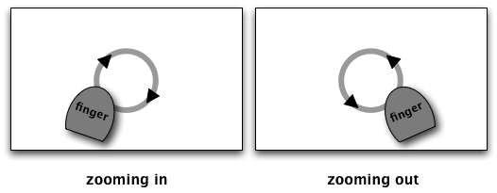
3. Overlays - as in Android, where +/- controls show up over content. This has the disadvantage of only controlling zoom level, not location.
4. Gestural
• Tracing the area to which you'd like to zoom
• "Dialing" to zoom: clockwise to zoom in, counterclockwise to zoom out - like this:

Slide 35
Saturation Color saturation refers to the intensity of a color.
Consistency is the quality of an interface when it behaves in ways users expect. It means that users can apply the knowledge obtained in some previous experience to enhance current performance

Slide 36
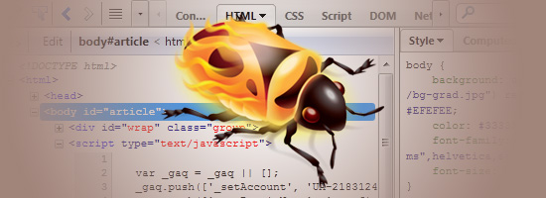
http://sixrevisions.com/tools/firebug-guide-web-designers/

