Slide 1

Becoming a Pro
IN Mobile Applications Testing

Slide 2
Mobile Test Industry Standards :
Testing Strategies for Mobile Apps
Security Test
2016 OWASP Release Candidate (not yet official)
M1 - Improper Platform Usage
M2 - Insecure Data Storage
M3 - Insecure Communication
M5 - Insufficient Cryptography
M4 - Insecure Authentication
M6 - Insecure Authorization
M7 - Client Code Quality
M8 - Code Tampering
M9 - Reverse Engineering
M10 - Extraneous Functionality

Slide 3
Mobile Test Industry Standards :
Testing Strategies for Mobile Apps
Security Test
CREATE CHECK LIST BEFORE
Phone identifiers such as (IMSI or IMEI)
Address Book
Account Details
E-maiL
Stock application data
Banking Data
GPS Location(s)
Web History
User’s Dictionary
Images
Notes
Calendar Appointments
Call Logs
Encryption Keys

Slide 4
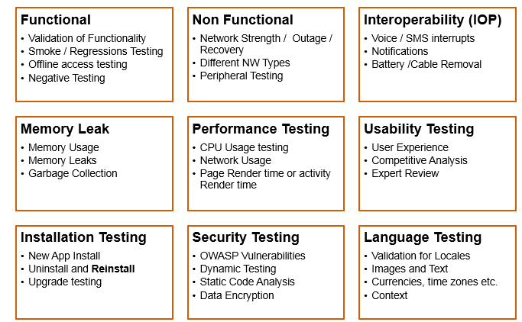
Mobile Test Industry Standards :
Testing Strategies for Mobile Apps EXTRA
SUMMARY

Slide 5
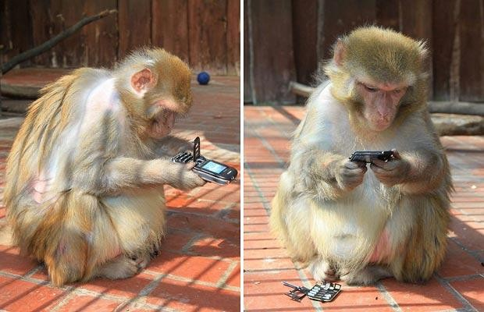
Mobile Test Industry Standards
Testing Strategies for Mobile Apps : LETS PRACTICE

Slide 6

Mobile Test Industry Standards
Testing Strategies for Mobile Apps : LETS PRACTICE
How to Start Testing a Mobile Page
Find and divide page into components/modules
Create a list/table of modules/testing types/ testing
Create a variety of variables and conditions within each module
Specify the Expected and leave place for Actual Results
FOR TROUBLESHOUTINGCreate a list/table to view ANY problem from different angels
Create a Check List for Testing Categories:
Connectivity testing
Compatibility testing
Performance testing
Security testing
Functionality Testing
Usability testing
Interruption testing

Slide 7
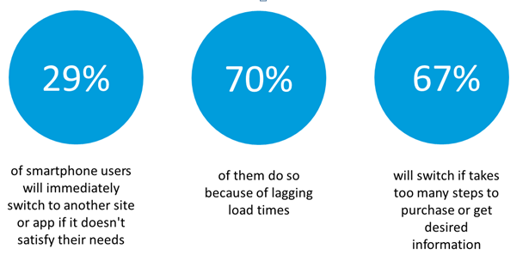
Mobile Test Industry Standards
Testing Strategies for Mobile Apps : LETS PRACTICE
Testing Strategies for Mobile Apps : LETS PRACTICE
Consumers behaviour only on the basis of experience delivered by app

Slide 8
Mobile Test Industry Standards :
Testing Strategies for Mobile Apps
GUI TEST Checklist
Navigation
Formatting
Color and fonts
Scrolls
Controls and alignments
Spelling and grammar
Justification
Look and feel
Default and shortcut keys
Tab
Opening input
Alternatives
Behavior
Modality and multiple windows
Contrast
Images

Slide 9
Mobile Test Industry Standards
Testing Strategies for Mobile Apps : LETS PRACTICE
top considerations for creating a release CHECK LIST for mobile app testing
Mobile interruptions
Battery Consumption
Mobile memory utilization
Mobile data utilization
Screen scrolling application screen
New OS release support
correct implementation of AdMob or other mobile ad platform
Application Installation/Update
Application Sign Up & Log in
Subscription scenarios
Application Sanity Suit
APP works in different Mobile modes
User Friendly
Network connectivity
Data save conditions

Slide 10
Mobile Test Industry Standards
Testing Strategies for Mobile Apps : LETS PRACTICE
Test case | Sub- Category | Description | Result
1. Installation |  | Verify that app can be Installed Successfully | App should be able to install Successfully
2. Un-installation |  | Verify that app can be Uninstall Successfully | User should be able to uninstall the app successfully
3. Network Test Cases |  | Verify the behavior of app when there is Network problem and user is performing operations for data call | User should get proper error message like “Network error. Please try later”…
 |  | Verify that User is able to establish data call when Network is back in action | User should be able to establish data call when Network is back in action

Slide 11
Mobile Test Industry Standards
Testing Strategies for Mobile Apps : LETS PRACTICE
TC | Sub-Category | Description | Result
4. Voice Call Handling | Call Accept | Verify that User can accept Voice call at the time when app is running and can resume back in app from the same point | User should be able to accept Voice call at the time when app is running and can resume
 |  |  | back in app from the
 |  |  | same point
 | Call Rejection | Verify that User can reject the Voice call at the time when app is running | User should be able to reject the Voice call at
 |  | and can resume back in app from the | the time when app is
 |  | same point | running and can resume
 |  |  | back in app from the
 |  |  | same point
 | Call Establish | Verify that User can establish a Voice call in case when app data call is running in background | User should be able to establish a Voice call in case when app data call is running in background

Slide 12
Mobile Test Industry Standards
Testing Strategies for Mobile Apps : LETS PRACTICE
TC | Sub- Category | Description | Result
5. SMS Handling |  | Verify that User can get SMS alert when app is running | User should be able to get SMS alert when app is running
 |  | Verify that User can resume back from the same point after reading the SMS | User should be able to resume back from the same point after reading the SMS
6. Unmapped Keys |  | Verify that unmapped keys are not working on any screen of app | Unmapped key should not work on any screen of app
7. Application Logo |  | Verify that app logo with App Name is present in app manager, on the App screen page, widgets (opt.) and user can select it | Application Logo with App Name should be present in app manager, on the App screen page, widgets (opt.) and User can select it.

Slide 13
Mobile Test Industry Standards
Testing Strategies for Mobile Apps : LETS PRACTICE
TC | Sub-Category | Description | Result
8. Splash Screen |  | Verify that when User selects app Logo in Splash is displayed. Note: Splash do not remain for fore than 3 sec Note: A splash screen is an image that appears while a game or program is loading. | When User selects app, Logo in app Splash should be displayed
9. Low Memory |  | Verify that app displays proper error message when device memory is low and exits gracefully from the situation | App should display proper error message when device memory is low and exits gracefully from the situation
10. Clear/Back Key |  | Verify that Clear key should navigate the User to previous screen | Clear Key should navigate the User to previous screen
11. End/Home Key |  | Verify that End Key should navigate the User to native Device screen | End Key should navigate the User to native Device screen

Slide 14
Mobile Test Industry Standards
Testing Strategies for Mobile Apps : LETS PRACTICE
TC | Sub-Category | Description | Result
12.Visual Feedback |  | Verify that there is visual feedback when response to any action takes more than 3 sec | There should be visual feedback given when response time for any action is longer than 3 sec
13. Continual Keypad Entry |  | Verify that continual key pad entry do not cause any problem. Note: Continual Keypad test consist in a multiple key press, done quickly as possible, in order to load at maximum capacity the handset's memory | Continual key pad entry should not cause any problem in app
14. Exit Application |  | Verify that User is able to exit from app with every form of exit modes such as Flap, Slider, Home Key or Exit option from any point of app | User should be able to exit with every from of exit mode such as Flap, Slider, Home Key or Exit option from any point of app
15. Charger Effect |  | Verify that when app is running then inserting and removing charger do not cause any problem and proper message is displayed when charger is inserted in device | When app is running, then insertion or remove of charger not cause any problem, and proper message displayed .

Slide 15
Mobile Test Industry Standards
Testing Strategies for Mobile Apps : LETS PRACTICE
TC | Sub-Category | Description | Result
16. Low Battery |  | Verify that when app is running and battery is low, then proper message is displayed to the User. | When app is running and battery is low, there should be proper message displayed to the User
17. Removal of Battery |  | Verify that removal of battery at the time of app data call is going on do not cause interruption and data call is completed after battery is inserted back in the device | Removal of battery at the time of app data call is going on should not cause interruption and data call should be completed after battery is inserted back in the device
18. Battery Consumption |  | Verify that app does not consume battery excessively | The app should not consume battery excessively
19. Application Start/Restart |  | Find the app icon and select it. Press tab on the Device to launch the app. Observe the app launch in the timeline defined. | App must not take longer than 25 sec to start

Slide 16
Mobile Test Industry Standards
Testing Strategies for Mobile Apps : LETS PRACTICE
TC | Sub-Category | Description | Result
20. Application Side Effects |  | Make sure that your app is not causing other apps of device to hamper | Installed app should not cause other apps of device to hamper
21. External incoming communication infrared |  | App should gracefully handle the condition when incoming communication is made via InfraRed | When incoming communication enters the device, the app must at least respect one of the following: Go into pause state during InfraRed session and automatically continue from the point it was suspended at after the InfraRed session is done Give a visual or audible notification The app must not crash or hung.

Slide 17

Mobile Test Industry Standards
Testing Strategies for Mobile Apps : LETS PRACTICE
TC | Sub-Category | Description | Result
22. Bluetooth interrupt: |  | When a file transfer is taking place with Bluetooth, the application must be paused and should be resumed from the same point after the transfer is done

Slide 18
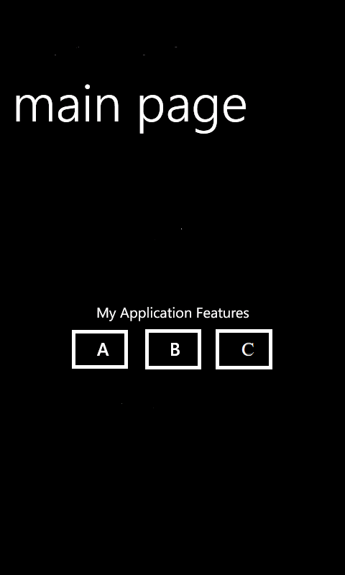
Mobile Test Industry Standards
Testing Strategies for Mobile Apps : LETS PRACTICE
HOMEWORK
Write as many Test Cases you can for this
simple app on Mobile device with three
buttons (A, B and C) that making different
sounds upon tapping on it.
A - for Audio 1
B - for Audio 2
C - for Audio 3
You are free to create conditions and Rules for each button , but be consistent.
Write Test Cases ( use previous slides for hints).
HAVE FUN !

