Slide 1

Becoming a Pro
IN Mobile Applications Testing

Slide 2
Mobile Test Industry Standards :
Testing Strategies for Mobile Apps EXTRA
FUNCTIONAL VS Non-FUNCTIONAL TEST
Load and Performance Testing
Ergonomics Testing
Stress & Volume Testing
Compatibility & Migration Testing
Data Conversion Testing
Penetration Testing
Operational Readiness Testing
Installation Testing
Security Testing
Unit Testing
Smoke testing / Sanity testing
System Testing
Regression Testing
Pre User Acceptance Testing
(Alpha & Beta)
White Box & Black Box Testing
Integration Testing (Top Down, Bottom up Testing)
Interface & Usability Testing
User Acceptance Testing
FUNCTIONAL
NON- FUNCTIONAL

Slide 3
Mobile Test Industry Standards :
Testing Strategies for Mobile Apps
COMPATIBILITY TEST
Different OS ->Android, IOS, Windows
Different browsers -> Firefox, Google Chrome, IE, Safari
Different Screen Size and resolution
OS versions and memory size
Hardware capable of interrupt handling without getting hanged
Multilingual Support
Different Time Zones Support

Slide 4
Mobile Test Industry Standards :
Testing Strategies for Mobile Apps EXTRA
ACCESABILITY TEST ( What is SCREEN READER ?)
Mobile Accessibility is critical to reaching all audiences. A product is accessible when a person with a disability can have an experience equivalent to that of a person without a disability
Users who are blind will use a screen reader to navigate and access information on mobile devices.
In the 2014 Webaim survey shows that 82% of Screen Reader users will use a mobile device
The screen readers are included in the device operating system and can be turned on in the device settings.
When Screen Reader is turned on, the gestures and keyboard shortcuts change.

Slide 5

Mobile Test Industry Standards :
Testing Strategies for Mobile Apps EXTRA
ACESSABILITY TEST ( SCREEN READER)
Web Content Accessibility Guidelines (WCAG)
A person who is blind using a screen reader or a talking browser can navigate your information and interact with it.
A person with low-vision can magnify the screen and understand the content.
A person who is deaf or hard-of-hearing can read captions in multimedia presentations.
A person with a dexterity limitation can use the alternative input devices for all interaction, or can use speech recognition software.
A person with ADHD or dyslexia can use and understand the content and complete tasks
Please refer to this link to learn more https://www.w3.org/TR/WCAG20/
Screen reader testing on mobile
Zooming site/application
Color ratios
Readability of the site
Navigation

Slide 6
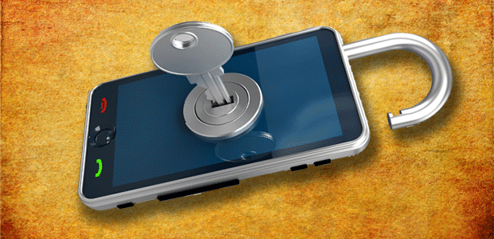
Mobile Test Industry Standards :
Testing Strategies for Mobile Apps
Security Test EXTRA
Workshop : ANSWER THESE QUESTIONS
1. What do you consider to be the biggest security issues with mobile phones?
2. How seriously are consumers and companies taking these threats?
3. What can be done about these threats?

Slide 7
Mobile Test Industry Standards :
Testing Strategies for Mobile Apps
Security Test EXTRA
Attacks on mobile devices range in volume and severity, but all have the potential to cause chaos at both a device and network level.
Just like in the conventional fixed Internet world, attacks come in all shapes and sizes – such as:
Phishing (criminals attempt to trick users into sharing passwords etc)
Spyware (tracks user’s activity, perhaps selling data to advertisers)
Worms (a program that copies itself onto multiple devices via network connections)
Trojans (a program that looks genuine but hides malicious intent)
Man-In-The-Middle Attacks (where a criminal intercepts and manipulates messages between two devices or device and computer).

Slide 8
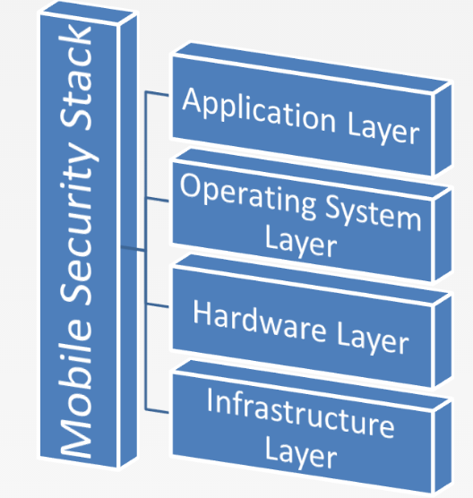
Mobile Test Industry Standards :
Testing Strategies for Mobile Apps
Security Test EXTRA
The Mobile Code Security Stack
The mobile code security stack can be broken up into four distinct layers.
Each layer of the mobile code security model is responsible for the security of its defined components and nothing more.
The upper layers of the stack rely on all lower layers to ensure that their components are appropriately safe

Slide 9
Mobile Test Industry Standards :
Testing Strategies for Mobile Apps
Security Test EXTRA
Mobile Device Risks at Every Layer
NETWORK
HARDWARE
OS
APPLICATION
Example :
Your device isn’t rooted but all your email and pictures are stolen, your location is tracked, and your phone bill is much higher than usual.

Slide 10

Mobile Test Industry Standards :
Testing Strategies for Mobile Apps
Security Test EXTRA
What is OWASP ?
The Open Web Application Security project is an online community which creates freely-available articles, methodologies, documentation, tools, and technologies in the field of Web App Security
OWASP Top Ten:
The Top Ten was first published in 2003 and is regularly updated.
Its goal is to raise awareness about application security by identifying some of the most critical risks facing organizations.
The Top 10 project is referenced by many standards, books, tools, and organizations, including MITRE, PCI DSS, Defense Information Systems Agency, FTC, and many more.
CWE – COMMON WEAKNESS ENUMERATION : https://cwe.mitre.org/about/

Slide 11

Mobile Test Industry Standards :
Testing Strategies for Mobile Apps
Security Test EXTRA- OWASP TOP TEN
Sensitive data leakage (inadvertent or side channel)
Unsafe sensitive data storage
Unsafe sensitive data transmission
Hardcoded password/keys
Activity monitoring and data retrieval
Unauthorized dialing, SMS and payments
Unauthorized network connectivity
UI impersonation
System modification (rootkit, APN proxy config)
Logic or time bomb
Malicious Functionality
Vulnerabilities

Slide 12
Mobile Test Industry Standards :
Testing Strategies for Mobile Apps
Security Test EXTRA- OWASP TOP TEN
There are two main categories of mobile code security risks:
MALICIOUS FUNCTIONALITY
The category of malicious functionality is a list of unwanted and dangerous mobile code behaviors that are stealthily placed in a Trojan app that the user is tricked into installing.
Users think they are installing a game or utility and instead get hidden spyware, phishing UI or unauthorized premium dialing.
VULNERABILITIES.
The category of Mobily Security vulnerabilities are errors in design or implementation that expose the mobile device data to interception and retrieval by attackers.
Mobile code security vulnerabilities can also expose the mobile device or the cloud applications used from the device to unauthorized access.

Slide 13
Mobile Test Industry Standards :
Testing Strategies for Mobile Apps
Security Test EXTRA- OWASP TOP TEN
1. Activity monitoring and data retrieval RISKS
EMAIL SPAM sent to 3rd Party addresses
Monitoring phone calls/MIC recording
Stored data, contact list or saved email messages retrieved.
Examples
attackers can monitor and intercept:
Messaging (SMS and Email)
Audio (calls and open microphone
recording)
Video (still and full-motion)
Location – Contact list
Call history
Browsing history
Input
Data files

Slide 14
Mobile Test Industry Standards :
Testing Strategies for Mobile Apps
Security Test EXTRA- OWASP TOP TEN
2. Unauthorized Dialing, SMS, and Payments RISKS
Directly monetize from a compromised device
Premium rate phone calls, premium rate SMS texts mobile payments
SMS text message as a spreading vector for worms.

Slide 15
Mobile Test Industry Standards :
Testing Strategies for Mobile Apps
Security Test EXTRA- OWASP TOP TEN
3. Unauthorized network connectivity RISKS
Mobile devices are designed for communication
Therefore Spyware or other malicious functionality typically requires exfiltration to be of benefit to the attacker.
Examples
examples of communication channels
attackers can use for distribution of a
malicious SW:
Email
SMS
HTTP (Hypertext Transfer Protocol) get/post
TCP ( Transmission Control Protocol) socket
UDP ( User Datagram Protocol) socket
DNS ( Domain Name Server ) exfiltration
Bluetooth
Blackberry Messenger

Slide 16
Mobile Test Industry Standards :
Testing Strategies for Mobile Apps
Security Test EXTRA- OWASP TOP TEN
4. UI impersonation RISKS
Similar to phishing - attacks that impersonating website of their bank or online service.
Web view applications on the mobile device can proxy to legitimate website.
Malicious app creates UI that impersonates phone’s native UI or the UI of a legitimate application.
Victim is asked to authenticate and ends up sending their credentials to an attacker.

Slide 17
Mobile Test Industry Standards :
Testing Strategies for Mobile Apps
Security Test EXTRA- OWASP TOP TEN
5.System modification RISKS
Malicious applications will often attempt to modify the system configuration to hide their presence.
This is often called rootkit behavior.
System Configuration changes also make certain attacks possible.

Slide 18
Mobile Test Industry Standards :
Testing Strategies for Mobile Apps
Security Test EXTRA- OWASP TOP TEN
6. Logic or Time Bomb RISKS
Logic or time bombs are classic backdoor techniques that trigger malicious activity based on a specific event, device usage or time.
A logic bomb is a piece of malicious code that executes when specific trigger conditions are met. A typical example would be a program that monitors a company's payroll system, and attacks the company if a specific employee is terminated.
When a logic bomb is programmed to execute when a specific date is reached, it is referred to as a time bomb. Time bombs are usually programmed to set off when important dates are reached
ALL SECURITY DATABASE : https://www.security-database.com/cwe.php?page=26&action=list

Slide 19
Mobile Test Industry Standards :
Testing Strategies for Mobile Apps
Security Test EXTRA- OWASP TOP TEN
7. Sensitive Data Leakage RISKS
Sensitive data leakage can be either inadvertent or side channel.
A legitimate apps usage of device information and authentication credentials can be poorly implemented thereby exposing this sensitive data to 3rd parties.
Location
Owner ID info: name, number, device ID
Authentication credentials
Authorization tokens

Slide 20
Mobile Test Industry Standards :
Testing Strategies for Mobile Apps
Security Test EXTRA- OWASP TOP TEN
8. Unsafe Sensitive Data Storage RISKS
Mobile apps often store sensitive data:
Banking and payment system PIN numbers, credit card numbers, or online service passwords.
Sensitive data should always be stored encrypted.
– Make use of strong cryptography to prevent data being stored in a manner that allows retrieval.
– Storing sensitive data without encryption on removable media such as a micro SD card is especially risky.

Slide 21
Mobile Test Industry Standards :
Testing Strategies for Mobile Apps
Security Test EXTRA- OWASP TOP TEN
9. Unsafe Sensitive Data Transmission RISKS
It is important that sensitive data is encrypted in transmission lest it be eavesdropped by attackers.
Mobile devices are especially susceptible because they use wireless communications exclusively and often public WiFi, which is known to be insecure.
SSL is one of the best ways to secure sensitive data in transit

Slide 22
Mobile Test Industry Standards :
Testing Strategies for Mobile Apps
Security Test EXTRA- OWASP TOP TEN
10. Hardcoded password/keys RISKS
The use of hardcoded passwords or keys is sometimes used as a shortcut by developers to make the application easier to implement, support, or debug.
Once this hardcoded password is discovered through reverse engineering it renders the security of the application or the systems it authenticates to with this password ineffective.

