Slide 1

Becoming a Pro
IN Mobile Applications Testing

Slide 2


Mobile APPS: Distribution/Installation: .IPA
What is iTunes?
iTunes is a media player, media library, online radio broadcaster, and mobile device management application developed by Apple Inc.
It is used to play, download, and organize digital downloads of music and video (as well as other types of media available on the iTunes Store) on personal computers running the macOS and Microsoft Windows operating systems.

Slide 3
Mobile APPS: Distribution/Installation: .IPA
Drag-and-drop IPA file into 'Apps' tab of iTunes BEFORE you connect the device
Connect your device
Select your device on iTunes
Select 'Apps' tab
Search app that you want to install
Click on 'Install' button. This will change to 'Will Install'
Click on 'Apply' button on right corner

Slide 4

LOGS: Collecting from iTunes
Sync your device with iTunes on your desktop.
After syncing, look for crash logs in the correct directory.
The Following few slides will give an instructions . Lets start !

Slide 5
LOGS: Collecting from iTunes
Mac OS X:
Open Finder (found in the Dock)
Click on the 'Go' menu at the top of your screen, and select 'Go to Folder'
Type (or paste): ~/Library/Logs/CrashReporter/MobileDevice/<DEVICE_NAME>
Open the folder with the same 'name' as your device.
(Note: your device name appears in iTunes on the left side, under 'Devices').
Open the folder called 'Retired'
You will see at least one item starting with 'ReadItLaterPro'.

Slide 6
LOGS: Collecting from iTunes
Windows Vista or 7:
Open any Windows Explorer Window (My Computer, My Documents, etc.)
Enter %appdata%, and press enter →Navigate to Roaming C:\Users\<USERNAME>\AppData\Roaming\Apple
Computer\Logs\CrashReporter\MobileDevice\<DEVICE_NAME>
(Note: your device name appears in iTunes on the left side, under 'Devices')
You will see at least one item starting with 'ReadItLaterPro'.

Slide 7
LOGS: Collecting from iTunes
Windows XP:
Locate your Application Data folder.
Navigate to Apple computer C:\Documents and Settings\<USERNAME>\Application Data\Apple
Computer\Logs\CrashReporter\MobileDevice\<DEVICE_NAME>
(Note: your device name appears in iTunes on the left side, under 'Devices')
You will see at least one item starting with 'ReadItLaterPro'.

Slide 8
LOGS: Collecting from your Device
To obtain iOS crash logs, please select your device and go to:
Settings > Privacy > Diagnostics & Usage (for iOS 8 or newer)
Settings > General > About > Diagnostics & Usage (for iOS 7 or older)
Select a Chrome crash from the list.
This will start with “Chrome_” and contain the timestamp of the crash.
Tap on the crash and you will see a text field with a crash log.
Long press to Select All and then Copy the crash text.
Paste it into something you can get off of your device (for example, an email to yourself).

Slide 9

Mobile APPS: Distribution/Installation: .IPA
What is TestFlight?
TestFlight is an online service for over-the-air installation and testing of mobile applications, currently owned by Apple Inc and only offered to developers within the iOSDeveloper Program
Developers signed up with the service to distribute applications to internal or external beta testers, who could subsequently send feedback about the application to developers
The TestFlight SDK additionally allowes developers to receive remote logs, crash reports and tester feedback.
HOMEWORK : READ AN ENTIRE ARTICLE ABOUT TestFLIGHT https://www.raywenderlich.com/48750/testflight-sdk-tutorial

Slide 10
Overview: Mobile APPS
Types
Categories
Troubleshooting Guide
Simulators
Emulators
Remote Device Access (RDA)
Mobile Test Industry Standards
Distribution/Installation/Logs
App Risk Analysis

Slide 11
Mobile Test Industry Standards :
Testing Strategies for Mobile Apps
Challenges
Like any desktop or web application testing, mobile application testing is also focused on the quality and performance of the final product.
However, mobile app testing becomes far more challenging because of the following key factors
Device fragmentation
In-house vs. outsourced testing
Availability of mobile testing tools
Application Lifecycle Testing

Slide 12
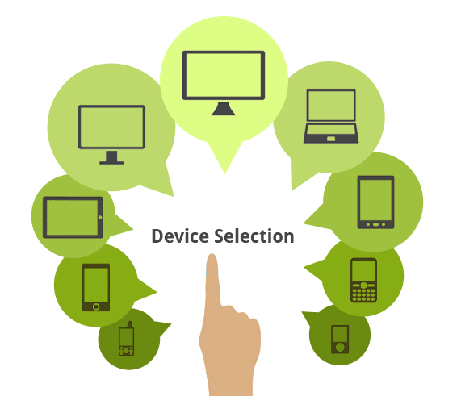
Mobile Test Industry Standards :
Testing Strategies for Mobile Apps
Device Model
OS Version
Screen Resolution
Form Factor
Emulators vs. Physical Devices

Slide 13

Mobile Test Industry Standards :
Testing Strategies for Mobile Apps
Network density
How the app behaves on specific devices
How real-world users interact with the app
Different battery states on the devices
Multiple networks (Wi-Fi, 4G, 3G, etc.)
Beta Testing of your Mobile App

Slide 14

Mobile Test Industry Standards :
Testing Strategies for Mobile Apps
applications can be deployed, tested, and managed
provides real-time testing results
capability to support complex apps
saves businesses from setting up on-premise test environments
Mobile App Testing on Cloud

Slide 15
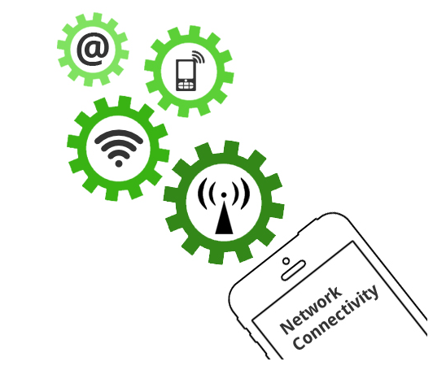
Mobile Test Industry Standards :
Testing Strategies for Mobile Apps
testing mobile apps in real network environments
testing the app in a full internet connectivity scenario and other factors
test mobile apps in various network speeds, bandwidths variations
network simulation tools are available

Slide 16
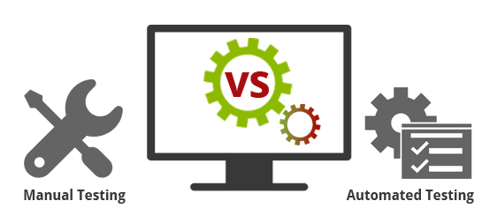

Mobile Test Industry Standards :
Testing Strategies for Mobile Apps
Automated testing is highly effective in consistently repeating a test procedure in regression testing as well as testing during the development stages.
However, test automation requires significant amount of initial investment.

Slide 17
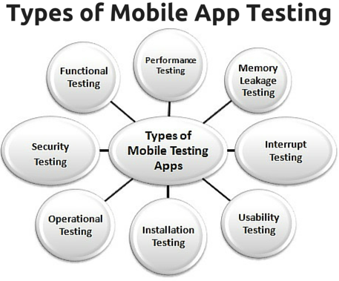
Mobile Test Industry Standards :
Testing Strategies for Mobile Apps

Slide 18
Mobile Test Industry Standards :
Testing Strategies for Mobile Apps
FUNCTIONAL TEST
Verifying that all documented requirements are implemented.
Verifying that all features work as expected.
Validating texts, logos, images, text captions and other UI elements.
Validating localization and globalization.
Evaluating ease of navigation and screen transitions.
Examining response speed.
Evaluating the intuitiveness of the touch interface.

Slide 19
Mobile Test Industry Standards :
Testing Strategies for Mobile Apps
PERFORMANCE TEST
Performance with low battery power
Performance while network out of coverage area
Performance while transferring heavy file
Testing from Application’s server and client side
Performance during poor bandwidth
Performance while changing internet connection mode

Slide 20
Mobile Test Industry Standards :
Testing Strategies for Mobile Apps
Memory Leakage TEST
Verifying if program runs for an extended time and consumes additional memory
Verifying when a system device driver causes the leak
Verifying where the leak occurs within the operating system or memory manager
Verifying where memory is very limited, such as in an embedded system or portable device
Verifying where the program can request memory — such as shared memory that is not released
Verifying if memory is allocated frequently for one-time tasks

Slide 21
Mobile Test Industry Standards :
Testing Strategies for Mobile Apps
INTERRUPT TEST
Battery full- when charging
Incoming phone call
Incoming SMS
Incoming Alert from another mobile application
Plugged in for charging
Plugged out from charging
Device shut off
Application Update reminders
Alarm
Network connection loss
Network connection restoration
Battery low

Slide 22
Mobile Test Industry Standards :
Testing Strategies for Mobile Apps
USABILITY TEST
To ensure that the buttons should have the required size and be suitable to big fingers.
To ensure that the buttons are placed in the same section of the screen to avoid confusion to the end users.
To ensure that the icons are natural and consistent with the application.
To ensure that the buttons, which have the same function should also have the same color.
To ensure that the validation for the tapping zoom-in and zoom-out facilities should be enabled.
To ensure that the keyboard input can be minimized in an appropriate manner.
To ensure that the application provides a method for going back or undoing an action, on touching the wrong item, within an acceptable duration.
To ensure that the contextual menus are not overloaded because it has to be used quickly.

Slide 23
Mobile Test Industry Standards :
Testing Strategies for Mobile Apps
INSTALLATION TEST
Verify application gets installed properly
Verify user can uninstall application successfully
Verify app updates are properly installed
Check app behavior on trying to install it on non-supported version/device.
Verify app is installed properly from app store and from side loading
Verify aborting installation does not affect other features

Slide 24
Mobile Test Industry Standards :
Testing Strategies for Mobile Apps
SECURITY TEST
Data flow -- Can you establish an audit trail for data, what goes where, is data in transit protected, and who has access to it?
Data storage -- Where is data stored, and is it encrypted? Cloud solutions can be a weak link for data security.
Data leakage -- Is data leaking to log files, or out through notifications?
Authentication -- When and where are users challenged to authenticate, how are they authorized, and can you track password and IDs in the system?
Server-side controls -- Don't focus on the client side and assume that the back end is secure.
Points of entry -- Are all potential client-side routes into the application being validated?

Slide 25
Mobile Test Industry Standards :
Testing Strategies for Mobile Apps EXTRA
FUNCTIONAL VS Non-FUNCTIONAL TEST
Load and Performance Testing
Ergonomics Testing
Stress & Volume Testing
Compatibility & Migration Testing
Data Conversion Testing
Security / Penetration Testing
Operational Readiness Testing
Installation Testing
Security Testing
Unit Testing
Smoke testing / Sanity testing
System Testing
Regression Testing
Pre User Acceptance Testing
(Alpha & Beta)
White Box & Black Box Testing
Integration Testing (Top Down, Bottom up Testing)
Interface & Usability Testing
User Acceptance Testing
FUNCTIONAL
NON- FUNCTIONAL

