Slide 1

WELCOME
Mobile Applications Testing

Slide 2
Mobile Ecosystem
Network
Manufactures
Devices
Platforms/OS
Frameworks
API-Apps
Services
Mobile World Statistics
Carriers/Service Providers

Slide 3

API-APP
Application Programming interface (API) is a set of functions, classes, libraries, or packages (a.k.a. frameworks)
API allowing developers access an application’s services by using the programming languages
An API may include specifications for routines, data structures, object classes, and variables
Generally speaking, API →specification of how some SW components should be interacting with one another other
Tutorial : Click Here

Slide 4

API-APPS : EXAMPLES
The following list contains several examples of popular APIs:
Google Maps API: Google Maps APIs lets developers embed Google Maps on webpages using a JavaScript or FlashInterface
YouTube APIs: YouTube API: Google's APIs lets developers integrate YouTube videos and functionality into websites or applications
Flickr API: The Flickr API is used by developers to access the Flick photo sharing community datThe Flickr API consists of a set of callable methods, and some API endpoints
Twitter APIs: Twitter offers two APIs. The REST API and Search API
Amazon Product Advertising API: Amazon's Product Advertising API gives developers access to product selection and discovery
UserEngage : Engagement tool, marketing automation platform that tracts you visitors

Slide 5
Mobile Ecosystem
Network
Manufactures
Devices
Platforms/OS
Frameworks
API-APP
Services
Mobile World Statistics
Carriers/Service Providers

Slide 6
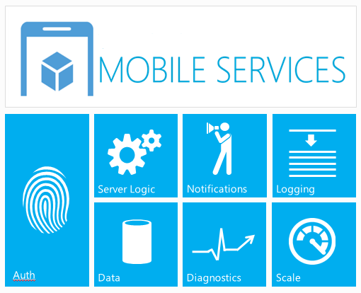
SERVICES

Slide 7
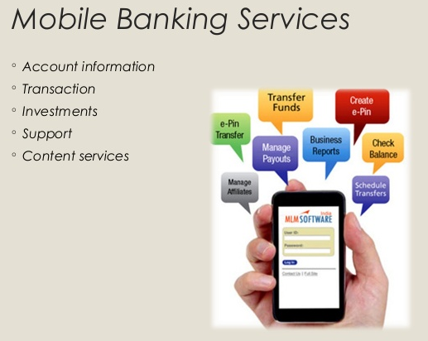
SERVICES : Mobile Banking, Payments
Mobile banking can be done
by accessing bank's web page through the web browser on your mobile phone,
via text messaging
by using an application downloaded to your mobile phone

Slide 8
SERVICES :
Location Based Services (LBS)
LBS include services are to identify a location of a person or object, such as discovering the nearest banking cash machine or the whereabouts of a friend or employee.
LBS include parcel tracking and vehicle tracking services.
LBS can include mobile commerce when taking the form of coupons or advertising directed at customers based on their current location.
They include personalized weather services and even location-based games.

Slide 9
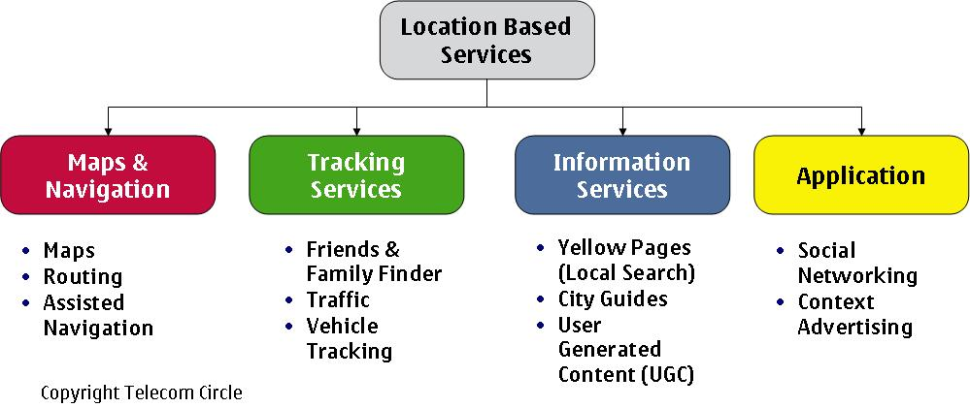
SERVICES :
Location Based Services (LBS)

Slide 10
SERVICES
Cloud Services and Infrastructure
Advertizing Platforms and Services
Analytics
Testing and Monitoring
M-Commerce Platforms

Slide 11
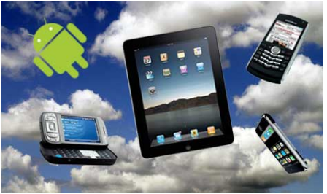
SERVICES :
Cloud Services and Infrastructure
WHAT IS THAT ?
According to the survey, mobile cloud computing is emerging as one of the most important branches of cloud computing, and is still in its infancy. Therefore it‘s highly relevant to clarify the confusion that has arisen around mobile cloud computing.
The Mobile Cloud is Internet-based data, applications and related Services accessed through Smart Phones, Laptop Computers, Tablets and other portable devices.

Slide 12
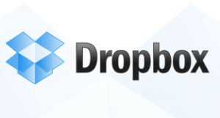

SERVICES :
Cloud Services and Infrastructure
A mobile cloud should be able to sync a wide variety of data and content, between any source and device.
Even with fast 4G networks, there will still be pockets of non-networked areas and times when devices are offline, and people will still want access to their data and content.
Furthermore, for a good user experience, it is necessary for many apps to access local device

Slide 13
SERVICES :
Cloud Services and Infrastructure : Summary
An important aspect of a mobile cloud platform is the ability to remotely manage devices over the air, in terms of provisioning devices, performing diagnostics, updating software and settings, and remotely locking devices and erasing data for security reasons.
These functions are typically found today with higher end SmartPhones such as BlackBerries and iPhones, but they are increasingly becoming expected with other types of portable devices.

Slide 14
SERVICES
Cloud Services and Infrastructure
Advertizing Platforms and Services
Analytics
Testing and Monitoring
M-Commerce Platforms

Slide 15
SERVICES :
Analytics
WHAT IS THAT ?
It could be separated in these categories
Mobile ANALYTICS involves measuring and analyzing data generated by mobile platforms and properties, such as mobile sites and mobile applications
It tracks, measures and understands how mobile users are interacting with mobile sites and mobile apps.
app analytics
digital analytics
web analytics

Slide 16
SERVICES :
Analytics
App analytics, or mobile app analytics, is the measurement and analysis of data generated when users interact with your mobile applications
Digital analytics encompasses the collection, measurement, analysis, visualization and interpretation of digital data illustrating user behavior on websites, mobile sites and mobile applications.
Web analytics groups together the measurement, collection, analysis and presentation of data from the Internet in order to understand and optimize how websites are used.
app analytics
digital analytics
web analytics

Slide 17
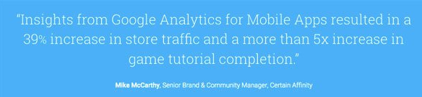

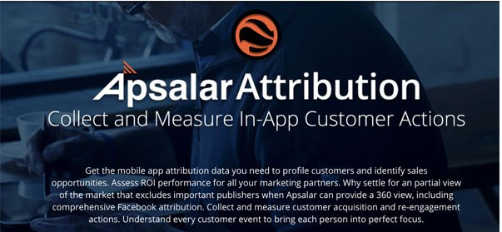
SERVICES :
Analytics TOOLS
http://www.bluecloudsolutions.com/blog/app-analytics-tools-developers/
Check this link to learn
more about TOOLS

