Slide 1

WELCOME
Mobile Applications Testing

Slide 2
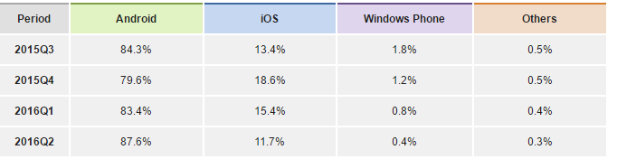
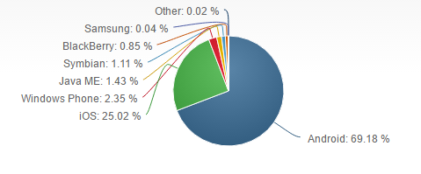
Platforms / OS Market Share 2016
The worldwide SmartPhone market grew 0.7% year over year in 2016Q2,
with 344.7 million shipments, according to data from the International Data Corporation (IDC) Worldwide Quarterly Mobile Phone Tracker.

Slide 3
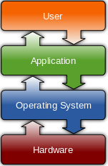
Platforms / OS : Explained
A computing platform is the “stage” where computer programs run.
An operating system sits between applications and hardware, managing how applications access hardware and software resources.
This means that an operating system is a kind of computing platform, but a computing platform is not necessarily a kind of operating system.
A runtime library can also be a computing platform.

Slide 4
Platforms / OS : In short
The terms PLATFORM and OPERATING SYSTEM mean almost the same thing. 
An OPERATING SYSTEM lets your computer run and control its most basic functions, but the platform is something, upon what programs/applications (like calendar or web browsers) can be installed and used.
Think of PLATFORM as a broader term denoting the difference between Mac and Windows in general, while OPERATING SYSTEM is more often used to when referring to specific versions of Windows or Mac

Slide 5


Platforms / OS Licensed
Licensed platforms are sold to device makers for
non-exclusive distribution on devices.
The major goal of Licensed Platforms was to create a common/standard
platform of Application Programming Interfaces (APIs) development
that work similarly across multiple devices with the minimum effort
required to adapt the device differences.
Example: Windows Mobile, JME - Sun Microsystems/Oracle; Brew MP – HTC Smart Phone or carrier’s firmware, etc

Slide 6
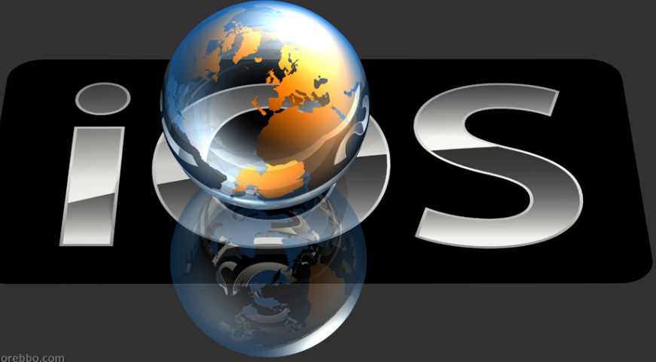
Platforms / OS Proprietary
A proprietary operating system is one which a particular company
conceptualizes, designs, develops and sells. Examples of proprietary
operating systems are Windows and Mac OS X
Pros
Simplified user experience making the overall user experience simpler and smoother.
User multiplier effect based on increasing number of people
already using it.
Cons
Limited Customizability
Interoperability Operating systems are often designed to work with a fixed set of hardware specifications

Slide 7
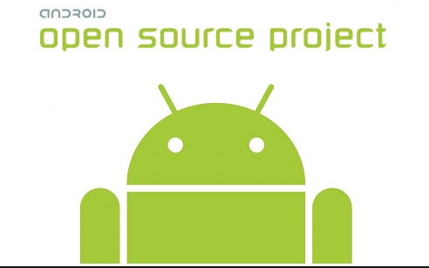
Platforms / OS Open Source
Open source is a philosophy which suggests that the source code behind
something should be freely available to the public.
Pros
The main advantage is that it allows end users to directly interact with the source, potentially modifying it to suit their wishes.
Encourages constant development and innovation, while also creating a community of shared information.
Cons
Vulnerable to malicious users
Might not be as user-friendly as commercial versions
Don’t come with extensive support

Slide 8
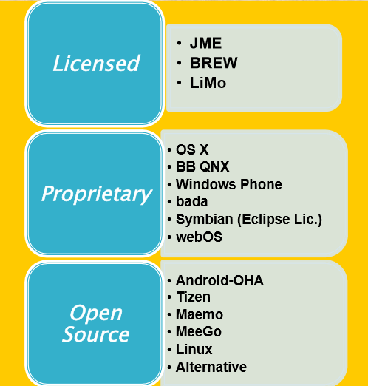
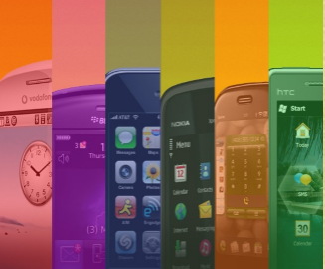
Platforms / OS SUMMARY

Slide 9
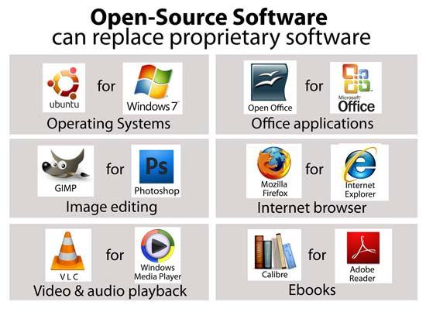
Platforms / OS : Open Source vs Proprietary

Slide 10
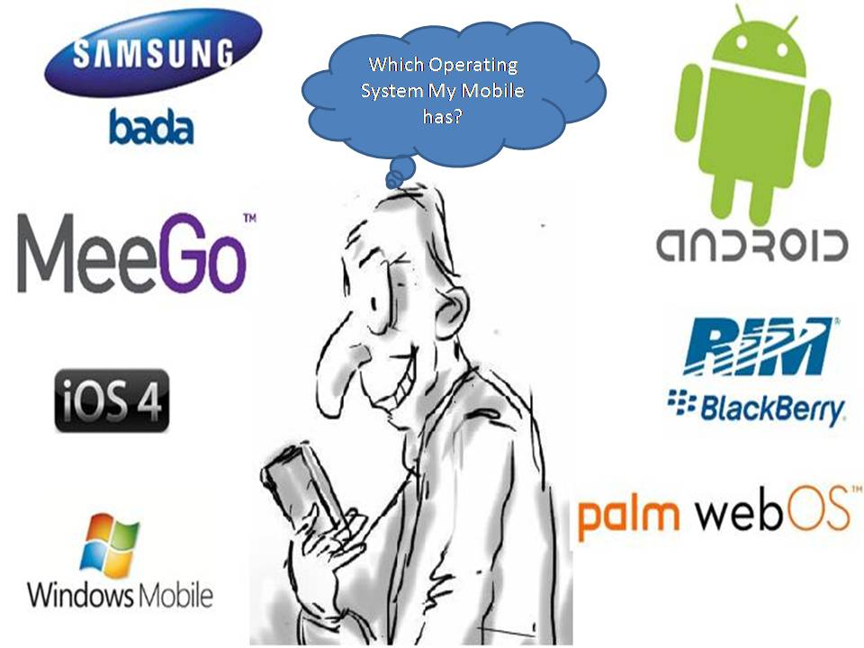
Platforms / OS : What do I HAVE ?

Slide 11

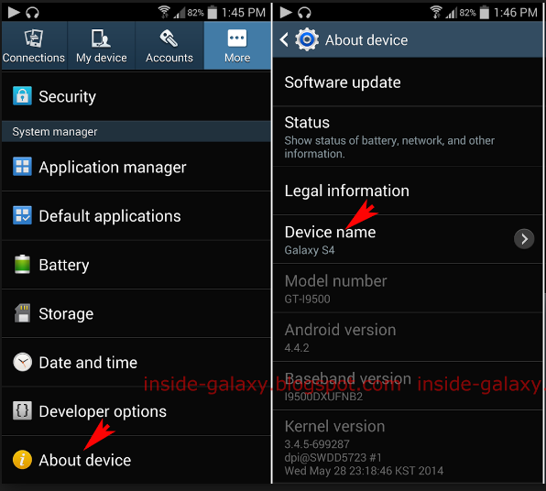
Platforms / OS :
How to find my Android OS Version ?
Open your device SETTINGS
Scroll to ABOUT PHONE
Look for line which says "Android Version"

Slide 12
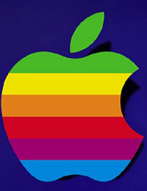
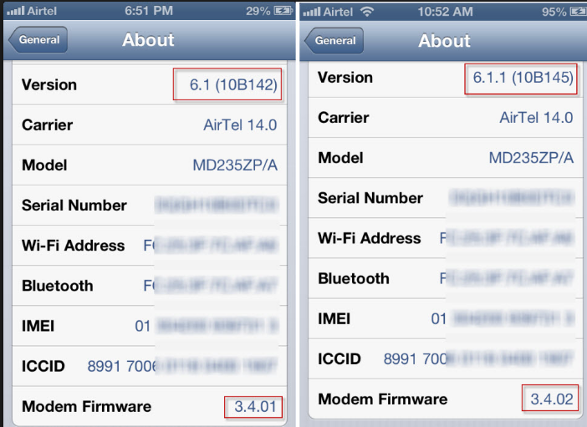
Platforms / OS :
How to find my Apple iOS Version ?
Open the Settings
Tap 'General'
Tap 'About'
Scroll down for 'Version'

Slide 13
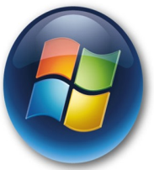
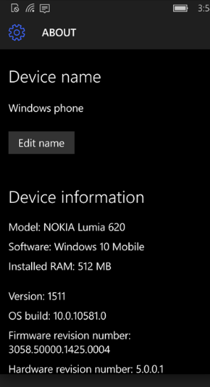
Platforms / OS :
How to find my WinPhone OS version ?
Windows Phone home screen
Scroll down and tap ’SETTIGS’
Scroll down and tap ’ABOUT’
‘About’ screen, tap MORE INFO
Swipe left to reveal more icons

Slide 14
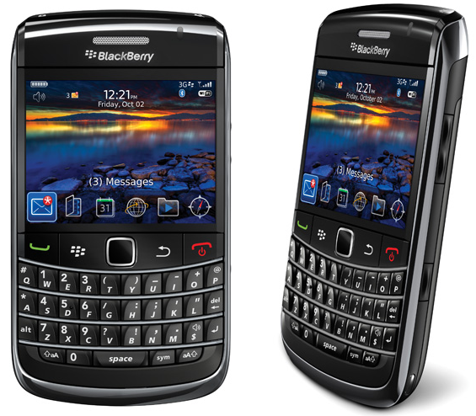
Platforms / OS :
BLACKBERRY current ver : 10.3.2
BlackBerry (RIM) is a proprietary operating system
It is tailor-made for business, with functionality taking a seat over personality or appearance
Its main focus is on messaging, email and other communication features.

Slide 15
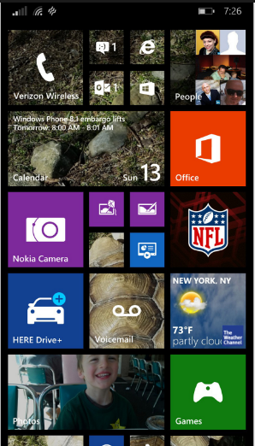

Platforms / OS :
Windows Phone current ver : 10.0
Windows Phone (WP) is a
family of mobile operating
systems developed by
Microsoft for SmartPhones
Replacement successor
to Windows Mobile and Zune
WP features a new UI derived
from Metro design language.

Slide 16

Platforms / OS :
ANDROID
ANDROID
is a mobile operating system developed by GoogleBased on the Linux Kernel and designed primarily for touch screen Mobile Devices such as : SmartPhones and Tablets.

Slide 17
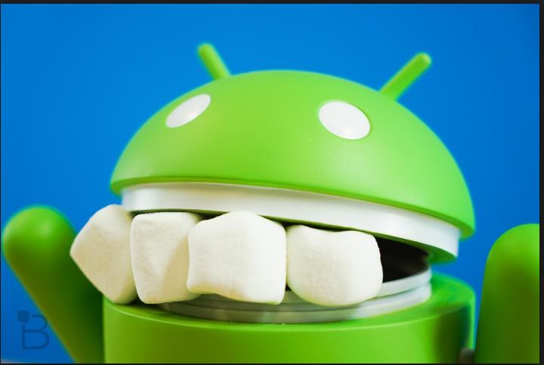

Platforms / OS :
ANDROID version 6.0-6.0.1
API level 23-24
“MARSHMALLOW“
Officially released in October 2015

Slide 18
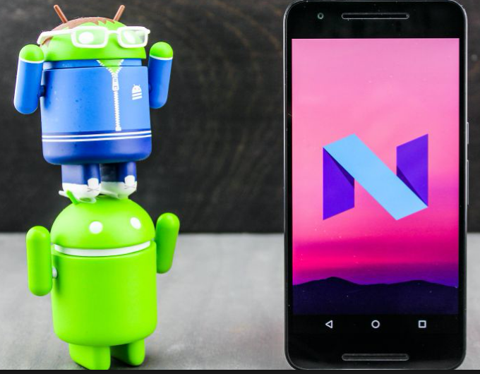
Platforms / OS :
ANDROID version 7.0-7.0.1
API level 24-25
Nexus 6, 5X, 6P, 9, Nexus Player, Pixel C, and General Mobile 4G
Android 7.0-7.1 "Nougat"
First released as a beta build on March 9, 2016, it was officially released on August 22, 2016, with Nexus devices being the first to receive the update.

Slide 19
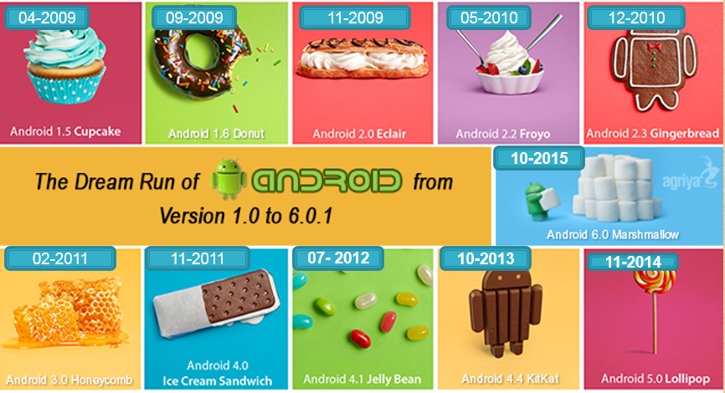
Platforms / OS :
ANDROID HISTORY 2005-2014

Slide 20
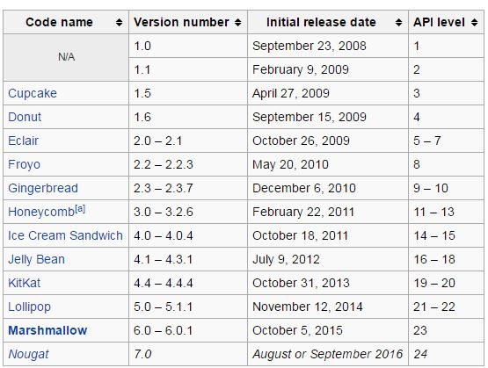
Platforms / OS :
ANDROID OS HISTORY

Slide 21
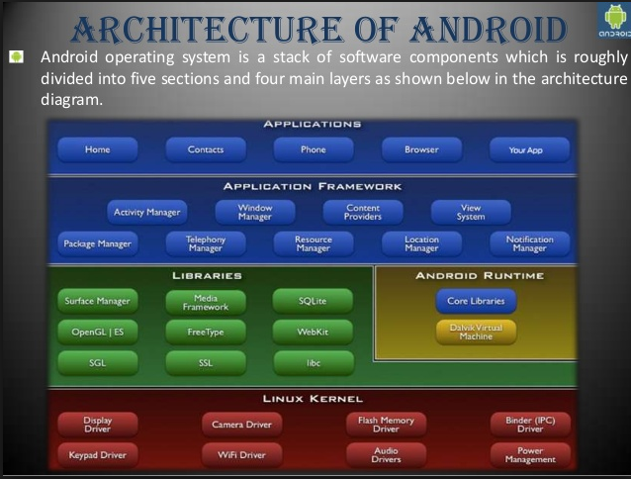
Platforms / OS :
ANDROID ARCHITECTURE

Slide 22
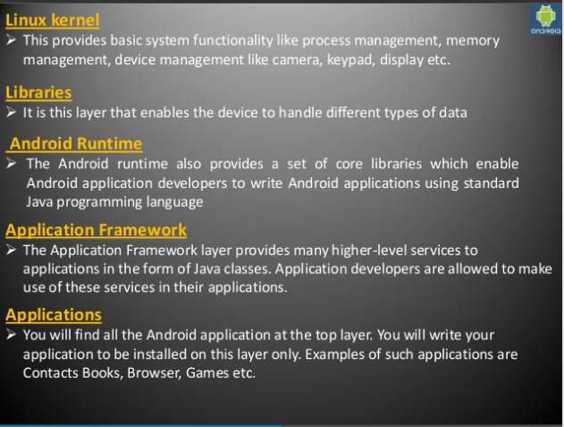
Platforms / OS :
ANDROID ARCHITECTURE

Slide 23
Platforms / OS :
ANDROID FILE FORMAT .APK
Android application package (APK) is the package file format used by the Android operating system for distribution and installation of mobile apps and middle-ware
What is an APK File?
Just like Windows (PC) systems use an .exe file for
installing software, Android does the same.
An APK file is the file format used for installing
software on the Android operating system.

Slide 24
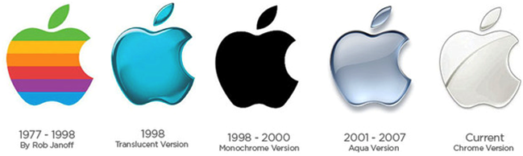
Platforms / OS : iOS
iOS (originally iPhone OS) is a mobile operating
system created and developed by Apple Inc.
and distributed exclusively for Apple hardware
It is the operating system that presently powers
many of the company's mobile devices, including
the iPhone, iPad, and iPod touch.

Slide 25
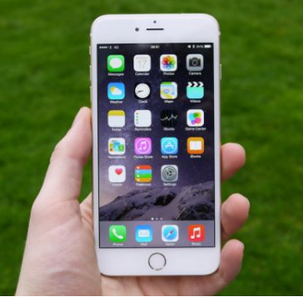
Platforms / OS : iOS latest version 10.0 – 10.1.1
Apple unveiled iOS 10, the next-generation operating system for the iPhone, iPad, and iPod touch, on June 13, 2016, releasing it to the public exactly three months later on September 13.
The most recent update, iOS 10.1.1, was released on 10/31/2016

Slide 26
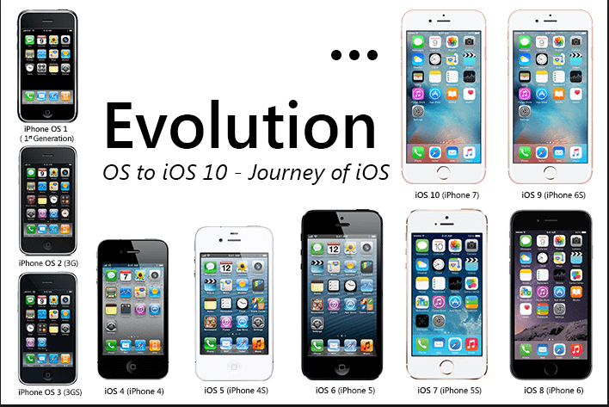
Platforms / OS : iOS latest version 10.0 – 10.1.1 http://www.mobiloitte.com/blog/evolution-iphone-os-1-ios-10-journey-ios

Slide 27

Platforms / OS :
Version Name HISTORY → iOS
1.0: Alpine (1.0.0 - 1.0.2: Heavenly)
1.1: Little Bear
2.0: Big Bear
2.1: Sugarbowl
2.2: Timberline
3.0: Kirkwood
3.1: Northstar
3.2: Wildcat (iPad only)
4.0: Apex
4.1: Baker
4.2: Jasper (4.2.5 - 4.2.10: Phoenix)
4.3: Durango
5.0: Telluride
5.1: Hoodoo
1.1.1: Snowbird, 1.1.2: Oktoberfest
6.0: Sundance
6.1: Brighton
7.0: Innsbruck
7.1: Sochi
8.0: Okemo
8.1: OkemoTaos
8.2: OkemoZurs
8.3: Stowe
8.4: Copper
9.0: Monarch
9.1: Boulder
9.2: Castlerock
9.3: Eagle
10.0: Whitetail

Slide 28
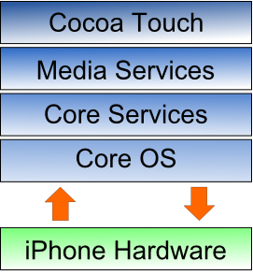

Platforms / OS : iOS (iPhone) Architecture (simplified)
Cocoa Touch Layer
It is a top layer of the iPhone OS stack and it contains the frameworks that are most commonly used by iPhone application developers.
Media Layer
It is the second layer from the top of the stack. It provides the iPhone OS with audio, video, animation and graphics capabilities.
Core Services Layer
It is the third layer from the top of the stack. The iPhone Core Services layer provides much of the foundation on which the above layers are built.
Core OS Layer
The Core OS Layer is the bottom layer of the iPhone OS stack and sits directly on top of the device hardware. This layer provides a variety of sevices
iPhone Hardware
Hardware devices are managed by iPhone OS and provides the technologies needed for implementing native applications on the phone.

Slide 29
Platforms / OS : iOS .IPA
An .ipa file is an iOS application archive file which stores an iOS app.
Each .ipa file includes a binary for the ARM architecture and can only be installed on an iOS device.
Files with the .ipa extension can be uncompressed by changing the extension to .zip and unzipping.

Slide 30
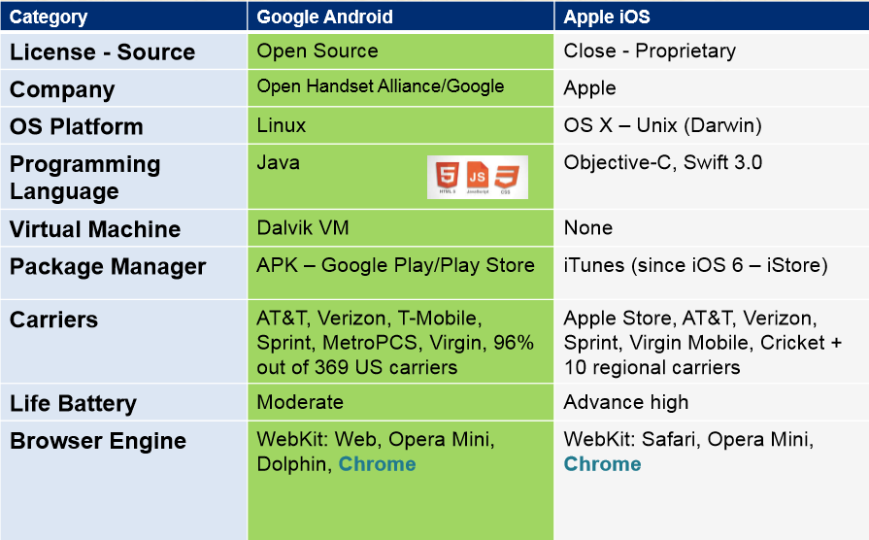
Platforms / OS :
ANDROID vs IOS : SUMMARY

Slide 31
Mobile Ecosystem
Network
Manufactures
Devices
Platforms/OS
Frameworks
API-Apps
Services
Mobile World Statistics
Carriers/Service Providers

Slide 32
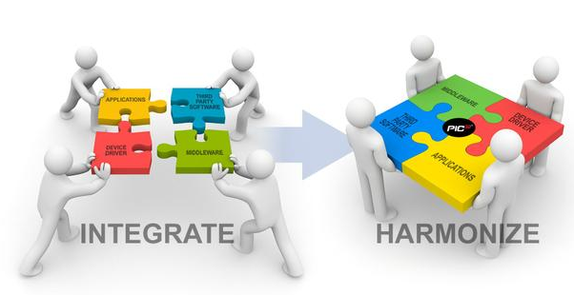
FRAMEWORKS
SOFTWARE FRAMEWORK in computer programming, is an abstraction in which common code providing generic functionality can be selectively overridden or specialized by user code providing specific functionality
FRAMEWORKS are a special case of software libraries in that they are reusable abstractions of code wrapped in a well-defined Application programming interface (API), yet they contain some key distinguishing features that separate them from normal libraries

Slide 33

FRAMEWORKS : distinguishing features
INVERSION OF CONTROL
DEFAULT BEHAVIOR
EXTENSIBILITY
NON-MODIFIABLE FRAMEWORK CODE

Slide 34
FRAMEWORKS
Example → ANDROID APP
Application Framework sits on top of native libraries, android runtime and Linux kernel.
This framework come pre-installed with high-level building blocks that developers can use to program applications.
RIGHT SIDE → the most important application framework components for our application and Android development in general.
Activity Manager
Content Provider
View system
Package Manager
Resource Manager
Location Manager
Notification Manager
Manages the lifecycle of application
Stores and retrieves data and makes it accessible to all applications
Handles GUI related Tasks
Retrieves various info related to the currently installed app on a device
Provides access to non-code resources such as icons, etc
Location-based and related services
Executes and Manages all Notifications, alerts, etc

Slide 35
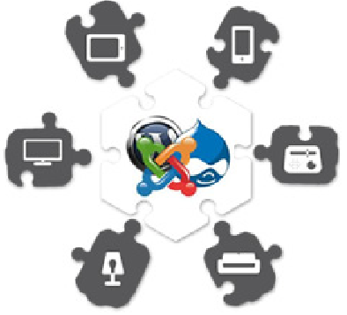
FRAMEWORKS
Example → Win CE and OS X
SF is a universal, reusable software platform used to develop applications, products and solutions.
SF include support programs, compilers, code libraries ,APIs and tool sets that bring together all the different components to enable development of a project or solution.
Platform: Windows CE
OS: Windows Phone
Framework: .NET
Platform: OS X
OS: iOS
Framework: Cocoa Touch

Slide 36


FRAMEWORKS : CONCLUSION
Soft development is about getting stuff done, not figuring out how to get it done.
Frameworks and libraries help the developers focus on creating rather than figuring stuff out.
Rather than reinventing the wheel, Developers can use a framework or library to delegate brunt, noncreative and repetitive work, freeing up their time and energy to create the actual website or application.

