Slide 1

WELCOME
Mobile Applications Testing

Slide 2
Mobile Ecosystem
Network
Manufactures
Devices
Platforms/OS
Frameworks
API-Apps
Services
Mobile World Statistics
Carriers/Service Providers

Slide 3
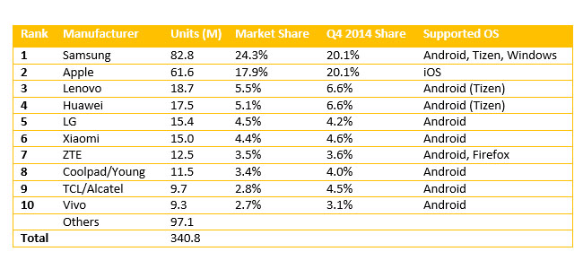
MANUFACTURES / MAKERS

Slide 4
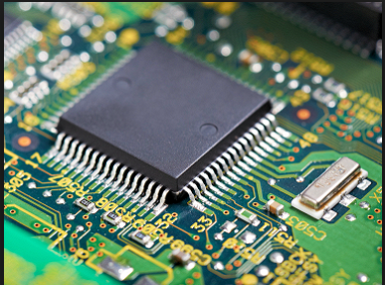
MANUFACTURES / MAKERS
Responsible for :
Concept and Prototyping:
Designs, features, and interface options (like keypad or touchscreen )
The phone's weight, scale, size, portability
Hardware and Software:
Printed circuit board, LCD screen, keypad, antenna, microphone, speaker and battery
Firmware/OS
GPS and WiFi capabilities
Documentation.

Slide 5
Mobile Ecosystem
Network
Manufactures
Devices
Platforms/OS
Frameworks
API-Apps
Services
Mobile World Statistics
Carriers/Service Providers

Slide 6
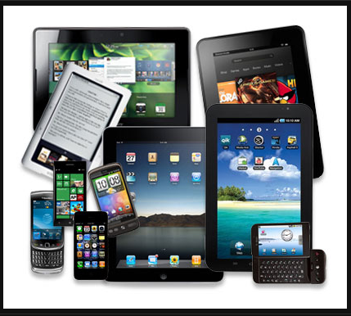
Devices

Slide 7
Devices
Handheld PC, Palm-size PC, Pocket PC, Pocket computer, Palmtop PC
PDA Electronic Organizer, Mobile Phone , Feature Phone, SmartPhone, Phablet
PMP, DAP
E-Reader
Handheld Game Console
Portable/Mobile Data Terminal

Slide 8
Devices: Principals of Mobile Computing
Portability
Facilitates movement of device(s) within the mobile computing environment
Connectivity
Ability to continuously stay connected with minimal amount of lag/downtime, without being affected by movements of the device
Social Interactivity
Maintaining the connectivity to collaborate with other users, at least within the same environment
Individuality
Adapting the technology to suit individual needs.

Slide 9
Devices : FeaturePhone vs SmartPhone
SmartPhones are those which have advanced computing capability than Feature phones
FeaturePhones are low-end device with lower-price

Slide 10
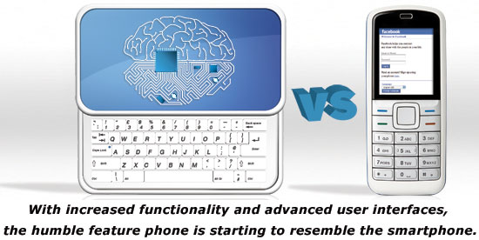
Devices : FeaturePhone vs SmartPhone
In short :
SmartPhones usually have a wider array of key features.
These can include a full Web browser, 3G or 4G network support, Flash player capability, GPS, higher-resolution camera, third-party application support , video conferencing and more

Slide 11
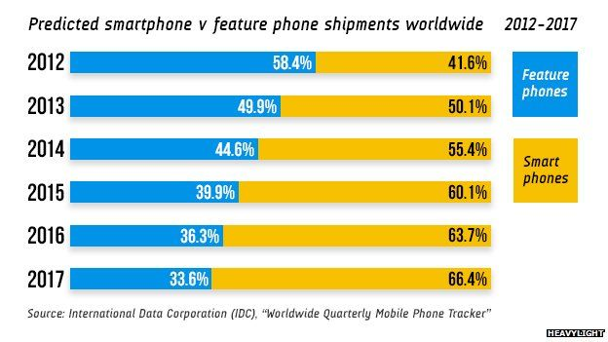
Devices :
FeaturePhone vs SmartPhone Comparison Data

Slide 12
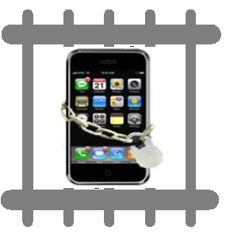
Devices :
JAILBREAKING : iOS
JAILBREAKING
process of modifying iOS system kernels to allow file system read and write access.
JAILBREAKING TOOLS
(and exploits) remove the limitations and security features built by the manufacturer Apple (the "jail")
JAILBREAKING TOOLS
allow users to run code not approved and signed by Apple.

Slide 13

Devices :
UNLOCKING : IPHONE
An UNLOCKED iPHONE
can be used with any carrier, not just those that have been approved by Apple.
many UNLOCKING solutions only work with certain iOS models
Factory IMEI UNLOCKS is a popular solution that works with all iPhone models.

Slide 14
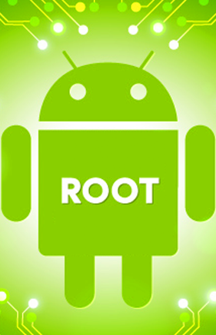
Devices :
ROOTING : ANDROID OS
An UNLOCKED iPHONE
can be used with any carrier, not just those that have been approved by Apple.
many UNLOCKING solutions only work with certain iOS models
Factory IMEI UNLOCKS is a popular solution that works with all iPhone models.
Copyright NataliaS@portnov.com

Slide 15
Devices :
ROOTING : GLOSSARY
ROOT
ROM
KERNEL
RADIO
FLASH
Rooting means you have root access to your device
A ROM is a modified version of Android.
A kernel is the component of your operating system that manages communications between your software and hardware.
Radios are part of your phone’s firmware that controls your cellular data, GPS, Wi-Fi, and other things like that.
Flashing essentially means installing something on your device, whether it be a ROM, a Kernel, or a Recovery
Copyright NataliaS@portnov.com

Slide 16
Devices :
ROOTING : GLOSSARY
BOOTLOADER
Breaking device during flashing or other acts.
BRICK
ADB stands for Android Debug Bridge
ADB
From most third-party recovery modules, user can make device backups called nandroid backups.
NANDROID
Software on a device that allow user to make backups, flash ROMs, and perform other system-level tasks
RECOVERY
Lowest level of software on a device, running all the code that’s necessary to start OS
Copyright NataliaS@portnov.com

Slide 17
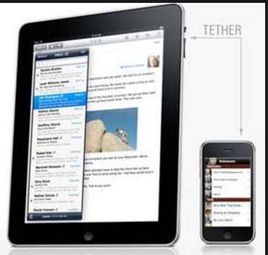
Devices :
TETHERING
TETHERING
connecting one device to another
In the context of mobile phones and tablet computers, tethering allows sharing the Internet connection of the phone or tablet with other devices such as laptops
Connection of the phone or tablet with other devices can be done overwireless LAN (Wi-Fi), over Bluetooth or by physical connection using a cable, for example through
Copyright NataliaS@portnov.com

Slide 18
Mobile Ecosystem
Network
Manufactures
Devices
Platforms/OS
Frameworks
API-Apps
Services
Mobile World Statistics
Carriers/Service Providers

Slide 19
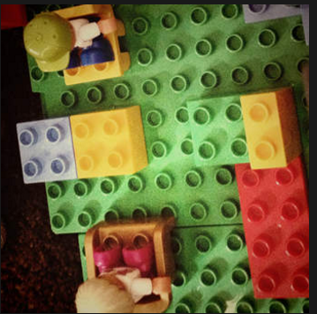
Platforms / OS
Mobile Application Development Platform (MADP) is a type of software that allows a business to rapidly build, test and perhaps deploy mobile apps for SmartPhone or Tablets
Mobile Operating System (or mobile OS) is an operating system for SmartPhones, tablets, PDAs, or other mobile devices

