Slide 1

WELCOME
Mobile Applications Testing

Slide 2

Mobile Applications Testing
List of “MUST HAVE” to survive this class
Google Drive account
Google email
Flash Drive
Mobile Phone (iPhone/Android)
Desired
Have your purpose to learn
Ready to get out of “comfort zone”
Motivation to become independent but reliable QA
Not take everything for granted (because I paid for it)
Required

Slide 3
Overview
Mobile Ecosystem
Carriers/Service Providers
Networks
Manufactures
Devices
Platforms/OS
Frameworks
API-Apps
Services
Mobile World Statistics

Slide 4
Mobile Ecosystem
Networks
Manufactures
Devices
Platforms/OS
Frameworks
API-Apps
Services
Mobile World Statistics
Carriers

Slide 5
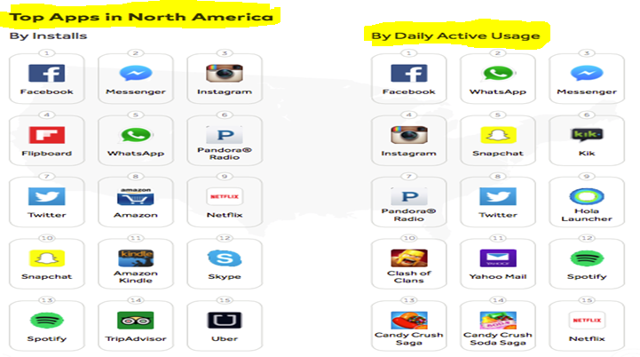
Mobile World Statistics

Slide 6
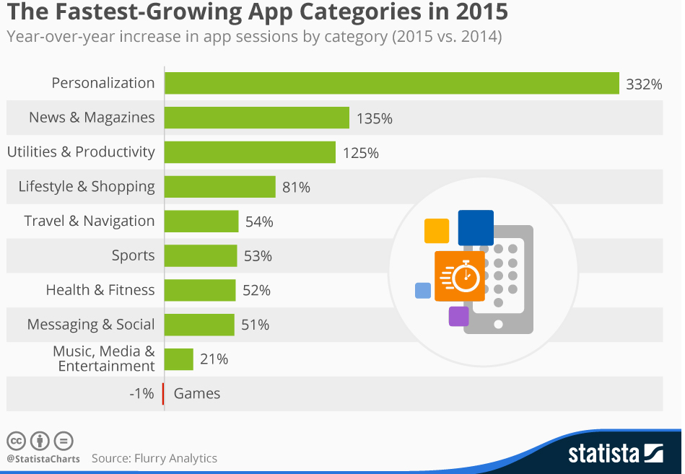
Mobile World Statistics

Slide 7
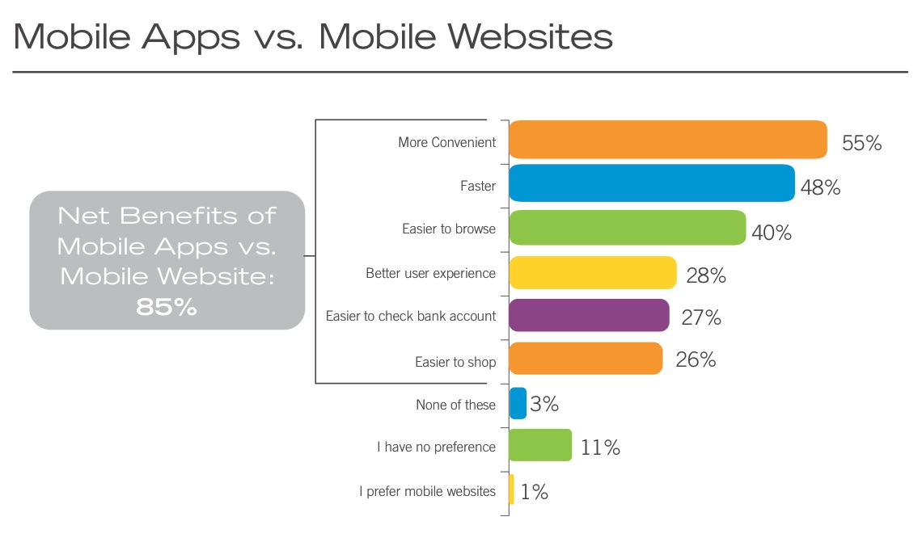
Mobile World Statistics

Slide 8
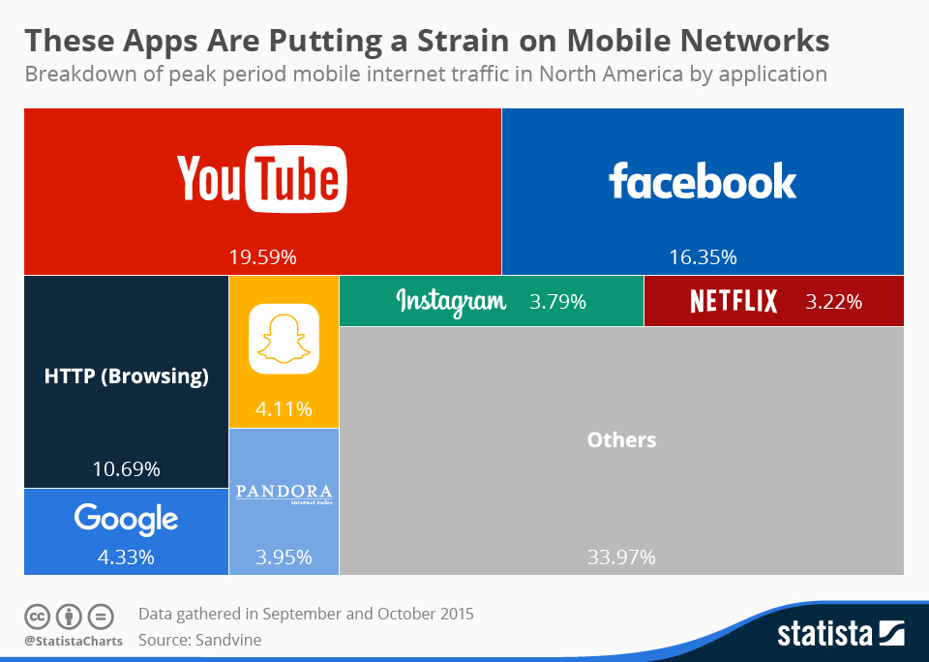
Mobile World Statistics

Slide 9
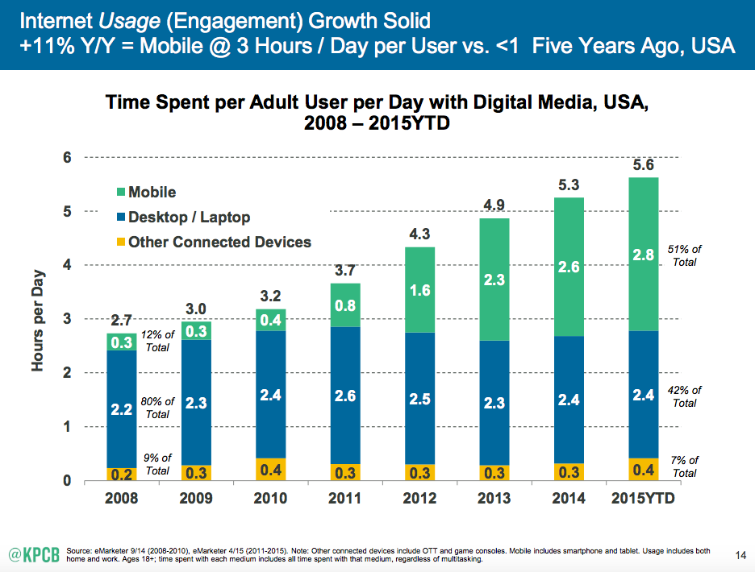
Mobile World Statistics

Slide 10
Mobile Ecosystem
Network
Manufactures
Devices
Platforms/OS
Frameworks
API-Apps
Services
Mobile World Statistics
Carriers/Service Providers

Slide 11
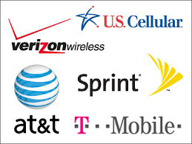
Carriers/Service Providers

Slide 12
Carriers/Service Providers
Subscriber Data (Q1 2016 in MM)
Verizon Wireless: 141.4
AT&T Mobility: 130.4
T-Mobile US: 65.5
Sprint Corp: 58.8
U.S. Cellular: 4.9

Slide 13
Carriers/Service Providers
Responsibilities
Install Cellular Towers
Operate the Cellular Network
Make Services (Internet) available for Mobile Subscribers
Handling Billing , Support and Sales

Slide 14
Mobile Ecosystem
Network
Manufactures
Devices
Platforms/OS
Frameworks
API-Apps
Services
Mobile World Statistics
Carriers/Service Providers

Slide 15
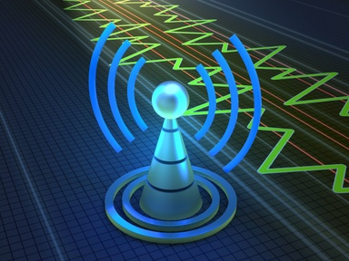
Network

Slide 16
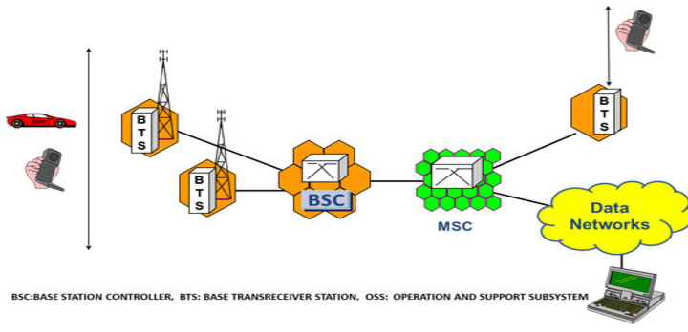
Cellular Network Architecture – Overview
Mobile Equipment (ME) – This refers to the physical phone itself. The phone must be able to operate on a cellular network.
Base Transceiver Station (BTS) – It is actually the antenna that you see installed on top of the tower. The BTS is the Mobile Phone’s access point to the network. It is responsible for carrying out radio communications between the network and the Mobile Phone.
What is a Cell – A base station (transmitter) having a number of RF channels is called a cell. Each cell covers a limited number of mobile subscribers within the cell boundaries (Coverage area).
Cell Size and Capacity – Cell size determines number of cells available to cover geographic area and (with frequency reuse) the total capacity available to all users. Capacity within cell limited by available bandwidth and operational requirements. Each network operator has to size cells to handle expected traffic demand
Base Station Controller (BSC) – The BSC controls multiple BTSs.
It handles allocation of radio channels, frequency administration, power and signal measurements from the MS, and handovers from one BTS to another (if both BTSs are controlled by the same BSC).
Mobile Switching Center (MSC) – The MSC is the heart of the GSM network. It handles call routing, call setup, and basic switching functions. An MSC handles multiple BSCs and also interfaces with other MSC's and registers.

Slide 17
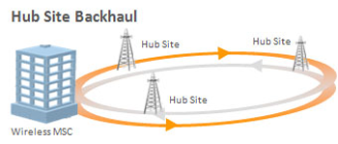
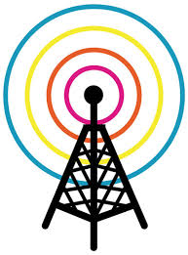
Cellular Network Architecture Simplified
Networks themselves are always about data transfer and technology dictates the transfer speed
CELL PHONE - It is the radio transmitter that sends the signals to the towers in order to transmit digitized voice signals through the network.
Cell Site/TOWER - is a cellular telephone site where antennas and electronic communications equipment are placed, usually on a radio mast, tower or other high place, to create a cell (or adjacent cells) in a cellular network.
HUB - It is what the tower communicates with. These hubs will either connect to other hubs or use satellite dishes to provide network connections back to the phone via the cell tower.

Slide 18

Network : GSM : AT&T and T-Mobile
GSM Standard - Global System for Mobile Communication
Service: Voice calling, text, messaging, data service similar to CDMA
Feature: One of the key features of GSM is the Subscriber Identity Module, commonly known as a SIM card.
The SIM is a detachable smart card containing the user's subscription information and phone book. This allows the user to retain his or her information after switching handsets.
SIM card that identify the user on the network and could be used as a storage.
SIM cards allowed users switch phones by simply moving their SIM’s between the phones.

Slide 19
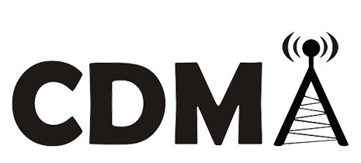
Network : CDMA : Sprint, Verizon and US Cellular
CDMA Standard - Code Division Multiple Access
Service: Voice calling, text, messaging, data transmission
Features: Five times up of GSM capacity. More secure –used by military.
QUALCOMM designs the chips for the CDMA air interface.
CDMA phones cannot roam internationally as extensively as GSM phones nor can they transmit voice and data at the same time like GSM handsets.
CDMA phones are locked to a carrier. It’s usually cheaper to buy unlocked GSM phones than on-contract CDMA phones.

Slide 20

Network : CDMA vs GSM :What’s a difference ?
Click here to watch a Video

Slide 21
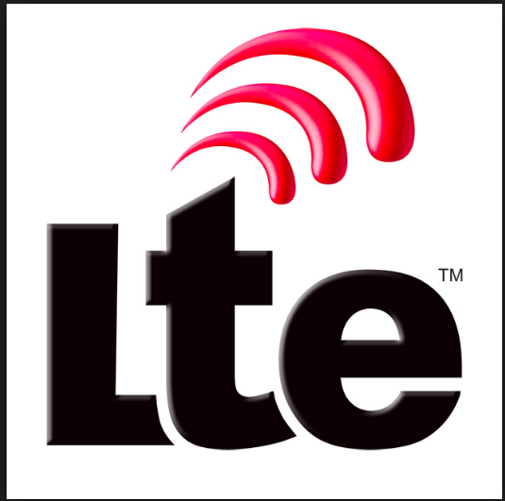
NETWORK: LTE
An acronym for Long Term Evolution
LTE is a 4G wireless communications standard developed by the 3rd Generation Partnership Project (3GPP) that's designed to provide up to 10x the speeds of 3G networks for mobile devices such as SmartPhones, Tablets, NetBooks, Notebooks and Wireless Hotspots.

Slide 22
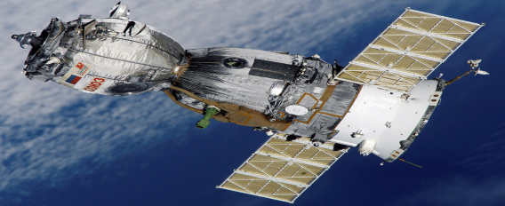
NETWORK: Satellite
SATTELITE - artificial object which has been intentionally placed into orbit.
Such objects are sometimes called artificial satellites to distinguish them
from natural satellites such as Earth's Moon.
The world's first artificial satellite, the Sputnik 1, was launched by the Soviet Union in 1957. Since then, thousands of satellites have been launched into orbit around the Earth.
Common types include military and civilian Earth observation
satellites, communications satellites, navigation satellites, weather satellites,
and research satellites. Space stations and human spacecraft in orbit are also
satellites.
Satellite orbits vary greatly, depending on the purpose of the satellite, and are
classified in a number of ways.

Slide 23
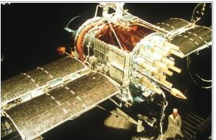
NETWORK: Satellite
What is satellite navigation?
Satellite navigation ("satnav") means using a portable radio receiver to pick up speed-of-light signals from orbiting satellites so you can figure out your position, speed, and local time
The best-known satnav system, the Navstar Global Positioning System (GPS), uses about 24 active satellites (including backups). Day and night, 365 days a year, they whiz round Earth once every 12 hours on orbital planes inclined at 55 degrees to the equator.
GPS was kick-started by the US military in 1973 and its satellites are designed to last about 7.5 years, but the latest generation typically survive about 10–12 years.

Slide 24
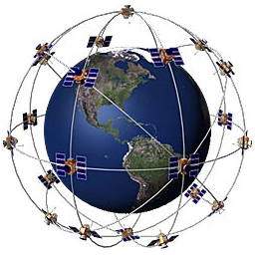
NETWORK: GPS
The Global Positioning System (GPS) is a satellite-based navigation system made up of a network of 24 satellites placed into orbit by the U.S. Department of Defense.
The 24 satellites that make up the GPS space segment are orbiting the earth about 12,000 miles above us. They are constantly moving, making two complete orbits in less than 24 hours. These satellites are travelling at speeds of roughly 7,000 miles an hour.
GPS satellites are powered by solar energy. They have backup batteries onboard to keep them running in the event of a solar eclipse, when there's no solar power. Small rocket boosters on each satellite keep them flying in the correct path.

Slide 25
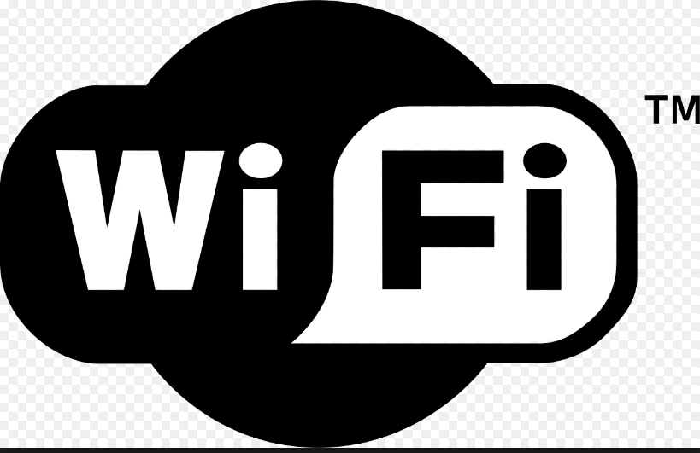
NETWORK: WiFi
WiFi is a technology that uses radio waves to provide network connectivity. WiFi- most widely accepted definition for the term in the tech community is Wireless Fidelity.
Wireless technology has widely spread lately and you can get connected almost anywhere; at home, at work, in libraries, schools, airports, hotels and even in some restaurants.
Like mobile phones, a WiFi network makes use of radio waves to transmit information across a network. The computer should include a wireless adapter that will translate data sent into a radio signal.

Slide 26
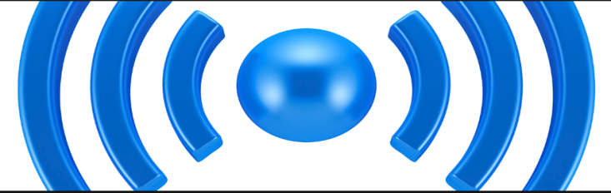
NETWORK: WiFi Frequencies
Wireless networking is known as WiFi or 802.11 networking as it covers the IEEE 802.11 technologies. The major advantage of WiFi is that it is compatible with almost every operating system, game device, and advanced printer.
A wireless network will transmit at a frequency level of 2.4 GHz or 5GHz to adapt to the amount of data that is being sent by the user. The 802.11 networking standards will somewhat vary depending mostly on the user's needs.
The 802.11a will transmit data at a frequency level of 5GHz. The Orthogonal Frequency-Division Multiplexing (OFDM) used enhances reception by dividing the radio signals into smaller signals before reaching the router. You can transmit a maximum of 54 megabits of data per second.
The 802.11b will transmit data at a frequency level of 2.4GHz, which is a relatively slow speed. You can transmit a maximum of 11 megabits of data per second.
The 802.11g will transmit data at 2.4GHz but can transmit a maximum of 54 megabits of data per second as it also uses an OFDM coding.
The more advanced 802.11n can transmit a maximum of 140 megabits of data per second and uses a frequency level of 5GHz.

Slide 27
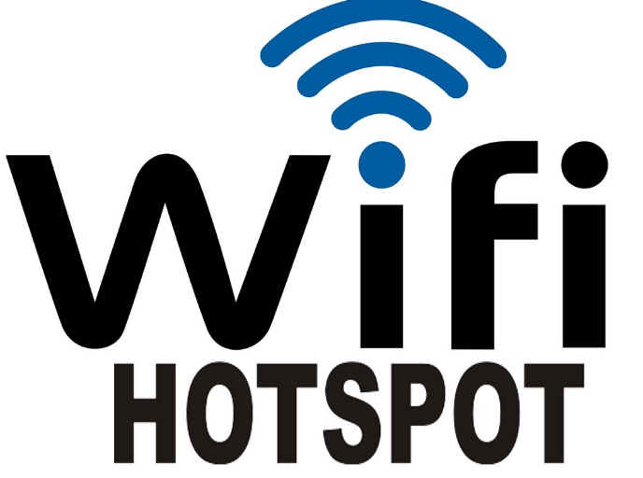
NETWORK: WiFi ( Hotspots)
A HOTSPOT is a physical location where people may obtain Internet access, typically using Wi-Fi technology, via a wireless local area network (WLAN) using a router connected to an internet service provider.
A WiFi connection is established using a wireless adapter to create HOTSPOTS - areas in the vicinity of a wireless router that are connected to the network and allow users to access internet services.
The term HOTSPOT is used to define an area where WiFi access is available. It can either be through a closed wireless network at home or in public places such as restaurants or airports.
Equipment is inexpensive (many newer computers have the needed hardware
built in), and Wi-Fi hotspots remains free in some locales.
Availability can be a problem, specifically in most suburban and rural areas.

Slide 28

NETWORK: BLUETOOTH
Bluetooth is a wireless technology standard for exchanging data over short distances
You can use Bluetooth with cell phones, PDAs, laptops, palmtops, printers, baby monitors, garage openers and other external devices.
Bluetooth networking transmits data via low-power radio waves. It communicates on a frequency of 2.45 gigahertz
This frequency band has been set aside by international agreement for the use of industrial, scientific and medical devices (ISM).

Slide 29

NETWORK: BLUETOOTH Facts
The maximum distance for a Bluetooth network is about 30 feet
Bluetooth requires very little power to use (befitting its design, which concentrates on battery-operated devices)
Slow compared with the 802.11b network standard.
No base station is required for Bluetooth communications between devices.
FUN FACT:
The Bluetooth symbol is a bind-rune, which means that it is formed from two runes that are merged together. Runes are the ancient Norse letters that, according to mythology, Odin discovered and gave to gods and humans. Runes have been used for over thousand years (probably a lot longer).

Slide 30
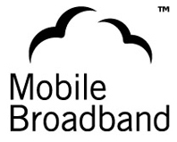
NETWORK: BROADBAND
MOBILE BROADBAND is the marketing term for
wireless Internet access through a portable modem,
mobile phone, USB wireless modem, tablet or other
mobile devices.
A barrier to MOBILE BROADBAND use is the coverage provided by the mobile phone networks.
This may mean no mobile phone service or that service is limited to older and slower mobile broadband technologies.
Customers will not always be able to achieve the speeds advertised due to mobile data coverage limitations including distance to the cell tower.
In addition, there are issues with connectivity, network capacity, application quality, and mobile network operators' overall inexperience with data traffic.
Peak speeds experienced by users are also often limited by the capabilities of their SmartPhone or other mobile device.

Slide 31
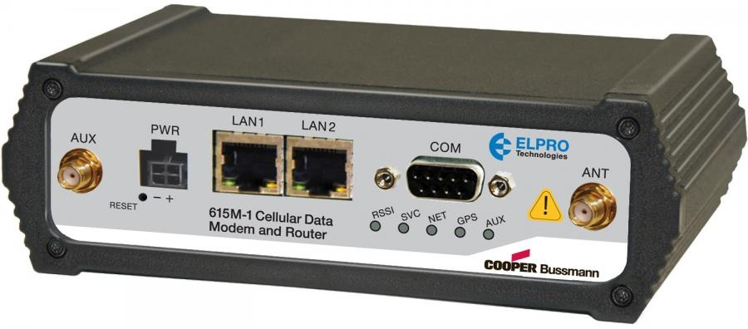
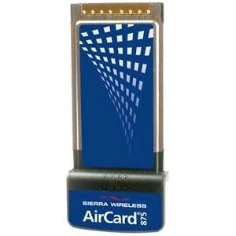
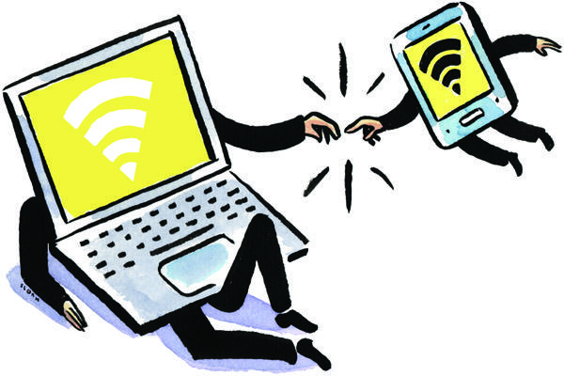
NETWORK: Cellular Modem
Three main types of cellular modems:
Cell phones - using phones as modems to enable Internet access on computers, aka tethering
Cellular cards - portable network adapters that plug into computers,aka aircards
Cellular routers - portable network routers that contain built-in cellular modems

Slide 32
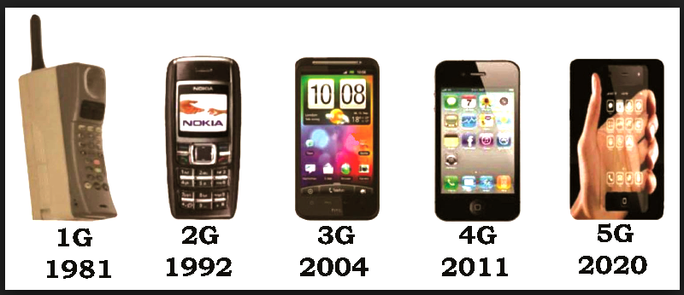
NETWORK: 1G to 4G
EVOLUTION

Slide 33
NETWORK: 1G to 4G Evolution
1G analog signal used by cellular towers
2G technology upgraded the analog signal to digital and powered the inclusion of sending text messages across the network
3G technology made use of electromagnetic
wavelengths, known as spectrum, to broadcast a wireless broadband signal that allowed users to access the Internet and download applications using a 3G data card or a handheld mobile device
4G called an “ultra-broadband” access for mobile devices.
4G networks are based on an all Internet protocol packet switching instead of circuit switching

Slide 34
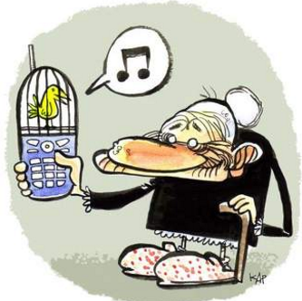
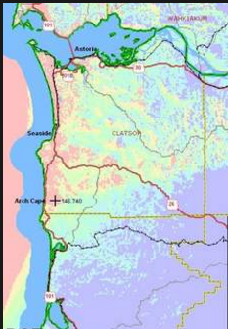
NETWORK: 1G to 4G Service Coverage Facts
In 2011, 90% of the world's population lived in areas with 2G coverage while 45% lived in areas with 2G and 3G coverage, and 5% lived in areas with 4G coverage.
By 2017 more than 90% of the world's population is expected to have 2G coverage, 85% is expected to have 3G coverage, and 50% will have 4G coverage.

Slide 35
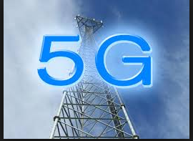
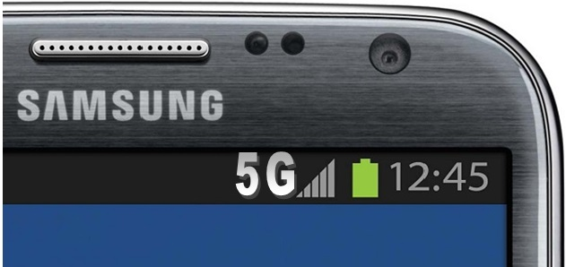
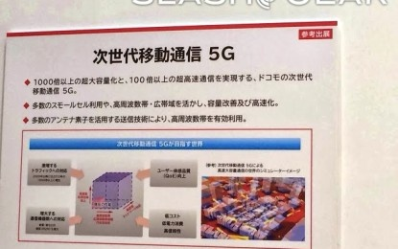
NETWORK: is 5G around the corner ?
Aug 28, 2013 – Huawei (Chinese company) intends to introduce commercial 5G networks by 2020, a service touted as "100 times faster" than current 4 G networks.
May 15, 2013 - Samsung says it has successfully tested technology that will be at the core of 5G mobile connectivity.

