Slide 1

Becoming a Pro (II)
IN Mobile Applications Testing

Slide 2

Troubleshooting Guide
COMMON ANDROID PROBLEM TROUBLESHOOTING
Memory Problems With Android
Memory problems with Android are quite popular especially among users of a bit older phones (and older versions of Android)
Android phones after a couple of months begin to display tons of different notifications, such as, memory full problem (or memory low) or memory card problem and much more.

Slide 3
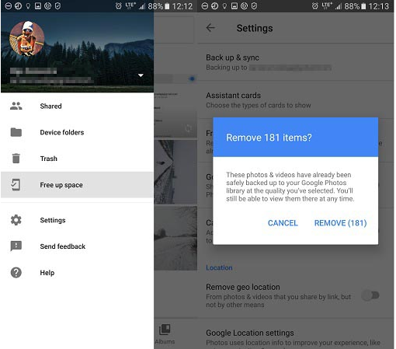
Troubleshooting Guide
COMMON ANDROID PROBLEM TROUBLESHOOTING
Memory Problems With Android and Possible Solutions
Back Up Photos To The Cloud (Settings > Backup & sync >TURN ON
Turn cellular data backup (Google Photos>swipe right >Click on Free up space
Save Photos To Memory Card (Storage > set to SD card.
Transfer Apps To SD Card
Backup your phone & restore it

Slide 4
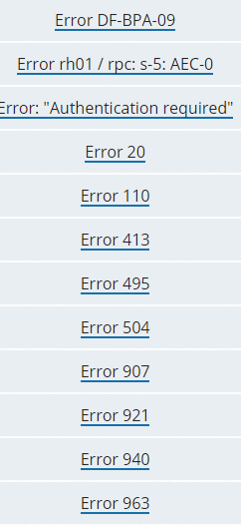
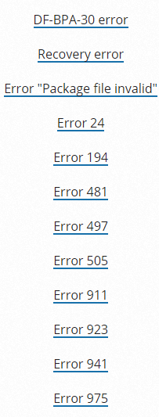
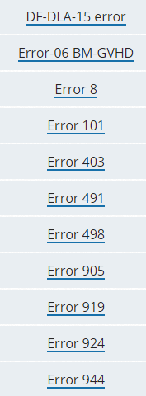
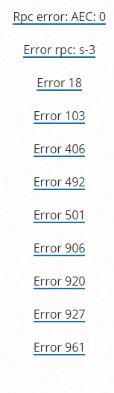
Troubleshooting Guide
COMMON ANDROID PROBLEM TROUBLESHOOTING
Android Apps & Problems Downloading From Google Play
Do you experience problems with downloading Android apps from Google Play?
Does everything seem O.K. but suddenly download of your favorite game or app fails?

Slide 5
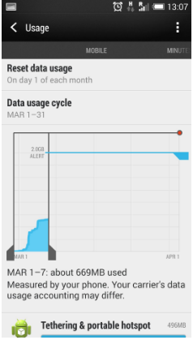
Troubleshooting Guide
COMMON ANDROID PROBLEM TROUBLESHOOTING
Android Apps & Problems Downloading From Google Play and
Possible Solutions
Restart Your Android Device
Make Sure Your Data Connection/WiFi Is Turned On And Working
Clear Cache Of Google Play App
Make Sure You Have Data Enough Phone Storage Available
Update Your Phone And Google Play App
Restore Factory Settings If Nothing Helps

Slide 6

Troubleshooting Guide
COMMON ANDROID PROBLEM TROUBLESHOOTING
Android Reboot Problem
Most Often Symptoms Of The Android Phone Reboot Problem:
Device restarts in specific situations
Device restarts when many apps are running simultaneously
Device restarts "on its own" (knows as Android self reboot problem) for no apparent reason
There Are Actually Two Types of Reboot
The phone restarts completely (all apps are loaded again), which takes up to a few minutes. With this kind of restart, you usually hear the welcome ringtone and see your manufacturer's logo.
There is also a softer type of reboot when only Android OS restarts. It usually takes a few seconds and you see a white screen for a few moments

Slide 7
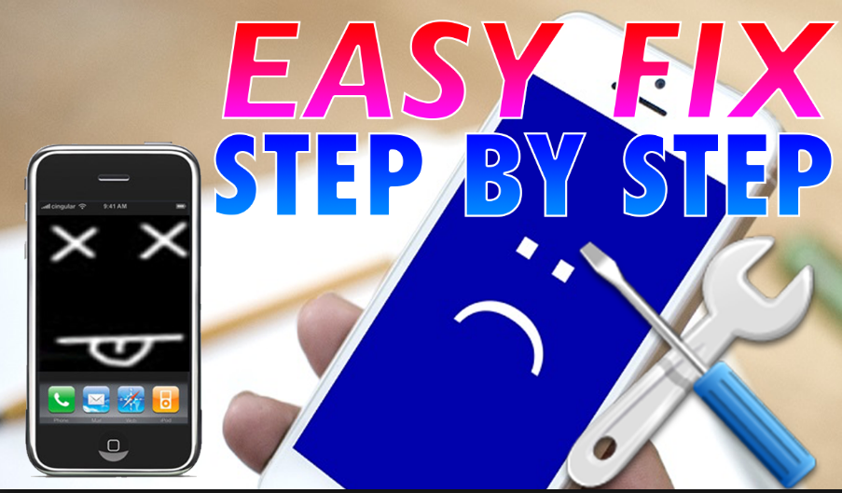
Troubleshooting Guide
COMMON ANDROID PROBLEM TROUBLESHOOTING
Android Reboot Problem and Possible Solutions
Restart Your Android Device
Make Sure Your Data Connection/WiFi Is Turned On And Working
Clear Cache Of Google Play App
Make Sure You Have Data Enough Phone Storage Available
Update Your Phone And Google Play App
Restore Factory Settings If Nothing Helps

Slide 8


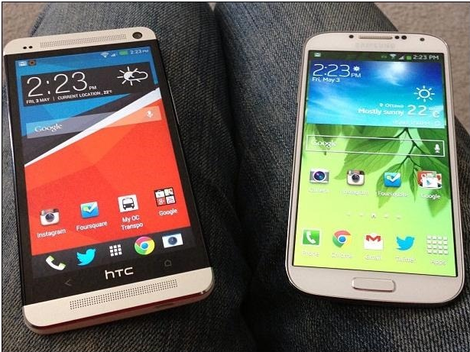
CyanogenMod

Slide 9
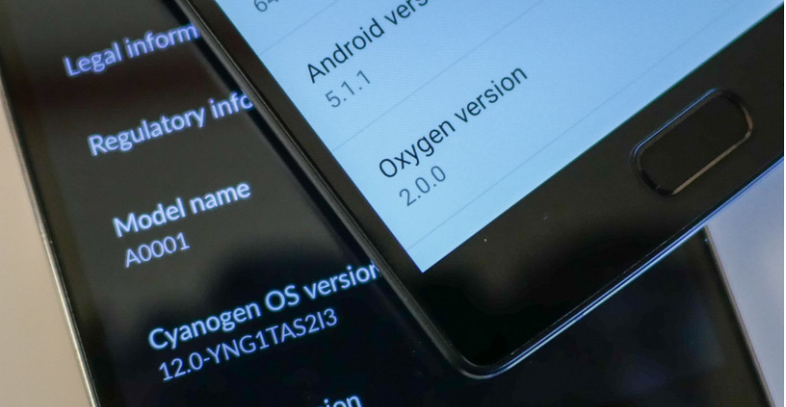
CyanogenMod
What is it ?
CyanogenMod is an enhanced open source firmware distribution for SmartPhones and tablet computers based on the Android mobile operating system.
It offers features and options not found in the official firmware distributed by vendors of these devices.

Slide 10

CyanogenMod
About 1-2 times a year, the vanilla Android operating system (known as AOSP, or the Android Open Source Project) is internally developed, then released to the public, by Google. They provide the source code to anyone who wants to download it.
The CyanogenMod community, comprised mostly of unpaid volunteers and enthusiasts from around the world, takes this newest Android code and "ports" it to dozens of new and older (aka "legacy") devices.

Slide 11
CyanogenMod
In many cases, CyanogenMod may increase performance and reliability compared with official firmware releases.
CyanogenMod is developed as free and open source software based on the official releases of Android by Google, with added original and third-party code.
Features supported
Native Theming
FLAC Audio Codec
Large Access Point Name List
Openvpn Client
Enhanced Reboot Menu
Wi-fi
Bluetooth
USB Tethering
CPU Overclocking
Other Performance Enhancements
Soft Buttons And Other "Tablet Tweaks"
App Permissions Management
Other Interface Enhancements

Slide 12
CyanogenMod
PROS
CONS
Remove Unwanted Programs ("Bloatware") Installed By Your Carrier
Receive More Frequent Security Updates
Have Access To The Current Version Of Android - Most Carriers Take Months To Update Devices
Better Performance
Extra Features
Cyanogenmod Has Proven To Be More Stable Than Many Official Roms.
Limited Or Voided Warranty After Modifying
New Security Risks.
Non-stock Firmware Could Contain Malicious Code
Stability Issues May Arise When Using An Experimental Operating System.

Slide 13
CyanogenMod
FEATURE LIST
CM Updater
Privacy Guard
Global Blacklist
Quick Setting Ribbon
Quick Settings Config
Them
Trebuchet
Status Bar Behavior
CM File Manager
Display and Lights
Profiles
Button Configuration
Navbar
AudioFX
Tethering
Developer Tools
Root Access
Superuser: Advanced Device controls
SMS Rate limit

Slide 14
CyanogenMod
Difference between CyangenMode and Cyangen OS
CyanogenMod is an aftermarket ROM.
It is a custom ROM based on AOSP, and has some nifty features of it's own. It is open source.
Cyanogen Inc. is a company which distributes CyanogenOS, a slightly more polished variant of CyanogenMod with certain device-specific features.
CyanogenOS is not open-source.
Cyanogen Inc. is the company
CyanogenOS is it's product
CyanogenMod is the ROM which essentially is the backbone of CyanogenOS, and Cyanogen Inc.

Slide 15

CyanogenMod
Latest Version for all devices
Marshmallow offers a number of useful features that Cyanogen leverages, including:
Tastes like Marshmallow
Doze
Permissions control + Privacy Guard
App Standby
Quick Settings tiles
Truecaller mod for Messaging
Supported Devices : http://www.ibtimes.co.uk/cyanogenmod-13-0-full-list-devices-getting-official-stable-release-1550461

Slide 16

CyanogenMod
OS 14.1: Released November 09, 2016
Available for Selected Devices ONLY
CM 14.1 is simply the latest version of CyanogenMod, based on the Android 7.1 Nougat source code.
Multi-window Mode
New System UI
Optimized Battery Management
Other Android 7.1 Features
Pre-set AudioFX audio settings
Supported Devices : http://www.cyanogenmods.org/official-cyanogenmod-14-1-cm14-1-devices-list/

Slide 17

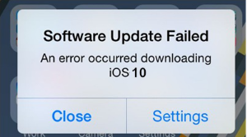
Troubleshooting Guide
COMMON iOS PROBLEM TROUBLESHOOTING ( 10 and 10.1)
How to Fix : iOS 10 Software Update Failed Error
Method 1:
Tap on the Close option and try to update again.
Method 2:
Wait for few hours or even several days and then download iOS 10 again.
Method 3:
Try updating via iTunes on computer.
Method 4:
For advanced users: try upgrading with IPSW File.

Slide 18
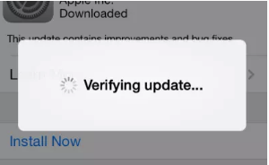
Troubleshooting Guide
COMMON iOS PROBLEM TROUBLESHOOTING ( 10 and 10.1)
How to Fix : iPhone Stuck on Verifying Update
Method 1 :
Try locking and waking your iDevice using power button and repeat it.
Method 2:
Do a hard reset or hard reboot.
Method 3:
Restore your iDevice with iTunes.
Method 4:
Update to iOS 10 with iTunes on computer.

Slide 19

Troubleshooting Guide
COMMON iOS PROBLEM TROUBLESHOOTING ( 10 and 10.1)
How to Fix : iOS 10 Stuck on Slide to Upgrade Screen
Step 1 :
Update your iTunes to the latest version. Connect your iPhone and run iTunes.
Step 2:
Click the device button.
Step 3:
Select Restore Backup... and choose a recent backup file.
Step 4 :
click Restore.

Slide 20
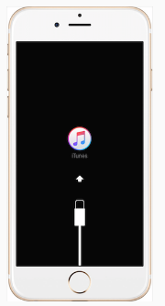
Troubleshooting Guide
COMMON iOS PROBLEM TROUBLESHOOTING ( 10 and 10.1)
How to Fix : iPhone Stuck in Recovery Mode
Method 1 :
"Force Restart" your device by holding both Power and Home buttons.
Method 2:
Recover your device using iTunes. You can connect your device to iTunes on your computer and recover in Recovery Mode.
Method 3:
Use iOS repairing software to fix this issue.

Slide 21

Troubleshooting Guide
COMMON iOS PROBLEM TROUBLESHOOTING ( 10 and 10.1)
How to Fix : iPhone Stuck on Apple Logo During iOS 10 Update
Method 1:
Force Restart your iPhone or iPad. Usually, this tip can make your device work again.
Method 2:
If Method 1 doesn't work, you may need to recovery your device in Recovery Mode.
Method 3:
There are some professional tools that you can use to repair your device.

Slide 22
Troubleshooting Guide
COMMON iOS PROBLEM TROUBLESHOOTING ( 10 and 10.1)
How to Fix : Failed to Activate iPhone After iOS 10/10.1 Update
Method 1:
Wait and Retry
There are a lot of people waiting for activation after the release of iOS 10.
Method 2:
Continue the Activation via iTunes
Step 1. Download the latest version of iTunes and open it > Plug in your device.
Method 3:
Release the Activation Lock in iCloud
Step 1. Turn off the power of your device.
Step 2. Select your device > Then you will see the activate screen on iTunes.
Step 3. Enter your Apple ID and password > Click on Continue
Step 2. Go to iCloud.com > Sign in with your Apple ID.
Step 3. Click on Find iPhone > Click on All Devices > Choose the device that can't be activated > Remove from Account.
Step 4. Turn on your device and try to activate it again.
You can try again later to activate your iPhone/iPad/iPod.

Slide 23

Troubleshooting Guide
COMMON iOS PROBLEM TROUBLESHOOTING ( 10 and 10.1)
How to Fix : iOS 10/10.1 Bluetooth Issues
Method 1:
Check and make sure Bluetooth is turn on.
Method 2:
Confirm your iDevice and Bluetooth accessory are close to each other.
Method 3:
Turn off Bluetooth and restart your iPhone, iPad.
Method 4.:
Pair the iDevice or car you connect again: Settings > Bluetooth > Choose the device you are having issues with > Tap on the info button next to the device > Tap on Forget This Device.

Slide 24
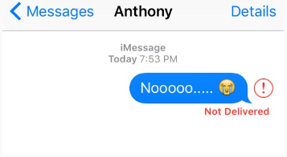
Troubleshooting Guide
COMMON iOS PROBLEM TROUBLESHOOTING ( 10 and 10.1)
How to Fix : Message/iMessage Not Working
Method 1 :
Make sure you have connected to Wi-Fi or 3G/4G network.
Method 2:
Turn iMessage off and then turn it on again.
Method 3:
Make sure Date & Time are correct.
Method 4:
Turn on Airplane mode and turn it off.

Slide 25
Troubleshooting Guide
COMMON iOS PROBLEM TROUBLESHOOTING ( 10 and 10.1)
How to Fix : Wi-Fi Issues on iPhone iPad
1. Potential Solutions to iPhone/iPad not connecting to Wi-Fi After iOS Update
1. Check Wi-Fi router.
2. Ensure your iPhone/iPad's Wi-Fi button is on, and you can see your network.
3. Input password when it is necessary.
4. Check all the cables and connections, and make sure your router is connected to the modem and it is turned on.
5. Restart Your iPhone/iPad, Router, Cable/DSL mode.
6. Reset network settings on your iPhone iPad.

Slide 26
Troubleshooting Guide
COMMON iOS PROBLEM TROUBLESHOOTING ( 10 and 10.1)
How to Fix : Wi-Fi Issues on iPhone iPad
1. Check if this problem also happened on your other devices
2. Renew Lease
3. Forget this network
4. Reset network settings
2. Potential Solutions to iPhone iPad Wi-Fi Greyed out/won't turn on After iOS 10 Upgrade

Slide 27
Troubleshooting Guide
COMMON iOS PROBLEM TROUBLESHOOTING ( 10 and 10.1)
How to Fix : Wi-Fi Issues on iPhone iPad
3. Potential fixes to iPhone iPad Keeps Dropping Wi-Fi After iOS 10 Upgrade
1. Upgrade your iPhone iPad to the latest iOS version
2. Reset network settings on iDevice
3. Forcibly reboot iDevice
4. Backup and restore iDevice
5 .Reset your router

Slide 28
Troubleshooting Guide
COMMON iOS PROBLEM TROUBLESHOOTING ( 10 and 10.1)
How to Fix : Wi-Fi Issues on iPhone iPad
4. How to Fix: iPhone iPad Slow on Wi-Fi After iOS 10 Upgrade
1. Find out it is a network problem or iDevice problem.
2. Update iDevice to the current iOS version.
3. Reset network settings.
4. Change iOS Default DNS to Google DNS.
5. Disable Q0S, MMS, WMM on your router.
6. Changing the wireless channel between 1, 6 and 11.
7. Turn off the background Apps.

Slide 29
Troubleshooting Guide
COMMON iOS PROBLEM TROUBLESHOOTING ( 10 and 10.1)
How to Fix : Wi-Fi Issues on iPhone iPad
5. Quick Solutions to iPhone iPad Unable to Join Wi-Fi After iOS 10 Update
1. Find out it is a network problem or iDevice problem.
2. Update iDevice to the current iOS version.
3. Reset network settings.
4. Change iOS Default DNS to Google DNS.
5. Disable Q0S, MMS, WMM on your router.
6. Changing the wireless channel between 1, 6 and 11.
7. Turn off the background Apps.

Slide 30
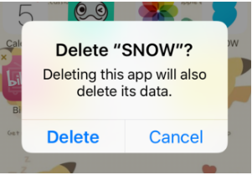
Troubleshooting Guide
COMMON iOS PROBLEM TROUBLESHOOTING ( 10 and 10.1)
How to Fix : App Issues on iPhone/iPad After iOS 10/10.1 Update
Solution 1: Reboot Your iDevice.
Solution 2: Update the App to the Latest Version.
Solution 3. Delete the App and Reinstall.
There are certain issues with apps on your iPhone or iPad after downloading iOS 10. Several iPhone users have been reported that app keeps crashing and some apps getting crashed at launch

Slide 31
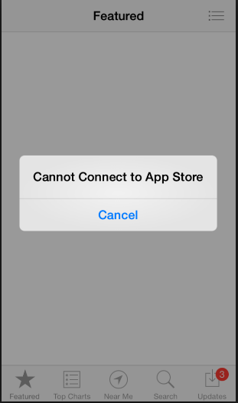
Troubleshooting Guide
COMMON iOS PROBLEM TROUBLESHOOTING ( 10 and 10.1)
How to Fix : App Store Problems
Tip 1. You can check whether your device is connected to a stable network.
Tip 2. If the network goes well, you can restart or force restart your device, and run App Store to see whether it works normally.
Tip 3. Some caches may save the old images and texts on your App Store, and when you view your visited pages, it doesn't refresh and shows you the latest interface or info. So you can clean these cached files to make your App Store work in normal.

Slide 32
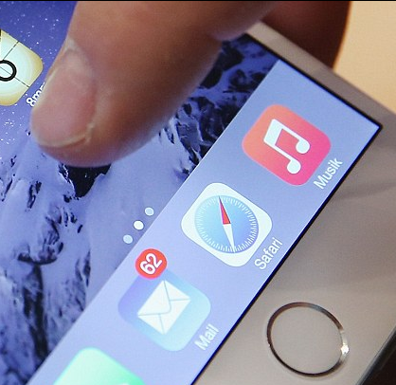
Troubleshooting Guide
COMMON iOS PROBLEM TROUBLESHOOTING ( 10 and 10.1)
How to Fix : Safari Issues on iPhone iPad
Actually this common problem is usually caused by bad network.
Try to change another network, or reset your Network Settings.
Cleaning Safari junk could be another tip to fix this Safari problem in iOS 10.
Simple "Restart" works to fix this iOS issue.

Slide 33

Troubleshooting Guide
COMMON iOS PROBLEM TROUBLESHOOTING ( 10 and 10.1)
How to Fix : Battery Issues on iPhone or iPad After iOS 10/10.1 Update
Solution 1:
Reboot your device.
Solution 2:
Erase All Settings. Open Settings app > General > Reset > Reset All Settings to factory default.
Solution 3:
Turn on Airplane Mode if you don’t use Device for a long time.
Solution 4:
Turn off Background App Refresh. When you enable this feature, the app will work in the background and use the battery.
Solution 5:
Enable Location Services When Using the App. Go to Settings app > Privacy > Location Services to set it.

Slide 34
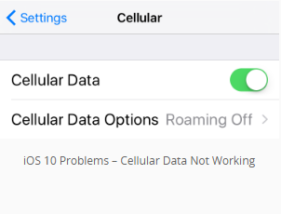
Troubleshooting Guide
COMMON iOS PROBLEM TROUBLESHOOTING ( 10 and 10.1)
How to Fix : Cellular Data Issues
Solution 1:
Turn Cellular Data Off and On. Go to Settings to turn off Cellular data and turn it on again after a few seconds.
Solution 2:
Check Out Carrier Update. Settings app > General > About to have a check.
Solution 3:
Reset Network Settings. Settings > General > Reset > Reset Network Settings.
Solution 4:
Turn Airplane Mode On and Off. Open Control Center > Turn on Airplane Mode > Turn it off after 30 seconds.
Solution 5:
Restart Your iDevice. Press and hold down the wake/sleep button > Drag slide to power off > Open your device.

Slide 35
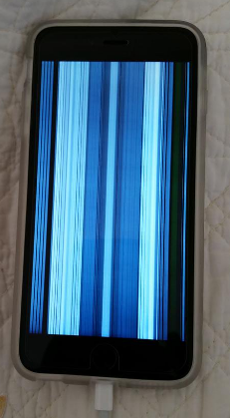
Troubleshooting Guide
COMMON iOS PROBLEM TROUBLESHOOTING ( 10 and 10.1)
How to Fix : Touch Screen Issues on iOS 10/10.1 Devices
Solution 1:
Restart Your iDevice. Press and hold down the on/off button and drag slide to power off, and then turn on your iPhone/iPad/iPod touch after a few seconds.
Solution 2:
Reset Your iDevice. If you cannot restart your device, then you can reboot your device. Hold down the on/off button and the Home button until the Apple logo appears.
Solution 3:
Clean Your Screen. Have a check on your screen to see if there are some oily or liquid splits and clean the screen with soft cloth. If you have a screen protector, you can remove it to have a try.
Solution 4:
Restore Your iDevice. Restore your device via iTunes. Make sure to download and install the latest version of iTunes.

Slide 36
Troubleshooting Guide
COMMON iOS PROBLEM TROUBLESHOOTING ( 10 and 10.1)
How to Fix : How to Fix Charging Problems on iOS 10/10.1 Devices
1. Use an Apple-matched USB cable, and don't use any cheap low quality cables.
2. Check and make sure your USB cables is not damaged.
3. Try hard resetting your iPhone or iPad.
4. Change a USB cable if you have one.
5. Use an iPad Charger will make it faster to charge your iPhone.

Slide 37
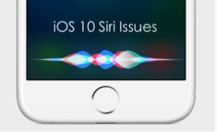
Troubleshooting Guide
COMMON iOS PROBLEM TROUBLESHOOTING ( 10 and 10.1)
How to Fix : Siri Issues on iOS 10/10.1
1. Restart Siri: Settings > General > Siri > Turn off Siri > Turn Siri on again.
2. Reset Network Settings: Go to Settings app > General > Tap on Reset > Tap on Reset Network Settings > Enter your Passcode > Tap on Reset Network Settings to Confirm.
3. Enable Hey Siri: Settings > General > Siri > Tap on Allow Hey Siri.
4. Clean your iPhone/iPad Microphone and make sure it is unobstructed and not damaged.

Slide 38
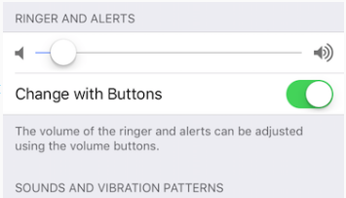
Troubleshooting Guide
COMMON iOS PROBLEM TROUBLESHOOTING ( 10 and 10.1)
How to Fix : iPhone Ringtone Not Working Problem in iOS 10/10.1
Method 1:
Go to Settings > Sounds to adjust the volume of ringtone.
Method 2:
Make sure you have "mute" button set to ring instead of silent.
Method 3:
Restart your iPhone.
Method 4:
Update to new iOS 10 update.
Method 5:
Contact Apple.

Slide 39
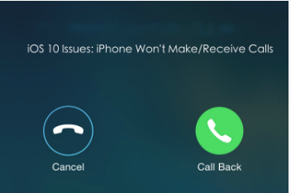
Troubleshooting Guide
COMMON iOS PROBLEM TROUBLESHOOTING ( 10 and 10.1)
How to Fix : iPhone Won't Make or Receive Calls After Update
1. Reset Network Settings.
2. Update your carrier.
3. Verify blocked phone numbers.
4. Try re-inserting the SIM card.
5. Try to restore your phone and set it up as new.

Slide 40
Troubleshooting Guide
COMMON iOS PROBLEM TROUBLESHOOTING ( 10 and 10.1)
How to Fix : Fix iTunes Error 14 When Installing iOS 10/10.1
Solution 1:
Check Your USB Cable. iTunes error 14 may happens when you have a USB connection issue.
Solution 2:
Backup and Try Clean Restore. First backup your device and then perform a clean restore of iOS 9.3.5.
Then have a clean restore of iOS 10. Finally restore your device with the backup you created after installing iOS 10 successfully.
Solution 3:
Update iTunes to the Latest Version. Apple has always released new version of iTunes to work with the new operating system, so go to have a check and update the iTunes to the latest version.

Slide 41
Troubleshooting Guide
COMMON iOS PROBLEM TROUBLESHOOTING ( 10 and 10.1)
How to Fix : iPhone/iPad Software Update Server Could Not Be Contacted
Solution 1:
Check Your Network Connection. Open a browser to see if it can load a webpage. You can also restart your computer to have a try.
Solution 2:
Wait and Retry. There might be too many people waiting for update, just wait for a while.
Solution 3:
Update Your iDevice Over the Air. Go to Settings > General > Software Update to make it.

Slide 42
Overview: Mobile APPS
Types
Categories
Troubleshooting Guide
Simulators
Emulators
Remote Device Access (RDA)
Mobile Test Industry Standards
Distribution/Installation/Logs
App Risk Analysis

Slide 43

APP RISK ANALYSIS
Setting Up a Mobile Test Lab
What mobile devices will you use to test?
What devices are officially supported?
Make a decision based on user statistics
How will you source the devices?
When will you use an emulator or a real device?
What software will be maintained on the mobile devices?
How will the devices be managed and stored?
How can you be effective with the device power consumption? Do the devices really need to be charging all the time?
How will you load apps onto multiple devices?
Is there a need for a booking system for test devices?
How will you label devices with useful information? (OS, screen resolution, pixel density)
Can you use a background image to communicate information to the user of the device? For example, device information or a reminder of guidelines.

Slide 44
APP RISK ANALYSIS
What Makes a Mobile App or Website...ACCESSABLE?
Does audio and voiceover function and make sense?
Can you zoom in and out effectively?
Does the app accommodate all sizes of text?
Does the full list of touch device options work?
How large can on-screen buttons and navigation be?
Is there voice activation or control?
Is color contrast at a sufficient accessible level?
Is it worth considering audible, visible and vibrating alerts?
How does the app look inverted in colors? For example, white on black.
Have you explored the accessibility features of the app and mobile device you are using?
What types of gesture controls are available

Slide 45
APP RISK ANALYSYS
What Makes a Mobile App or Website...Social?
Can you register as a user via the app?
Can you login via the app?
Do you remain logged in when the app is not in use? If not, how does that affect the user experience?
Does the app or website support social authentication methods?
How easy is it to share media content, links, or files as well as comments and notes?
How easy is it to disconnect updates and communications via the app?
Can notifications be switched off or changed?

Slide 46
APP RISK ANALYSYS
What Makes a Mobile App or Website...Secure?
Can the app be decompiled?
How secure is the connection to the cloud server, if used?
Can the data in transit be intercepted and decoded?
Is any data or temporary data that the app uses stored securely on the device?
Is all app data removed when the app is uninstalled?
Is the app obfuscated using ProGuard/DexGuard (Android only)
Does the app authenticate? How?
After an update, is my data still safe?
Should the user automatically log out after a period of time?
Can security be changed from other devices or websites?
What happens if the user gets locked out?

Slide 47
APP RISK ANALYSIS
What about … – The Product – What Are The Basics?
Can I download the app?
Can I download an update?
Can I update the app when there are multiple updates available? What happens if I don’t update?
What happens when the OS is updated?
With what systems should it be compatible? For example, OS, platforms and browsers.
Can I uninstall the app?
Can I re-install the app?
Can I downgrade? Should I be able to downgrade?

Slide 48
APP RISK ANALYSIS
What about … – Functional Testing – What Does it do?
Does the app perform the designed tasks?
Does the app perform non-designed tasks?
Is prevention of actions adequate?
Does the app ask me to turn on services? For example, location specific, Wi-Fi, and social media.
Is the user redirected?
If so, where? From app to Web or visa versa? What do errors look like?
Does the user interface (UI) and design work as intended? Is there room for misunderstanding or error?
Is the UI appropriate for the form factor? For example, phone versus tablet, screen size, resolution, and existence of hardware buttons or keyboard.
Does it comply with any standards, good practice and guidelines?
Is the mobile app consistent with the desktop version, if it exists?

Slide 49
APP RISK ANALYSIS
What about … – Data – Testing What It Processes?
How time applied to the app? For example phone time and server time? What about time zones?
What does it track and update? For example, reward points, friends, purchases, check-ins, social updates and user activity.
Does it sync and update?
What happens when it can’t sync or update because the
Connecting through a paywall and haven’t yet authenticated (Wi-Fi in Starbucks, an airport, or a local pub)
Disconnected because Web filtering rejected the request
Is there consistency between Web and mobile?
What clues can analytics provide?
How are things like user details and data saved?
What about data input and output? What type of data is accepted? For example, locations, preferences, friends, contacts, languages, files, size, media and audio

Slide 50
APP RISK ANALYSIS
What about : Platform – What Does it depend on?
Change the device settings around.
What do you notice?
What permissions does the app need?
What tablet device is being used?
What version of hardware or software?
Review app store submission requirements
Test content.
For example, text size, content adjustment and responsive design.
Test the UI and touchscreen gestures.
For example, swipe, zoom, pinch, multi-touch, shake and orientation.
Test peripherals. For example, keyboards, Mi-fi devices, BT peripherals, iBeacon, and syncing peripherals.
Test Camera, if applicable. For example, taking photos, using stored photos and photo data.
How does the app run when the device is locked?

Slide 51
APP RISK ANALYSIS
Operations – How Is It Used?
Wi-Fi
3G
4G
Intermittent
Airplane mode
NFC
Through a proxy
Testing under no, low and partial connectivity

Slide 52
APP RISK ANALYSIS
How Is Data Saved?
Does the app write to the SD card?
What happens if the SD card is full? What happens if it is removed?
Is data saved online (in the cloud)?
If the data is saved online, can it be retrieved after reinstalling the app, or will it be available on the app on a different device with the same user account?
If the cloud is used, how does lack of connectivity affect the user experience?
Is the data saved securely? (See “Security” section)
What if data is lost? Are there backups?

Slide 53
APP RISK ANALYSIS
Interruptions?
Phone calls
Text messages
App notifications
Battery Warning
Forced updates
Voicemail
Switching between apps
Locking and unlocking the screen
Music playing while using the app
MAM/MDM solution running on the device
Out of memory (general performance interruptions)
Data app interruptions (WhatsApp, Viber, Tango)
Audio interrupts from multiple sources (iPod, Media player, Other audio apps)

Slide 54
APP RISK ANALYSIS
Customer Feedback
What are customers saying about app?
App reviews
App ratings / comments
Comments, forum posts and articles on the (social) web
Complaints and support request

Slide 55


GOOD LUCK!!!

