Slide 1

Becoming a Pro (II)
IN Mobile Applications Testing

Slide 2
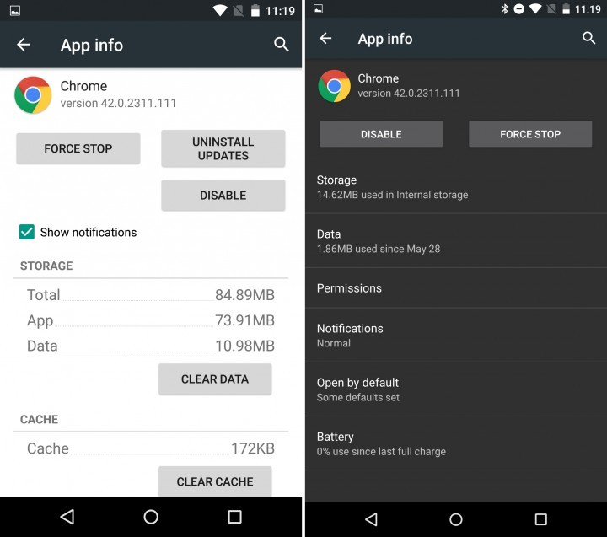
ANDROID
APP INFO
5.1
6.0

Slide 3
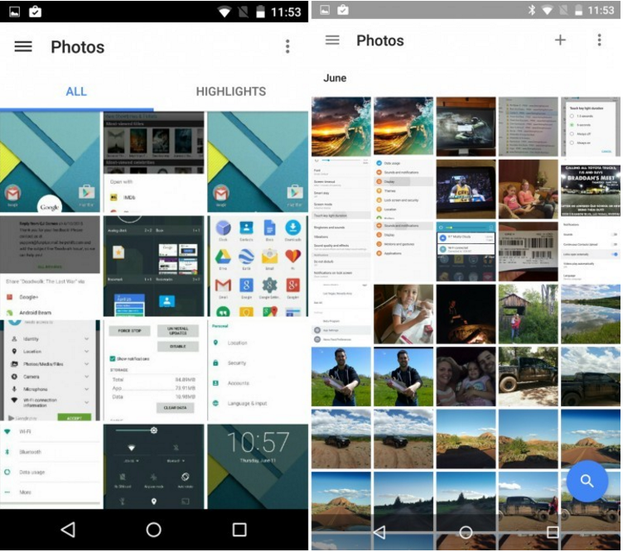
ANDROID
Google Photos
5.1
6.0

Slide 4
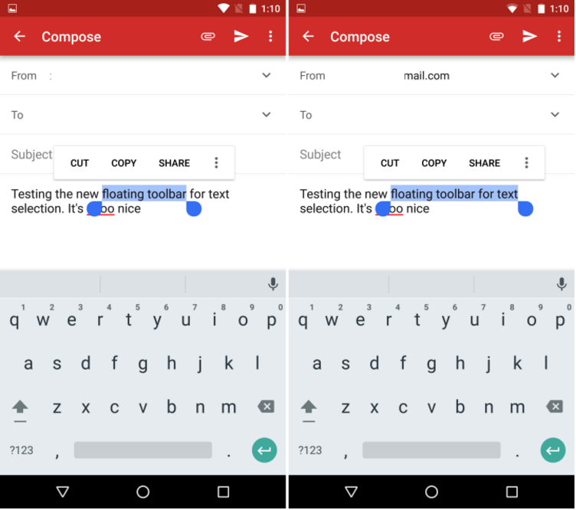
ANDROID
Text Selection and More ( Greatly improved on 6.0)
6.0

Slide 5
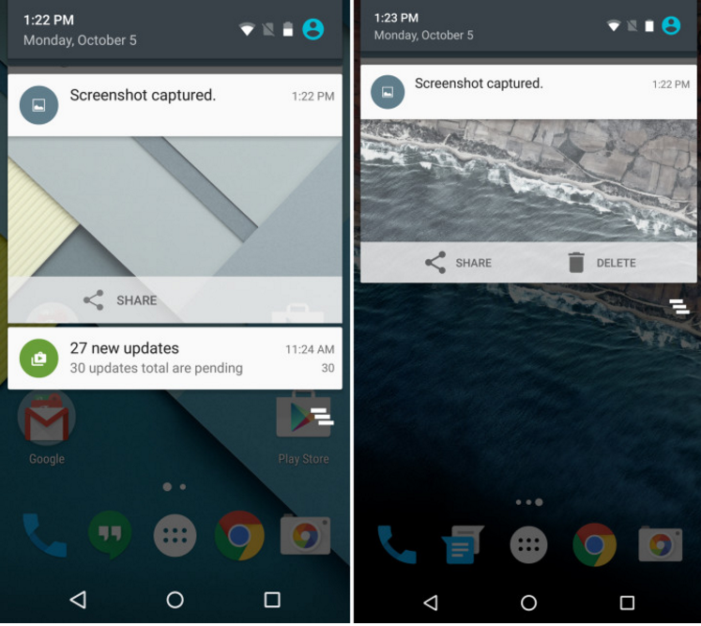
ANDROID
Delete Screenshot
5.1
6.0

Slide 6
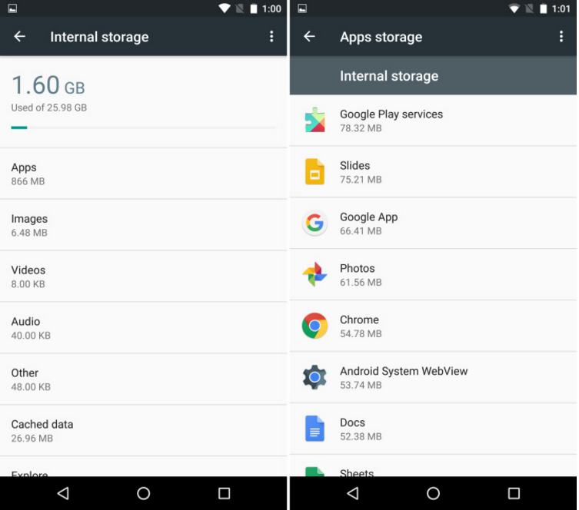
ANDROID
Internal Storage (shown for 6.0 only)
6.0

Slide 7
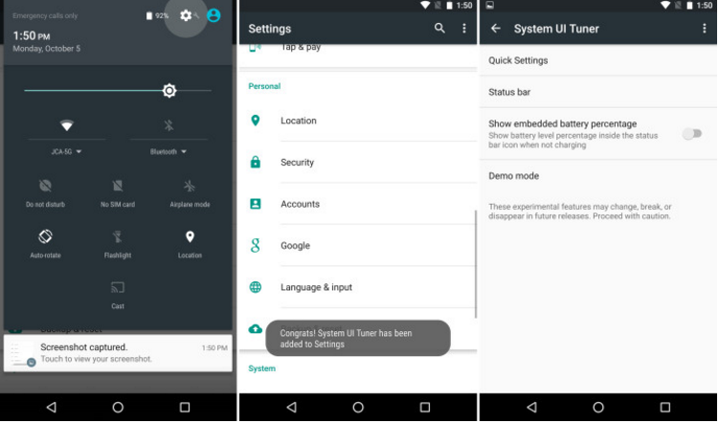
ANDROID
System UI Tuner (shown for 6.0 only)
6.0

Slide 8

ANDROID
What’s New in Android 7.0 and 7.1 Nougat vs 6.X?

Slide 9
ANDROID
Android 7.0 (7.1) Nougat available
Android 7.0 (7.1) Nougat unavailable
Nexus
Nexus 6
Nexus 6P
Nexus 9
Nexus Player
Pixel C tablet
Pixel Phones
Nexus 5
Nexus 7 (2013)
Nexus 10
Nexus 5 won’t officially get the update to Android 7.0 at all

Slide 10
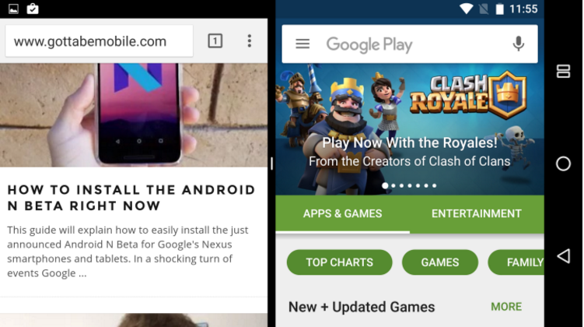
ANDROID
Multi-window Support
6.0.1
7.X

Slide 11
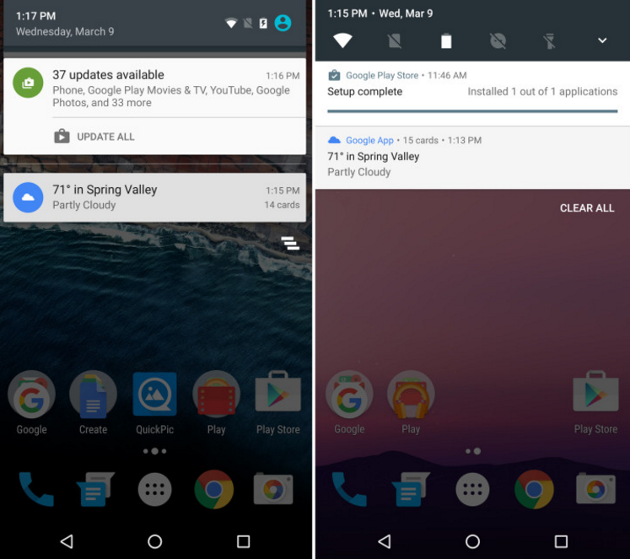
ANDROID
Notification Bar Toggles
6.0.1
7.X

Slide 12
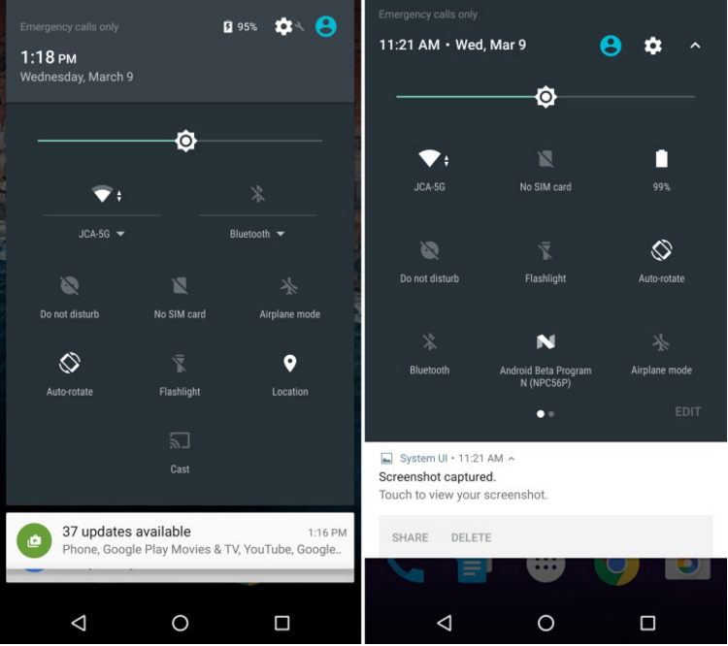
ANDROID
Quick Settings
6.0.1
7.X

Slide 13
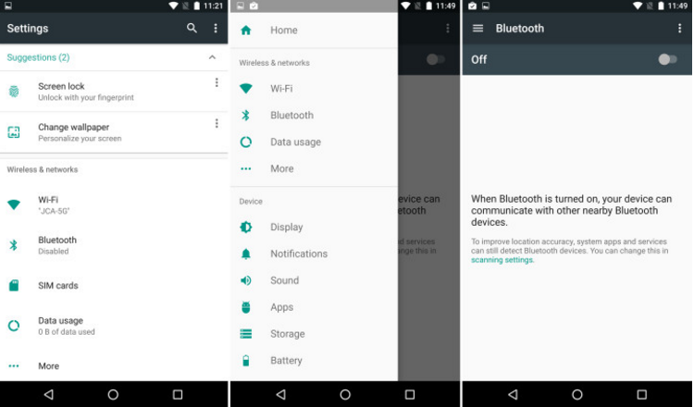
ANDROID
Android N Settings Menu
6.0.1
7.X

Slide 14
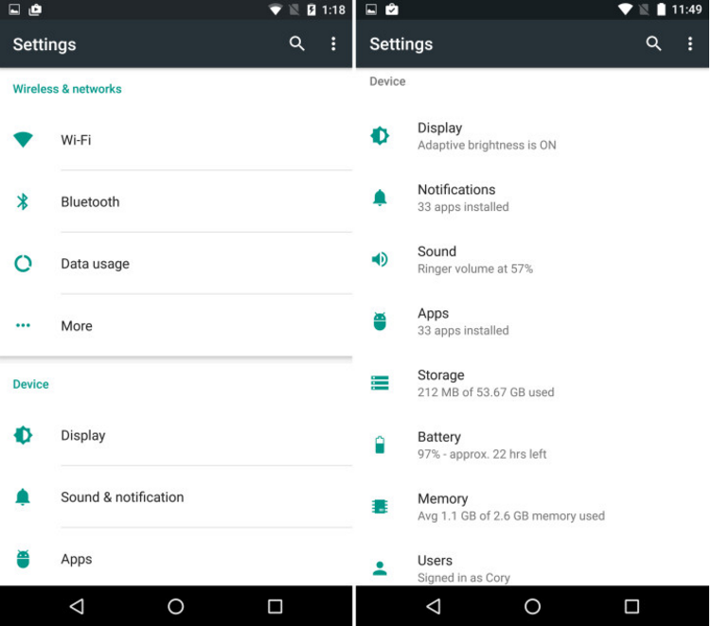
ANDROID
Smarter Settings Menu
6.0.1
7.1

Slide 15
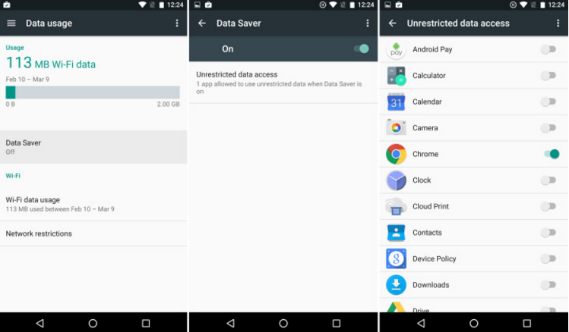
ANDROID
Android N Data Saver
6.0.1
7.X

Slide 16
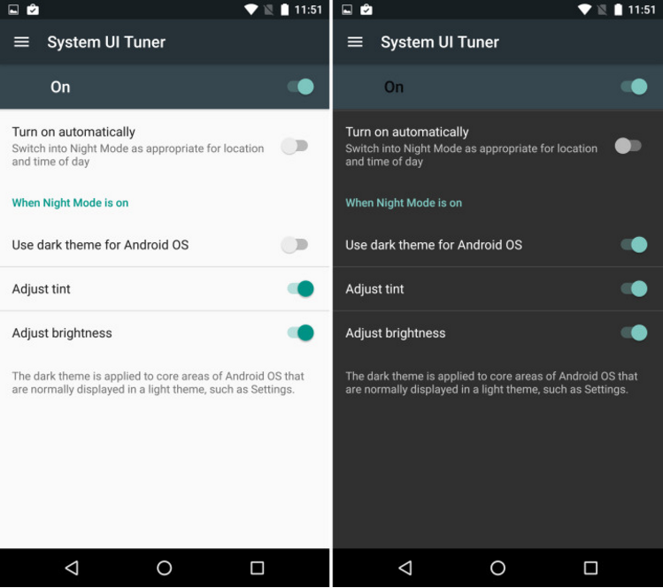
ANDROID
Night Mode
6.0.1
7.X

Slide 17
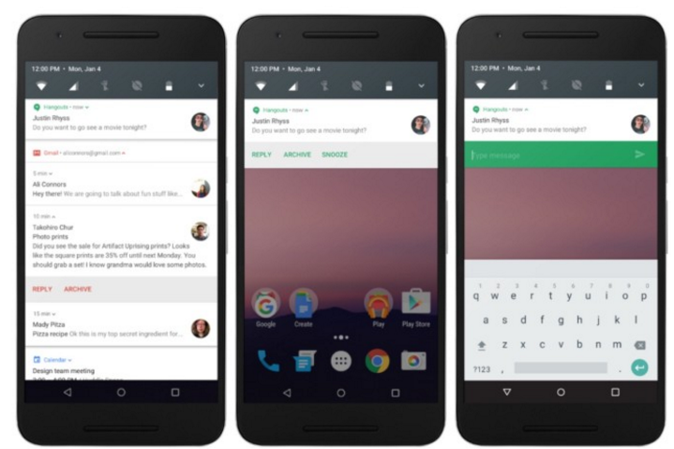
ANDROID
Improved & Bundled Notifications
6.0.1
7.X

Slide 18
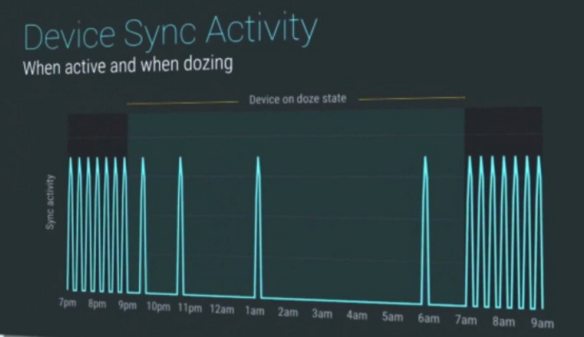
ANDROID
Doze on the Go (Better Battery Life
(up to 30% over 6.X)
6.0.1
7.X

Slide 19
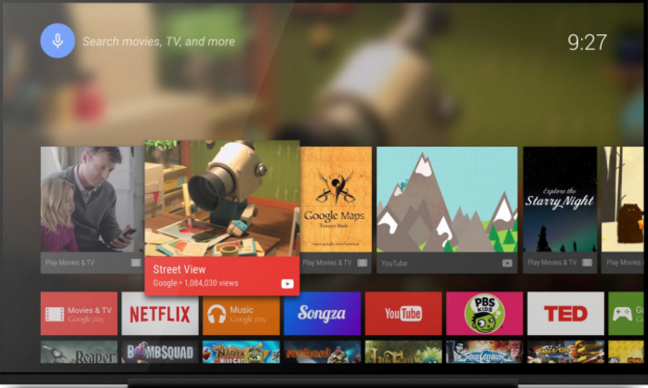
ANDROID
Android TV Recording
6.0.1
7.X

Slide 20
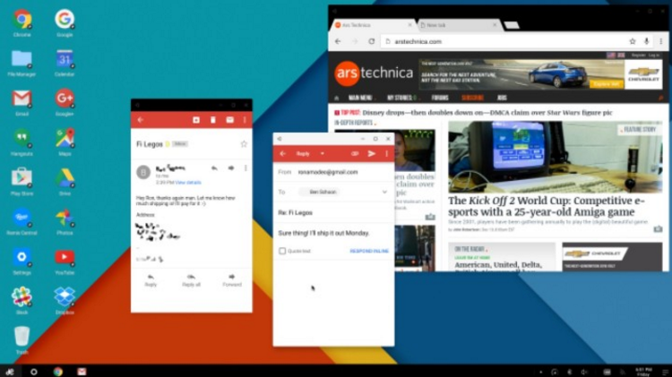
ANDROID
FreeForm Open Window Mode
6.0.1
7.X

Slide 21
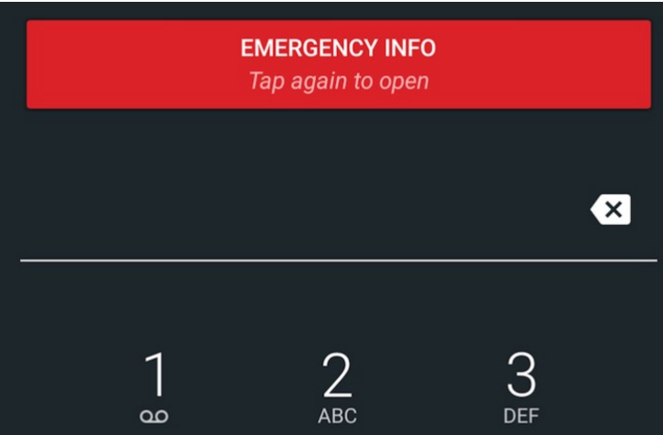
ANDROID
Emergency Info
6.0.1
7.X

Slide 22
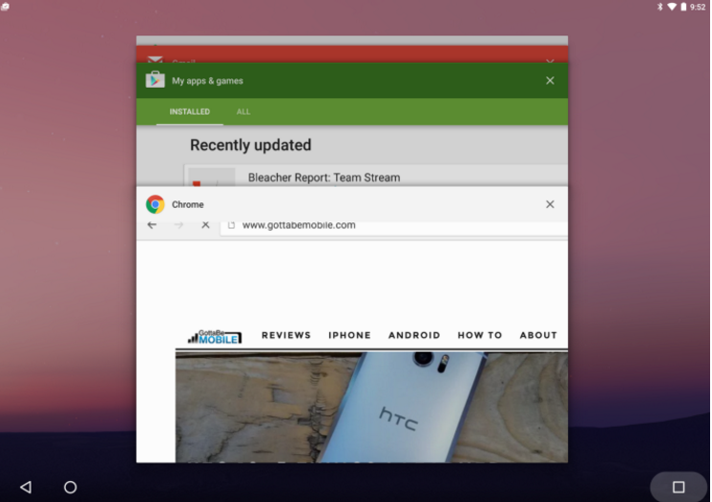
ANDROID
Fast App Switching
6.0.1
7.X

Slide 23
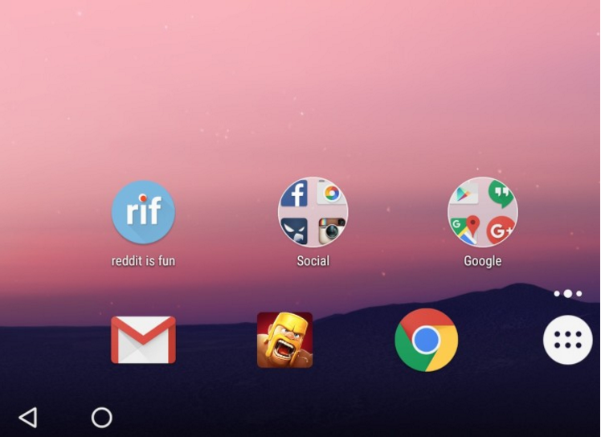
ANDROID
New Folder Icon
6.0.1
7.X

Slide 24
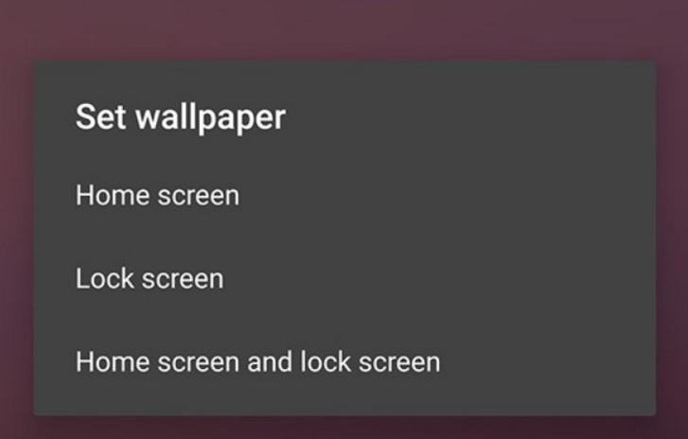
ANDROID
Different Wallpaper for Lock screen & Home screen
6.0.1
7.X

Slide 25
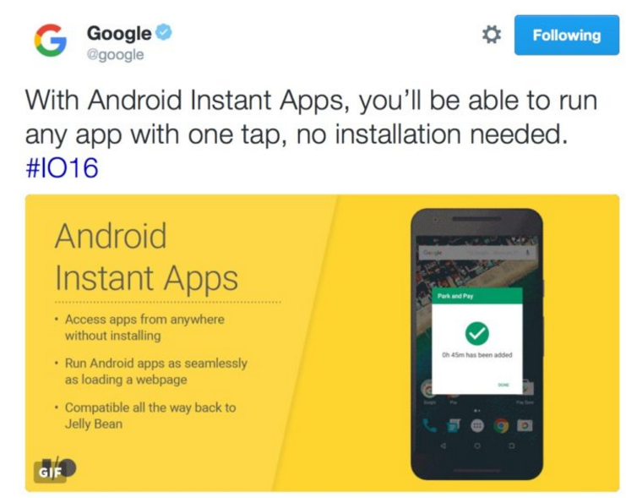
ANDROID
Android Instant Apps
6.0.1
7.X

Slide 26
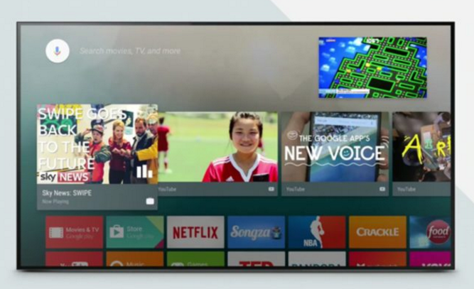
ANDROID
Picture-In-Picture
6.0.1
7.X

Slide 27

ANDROID
Better Emoji Support
6.0.1
7.X

Slide 28
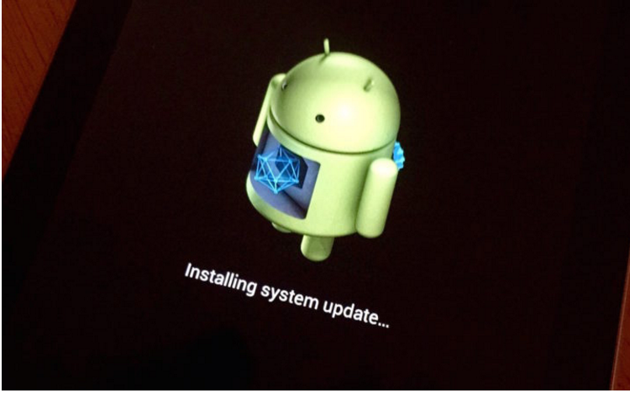
ANDROID
Seamless Updates
6.0.1
7.X

Slide 29
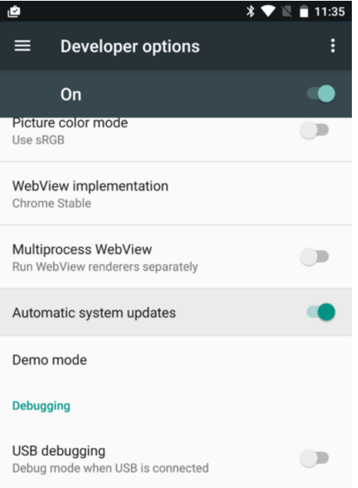
ANDROID
Automatic System Updates
6.0.1
7.X

Slide 30
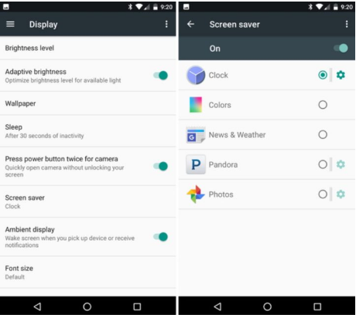
ANDROID
Screen Saver (Always-On Display)
6.0.1
7.X

Slide 31
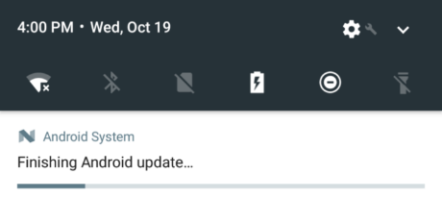
ANDROID
Android Is Upgrading
6.0.1
7.X

Slide 32
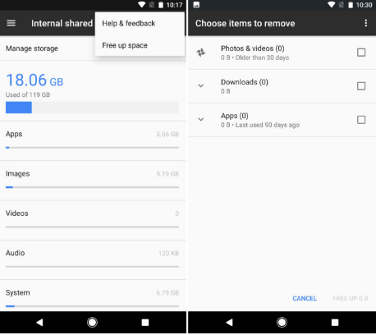
ANDROID
Smart Storage
6.0.1
7.X

Slide 33
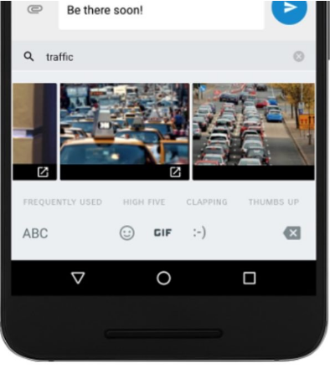
ANDROID
GIF Keyboard Support
6.0.1
7.X

Slide 34
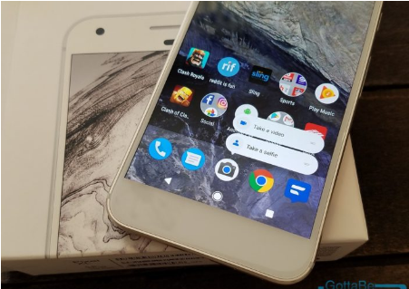
ANDROID
App Shortcuts
6.0.1
7.X

Slide 35
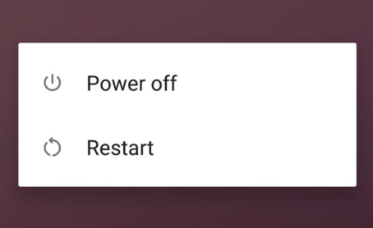
ANDROID
Restart or Reboot Button
6.0.1
7.X

Slide 36
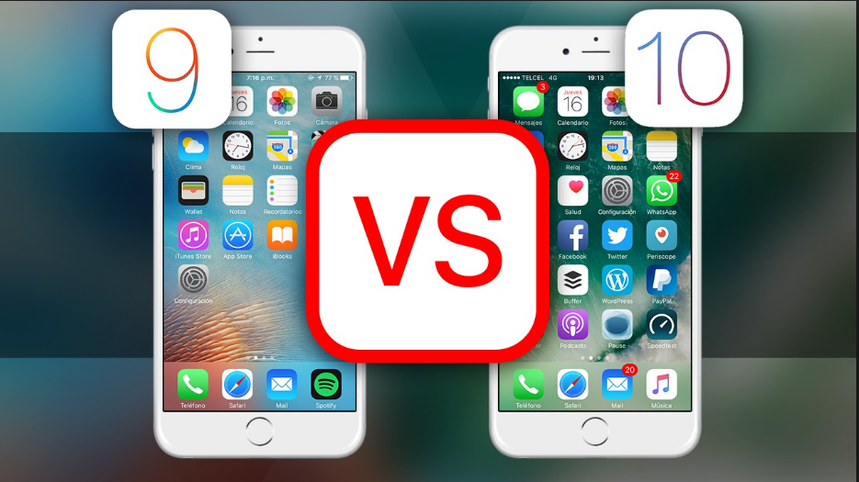
iOS

Slide 37
iOS
HOMEWORK
100+ New Features
in iOS 10 for iPhone & iPad
https://www.youtube.com/watch?v=_qyH4JXpA9k&feature=youtu.be

Slide 38
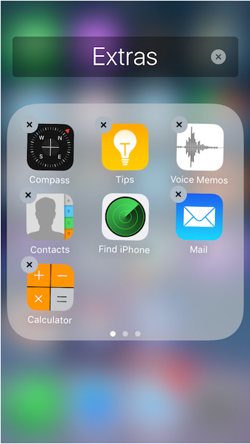
iOS
Stock Apps Begone !
10.X

Slide 39
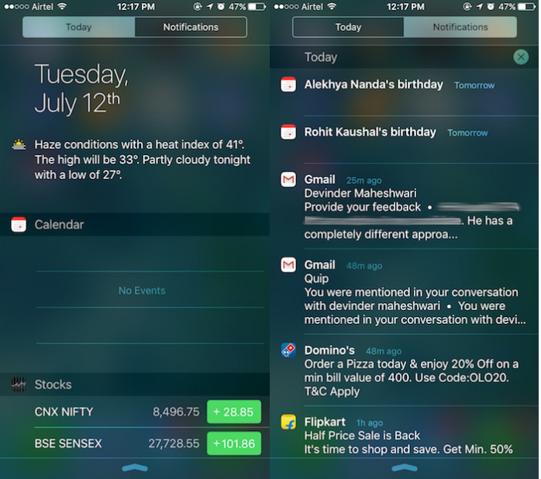
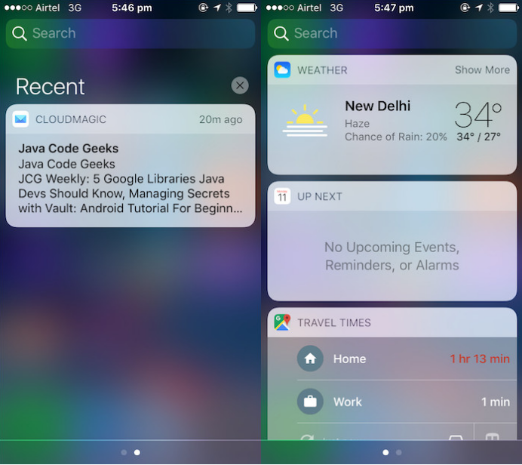
iOS
Notification Center
9.X
10.X

Slide 40
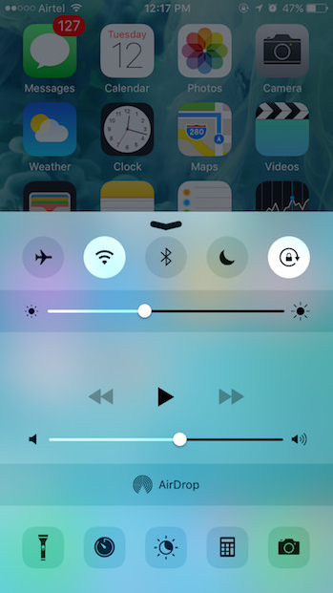
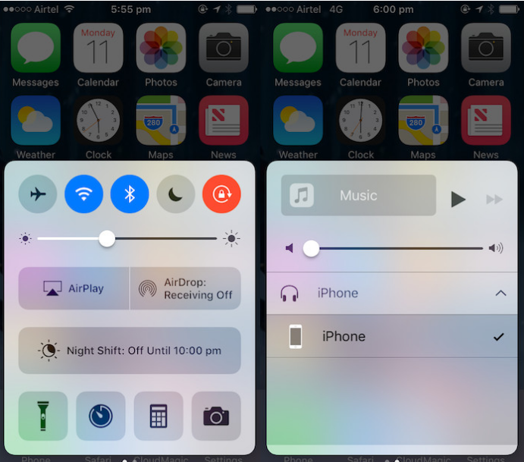
iOS
Control Center
9.X
10.X

Slide 41
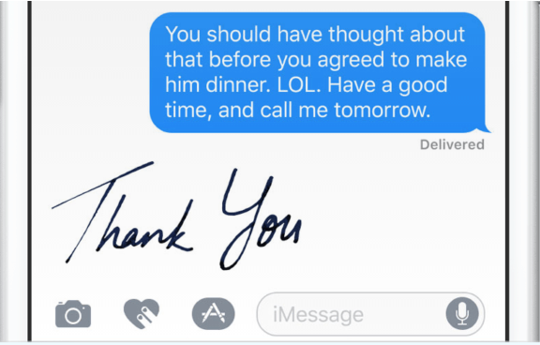

iOS
iMessage new features
10.X

Slide 42
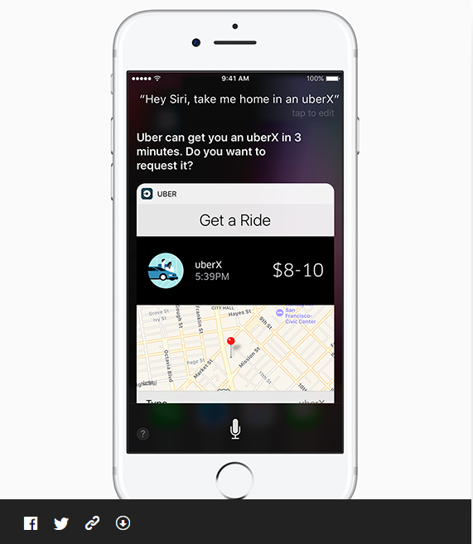
iOS
Siri
Contextual predictions in QuickType
Suggested Apps in the Keyboard
Suggested Locations
Suggested content between apps
Intelligent Scheduling
Calendar availability
Multilingual language
10.X

Slide 43
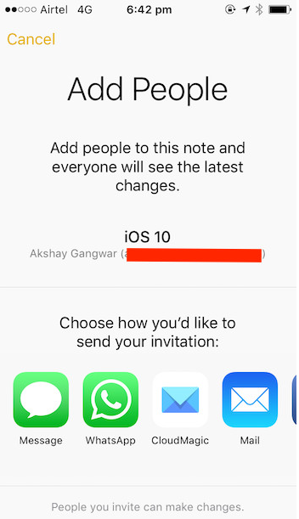
iOS
Collaboration in Notes
10.X

Slide 44
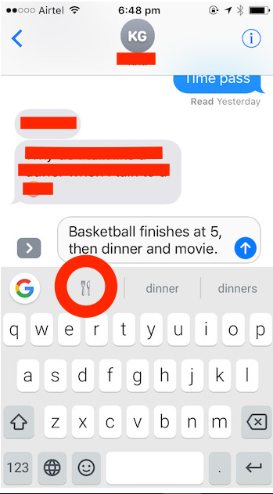
iOS
Emoji Suggestions in Keyboards
10.X

Slide 45
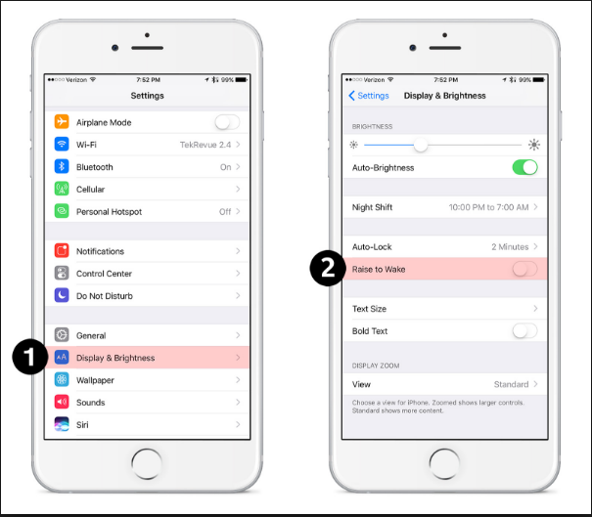
iOS
Raise to Wake
10.X

Slide 46
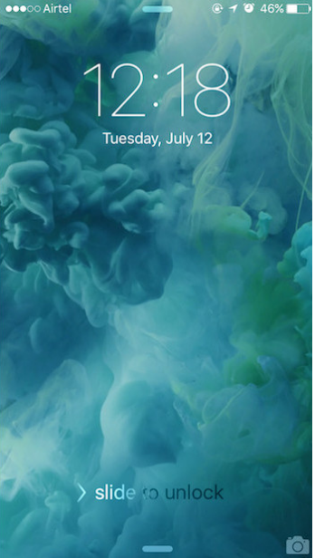
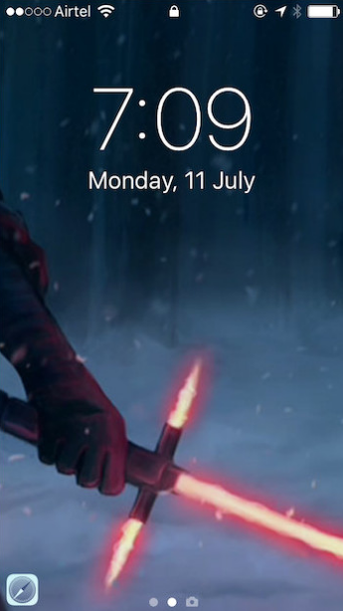
iOS
Lock-screen Changes
9.X
10.X

