Slide 1

Becoming a Pro (II)
IN Mobile Applications Testing

Slide 2
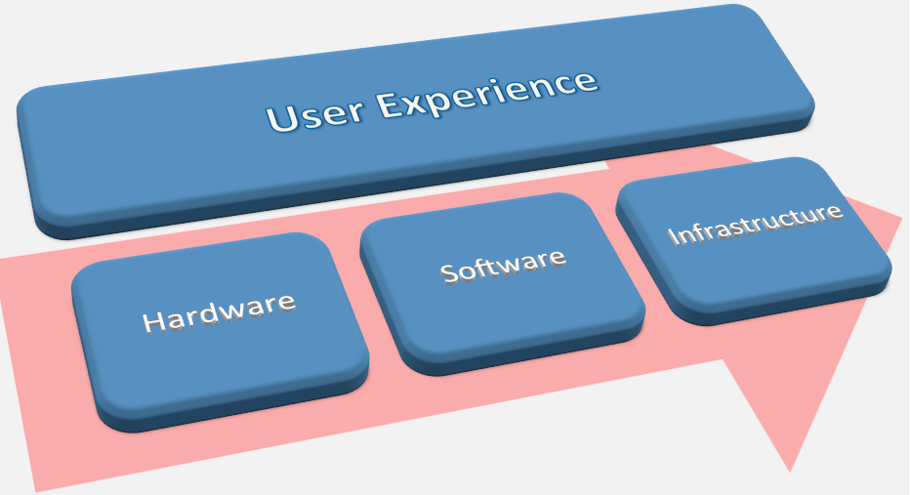
EMULATORS vs Real Devices
USER EXPERIENCE AND USABILITY
SPECTRUM OF DEVICE CONFIGURATIONS (HARDWARE)
User Interactions
Real occurring events
Overall performance
Consistency in results
Chipset
Display
Memory
Sensors
Platform/OS version
PLATFORM + CUSTOMIZATIONS (SOFTWARE)
OEM and Carrier customizations
Dependencies to other software/app
INFRASTRUCTURE (NETWORK)
Network/WiFi

Slide 3
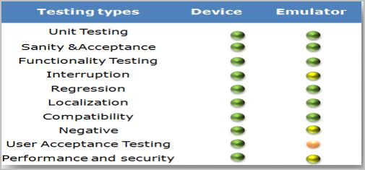

EMULATORS vs Real Devices Summary
REAL DEVICE
EMULATOR
When there is a necessity to observe the behaviors of the software product under various adverse conditions such as memory shortage of the device;
In the process of finding obvious issues on several platforms, performing functional testing.
You need to test your app on as many devices as possible to ensure the maximal coverage either geographically or globally.
One of the main tasks of the mobile applications testing is usability testing, which is impossible without having the real device at hand;
It is impossible to monitor possible network issues with the help of an emulator. In this case you will definitely need an actual mobile device.
Usage of real devices is much needed in the process of testing the hardware characteristics, such as quality of the display. Besides, the best way of testing memory consumption is testing it on the whole range of actual devices;
Only actual mobile device has the platform that is suitable for testing experiences of the end-users;
Real mobile devices mean real user environment. Some definite actions like scrolling and zooming are to a great extent different on the touchscreen;

Slide 4
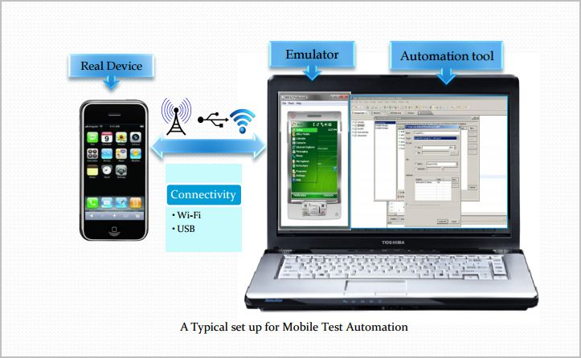
EMULATORS : Mobile Automation- Desktop Based
Mobile test automation tools are installed on a desktop locally
Interacts with the mobile devices through USB connection or Wi-Fi
Mobile Apps can be installed & tested on both Emulators as well as real devices

Slide 5
Overview: Mobile APPS
Types
Categories
Troubleshooting Guide
Simulators
Emulators
Remote Device Access (RDA)
Mobile Test Industry Standards
Distribution/Installation/Logs
App Risk Analysis

Slide 6
Simulators : MOBILE
Mobile Simulator is a software application for a personal computer which creates a virtual machine version of a mobile device,such as a mobile phone, iPhone, other smartphone, or calculator, on the computer.
The mobile simulator allows the user to use features and run applications on the virtual mobile on their computer as though it was the actual mobile device.
A mobile simulator lets you test a website and determine how well it performs on various types of mobile devices.
Mobile simulators may be developed using programming languages such as Java and .NET
A good simulator tests mobile content quickly on multiple browsers and emulates several device profiles simultaneously.
This allows analysis of mobile content in real-time, locate errors in code, view rendering in an environment that simulates the mobile browser, and optimize the site for performance.
A SIMULATOR sets up a similar environment to the original device's OS, but doesn't attempt to simulate the real device's hardware.
Some programs may run a little differently, and it may require other changes (like that the program be compiled for the computer's CPU instead of the device's), but it's a close enough match that you can do most of your development against the simulator.

Slide 7


Simulators Pros and Cons
1. Study the behavior of a system without building it.
2. Results are accurate in general, compared to analytical model.
3. Help to find un-expected phenomenon, behavior of the system.
4. Easy to perform ``What-If'' analysis.
1. No support for placing or receiving actual phone calls.
You can simulate phone calls through the emulator console, however.
2. No support for USB connections
3. No support for camera/video capture (input).
4. No support for determining connected state
5. No support for Bluetooth
6. No support for actual GPS
7. No support for Accelerometer feature used in Gaming applications

Slide 8
SIMULATORS vs EMULATOR
Functionality | Emulator | Simulator
What it mimics ? | Mobile device software Mobile device hardware Mobile operating system | Internal behavior of the device. It does not mimic hardware.
How to get it ? | It is generally provided by the device manufacturer. | It is generally provided by the device manufacturer or some other company.
Internal structure | It is written in machine-level assembly language. | It is written in high-level language.
Debugging | It is more suitable for debugging. | It is not suitable for debugging purpose.
Performance | Emulators are really slow. Emulating the actual hardware usually makes the software run slower than it would natively. | Faster than emulators.
Example | Google’s Android SDK | Apple’s iOS Simulator

Slide 9
SIMULATORS vs EMULATOR vs Real Device SUMMARY
Functionality | Real Device | Emulator / Simulator
Price | Getting real devices will cost you a lot. | It is almost free, we just need to download and install them
Processing Speed | It has faster processing; however network latency may be normal. | It is slower as compared to actual devices. It has observed less latency than real devices connected to the local network or in the cloud.
Debugging | Debugging is not that easy. | It provides step-by-step debugging of an application. Also, it provides an efficient way for capturing screenshots.
Web-app Testing | Web applications can be tested in a normal way. | Testing a web application is much easier.
Reliability | Testing on a real device has a major advantage that it always gives accurate results. | It cannot simulate all types of user interactions; hence it may lead to false results sometimes. So it scores low when it comes to reliability.

Slide 10
SIMULATORS vs EMULATOR vs Real Device
SUMMARY EXTRA “ADVANTAGES”
Issue | Emulator /Simulator Testing | Real Device Testing
Situation-based application | There are specific situations where the deadline to produce text execution results are short and purchasing the required mobile devices may be not possible. | The real device allows the testers to test almost all the real time scenarios which can be tested for the mobile applications. These devices are operated using fingers and simulate real-life usage.
Feeling of closeness towards the real handheld devices | The wide gamut of mobile devices creates the problems, whereby the testers are not confident about which mobile devices to invest in. | The real device allows the testers to test even usability
Ease of availability | Emulator/simulator(s) are in most cases open and free software | The real devices allow stringent performance testing issues like working with a real time transport application for 15 hours continuously which cannot be successfully simulated by the emulators.
Ease of opening an Web application through URL | It is easier to do web application testing when it comes to opening the web application. The user just needs to copy and paste the application URL. | Testing on real devices provides more in terms of reliability.

Slide 11
SIMULATORS vs EMULATOR vs Real Device
SUMMARY EXTRA “ADVANTAGES”
Issue | Emulator Testing | Real Device Testing
Capturing screenshots of the situations where defects appear | Capturing issue of screenshots over simulator is very easy with the simulator since we just need to use Microsoft office facilities. | Testing with real world devices is very helpful in terms of interoperability testing.
Simulation of validation of battery scenarios | The emulator/simulators are not able to simulate the battery issues. | Real world devices can easily perform the same.
Validation of incoming interrupts | The emulator/simulators are not able to simulate the incoming interrupts for SMS as well as the incoming calls. | Real world devices can easily simulates incoming interrupts.
Validation of exact color displays | The emulator/simulator is not able to properly emulate/simulate the exact color display of the devices when the real device is in sunlight or in black. | Real world devices can easily simulates the exact color displays.
Validation of the performance | The performance of the emulator/simulator tends to be slower than the original devices at times. | The original devices tend to perform faster than the emulator or the simulators.
Simulating memory related issues | The memory available at the emulator/simulator tends to be far more than in the real devices | The memory storage level of the devices tend to be far less than the emulators thus it may

Slide 12
SIMULATORS vs EMULATOR vs Real Device
SUMMARY EXTRA “DISADVANTAGES”
Emulator/Simulator Testing | Real Device Testing
The emulator/simulator is not always the best type of solution for scenarios such as the ones whereby the testing team needs to validate the performance of the application for a longer period of time. | The real devices are costly compared to the emulator/simulators. Thereby projects under budget and timeline constraints may risk profitability as well as the viability of the overall project.
The emulator/simulator is suitable mostly for certain types of functional test case executions. | There is a very wide variety of mobile devices from apple to Samsung to android and to Symbian and so on.
The emulator/simulator can some time not be supportive of certain types of application | Real Mobile devices when used in the developing stage for unit testing and similar purposes could turn out to be harder to connect to the IDE than the emulators
Not all the emulator/simulator supports the complete gamut of mobile applications. | In order to test with the real world devices, the devices need to be always connected to the USB port of the machines.

Slide 13
Simulators : iPhone
Prerequisites:
MAC Environment
Getting Started:
• Deploy Native app into iPhone Simulator using Xcode.
• Xcode - an integrated development environment that manages your application projects and lets to edit, compile, run, and debug code
• Once the native app is deployed, the app icon appears on simulator, thus aids to access the app directly from simulator
• Testing in UIAutomation can be done by both developer and tester, it requires knowledge of iPhone development.
• UIAutomation is the automation technique for iPhone.
It uses JavaScript as test script to perform automation. This can be done both in device and simulator
• iPhone Simulator does not emulate an iPhone processor, disk drive, memory constraints
iPhone and iPad are popular devices from Apple. Its has its own proprietary operating system, iOS. Its well known for its design and performance.

Slide 14
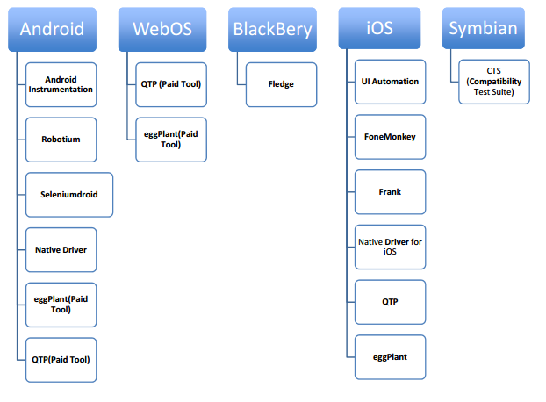









Most Popular Mobile App Testing Tools
Existing Mobile Platforms And Available Test Automation Tools

Slide 15
EXTRA WHAT’S NEW ?
Mobile Applications Testing

Slide 16
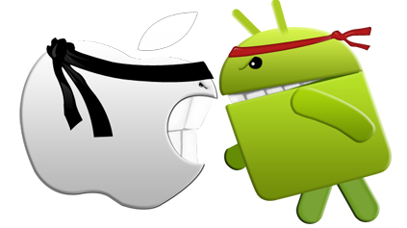
Overview
iOS
Android

Slide 17
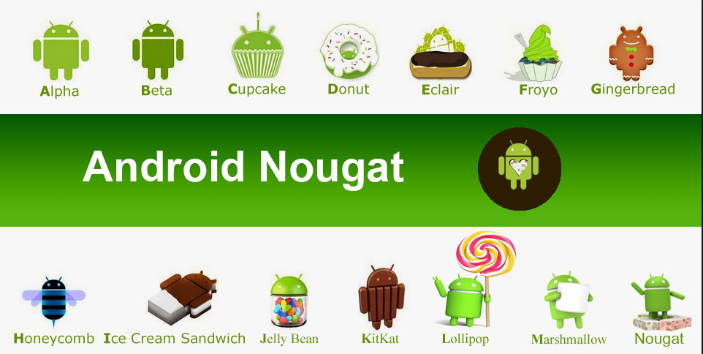
ANDROID
RELEASE HISTORY and Current Versions ( as of Dec 8th,2016)
Marshmallow
6.0-6.0.1
All devices
7.0 -7.1 For selected devices
Lollipop 5.x

Slide 18
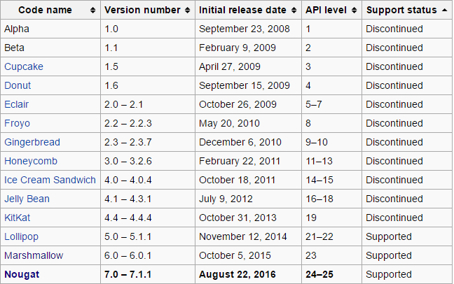
ANDROID
RELEASE HISTORY

Slide 19
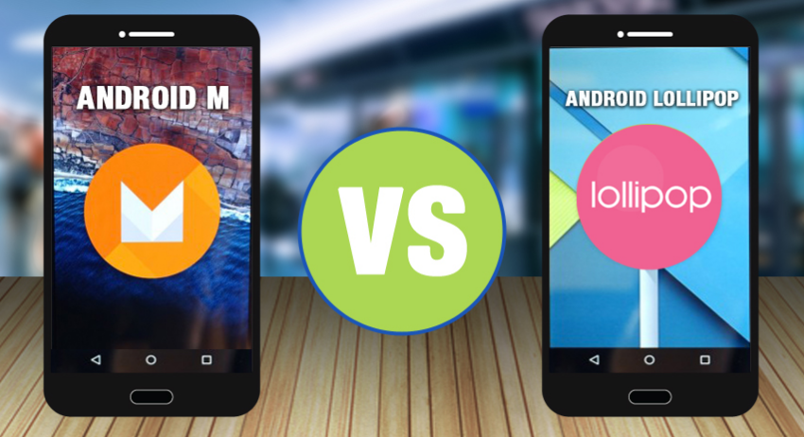
ANDROID
Android 6.0 vs Android 5.1 Lollipop:
What’s New in Marshmallow ?

Slide 20
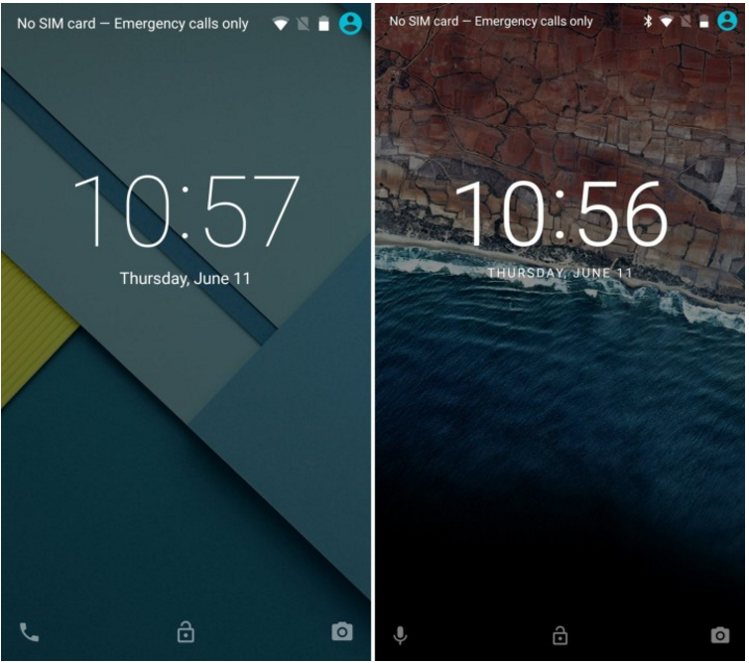
ANDROID
LOCKSCREEN
5.1
6.0

Slide 21
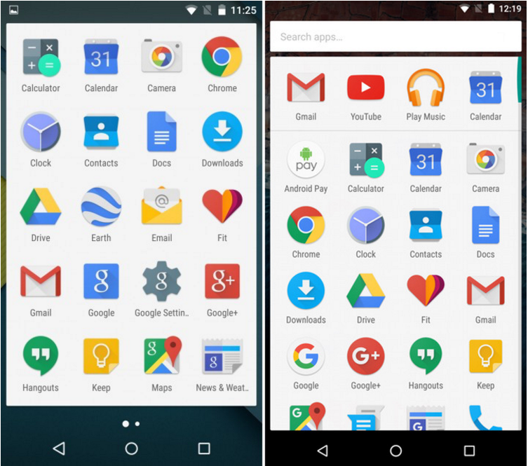
ANDROID
APP TRAY
5.1
6.0

Slide 22
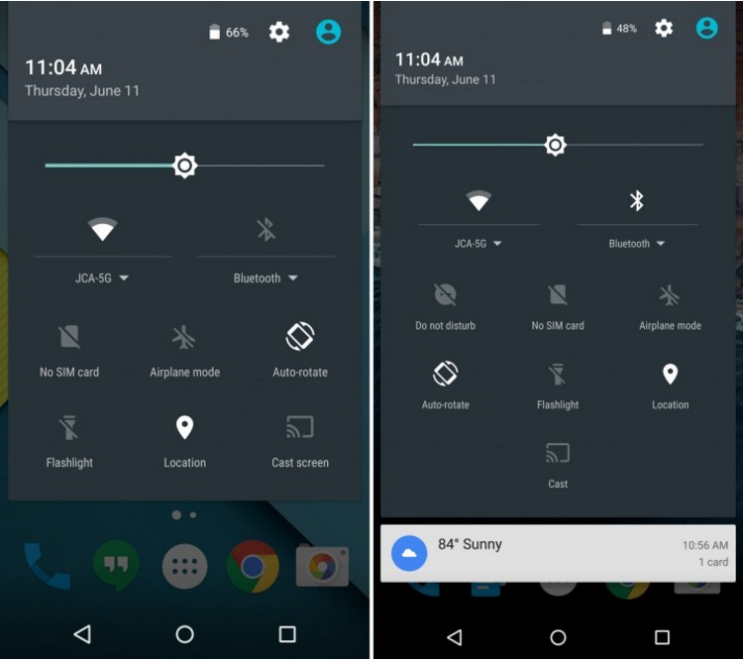
ANDROID
Notification Bar Settings
5.1
6.0

Slide 23
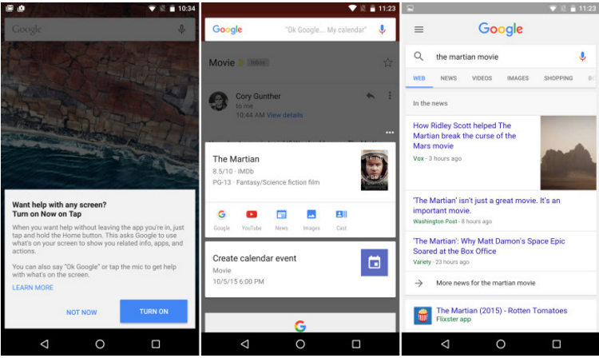
ANDROID
Google Now on Tap (N/A for 5.1)
6.0

Slide 24
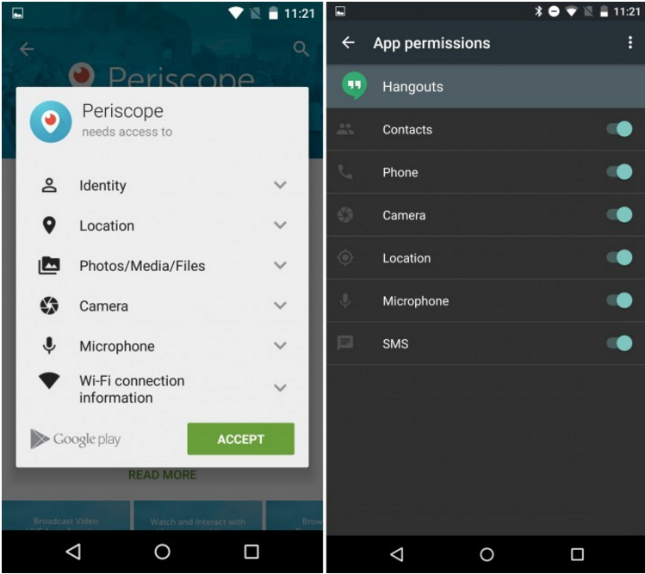
ANDROID
Permissions
5.1
6.0

Slide 25
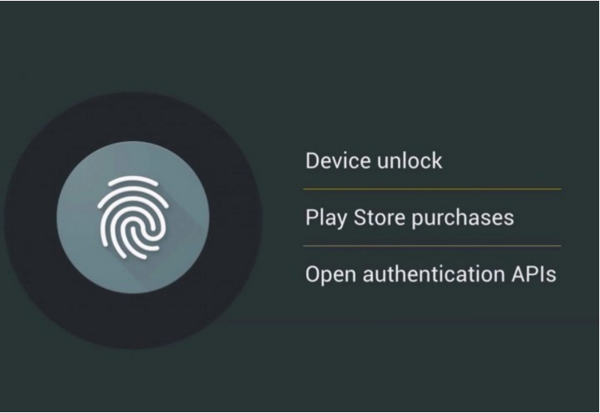
ANDROID
Fingerprint Support (N/A for 5.1)
6.0

Slide 26
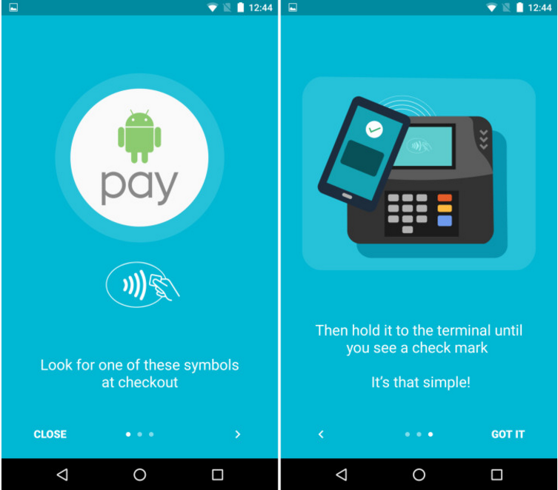
ANDROID
Android Pay ( N/A for 5.1)
6.0

Slide 27
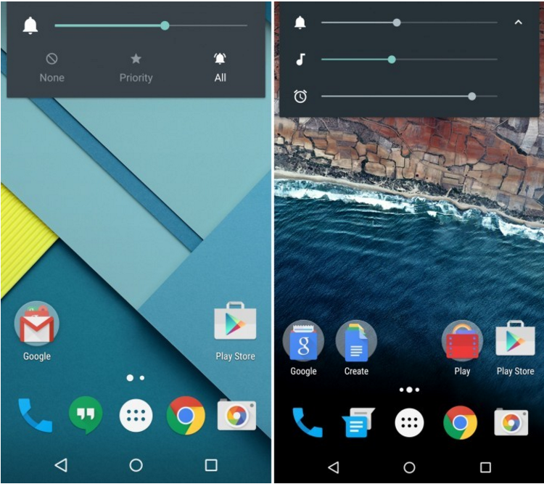
ANDROID
Volume Controls
5.1
6.0

Slide 28
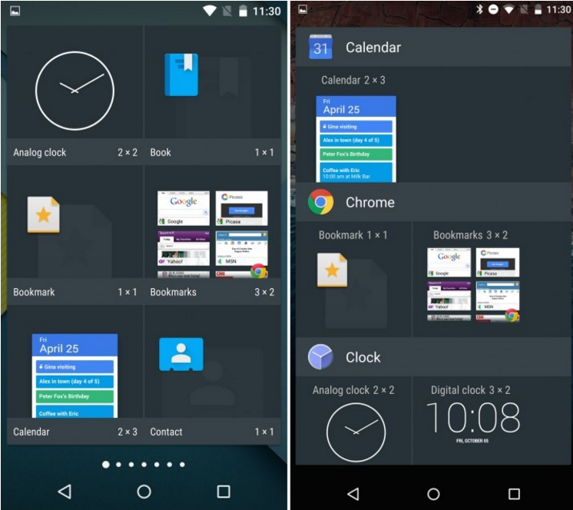
ANDROID
Widget Menu
5.1
6.0

Slide 29
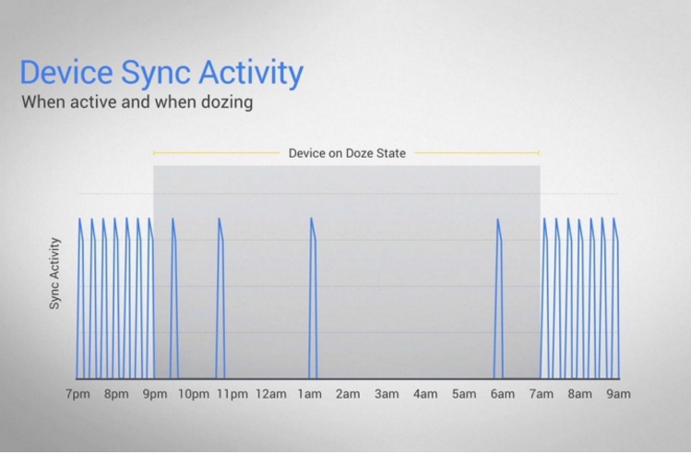
ANDROID
Doze Battery Life ( N/A for 5.1)
6.0

Slide 30
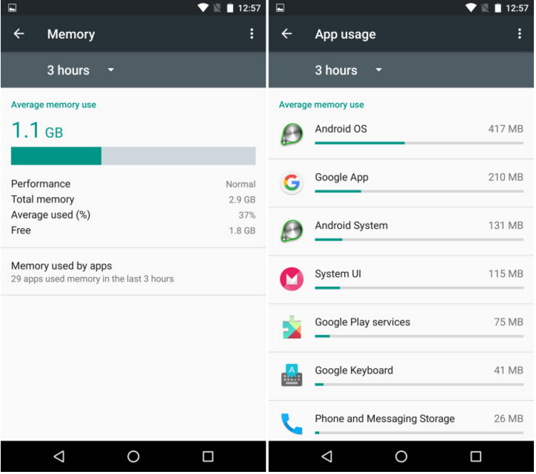
ANDROID
Memory Usage (N/A for 5.1)
6.0

