Slide 1

Becoming a Pro
IN Mobile Applications Testing

Slide 2
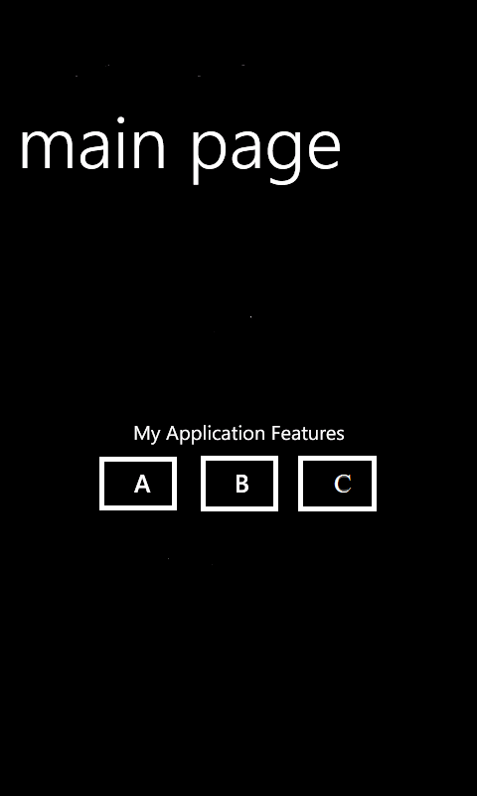
Mobile Test Industry Standards
Testing Strategies for Mobile Apps : LETS PRACTICE
HOMEWORK
Write as many Test Cases you can for this
simple app on Mobile device with three
buttons (A, B and C) that making different
sounds upon tapping on it.
A - for Audio 1
B - for Audio 2
C - for Audio 3
You are free to create conditions and Rules for each button , but be consistent.
Write Test Cases ( use previous slides for hints).
HAVE FUN !

Slide 3
Mobile Test Industry Standards
Testing Strategies for Mobile Apps : LETS PRACTICE
HOMEWORK REVIEW
Case | Description | Result
Button A | Verify that when Button A is pressed, sound tone A appeared | When button A is pressed the sound tone A should be audible
Button B | Verify that when Button B is pressed, sound tone B appeared | When button B is pressed the sound tone B should be audible
Button C | Verify that when Button C is pressed, sound tone C appeared | When button C is pressed the sound tone C should be audible
Combination of buttons and sounds | Verify that when A,B,C buttons are pressed consecutively, the specific sound A,B,C is appeared | When buttons A,B, C are pressed consecutively, the audible tones A, B, C should be observed
Functional Test

Slide 4
Mobile Test Industry Standards
Testing Strategies for Mobile Apps : LETS PRACTICE
HOMEWORK REVIEW
Case | Description | Result
Panning (sliding horizontally | Verify that when main Page is | The buttons A,B,C, should not loose the
left-right) | panned/swiped, the | order or make any
Swiping | sound buttons A,B,C remains in the same | sound during panning/swiping
 | order, the same | gestural input
 | position on the page | procedures
 | screen, and do not
 | make sound
Rotation | Verify that when device is rotated, Buttons ABC should not loose it’s order and make any sound | During device’s rotation Buttons ABC should not loose it’s order and make any sound
Zooming | Verify that buttons A,B, C should not loose the order or make any sound during the Zooming gestural procedure | Buttons A,B,C should not loose the order or make and sound during the Zooming procedure
UI Test

Slide 5
Mobile Test Industry Standards
Testing Strategies for Mobile Apps : LETS PRACTICE
HOMEWORK REVIEW
Case | Description | Result
Phone Call Interruption | Verify that when Phone Call is initiate, buttons ABC are in | When Phone Call is occurred, the Buttons ABC should be saved in ‘pause” mode and do
 | “pause” mode and | not perform assigned sound
 | do not perform | tone.
 | assigned sound
 | tones.
Text message interruption | Verify that when SMS notifications/ message appears, the main app page | When SMS action occurs, proper error message should be displayed and app will be closed gracefully with saved
 | will response with | information
 | safe, end session
Verge App Notification (w/ TuneTone) | Verify that when TechNews Notification with the Ringtone occurs, buttons ABC will | When TechNews Notification (w/Ringtone) occurs the Buttons ABC should be pause until Ringtone tune are done, and continue to perform ABC
 | pause and perform | assigned sound after no more
 | assigned sound | than 3 sec delay.
 | tones after
 | Notification Ringtone
 | is done.
Interruption Test

Slide 6
Mobile Test Industry Standards
Testing Strategies for Mobile Apps : LETS PRACTICE
HOMEWORK REVIEW
Case | Description | Result
Flight Mode of | Verify that when | Buttons ABC should
Mobile Device | Device has Flight | be active and
 | Mode ON, the Buttons | perform assigned
 | ABC are still active | sounds when
 | and performing sound | Mobile Device is in
 |  | Offline Mode.
Bluetooth | Verify that when | Buttons ABC should
Connection | Wearable Device BT | be active and
active with | connected and play | perform assigned
Wearable Device | Music, the Buttons | sounds when
 | ABC are still active | Mobile Device is in
 | and performing sound | active Bluetooth
 |  | Mode.
Low bandwidth | Verify that when | Buttons ABC should
Network | Device is in | be active and
 | Frequently changed | perform assigned
 | “hopping” area the | sounds when
 | Buttons ABC are still | Mobile Device is in
 | active and performing | the “hopping mode”
 | sound
Connectivity Test

Slide 7
Mobile Test Industry Standards
Testing Strategies for Mobile Apps : LETS PRACTICE
HOMEWORK REVIEW
Module | Description | Result
Define the maximum amount of load that a | Verify that when 10,000 Users press A,B,C buttons pressed simultaneously, the | When buttons ABC are pressed simultaneously the tune combined of three sounds should
system can handle | designed combination of three sound tone is appeared | appeared
The number of concurrent user that application | Verify that when 10,000 User concurrently press Buttons A, there is not drop in functionality and | When 10,000 User concurrently press Button A it should be not affect the functionality or
can handle | sound quality. | sound quality
Check application scalability | Verify that during the Device OS/Firmware/ Native App upgrades | When Device OS/or Phone Firmware/or Phone Native App
 | application can run | upgrades occurs the
 | without drop in | application runs without
 | performance | significant performance
 |  | degradation
Performance Test

Slide 8

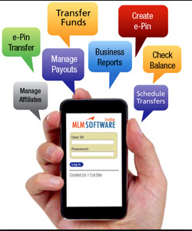
Mobile Test Industry Standards :
Testing Strategies for Mobile Apps : Banking
Banking applications are considered to be one of the most complex applications in development and testing industry.
What makes Banking application so complex?
What approach should be followed in order to test the complex workflows involved?

Slide 9
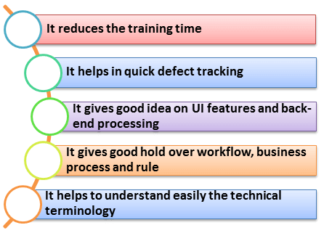
Mobile Test Industry Standards :
Testing Strategies for Mobile Apps : Banking
Why Domain Knowledge Matters?

Slide 10
Mobile Test Industry Standards :
Testing Strategies for Mobile Apps : Banking
BANKING DOMAIN in TESTING
Core Banking
Corporate Banking
Retail Banking
Core
Corporate
Retail
Loan
Trade Finance
Private Banking
Consumer Finance
Islamic Banking
Customer Delivery Channels/Front End Delivery
Traditional Banking sector
Service based Banking sector

Slide 11
Mobile Test Industry Standards :
Testing Strategies for Mobile Apps : Banking
12 most important characteristics of a Banking application
It should support thousands of concurrent user sessions
A banking application should integrate with other numerous applications like trading accounts, Bill pay utility, credit cards, etc.
It should process fast and secure transactions
It should include massive storage system.
To troubleshoot customer issues it should have high auditing capability
It should handle complex business workflows
Need to support users on multiple platforms (Mac, Linux, Unix, Windows)
It should support users from multiple locations
It should support multi-lingual users
It should support users on various payment systems (VISA, AMEX, MasterCard)
It should support multiple service sectors (Loans, Retail banking etc.)
Foolproof disaster management mechanism

Slide 12

Mobile Test Industry Standards :
Testing Strategies for Mobile Apps : Banking
Banking applications have multiple tiers involved in performing an operation. For Example, a banking application may have:
Web Server to interact with end users via Browser
Middle Tier to validate the input and output for web server
Data Base to store data and procedures
Transaction Processor which could be a large capacity Mainframe or any other Legacy system to carry out Trillions of transactions per second.
Requirement Analysis
Requirement Review
Business Reqs Documentation
Database Testing
Integration Testing
Functional Testing
Security Testing
Usability Testing
User Acceptance Testing

Slide 13
Mobile Test Industry Standards :
Testing Strategies for Mobile Apps : Banking Security
Many banks failed when it came to proper SSL encryption, authentication and secure feature implementation.
90% of tested apps initiated connections without proper SSL encryption
70% didn’t have alternative authentication solutions
50% used an iOS featured called UIWebView (designed to display web content in native apps) insecurely
40% didn’t validated the authenticity of digital certifications received from a server
20% were complied without using features designed to limit the risk of memory corruption attacks
Many apps exposed sensitive information through iOS system logs and crash logs

Slide 14
Mobile Test Industry Standards :
Testing Strategies for Mobile Apps : Banking Security
 | Sample Test Cases For Banking Application (OVERVIEW)
1 | Verify that user is able to login with valid username and password
2 | Verify that user is able to perform basic financial transactions
3 | Verify that user is able to add a beneficiary with valid name and account details
4 | Verify that user is able to make financial transactions to added beneficiary
5 | Verify that user is able to add decimal number into amount ( limited by 2 numbers)
6 | Verify that user is not able to add negative number into amount field
7 | Verify that user is allowed to transfer money only if there is proper account balance.
8 | Verify that there is a confirmation check for financial transactions

Slide 15
Mobile Test Industry Standards :
Testing Strategies for Mobile Apps : Banking Security
 | Sample Test Cases For Banking Application
9 | Verify that user is given an acknowledgment receipt upon successful financial transaction.
10 | Verify that customer is able to send money to multiple people
11 | Verify that user is allowed to change password
12 | Verify that account details reflect financial transactions also.
13 | Verify that user with invalid password is not allowed to login.
14 | Verify that after repeated attempts to login with incorrect password( as per the limits), user should be blocked.
15 | Verify that time-out feature is implemented
16 | Verify that if either of the username or password is blank, user is not allowed to login. User should be given an alert also.

Slide 16
Mobile Test Industry Standards :
Testing Strategies for Mobile Apps : Banking Security
 | Challenges faced by QA
1 | Getting access to production data and replicating it as test data, for testing is challenging
2 | The biggest challenge in testing banking system is during the migration of the system from the old system to the new system like testing of all the routines, procedures and plans. Also how the data will be fetched, uploaded and transferred to the new system after migration
3 | There may be the cases where requirements are not documented well and may lead to functional gaps in test plan Many non-functional requirements are not fully documented, and testers do not know whether to test it or not
4 | The most important point is to check whether the said system follows the desired policies and procedures
5 | The scope and the timelines increases as banking application are integrated with other application like internet or mobile banking

Slide 17
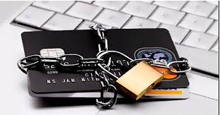
Mobile Test Industry Standards :
Testing Strategies for Mobile Apps : Banking Security
Guidance For Banking Application: Scope
For Admin
For a New Branch
For a New Role
For Customer and Visitor
For New Users
SUMMARY
Majority of banking software are developed on Mainframe and Unix
Testing helps to lessen possible glitches encounter during software development
Proper testing and compliance to industry standards, save companies from penalties
Good practices help develop good results, reputation and more business for companies
Both manual and automated testing have respective merits and usability

Slide 18
Overview: Mobile APPS
Types
Categories
Troubleshooting Guide
Simulators
Emulators
Remote Device Access (RDA)
Mobile Test Industry Standards
Distribution/Installation/Logs
App Risk Analysis

Slide 19
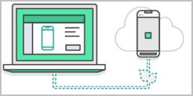
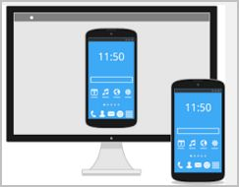
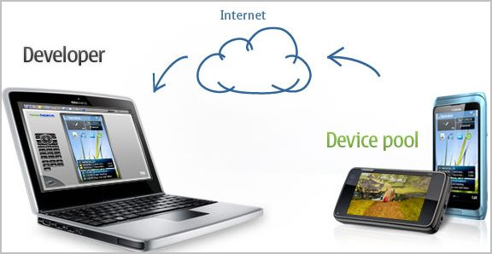
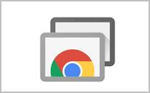
REMOTE DEVICE ACCESS (RDA)
Fast screenshot export
PC keyboard text input
Scalable picture from device to PC
Control over audio/video quality (important for slow Internet connection)
Test case manager, business paper organizer
Automation script creation and processing upon several devices (enterprise package)
Manual application and website testing run on the company`s devices
Application testing supported with outgoing and incoming text messages
Calls and messages exchange among several virtual devices
Full control over the device operation process (physical and virtual keypad, touch and slide functions, g-sensor, device restart, battery disconnection)
Website testing on multiple devices with URL input
Operation of an unlimited number of devices simultaneously (with an hourly fee)

Slide 20
REMOTE DEVICE ACCESS (RDA) Summary
Brief Comparison between
DeviceAnywhere (DA) and PerfectoMobile(PM)
Provides testing access to a huge variety of mobile devices.
Works on: Windows, Linux, Mac OS X
The specialty of the service is that they actually make use of remote connection to real devices
DA Service can be used for testing of mobile websites as well as HTML5 hybrid apps and native apps.
it's the real thing you are testing against, and not just an emulator.
DA - has wider scope of devices covering multiple countries- covering US/UK/France/Europe etc.. and supports corresponding carriers when compared to PM.
PM is cheaper when compared to DA
PM supports Indian carriers where as DA does not.
PM has advantage with regards to automation over DA.
Camera quality is really good in DA when compared to PM(for taking screenshots, capturing videos)
DA has wide range of handsets when compared to PM.

Slide 21
Overview: Mobile APPS
Types
Categories
Troubleshooting Guide
Simulators
Emulators
Remote Device Access (RDA)
Mobile Test Industry Standards
Distribution/Installation/Logs
App Risk Analysis

Slide 22
EMULATORS : MOBILE
Generally provided by Device Manufacturers and simulate the actual device.
An Emulator has the goal of taking the place of the real (in our case) mobile device.
Emulator duplicates every aspect of the original device’s behaviour, both hardware and software.
Basically simulates all of the hardware the real device uses, allowing the exact same app to run on it unmodified, and all of the software.
BROWSER EMULATORS
These simulate mobile browser environments. Whilst useful for determining the functionality available in a particular mobile browser, they are useless for device-specific testing.
Operating System Emulators
Microsoft provides emulators for Windows Mobile, and Google provides an emulator for Android. These run within a simulated mobile device environment and provide access to applications running within the operating system, e.g. a Web browser.
DEVICE EMULATORS
Excellent for testing your site or application on a particular device or set of devices.

Slide 23
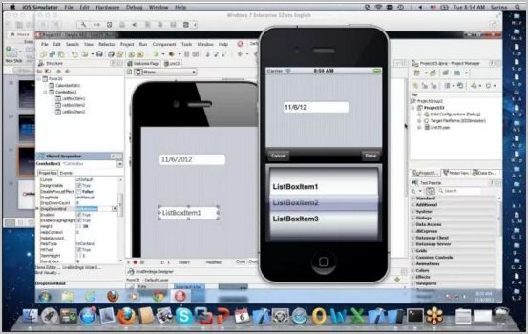
EMULATORS : MOST POPULAR
There are a large number of emulators available.
The following companies offer emulators for some or all of their mobile devices :
Research in Motion (BlackBerry)
Apple (iPhone)
Samsung
Palm
LG
Motorola
Browser Emulators
Opera Mini
Openwave
Microsoft (Windows Mobile)
Google (Android)
Nokia (Series 40 and Series 60)
Operating system emulators are available from:

Slide 24
EMULATORS :Android
Android Emulator comes as part of the android SDK commonly known as AVD – Android Virtual Device. It lets the user to prototype, develop, and test Android applications without using a physical device.
Android Emulators
The AVD’s are OS version specific and provides the user the flexibility to customize OS version, resolution,skin, sd card size and various other hardware properties to be emulated.
There are many command line utilities and tools which comes as part of the sdk which makes it easy to debug and interact with emulator
Prerequisites for Android Emulator
• JRE – Java Runtime Environment
• Android SDK
Installing an application on Android Emulator
• If the application is available in Google Playstore it can be directly downloaded and installed on to the device.
• If the application is available in ‘.apk’ format ,it can be installed using the command, ‘adb install ’ .
Adb is a command line utility which comes as part of the SDK.

Slide 25
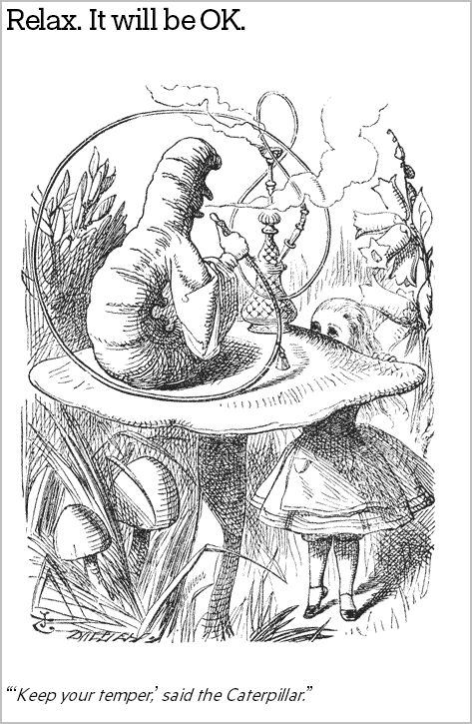
EMULATORS : iPhone
A note about terminology:
The terms ‘Mobile Emulator’ and ‘Simulator’ are sometimes used interchangeably.
It doesn’t help that Apple considers its native emulator a ‘simulator’ whereas Android tools are called emulators.
In the case of Apple, you need Xcode
Apple always harps on the importance of device testing because iPhone Simulator does not emulate an iPhone processor, disk drive, memory constraints and whatnot.
You hardly ever get memory warnings unless your Mac is struggling to manage resources itself, unless you simulate (again) memory warnings from the Simulator's menu item.

Slide 26
EMULATORS : Blackberry
BlackBerry Simulators is different from the other emulators as this is Device model specific (rather than OS version) • Easy to use interface for installing and testing apps
Blackberry Emulators
• Model specific blackberry emulators are available from RIM as standalone window applications and also along with BB JDK.
• The BlackBerry MDS Simulator and the BlackBerry Email Simulator simulates internet and email services respectively.
Prerequisites for Blackberry Simulator
• JRE – Java Runtime Environment
• Blackberry simulator package • Blackberry email and MDS Simulator
Installing an application on Blackberry emulator
• If the application is in .cod format, it can be directly loaded in to the emulator from the menu options in emulator.
• If the simulator is being used with an IDE or Blackberry JDE it directly loads the application into the simulator and runs it.
• The blackberry device manager can also be used to for installing the applications on emulator and device

Slide 27
EMULATORS : Windows Phone
The Windows Phone 7 emulator comes with SDK and Windows Developer Tool Kit.
Pre-requisites for the emulator
•Windows Vista and higher Desktop OS
• Microsoft Silverlight along with silver light toolkit for windows phone
• Visual Studio 2010
• Windows mobile 7 sdk
Installing applications in emulator
• Open the “Application Deployment” tool which is the part of “Windows Phone Developers Tool”
• Provide the path to the .xap file of the application in the tool
• The emulator opens showing the application that has been installed
Windows Phone 7 is a mobile operating system developed by Microsoft, and is the successor to its Windows Mobile platform.

Slide 28


EMULATORS Pros and Cons
1. Freeware and easily downloadable for use
2. It is possible real time scenarios like out of network, Emergency calls etc
3. Since emulator integrates with the development IDE, it would be easy to debug the application for a developer.
1. The Real live interactions cannot be performed( Ex. scanning , capturing etc)
- It is not possible to test the applications on a live network connectivity.
2. It just mimics the mobile device from various platforms and hence testing on the emulator cannot guarantee the stability of the application.
3. Some of the interruption test scenarios may also not work properly as like in real handset to predict the actual behavior of the application.
4. Memory Leak issues and Performance issues cannot be detected.
5. Dependency on platform to launch the simulator (Ex. MAC Desktop)

