Slide 1

Becoming a Pro
IN Mobile Applications Testing

Slide 2

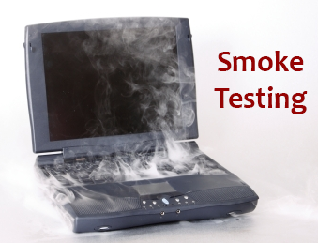
Mobile Test Industry Standards :
Testing Strategies for Mobile Apps
Smoke TEST aka “build verification test”
Performed after software build to ascertain that the critical functionalities of the program is working fine.
Executed "before" any detailed functional or regression tests
The purpose is to reject a badly broken application, so that the QA team does not waste time installing and testing the software application.
Example :
a smoke test may address basic questions like
"Does the app run?",
"Does it open a page ?", or "Does tapping on the home key do anything?"

Slide 3

Mobile Test Industry Standards :
Testing Strategies for Mobile Apps
Sanity TEST aka “tester acceptance test”
After receiving a software build, with minor changes in code, or functionality, Sanity testing is performed
The goal is to determine that the proposed functionality works roughly as expected.
If sanity test fails, the build is rejected to save the time and costs involved in a more rigorous testing.
Example :
if your scientific calculator gives the result of 2 + 2 =5!
Then, there is no point testing the advanced functionalities like
sin 30 + cos 50

Slide 4
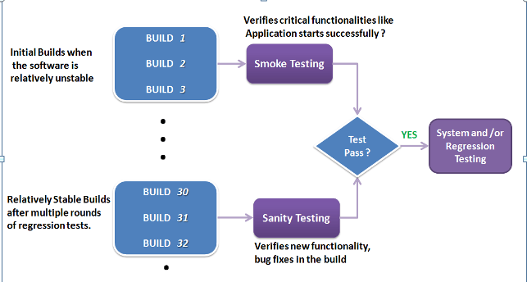
Mobile Test Industry Standards :
Testing Strategies for Mobile Apps
Smoke vs Sanity TEST

Slide 5
Mobile Test Industry Standards :
Testing Strategies for Mobile Apps
Comparison SUMMARY
Smoke Testing | Sanity Testing
Smoke Testing is performed to ascertain that the critical functionalities of the program is working fine | Sanity Testing is done to check the new functionality / bugs have been fixed
The objective of this testing is to verify the "stability" of the system in order to proceed with more rigorous testing | The objective of the testing is to verify the "rationality" of the system in order to proceed with more rigorous testing
This testing is performed by the developers or testers | Sanity testing is usually performed by testers
Smoke testing is usually documented and is scripted | Sanity testing is usually undocumented and unscripted
Smoke testing is a subset of Acceptance testing | Sanity testing is a subset of Regression testing
Smoke testing exercises the entire system from end to end | Sanity testing exercises only the particular component of the entire system
Smoke testing is like General Health Check Up | Sanity Testing is like specialized health check up

Slide 6
Mobile Test Industry Standards :
Testing Strategies for Mobile Apps
Smoke and Sanity TEST Checklist –UI
1. APP/Webpage title as per the page’s functionality.
2. Spelling/
grammatical mistake (e.g. Text, Caption, Label).
3. Proper field alignment (Left margin, right margin, bottom margin, top margin).
4. Same font size/style or as per the requirement.
6. Standard format and size of button.
7. Textbox: Border, alignment, size, length, Data Type.
8. Combo box: Size, alignment, showing valid value.
9. Date picker (Not by keyboard, from date to date range).
10. Mandatory field identified with an identification like (*) sign.
11. Image length, size, alignment
5. Proper space between texts, text lines, fields.

Slide 7
Mobile Test Industry Standards :
Testing Strategies for Mobile Apps
Smoke and Sanity TEST Checklist –Functional
1. Mandatory and composite field validation.
2. Error message not mandatory for optional field.
3. Numeric field does not accept the alpha numeric and proper error message display.
4. Max length checking for specific input field (e.g. Credit card number, Account number).
5. Confirmation message for Insert/update/
delete operations.
6. Correct format of amount value.(Should be numeric)
7. Uploaded documents are opened and generated properly.
8. Validation (Equivalence partitioning/Boundary value analysis/Positive testing/Negative/Page Refreshing ).
9. System works properly with multiple browsers.
10. Pagination works and number shows properly.

Slide 8
Mobile Test Industry Standards :
Testing Strategies for Mobile Apps
Smoke and Sanity TEST Checklist –Database
1. Database name, Tables, columns name, column types matches according to requirement.
2. Data saves properly into the database after the each page submission.
3. Data display on the front end and make sure it is same in the back end.
4. Is any difference between Live and Test environment (Database Name, Table Name, Column Name, Data Type, Entity Relationship Key – Primary, Foreign, Unique key)
5. Checking Procedure/Function Create/Update related information(Entity Name, Author, Create/Update Date, Description/Purpose)

Slide 9
Mobile Test Industry Standards :
Testing Strategies for Mobile Apps
Smoke and Sanity TEST Checklist –Security
1. Session timeout checking. Whether the page is expiring after the specific time.
2. Does the page browse if I paste it in a newly open browser?
3. Browser back-forward button checking if the page consist any calculation or information submission.
5. Does this application has admin/user log in the database?
7. Access the secured App/web page directly without login
8. User account gets locked out if the user is entering the wrong password several times.
6. Password, Account number, credit card number display in encrypted format.
4. Does the browser’s back-forward button re-submit the page?

Slide 10

Mobile Test Industry Standards :
Testing Strategies for Mobile Apps : GAMES
Mobile game testing differs from the regular mobile app testing.
Effective mobile game testing derives from a well-structured and systematic approach, use of test automation framework and seamless integration with your agile process.

Slide 11
Mobile Test Industry Standards :
Testing Strategies for Mobile Apps : GAMES
Black-Box Testing Approach focuses on :
Menus
Graphical Elements
Special Effects
Animations
Actual Gameplay
Functional and overall Playability aspects of the game
GUI
User Experience
Any Visual Appearance

Slide 12
Mobile Test Industry Standards :
Testing Strategies for Mobile Apps : GAMES
White Box Testing Approach focuses on :
Components
Databases
Social Media
/External Entities
Graphics/
Game Engines
Audio Play
Architecture
Integration
Systemic Aspects of mobile game

Slide 13
Mobile Test Industry Standards :
Testing Strategies for Mobile Apps : GAMES
Test Type | Purpose
Functional | reveal issues related to user interface (and graphics), stability, game flow/mechanism, and integration of graphics assets.
Compatibility | reveal incompatibility issues with any parts of the game, its third-party components or integrations with those actual devices that end-users use.
Performance | important to understand how used device ecosystem varies and what are actual requirements of the game for its users.
Localization | your game titles, texts and content needs to be translated and tested with devices in multiple languages.
Regression | needs to happen when anything changes in software : server-client interaction, requiring a login, uploading of data (e.g. results) and downloading of data (e.g. data, images).
Load | tests the limits of a system, such as the number of players on a server, the graphic content on the screen (e.g. frames per second, FPS), or memory consumption (allocation and deallocation of it).

Slide 14
Mobile Test Industry Standards :
Testing Strategies for Mobile Apps : GAMES
KEY AREAS IN MOBILE GAME TESTING
User Interface and Functionality
Graphics Performance
Usability and User Experience
Multi-player/User Features
Social Integrations
Security and Liabilities

Slide 15


Mobile Test Industry Standards :
Testing Strategies for Mobile Apps : Banking
Banking applications are considered to be one of the most complex applications in development and testing industry.
What makes Banking application so complex?
What approach should be followed in order to test the complex workflows involved?

