Slide 1

Becoming a Pro (II)
IN Mobile Applications Testing

Slide 2
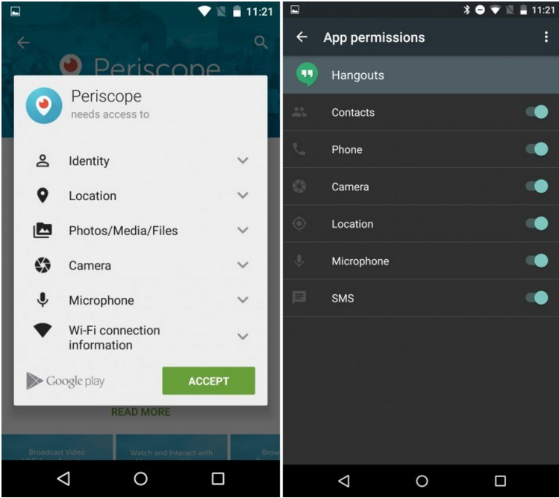
ANDROID
Permissions
5.1
6.0

Slide 3
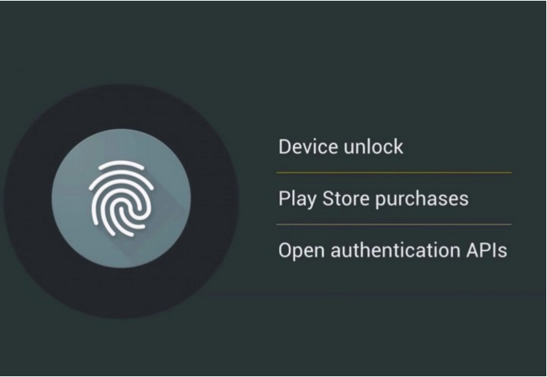
ANDROID
Fingerprint Support (N/A for 5.1)
6.0

Slide 4
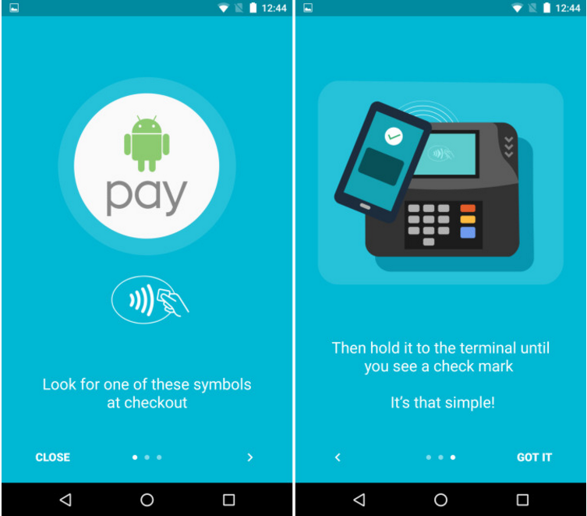
ANDROID
Android Pay ( N/A for 5.1)
6.0

Slide 5
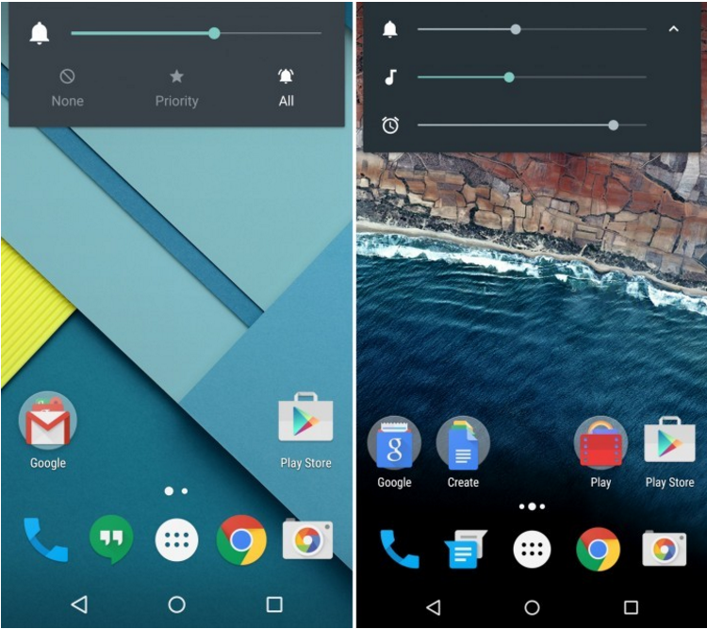
ANDROID
Volume Controls
5.1
6.0

Slide 6
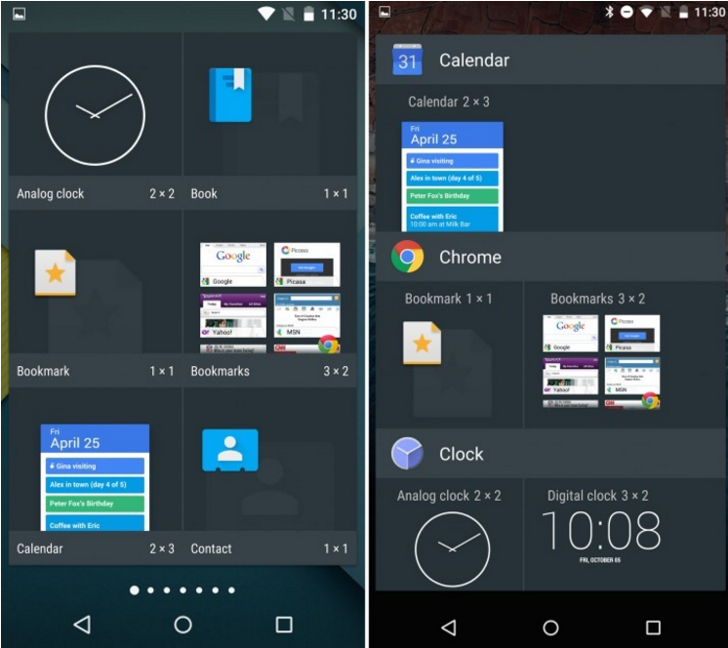
ANDROID
Widget Menu
5.1
6.0

Slide 7
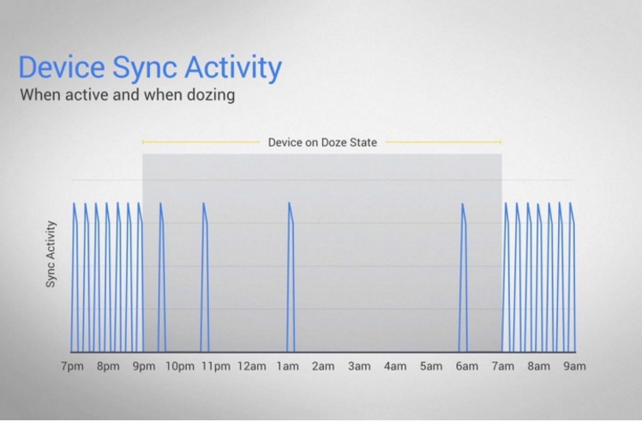
ANDROID
Doze Battery Life ( N/A for 5.1)
6.0

Slide 8
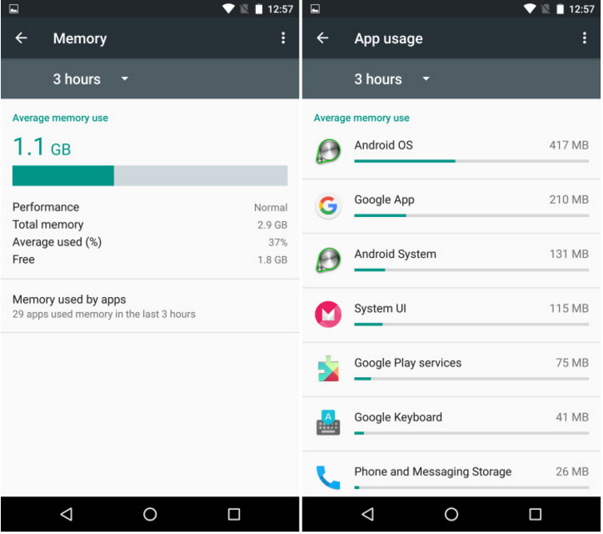
ANDROID
Memory Usage (N/A for 5.1)
6.0

Slide 9
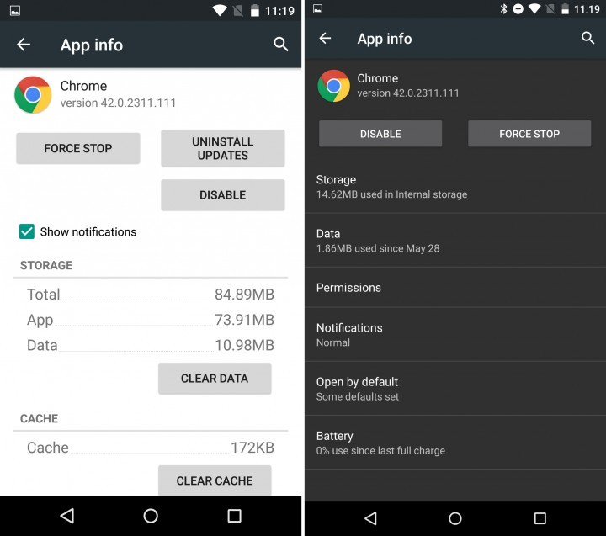
ANDROID
APP INFO
5.1
6.0

Slide 10
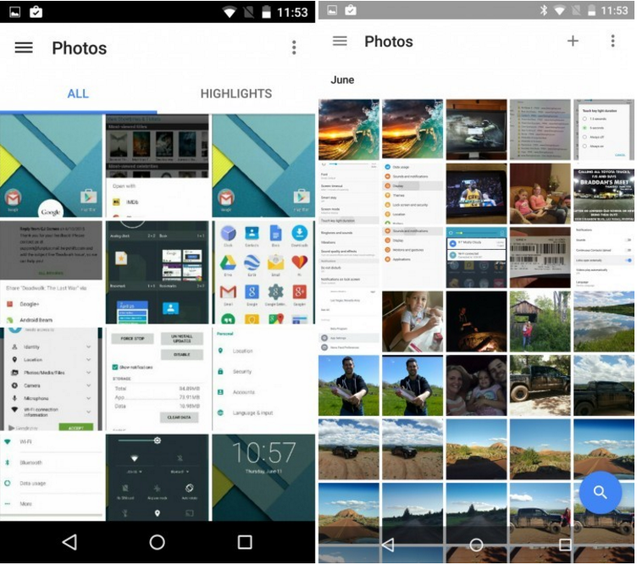
ANDROID
Google Photos
5.1
6.0

Slide 11
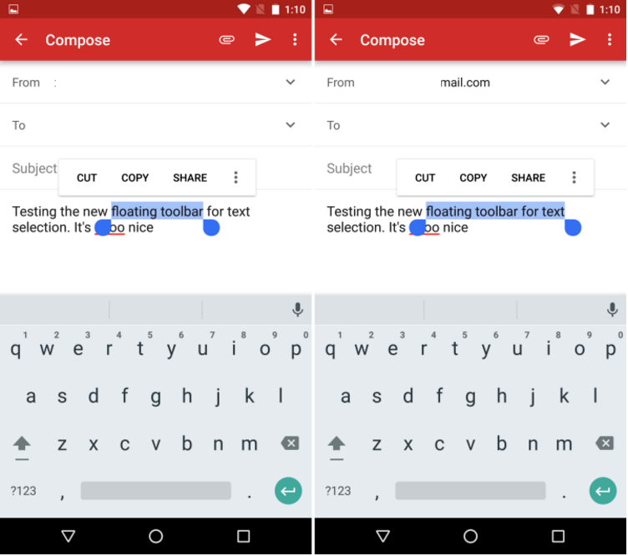
ANDROID
Text Selection and More ( Greatly improved on 6.0)
6.0

Slide 12
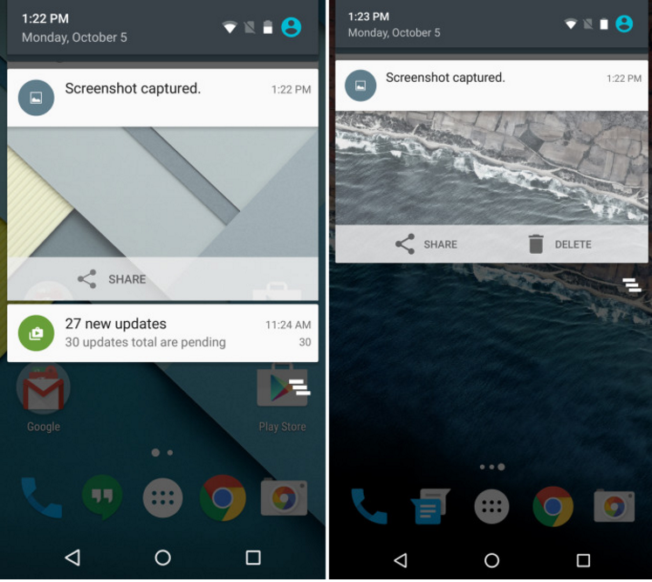
ANDROID
Delete Screenshot
5.1
6.0

Slide 13
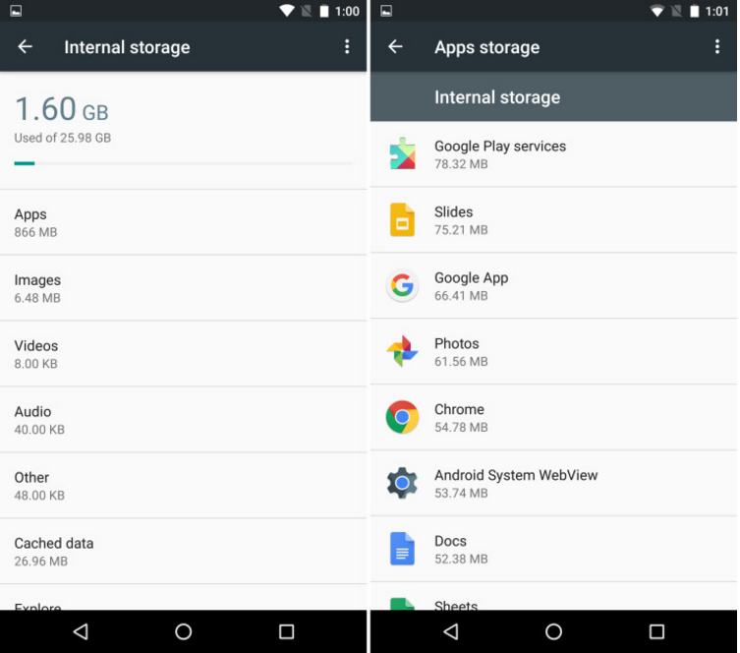
ANDROID
Internal Storage (shown for 6.0 only)
6.0

Slide 14
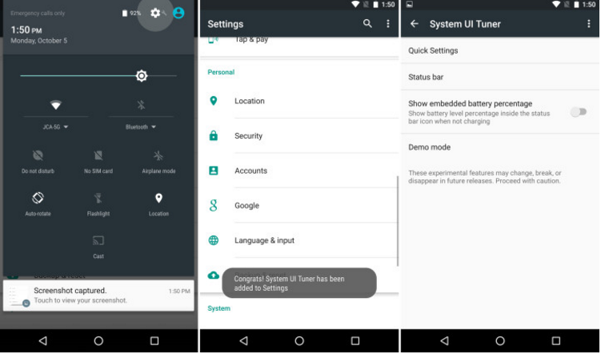
ANDROID
System UI Tuner (shown for 6.0 only)
6.0

Slide 15

ANDROID
What’s New in Android 7.0 and 7.1 Nougat vs 6.X?

Slide 16
ANDROID
Android 7.0 (7.1) Nougat available
Android 7.0 (7.1) Nougat unavailable
Nexus
Nexus 6
Nexus 6P
Nexus 9
Nexus Player
Pixel C tablet
Pixel Phones
Nexus 5
Nexus 7 (2013)
Nexus 10
Nexus 5 won’t officially get the update to Android 7.0 at all

Slide 17

ANDROID
Multi-window Support
6.0.1
7.X

Slide 18
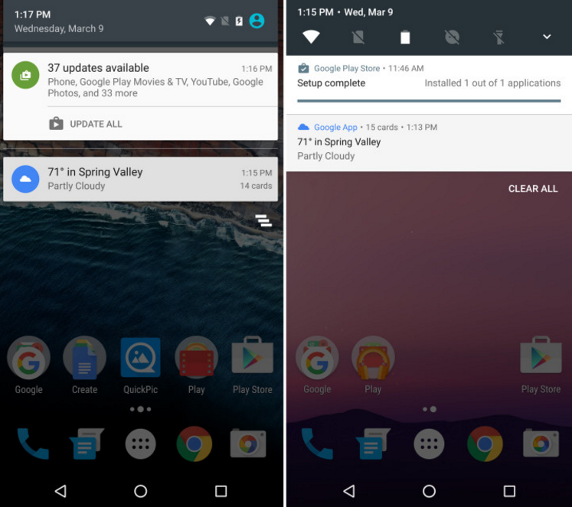
ANDROID
Notification Bar Toggles
6.0.1
7.X

Slide 19
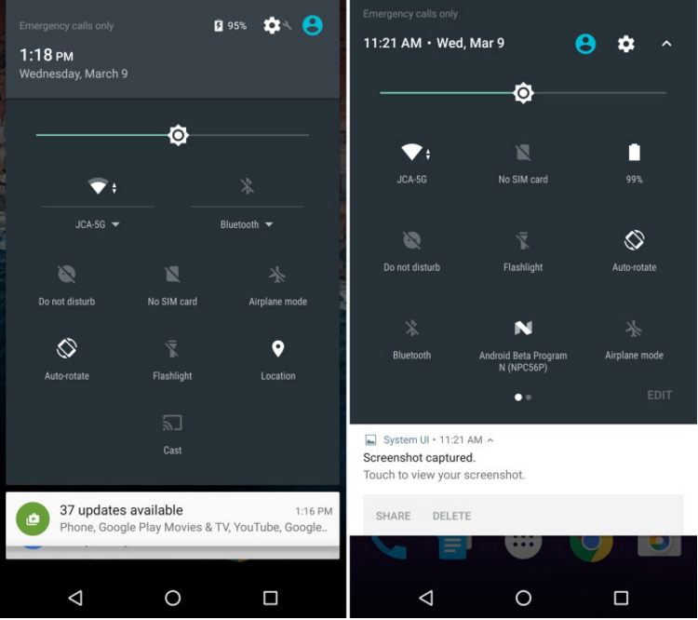
ANDROID
Quick Settings
6.0.1
7.X

Slide 20
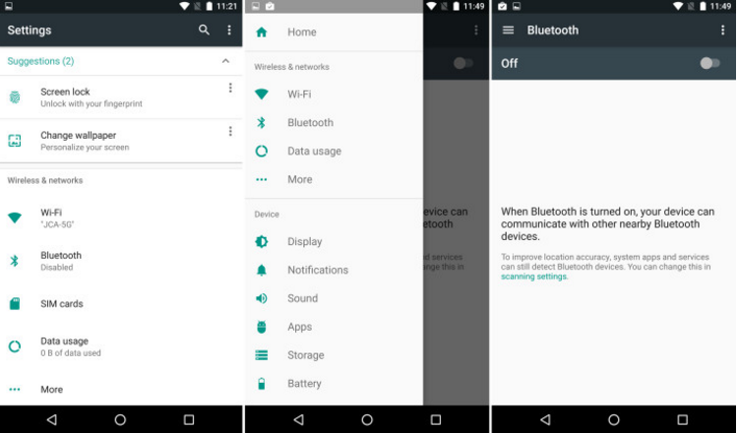
ANDROID
Android N Settings Menu
7.X

Slide 21
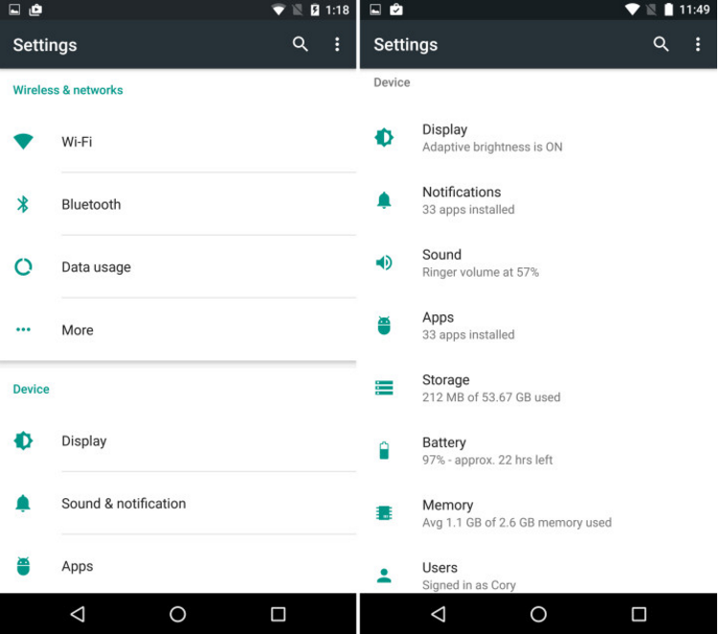
ANDROID
Smarter Settings Menu
6.0.1
7.1

Slide 22
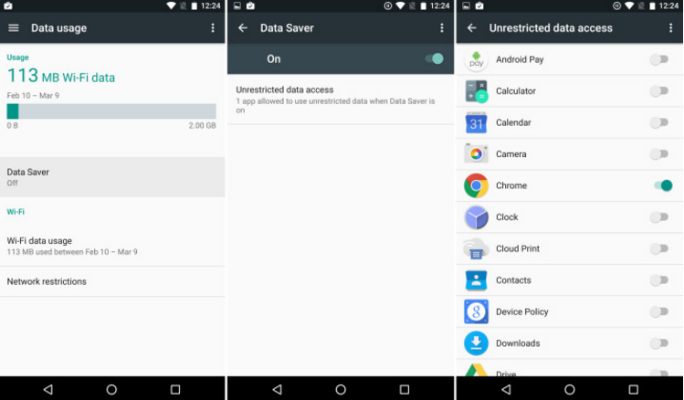
ANDROID
Android N Data Saver
7.X

Slide 23
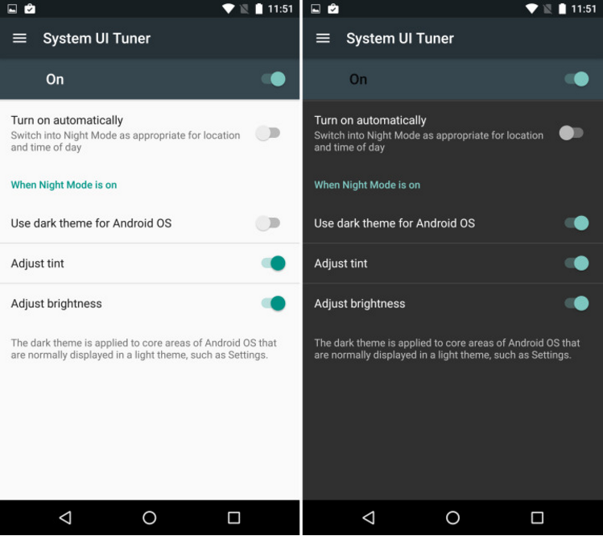
ANDROID
Night Mode
6.0.1
7.X

Slide 24
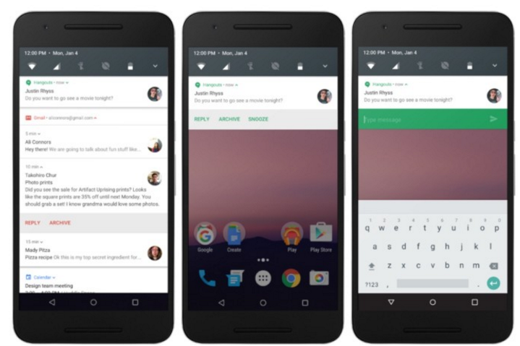
ANDROID
Improved & Bundled Notifications
6.0.1
7.X

Slide 25
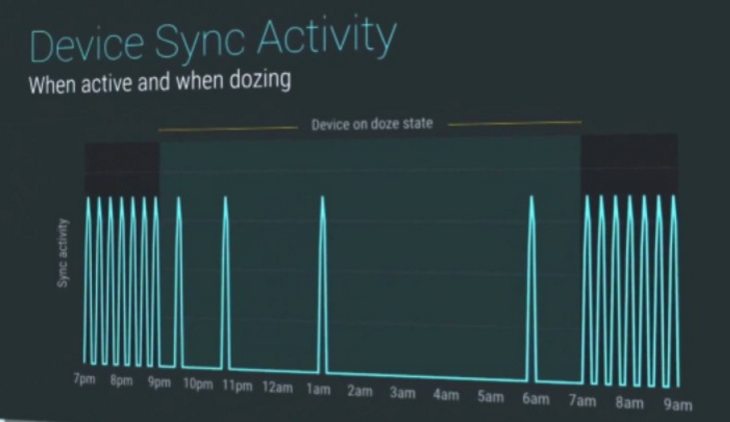
ANDROID
Doze on the Go (Better Battery Life
(up to 30% over 6.X)
6.0.1
7.X

Slide 26
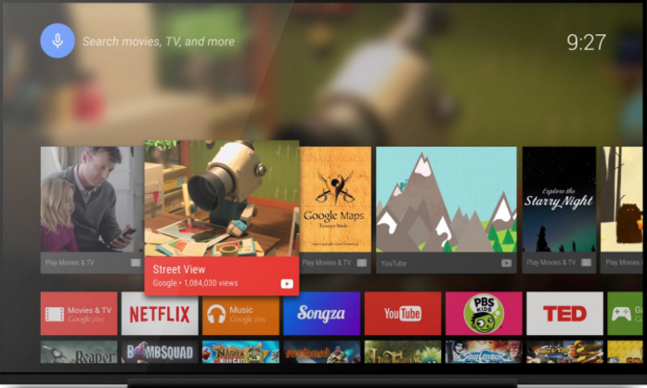
ANDROID
Android TV Recording
7.X

Slide 27

ANDROID
FreeForm Open Window Mode
7.X

Slide 28
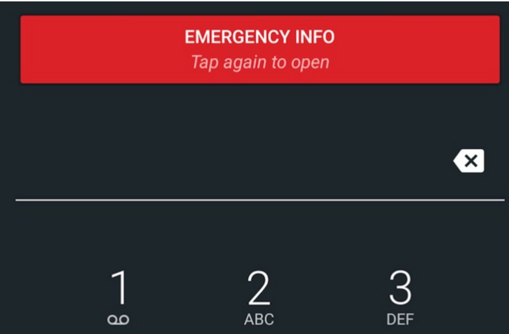
ANDROID
Emergency Info
7.X

Slide 29
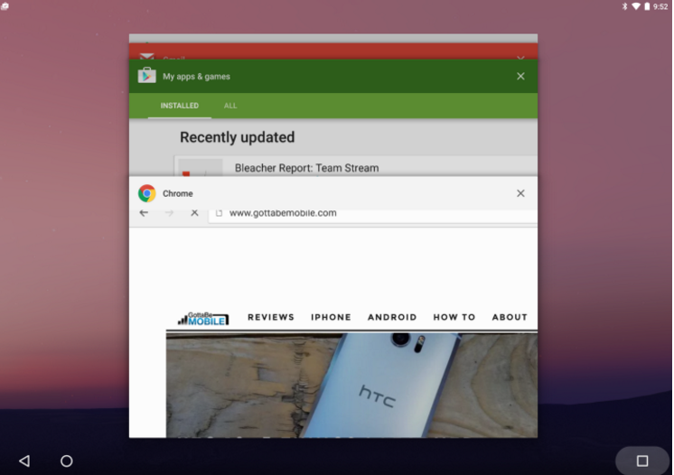
ANDROID
Fast App Switching
7.X

Slide 30

ANDROID
New Folder Icon
7.X

Slide 31
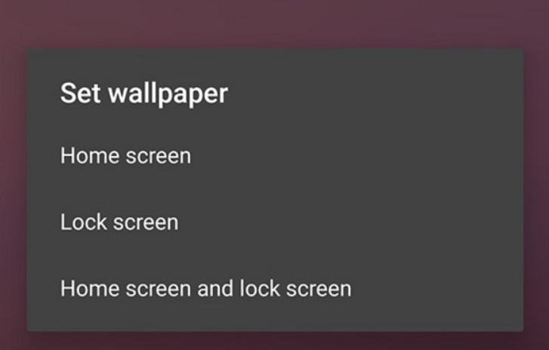
ANDROID
Different Wallpaper for Lock screen & Home screen
7.X

Slide 32
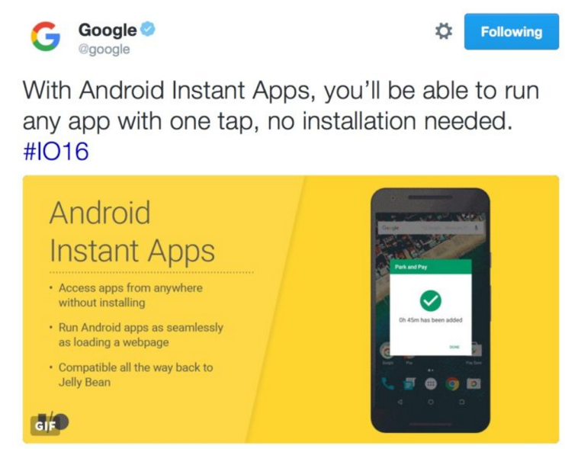
ANDROID
Android Instant Apps
7.X

Slide 33
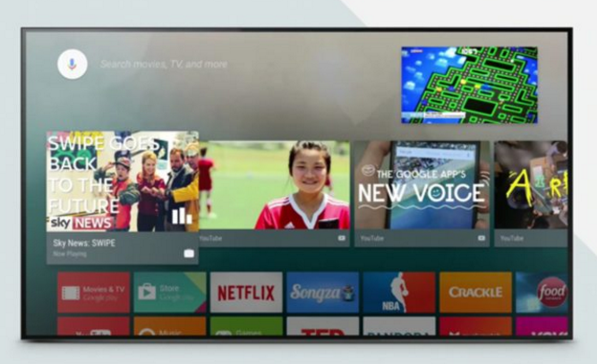
ANDROID
Picture-In-Picture
7.X

Slide 34

ANDROID
Better Emoji Support
7.X

Slide 35
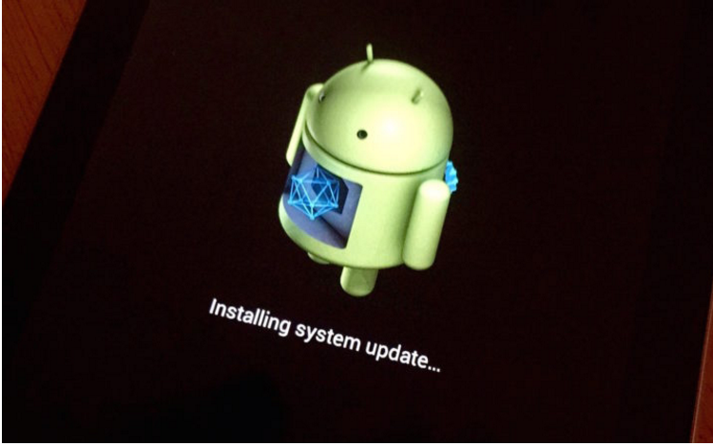
ANDROID
Seamless Updates
6.0.1
7.X

Slide 36
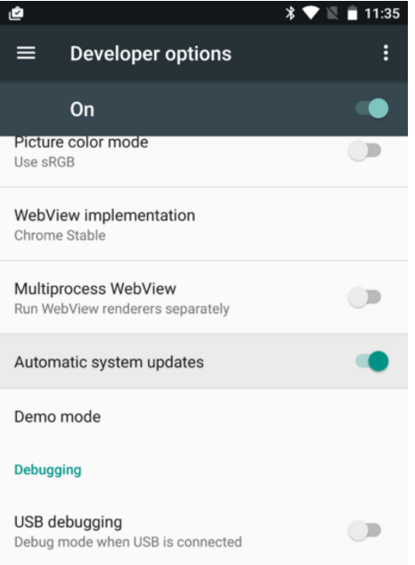
ANDROID
Automatic System Updates
7.X

Slide 37
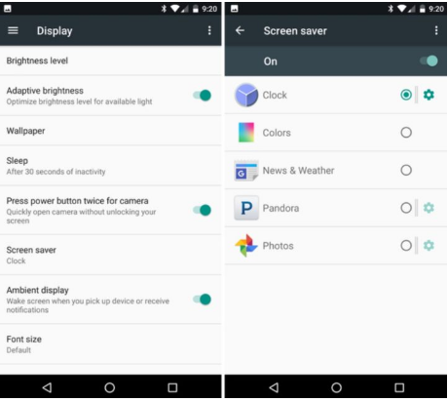
ANDROID
Screen Saver (Always-On Display)
7.X

Slide 38
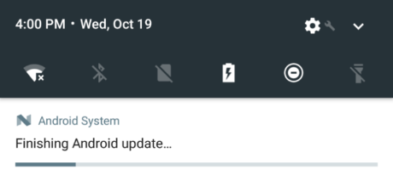
ANDROID
Android Is Upgrading
6.0.1
7.X

Slide 39
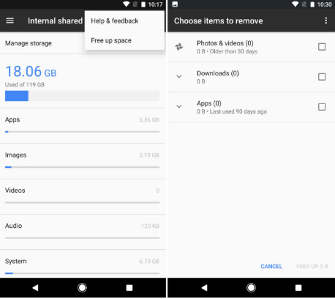
ANDROID
Smart Storage
6.0.1
7.X

Slide 40
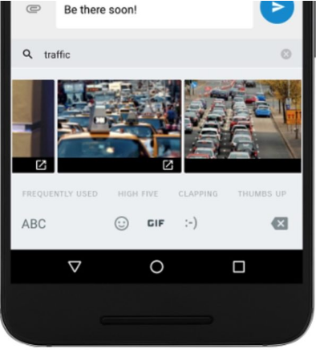
ANDROID
GIF Keyboard Support
6.0.1
7.X

Slide 41
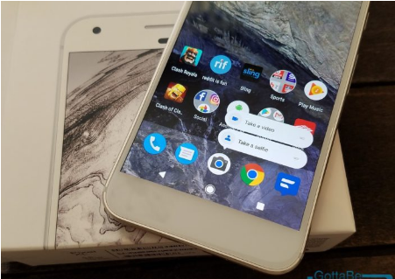
ANDROID
App Shortcuts
6.0.1
7.X

Slide 42
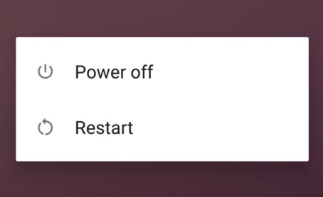
ANDROID
Restart or Reboot Button
7.X

Slide 43
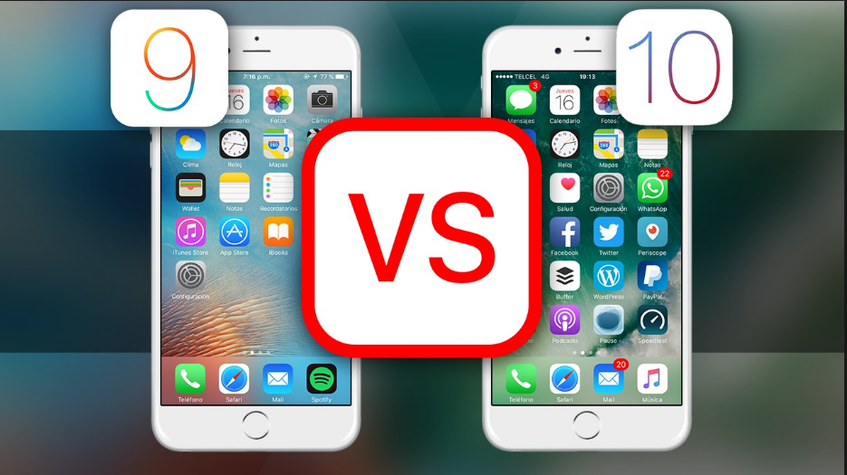
iOS

Slide 44
iOS
HOMEWORK
100+ New Features
in iOS 10 for iPhone & iPad
https://www.youtube.com/watch?v=_qyH4JXpA9k&feature=youtu.be

Slide 45
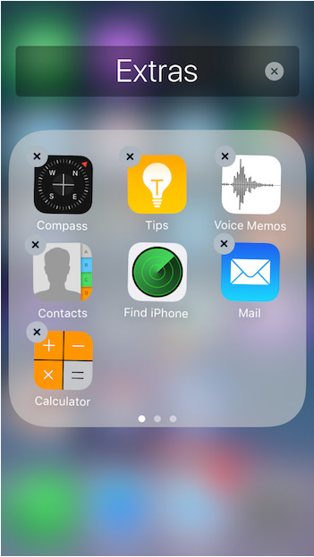
iOS
Stock Apps Begone !
10.X

Slide 46
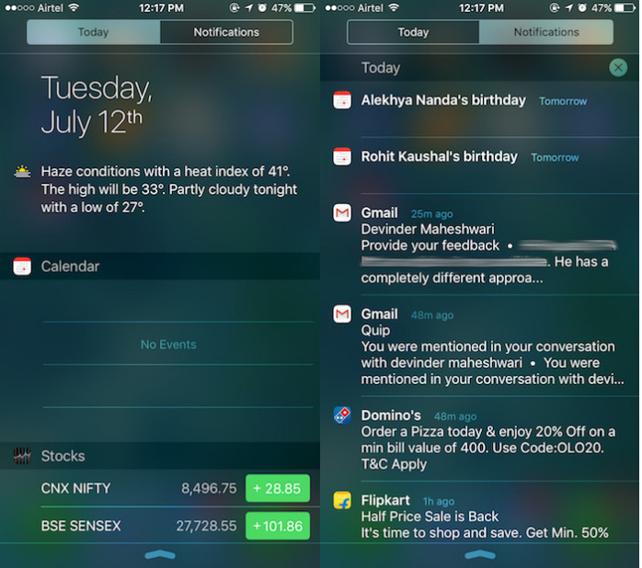
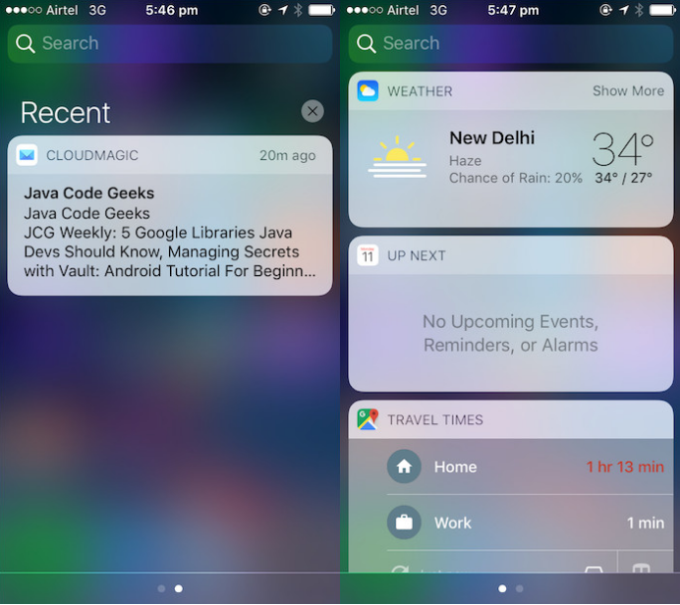
iOS
Notification Center
9.X
10.X

Slide 47
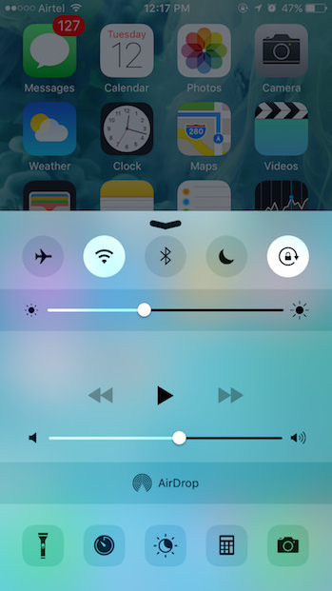
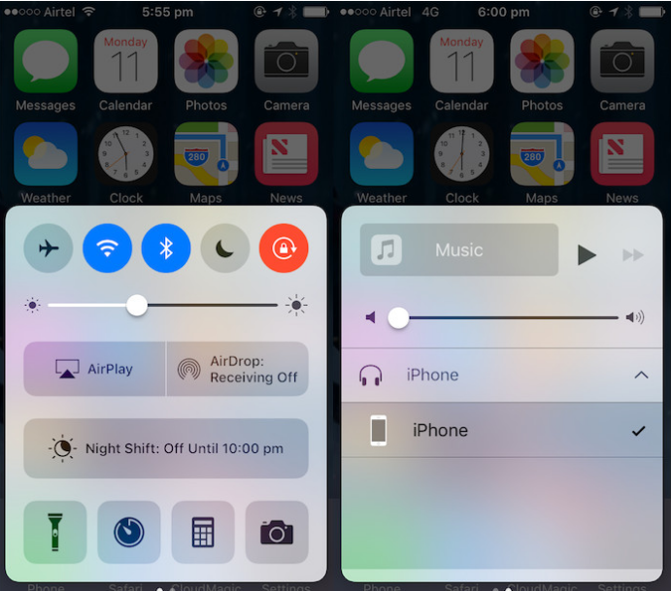
iOS
Control Center
9.X
10.X

Slide 48
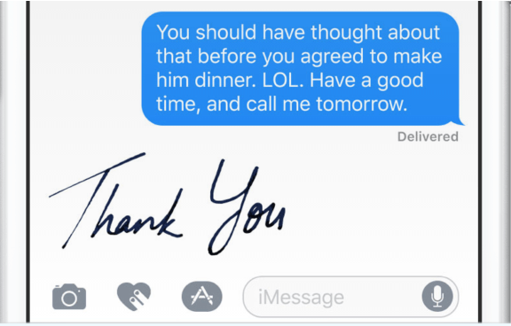

iOS
iMessage new features
10.X

Slide 49
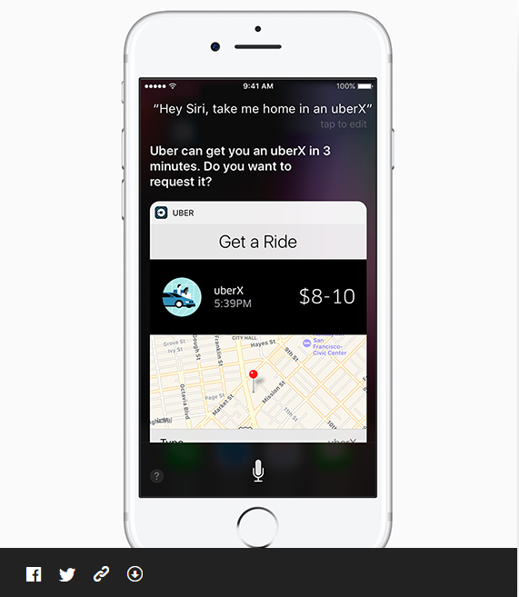
iOS
Siri
Contextual predictions in QuickType
Suggested Apps in the Keyboard
Suggested Locations
Suggested content between apps
Intelligent Scheduling
Calendar availability
Multilingual language
10.X

Slide 50
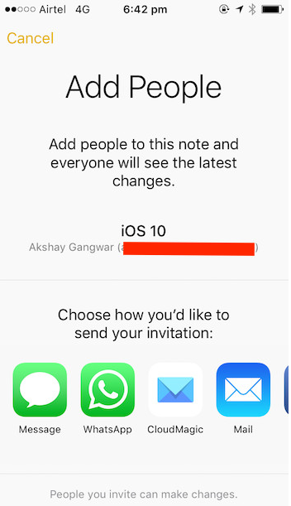
iOS
Collaboration in Notes
10.X

Slide 51
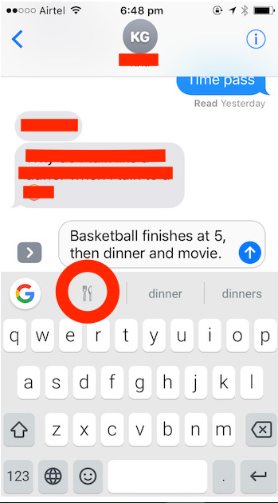
iOS
Emoji Suggestions in Keyboards
10.X

Slide 52
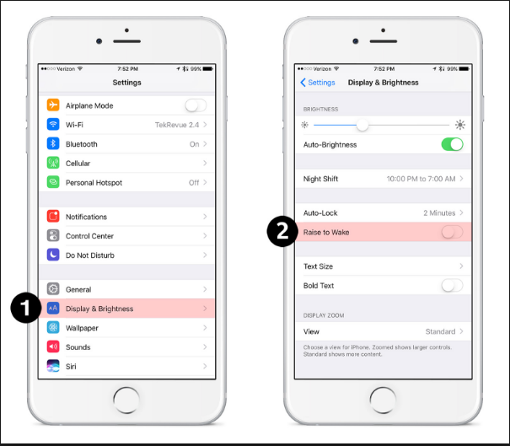
iOS
Raise to Wake
10.X

Slide 53
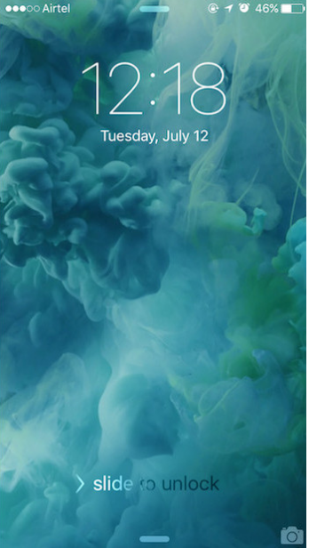

iOS
Lock-screen Changes
9.X
10.X

Slide 54
Overview: Mobile APPS
Types
Categories
Troubleshooting Guide
Simulators
Emulators
Remote Device Access (RDA)
Mobile Test Industry Standards
Distribution/Installation/Logs
App Risk Analysis

Slide 55

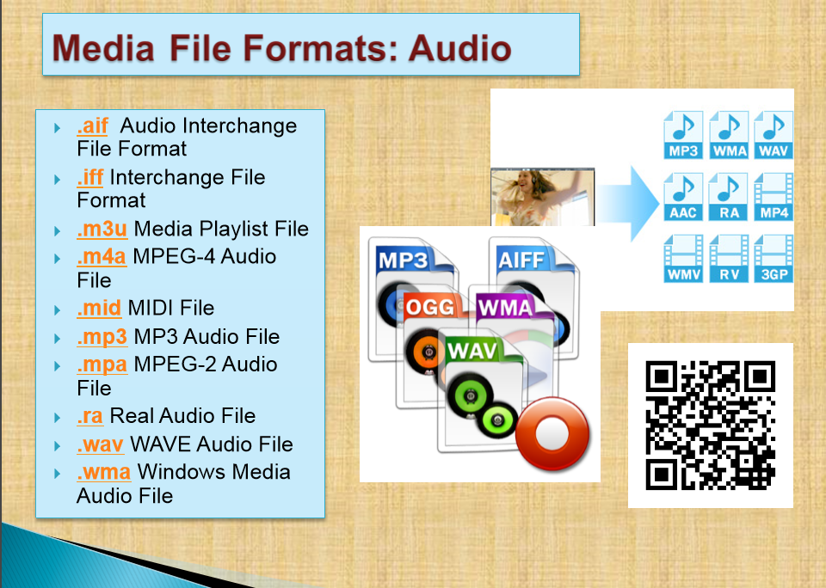
Troubleshooting Guide

Slide 56

Troubleshooting Guide

Slide 57
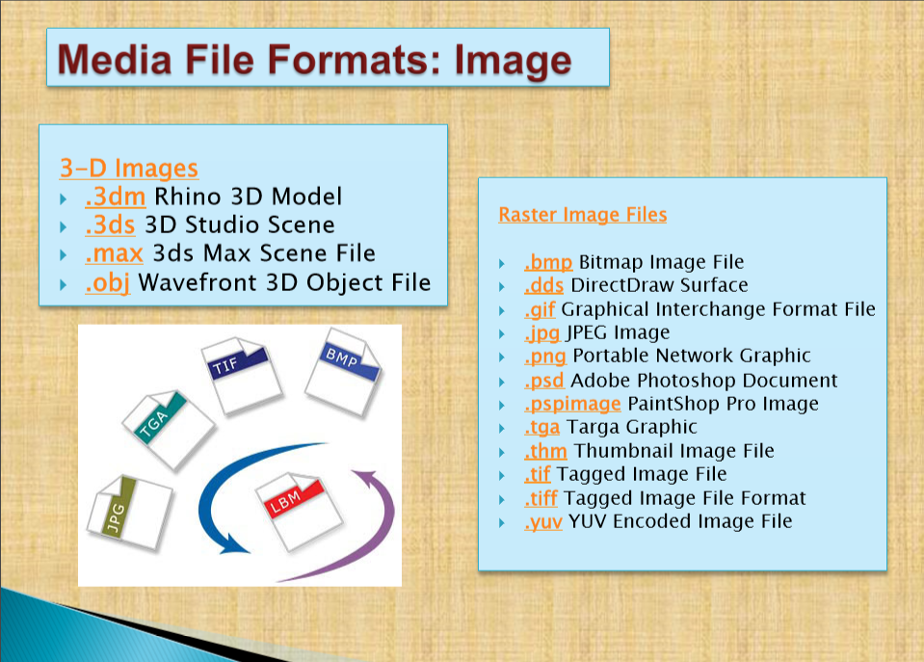
Troubleshooting Guide

Slide 58

Troubleshooting Guide

Slide 59
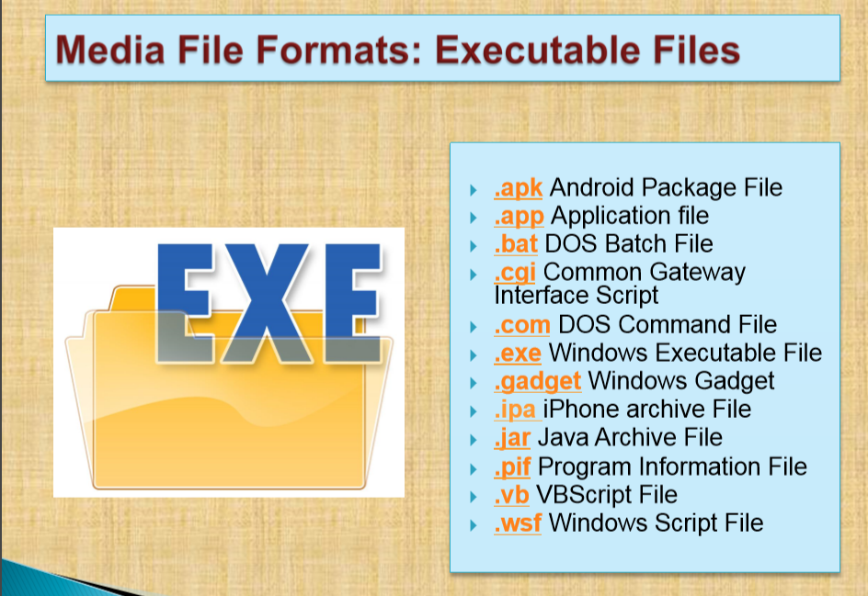
Troubleshooting Guide

Slide 60

Troubleshooting Guide

Slide 61

Troubleshooting Guide
Clear App Cache And App Data : ANDROID
Among the changes that happened between Android 5.0 and 6.0 is the placement of the buttons for clearing the app caches and data.
Step 1: Head to the Settings menu. This can be done by tapping the cog icon in your notification shade.
Step 2: Find Apps (or Applications, depending on your device) in the menu, then locate the app that you want to clear the cache or data for.
Step 3: Tap on Storage and the buttons for clearing the cache and app data will become available (See Right→).

Slide 62

Troubleshooting Guide
Clear App Cache And App Data : iOS
Delete Safari Cache :
Press Settings > Safari
Scroll down and tap Clear History
and Website Data.
3. Tap Clear History and Data.
How to clean out your iPhone's memory:
Remove file data
Tap Settings > General > Storage & iCloud Usage
Tap Manage Storage.

Slide 63

Troubleshooting Guide
Clear App Cache And App Data : WinPhone
Internet Explorer (Windows Phone) - Clearing Cache and Cookies
Tap the Internet Explorer live tile on the home screen.
2. Tap on the ellipses (...) at the bottom right.
3. Scroll down and tap settings.
4. Scroll down and tap delete history.
5. Tap delete to confirm.
Wait a few seconds for the cache and cookies to clear.

Slide 64

Troubleshooting Guide
Clear App Cache And App Data : WinPhone
On the Home screen of the BlackBerry smartphone TAP BROWSER.
2. Tap Menu key
3. Tap Options.
4. Scroll to the very bottom of the options list where there will be a section called Clear Browsing Data.
5. Select the desired options and choose Clear
For more options http://support.blackberry.com/kb/articleDetail?articleNumber=000003865

Slide 65

Troubleshooting Guide
COMMON ANDROID PROBLEM TROUBLESHOOTING
Common Android USB Connection Problems
One of the most often reasons for the Android USB connection problem is the faulty USB cable.
They wear down very quickly, so make sure have a new and working one.
the computer doesn't recognize your plugged Android device (your Android USB connection now showing up)
the computer does recognize it but you still can't access its memory (your Android USB connection not working properly)
either the phone or the computer hangs up after plugging in your device
you plug your Android device in but "nothing happens" (your Android USB is connected but now showing up or your PC is not detecting phone)
you plug your Android device in but Windows fails to install necessary drives so you can't access phone storage
the automatic installation of PC suite provided by your device's manufacturer fails

Slide 66

Troubleshooting Guide
COMMON ANDROID PROBLEM TROUBLESHOOTING
Common Android USB Connection Problems Possible Solutions
Restart your phone and your computer
Update your phone
Update your computer
Use debug mode
Kill processes using task manager and try again ( Android App Killer )
Clean up your USB devices using USBDeview

Slide 67

Troubleshooting Guide
COMMON ANDROID PROBLEM TROUBLESHOOTING
Android Heating Problem
Problems with the USB cable, charger or battery (Android battery overheating)
You are using your phone too heavily (Android CPU heating)
External conditions may impact your Android phone overheating too.
There may be in fact a lot of possible reasons why your Android phone keeps heating up.
However, some reasons are much more prominent than others.

Slide 68

Troubleshooting Guide
COMMON ANDROID PROBLEM TROUBLESHOOTING
Common Android Heating Problems Possible Solutions
Don't play games or shoot HD movies when your phone is charging.
Use some Android heat control app.
Make sure that only the features you need and use are enabled.
Get rid of all the unnecessary apps from your device.
Use a good protective case.
Make sure your phone isn't exposed to external heat (especially direct sunlight).
Make sure your charger and USB cable are OK.
Is it your Android battery heating up or CPU? Make sure to know the answer.
Don't enable a feature unless you are going to actively use it. Each feature, when enabled, consumes some CPU resources and overloads your phone in some way.
If there are just too many such features enabled (in addition to useless apps running in the background), you device may quickly end up overheating.

Slide 69

Troubleshooting Guide
COMMON ANDROID PROBLEM TROUBLESHOOTING
Common Android Wi-Fi Problems
If you don't have the unlimited data plan, you must rely on the Wi-Fi connection almost entirely.
It may become really frustrating if you are experiencing Wi-Fi problems on your Android phone at the moment when you really need to be online.
In most cases the reasons for Android Wi-Fi problems are very trivial and you can solve them within seconds.
In 95% of cases the five (next slide) methods worked.
In the remaining 5% the problem was very specific or software/hardware related

Slide 70

Troubleshooting Guide
COMMON ANDROID PROBLEM TROUBLESHOOTING
Common Android Wi-Fi Problems Possible Solutions
Check Your Wi-Fi Settings and toggle ON/OFF
Check Your Wi-Fi Router & Restart It
Remove (Forget) The Wi-Fi Network & Add It Again
Activate Smart Network Switch
Use A Wi-Fi App (WiFi Analyzer)

Slide 71

Troubleshooting Guide
COMMON ANDROID PROBLEM TROUBLESHOOTING
Flashlight Android App Problems
The most often symptoms of problems with flashlight apps include:
One or more flashlight apps installed simply don't turn the flash on. They seem to work perfectly, but no flashlight comes from our Android device.
One or more flashlight apps crash after installing so there is not even a chance to check if they really work.
Generally, a flashlight app works but some of its specific options (e.g. Morse code) don't.
Even though flashlight apps are generally great and very useful, they sometimes create problems

Slide 72

Troubleshooting Guide
COMMON ANDROID PROBLEM TROUBLESHOOTING
Flashlight Android App Problems Possible Solutions
Use an in-built flashlight app
Update your Android or look for an app which supports your Android version
Try a different app
Make sure that LED is checked in your flashlight app settings
Don't use many flashlight Android apps simultaneously
Restart your phone
Download other free Android flashlight apps
High-Powered Flashlight
Flashlight by smallte.ch
Flashlight by App Phobia
Flashlight for Kindle

Slide 73

Troubleshooting Guide
COMMON ANDROID PROBLEM TROUBLESHOOTING
Android Photo Contact Problems
Even though Android phones are the most reliable devices, you may sometimes experience a few problems.
One of the most often ones concern contact photos. We want them to appear but they just won't do it.
We want them to be in high quality, but they will appear downsized and pixelated.
There are three main issues with Android contact photos:
Facebook contact picture sync problem
Poor quality of contact photos after syncing back
Problems with assigning many different contact photos to a greater number of contacts

Slide 74



Troubleshooting Guide
COMMON ANDROID PROBLEM TROUBLESHOOTING
Android Photo Contact Problems Possible Solutions
Make sure you REALLY synced contacts
Use an app designed specifically for syncing contact photos
Manually assign pictures if it's just about a few people
Use an app Contact Photo Sync
Use Contact Photo Finder

Slide 75

Troubleshooting Guide
COMMON ANDROID PROBLEM TROUBLESHOOTING
Memory Problems With Android
Memory problems with Android are quite popular especially among users of a bit older phones (and older versions of Android)
Android phones after a couple of months begin to display tons of different notifications, such as, memory full problem (or memory low) or memory card problem and much more.

Slide 76

Troubleshooting Guide
COMMON ANDROID PROBLEM TROUBLESHOOTING
Memory Problems With Android and Possible Solutions
Back Up Photos To The Cloud (Settings > Backup & sync >TURN ON
Turn cellular data backup (Google Photos>swipe right >Click on Free up space
Save Photos To Memory Card (Storage > set to SD card.
Transfer Apps To SD Card
Backup your phone & restore it

Slide 77




Troubleshooting Guide
COMMON ANDROID PROBLEM TROUBLESHOOTING
Android Apps & Problems Downloading From Google Play
Do you experience problems with downloading Android apps from Google Play?
Does everything seem O.K. but suddenly download of your favorite game or app fails?

Slide 78

Troubleshooting Guide
COMMON ANDROID PROBLEM TROUBLESHOOTING
Android Apps & Problems Downloading From Google Play and
Possible Solutions
Restart Your Android Device
Make Sure Your Data Connection/WiFi Is Turned On And Working
Clear Cache Of Google Play App
Make Sure You Have Data Enough Phone Storage Available
Update Your Phone And Google Play App
Restore Factory Settings If Nothing Helps

Slide 79

Troubleshooting Guide
COMMON ANDROID PROBLEM TROUBLESHOOTING
Android Reboot Problem
Most Often Symptoms Of The Android Phone Reboot Problem:
Device restarts in specific situations
Device restarts when many apps are running simultaneously
Device restarts "on its own" (knows as Android self reboot problem) for no apparent reason
There Are Actually Two Types of Reboot
The phone restarts completely (all apps are loaded again), which takes up to a few minutes. With this kind of restart, you usually hear the welcome ringtone and see your manufacturer's logo.
There is also a softer type of reboot when only Android OS restarts. It usually takes a few seconds and you see a white screen for a few moments

Slide 80

Troubleshooting Guide
COMMON ANDROID PROBLEM TROUBLESHOOTING
Android Reboot Problem and Possible Solutions
Restart Your Android Device
Make Sure Your Data Connection/WiFi Is Turned On And Working
Clear Cache Of Google Play App
Make Sure You Have Data Enough Phone Storage Available
Update Your Phone And Google Play App
Restore Factory Settings If Nothing Helps

Slide 81


Troubleshooting Guide
COMMON iOS PROBLEM TROUBLESHOOTING ( 10 and 10.1)
How to Fix : iOS 10 Software Update Failed Error
Method 1:
Tap on the Close option and try to update again.
Method 2:
Wait for few hours or even several days and then download iOS 10 again.
Method 3:
Try updating via iTunes on computer.
Method 4:
For advanced users: try upgrading with IPSW File.

Slide 82

Troubleshooting Guide
COMMON iOS PROBLEM TROUBLESHOOTING ( 10 and 10.1)
How to Fix : iPhone Stuck on Verifying Update
Method 1 :
Try locking and waking your iDevice using power button and repeat it.
Method 2:
Do a hard reset or hard reboot.
Method 3:
Restore your iDevice with iTunes.
Method 4:
Update to iOS 10 with iTunes on computer.

Slide 83

Troubleshooting Guide
COMMON iOS PROBLEM TROUBLESHOOTING ( 10 and 10.1)
How to Fix : iOS 10 Stuck on Slide to Upgrade Screen
Step 1 :
Update your iTunes to the latest version. Connect your iPhone and run iTunes.
Step 2:
Click the device button.
Step 3:
Select Restore Backup... and choose a recent backup file.
Step 4 :
click Restore.

Slide 84

Troubleshooting Guide
COMMON iOS PROBLEM TROUBLESHOOTING ( 10 and 10.1)
How to Fix : iPhone Stuck in Recovery Mode
Method 1 :
"Force Restart" your device by holding both Power and Home buttons.
Method 2:
Recover your device using iTunes. You can connect your device to iTunes on your computer and recover in Recovery Mode.
Method 3:
Use iOS repairing software to fix this issue.

Slide 85

Troubleshooting Guide
COMMON iOS PROBLEM TROUBLESHOOTING ( 10 and 10.1)
How to Fix : iPhone Stuck on Apple Logo During iOS 10 Update
Method 1:
Force Restart your iPhone or iPad. Usually, this tip can make your device work again.
Method 2:
If Method 1 doesn't work, you may need to recovery your device in Recovery Mode.
Method 3:
There are some professional tools that you can use to repair your device.

Slide 86
Troubleshooting Guide
COMMON iOS PROBLEM TROUBLESHOOTING ( 10 and 10.1)
How to Fix : Failed to Activate iPhone After iOS 10/10.1 Update
Method 1:
Wait and Retry
There are a lot of people waiting for activation after the release of iOS 10.
Method 2:
Continue the Activation via iTunes
Step 1. Download the latest version of iTunes and open it > Plug in your device.
Method 3:
Release the Activation Lock in iCloud
Step 1. Turn off the power of your device.
Step 2. Select your device > Then you will see the activate screen on iTunes.
Step 3. Enter your Apple ID and password > Click on Continue
Step 2. Go to iCloud.com > Sign in with your Apple ID.
Step 3. Click on Find iPhone > Click on All Devices > Choose the device that can't be activated > Remove from Account.
Step 4. Turn on your device and try to activate it again.
You can try again later to activate your iPhone/iPad/iPod.

Slide 87

Troubleshooting Guide
COMMON iOS PROBLEM TROUBLESHOOTING ( 10 and 10.1)
How to Fix : iOS 10/10.1 Bluetooth Issues
Method 1:
Check and make sure Bluetooth is turn on.
Method 2:
Confirm your iDevice and Bluetooth accessory are close to each other.
Method 3:
Turn off Bluetooth and restart your iPhone, iPad.
Method 4.:
Pair the iDevice or car you connect again: Settings > Bluetooth > Choose the device you are having issues with > Tap on the info button next to the device > Tap on Forget This Device.

Slide 88

Troubleshooting Guide
COMMON iOS PROBLEM TROUBLESHOOTING ( 10 and 10.1)
How to Fix : Message/iMessage Not Working
Method 1 :
Make sure you have connected to Wi-Fi or 3G/4G network.
Method 2:
Turn iMessage off and then turn it on again.
Method 3:
Make sure Date & Time are correct.
Method 4:
Turn on Airplane mode and turn it off.

Slide 89
Troubleshooting Guide
COMMON iOS PROBLEM TROUBLESHOOTING ( 10 and 10.1)
How to Fix : Wi-Fi Issues on iPhone iPad
1. Potential Solutions to iPhone/iPad not connecting to Wi-Fi After iOS Update
1. Check Wi-Fi router.
2. Ensure your iPhone/iPad's Wi-Fi button is on, and you can see your network.
3. Input password when it is necessary.
4. Check all the cables and connections, and make sure your router is connected to the modem and it is turned on.
5. Restart Your iPhone/iPad, Router, Cable/DSL mode.
6. Reset network settings on your iPhone iPad.

Slide 90
Troubleshooting Guide
COMMON iOS PROBLEM TROUBLESHOOTING ( 10 and 10.1)
How to Fix : Wi-Fi Issues on iPhone iPad
1. Check if this problem also happened on your other devices
2. Renew Lease
3. Forget this network
4. Reset network settings
2. Potential Solutions to iPhone iPad Wi-Fi Greyed out/won't turn on After iOS 10 Upgrade

Slide 91
Troubleshooting Guide
COMMON iOS PROBLEM TROUBLESHOOTING ( 10 and 10.1)
How to Fix : Wi-Fi Issues on iPhone iPad
3. Potential fixes to iPhone iPad Keeps Dropping Wi-Fi After iOS 10 Upgrade
1. Upgrade your iPhone iPad to the latest iOS version
2. Reset network settings on iDevice
3. Forcibly reboot iDevice
4. Backup and restore iDevice
5 .Reset your router

Slide 92
Troubleshooting Guide
COMMON iOS PROBLEM TROUBLESHOOTING ( 10 and 10.1)
How to Fix : Wi-Fi Issues on iPhone iPad
4. How to Fix: iPhone iPad Slow on Wi-Fi After iOS 10 Upgrade
1. Find out it is a network problem or iDevice problem.
2. Update iDevice to the current iOS version.
3. Reset network settings.
4. Change iOS Default DNS to Google DNS.
5. Disable Q0S, MMS, WMM on your router.
6. Changing the wireless channel between 1, 6 and 11.
7. Turn off the background Apps.

Slide 93
Troubleshooting Guide
COMMON iOS PROBLEM TROUBLESHOOTING ( 10 and 10.1)
How to Fix : Wi-Fi Issues on iPhone iPad
5. Quick Solutions to iPhone iPad Unable to Join Wi-Fi After iOS 10 Update
1. Find out it is a network problem or iDevice problem.
2. Update iDevice to the current iOS version.
3. Reset network settings.
4. Change iOS Default DNS to Google DNS.
5. Disable Q0S, MMS, WMM on your router.
6. Changing the wireless channel between 1, 6 and 11.
7. Turn off the background Apps.

Slide 94

Troubleshooting Guide
COMMON iOS PROBLEM TROUBLESHOOTING ( 10 and 10.1)
How to Fix : App Issues on iPhone/iPad After iOS 10/10.1 Update
Solution 1: Reboot Your iDevice.
Solution 2: Update the App to the Latest Version.
Solution 3. Delete the App and Reinstall.
There are certain issues with apps on your iPhone or iPad after downloading iOS 10. Several iPhone users have been reported that app keeps crashing and some apps getting crashed at launch

Slide 95

Troubleshooting Guide
COMMON iOS PROBLEM TROUBLESHOOTING ( 10 and 10.1)
How to Fix : App Store Problems
Tip 1. You can check whether your device is connected to a stable network.
Tip 2. If the network goes well, you can restart or force restart your device, and run App Store to see whether it works normally.
Tip 3. Some caches may save the old images and texts on your App Store, and when you view your visited pages, it doesn't refresh and shows you the latest interface or info. So you can clean these cached files to make your App Store work in normal.

Slide 96

Troubleshooting Guide
COMMON iOS PROBLEM TROUBLESHOOTING ( 10 and 10.1)
How to Fix : Safari Issues on iPhone iPad
Actually this common problem is usually caused by bad network.
Try to change another network, or reset your Network Settings.
Cleaning Safari junk could be another tip to fix this Safari problem in iOS 10.
Simple "Restart" works to fix this iOS issue.

Slide 97

Troubleshooting Guide
COMMON iOS PROBLEM TROUBLESHOOTING ( 10 and 10.1)
How to Fix : Battery Issues on iPhone or iPad After iOS 10/10.1 Update
Solution 1:
Reboot your device.
Solution 2:
Erase All Settings. Open Settings app > General > Reset > Reset All Settings to factory default.
Solution 3:
Turn on Airplane Mode if you don’t use Device for a long time.
Solution 4:
Turn off Background App Refresh. When you enable this feature, the app will work in the background and use the battery.
Solution 5:
Enable Location Services When Using the App. Go to Settings app > Privacy > Location Services to set it.

Slide 98

Troubleshooting Guide
COMMON iOS PROBLEM TROUBLESHOOTING ( 10 and 10.1)
How to Fix : Cellular Data Issues
Solution 1:
Turn Cellular Data Off and On. Go to Settings to turn off Cellular data and turn it on again after a few seconds.
Solution 2:
Check Out Carrier Update. Settings app > General > About to have a check.
Solution 3:
Reset Network Settings. Settings > General > Reset > Reset Network Settings.
Solution 4:
Turn Airplane Mode On and Off. Open Control Center > Turn on Airplane Mode > Turn it off after 30 seconds.
Solution 5:
Restart Your iDevice. Press and hold down the wake/sleep button > Drag slide to power off > Open your device.

Slide 99

Troubleshooting Guide
COMMON iOS PROBLEM TROUBLESHOOTING ( 10 and 10.1)
How to Fix : Touch Screen Issues on iOS 10/10.1 Devices
Solution 1:
Restart Your iDevice. Press and hold down the on/off button and drag slide to power off, and then turn on your iPhone/iPad/iPod touch after a few seconds.
Solution 2:
Reset Your iDevice. If you cannot restart your device, then you can reboot your device. Hold down the on/off button and the Home button until the Apple logo appears.
Solution 3:
Clean Your Screen. Have a check on your screen to see if there are some oily or liquid splits and clean the screen with soft cloth. If you have a screen protector, you can remove it to have a try.
Solution 4:
Restore Your iDevice. Restore your device via iTunes. Make sure to download and install the latest version of iTunes.

Slide 100
Troubleshooting Guide
COMMON iOS PROBLEM TROUBLESHOOTING ( 10 and 10.1)
How to Fix : How to Fix Charging Problems on iOS 10/10.1 Devices
1. Use an Apple-matched USB cable, and don't use any cheap low quality cables.
2. Check and make sure your USB cables is not damaged.
3. Try hard resetting your iPhone or iPad.
4. Change a USB cable if you have one.
5. Use an iPad Charger will make it faster to charge your iPhone.

Slide 101

Troubleshooting Guide
COMMON iOS PROBLEM TROUBLESHOOTING ( 10 and 10.1)
How to Fix : Siri Issues on iOS 10/10.1
1. Restart Siri: Settings > General > Siri > Turn off Siri > Turn Siri on again.
2. Reset Network Settings: Go to Settings app > General > Tap on Reset > Tap on Reset Network Settings > Enter your Passcode > Tap on Reset Network Settings to Confirm.
3. Enable Hey Siri: Settings > General > Siri > Tap on Allow Hey Siri.
4. Clean your iPhone/iPad Microphone and make sure it is unobstructed and not damaged.

Slide 102

Troubleshooting Guide
COMMON iOS PROBLEM TROUBLESHOOTING ( 10 and 10.1)
How to Fix : iPhone Ringtone Not Working Problem in iOS 10/10.1
Method 1:
Go to Settings > Sounds to adjust the volume of ringtone.
Method 2:
Make sure you have "mute" button set to ring instead of silent.
Method 3:
Restart your iPhone.
Method 4:
Update to new iOS 10 update.
Method 5:
Contact Apple.

Slide 103

Troubleshooting Guide
COMMON iOS PROBLEM TROUBLESHOOTING ( 10 and 10.1)
How to Fix : iPhone Won't Make or Receive Calls After Update
1. Reset Network Settings.
2. Update your carrier.
3. Verify blocked phone numbers.
4. Try re-inserting the SIM card.
5. Try to restore your phone and set it up as new.

Slide 104
Troubleshooting Guide
COMMON iOS PROBLEM TROUBLESHOOTING ( 10 and 10.1)
How to Fix : Fix iTunes Error 14 When Installing iOS 10/10.1
Solution 1:
Check Your USB Cable. iTunes error 14 may happens when you have a USB connection issue.
Solution 2:
Backup and Try Clean Restore. First backup your device and then perform a clean restore of iOS 9.3.5.
Then have a clean restore of iOS 10. Finally restore your device with the backup you created after installing iOS 10 successfully.
Solution 3:
Update iTunes to the Latest Version. Apple has always released new version of iTunes to work with the new operating system, so go to have a check and update the iTunes to the latest version.

Slide 105
Troubleshooting Guide
COMMON iOS PROBLEM TROUBLESHOOTING ( 10 and 10.1)
How to Fix : iPhone/iPad Software Update Server Could Not Be Contacted
Solution 1:
Check Your Network Connection. Open a browser to see if it can load a webpage. You can also restart your computer to have a try.
Solution 2:
Wait and Retry. There might be too many people waiting for update, just wait for a while.
Solution 3:
Update Your iDevice Over the Air. Go to Settings > General > Software Update to make it.

Slide 106
Overview: Mobile APPS
Types
Categories
Troubleshooting Guide
Simulators
Emulators
Remote Device Access (RDA)
Mobile Test Industry Standards
Distribution/Installation/Logs
App Risk Analysis

Slide 107

APP RISK ANALYSIS
Setting Up a Mobile Test Lab
What mobile devices will you use to test?
What devices are officially supported?
Make a decision based on user statistics
How will you source the devices?
When will you use an emulator or a real device?
What software will be maintained on the mobile devices?
How will the devices be managed and stored?
How can you be effective with the device power consumption? Do the devices really need to be charging all the time?
How will you load apps onto multiple devices?
Is there a need for a booking system for test devices?
How will you label devices with useful information? (OS, screen resolution, pixel density)
Can you use a background image to communicate information to the user of the device? For example, device information or a reminder of guidelines.

Slide 108
APP RISK ANALYSIS
What Makes a Mobile App or Website...ACCESSABLE?
Does audio and voiceover function and make sense?
Can you zoom in and out effectively?
Does the app accommodate all sizes of text?
Does the full list of touch device options work?
How large can on-screen buttons and navigation be?
Is there voice activation or control?
Is color contrast at a sufficient accessible level?
Is it worth considering audible, visible and vibrating alerts?
How does the app look inverted in colors? For example, white on black.
Have you explored the accessibility features of the app and mobile device you are using?
What types of gesture controls are available

Slide 109
APP RISK ANALYSYS
What Makes a Mobile App or Website...Social?
Can you register as a user via the app?
Can you login via the app?
Do you remain logged in when the app is not in use? If not, how does that affect the user experience?
Does the app or website support social authentication methods?
How easy is it to share media content, links, or files as well as comments and notes?
How easy is it to disconnect updates and communications via the app?
Can notifications be switched off or changed?

Slide 110
APP RISK ANALYSYS
What Makes a Mobile App or Website...Secure?
Can the app be decompiled?
How secure is the connection to the cloud server, if used?
Can the data in transit be intercepted and decoded?
Is any data or temporary data that the app uses stored securely on the device?
Is all app data removed when the app is uninstalled?
Is the app obfuscated using ProGuard/DexGuard (Android only)
Does the app authenticate? How?
After an update, is my data still safe?
Should the user automatically log out after a period of time?
Can security be changed from other devices or websites?
What happens if the user gets locked out?

Slide 111
APP RISK ANALYSIS
What about … – The Product – What Are The Basics?
Can I download the app?
Can I download an update?
Can I update the app when there are multiple updates available? What happens if I don’t update?
What happens when the OS is updated?
With what systems should it be compatible? For example, OS, platforms and browsers.
Can I uninstall the app?
Can I re-install the app?
Can I downgrade? Should I be able to downgrade?

Slide 112
APP RISK ANALYSIS
What about … – Functional Testing – What Does it do?
Does the app perform the designed tasks?
Does the app perform non-designed tasks?
Is prevention of actions adequate?
Does the app ask me to turn on services? For example, location specific, Wi-Fi, and social media.
Is the user redirected?
If so, where? From app to Web or visa versa? What do errors look like?
Does the user interface (UI) and design work as intended? Is there room for misunderstanding or error?
Is the UI appropriate for the form factor? For example, phone versus tablet, screen size, resolution, and existence of hardware buttons or keyboard.
Does it comply with any standards, good practice and guidelines?
Is the mobile app consistent with the desktop version, if it exists?

Slide 113
APP RISK ANALYSIS
What about … – Data – Testing What It Processes?
How time applied to the app? For example phone time and server time? What about time zones?
What does it track and update? For example, reward points, friends, purchases, check-ins, social updates and user activity.
Does it sync and update?
What happens when it can’t sync or update because the
Connecting through a paywall and haven’t yet authenticated (Wi-Fi in Starbucks, an airport, or a local pub)
Disconnected because Web filtering rejected the request
Is there consistency between Web and mobile?
What clues can analytics provide?
How are things like user details and data saved?
What about data input and output? What type of data is accepted? For example, locations, preferences, friends, contacts, languages, files, size, media and audio

Slide 114
APP RISK ANALYSIS
What about : Platform – What Does it depend on?
Change the device settings around.
What do you notice?
What permissions does the app need?
What tablet device is being used?
What version of hardware or software?
Review app store submission requirements
Test content.
For example, text size, content adjustment and responsive design.
Test the UI and touchscreen gestures.
For example, swipe, zoom, pinch, multi-touch, shake and orientation.
Test peripherals. For example, keyboards, Mi-fi devices, BT peripherals, iBeacon, and syncing peripherals.
Test Camera, if applicable. For example, taking photos, using stored photos and photo data.
How does the app run when the device is locked?

Slide 115
APP RISK ANALYSIS
Operations – How Is It Used?
Wi-Fi
3G
4G
Intermittent
Airplane mode
NFC
Through a proxy
Testing under no, low and partial connectivity

Slide 116
APP RISK ANALYSIS
How Is Data Saved?
Does the app write to the SD card?
What happens if the SD card is full? What happens if it is removed?
Is data saved online (in the cloud)?
If the data is saved online, can it be retrieved after reinstalling the app, or will it be available on the app on a different device with the same user account?
If the cloud is used, how does lack of connectivity affect the user experience?
Is the data saved securely? (See “Security” section)
What if data is lost? Are there backups?

Slide 117
APP RISK ANALYSIS
Interruptions?
Phone calls
Text messages
App notifications
Battery Warning
Forced updates
Voicemail
Switching between apps
Locking and unlocking the screen
Music playing while using the app
MAM/MDM solution running on the device
Out of memory (general performance interruptions)
Data app interruptions (WhatsApp, Viber, Tango)
Audio interrupts from multiple sources (iPod, Media player, Other audio apps)

Slide 118
APP RISK ANALYSIS
Customer Feedback
What are customers saying about app?
App reviews
App ratings / comments
Comments, forum posts and articles on the (social) web
Complaints and support request

Slide 119


GOOD LUCK!!!

