Slide 1

WELCOME : OVERVIEW
Mobile Applications Testing

Slide 2
INTRODUCTION: Mobile APP vs Desktop and WEB
Ever since the first cell phone hit the commercial market in 1983, the mobile market has rapidly innovated from a handset that weighed over 2 pounds and could only make one phone call at a time, to a modern-day smartphone that weighs barely 5 ounces and can hold enough apps to practically run your entire life
Lets discuss how testing mobile apps differs from desktop and web testing, and points out the complexities and nuances that make mobile testing a unique skill for testers.
We have witnessed transition from desktop to web and are witnessing another transition from web to mobile.
It is important to understand how testing mobile applications is different from testing browser / desktop applications.

Slide 3
Test Approach: Mobile APP vs Desktop and WEB
Desktop application:
A native application that executes on a user's local machine.
Mobile application:
An application built to run natively on a mobile device.
Web applications:
Applications that run 100% within a browser.
No download from

Slide 4
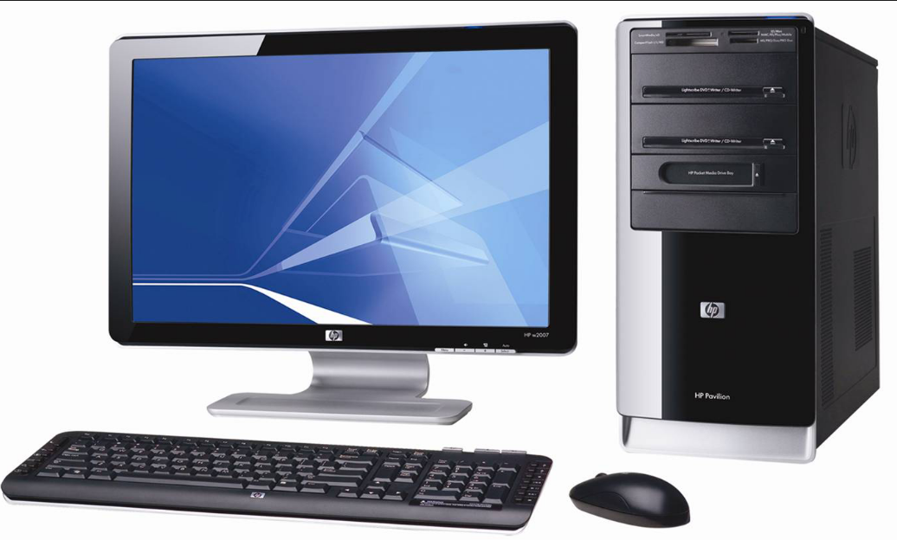
INTRODUCTION: Mobile APP vs Desktop and WEB
Desktop application:
This application may or may not have a network component, although most desktops have some kind of network component these days, even if it's just to update itself online.
If you need to update the application, an update needs to be downloaded locally.

Slide 5

INTRODUCTION: Mobile APP vs Desktop and WEB
Mobile application:
The most common devices these days are either iOS or Android based, but there is a small population of Windows mobile users and a few folks still clinging to their Blackberries.
Mobile applications, similar to desktop apps may or may not have a network component
Just like a desktop app, if you need to make an update to this app, something needs to be downloaded and installed.

Slide 6

INTRODUCTION: Mobile APP vs Desktop and WEB
WEB application:
There a group of apps on both the desktop and on mobile that are just web apps, running within an app-specific browser.
An example of one of these would have been the early versions of the Facebook app -- those were just a bunch of web views running within a browser window.
Sometimes those are hard to identify, but a surefire tell is if your app updates without you needing to do anything from the App Store/Play Store.

Slide 7
INTRODUCTION: SUMMARY
What is a difference between WEB and DESKTOP APP ?
# | WEB | Desktop
1. | Deployment and upgrade for web based application requires deployment on single set of server machines. | Deployment and any upgrade/patching is done on individual client machines separately
2. | Web applications can be accessed from anywhere, so there is no location constraint | As desktop are confined to a standalone machine, so they can be only accessed from the machines they are deployed in
3. | Web applications are platform independent, they can work in different types of platforms with the only requirement of web browser | Desktop applications need to be developed separately for different platform machines
4. | Web applications are at higher security risks as they are inherently designed to increase accessibility | Desktop application on the other hand have better authorization and administrators have better control, hence more secure
5 | Web applications rely heavily on internet connectivity in order to operate | Desktop applications doesn't require internet for their operations. Some applications just require internet connectivity at the time of updates

Slide 8
INTRODUCTION: Testing a SMARTPHONE
Test for reception. Devices which have the same carrier can receive different reception. Perform signal tests at each of the identified major wireless carrier locations.
Call automated systems that specialize in voice recognition.
Call answering machines.
Place calls from indoor and outdoor locations, as well as remote and populated, areas.
Listen to your voice on audio message and voice dialing systems.
Check vibrating alerts, and ringtone volume.
Test the quality of voice dialing, ringtone volume, and the strength of the vibrating alert.
Observe and analyze physical design to assess ease and preference of use, including display quality and size, controls, storage, ports.
Test LTE speed in multiple locations.

Slide 9
INTRODUCTION: Testing a SMARTPHONE (cont)
Test the quality of voice dialing, ringtone volume, and the strength of the vibrating alert.
Assess different microphone and the speakerphone volume levels.
Test the device stereo and mono Bluetooth connections. Try to make calls and play music using Bluetooth technology.
Perform continuous talk-time metrics on the battery life.
Ensure access to a full signal. Then dial in a perpetual loop recording until the phone battery dies.
Measure active battery time against prime battery retention times.
Verify that the phone has Wi-Fi. Check the Wi-Fi speed at distances of up to 150 feet.
Testing must center around both cell phone and smartphone operations, as well as associated carrier connections.

Slide 10
INTRODUCTION: Testing a SMARTPHONE
EXAMPLE : TEST CASES for Device
# | Description
1 | Verify that all the required buttons- numbers 0-9, calling buttons etc are present
2 | Verify that user can make a call by pressing numbers and hitting calling(green) button
3 | Verify that user can make a call by selecting contact person from phone directory
4 | Verify that user can reject an incoming call
5 | Verify that user can receive an SMS
6 | Verify that user can type and send an SMS
7 | Verify that the dimension of the mobile is as per specification
8 | Verify the screen size of the mobile
9 | Verify that the weight of the mobile is as per the specification
10 | Verify the font type and size of the characters printed on the keypad
11 | Verify the color of the mobile phone's outer body and characters printed on keypad
12 | Verify the pressure required to press a key on the keypad

Slide 11
INTRODUCTION: Testing a SMARTPHONE
EXAMPLE : TEST CASES for Device
# | Description
13 | Verify that spacing between the keys on the keypad are adequate
14 | Check the type of mobile- smart phone or feature phone
15 | Check if the mobile is colored or black-white
16 | Check the lighting on the mobile screen is adequate- verify in dark or day light
17 | Check if mobile phone can be locked out without password or pin
18 | Check if mobile phone can be locked out with password or pin
19 | Verify that mobile phone can be unlocked with/without password
20 | Verify that user can receive call when phone is locked
21 | Verify that receiving a call when phone is locked, doesn't unlocked it after call completion
22 | Verify that user can select an incoming call and SMS alert ringtone
23 | Verify that user can make silent or vibrate mode or incoming calls and SMS
24 | Verify the battery requirement of the mobile

Slide 12
INTRODUCTION: Testing a SMARTPHONE
EXAMPLE : TEST CASES for Device
# | Description
25 | Verify the total time taken to charge the mobile completely
26 | Verify the total time for mobile to get completely discharged when left idle
27 | Verify the total talk for mobile to get completely discharged when continuously used in conversation
28 | Verify the length of charger wire
29 | Verify that mobile can be switched off and ON
30 | Verify that user can store contact details on the phone book directory
31 | Verify that user can delete and update contact details in the phonebook directory
32 | Verify that Call logs are maintained in the Call Logs
33 | Verify that received and Sent SMSs are saved in mobile
34 | Verify that user can silent the phone during an incoming call
35 | Verify the auto-reject option can be applied and removed on particular numbers

Slide 13
INTRODUCTION: Testing a TABLET
Analyze the quality, display size, ports, storage, and controls of the physical design.
Check Web search engine browsing speed.
Check the processor performance, including interface fluidity and 2D/3D resolution.
Launch and play games.
Test various MP3 and other file formats at several bit rates.
Test internal and Bluetooth headphones.
Test video operations at various resolutions
Verify Wi-Fi performance on open and WPA2 networks.
Test LTE speed.
Test digital camera capabilities.
Use rundown loop testing to assess the length of battery life.
Test for pressure-sensitive pen quality.
If the tablet provides GPS, display accurate locations which have different environmental conditions.
Create testing procedures that conform to the tablet’s operating system and release level.
Windows 10, for instance, may require different testing metrics and procedures than Windows 8.
iOS iPads can be initially tested by using roughly the same procedures as with Android tablet testing.
In addition, test the performance of new apps, including the amount of time to launch, UI experience, and frame rate. Use automated metrics to confirm performance times, and Wi-Fi reception.
Test Windows tablets similarly to laptops, focusing precisely on the operating system. Verify overall performance, including:
Video editing
Music
Gaming
Communications
Productivity
Battery life
Test from every-day-task, media, and entertainment perspectives. Perform automated 3D tests that simulate movement within complex environments. Testing Adobe Photoshop reveals the length of time it takes the software to manage images.

Slide 14
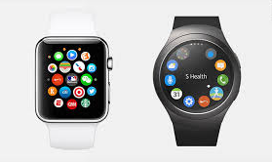
INTRODUCTION: Testing a SMART WATCH
SmartWatches
require similar primary testing procedures as Smartphones and Tablets.
Test also for :
Wearability
Screen quality
Battery life
Smooth performance
Built in GPS efficiency
Efficient charging

Slide 15
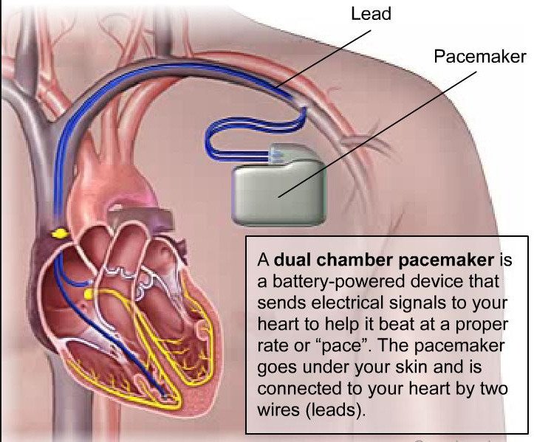
INTRODUCTION: Testing a HEART MAKER
( medical device)
You’ll want to test for:
The spectrum of pulse shapes
ECG wave measurements
Measured energy output
Test automation is crucial in testing pacemakers to assure standardized clinical requirements.
Use a defibrillator tester to analyze a pacemaker. Perform the specified test loads and measurement algorithms required for operational assurance.

Slide 16
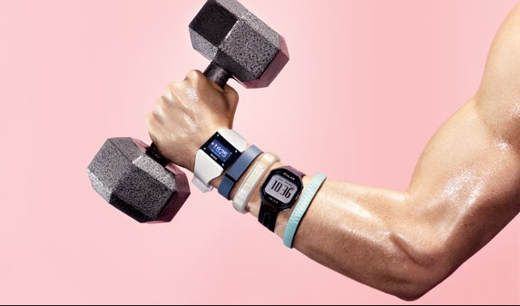
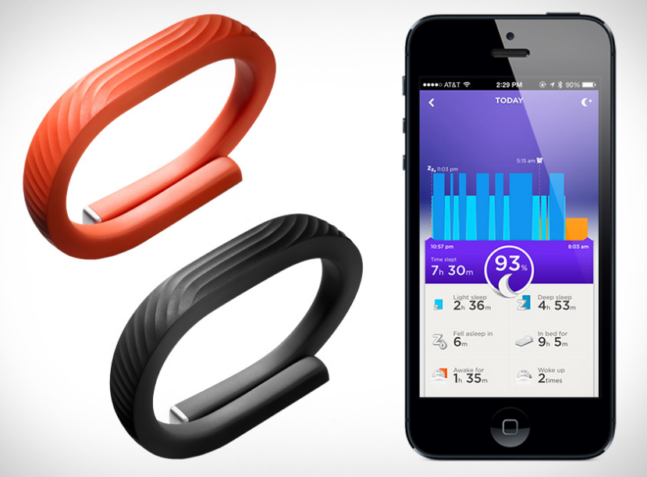
INTRODUCTION: Testing a Fitness Tracker
The primary required attribute is accuracy. Test for in depth fitness analysis that includes the elimination of such deficiencies as:
Overestimated or underestimated performance
Overestimated or underestimated calories
Lack of useful features
Overestimated or underestimated distances
Overall tracking accuracy
Testing is performed using various scenarios that virtually duplicate normal usage.

Slide 17
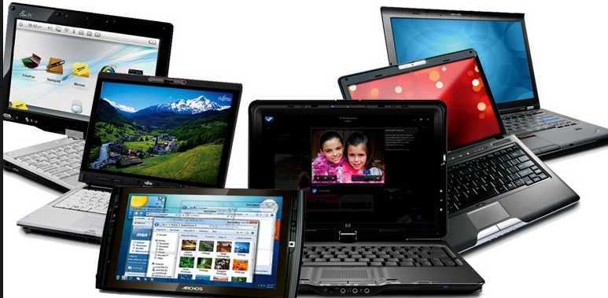
Testing Mobile APP vs WEB :
1. Limited Real Estate : SCREEN SIZE
MOBILE
WEB
Mobile devices are much smaller. Aligning images and text becomes a real challenge in features like portrait and landscape orientation
More variation – even when dealing with the same manufacturer
Responsive design is relatively easy to code for desktop and laptop browsers – most of which come with predefined ratios

Slide 18
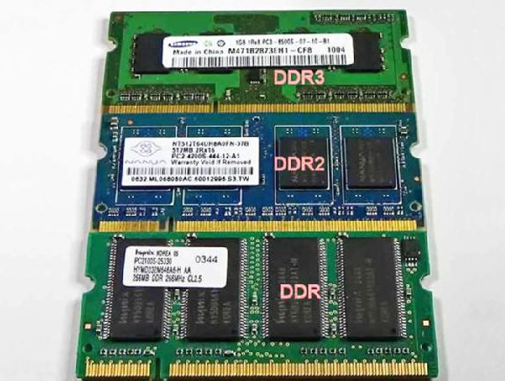
Testing Mobile APP vs WEB :
2. STORAGE and RAM
MOBILE
WEB
Even high capacity phones can quickly fill up as users download apps and multimedia.
Limited storage and processing power of today’s mobile devices.
Desktop storage is essentially unlimited (measured in terabytes).
Cloud-based storage is easy to increase, even if this requires charging higher prices to end-users.

Slide 19


Testing Mobile APP vs WEB :
3. INTERNET ACCESS
MOBILE
WEB
Mobile apps may or may not need online access
With the exception of a few off-line browser applications (e.g. Gmail), Web-based software always requires an Internet connection.

Slide 20

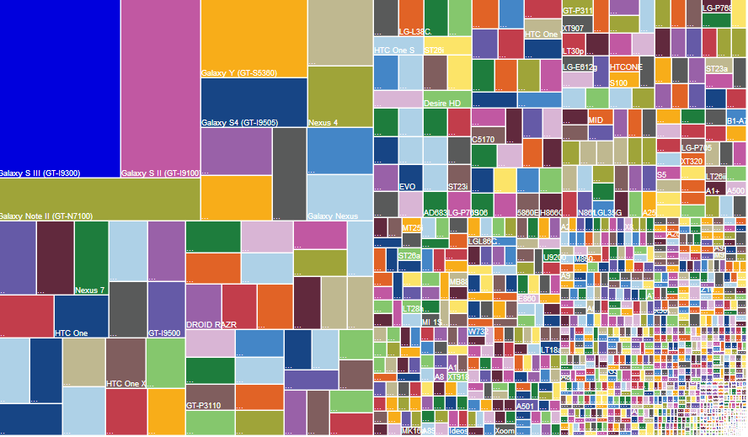
Testing Mobile APP vs WEB :
4. MORE CONFIGURATIONS
MOBILE
WEB
The majority of today’s browsers follow the same basic logic. Chrome is not radically different from Internet Explorer. And Firefox has more in common with Safari than Mozilla
Web-based software testers nearly always have access to the platforms they’re testing
iOS, Android, Windows OS, and BlackBerry.
Hardware limitations specific to devices manufactured by Nokia, HTC, Sony, Samsung, Apple ,etc
New mobile devices frequently hit the market
Emulators and Simulators

Slide 21
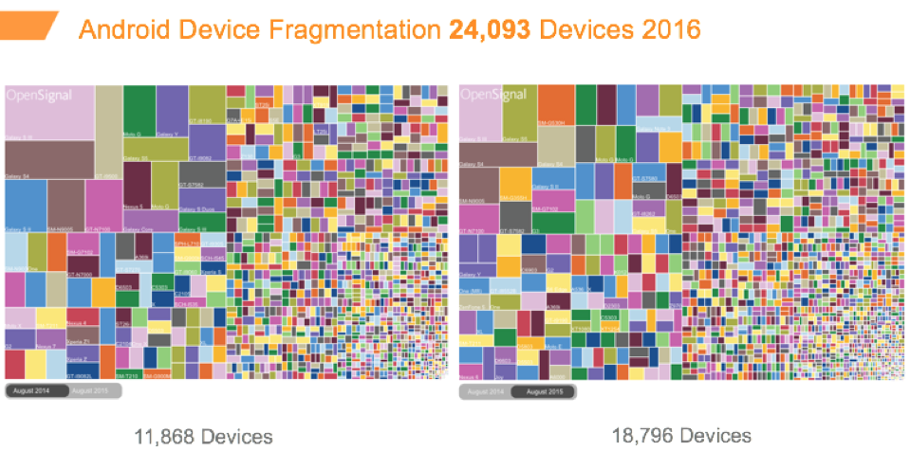
Testing Mobile APP vs WEB : (cont)
DEVICE FRAGMENTATION
August , 2014
August , 2015

Slide 22
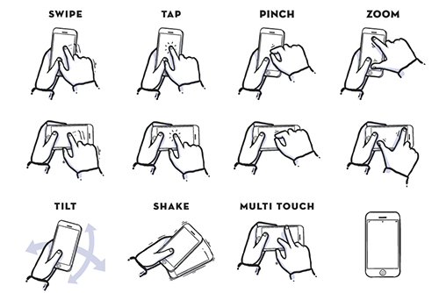

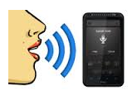
Testing Mobile APP vs WEB :
5. INPUT INTERFACE
MOBILE
WEB
Touch Screens, USB connections, and even voice recognition (thanks, Siri).
Usually with keyboards and mouse (although even this is changing)

