Slide 1

Mobile Testing
Online Part 3
Created by Ivette Doss

Slide 2
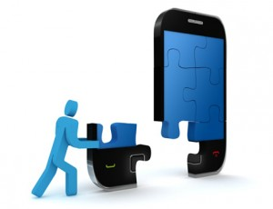
Groups of Questions to be discuss:
Mobile OS/Platform Fundamental
Mobile/Software literacy
How well you know Mobile Devices
Specific of Mobile Testing
The future Trends in Mobile World

Slide 3
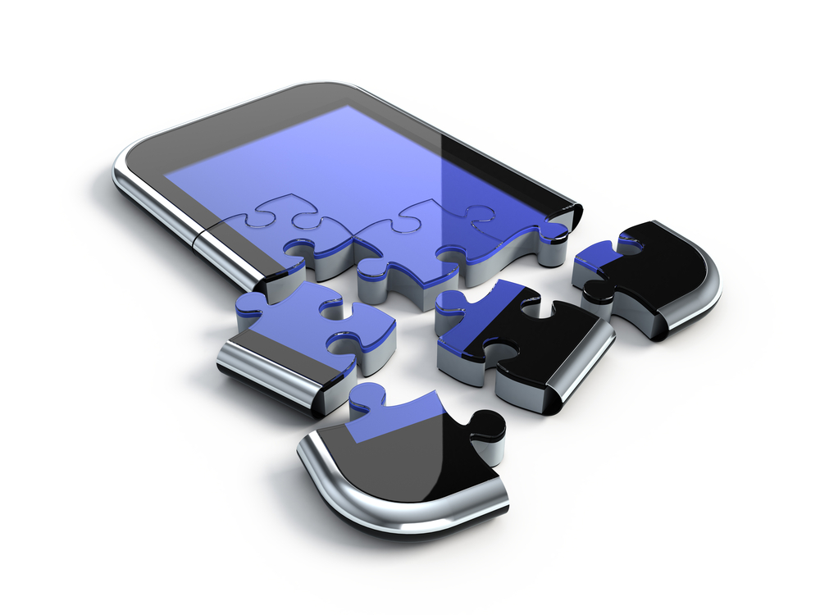
Learning Objective Today: cover 12 questions
Section 2:
Mobile World Literacy
2 questions
2. Section 4:
Specific of Mobile Testing
10 questions
3. Section 5:
The future Trends in Mobile World

Slide 4

To use the presentation effectively:
  The helpful online Resources
  The information you should remember
  Last Minute Update
Q
Interview Question
U
The information you need to find
by yourself and learn

Slide 5

The Terms and Definitions you should know:
Five Interchangeable means of Platform
Three types of Platforms
Operating System
Open vs. Closed Operating System
Four types of Operating System
Framework
Kernel
Machine code
Source code
Logic Code
Operators/Carriers/Providers
Makers/Manufactures
Two major Network types in US
The rate of data transmission that the Network is capable to deliver under GSM, CDMA, WiMax, and LTE
Tethering
API
Application Framework (name at least two with some brand’s examples)
HTML 5
Fragmentation
SDK
Rooted vs. un-rooted phone
Locked vs. un-locked phone
Jailbreak
Mobile Terminology basics:
http://www.gsmarena.com/glossary.php3
http://www.youtube.com/watch?v=nLTlu62sKAM

Slide 6

Mobile/Software Literacy
Section 3

Slide 7
List of Interview Questions: Section 3
1. Describe Smartphone vs. Feature phone
2. What is the about Smartphone that change everything?
3. What is a Mobile application?
4.What is a Native Mobile Application?
5. What is a Mobile Web Application?
6. What came first for the mobile phone – the Native or Web apps?
7. What is a difference between a Web and a Native app?
8. Explain the tendencies and reasons for organizations to choose the Native, Web, or both app’s options
9. What a difference does HTML5 make?
10. What is an application structure?

Slide 8
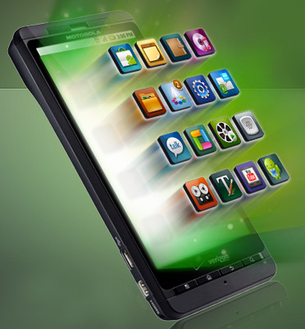
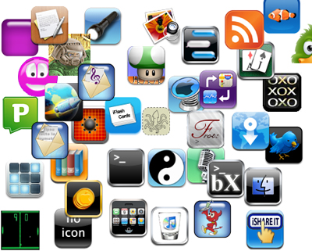
4. What is a Native Mobile Application?
Native app is the one that is specifically designed to run on a device’s operating system and machine firmware, and typically needs to be adapted for different devices.
Examples: AngryBirds, RxFiles, Evernote, Boxcar, CoPilot Life HD North America

Slide 9
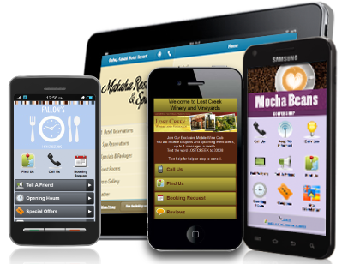

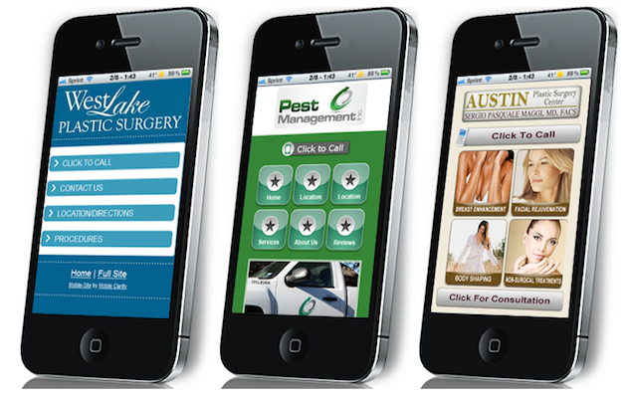



5. What is a Mobile Web Application?
http://www.sencha.com/apps/
http://www.openappmkt.com/

Slide 10
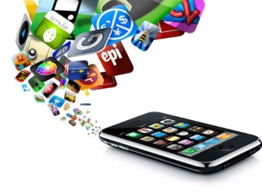
Main reasons for organizations to choose: 1
NATIVE
WEB
Complies with company’s own technological expertise (Java, C++ and/or Objective C are mastered better than HTML)
uses makes creating of an excellent
contains relevant content (e.g. an interactive game)
performs complex calculations (bank payments, etc.)
Suits best for chosen model of business management and promotion
complies with company’s own technological expertise (HTML is mastered better than C + + or Objective C).
BOTH: Native and Web
Opportunity to develop both options
Desire to test what works best
Expansion of contacts with users
Other (order of company management, integrated solution)

Slide 11

Tendencies that let organizations to choose: 2
Develop Web Apps
Develop Native Apps
If your goals are firstly focused on marketing
if you offer timely and quickly updated information
if you want to be easily found through search engines
if you want to save your money
Communication and interaction with users
creating an application working like a computer program
ensuring an instant access to information about your company, regardless of accessibility of the Internet
creation of a creative and catchy user interface
YOUR personal opinion regarding the best option is:
starting with mobile version of web site,
finding out places where users are most active (using Analytics),
creating a native mobile application based on this information.
Useful tips for last:
If most people find company through search results, it is better to create a mobile version of your web site.
If company already have a vast audience, it is better develop native mobile application extending the functionality of company website.

Slide 12
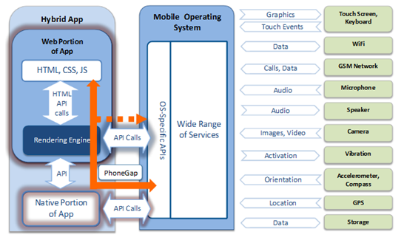
Web + Native= LOVE Hybrid
As mobile browsers gain direct access to the hardware of mobile devices (including accelerometers and GPS chips), and the speed and abilities of browser-based applications improve, the difference between Web and Native is blurred.
Persistent storage and access to sophisticated user interface graphics functions may further reduce the need for the development of platform-specific native applications.

Slide 13
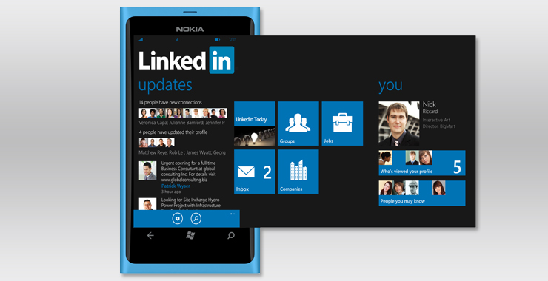
Good to know: Hybrid Application
Hybrid apps is built using web technology (HTML5, CSS and JavaScript), and then wrapped in a platform specific shell.
Hybrid apps run inside a native container and leverage the device’s browser engine (but not the browser) to render the HTML and process the JavaScript locally.
A web-to-native abstraction layer ensure cross-platform compatibility and enables access to device capabilities such as the accelerometer, camera, local storage, User’s contacts (that what Web app is missing).
For cross-platform, developers would need to code the native part separately for each platform but they can use the same HTML5 part across all of them.
Hybrid apps rely on development frameworks like Sencha, PhoneGap, Titanium, Rhomobile, ParticleCode, Corona, Mosync, Worklight, BkRender…
Examples: LinkedIn, Facebook, Twitter, Yelp. Amazon Cloud Reader, Netflix
http://www.gsmarena.com/glossary.php3?term=accelerometer
http://icenium.com/community/blog/icenium-team-blog/2012/06/14/what-is-a-hybrid-mobile-app-

Slide 14
List of Interview Questions: Section 3
1. Describe Smartphone vs. Feature phone
2. What is the about Smartphone that change everything?
3. What is a Mobile application?
4. What is a Native Mobile Application?
5. What is a Mobile Web Application?
6. What came first for the mobile phone – the Native or Web apps?
7. What is a difference between a Web and a Native app?
8. Explain the tendencies and reasons for organizations to choose the Native, Web, or both app’s options
9. What a difference does HTML5 make?
10. What is an application structure?

Slide 15
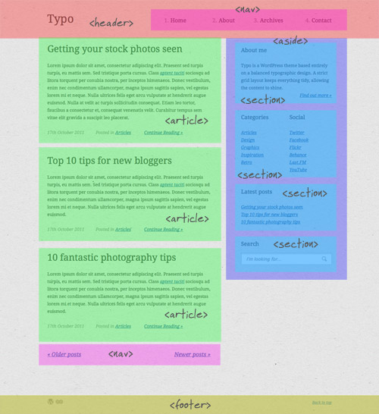
9. What a difference does HTML5 make? 1
HTML 5 Layout
HTML5, the 5th version of HTML, is the latest web technology with rich multimedia features and interoperability features for smartphones and tablets.
HTML5 web apps can be accessed on mobile browsers and runs on different mobile platforms just like native apps.
HTML5 provides offline support via local data and application caching without the need for internet connection.
Developers are adopting HTML5 to build cross-platform mobile apps as a "Build Once, Run Many" solution to make mobile web better with device-neutral mobile app development.

Slide 16

9. What a difference does HTML5 make? 2
HTML5 Features
Dynamic scrolling banners for online promotions of products
Improved navigation, menus and pop-up windows allows more content integration
Games with advanced graphics support, image galleries with scroll, swipe and zoom features
Cross-platform mobile application development
Advanced GPS, IP address, RFID data integrated
Rapid search results
Mini-Carts integration on mobile sites allows users to stay in the page

Slide 17

9. What a difference does HTML5 make? 3
Features | HTML5 | Native App
Security | In a Browser environment, users can manipulate native code which leads to possible hacking; Debugging tool can be abused; Local database can be manipulated; | Native apps require updates; While accessing internet for sending information, it should be made secure with SSL.
Synchronization | Offline storage capabilities; If a Web part of app is connected to the Internet, it can continually save data to the cloud. When it's offline, changes aren't always stored in the cloud. Problems of data synchronization occurs (difficult to find the latest saved data) while changing browsers . | Problems in synchronization can be found by tracking file names and change dates
Storage | Local data storage is limited as compared to desktop apps; | For syncing local data on device, data should be encrypted

Slide 18
9. What a difference does HTML5 make? 4
Features | HTML5 | Native App
Capabilities | Unique and engaging features not available in Mobile web apps; In-app features not within scope of HTML5 app. Developers can build a hybrid app through PhoneGap and get platform features; Evolving standards and adding features. | Better in-app experience and integrates well into the device eco-system with widgets and notifications. Interact with device’s hardware using GPS, Accelerometer, Camera
Marketing/ Distribution | Apps published in websites. Share web apps with friends by linking with email and social media | App Store or Android Market; Users can browse, search on the market
Monetization | Possible to monetize on the web through a viable SaaS solution; Online advertising, affiliate links, sponsorships, cross-promotion to other products and services are the other ways; Build cross-platform apps through PhoneGap or Titanium, wrap them as native apps and distribute via various market places | Mobile platforms offer developers One-time payment directly charge for their apps. In-app payment and subscription mechanisms help developers to convert a successful app into a long-term revenue stream. Advertising and sponsorship are the other web models for easy monetization

Slide 19
9. What a difference does HTML5 make? 5
Features | HTML5 | Native App
Performance | Today web apps run faster with advanced functionality, multimedia, games optimized for improved performance | Faster and better; Taking advantage of GPU acceleration and multithreading
User experience | More control over look and feel; Custom UI build according to needs | Native look and feel
Development | Cross-platform and cross-browser support to develop apps for various mobile platforms using HTML5, CSS3, Javascript; HTML5 will be fully ready by 2014; | Easier to develop using Objective C, C++

Slide 20
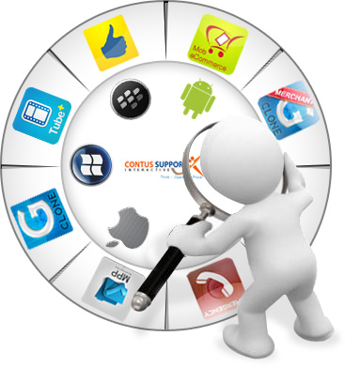
Specific of Mobile Testing

Slide 21
Specific of Mobile Testing
Section 4
1. How do you usually explore the new Mobile Device/Phone?
2. How would you test UI of mobile app?
3. How would you test the mobile app page?
4. Give Examples of Major Test Cases for mobile device
5. Write as many Test Cases you can for the following: Mobile device, simple app with three buttons (1,2,3) that making the sounds.
6. How would you troubleshoot networking issues on iPhone?
7. How would you test the following: you send Yahoo message from your mobile device to someone else device, and recipient doesn’t receive a message?
8. What is your Stress test approach when testing Facetime on iPhone?
9. How do you do Boundary testing to verify a battery’s life, if a game application suppose to last for 24 hours?
10. Tell me about Specifics of the Mobile games testing?

Slide 22
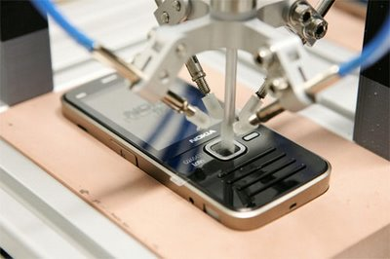
Specific of Mobile Testing
Testing of mobile applications is significantly different from the standard approach of testing applications designed for use with personal computers, because of the large number of specific work, the design features of mobile devices and a variety of mobile platforms.
http://developer.android.com/guide/developing/testing/index.html

Slide 23
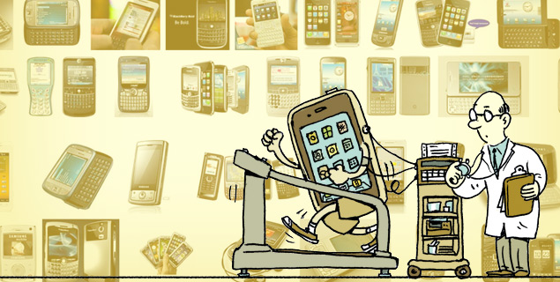
1. How do you usually explore the new Mobile Device/Phone? 1
1. Start with Ad-Hoc/Exploratory:
Turn ON/OFF
Check Navigation/Users Controls/Notifications (Scrolls, Tabs, Links, Gestural Movements)
Go to Settings:
  Look for Tutorial
  Explore each option
Play with Home, Menu, Start, Audio Buttons
2. Check WI-FI, BT, Internet Connectivity
3. Check Features that related to the company product
4. Check Company specific documentations (if any exist)
5. Check Internet Resources for:
  Maker Site
  Provider Site
  Device Review Highlights
  Device YouTube Highlights
EASY Answer
http://www.android.com/about/
http://www.apple.com/support/

Slide 24

1. How do you usually explore the new Mobile Device/Phone? 2
Advance Answer
IN ADDITION TO PREVIOUS EXPLANATION:
Check the intensity of power consumption, sensitivity to the charge;
Check the use of disk space, stability in the limited disk space, logging, work with memory cards;
Check the Accelerometer’s functions;
Check the Connectivity to the Internet, using the best connection: Active Sync, USB, GPRS, Wi-Fi; work in conditions of unstable compounds;
Check the stability of the applications for incoming / outgoing calls, sending and receiving SMS / MMS;
Check the Specificity of data synchronization with the phone book, calendar, programs on your PC;
Check the proper installation / un-installation program in the phone memory and memory card;
Check the correct geo-location;
Check the Stable operation in conditions of stress, recovery from crashes.
Download LogCollector and SpeedTest.net (using App/Play Store)
http://code.google.com/p/android-log-collector/
http://www.speedtest.net/mobile.php/

Slide 25
Specific of Mobile Testing
Section 4
1. How do you usually explore the new Mobile Device/Phone?
2. How would you test UI of mobile app?
3. How would you test the mobile app page?
4. Give Examples of Major Test Cases for mobile device
5. Write as many Test Cases you can for the following: Mobile device, simple app with three buttons (1,2,3) that making the sounds.
6. How would you troubleshoot networking issues on iPhone?
7. How would you test the following: you send Yahoo message from your mobile device to someone else device, and recipient doesn’t receive a message?
8. What is your Stress test approach when testing Face time on iPhone?
9. How do you do Boundary testing to verify a battery’s life, if a game application suppose to last for 24 hours?
10. Tell me about Specifics of the Mobile games testing?

Slide 26
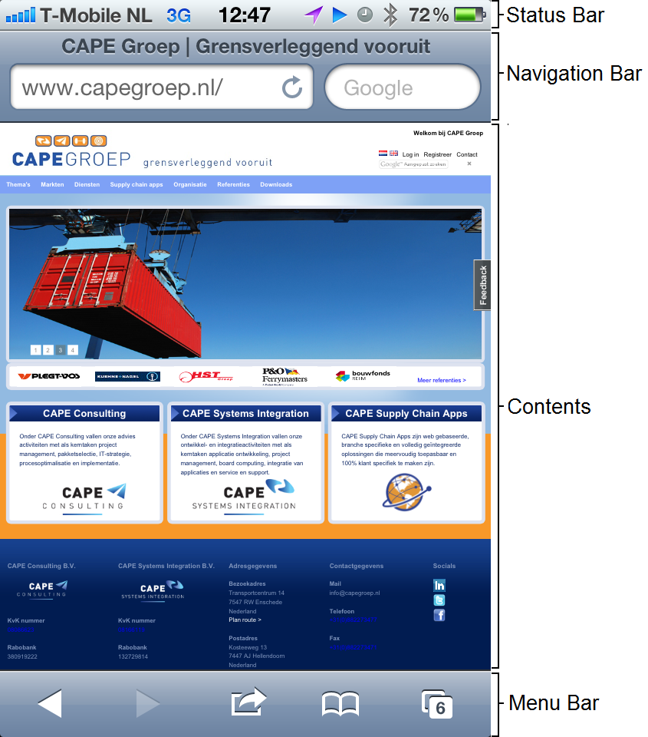
2. How would you test UI of mobile app? 1
Installation of Application:
Splash Screen
Install – Accept & download – Open – Uninstall buttons
Sync view loading, view transitions, and view installation.
View of Home/Content Page:
General Look – Image & Text Alignments
Layout:
Fit well the Form Factor
Resolution
Screen Size alignments
Truncation
Invalid/Garbage Symbols
Orientation: Portrait vs. Landscape
Buttons:
Functionality
Place on the screen, color and size adjustments
Customized style
Active vs. none-active mode
Alignment with the Naming
Links
EASY Answer
http://www.quora.com/User-Interfaces/Which-are-the-best-iPhone-iPad-apps-from-a-UI-design-perspective

Slide 27
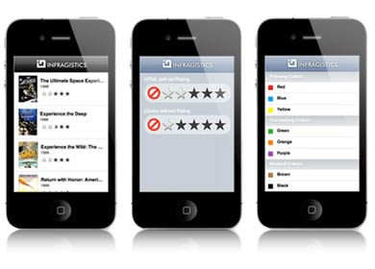
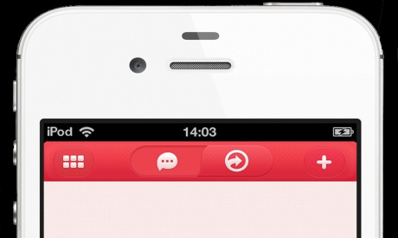
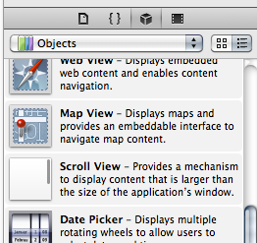
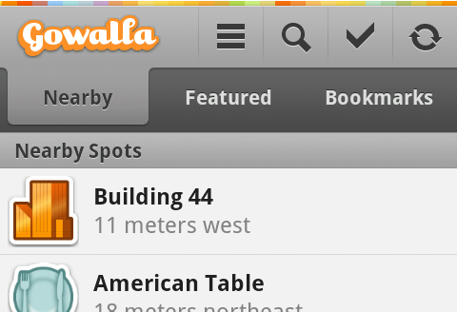
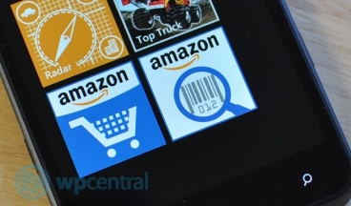
2. How would you test UI of mobile app? 2
List View
ListView:
Backbone of App
Grids of Mobile app
NavBar/ActionBar:
Title NavBar (example: on the top of iOS apps and on the bottom of Android apps.)
ScrollView:
“Swipe” through a list of items left-right and top-bottom
Switch
TabStrip
Navigation Bars
Scroll View
Tab Strip
Switch

Slide 28
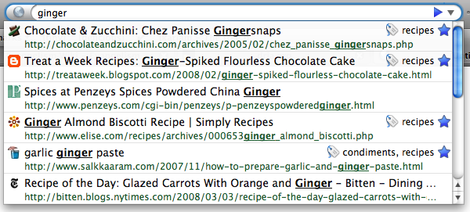
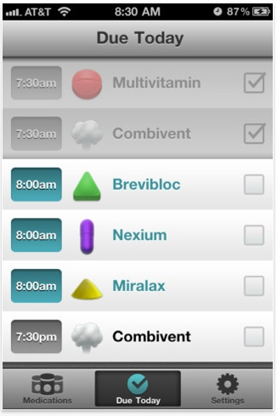
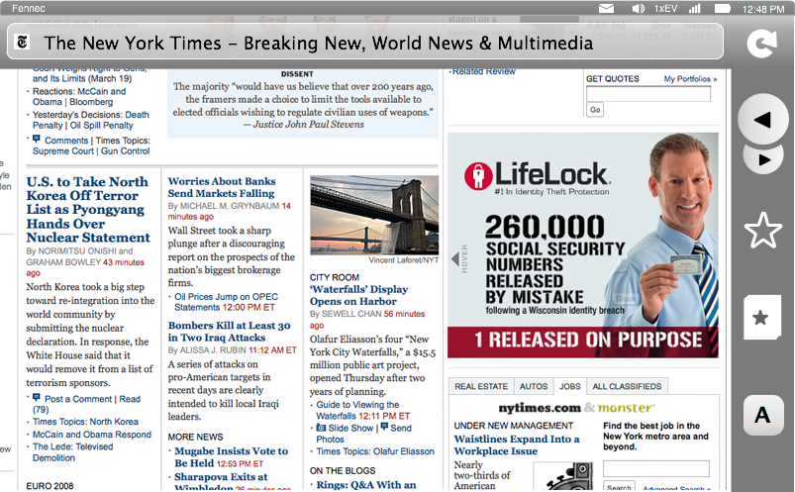
2. How would you test UI of mobile app? 3
Touch Screen UI:
Panning and Zooming
Controls: Dragging horizontally beyond the page edge reveals the control strip
Navigation/Searching to a new page
Tabs
Notifications: New,
Preferences, Geo-location
Downloads
Add-ons
Identity: Authentication
Client Certificates, Username/Password
awesome bar
Control Strip
Tabs
https://wiki.mozilla.org/Mobile/UI/Designs/TouchScreen/workingUI

Slide 29
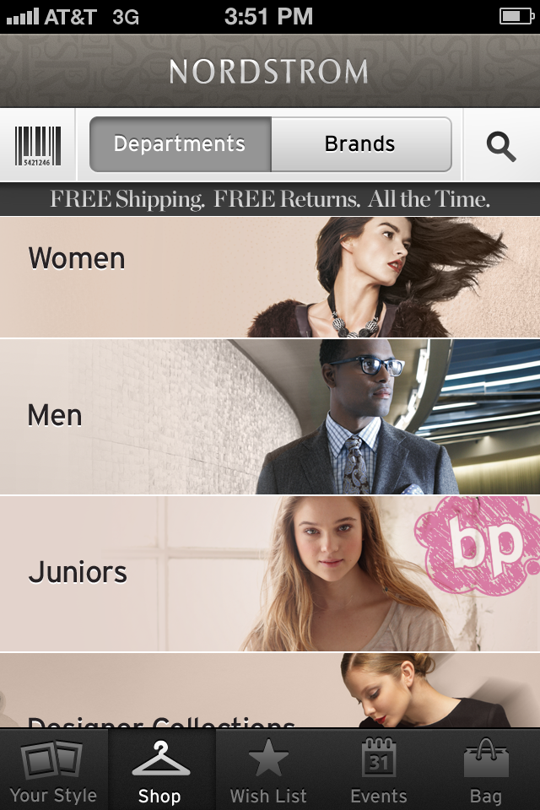
UI Checklist
4
Location Bar
Control Strip:
Back/forward
Create bookmark
Actions
Bookmarks list
Navigation Screen / Location Bar:
URL entry
awesome bar results
search engines
Tab switching:
local tabs
weave integration
Page notifications:
(general)
Pop-up blocking
File Install
Geolocation
Password Manage
Notification
Preferences section

Slide 30
UI Checklist
5
Identity
Find in page/Search
Add-ons:
Installation UI
List of add-ons (manage)
Get add-ons
Status notifications
Downloads:
Status notifications
Manager
Context Menu:
Tap-and-hold mechanism
Menu contents (multiple cases)
Update Notifications
Certificate Management
Keyboard Shortcuts
First-run page
Polish issues:
off-screen areas panning into view

Slide 31
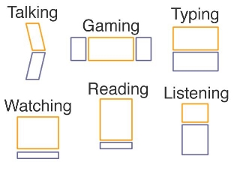
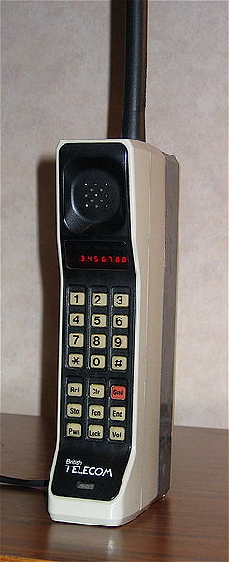
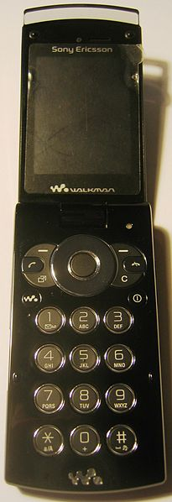
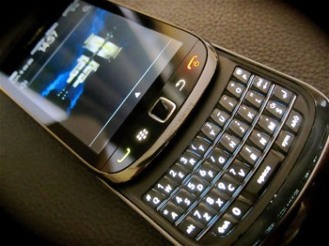
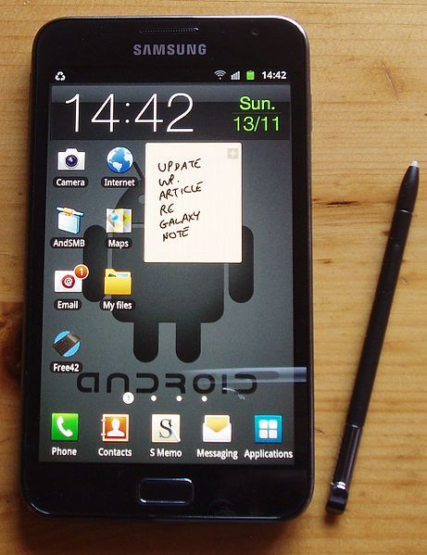
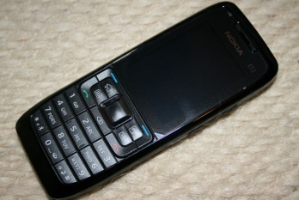
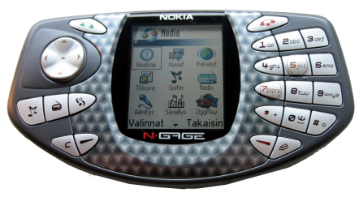
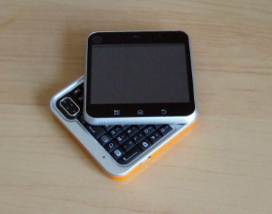
Good to know: Mobile Form Factor
Brick
Bar
Touch screen
Taco
Flip
Slider
Swivel

Slide 32
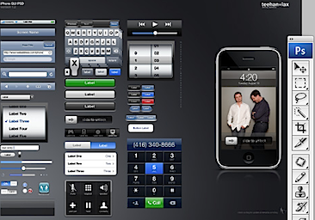
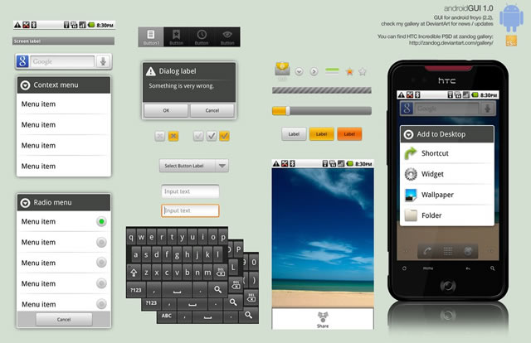
Good to know: different Mobile UI
Self-Learning
ANDROIDs Popular UI:
Android GUI PSD
Stock (Droid 1, Nexus1)
Sense UI (Eris, Incredible, Evo)
Motoblur(*new* Droid X, Droid 2)
Touchwiz(Galaxy S devices)
iPhone Popular UI:
iPhone GUI PSD (Photoshop file)
iPhone GUI stencil for Omnigraffle
Favorites UI Design Walkthrough
Edward Tufte on iPhone interface design
http://mobileorchard.com/7-iphone-ui-user-interface-design-resources/
http://speckyboy.com/2010/10/27/30-fresh-web-ui-mobile-ui-and-wireframe-kits/

Slide 33
Specific of Mobile Testing
Section 4
1. How do you usually explore the new Mobile Device/Phone?
2. How would you test UI of mobile app?
3. How would you test the mobile app page?
4. Give Examples of Major Test Cases for mobile device
5. Write as many Test Cases you can for the following: Mobile device, simple app with three buttons (1,2,3) that making the sounds.
6. How would you troubleshoot networking issues on iPhone?
7. How would you test the following: you send Yahoo message from your mobile device to someone else device, and recipient doesn’t receive a message?
8. What is your Stress test approach when testing Face time on iPhone?
9. How do you do Boundary testing to verify a battery’s life, if a game application suppose to last for 24 hours?
10. Tell me about Specifics of the Mobile games testing?

Slide 34
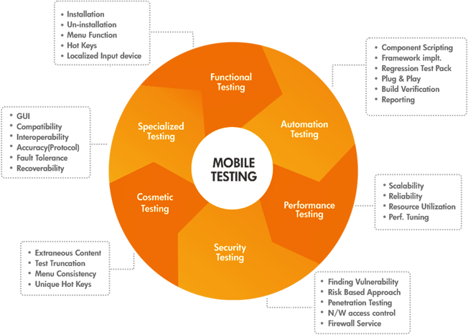
3. How would you test the mobile app page? 1
http://msdn.microsoft.com/en-us/library/windows/desktop/bb226821(v=vs.85).aspx#GlossaryA

Slide 35
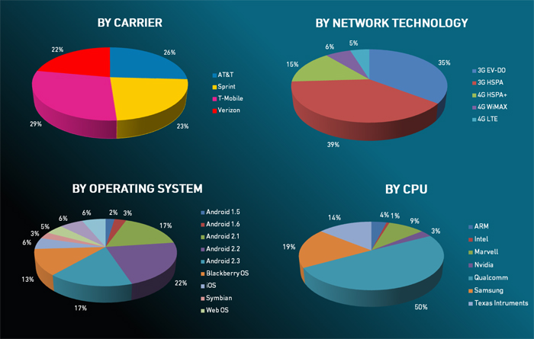
Mobile Testing Approach:
http://www.drdobbs.com/joltawards/jolt-awards-the-best-testing-tools/232901286?pgno=5

Slide 36


3. How would you test the mobile app page? 1
General INTRODUCTION:
Depends on the nature of the application being developed, some general criteria should be considered:
Browser/Metrics capability
Device Popularity (iPhone, HTC g1, Motorola Droid, Google and Nexus One)
Metrics for regions, carriers (analysis for device/carrier popularity in terms of web traffic from devices in particular countries and regions)
Testing Approach
First, HTML should be validate to make sure that there are no egregious errors.
Next test on the desktop browser to find the functional bugs and make sure that functionality of the site is stable.
Once the site or module functionality is complete, then test on the device emulator to get the browser/platform coverage (in case if you don’t have the device).
If device is already available, then test on the device itself to find the device specific bugs instead of testing on the emulator.
http://metrics.admob.com
http://webdesign.about.com/od/validators/l/bl_validation.htm

Slide 37
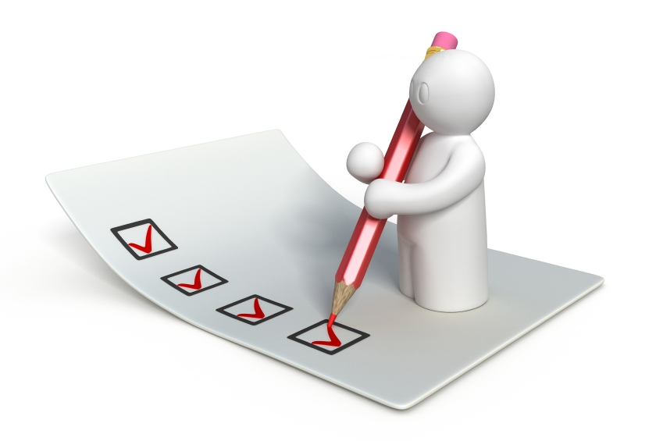
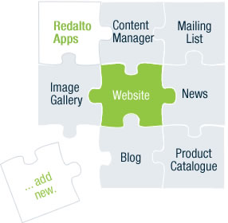
3. How would you test the mobile app page? 2
Create a Check List:
1) Functionality Testing
2) Usability testing
3) Interface testing
4) Compatibility testing
5) Performance testing
6) Security testing
OR
Get prepared to Interview ‘SMART’ way and print the Mobile Application Checklist from the Answer to the Question # 4 and take it to Interview.
http://www.mobileappstesting.com/tag/testing-checklist-for-mobile-application/
http://sixrevisions.com/tools/10-excellent-tools-for-testing-your-site-on-mobile-devices/

Slide 38
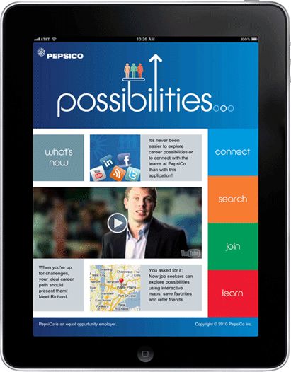
3. How would you test the mobile app page? 3
1. Functionality Testing:
Test for – all the links in web pages, database connection, forms used in the web pages for submitting or getting information from user, Cookie testing.
Check all the links:
Test the outgoing links from all the pages from specific domain under test.
Test all internal links.
Test links jumping on the same pages.
Test links used to send the email to admin or other users from web pages.
Test to check if there are any orphan pages.
Lastly in link checking, check for broken links in all above-mentioned links.
Test forms in all pages:
Forms are the integral part of any web site. Forms are used to get information from users and to keep interaction with them. So what should be checked on these forms?
First check all the validations on each field.
Check for the default values of fields.
Wrong inputs to the fields in the forms.
Options to create forms if any, form delete, view or modify the forms.

Slide 39
3. How would you test the mobile app page? 4
Cookies testing:
Cookies are small files stored
on user machine. These are
basically used to maintain the
session mainly login sessions.
Test the application by
enabling or disabling the
cookies in your browser
options.
Test if the cookies are
encrypted before writing to
user machine.
If you are testing the session
cookies (i.e. cookies expire
after the sessions ends) check
for login sessions and user
stats after session end. Check
effect on application security
by deleting the cookies.
Validate your HTML/CSS:
If you are optimizing your site
for Search engines then
HTML/CSS validation is very
important. Mainly validate the
site for HTML syntax errors.
Check app’s behavior on
different search engines.
Database testing:
Data consistency and sync are
very important in Mobile
application. Check for data
integrity and errors while you edit,
delete, modify the forms or do any
DB related functionality.
Check if all the database queries
are executing correctly, data is
retrieved correctly and also
updated correctly.

Slide 40
3. How would you test the mobile app page? 5
Test for navigation:
Navigation means how the user surfs the
web pages, different controls like buttons,
boxes or how user using the links on the
pages to surf different pages.
Mobile site should be easy to use.
Many popular mobile devices use touch
and gestural input.
Touch targets, such as buttons, must be
fairly large and widely spaced in
comparison with the mouse and pointer
style input in conventional installed or web
applications. On phones, constrained
Screen sizes, coupled with large
interaction targets, result in fewer
controls per panel.
The input characteristics of
Different types of devices also
must be considered.
2. Usability Testing
Content checking:
Content should be logical and
easy to understand.
Check for spelling errors.
Use of dark colors annoys users
and should not be used in site
theme.
You can follow some standards
that are used for web page and
content building. These are
common accepted standards
like annoying colors, fonts,
frames,
Content should be meaningful.
All the anchor text links should
Be working properly.
Images should be placed
properly with proper sizes.

Slide 41
3. How would you test the mobile app page? 6
3. Interface Testing
The main interfaces are:
Mobile Web server and Mobile app server interface
Mobile Application server and Database server interface.
Check if all the interactions between these servers are executed properly.
Errors are handled properly. If database or web server returns any error message for any query by application server then application server should catch and display these error messages appropriately to users.
Check what happens if user interrupts any transaction in-between?
Check what happens if connection to web server is reset in between?

Slide 42
3. How would you test the mobile app page? 7
4. Compatibility Testing
Compatibility of your Mobile web site is very important testing aspect. See which compatibility test to be executed:
Browser compatibility
Operating system compatibility
Printing options

Slide 43
3. How would you test the mobile app page? 8
Browser compatibility:
Some applications are very dependent on browsers.
Different browsers have different configurations and settings that Mobile page should be compatible with. The Mobile site coding should be cross browser platform compatible.
If we are using Java scripts or HTML5 calls for UI functionality, performing security checks or validations then give more stress on browser compatibility testing of Mobile application.
Test web application on different browsers like Safari, Opera, Opera Mini, Dolphin, Fennec, Google Chrome, Mozilla Firefox browsers with different versions.
OS compatibility:
Some functionality in the Mobile Web application may not be compatible with all operating systems.
All new technologies used in Mobile development like graphics designs and API’s, may not be available in all Operating Systems.
We need to test the Mobile Web application on different operating systems like iOS, Android, BBX QNX, Window Phone with different OS flavors.

Slide 44
3. How would you test the mobile app page? 9
Printing options:
If you are giving page-printing options then make sure fonts, page alignment, page graphics getting printed properly. Pages should be fit to paper size or as per the size mentioned in printing option.

Slide 45
3. How would you test the mobile app page? 10
5. Performance testing
Mobile application should sustain to heavy load.
Mobile performance testing should include:
Web Load Testing
Web Stress Testing
Analytics Testing
Test application performance on different internet connection speed.
In Mobile load testing test if many users are accessing or requesting the same page.
Can system sustain in peak load times? Site should handle many simultaneous user requests, large input data from users, Simultaneous connection to DB, heavy load on specific pages etc.

Slide 46
3. How would you test the mobile app page? 11
Stress testing:
Generally stress means stretching the system beyond its specification limits.
Mobile stress testing is performed to break the site by giving stress and checked how system reacts to stress and how system recovers from crashes.
Stress is generally given on input fields, login and sign up areas.
In Mobile performance testing Mobile page functionality on different operating systems and different hardware platforms is checked for software, hardware memory leakage errors.

Slide 47


3. How would you test the mobile app page? 12
Security Testing
Following are some test cases for Mobile security testing:
Test by pasting internal URL directly into browser address bar without login. Internal pages should not open.
If you are logged in using username and password, and browsing internal pages, then try changing URL options directly.
If you are checking some publisher site statistics with publisher site ID= 123. Try directly changing the URL site ID parameter to different site ID which is not related to logged in user. Access should denied for this user to view others stats.
Try some invalid inputs in input fields like login username, password, input text boxes. Check the system reaction on all invalid inputs.
Web directories or files should not be accessible directly unless given download option.
Test the CAPTCHA for automates scripts logins.
Test if SSL is used for security measures. If used proper message should get displayed when user switch from non-secure http:// pages to secure https:// pages and vice versa.
All transactions, error messages, security breach attempts should get logged in log files somewhere on Mobile web server.

Slide 48
Specific of Mobile Testing
Section 4
1. How do you usually explore the new Mobile Device/Phone?
2. How would you test UI of mobile app?
3. How would you test the mobile app page?
4. Give Examples of Major Test Cases for mobile device
5. Write as many Test Cases you can for the following: Mobile device, simple app with three buttons (1,2,3) that making the sounds.
6. How would you troubleshoot networking issues on iPhone?
7. How would you test the following: you send Yahoo message from your mobile device to someone else device, and recipient doesn’t receive a message?
8. What is your Stress test approach when testing Face time on iPhone?
9. How do you do Boundary testing to verify a battery’s life, if a game application suppose to last for 24 hours?
10. Tell me about Specifics of the Mobile games testing?

Slide 49
4. Give Examples of Major Test Cases for mobile device 1
Category | Sub-Category | Description | Result
1. Installation |  | Verify that app can be Installed Successfully | App should be able to install Successful
2. Un-installation |  | Verify that app can be Uninstall Successfully | User should be able to uninstall the app successfully
3. Network Test Cases |  | Verify the behavior of app when there is Network problem and user is performing operations for data call | User should get proper error message like “Network error. Please try later”…
 |  | Verify that User is able to establish data call when Network is back in action | User should be able to establish data call when Network is back in action

Slide 50
4. Give Examples of Major Test Cases for mobile device 2
Category | Sub-Category | Description | Result
4. Voice Call Handling | Call Accept | Verify that User can accept Voice call at the time when app is running and can resume back in app from the same point | User should be able to accept Voice call at the time when app is running and can resume back in app from the same point
 | Call Rejection | Verify that User can reject the Voice call at the time when app is running and can resume back in app from the same point | User should be able to reject the Voice call at the time when app is running and can resume back in app from the same point
 | Call Establish | Verify that User can establish a Voice call in case when app data call is running in background | User should be able to establish a Voice call in case when app data call is running in background

Slide 51
4. Give Examples of Major Test Cases for mobile device 3
Category | Sub-Category | Description | Result
5. SMS Handling |  | Verify that User can get SMS alert when app is running | User should be able to get SMS alert when app is running
 |  | Verify that User can resume back from the same point after reading the SMS | User should be able to resume back from the same point after reading the SMS
6. Unmapped Keys |  | Verify that unmapped keys are not working on any screen of app | Unmapped key should not work on any screen of app
7. Application Logo |  | Verify that app logo with App Name is present in app manager, on the App screen page, widgets (opt.) and user can select it | Application Logo with App Name should be present in app manager, on the App screen page, widgets (opt.) and User can select it.

Slide 52
4. Give Examples of Major Test Cases for mobile device 4
Category | Sub-Category | Description | Result
8. Splash Screen |  | Verify that when User selects app Logo in Splash is displayed. Note: Splash do not remain for fore than 3 sec Note: A splash screen is an image that appears while a game or program is loading. | When User selects app, Logo in app Splash should be displayed
9. Low Memory |  | Verify that app displays proper error message when device memory is low and exits gracefully from the situation | App should display proper error message when device memory is low and exits gracefully from the situation
10. Clear/Back Key |  | Verify that Clear key should navigate the User to previous screen | Clear Key should navigate the User to previous screen
11. End/Home Key |  | Verify that End Key should navigate the User to native Device screen | End Key should navigate the User to native Device screen

Slide 53
4. Give Examples of Major Test Cases for mobile device 5
Category | Sub-Category | Description | Result
12.Visual Feedback |  | Verify that there is visual feedback when response to any action takes more than 3 sec | There should be visual feedback given when response time for any action is longer than 3 sec
13. Continual Keypad Entry |  | Verify that continual key pad entry do not cause any problem. Note: Continual Keypad test consist in a multiple key press, done quickly as possible, in order to load at maximum capacity the handset's memory | Continual key pad entry should not cause any problem in app
14. Exit Application |  | Verify that User is able to exit from app with every form of exit modes such as Flap, Slider, Home Key or Exit option from any point of app | User should be able to exit with every from of exit mode such as Flap, Slider, Home Key or Exit option from any point of app
15. Charger Effect |  | Verify that when app is running then inserting and removing charger do not cause any problem and proper message is displayed when charger is inserted in device | When app is running, then insertion or remove of charger not cause any problem, and proper message displayed .

Slide 54
4. Give Examples of Major Test Cases for mobile device 6
Category | Sub-Category | Description | Result
16. Low Battery |  | Verify that when app is running and battery is low, then proper message is displayed to the User. | When app is running and battery is low, there should be proper message displayed to the User
17. Removal of Battery |  | Verify that removal of battery at the time of app data call is going on do not cause interruption and data call is completed after battery is inserted back in the device | Removal of battery at the time of app data call is going on should not cause interruption and data call should be completed after battery is inserted back in the device
18. Battery Consumption |  | Verify that app does not consume battery excessively | The app should not consume battery excessively
19. Application Start/Restart |  | Find the app icon and select it. Press tab on the Device to launch the app. Observe the app launch in the timeline defined. | App must not take longer than 25 sec to start

Slide 55
4. Give Examples of Major Test Cases for mobile device 7
Category | Sub-Category | Description | Result
20. Application Side Effects |  | Make sure that your app is not causing other apps of device to hamper | Installed app should not cause other apps of device to hamper
21. External incoming communication infrared |  | App should gracefully handle the condition when incoming communication is made via InfraRed | When incoming communication enters the device, the app must at least respect one of the following: Go into pause state during InfraRed session and automatically continue from the point it was suspended at after the InfraRed session is done Give a visual or audible notification The app must not crash or hung.

Slide 56
Specific of Mobile Testing
Section 4
1. How do you usually explore the new Mobile Device/Phone?
2. How would you test UI of mobile app?
3. How would you test the mobile app page?
4. Give Examples of Major Test Cases for mobile device
5. Write as many Test Cases you can for the following: Mobile device, simple app with three buttons (1,2,3) that making the sounds.
6. How would you troubleshoot networking issues on iPhone?
7. How would you test the following: you send Yahoo message from your mobile device to someone else device, and recipient doesn’t receive a message?
8. What is your Stress test approach when testing Face time on iPhone?
9. How do you do Boundary testing to verify a battery’s life, if a game application suppose to last for 24 hours?
10. Tell me about Specifics of the Mobile games testing?

Slide 57
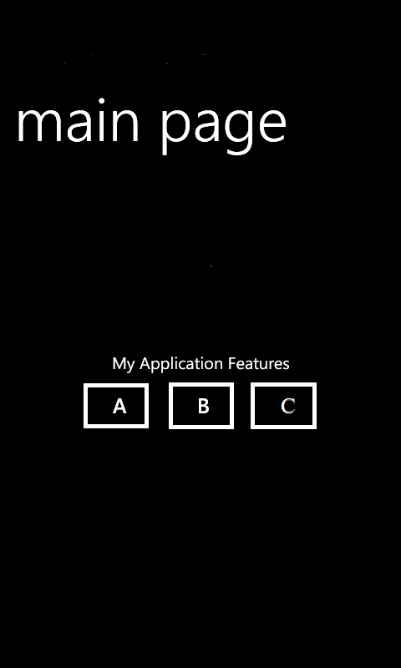
5. Write as many Test Cases you can for the following: Mobile device, simple app with three buttons (1,2,3) that making the sounds. 1
1. Stay with the TC Plan to cover different area of testing:
1) Functionality Testing
2) Usability testing
3) Interface testing
4) Compatibility testing
5) Performance testing (with Soak Testing)
Add Audible specific Testing
Self-Learning:
http://www.guru99.com/testing-tools.html
http://www.mobileapptesting.com/the-best-tools-for-mobile-app-testing/2011/08/
http://en.wikipedia.org/wiki/Soak_testing

Slide 58

5. Write as many Test Cases you can for the following: Mobile device, simple app with three buttons (1,2,3) that making the sounds. 2
Module | Description | Result
Button A | Verify that when Button A is pressed, sound tone A appeared | When button A is pressed the sound tone A should be audible
Button B | Verify that when Button B is pressed, sound tone B appeared | When button B is pressed the sound tone B should be audible
Button C | Verify that when Button C is pressed, sound tone C appeared | When button C is pressed the sound tone C should be audible
Combination of buttons and sounds | Verify that when A,B,C buttons are pressed consecutively, the specific sound A,B,C is appeared | When buttons A,B, C are pressed consecutively, the audible tones A, B, C should be observed
Functional Testing

Slide 59
5. Write as many Test Cases you can for the following: Mobile device, simple app with three buttons (1,2,3) that making the sounds. 3
Module | Description | Result
Panning (sliding horizontally left-right) Swiping | Verify that when main Page is panned/swiped, the sound buttons A,B,C remains in the same order, the same position on the page screen, and do not make sound | The buttons A,B,C, should not loose the order or make any sound during panning/swiping gestural input procedures
Rotation | Verify that when device is rotated, Buttons ABC should not loose it’s order and make any sound | During device’s rotation Buttons ABC should not loose it’s order and make any sound
Zooming | Verify that buttons A,B, C should not loose the order or make any sound during the Zooming gestural procedure | Buttons A,B,C should not loose the order or make and sound during the Zooming procedure
Usability Testing

Slide 60
5. Write as many Test Cases you can for the following: Mobile device, simple app with three buttons (1,2,3) that making the sounds. 4
Module | Description | Result
Flight Mode of Mobile Device | Verify that when Device has Flight Mode ON, the Buttons ABC are still active and performing sound | Buttons ABC should be active and perform assigned sounds when Mobile Device is in Offline Mode.
Low Battery interruption | Verify that when low battery warning message appears, the main app page will response with safe, end session | When low battery interruption occurs proper error message should be displayed and app will be closed gracefully with saved information
Multiple Audible Files Interruption | Verify that when multiple mixed/audio files are running on the background of app, buttons ABC still active and perform assigned sound tones. | When multiple files (mixed/audio) are running on the background app, the Buttons ABC should be active and perform assigned sound tone.
Interface Testing

Slide 61
5. Write as many Test Cases you can for the following: Mobile device, simple app with three buttons (1,2,3) that making the sounds. 5
Module | Description | Result
Combination of buttons and sounds | Verify that when A,B,C buttons pressed simultaneously, the designed combination of three sound tone is appeared | When buttons ABC are pressed simultaneously the tune combined of three sounds should appeared
10,000 User press Button A (load, automated) | Verify that when 10,000 User simultaneously press Button A, there is not drop in functionality and sound quality. | When 10,000 User simultaneously press Button A it should be not affect the functionality or sound quality
User press and Hold B button for 8 hours | Verify that when the User press and Hold B button for 8 hours the app should be functional, and after 8 hours gracefully closed with proper error message | When the User press and hold B button for 8 hours the app should be functional and responsive, after 8 hours the proper error message should appeared and app should close gracefully
Performance Testing

Slide 62

5. Write as many Test Cases you can for the following: Mobile device, simple app with three buttons (1,2,3) that making the sounds. 6
Module | Description | Result
Rating Loudness (automated)
Frequency Response (automated)
Noise (automated)
http://mobiforge.com/developing/story/audiovideo-playback-streaming-support-mobile-devices
http://www.soundonsound.com/sos/may10/articles/firestudiomobile.htm
Audible Testing

Slide 63
Specific of Mobile Testing
Section 4
1. How do you usually explore the new Mobile Device/Phone?
2. How would you test UI of mobile app?
3. How would you test the mobile app page?
4. Give Examples of Major Test Cases for mobile device
5. Write as many Test Cases you can for the following: Mobile device, simple app with three buttons (1,2,3) that making the sounds.
6. How would you troubleshoot networking issues on iPhone?
7. How would you test the following: you send Yahoo message from your mobile device to someone else device, and recipient doesn’t receive a message?
8. What is your Stress test approach when testing Face time on iPhone?
9. How do you do Boundary testing to verify a battery’s life, if a game application suppose to last for 24 hours?
10. Tell me about Specifics of the Mobile games testing?

Slide 64
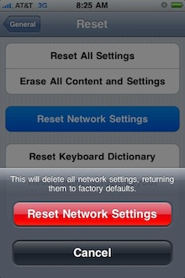
6. How would you troubleshoot networking issues on iPhone? 1
1. Home Screen – Settings Tab – General – Network – Wi-FI (On/Off) – Choose Network) – Ask to Join Networks (On/Off)
2. Home Screen – Settings Tab – General – Reset – Reset Network Settings
Note: It will also reset your remembered Wi-Fi access points and their passwords, so be ready to re-enter a bunch of WEP/WPA keys!
3.Connect through the iOS VPN under Setting- General – Network.
It is a “virtual private network” (VPN) configuration for Apple iOS devices: iPad, iPhone, and iPod Touch. The VPN allows users not on the UCSF network (alternative to traditional wired connectivity), access to restricted resources on the UCSF network in the same way as you would from the UCSFwpa wireless network.
http://support.apple.com/kb/HT3204

Slide 65
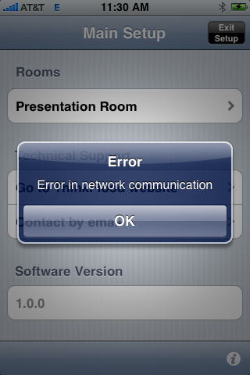
6. How would you troubleshoot networking issues on iPhone? 2
4. If you are experiencing network timeouts when connected to your home Wi-Fi network, please try turning off Bluetooth, as the iPhone’s current Bluetooth drivers sometimes interfere with Wi-Fi.
5. Sometimes the iPhone does not “like” being attached to an ad-hoc network, and will often drop the Wi-Fi network connection and jump over to the cellular network. This problem does not exist for iPod touch devices, as they do not have other network options.
Home Screen – Settings – Airplane Mode ON – WI-FI ON – Select RedEye Network
Note: You will not be able to receive calls on your phone with Airplane Mode ON, so please remember to turn it off when you are finished.

Slide 66
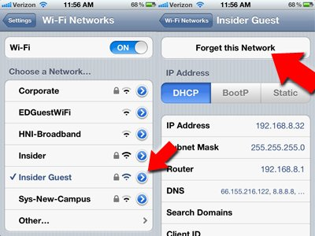
6. How would you troubleshoot networking issues on iPhone? 3
6. I can't connect to my Wi-Fi network anymore
Wi-Fi routers are fickle creatures.
Whether it's a problem on your iPhone or a router problem, one quick trick to "start from scratch" with your Wi-Fi connection is by "forgetting" a network you've joined.
Go to Settings, then Wi-Fi, then tap the blue arrow next to the network you want to forget, then tap "Forget This Network."
Once you've forgotten the network, tap it in your Wi-Fi screen to do a fresh re-connect

Slide 67
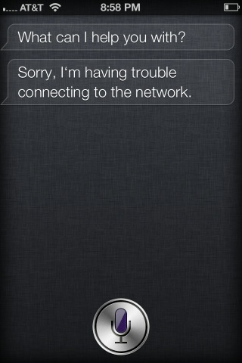
6. How would you troubleshoot networking issues on iPhone? 4
7. Troubleshooting of Siri (4S)
Go to Settings in your iPhone and go to the Siri tab.
Disable Siri
Turn off the iPhone 4S
Turn on the iPhone 4S
Go to Settings again and enable Siri
The steps are basically about resetting Siri and it would again catch up with the network and the connection would normally happen.
The fix worked for many, but a few couldn’t still resolve the problem, but keep trying and the response from Siri would be back at any point of time.

Slide 68
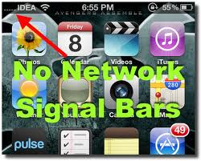
6. How would you troubleshoot networking issues on iPhone? 5
8. No network signal Bars
Try rebooting the iPhone.
If it dint work do a hard reboot on iPhone. Press and hold the Lock button on top + the home button until you see the apple logo. Don't worry you wont loose any data or settings.
Still the same? Dial 112 and end the call now quickly turn on airplane mode and then off. Wait a few seconds till your phone searches for network. After a few seconds you will see full network signal bars on your iPhone.
The last option is doing a complete restore from iTunes if you just cannot get back the signal bars.
Backup your phone from iTunes and then restore, after that right click on the iPhone name on left sidebar and select restore from backup to restore all your apps and settings like before.
Still no network on iPhone?. Time to contact apple.
http://support.apple.com/kb/index?page=search&src=support_site.home.search&locale=en_US&q=network

Slide 69
Specific of Mobile Testing
Section 4
1. How do you usually explore the new Mobile Device/Phone?
2. How would you test UI of mobile app?
3. How would you test the mobile app page?
4. Give Examples of Major Test Cases for mobile device
5. Write as many Test Cases you can for the following: Mobile device, simple app with three buttons (1,2,3) that making the sounds.
6. How would you troubleshoot networking issues on iPhone?
7. How would you test the following: you send Yahoo message from your mobile device to someone else device, and recipient doesn’t receive a message?
8. What is your Stress test approach when testing Face time on iPhone?
9. How do you do Boundary testing to verify a battery’s life, if a game application suppose to last for 24 hours?
10. Tell me about Specifics of the Mobile games testing?

Slide 70
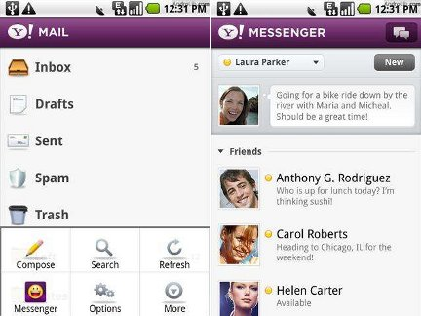

7. How would you test the following: you send Yahoo message from your mobile device to someone else device, and recipient doesn’t receive a message? 1
Check for the network connection.
Try to send message from different device and check if it does works.
Try to send message to your mobile device from different device. Check your ability to receive message.
Check the source code.
Check sync with Yahoo.
Check manual/documentation about compatibility with “provider” Mobile Email
Check the Spelling of account settings
Double Check the spelling of each account setting, domain name, account name (is the email address complete)
Note: Passwords are case sensitive
Make sure that you do not have CAP LOCK on - passwords are case sensitive.
http://www.tricksmachine.com/2012/08/5-best-email-apps-for-android.html

Slide 71


7. How would you test the following: you send Yahoo message from your mobile device to someone else device, and recipient doesn’t receive a message? 2
Check your Outgoing Mail, Incoming Mail, Drafts, Sent, and Outbox mailboxes.
If error message occurs on iPhone because of other email applications not made by Apple, then try to send a message via your me.com or mac.com account
Ask the recipient to check any "Junk" mail folders or mailboxes on their end. Perhaps your message was received but inadvertently filtered.
If your recipient still does not receive your mail, but your mail is being sent without any alerts or "Undelivered mail" messages, then your mail might be blocked or filtered by the mail systems at MobileMe or the recipient's location. The best way to determine if this is the issue is to contact MobileMe Support directly

Slide 72

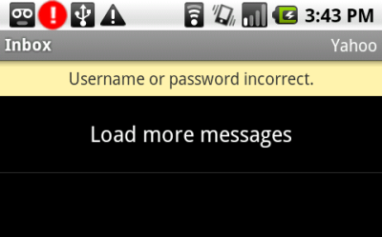
7. How would you test the following: you send Yahoo message from your mobile device to someone else device, and recipient doesn’t receive a message? 3
Ensure mail is enabled for your account
From the Home screen, tap Settings > Mail, Contacts, and Calendars > (your MobileMe account). Make sure the Mail slider is On. Ensure Push is selected for your MobileMe account's mail
Ensure Push is enabled on your iPhone, iPad, or iPod touch
From the Home screen, tap Settings > Mail, Contacts, and Calendars > Fetch New Data. Make sure the Push slider is On.

Slide 73


7. How would you test the following: you send Yahoo message from your mobile device to someone else device, and recipient doesn’t receive a message? 4
The problem is possibly could related to the email storage limit.
The size limit on any individual email is total encoded size 25MB.
If the error message is about a “Relay Failure”, you will notice that it refers to a non-Virgin email address. This happens because most Internet Service Providers (ISP's) do not allow a user to send emails using that company's mail server unless the user is currently connected to that ISP's network (via their dialup/broadband connection).
Email some Internet link to yourself.
Check "use authentication" for the outgoing server
Change outgoing port

Slide 74
Specific of Mobile Testing
Section 4
1. How do you usually explore the new Mobile Device/Phone?
2. How would you test UI of mobile app?
3. How would you test the mobile app page?
4. Give Examples of Major Test Cases for mobile device
5. Write as many Test Cases you can for the following: Mobile device, simple app with three buttons (1,2,3) that making the sounds.
6. How would you troubleshoot networking issues on iPhone?
7. How would you test the following: you send Yahoo message from your mobile device to someone else device, and recipient doesn’t receive a message?
8. What is your Stress test approach when testing Face time on iPhone?
9. How do you do Boundary testing to verify a battery’s life, if a game application suppose to last for 24 hours?
10. Tell me about Specifics of the Mobile games testing?

Slide 75
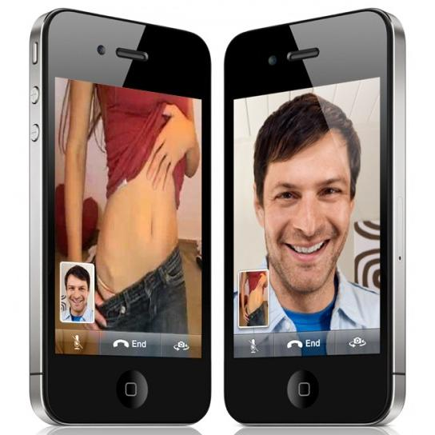
8. What is your Stress test approach when testing Face time on iPhone? 1
Video Chatting Technology of Apple
Please, see these two YouTube video before proceed
http://www.youtube.com/watch?v=LGzEy3oQ4Co
http://www.youtube.com/watch?v=KRV4FYSMWVM

Slide 76
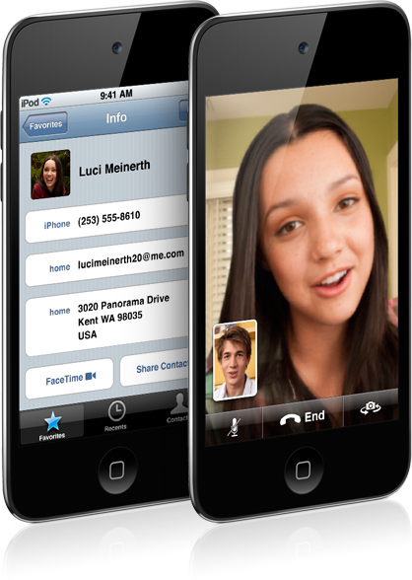
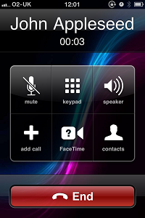
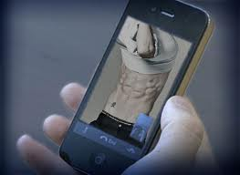
8. What is your Stress test approach when testing Face time on iPhone? 2
What is the Face Time general features? What we need to “Stress out”?How we can stressed it?
Activation of FaceTime option on your iPhone/iPad/iPod
New Call begin when the person you’re calling accepts the Face Time invitation
Video Call
Voice Call
Switching between Front and Back Camera
My own picture/video on the chat -screen

Slide 77

8. What is your Stress test approach when testing Face time on iPhone? 3
Contacts info invalid
Invitation to Contact send it with the Fake Identity
Try to Edit/Modify/Delete Contact info during a Chat
During a Video Call/Chat:
Initiate multiple calls/video/chats with other Face Time Contacts
Running Music/Games/Video/Web apps during the Video/Call Chat
Download some big File during the Chat session
Play abusive way with Portrait/Landscape Layout
Play abusive way with the Front/Back Camera
Turn video chatting, still running call session and try to open multiple apps, website, music, video
Use Face Time Session outside, with the street noise, sunlight/nighttime, in the Disco club, etc.

Slide 78
Specific of Mobile Testing
Section 4
1. How do you usually explore the new Mobile Device/Phone?
2. How would you test UI of mobile app?
3. How would you test the mobile app page?
4. Give Examples of Major Test Cases for mobile device
5. Write as many Test Cases you can for the following: Mobile device, simple app with three buttons (1,2,3) that making the sounds.
6. How would you troubleshoot networking issues on iPhone?
7. How would you test the following: you send Yahoo message from your mobile device to someone else device, and recipient doesn’t receive a message?
8. What is your Stress test approach when testing Face time on iPhone?
9. How do you do Boundary testing to verify a battery’s life, if a game application suppose to last for 24 hours?
10. Tell me about Specifics of the Mobile games testing?

Slide 79


9. How do you perform Boundary testing to verify a battery’s life, if a game application suppose to last for 24 hours? 1
1. Tricky question that must be immediately clarified and specified:
Part one – boundary testing of the battery life (that more likely less than 24 hours)
Part two – what happen to the game apps that suppose to last for 24 hours.
Under what conditions: actively run, in sleep mode, or pause…
What are our points of interest in this Question:
How is the game application affect battery consumption?
How is the usage of battery affect functionality and performance of game?
What will happen to the game when battery will turn dead and need to be charged?

Slide 80

9. How do you perform Boundary testing to verify a battery’s life, if a game application suppose to last for 24 hours? 2
Helpful App to track the battery life and consumption:
Battery Life Pro/Battery Doctor Pro (iPhone, iPod Touch)
Battery Monitor Widget (Android)
Karat (for iPhone and Android) – shown what app to kill and how much battery life/time you save
Example of Battery Life Test
When we conduct battery life test, we start with a fully charged phone. The phone's display is set to a brightness level of 50 percent, and the backlight is set to turn off after 10 seconds. All phones are set to the same volume level, which we measure electronically to ensure fairness and consistency in testing. If the phone includes an EQ setting, we set it to "flat." We play a set of repeating audio files and record the amount of time that passes until the phone's battery drains and it shuts off. We run this test multiple times until we have at least two sets of scores that are within +/-5 percent of each other, and we report the average.
http://www.youtube.com/watch?feature=player_embedded&v=P1Hv2sUPKeM

Slide 81

9. How do you perform Boundary testing to verify a battery’s life, if a game application suppose to last for 24 hours? 3
Test Cases that should be create:
1. When Battery life become less than 10% - audible or text message appears.
2. When Battery life become less than 10% - game notifications appears, game will be saved at the current level, session will be ended/paused
3. When Battery life less than 50%- 30%-25%-10% it should not affect any game functionality or performance
4. If multiple application running on the background (on the device) it should not affect game functionality and performance)
5. When battery life is 0%, it should not affect saved, backup, or sync processes of game app. After battery is charged, game should be able to resumed/re-loaded from the same point (or within 1 minute before).
http://reviews.cnet.com/cell-phone-battery-life-charts/

Slide 82
Specific of Mobile Testing
Section 4
1. How do you usually explore the new Mobile Device/Phone?
2. How would you test UI of mobile app?
3. How would you test the mobile app page?
4. Give Examples of Major Test Cases for mobile device
5. Write as many Test Cases you can for the following: Mobile device, simple app with three buttons (1,2,3) that making the sounds.
6. How would you troubleshoot networking issues on iPhone?
7. How would you test the following: you send Yahoo message from your mobile device to someone else device, and recipient doesn’t receive a message?
8. What is your Stress test approach when testing Face time on iPhone?
9. How do you do Boundary testing to verify a battery’s life, if a game application suppose to last for 24 hours?
10. Tell me about Specifics of the Mobile games testing?

Slide 83

10. Tell me about Specifics of the Mobile games testing? 1
http://en.wikipedia.org/wiki/Tweaking
http://www.youtube.com/watch?v=ppW7UlnMdAQ

Slide 84

10. Tell me about Specifics of the Mobile games testing? 2
Game testing, a subset of game development, is a software testing process for quality control of video games.
Specific of the Mobile Game testing:
1. Layer: Functionality – Usability – Performance – Sync Services
2. Layer: Game Script –Player Profile – Score/Championship - Upgrade Store – Bonus – Social Network (OMP/MMORPG)
3. Layer: Global Monetanization System
4. Layer: Security – Analytics Testing
5. Layer: Classic Web site application testing techniques
6. Industry Specific: Compliance testing, Soak Testing

Slide 85



10. Tell me about Specifics of the Mobile games testing? 3
1. Agile Environment:
Short-Term Release – 1-4 weeks Sprint.
Production of Modules – ready to go with certain Block-features.
2. Game testing Psychology:
Put yourself in the shoes of End User
Open ID account
Statistics: Install – Uninstall Games
3. Game App development:
Native vs. Hybrid vs. Web
4. Test approach:
Ad-Hoc
Sprint Checklist
Test Plan/Test Cases
http://openid.net/
http://en.wikipedia.org/wiki/OpenID

Slide 86

Mobile Technology in near future

Slide 87

Google Android Future – Q1 2014
Google Project Glass
http://www.youtube.com/watch?v=9c6W4CCU9M4&feature=player_embedded

Slide 88



Era of Augmented Reality by iPhone:
http://mashable.com/follow/topics/augmented-reality/
http://www.youtube.com/embed/hsEUBLIJvmE
Researchers and engineers are pulling graphics out of your television screen or computer display and integrating them into real-world environments. This new technology, called augmented reality, blurs the line between what's real and what's computer-generated by enhancing what we see, hear, feel and smell.
http://www.youtube.com/watch?v=rczqP0FwWrk&feature=related

Slide 89


Apple patent ergonomic input device
http://www.ergonomicchair.org/news/43/Apple-Patents-the-Ergonomic-Input-Device-of-the-Future.htm

Slide 90






Flexible Phones: Nokia. Samsung, Phillips, Axus

Slide 91




Slide 92

Paper Phone Technology (Canada 2011)
http://www.youtube.com/watch?v=lu3z-G1rE6k

Slide 93


Nokia flex 888
http://www.youtube.com/watch?v=8xrZduRfX_M&feature=related

Slide 94

Finger Touching Wearable Mobile Device
A wearable mobile device for enhanced chatting. It introduces a new wearable device that anyone can communicate with that is easier and lighter in mobile circumstances corresponding to the 3.5G, 4G communication standard.
Human hand is the most basic communication method.
For easier and simpler controls, it uses the instinctive input method “finger joint”. Excluding the thumb, each finger joint makes up twelve buttons, with “the knuckle button”, using the cell phone's 3X4 keypad, likely being the most popular input method.

Slide 95

BlackBerry biometric Phone
Imagine sharing your feelings not directly, but via the ring we mentioned. How cool is that?
BlackBerry Empathy connects the user straight away to sites like FaceBook and MySpace for quick messaging and status updates.
The device also comes with proximity sensors, allowing you to detect the emotions of the folks nearby through an emotion chart with a visual timeline.
Empathy uses movable keys, a translucent tactile keyboard and a flexible OLED display, plus a HUD (heads up display).
The keypad on this phone can change color according to the user’s emotions, that are sensed through messages, phones calls and biometric sensors.
Does this new take on social networking scare you, or do you find the concept appealing?

Slide 96

New Input Device by Nokia
Researchers at Nokia have created a magnetic ring that works as an input device from which you can control your mobile phone.
The ring is called Nenya and it is tracked by a wrist-worn ‘bracelet’, which connects to the users phone via Bluetooth.
Twisting the ring on your finger causes changes in the magnetic field, which are picked up by the base bracelet and transmitted to the connected mobile device.
As you rotate the ring, this effectively scrolls through different functions such as turning up your music, putting a caller on hold or updating social network sites. Pushing the ring towards your fingertip works like a ‘select’ button and the instruction is sent to your mobile.
The researchers found that users who tested the ring could accurately position it in 45 degree increments, suggesting it could be used to control eight different functions.
http://www.psfk.com/2011/04/nokias-ring-that-can-control-your-mobile-phone.html

Slide 97




Nike-Android Watch 2013

