Slide 1
Mobile Testing In questions and answers
Created by Ivette Doss

Slide 2
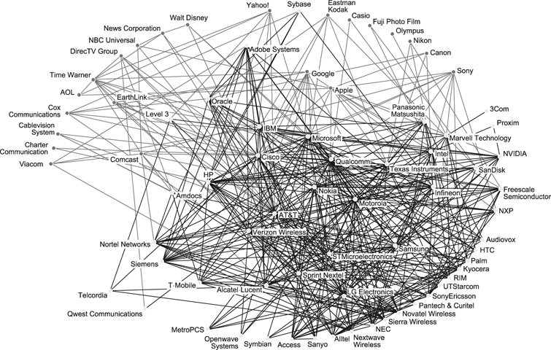
http://www.mobileappstesting.com/getting-started-with-mobile-apps-testing/

Slide 3
Quick Starter for Newbies:
Basics of Software Testing: Software testing principles, Software Testing Techniques, Types of Software Testing, Objective of Testing, Creation of Defect Report
Basics of Telecommunication/Network: CDMA, GSM, SIM, 3G, 4G, WAP 2.0,etc
Awareness about Mobile OS/Platforms: the capabilities and limitations of these platforms gives confidence to differentiate application bug with platform/OS limitations.
Get familiar with your own Mobile Phone: Use Wi-Fi, GPRS. Check what is the IMEI number, OS version of your phone. Experiment with different settings and user permissions on your phone. It will help you to dig out more scenarios while testing any mobile app or any mobile Handset you are given to test.
Get aware of Testing in Mobile Domain: Downloadable Mobile Application Testing, Mobile Handset Testing, Mobile Website Testing
Get Aware of Types of Mobile Apps Testing: User Interface Testing, Functional Testing, Performance & Stress Testing, Usability Testing
Get Aware of Specific Types of Mobile Apps Testing:-Testing for Compatibility, Certification Compliance Testing, Submission Guidelines Compliance Testing, Interruption Testing , Monkey/Soap Testing, Low Network/No Network case Testing
Go through the Sample Test Cases for Mobile Application
Explore the Necessities and Capabilities of Simulator:-Simulators always play big role when there are no mobile devices available for testing. Though Device testing is always preferred as it represents more likely end user scenarios, the importance of simulators cannot be ignored.
Popularity of Remote Device Access Service-Due to a large number of devices available in the market, it is not feasible to buy a new device every time. At the same time Simulators are not completely reliable enough to launch a mobile app based on testing conducted only on simulators. RDA (Remote device services) can be a good solution to deal with these challenges. The remote device access services enable access to a live device over the Internet.
Self-Explore Tools and Utilities
Self-Explore Automation Tools for Mobile
Self- Explore Communities, Forums, Blogs

Slide 4
Mobile Ecosystem
Services
Networks
Operators
Applications
Devices
Manufactures
Application Frameworks
Platforms/OS
http://www.mobileburn.com/definitions.jsp

Slide 5
Operators-Carriers-Providers
We hate them, but Operators are what essentially make the entire mobile ecosystem work.
They install cellular towers, operate the cellular network, make services (such as the Internet) available for mobile subscribers, and they maintain relationships with the subscribers, handling billing and support, and offering subsidized device sales and a network of retail stores.
The operator’s role in Mobile World is to create and maintain a specific set of wireless services over a reliable cellular network.
In US top four carriers are: Verizon, AT&T, Sprint, T-Mobile

Slide 6
Mobile Ecosystem
Services
Networks
Operators
Applications
Devices
Manufactures
Application Frameworks
Platforms/OS
http://www.mobileburn.com/definitions.jsp

Slide 7
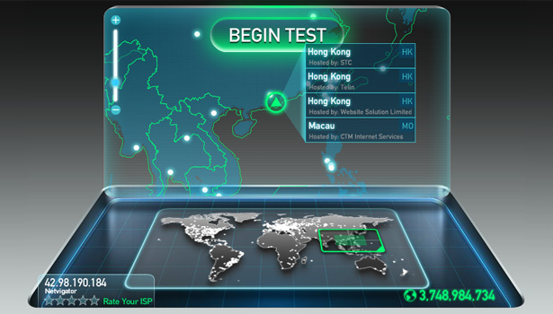
Network in Mobile testing
1. Connection
2. Mobile Protocol stack testing. (using network simulators)
3. Ability to save and transfer information
4.Performance – Load-Stress Testing
5. Geo-Location API and application

Slide 8
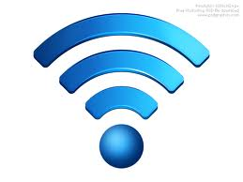
Network: Concept
The cellular technology is just a radio that receives a signal from an antenna.
The types of radio waves and antennas determines the capability of the network and differentiate the services.
The basic networks around the world are the GSM (Global System for Mobile Communications) and CDMA (Code Division Multiple Access)

Slide 9
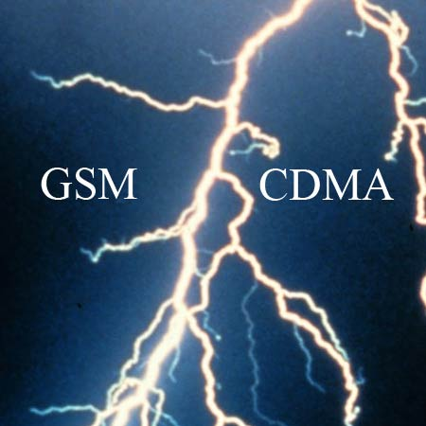
Definition you should know:
Global System for Mobile Communication
AT&T and T-Mobile
Voice calling, text
messaging, data service
similar to CDMA
Visible feature – SIM card
that identify the user on the
network and could be use as
a storage. SIM cards allowed
Users switch phones by
simply moving their SIM’s
between the phones.
Advance (2.5-3G) techno-
logy refers to: GPRS, EDGE.
Standard speed 128 kb/s to max 480 kb/s
Code Division Multiple Access
Verizon and Sprint
Five times up of GSM
capacity. More secure –
used by military
QUALCOMM designs the
chips for the CDMA air
interface.
Advance technology refers to: WCDMA, FDMA, TDMA, CDPD.
Standard speed 500 kb/s to max 2.5 Mbit/s

Slide 10
Types of Wireless Network: Satellite
Compared to other forms of wireless Internet service, satellite enjoys the advantage of availability. Requiring only a small dish antenna, satellite modem and subscription plan, satellite works in almost all rural areas not serviced by other technologies.
However, satellite also offers relatively low performing wireless Internet. Satellite suffers from high latency (delay) connections due to the long distance signals must travel between Earth and the orbiting stations.
Satellite also supports relatively modest amounts of network bandwidth.
http://related.wisegeek.com/related/?kw=Maps+Earth+Satellite&rt=ChBRBhz8AA5PFwpFAamAAExFEhRNYXBzIEVhcnRoIFNhdGVsbGl0ZRoIHphUDNR_QIYoAVITCMKpw764irUCFWMGRQod_FUAog&url=http%3A%2F%2Fwww.wisegeek.com%2Fhow-many-satellites-are-orbiting-the-earth.htm

Slide 11
GPS.gov and other
The Global Positioning System (GPS) is a space-based satellite navigation system that provides location and time information in all weather conditions, anywhere on or near the Earth where there is an unobstructed line of sight to four or more GPS satellites.
It is maintained by the United States government and is freely accessible to anyone with a GPS receiver.
As of December 2012,there are 32 satellites in the GPS constellation (named patterns of stars).
The Russian Global Navigation Satellite System (GLONASS) was developed contemporaneously with GPS, but suffered from incomplete coverage of the globe until the mid-2000s.
There are also the planned European Union Galileo positioning system, Chinese Compass navigation system, and Indian Regional Navigational Satellite System.
http://en.wikipedia.org/wiki/Global_Positioning_System

Slide 12
Types of Wireless Network: Wi-Fi
Wi-Fi networks are a very common public wireless Internet service.
Those so-called mesh networks join numerous wireless access points together to span larger urban areas.
Individual Wi-Fi hotspots also provide public wireless Internet service in select locations.
Equipment is inexpensive (many newer computers have the needed hardware built in), and Wi-Fi hotspots remains free in some locales.
Availability can be a problem, specifically in most suburban and rural areas.

Slide 13
Types of Wireless Network: Mobile Broadband
The term mobile broadband refers to high-speed wireless Internet connections and services designed to be used from arbitrary (not restrained or limited) locations.
With an installed cellular network adapter, or by tethering a cell phone to any kind of computing device, Internet connectivity can be maintained in any area with cell tower coverage.

Slide 14
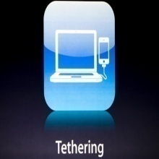
What is a Tethering?
Tethering is a way to share an Mobile phone cellular data connection with other nearby computers and wireless devices.
All data send to and from those devices is routed through the Mobile Phone.
Devices can connect to the Mobile Phone when it's in tethering mode in three different ways:
Wi-Fi, Bluetooth, USB
When tethering is enabled, the Mobile phone functions like a cellular modem or Wi-Fi hotspot, and broadcasts the Internet connection to devices it connected to.
http://tether.com/

Slide 15
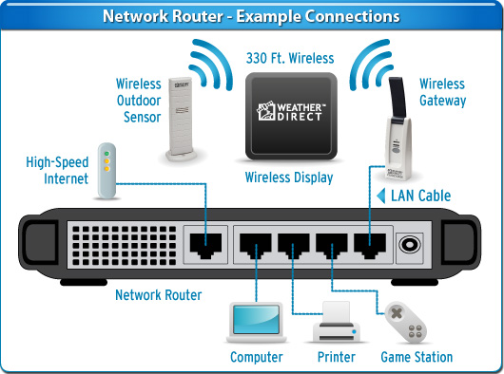
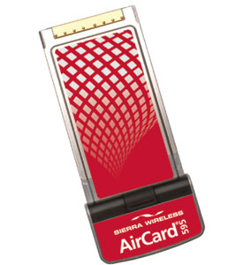
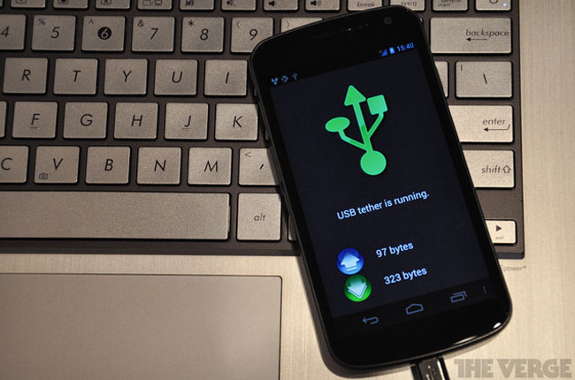
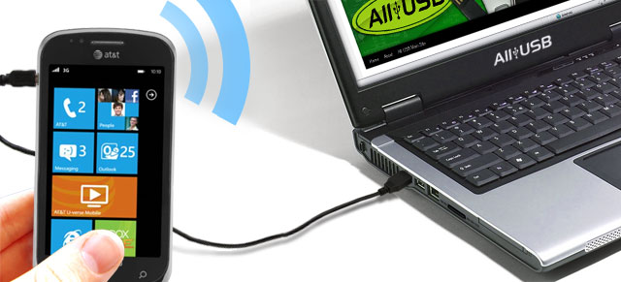
Interview Question: Types of Cell Modems
Three main types of cellular modems exist for computer networking:
cell phones - using phones as modems to enable Internet access on computers, sometimes called tethering.
cellular cards - portable network adapters that plug into computers, sometimes called aircards
cellular routers - portable network routers that contain built-in cellular modems

Slide 16
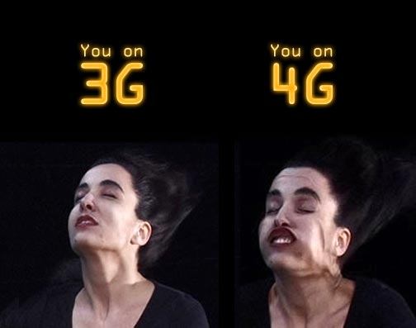
Mobile Network: 1 to 4G – era
The first generation of wireless technology 1G, refers to the analog signal used by cellular towers.
2G technology upgraded the analog signal to digital and allowed the inclusion of sending text messages across the network.
3G technology made use of electromagnetic wavelengths, known as spectrum, to broadcast a wireless broadband signal that allowed users to access the Internet and download applications using a 3G data card or a handheld mobile device such as a Blackberry or iPhone.
4G is called an “ultra-broadband” access for mobile devices. 4G networks are based on an all Internet protocol packet switching instead of circuit-switched technology, and use OFMDA multi-carrier transmission methods or other frequency-domain equalization (FDE) methods instead of spread spectrum radio technology.
Types of 3G broadband include: Enhanced Data GSM Environment (EDGE), EV-DO, and High-Speed Downlink Packet Access (HSDPA).
WiMax and LTE represent 4G broadband.

Slide 17
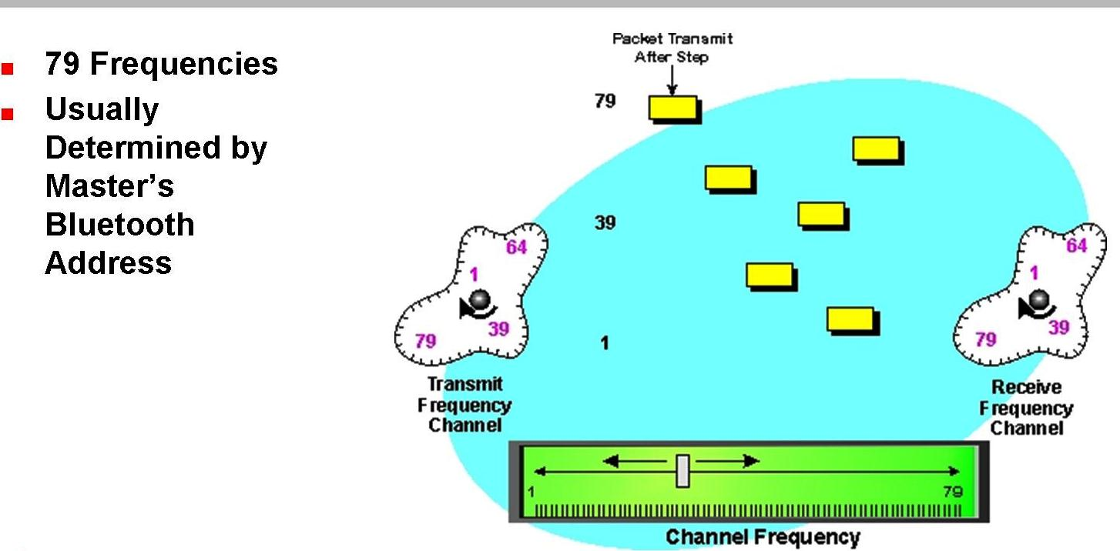
Mobile Protocol Stack - terminology
handover or handoff refers to the process of transferring an ongoing call or data session from one channel connected to the core network to another.
Frequency-hopping spread spectrum (FHSS) is a method of transmitting radio signals by rapidly switching a carrier among many frequency channels.

Slide 18
Connecting via Mobile Network
Technology | Abbreviation Meaning | Connection Speed
GPRS | General Packet Radio Service (2-3G GSM) | 128 kb/s
EDGE | Enhanced Data for GSM Evolution | Up to 476 kb/s
HSPA | High-Speed Packet Access | Up to 1 Mbit/s
3G | Third Generation | 384 kb/s to 2 Mbit/s
HSDPA (“3.5G”) | High-Speed Downlink Packet Access | 14.4Mbit/s
4G WiMax | Worldwide Interoperability for Microwave Access | 128Mbit/s
4G LTE | Long Term Evolution | 300Mbit/s to 1Gbit/s

Slide 19
Mobile Ecosystem
Services
Networks
Operators
Applications
Devices
Manufactures
Application Frameworks
Platforms/OS
http://www.mobileburn.com/definitions.jsp

Slide 20
Makers/Manufactures in Mobile Testing
Manufacture determines and affects:
1. OS Hardware and Firmware (Software)
2. Mobile Platform
3.Mobile Browsers
4. Devices
5. Ways of future technology
6. The model and approach of Mobile Testing

Slide 21
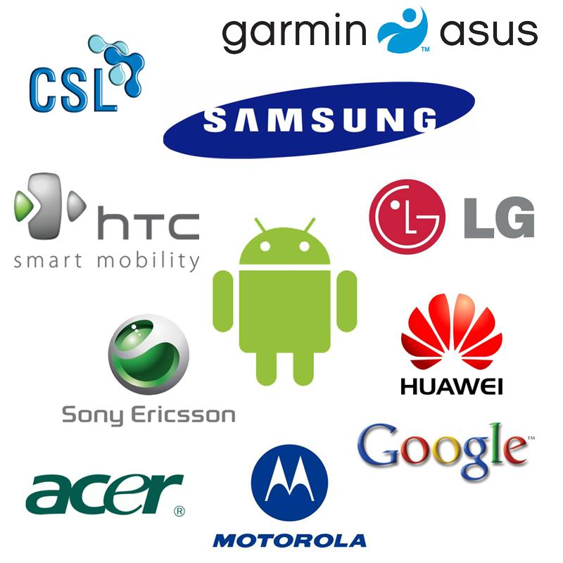
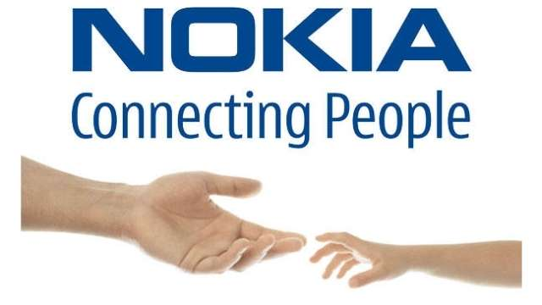
Mobile Phones Makers/Manufactures

Slide 22
Mobile Ecosystem
Services
Networks
Operators
Applications
Devices
Manufactures
Application Frameworks
Platforms/OS
http://www.mobileburn.com/definitions.jsp

Slide 23
Mobile Devices in Mobile Testing
1. Form Factor
2.Hard and Software
3. Features and Options
4. UI
5. Target in Testing Planning

Slide 24
Types of Mobile Devices:
Mobile computers
Pager
Personal Navigation device (PND)
Tablet Computer
Mobile phone
Digital video Camera (DVC)
Digital still camera(DSC)

Slide 25
Mobile Computers:
Mobile Internet device
Mobile WEB
Personal Digital Assistant
Calculator
Handheld game console
Mobile Collaboration
Portable media player

Slide 26
Mobile Ecosystem
Services
Networks
Operators
Applications
Devices
Manufactures
Application Frameworks
Platforms/OS
http://www.mobileburn.com/definitions.jsp

Slide 27
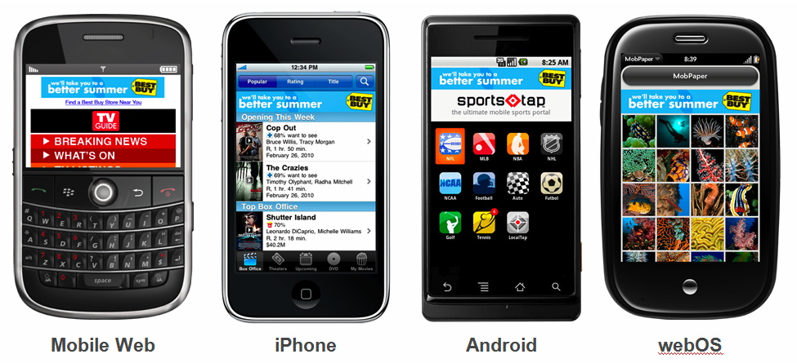
Platforms in Mobile Testing:
1.Mobile Features
2. Standard/Pre-installed Software
3. GPS
4. Multi-tasking
5. Email
6. Switching between apps
7. Network Connection
8.UI
9. Apps Store:
Submission requirements
Development specifications
User guides
Number of application

Slide 28
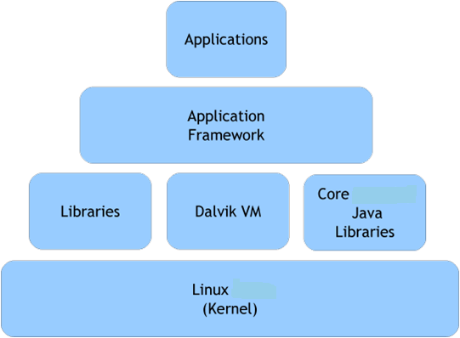
Interview Question: What do you know about Mobile Platforms?
Mobile Platform is the term that includes a hardware architecture and a software framework (including application framework), where the combination of components allows software (application software) to run.
Typical platforms include computer architecture, operating system, programming languages and related user interface (Run-Time system libraries or graphical user interface).
A Platform is a crucial fundamental element in software development.
It might be simply defined as a place to establish software.
Some software platforms emulate entire hardware platforms – as in systems virtualization (JVM).
Hardware

Slide 29
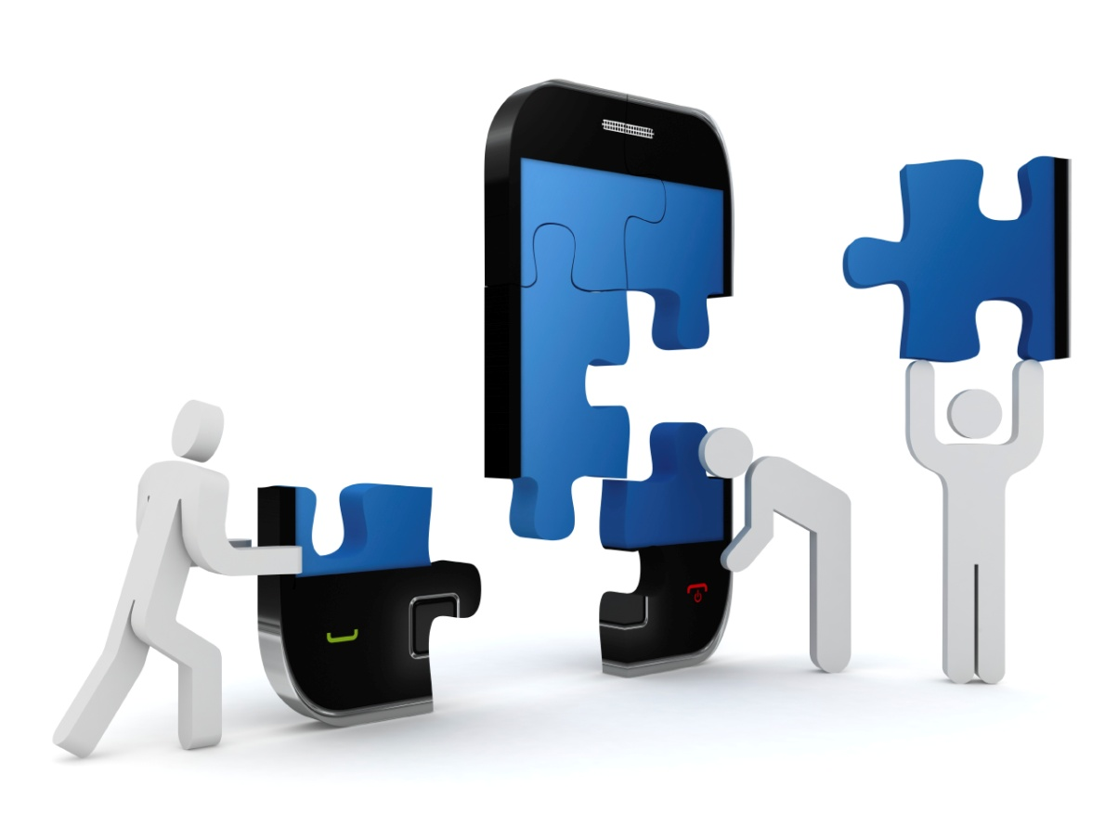
Clarify definition of Platform:
1. Platform as Conceptual Mobile Architecture.
2. Platform as an Operating System.
3. Platform as an Application Development base.
4. Platform as a kernel/platform, buffer and bridge between hardware and software
5. Platform as a core programming language in which all program for device are written

Slide 30
Types Mobile Platforms
Licensed
JME
BREW
Proprietary
OS X
Symbian (Eclipse Lic.)
Open Source
Android-OHA
LiMo
BB QNX
Windows Phone
bada
Maemo
MeeGo
webOS
Tizen
Linux
Alternative

Slide 31
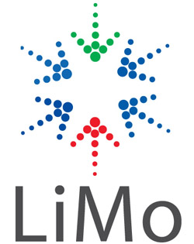
Platforms: Licensed
The major goal of Licensed Platforms was to create a common/standard platform of Application Programming Interfaces (APIs) development that work similarly across multiple devices with the minimum effort required to adapt the device differences.
Licensed platforms are sold to device makers for non-exclusive distribution on devices.
Example: JME - Sun Microsystems/Oracle; Brew MP – HTC Smart Phone or carrier’s firmware, etc

Slide 32
Proprietary Platforms
GOOD
BAD
Simplified User Experience
Limited Customizability
User Multiplier Effect
Interoperability
Proprietary platforms are conceptualized, designed, developed and sold by device-makers to use on their devices.
They are not available for competitor device makers use.
http://www.ehow.com/info_8366503_advantages-disadvantages-proprietary-operating-system.html

Slide 33
Open Source Platforms
Open source platforms are practicing the main principle of Open-Source software development: the Peer production by bartering and collaborating with the end-product, source material, “blueprints”, and documentation that available at no cost to the public.
Platforms are freely available for users to download, alter, or edit.
The major Open Source Platforms are Android, webOS, Tizen, Linux

Slide 34
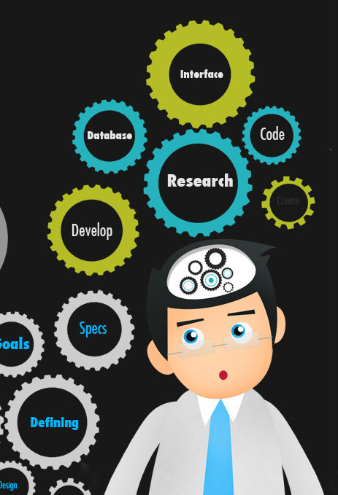
What mobile platforms are you familiar with?
Android
OS X (iOS)
BlackBerry QNX
Windows Phone
Tizen
Linux (OS)
BREW MP
Symbian (OS)
Palm webOS

Slide 35
Clarify confusion: OS=Platform
The terms platform and operating system mean almost the same thing.
An operating system lets your computer run and control its most basic functions, but the platform is something, upon what programs/applications (like calendar or web browsers) can be installed and used.
Think of platform as a broader term denoting the difference between Mac and Windows in general, while operating system is more often used to when referring to specific versions of Windows or Mac.
http://www.pcmag.com/category2/0,2806,2362,00.asp

Slide 36
Open vs. Close Mobile System
Proprietary - iOS
Open Source - Android

Slide 37
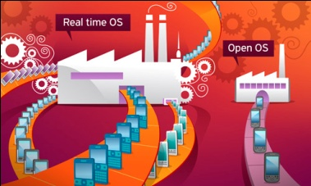
Types of Operating System
Real Time OS
Real time operating systems (RTOS) intended to serve real-time application requests.
Real-time computing (RTC) is the study of hardware and software systems where the subject is an operational deadline from event to system response. Real-time programs must guarantee response within strict time constraints.
As Example: Related to the Virtual Machine or embedded systems.

Slide 38
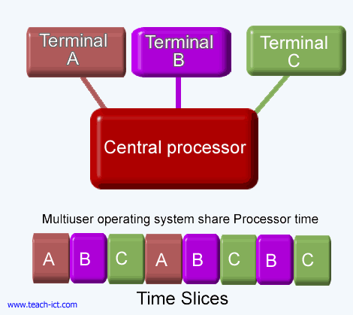
Types of Operating System
Multiuser operating systems, as the name indicates, allows multiple users to run programs concurrently on the computer.
Some multiuser operating systems allows only tens of users, whereas some other OS allows thousands of users to work at the same time, without compromising the performance.
As Example: Related to the Servers and Cloud Services

Slide 39
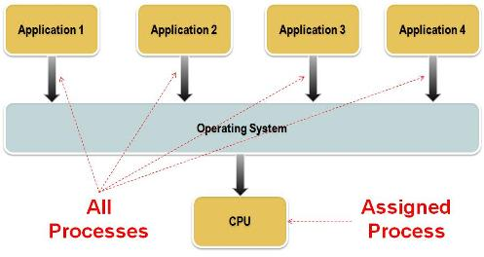
Types of Operating Systems
Multitasking operating systems allows multiple programs to run on the computer simultaneously.

Slide 40
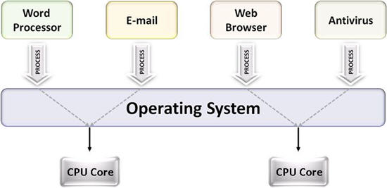
Types of Operating Systems
Multithreading OS is even smarter, because it allows different parts of different programs to run concurrently, thus increasing the performance to a higher extend.

Slide 41
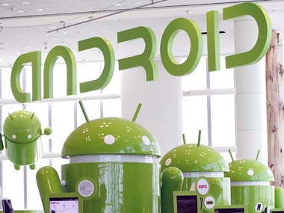
Android is the Number ONE
Android, the flagship software of the OHAlliance, is based on an open source license and has been available since October 2008.
Google published the entire source code (including network and telephony stacks) under an Apache License.
With the Apache License, vendors can add proprietary extensions without submitting those back to the open source community.

Slide 42
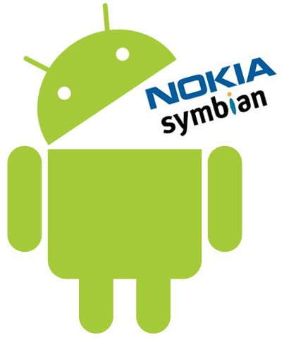
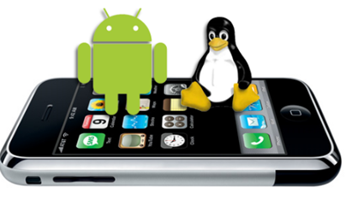
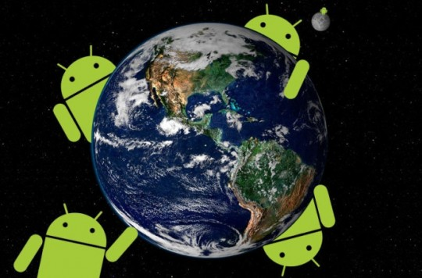
Describe Android OS
Source
Platform
Core Language
OS Architecture
Version History
Updates/Upgrades
Makers
Carriers
Life Battery
Web Browsers

Slide 43
Architecture of Android
Applications
Home
Phone
Application Framework
Package Manager
Telephony Manager
Libraries and Android Runtime
Android Runtime consist:
Contacts
Browser
Content Providers
Location System
Notification System
Dalvik Virtual Machine
Linux Kernel
Drivers Package
Power management
Hardware
Core Java Libraries
Libraries:
Media SurfaceM FreeType
Open GL\ SSL SQLite
WebKit SGL libc
OS
http://www.mindcracker.com/Story/1076/architecture-of-android

Slide 44
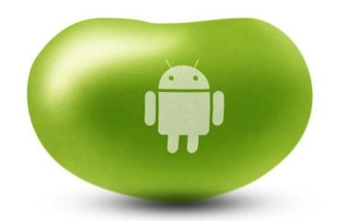
Android Versions History – NEED to KNOW
July 9, 2012
Jelly Bean
Android 4.1
04-2009
09-2009
11-2009
05-2010
Jelly Bean
Android 4.2
November, 2012
12-2010
02-2011
10-2011

Slide 45
Most common Android Version:
2.3.3-2.3.7 Gingerbread | 02-2011 | 39.5%
4.0 Ice Cream Sandwich | 10-2011 | 28.7%
4.1 Jelly Bean | 07-2012 | 15.5%
http://www.theverge.com/2011/12/7/2585779/android-history

Slide 46
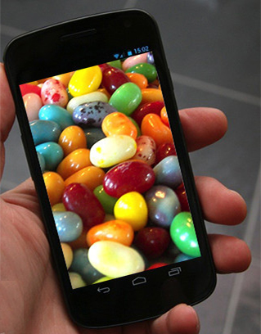
What is the Latest Android version?
JellyBean 4.2
November 13, 2012
http://www.youtube.com/watch?v=afNRAOg5jUk

Slide 47
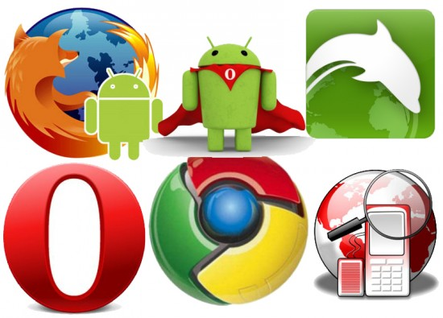
What Android Browsers do you know?
SkyFire
Google Chrome
June 28, 2012
Opera Mini 7
Opera
Maxthon
Sleipnir
Dolphin
Mozilla FireFox
xScope
Web Android
http://www.youtube.com/watch?v=reYXAERpdWQ
http://techhamlet.com/2012/06/best-browser-apps-android-device/

Slide 48
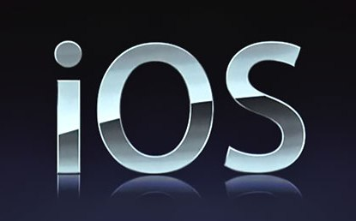
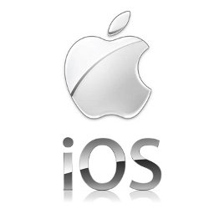
What do you know about iOS/Platform?
Source
Platform
Core Language
OS Architecture
Version History
Updates/Upgrades
Makers
Carriers
Life Battery
Web Browsers

Slide 49
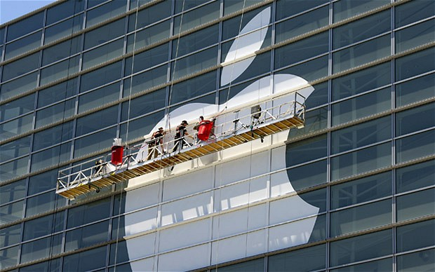
Operating System: iOS
iOS is derived from Mac OS X that shares with the Darwin foundation; and therefore, it is a Unix operating system.
Primary Apple development language is Objective-C; although, it is possible, with some translation work, to port Java code into iPhone.
http://www.techotopia.com/index.php/The_iOS_4_Architecture_and_SDK_Frameworks
http://iosframeworks.com/

Slide 50
Operating System: iOS
Hardware

Slide 51
iOS: Core OS layer 3
Compression
Ports
Exception Handler
Block Interpreter
Data types
Network Protocols
Sandboxes
Block Translator
Native Functions
Memory Manager
The Core OS Layer sits directly on top of the device hardware.
The layer provides a variety of services including low level networking, access to external accessories and the usual fundamental operating system services such as memory management, file system handling and threads.

Slide 52
iOS: Core Services 4
The iOS 4 Core Services layer, built on the previous, Core OS, provides the foundation for the bundle of the frameworks:
1 Address Book framework
2 CF Network Framework
3 Core Data Framework
4 Core Foundation Framework
5 Core Media Framework
6 Core Telephony Framework
7 EventKit Framework
8 Foundation Framework
9 Core Location Framework
10 Mobile Core Services Framework
11 Store Kit Framework
12 SQLite library
13 System Configuration Framework
14 Quick Look Framework

Slide 53
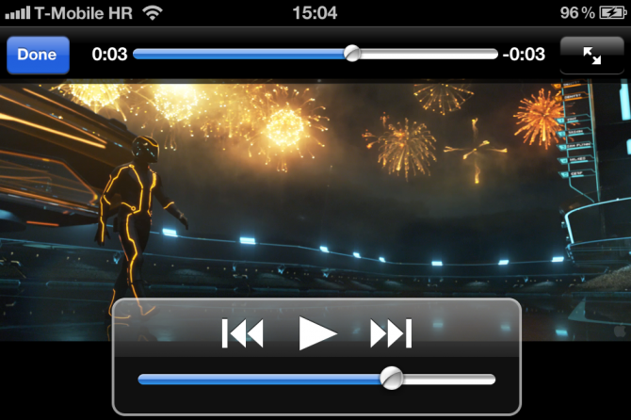
iOS: Media 5
1 iOS Graphics and Video Support
1.1 Core Video Framework
1.2 Core Text Framework
1.3 Image I/O Framework
1.4 Assets Library Framework
1.5 Core Graphics Framework
1.6 Quartz Core Framework
1.7 OpenGL ES framework
2 iOS Audio Support
2.1 AV Foundation framework
2.2 Core Audio Framework
2.3 Open Audio Library (OpenAL)
2.4 Media Player framework
2.5 Core Midi Framework
The role of the Media layer is to provide iOS with audio, video, animation and graphics capabilities.
As the others layers that composed the iOS stack, the Media layer consist a number of frameworks that may be utilized when developing iPhone apps.

Slide 54
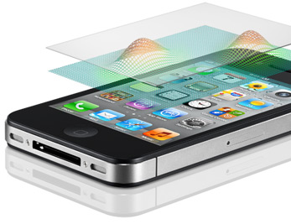
iOS: Cocoa Touch
The Cocoa Touch layer sits at the top of the iOS stack and contains the frameworks that are most commonly used by iPhone application developers.
Cocoa Touch is primarily written in Objective-C, is based on the standard Mac OS X Cocoa API (as found on Apple desktop and laptop computers) and has been extended and modified to meet the needs of mobile technology.
The Cocoa Touch layer provides the following frameworks for iPhone app development:
1 UIKit Framework
2 Map Kit Framework
3 Push Notification Service
4 Message UI Framework
5 Address Book UI Framework
6 Game Kit Framework
7 iAd Framework
8 Event Kit UI Framework
https://developer.apple.com/library/mac/#documentation/Cocoa/Conceptual/CocoaFundamentals/WhatIsCocoa/WhatIsCocoa.html

Slide 55
iOS Version’s History – NEED to KNOW
Version | First Release | Originally create/Highest Version to Upgrade for
3.1.3 (D/C) | February, 2010 | iPhone (original); iPod Touch (1st generation)
4.2.1 (D/C) | November, 2010 | iPhone 3G; iPod Touch (2nd generation)
5.0 | October, 2011 | iPhone 4S
5.1 | March, 2012 | iPad (3rd generation)
5.1.1 | May, 2012 | iPod Touch (4th generation); iPhone 4S
 | June, 2012 | Apple TV (3rd generation)
6.0 | September 12,2012 | iPhone 3GS, iPhone 4, iPhone 4S, iPod Touch 4, iPad 2, iPad 3, iPad 4 Apple TV 3, nano touch – upgrade iPhone 5,iPod Touch 5 - originally
Apple's iOS did not have an official name until the release of the iPhone software development kit (iPhone SDK) on March 6, 2008.
When introduced, it was named iPhone OS. It was renamed iOS on June 2010, as iPhone was no longer the only device to run iOS.
http://en.wikipedia.org/wiki/IOS_version_history

Slide 56
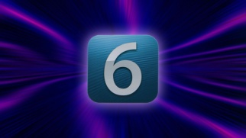
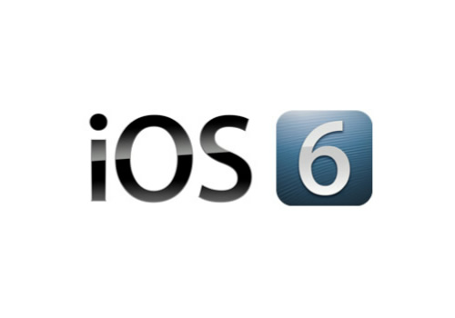
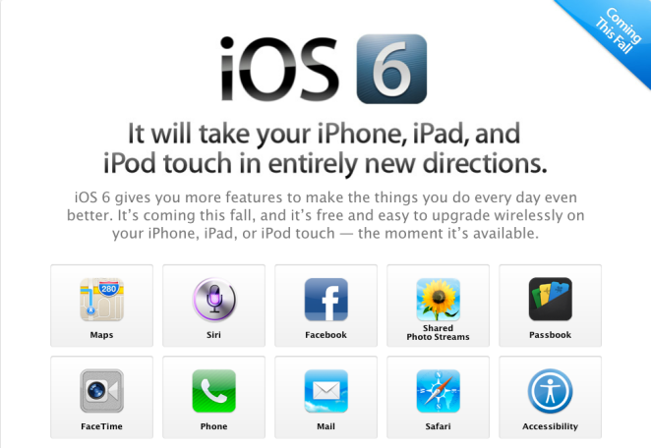
What is the latest iOS version?
September 12, 2012 – day of official release of iPhone 5 that run on iOS6
http://www.youtube.com/watch?v=u5X5cV-4LRo
http://www.youtube.com/watch?v=ii19ICY6tyg&feature=related

Slide 57
What iPhone Browsers do you know?
Opera Mini
Chrome
Atomic Web
Dolphin
Aquari
Firefox Home
Wide Web
Safari
Incognito
iBrowse2
http://www.youtube.com/watch?v=DlI-K9PgONo
http://www.youtube.com/watch?v=rPPIsqFRPsI
http://lifehacker.com/5922808/lifehacker-faceoff-the-best-web-browsers-for-iphone-and-ipad

Slide 58
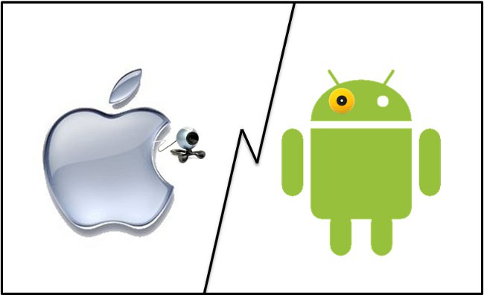
Describe Android OS vs. iOS
Source
Security
Platform
OS Architecture
Carriers
Life Battery
Web Browsers
iOS
ANDROID
http://www.youtube.com/watch?v=6S7dOn_i1Jw&feature=related
http://www.youtube.com/watch?v=H5ejrg-nF68&feature=fvwrel

Slide 59
Comparison Table: Android vs. iOS 2
Category | Google Android | Apple iOS
License - Source | Open Source | Close - Proprietary
Company | Open Handset Alliance/Google | Apple
OS Platform | Linux | OS X – Unix (Darwin)
Programming Language | Java | Objective-C
Virtual Machine | Dalvik VM | None
Package Manager | APK – Google Play/Play Store | iTunes (with iOS 6 – iStore)
Carriers | AT&T, Verizon, T-Mobile, Sprint, MetroPCS, Virgin, 96% out of 369 US carriers | Apple Store, AT&T, Verizon, Sprint, Virgin Mobile, Cricket + 10 regional carriers
Life Battery | Moderate | Advance high
Browser Engine | WebKit: Web, Opera Mini 7, Dolphin, Chrome | WebKit: Safari, Opera Mini 7, Atomic Web, Chrome

Slide 60
Mobile Ecosystem
Services
Networks
Operators
Applications
Devices
Manufactures
Application Frameworks
Platforms/OS
http://www.mobileburn.com/definitions.jsp

Slide 61
Framework, Kernel - definitions
A framework is a collection of pre-made tools and functions such as a code library, API, compilers, tool sets.
For example:
Platform: Windows CE;
OS: Windows Phone;
Framework: .NET
Platform: OS X;
OS: iOS;
Framework: Cocoa Touch
A kernel is the main component of most operating systems; it is a bridge between applications and the actual data processing done at the hardware level.
Most popular Kernels are Linux and Unix.
http://en.wikipedia.org/wiki/Kernel_(computing)

Slide 62
Application Framework:
An application framework is a software database that provides a fundamental structure to support the development of applications for a specific environment.
An application framework acts as the skeletal support to build an application.
Application frameworks are not a recently emerged idea. Some of the old application frameworks that are still used today are the SmallTalk user interface framework, MacApp (for Macintosh), and Struts (for Web-based Java applications).

Slide 63
What is API?
An Application Programming interface (API) is a set of functions, classes, libraries, or packages (a.k.a. frameworks) that allowing the programmer to access an application’s services by using the programming languages.
An API may include specifications for routines, data structures, object classes, and variables.
An API specification can take many forms, including an International Standard such as POSIX or vendor documentation such as the Microsoft Windows API, or the libraries of a programming language such as Standard Template Library in C++ or Java API.
API examples: Google Maps, Twitter, Instagram

Slide 64
Top Apps Frameworks
jQTouch (Amazon, Mozilla, Google, Twitter, MS, Craiglist, WordPress)
Prototype (Apple, HubPages, AutoTrader, TicketMaster)
Struts (Yell, IRS, TelecomFrance, The ShoppingChannel, One Entry)
Bootstrap (NASA, Read.gov, InEx Finance, Syd PHP, PressAboutUs)
JavaScript MVC (T-Mobile, Grooveshark, Wegener, Mindjet, Kaplan)
http://www.sparkyhub.com/top-5-front-end-frameworks-infographic/

Slide 65
Application Framework: Top 5
Cocoa Touch
Apple developed one of the first commercial application frameworks, MacApp (first released in 1985), for the Macintosh.
Originally written in an extended (object-oriented) version of Pascal, it later appeared rewritten in C++.

Slide 66
Top 5 Application Framework
Adobe AIR is a cross-operating system runtime that lets developers combine HTML, JavaScript, Adobe Flash® and Flex technologies, and ActionScript® to deploy rich Internet applications (RIAs) on a broad range of devices including desktop computers, netbooks, tablets, smartphones, and TVs

Slide 67
Application Framework: Top 5
The Android SDK allows developers to create native applications for any device that runs the Android platform.
By using the Android SDK, developers can write applications in C/C++ or use a Java virtual machine (that included in the OS) to create the applications with Java, which is more common language in the mobile ecosystem.

Slide 68
Application Framework: Top 5
Web Runtimes (WRTs)
Nokia, Opera (Presto), and Yahoo! provide various Web Runtimes, or WRTs.
Those are mini-frameworks, based on web standards, to create mobile widgets.
Both Opera’s and Nokia’s WRTs meet the W3C-recommended specifications for mobile widgets.

Slide 69
Application Framework: Top 5
The Web2.0 is the only application framework that virtually works across all devices and all platforms.
Increased demand to offer products and services outside of operator’s control, together with a desire to support more devices in shorter development cycles.

Slide 70
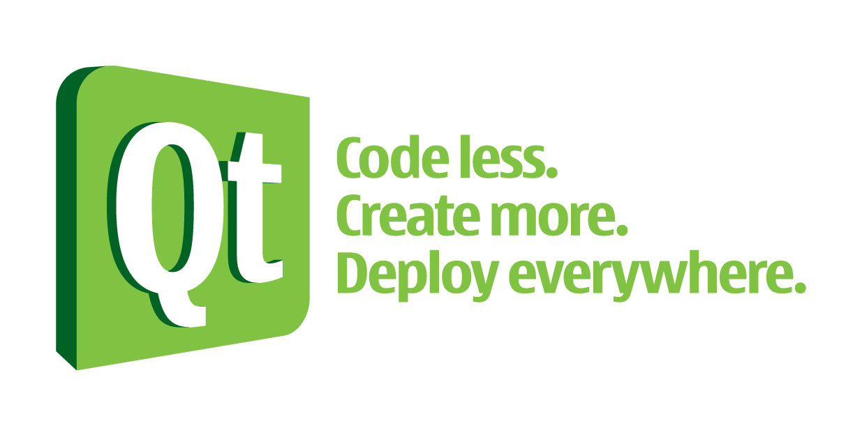
Application Framework: Examples
Free-software frameworks exist as part of the Mozilla, OpenOffice.org, GNOME, KDE, NetBeans and Eclipse projects.
Microsoft markets a framework for developing Windows applications in C++ called the Microsoft Foundation Class Library.
A number of frameworks can build cross-platform applications for Linux, Macintosh, and Windows from the same source code, such as Qt, the widget toolkits wxWidgets, FOX toolkit, or Eclipse RCP.
Oracle Application Development Framework (Oracle ADF) aids in producing Java-oriented systems.

Slide 71
Definition you should know
Fragmentation is the inability to "write once and run anywhere".
More formally, it is the inability to develop an application against a reference operating context (OC) and achieve the intended behavior in all OCs suitable for the application.
Causes of fragmentation:
Hardware diversity
Software diversity:
Platform diversity
Implementation diversity
Feature variations
User-preference diversity
Environmental diversity
http://www.comp.nus.edu.sg/~damithch/df/device-fragmentation.htm

Slide 72
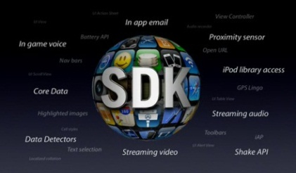
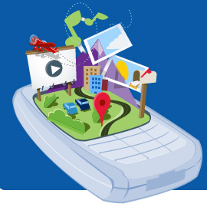
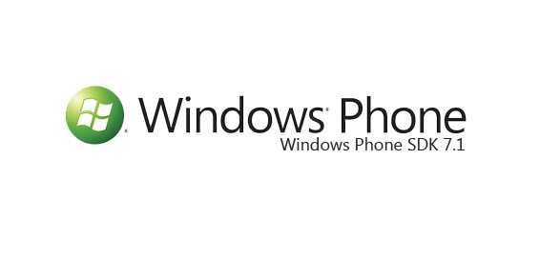
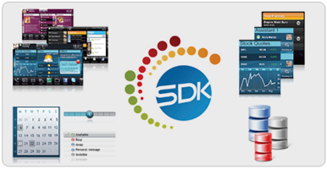
Term to know: SDK
Software Development Kit, is a programming package that enables a programmer to develop applications for a specific platform.
Typically an SDK includes one or more APIs, programming tools, and documentation.
Common tools include debugging aids and other utilities often presented in an integrated development environment (IDE).
SDKs also frequently include sample code and supporting technical notes or other supporting documentation to help clarify points from the primary reference material.
iPhone SDK:
http://www.morgana.ca/freedev.html
Android SDK:
http://developer.android.com/training/basics/firstapp/index.html
Windows Phone SDK:
http://msdn.microsoft.com/en-us/library/ff402523(v=vs.92).aspx
Reminder: An Application Programming interface (API) is a set of functions, classes, libraries, or packages.

Slide 73
Rooted vs. un-rooted phone
Un-rooted phone will have pre-set OS configuration and you will be not able to change system settings.
Rooted phone means that you could install whatever your liked or change settings and configuration of your phone.
Basically, rooted phone allows you to have administrator rights.
http://root-android.org/
http://www.theverge.com/2011/12/7/2585779/android-history

Slide 74
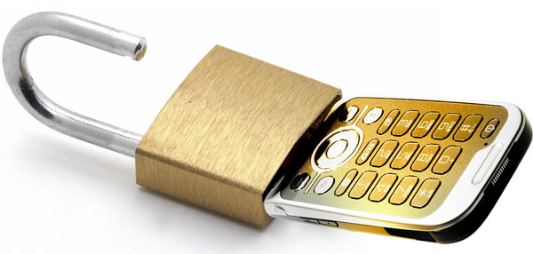
Locked vs. un-locked phone
Unlocked cell phones are mobile phones that can be used on any GSM network with interchangeable SIM cards.
No matter which carrier makes the card, the phone will be able to recognize it and send voice and data over the network.
This contrasts with a locked phone, which is bound to a specific cell phone service provider (or carrier) network with software settings, and is typically offered with a contract when someone starts mobile service.

Slide 75
Definition to know: Jailbreak
Jailbreaking is the process of adding unofficial application installers to your iOS device with the purpose to gain access to many 3rd-party applications and extensions that normally are unavailable through the App Store.
You can install extensions that give you instant access to your system settings from anywhere on your iOS device, bypassing certain Apple restrictions or find packages that give you administrator control over your iOS or carrier experience.

Slide 76
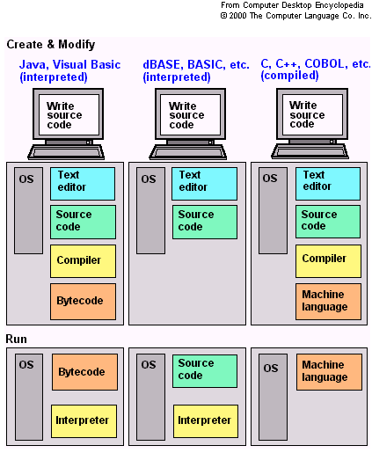
Interview Question: What do you know about an interpreter and compiler?
An interpreter translates to machine code and executes it on the fly when the program is running, while a compiler translates the program to machine code in advance by executing stored files that can proceed as a separate step.

Slide 77
Build Professional Language:
compile - Produce (something: list, file, application) by assembling information collected from other sources;
debug - Identify and remove errors from (computer hardware or software).
deploy - To bring (something: application) into action

Slide 78
What is the file extensions for Android?
.apk - application package file (APK) is the file format used to distribute and install application software and middleware onto Google's Android operating system.
.dex -Android programs are compiled into .dex (Dalvik Executable) files, which are in turn zipped into a single .apk file on the device.

Slide 79
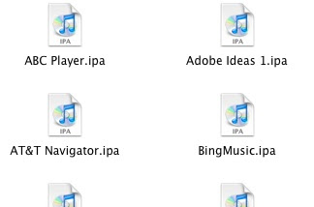
What is the iPhone file extensions?
An .ipa file is an iPhone application archive file which stores an iPhone app.
Each .ipa file is compressed with a binary for the ARM architecture and can only be installed on an iPhone, iPod Touch, or iPad.
Files with the .ipa extension can be uncompressed by changing the extension to .zip and unzipping.
.ipa files cannot be installed on the iPhone Simulator because they do not contain a binary for the x86 architecture.
To run applications on the simulator, we need to open original project files using the Xcode SDK.

Slide 80
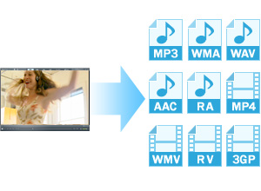
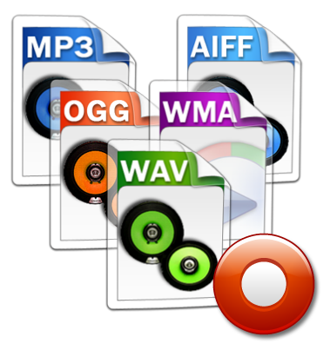
Media File Formats: Audio
.aif Audio Interchange File Format
.iff Interchange File Format
.m3u Media Playlist File
.m4a MPEG-4 Audio File
.mid MIDI File
.mp3 MP3 Audio File
.mpa MPEG-2 Audio File
.ra Real Audio File
.wav WAVE Audio File
.wma Windows Media Audio File
http://www.fileinfo.com/filetypes/common

Slide 81
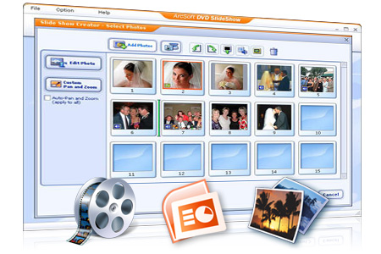
Media File Formats: Video
.3g2 3GPP2 Multimedia File
.3gp 3GPP Multimedia File
.asf Advanced Systems Format File
.asx Microsoft ASF Redirector File
.avi Audio Video Interleave File
.flv Flash Video File
.mov Apple QuickTime Movie
.mp4 MPEG-4 Video File
.mpg MPEG Video File
.rm Real Media File
.srt SubRip Subtitle File
.swf Shockwave Flash Movie
.vob DVD Video Object File
.wmv Windows Media Video File
http://www.fileinfo.com/filetypes/common

Slide 82
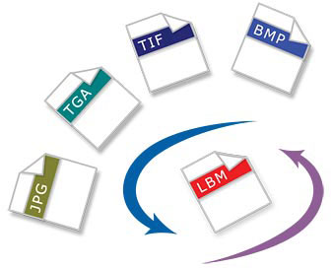
Media File Formats: Image
3-D Images
.3dm Rhino 3D Model
.3ds 3D Studio Scene
.max 3ds Max Scene File
.obj Wavefront 3D Object File
Raster Image Files
.bmp Bitmap Image File
.dds DirectDraw Surface
.gif Graphical Interchange Format File
.jpg JPEG Image
.png Portable Network Graphic
.psd Adobe Photoshop Document
.pspimage PaintShop Pro Image
.tga Targa Graphic
.thm Thumbnail Image File
.tif Tagged Image File
.tiff Tagged Image File Format
.yuv YUV Encoded Image File
http://www.fileinfo.com/filetypes/common

Slide 83
Media File Formats: Game
.dem Video Game Demo File
.gam Saved Game File
.nes Nintendo (NES) ROM File
.rom N64 Game ROM File
.sav Saved Game
http://www.fileinfo.com/filetypes/common

Slide 84
Media File Formats: Executable Files
.apk Android Package File
.app Application file
.bat DOS Batch File
.cgi Common Gateway Interface Script
.com DOS Command File
.exe Windows Executable File
.gadget Windows Gadget
.ipa iPhone archive File
.jar Java Archive File
.pif Program Information File
.vb VBScript File
.wsf Windows Script File
http://www.fileinfo.com/filetypes/common

Slide 85
Media File Formats: Web Files
.asp Active Server Page
.aspx Active Server Page Extended File
.cer Internet Security Certificate
.cfm ColdFusion Markup File
.csr Certificate Signing Request File
.css Cascading Style Sheet
.htm Hypertext Markup Language File
.html Hypertext Markup Language File
.js JavaScript File
.jsp Java Server Page
.php PHP Source Code File
.rss Rich Site Summary
.xhtml Extensible Hypertext Markup Language File
http://www.fileinfo.com/filetypes/common

Slide 86
The Terms and Definitions you should know:
Five Interchangeable means of Platform
Three types of Platforms
Operating System
Open vs. Closed Operating System
Framework
Kernel
Operators/Carriers/Providers
Makers/Manufactures
Tethering
Two major Network types in US
The rate of data transmission that the Network is capable to deliver under GSM, CDMA, WiMax, and LTE
API and API testing
Application Framework (name at least two with some brand’s examples)
HTML 5
Fragmentation
SDKs
Rooted vs. un-rooted phone
Locked vs. un-locked phone
Jailbreak
Mobile Terminology basics:
http://www.gsmarena.com/glossary.php3
http://www.youtube.com/watch?v=nLTlu62sKAM

Slide 88
Additional OS that may considered:

Slide 89
Operating System: Windows Phone
Window Phone is a mobile OS developed by Microsoft and is the successor to its Windows Mobile platform, although incompatible with it.

Slide 90
Windows Phone Versions
WP 7.5 “Mango” (+ Q1 2012 update version “Tango”) addressed many of the platform’s shortcomings, including a mobile version of IE 9, multi-tasking of third-party apps, Twitter integration for People Hub, and Windows Live SkyDrive access.
On Feb, 2011 Windows Phone became the primary Smartphone operating system for Nokia.

Slide 91
Proprietary Platforms: Windows Phone
Windows Phone is a mobile platform developed by Microsoft.
It is the successor to its Windows Mobile platform, although incompatible with it.
Mobile Phone primarily targeting at the consumer market rather than the enterprise market.
With Windows Phone Microsoft created a new user interface, featuring its design language called Metro.
Additionally, the software is integrated with third party services and Microsoft services with minimum requirements for the hardware to run.

Slide 92
Top 5 Windows Phone Browsers
Next
Metro
Vable
UC Browser
Beyond
http://withwindows.com/best-web-browsers-windows-phone/

Slide 93
Tools for developing WP applications
Visual Studio 2010 Express for Windows Phone
Windows Phone Emulator
Silverlight for Windows Phone
XNA 4.0 Game Studio

Slide 94
What is BlackBerry special for?
The BlackBerry platform is perhaps best known for its native support for corporate email, through MIDP 1.0 and, more recently, a subset of MIDP 2.0, which and allows complete wireless activation and synchronization with Microsoft Exchange, Lotus Domino, or Novell GroupWise email, calendar, tasks, notes, and contacts, when used in conjunction with BlackBerry Enterprise Server.
New BB use BBX QNX Platform, Linux related.
MIDP - Mobile Information Device Profile.
MIDP is a set of J2ME APIs that define how software applications interface with cellular phones and two-way pagers.
http://en.wikipedia.org/wiki/BlackBerry_OS

Slide 95
Proprietary Platforms: BBX
QNX Screen Composited Windowing System makes it easier for developers to create graphics, multimedia, and Human Machine Interface (HMI) applications using techniques and workflows with which they are familiar.
The framework brings together modern graphics, multimedia, and HMI technologies and provides a platform for applications built with Adobe AIR and HTML5, as well as for native applications.

Slide 96
Mind Exercise: Tizen
Tizen combines the best of LiMo/MeeGo/Bada to create an open source cross device platform with support from Intel AppUp developer program, and a development framework based on HTML5 & WAC standards.
Intel’s Moblin
+
Nokia’s Maemo
Linux Foundation MeeGo
+
LiMo
+
Samsung’s Bada
TIZEN
http://appdeveloper.intel.com/en-us/blog/2011/09/27/new-tizen-platform-linux-foundation-limo-intel-appup

Slide 97
Operating System: Tizen
Tizen is a free and open source mobile operating system based on Linux OS.
Currently , Samsung and Intel leading the company.
Tizen’s software framework for third-party developers is based on web standards such as HTML 5, web technology WAC and concentrated on tablets, netbooks, smartphones, smartTVs and in-vehicle infotainment systems.
In October 2011 the Mer project was announced, centered around a ultra-portable Linux + HTML5/QML/JS Core for building products with, derived from the MeeGo codebase.
Tizen’s SDK is under proprietary Samsung license.
http://www.youtube.com/watch?v=rJ1y7CpIaVA

Slide 98
Linux Closer Look
http://www.youtube.com/watch?v=yVpbFMhOAwE

Slide 99
Open Source: Linux Platform
Linux is strongest in China where it is used by Motorola, and in Japan, used by DoCoMo.
Rather than being an Platform in its own right, Linux is used as a basis for a number of different operating systems developed by several vendors, including Android, GridOS, Boot to Gecko, LiMo, Maemo, MeeGo, Openmoko and Qt Extended, which are mostly incompatible.
Another software platform based on Linux is being developed by Motorola, NEC, NTT DoCoMo, Panasonic, Samsung, and Vodafone.
http://www.linuxfoundation.org/

Slide 100
Open Source: Boot to Gecko/Firefox OS
Firefox OS (formerly Boot to Gecko, B2G) is an open source operating system in development by Mozilla Corporation that aims to support HTML5 apps written using "open Web" technologies rather than platform-specific native APIs.
The idea is essentially to have all user-accessible software running on the phone be a Web app that uses advanced HTML5 techniques and device APIs to access the phone's hardware directly via JavaScript.
In March, 2012 Mozilla Foundation entered the market with its mobile Linux-based platform, “Boot to Gecko”.
Brazil was the first country to benefit, via the operator Telefonica Vivo.
The mobile OS is open source Mozilla, so it will compete directly Android.
http://en.wikipedia.org/wiki/Boot_to_Gecko

Slide 101
Open Source: Aliyun (Cloud based)
AliCloud's platform revolves around the idea of bringing cloud functionality to the mobile platform.
According to the company, Aliyun will feature cloud-based e-mail, Web search, weather updates, and GPS navigation tools.
In addition, the operating system will synchronize and store call data, text messages, and photos in the cloud for access across other devices, including PCs.
Alibaba says it will offer customers 100GB of storage at launch.
The operating system would allow users to access applications from the Web, rather than download apps to their devices
The Chinese gadget maker Haier who is famous for air conditioners, refrigerators, home theatre is about to extend their mobile phone offerings to a new height with the waterproof phone, Zing.
http://www.gizbot.com/mobile/haier-launches-waterproof-phone-zing-on-alibabas-aliyun-os

Slide 102
Mind Exercise: Find Platforms
Danger OS
Nucleus (Mentor Graphics(RTOS))
Mer project
GridOS
SHR

Slide 103
Platforms Comparison
Platform | Language | Remarks
Android | Java, C, C++, JVM languages | Open Source OS (Linux)
Bada | C, C++ | Samsung’s mobile platform running on Linux or RealTime OS
Blackberry | Java | J2ME compatible, extensions enable tighter integration
iPhone | Objective-C, C | Requires Apple Developer Account
MeeGo/Maemo | Qt, Web Apps, C++, others | Intel and Nokia guided open source OS (Based on Linux)
Symbian | C, C++. Java, Qt, Web Apps, others | Open source OS built from the ground up for mobile devices
webOS | HTML, CSS, JavaScript, C | Supports widget style programming (Based on Linux)
Windows Phone | C#, VB.NET | Silverlight, XNA frameworks

Slide 104
Application Framework Comparison
 | Java ME | .NET Compact | Flash Lite | Android
Develop. Language | Java | C#, VB.NET | ActionScript | Java
Application Framework | Optional packages, JSRs: Media API, Location API, 3D&2D Vector Graphics API | Unique .NET CF classes, device-specific and third-party extensions | ActionScript API | Window/Telephony/Location/Manager (Android SDK)
 | Profile (example) MIDP 2.0 | Core components (Subsets of the full .NET class library) |  | C/C++ libraries (2D/3D graphics, media and database libraries, etc)
 | Configuration (CLDC) |  |  | Core Java Libraries
Runtime | Kernel-based virtual machine (KVM) | Common Language Runtime (CLR) | Flash Lite player runtime | Dalvik Virtual Machine
Operating System | Symbian OS, Palm OS, BB OS | Windows CE, Windows Phone | Symbian OS, Windows Phone, Qualcomm’s Brew | Linux Kernel

Slide 105
Markus Falk’s Mobile Framework chart
It is always good to know the cons and pros of tools Developers use to create a mobile software…
A frequently-updated chart by Markus Falk does this for the mobile frameworks as there is a detailed comparison of their capabilities.
The chart displays the rendering engines supported, target platform, hardware, development languages, UI features and license for each framework.
It also contains a wizard for project’s strict requirements that helps filtering the frameworks.
http://www.markus-falk.com/mobile-frameworks-comparison-chart/

Slide 108
Platforms Comparison: Review Level 5

Slide 109
Proprietary Platforms: OS X
Apple uses a proprietary version of OS X as a platform for their iPhone and iPod touch line of devices.
OS X is serie’s of Unix-based graphical interface operating systems that developed, marketed, and sold by Apple Inc since 2002.

Slide 110
Good to Know: Mac OSX History
10.0 "Cheetah" – 2001 (6 mnts)
10.1 "Puma" - 2001 (11 mnts)
10.2 "Jaguar" - 2002 (13 months)
10.3 "Panther" -, 2003 (18 months)
10.4 "Tiger" - 2005 (30 months)
10.5 "Leopard" - 2007 (22 months)
10.6 "Snow Leopard" - 2009 (22 months)
10.7 "Lion" - 2011 (11 months)
10.8 "Mountain Lion" – July 19, 2012
http://www.youtube.com/watch?v=9c6W4CCU9M4&feature=player_embedded

