Slide 1
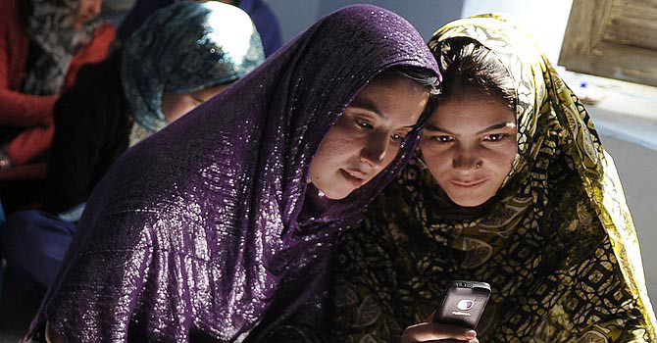
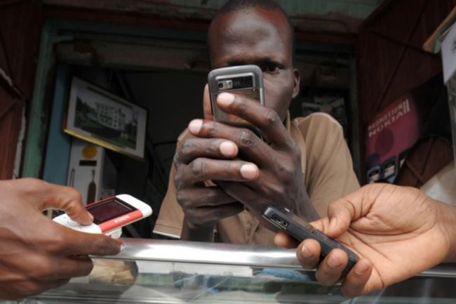

Mobile Testing III
In questions and Answers

Slide 2
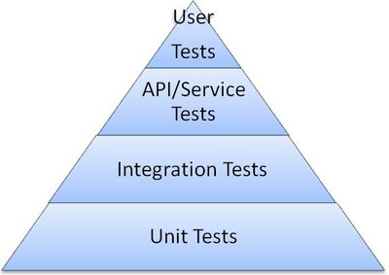
Levels of Testing
Black Box/Manual
Gray Box/Automation/Semi-Automation
Automation
Developers & White Box

Slide 3
Specific of Mobile Testing
1. What Type of Mobile Domains you know?
2. What are the different ways you can install a Mobile Application?
3. What is the difference between Mobile Testing and Mobile Application Testing?
4. Compare Web Application Testing vs. Mobile Application Testing
5. How do you usually explore the new Mobile Device/Phone?
6. How would you test UI of mobile app?
7. Tell me about Test Plan Specifics that must emphasized while writing TP for Mobile Application
8. How would you test the mobile app page?
9. Give Examples of Major Test Cases for mobile device.
10. What are your steps in Performance Testing for Mobile Application? Name some Performance Tools.
11. Write as many Test Cases you can for the following: Mobile device, simple app with three buttons (1,2,3) that making the sounds.
12. How would you troubleshoot networking issues on iPhone?
13. How would you test the following: you send Yahoo message from your mobile device to someone else device, and recipient doesn’t receive a message?
14. What is your Stress test approach when testing Facetime on iPhone?
15. How do you do Boundary testing to verify a battery’s life, if a game application suppose to last for 24 hours?
16. Tell me about Specifics of the Mobile games testing?
17. What Remote Device Access tools do you know?
18. Can you give the view of Testing the Mobile Application on the Emulators/Simulators?
19. Some name for Mobile Testing Automation tools
20. Do you have idea about Application certification programs such as TBT, SSTC, JVP?
21. How you test a Location Based Services (LBS) Mobile Application?

Slide 4
1. Types of Testing in Mobile Domain
Downloadable Mobile Application Testing: Some applications come pre-installed in mobile handset while some mobile applications are downloadable from different mobile application stores(iStore, Google Play, Getjar, Nokia Ovi Store, BB App world etc.) – Production Mode.
Beside that we work with the QA-version of app (some 3web, float.qa, qa, test), Developer’s Site (some .dev), and Pre-production Site that we compare with the Master Web Site version.
Mobile Handset Testing: Similar to Organizations that develop third party downloadable mobile applications, there are many companies that develop complete mobile handset.
A mobile QA here may need to test native applications or features that are available in the phone. SMS, MMS, Voice Call, MMS, Phonebook, Calculator, Bluetooth and other mobile features. It also includes Multimedia (Camera, Video, Media player, ringtones) and Mobile Protocol stack testing.
Mobile Website Testing (WAP Sites): Unlike downloadable mobile applications, mobile websites can be accessed via browser. No download involved. Testing of Mobile WAP sites has its own challenges. Proper navigation, good user interfaces (design), security, performance and mobile browser compatibility are important areas.

Slide 5
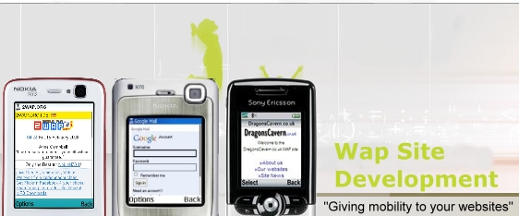
WAP Sites Testing:
Wireless Application Protocol (WAP) is a technical standard for accessing information over a mobile wireless network.
A WAP site is just like a website, but for your mobile phone.
Because bandwidth is far less on a mobile phone, and because your mobile phone screen size is only a fraction of what is on a computer, WAP sites are tiny compared to their larger brothers.
The WAP standard described a protocol suite allowing the interoperability of WAP equipment and software with different network technologies, such as GSM and IS-95(also known as CDMA).
Wireless Application Environment (WAE)
Wireless Session Protocol (WSP)
Wireless Transaction Protocol (WTP)
Wireless Transport Layer Security (WTLS)
Wireless Datagram Protocol (WDP)
Any Wireless Data Network
http://www.suncellular.com.ph/faqs_vas_freewap.php

Slide 6
Specific of Mobile Testing
1. What Type of Mobile Domains you know?
2. What are the different ways you can install a Mobile Application?
3. What is the difference between Mobile Testing and Mobile Application Testing?
4. Compare Web Application Testing vs. Mobile Application Testing
5. How do you usually explore the new Mobile Device/Phone?
6. How would you test UI of mobile app?
7. Tell me about Test Plan Specifics that must emphasized while writing TP for Mobile Application
8. How would you test the mobile app page?
9. Give Examples of Major Test Cases for mobile device.
10. What are your steps in Performance Testing for Mobile Application? Name some Performance Tools.
11. Write as many Test Cases you can for the following: Mobile device, simple app with three buttons (1,2,3) that making the sounds.
12. How would you troubleshoot networking issues on iPhone?
13. How would you test the following: you send Yahoo message from your mobile device to someone else device, and recipient doesn’t receive a message?
14. What is your Stress test approach when testing Facetime on iPhone?
15. How do you do Boundary testing to verify a battery’s life, if a game application suppose to last for 24 hours?
16. Tell me about Specifics of the Mobile games testing?
17. What Remote Device Access tools do you know?
18. Can you give the view of Testing the Mobile Application on the Emulators/Simulators?
19. Some name for Mobile Testing Automation tools
20. Do you have idea about Application certification programs such as TBT, SSTC, JVP?
21. How you test a Location Based Services (LBS) Mobile Application?

Slide 7
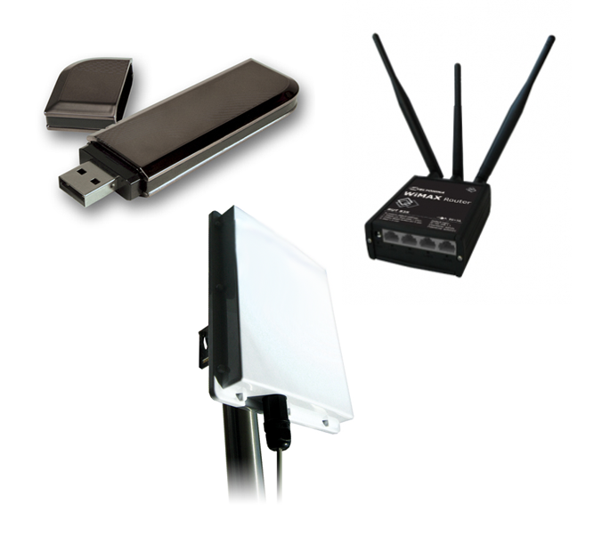
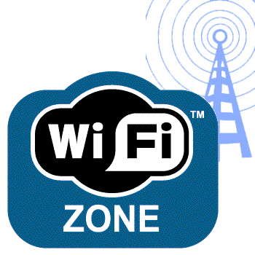
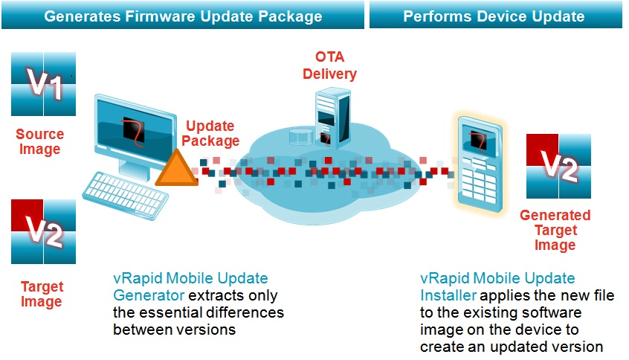

2. What are the different ways you can install a Mobile Application?
1. FOTA (Firmware Over The Air)- Need GPRS SIM card and Internet connection.
2. Wi-Fi
3. Data-cable/USB cable
4. Bluetooth

Slide 8
Specific of Mobile Testing
1. What Type of Mobile Domains you know?
2. What are the different ways you can install a Mobile Application?
3. What is the difference between Mobile Testing and Mobile Application Testing?
4. Compare Web Application Testing vs. Mobile Application Testing
5. How do you usually explore the new Mobile Device/Phone?
6. How would you test UI of mobile app?
7. Tell me about Test Plan Specifics that must emphasized while writing TP for Mobile Application
8. How would you test the mobile app page?
9. Give Examples of Major Test Cases for mobile device.
10. What are your steps in Performance Testing for Mobile Application? Name some Performance Tools.
11. Write as many Test Cases you can for the following: Mobile device, simple app with three buttons (1,2,3) that making the sounds.
12. How would you troubleshoot networking issues on iPhone?
13. How would you test the following: you send Yahoo message from your mobile device to someone else device, and recipient doesn’t receive a message?
14. What is your Stress test approach when testing Facetime on iPhone?
15. How do you do Boundary testing to verify a battery’s life, if a game application suppose to last for 24 hours?
16. Tell me about Specifics of the Mobile games testing?
17. What Remote Device Access tools do you know?
18. Can you give the view of Testing the Mobile Application on the Emulators/Simulators?
19. Some name for Mobile Testing Automation tools
20. Do you have idea about Application certification programs such as TBT, SSTC, JVP?
21. How you test a Location Based Services (LBS) Mobile Application?

Slide 9
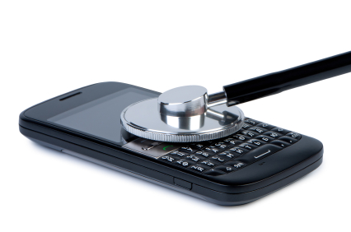
3. What is the difference between Mobile Testing and Mobile Application Testing? 1
1. Mobile Protocol stack testing. (using network simulators)
2. Multimedia Testing
3. Feature Testing
Mobile Testing means the complete testing of mobile in System level + Application level
1.Multimedia Testing
2. Feature Testing
Mobile Application testing deals with only the features and multimedia part.
Mobile Testing
Mobile Application Testing

Slide 10
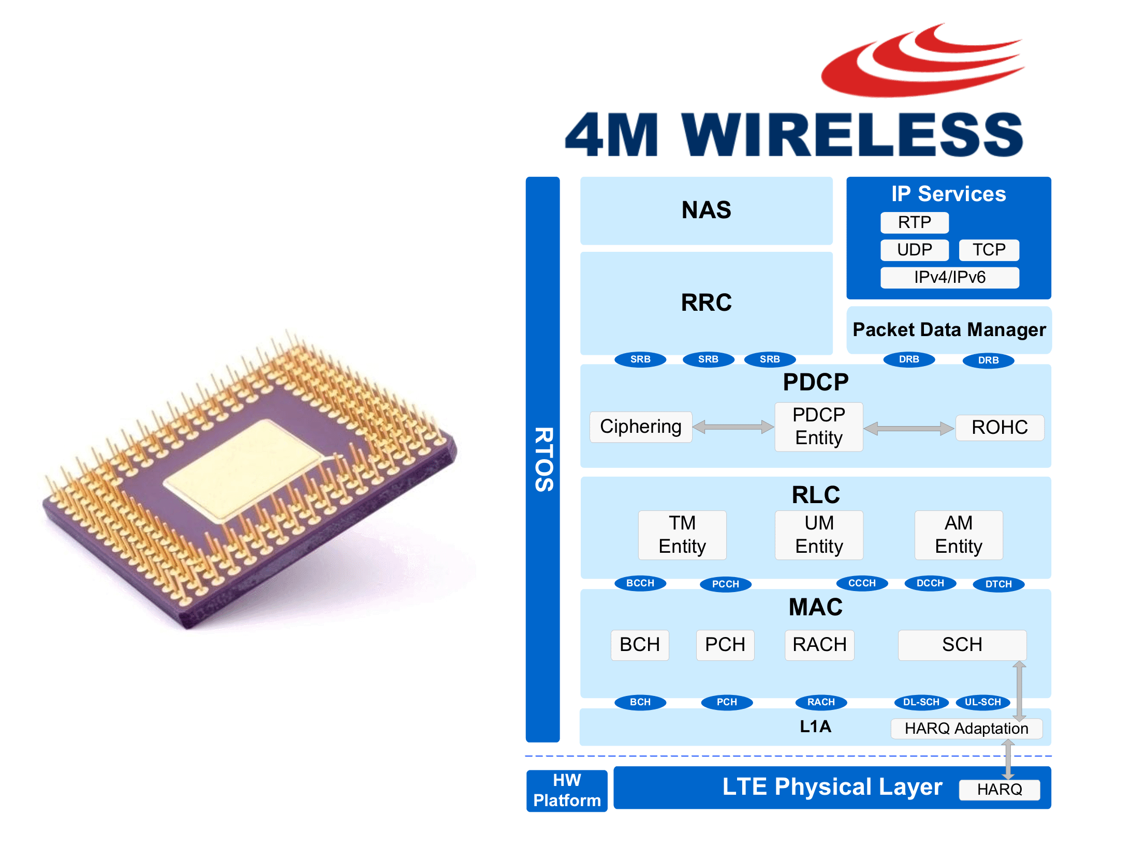
Parts of Mobile Testing: Mobile Protocol Stack
1. Mobile Protocol stack testing. (using network simulators)
few examples are below:
* Stack supports 4 bands EGSM,PGSM,GSM-850,DCS.Mobile originating and mobile terminating call in all those bands.
*cell selection reselection
*cell bar
*All types of handover
*frequency hopping
*Coding schemes etc
handover or handoff refers to the process of transferring an ongoing call or data session from one channel connected to the core network to another.
Frequency-hopping spread spectrum (FHSS) is a method of transmitting radio signals by rapidly switching a carrier among many frequency channels.

Slide 11
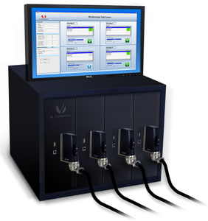
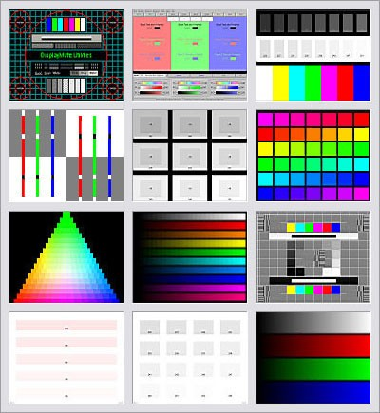
Parts of Mobile Testing: Multimedia Testing
* Midi polyphonic tones ringer and player
* MP3 as ringer and player &other supported formats
* Camera
* Video Conferencing etc

Slide 12
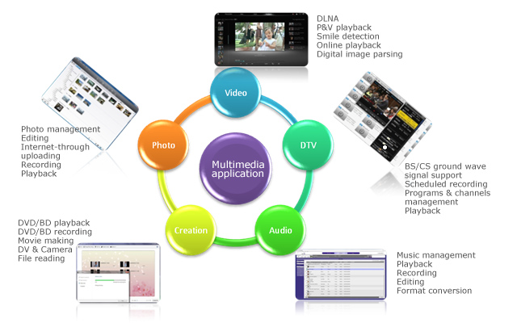
Parts of Mobile Testing: Multimedia Testing

Slide 13
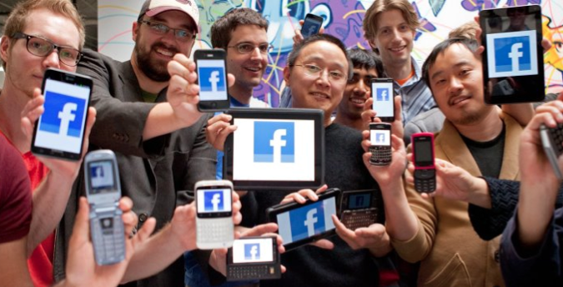
Parts of Mobile Testing: Feature Testing
*Phonebook
*SMS
*Supplementary calls
*Security
*Calculator
*Gaming
*Fast dialing etc

Slide 14
Specific of Mobile Testing
1. What Type of Mobile Domains you know?
2. What are the different ways you can install a Mobile Application?
3. What is the difference between Mobile Testing and Mobile Application Testing?
4. Compare Web Application Testing vs. Mobile Application Testing
5. How do you usually explore the new Mobile Device/Phone?
6. How would you test UI of mobile app?
7. Tell me about Test Plan Specifics that must emphasized while writing TP for Mobile Application
8. How would you test the mobile app page?
9. Give Examples of Major Test Cases for mobile device.
10. What are your steps in Performance Testing for Mobile Application? Name some Performance Tools.
11. Write as many Test Cases you can for the following: Mobile device, simple app with three buttons (1,2,3) that making the sounds.
12. How would you troubleshoot networking issues on iPhone?
13. How would you test the following: you send Yahoo message from your mobile device to someone else device, and recipient doesn’t receive a message?
14. What is your Stress test approach when testing Facetime on iPhone?
15. How do you do Boundary testing to verify a battery’s life, if a game application suppose to last for 24 hours?
16. Tell me about Specifics of the Mobile games testing?
17. What Remote Device Access tools do you know?
18. Can you give the view of Testing the Mobile Application on the Emulators/Simulators?
19. Some name for Mobile Testing Automation tools
20. Do you have idea about Application certification programs such as TBT, SSTC, JVP?
21. How you test a Location Based Services (LBS) Mobile Application?

Slide 15

4. Compare Web Application Testing vs. Mobile Application Testing
Category | Web Application | Mobile Web Application
Device for Testing | PC, Laptop, Server | Huge variety of devices
Platforms | Win, Mac, Linux, Unix, Oracle Solaris, some other server Platforms | Currently, more than 20
Operating System | Win, Mac OS X, Linux | iOS, Android, Windows Phone, BB QNX, Linux, Tizen, + another 5
Browsers | IE, Safari, Chrome, Firefox, Opera | About 100 Web Browsers depends on the region
User Interfaces | One for each OS and Browser | Many for each OS and Browser

Slide 16
Specific of Mobile Testing
1. What Type of Mobile Domains you know?
2. What are the different ways you can install a Mobile Application?
3. What is the difference between Mobile Testing and Mobile Application Testing?
4. Compare Web Application Testing vs. Mobile Application Testing
5. How do you usually explore the new Mobile Device/Phone?
6. How would you test UI of mobile app?
7. Tell me about Test Plan Specifics that must emphasized while writing TP for Mobile Application
8. How would you test the mobile app page?
9. Give Examples of Major Test Cases for mobile device.
10. What are your steps in Performance Testing for Mobile Application? Name some Performance Tools.
11. Write as many Test Cases you can for the following: Mobile device, simple app with three buttons (1,2,3) that making the sounds.
12. How would you troubleshoot networking issues on iPhone?
13. How would you test the following: you send Yahoo message from your mobile device to someone else device, and recipient doesn’t receive a message?
14. What is your Stress test approach when testing Facetime on iPhone?
15. How do you do Boundary testing to verify a battery’s life, if a game application suppose to last for 24 hours?
16. Tell me about Specifics of the Mobile games testing?
17. What Remote Device Access tools do you know?
18. Can you give the view of Testing the Mobile Application on the Emulators/Simulators?
19. Some name for Mobile Testing Automation tools
20. Do you have idea about Application certification programs such as TBT, SSTC, JVP?
21. How you test a Location Based Services (LBS) Mobile Application?

Slide 17
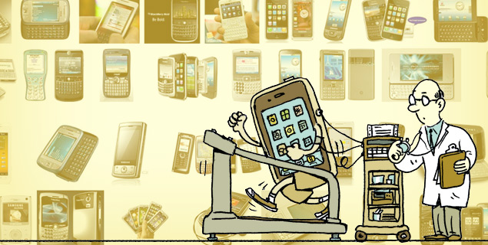
5. How do you usually explore the new Mobile Device/Phone? 1
1. Start with Ad-Hoc/Exploratory:
Turn ON/OFF
Check Navigation/Users Controls/Notifications (Scrolls, Tabs, Links, Gestural Movements)
Go to Settings:
  Look for Tutorial
  Explore each option
Play with Home, Menu, Start, Audio Buttons
2. Check WI-FI, BT, Internet Connectivity
3. Check Features that related to the company product
4. Check Company specific documentations (if any exist)
5. Check Internet Resources for:
  Maker Site
  Provider Site
  Device Review Highlights
  Device Youtube Highlights
EASY Answer
http://www.android.com/about/
http://www.apple.com/support/

Slide 18

5. How do you usually explore the new Mobile Device/Phone? 2
Advance Answer
IN ADDITION TO PREVIOUS EXPLANATION:
Check the intensity of power consumption, sensitivity to the charge;
Check the use of disk space, stability in the limited disk space, logging, work with memory cards;
Check the Accelerometer’s functions;
Check the Connectivity to the Internet, using the best connection: Active Sync, USB, GPRS, Wi-Fi; work in conditions of unstable compounds;
Check the stability of the applications for incoming / outgoing calls, sending and receiving SMS / MMS;
Check the Specificity of data synchronization with the phone book, calendar, programs on your PC;
Check the proper installation / un-installation program in the phone memory and memory card;
Check the correct geo-location
Download LogCollector, WI-Fi Analyzer, and Carat (using App/Play Store)
http://code.google.com/p/android-log-collector/
http://www.speedtest.net/mobile.php/

Slide 19
Specific of Mobile Testing
1. What Type of Mobile Domains you know?
2. What are the different ways you can install a Mobile Application?
3. What is the difference between Mobile Testing and Mobile Application Testing?
4. Compare Web Application Testing vs. Mobile Application Testing
5. How do you usually explore the new Mobile Device/Phone?
6. How would you test UI of mobile app?
7. Tell me about Test Plan Specifics that must emphasized while writing TP for Mobile Application
8. How would you test the mobile app page?
9. Give Examples of Major Test Cases for mobile device.
10. What are your steps in Performance Testing for Mobile Application? Name some Performance Tools.
11. Write as many Test Cases you can for the following: Mobile device, simple app with three buttons (1,2,3) that making the sounds.
12. How would you troubleshoot networking issues on iPhone?
13. How would you test the following: you send Yahoo message from your mobile device to someone else device, and recipient doesn’t receive a message?
14. What is your Stress test approach when testing Facetime on iPhone?
15. How do you do Boundary testing to verify a battery’s life, if a game application suppose to last for 24 hours?
16. Tell me about Specifics of the Mobile games testing?
17. What Remote Device Access tools do you know?
18. Can you give the view of Testing the Mobile Application on the Emulators/Simulators?
19. Some name for Mobile Testing Automation tools
20. Do you have idea about Application certification programs such as TBT, SSTC, JVP?
21. How you test a Location Based Services (LBS) Mobile Application?

Slide 20
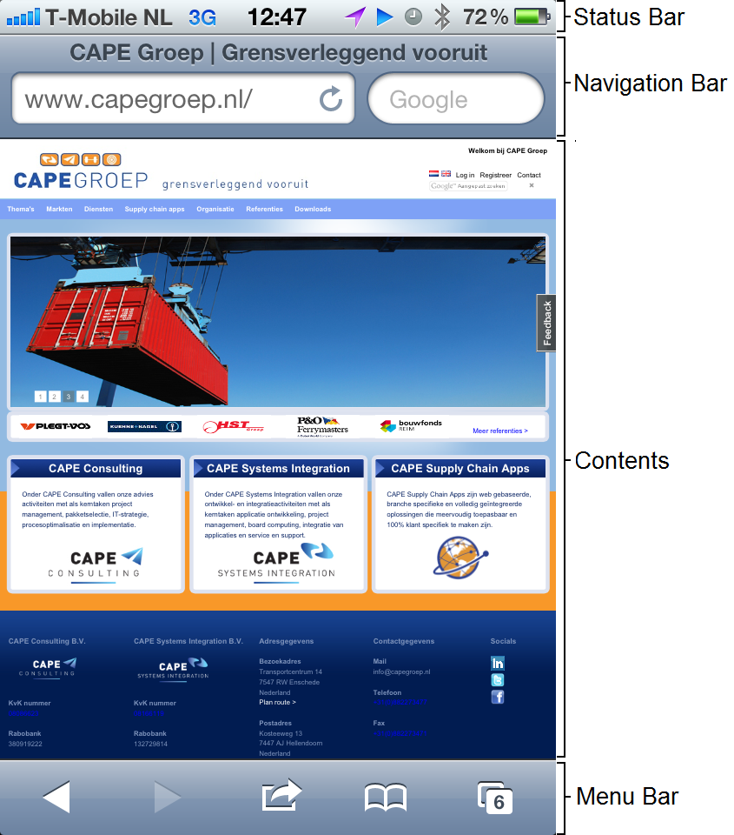
6. How would you test UI of mobile app? 1
Installation of Application:
Splash Screen
Install – Accept & download – Open – Uninstall buttons
Sync view loading, view transitions, and view installation.
View of Home/Content Page:
General Look – Image & Text Alignments
Layout:
Fit well the Form Factor
Resolution
Screen Size alignments
Truncation
Invalid/Garbage Symbols
Orientation: Portrait vs. Landscape
Buttons:
Functionality
Place on the screen, color and size adjustments
Customized style
Active vs. none-active mode
Alignment with the Naming
Links
EASY Answer
http://www.quora.com/User-Interfaces/Which-are-the-best-iPhone-iPad-apps-from-a-UI-design-perspective

Slide 21
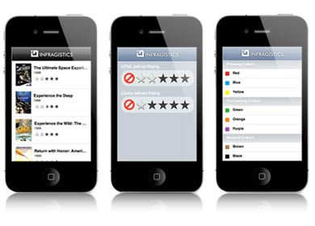
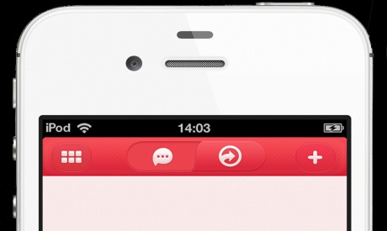
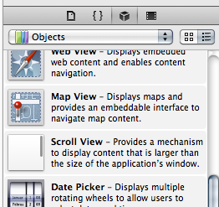
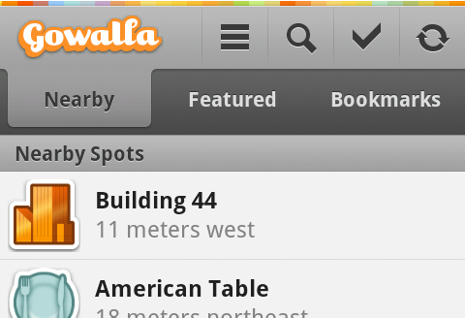
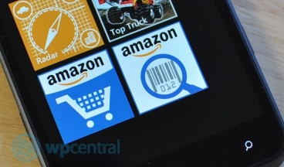
6. How would you test UI of mobile app? 2
List View
ListView:
Backbone of App
Grids of Mobile app
NavBar/ActionBar:
Title NavBar (example: on the top of iOS apps and on the bottom of Android apps.)
ScrollView:
“Swipe” through a list of items left-right and top-bottom
Switch
TabStrip
Navigation Bars
Scroll View
Tab Strip
Switch

Slide 22
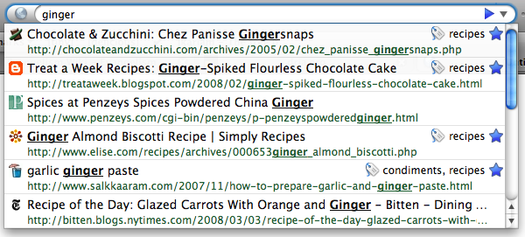
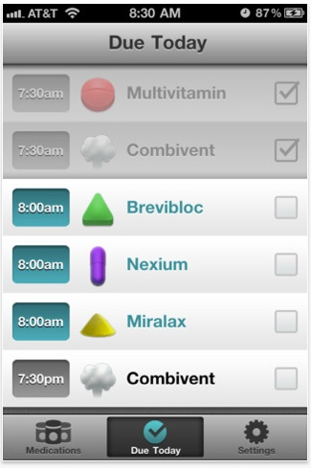
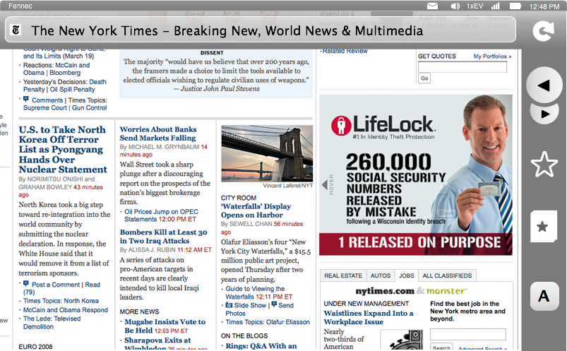
6. How would you test UI of mobile app? 3
TouchScreen UI:
Panning and Zooming
Controls: Dragging horizontally beyond the page edge reveals the control strip
Navigation/Searching to a new page
Tabs
Notifications: New,
Preferences, Geolocation
Downloads
Add-ons
Identity: Authentication
Client Certificates, Username/Password
awesomebar
ControlStrip
Tabs
https://wiki.mozilla.org/Mobile/UI/Designs/TouchScreen/workingUI

Slide 23
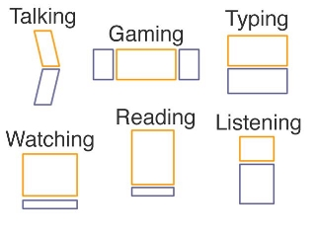
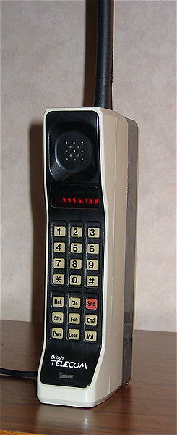
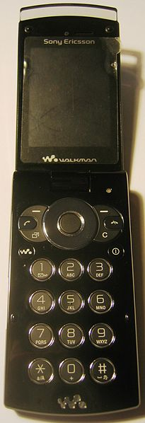
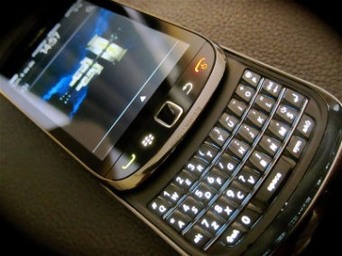
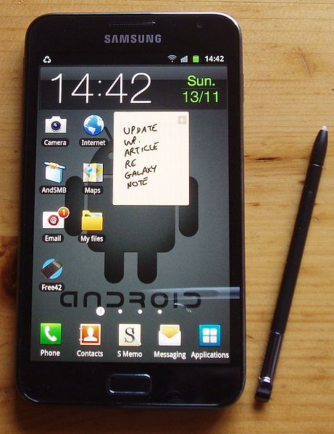
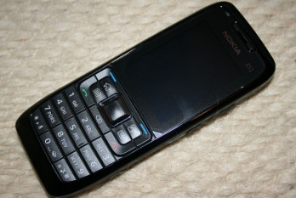
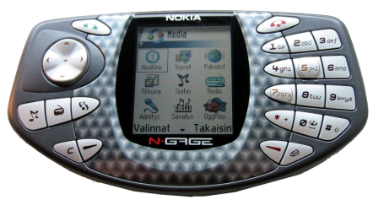
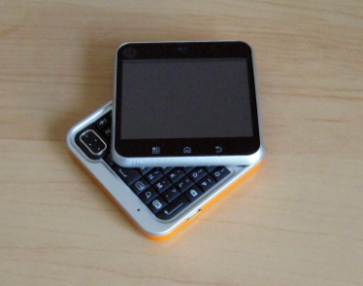
Good to know: Mobile Form Factor
Brick
Bar
Touchscreen
Taco
Flip
Slider
Swivel

Slide 24
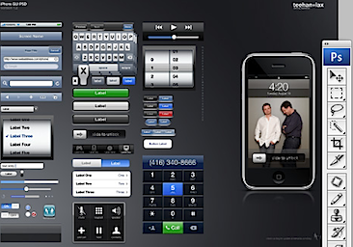
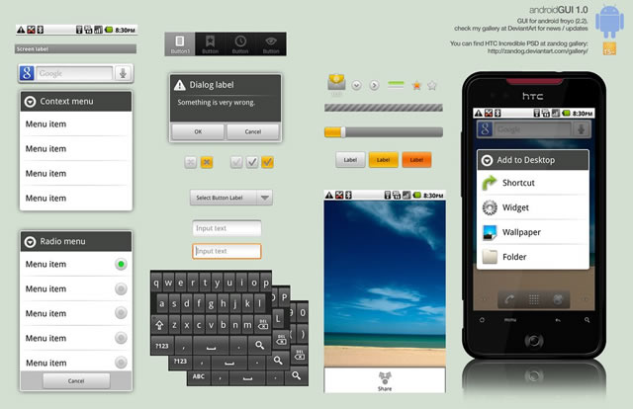
Good to know: different Mobile UI
Self-Learning
ANDROIDs Popular UI:
Android GUI PSD
Stock (Droid 1, Nexus1)
Sense UI (Eris, Incredible, Evo)
Motoblur(*new* Droid X, Droid 2)
Touchwiz(Galaxy S devices)
iPhone Popular UI:
iPhone GUI PSD (Photoshop file)
iPhone GUI stencil for Omnigraffle
Favorites UI Design Walkthrough
Edward Tufte on iPhone interface design
iida A02 infobar
http://www.youtube.com/watch?v=ass2rWIqd8I&feature=player_embedded&list=PLS7azqUNoh8szi0WyRZPE4CSxfxH1L7cF#!
http://mobileorchard.com/7-iphone-ui-user-interface-design-resources/
http://speckyboy.com/2010/10/27/30-fresh-web-ui-mobile-ui-and-wireframe-kits/

Slide 25
Specific of Mobile Testing
1. What Type of Mobile Domains you know?
2. What are the different ways you can install a Mobile Application?
3. What is the difference between Mobile Testing and Mobile Application Testing?
4. Compare Web Application Testing vs. Mobile Application Testing
5. How do you usually explore the new Mobile Device/Phone?
6. How would you test UI of mobile app?
7. Tell me about Test Plan Specifics that must emphasized while writing TP for Mobile Application
8. How would you test the mobile app page?
9. Give Examples of Major Test Cases for mobile device.
10. What are your steps in Performance Testing for Mobile Application? Name some Performance Tools.
11. Write as many Test Cases you can for the following: Mobile device, simple app with three buttons (1,2,3) that making the sounds.
12. How would you troubleshoot networking issues on iPhone?
13. How would you test the following: you send Yahoo message from your mobile device to someone else device, and recipient doesn’t receive a message?
14. What is your Stress test approach when testing Facetime on iPhone?
15. How do you do Boundary testing to verify a battery’s life, if a game application suppose to last for 24 hours?
16. Tell me about Specifics of the Mobile games testing?
17. What Remote Device Access tools do you know?
18. Can you give the view of Testing the Mobile Application on the Emulators/Simulators?
19. Some name for Mobile Testing Automation tools
20. Do you have idea about Application certification programs such as TBT, SSTC, JVP?
21. How you test a Location Based Services (LBS) Mobile Application?

Slide 26
7. Tell me about Test Plan Specifics that must emphasized while writing TP for Mobile Application
1. Requirements Analysis considering Mobile Factors:
What kinds of media files are going to be supported
If download is going to be on SD Card or internal memory
What if SD card will not be available
What if user changes the SD Card
2. UI Mock Ups:
Ask your client to provide the wire frames or UI mock ups which will help you understand how the application screens will look like. Wire frames can also help you to go through the flow of the application.
3. Study the Architecture and Technology:
By the time developers are busy in developing the architecture or going through requirement analysis, it is very important that a tester should also look in to the technology perspective of the application.
For example, if your client is developing any streaming or media sharing applications, then apart from regular requirement analysis a QA should make sure what kind of streaming technology is going to use.
What are the different APIs will be used in the applications. If the application is related to media, then what are the different kind of media file types this application will support etc.

Slide 27
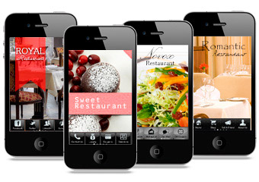
4. Competitors application Analysis:
Download competitors app and verify various features and functionality in this application.
For example some twitter based application. You can take a look on Seesmic, tvider, twitpic.
These all are media sharing app on Twitter and many Features resembles as finally they are developed based on twitter APIS. By following this practice you can:
  Suggest some new features and improvements in the product your org is going to develop.
  Get some hands-on on the kind of technology and features being used
  Help you being familiar with the app
  Help you to chalk out some important scenarios

Slide 28
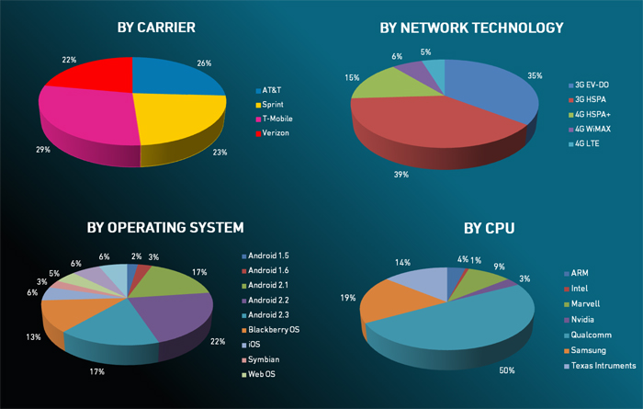
Mobile Testing Approach:
http://www.drdobbs.com/joltawards/jolt-awards-the-best-testing-tools/232901286?pgno=5

Slide 29
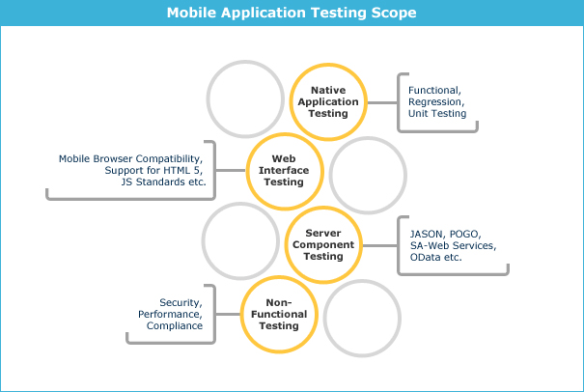

Slide 30
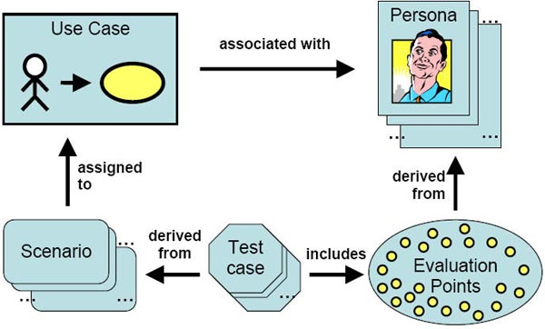
5. Keep in Mind the Target devices:
This will be decided by your client or by your manager that which device they will be targeting the app on. It is very important if you can provide your inputs on that as well. For a testing purpose, make sure you have devices of different screen sizes and resolution. Also some device may support orientation and some may not. So this should also be taken in consideration. We will discuss later on about how to choose a right set of devices. The point here what I am making is we should be in condition to provide our inputs in this front as well.
6. Design Scenarios and Test Cases:
Once Test Planning is done, it is very important to design some test scenarios and Test Cases. You can design a complete Test Suite which will have various modules feature wise.
You may add some tabs dedicated to Performance, system and interruption test cases as well. Make sure you involve these kind of generic test cases as well.
Apart from bulky test suite, you should have a quick checklist which will cover important features in the application. So in case you need a quick round of testing then you can follow this checklist.

Slide 31
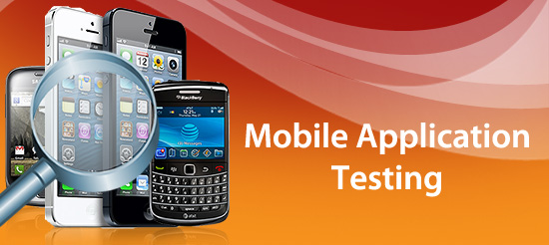
Techniques of Mobile Application Testing
1. Manual Testing
2. Remote-manual Testing (DeviceAnyWhere, Perfecto Mobile)
3. Testing using Emulators
4. Performance Testing (Automated Testing)

Slide 32
7. Analysis on Need of Tools and Utilities:
Make sure to put some efforts on the kind of told you can use later which will help you test the mobile app. I am not only talking about the Automation Tools but also some small utilities like log capturing tools, screenshot capturing tools, memory consumption by app checking tools etc.
8. Keep performance in Mind:
While testing your application, apart from regular functional testing scenarios, analyze the application for app size, behavior of the application in long run i.e. behavior of app if app being used excessively for long time, application launch time and time to load any screen, behavior of app when app do not have enough space, simultaneously running many apps should be considered.
Performance testing serves to:
evaluate response times of all business critical transactions
identify bottlenecks in the software
determine software design issues
define the maximum amount of load a system can handle
determine the number of concurrent users the application can support
identify server configuration issues with web server, application server, database server etc.
assess hardware limitations and determine whether current infrastructure is sufficient to handle predicted user demand.
ascertain if the application is scalable.
identify the processes that can be run simultaneously without significant performance degradation.

Slide 33
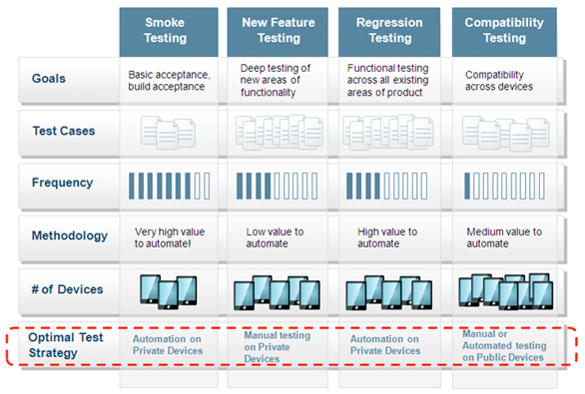

Slide 34
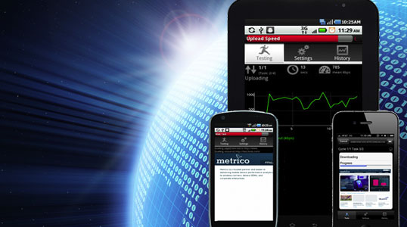
9. Application Submission Related Strategy:
Be sure about the distribution channel for your mobile application. If you are submitting your app to app store then go through the guidelines provided by apple to make sure that you application is getting accepted.
Similarly depending on the application store, go through the application and verify that whether your app satisfies the criteria for that store.
10. Testing Among The Beta Crowd:
Many times testers test the application in order to complete the testing within time as they have challenge to complete the testing within time. In this case sometimes they miss some scenarios that the normal user can encounter.
For example, if movie app is of 1-2 hours then will the tester actually see the complete movie ? Mostly no …he will just fast forward it and will verify the rest of the scenarios. But the actual user will be interested more in watching movies and hence if he finds disturbance in this process then he will just throw this application away.
The probability to see long term impacts of using the application can be dig out more in this kind of testing which is normally not possible.

Slide 35
Specific of Mobile Testing
1. What Type of Mobile Domains you know?
2. What are the different ways you can install a Mobile Application?
3. What is the difference between Mobile Testing and Mobile Application Testing?
4. Compare Web Application Testing vs. Mobile Application Testing
5. How do you usually explore the new Mobile Device/Phone?
6. How would you test UI of mobile app?
7. Tell me about Test Plan Specifics that must emphasized while writing TP for Mobile Application
8. How would you test the mobile app page?
9. Give Examples of Major Test Cases for mobile device.
10. What are your steps in Performance Testing for Mobile Application? Name some Performance Tools.
11. Write as many Test Cases you can for the following: Mobile device, simple app with three buttons (1,2,3) that making the sounds.
12. How would you troubleshoot networking issues on iPhone?
13. How would you test the following: you send Yahoo message from your mobile device to someone else device, and recipient doesn’t receive a message?
14. What is your Stress test approach when testing Facetime on iPhone?
15. How do you do Boundary testing to verify a battery’s life, if a game application suppose to last for 24 hours?
16. Tell me about Specifics of the Mobile games testing?
17. What Remote Device Access tools do you know?
18. Can you give the view of Testing the Mobile Application on the Emulators/Simulators?
19. Some name for Mobile Testing Automation tools
20. Do you have idea about Application certification programs such as TBT, SSTC, JVP?
21. How you test a Location Based Services (LBS) Mobile Application?

Slide 36
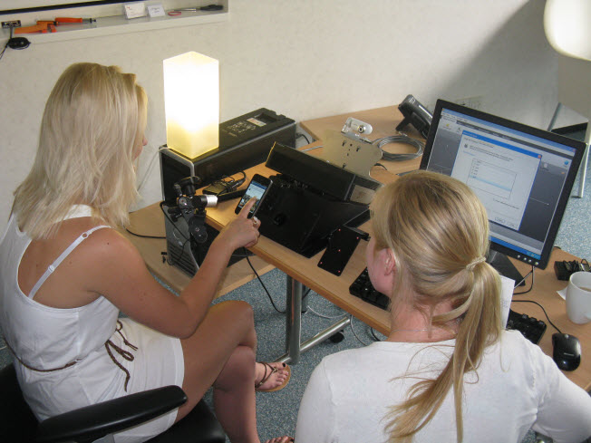
General Types of Mobile Apps Testing
User Interface Testing (Color scheme, Menu styles, Consistency of UI over various Devices)
Usability Testing (Testing of usability aspects of Mobile Apps)
Functional Testing (Testing core functionality of Mobile App as per specification)
Performance & Stress Testing Behavior of Mobile Application in Low resources (Memory/Space/Battery), Behavior of mobile website when many mobile user simultaneously access mobile website)
Security Testing
Cover: authentification and authorization, data security, allocation of data in offline mode, protection of the file system, options, hardware, network resources, etc.

Slide 37
Specific Types of Mobile Apps Testing
Testing for Compatibility: Testing the compatibility of your application with native device features (i.e. To make sure your application is not hampering native device functionality)
Certification Compliance Testing: For downloadable mobile applications, there are various Third party Mobile Quality Certification program for various platforms. True Brew Testing (TBT), Java Verified Program (JVP for J2ME apps), Symbian Signed Test Criteria (SSTC) are some examples.
Apart from regular functional testing, you may need to test your application against the Test cases/Testing criteria provided by these certification processes. However, it depends on your client, whether they want to certify their application or not.
Submission Guidelines Compliance Testing: – The application needs to adhere to the specified submission guidelines to publish it in any mobile application store. Failure to meet these guidelines may result in rejection of your app on mobile application stores. For example failure to comply with application Submission guidelines for iStore may result in rejection of your app in Apple app store.
Interruption Testing (Voice Calls, SMS, Charger, Low memory Notification) while application is running.
Soak Testing: – Continual key pad entries via tools to test application stability with various key press events.
Low Network/No Network case Testing: – Application behavior when there is no network coverage or Low network strength.

Slide 38
Specific of testing Mobile application:
Operations with memory, control of memory leaks | Stable work under conditions of stress, recovery from failures | The industry is re-inventing itself every year and Tester should stay on top of trends
The intensity of power consumption, sensitivity to the charge | Internet connection using an optimum connection: Active Sync, USB, GPRS, Wi-Fi; work under conditions of unstable connection | Data synchronization with the phone book, calendar, programs on the PC
The use of disk space, stability in the limited space on the drive, logging, work with memory cards | Standards compliance TBT, SSTC, JVP | Correct install/un-install of the programs in the phone memory and memory card
Support for various screen resolutions, portrait and landscape modes | Stability of the application for incoming/outgoing calls, sending | Correct Localization
Test the app’s installation and deletion process | Test the update process from an older to a newer version. When local database has changed, which in turn could cause some serious migration problems.

Slide 39
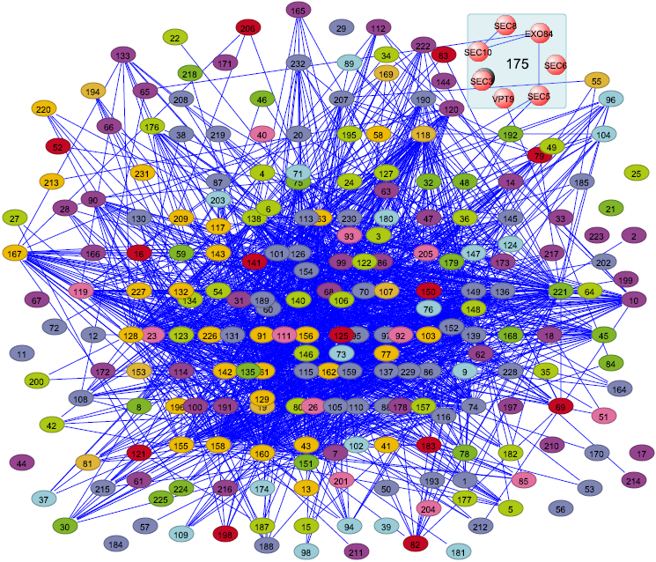
Areas That Would Be Tested on a
Mobile Application
Network Interactions
Feature phones are used, particularly in the developing world, in areas where the mobile network is not as reliable, nor the signal as strong, as in developed countries.
Infrastructure in cities is typically more overloaded with users and network cells are typically larger in the country side, meaning that the distance from cell tower to mobile phone is greater. This means that any mobile application needs to be highly resilient to network, or data carrier, loss or degradation.
Considering cases where network interaction is abruptly lost, and the effect that has on the application under test, is critical. Use cases, such as going into and out of network coverage whilst using an application, are also highly relevant.

Slide 40
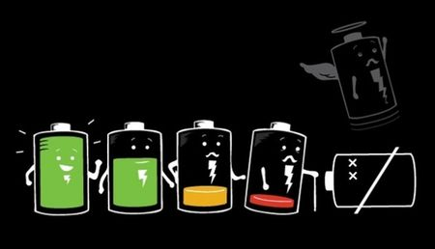
Areas That Would Be Tested on a
Mobile Application
Battery Life
The effect of an application on battery life should be well understood when testing mobile devices, irrespective of the platform.
However, in the feature phone case, battery life can become even more important when one considers a typical developing world use case related to battery life. In countries where the electricity supply can be erratic and homes may not have their own supply at all, necessitating charging at ‘charging shops’, then good battery life becomes crucial.
A well written application should not use excessive battery, and it is important to test for battery life impact, either by using an off-device monitor, or by executing typical cases and monitoring the battery life via the device’s battery level indicator.
It is also important to consider the performance of the device or application when the battery runs out; does it crash or does it exit gracefully when power becomes low?

Slide 41
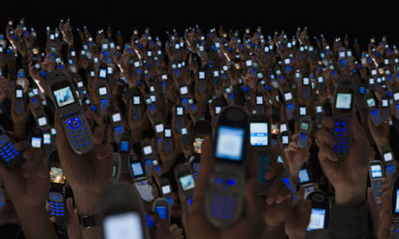
Areas That Would Be Tested on a
Mobile Application
Device Use Time
Feature phones typically have much better battery life than smartphones and, as a result, are often left for longer before either being power cycled or rebooted. Some typical use cases also lead to longer device use times.
A good example would be music player usage – in developing countries the mobile device is often used as the primary music player and radio, and therefore the music player applications can be left running for 10 hours or more. Ensuring that the applications themselves continue to function, and that bugs such as memory leaks are not present, requires a different approach to testing.
Long use case tests are more important in the feature phone space than the smartphone one and can reveal bugs than otherwise would not be found by shorter functional testing.

Slide 42
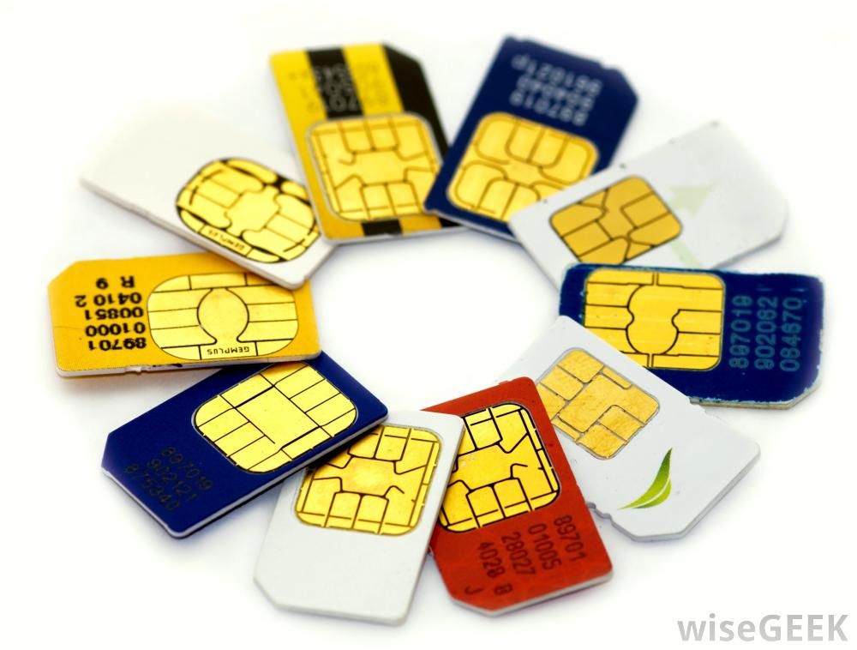
Areas That Would Be Tested on a
Mobile Application
SIM Cards
If the application under test uses data stored on a SIM card or memory card, then it is very important to ensure a relevant number of cards are obtained and used for testing.
Not all SIM cards are created the same and some are considerably slower than others; this seems to be a particular problem in developing countries, such as India.
Some brands of memory card can also be slower and this can have an effect on the functionality of the device or application. Obtaining, and testing with, cards that are relevant to the intended launch country/area for the application or device will help to reduce the risk of early field returns due to incompatible or slow cards.
Significant numbers of feature phones support multiple SIMs and may also support the swapping of these SIMs without a need to power down the device. There are a number of related use cases to consider including:
▪ What happens to the application when removing the battery without shutting down the application? This is a typical use case when
swapping SIMs.
▪ What happens to an application which uses SIM data when the SIM
is swapped? Is the data still available or is it removed?

Slide 43
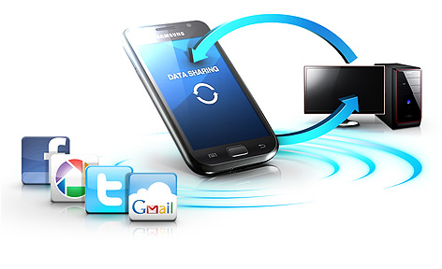
Areas That Would Be Tested on a
Mobile Application
Data Sharing
Although data usage and its cost are becoming highly prevalent and increasingly cheap in the West, this is less so in developing markets where consumers are extremely cost conscious.
As a result, usage of applications such as cloud based proxy browsers, which reduce data usage by compressing web pages prior to delivery to the mobile device, are very popular.
Users are also most likely to share content via free channels such as Bluetooth and Infrared.
It is important to consider all sharing methods when testing and also to consider whether the application under test offers the lowest cost methods.

Slide 44
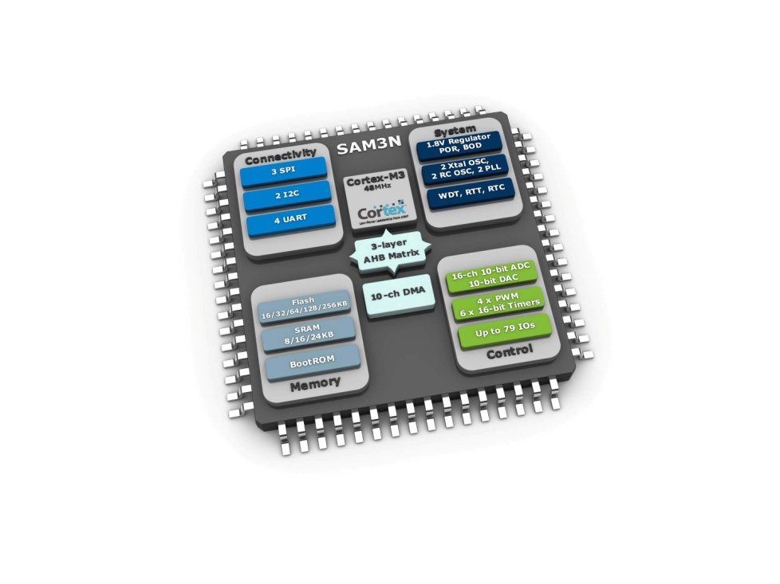
Areas That Would Be Tested on a
Mobile Application
Limited Device Memory and Processor Capability
Feature phones, by their cheaper nature, contain less device memory and lower specification processors than smartphones.
They are unlikely to have dedicated graphics processors. Therefore it is crucial that any test strategy for the device or application considers use cases where the memory is full and where the device is being stressed by multi-application usage.
Users will often run their feature phones with almost all available memory full, since often only around 10Mb is available, and the behavior of any application should be tested under these conditions.
Although few feature phone OSs offer multitasking and background applications, it is also important to test for interruptions from other applications such as incoming calls and SMSs, the music player (typically allowed to run in the background on feature phones) and data synchronization via Bluetooth, cellular data or IR. Other functionality, such as backup and restore, can also run in the background on some feature phone OSs.

Slide 45
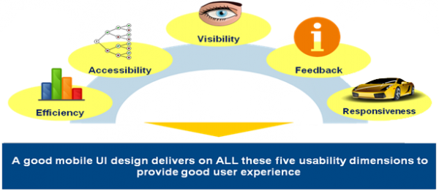

Areas That Would Be Tested on a
Mobile Application
Usability
Feature phones typically have smaller screens and different input mechanisms when compared with smartphones.
Feature phones can have screens as small as 128×128 pixels. Issues such as text size, the level of information detail to present per page, and the amount of scrolling required in order to view the most important information, become more important when the screen is so small.
Although a significant number of feature phones have mechanical keypads, typically in an ITU-T (i.e. numbers only) or QWERTY configuration, and this makes selecting options on the screen easier, more and more are now being produced with touch screens.
Consideration should be given to how the user will scroll and pan around the screen, and how they will select areas using either finger or stylus.
It is also relevant to consider, and test for, multiple language support. In countries where more than one language is spoken, applications may need to support multiple languages and this is equally true for an application.

Slide 46
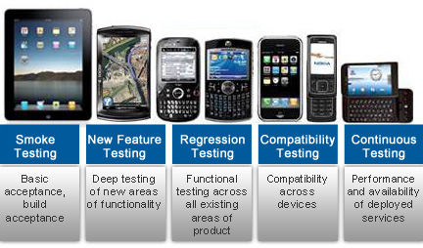

Slide 47


Testing Approach
First, HTML should be validate to make sure that there are no egregious errors.
Next test on the desktop browser to find the functional bugs and make sure that functionality of the site is stable.
Once the site or module functionality is complete, then test on the device emulator to get the browser/platform coverage (in case if you don’t have the device).
If device is already available, then test on the device itself to find the device specific bugs instead of testing on the emulator.
http://metrics.admob.com
http://webdesign.about.com/od/validators/l/bl_validation.htm

Slide 48
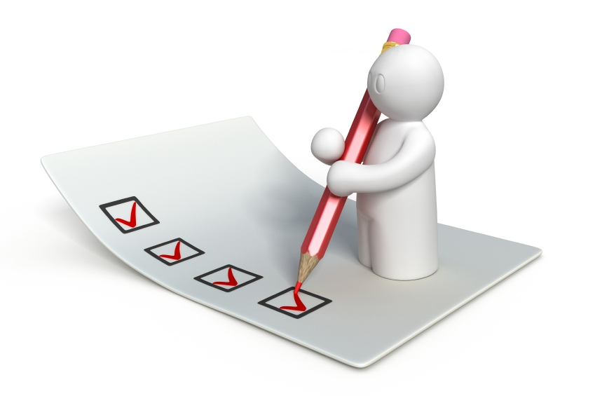

How would you test the mobile app page?
Create a Check List:
1) Functionality Testing
2) Interface testing/Usability testing
3) Interruption Testing
4) Compatibility testing
5) Performance/Load testing
6) Low Network Testing
7) Soak Testing
OR
Get prepared to Interview ‘SMART’ way and print the Mobile Application Checklist from the Answer to the Question # 9 and take it to Interview.
http://www.mobileappstesting.com/tag/testing-checklist-for-mobile-application/
http://sixrevisions.com/tools/10-excellent-tools-for-testing-your-site-on-mobile-devices/

Slide 49
Specific of Mobile Testing
1. What Type of Mobile Domains you know?
2. What are the different ways you can install a Mobile Application?
3. What is the difference between Mobile Testing and Mobile Application Testing?
4. Compare Web Application Testing vs. Mobile Application Testing
5. How do you usually explore the new Mobile Device/Phone?
6. How would you test UI of mobile app?
7. Tell me about Test Plan Specifics that must emphasized while writing TP for Mobile Application
8. How would you test the mobile app page?
9. Give Examples of Major Test Cases for mobile device.
10. What are your steps in Performance Testing for Mobile Application? Name some Performance Tools.
11. Write as many Test Cases you can for the following: Mobile device, simple app with three buttons (1,2,3) that making the sounds.
12. How would you troubleshoot networking issues on iPhone?
13. How would you test the following: you send Yahoo message from your mobile device to someone else device, and recipient doesn’t receive a message?
14. What is your Stress test approach when testing Facetime on iPhone?
15. How do you do Boundary testing to verify a battery’s life, if a game application suppose to last for 24 hours?
16. Tell me about Specifics of the Mobile games testing?
17. What Remote Device Access tools do you know?
18. Can you give the view of Testing the Mobile Application on the Emulators/Simulators?
19. Some name for Mobile Testing Automation tools
20. Do you have idea about Application certification programs such as TBT, SSTC, JVP?
21. How you test a Location Based Services (LBS) Mobile Application?

Slide 50
4. Give Examples of Major Test Cases for mobile device 1
Category | Sub-Category | Description | Result
1. Installation |  | Verify that app can be Installed Successfully | App should be able to install Successful
2. Un-installation |  | Verify that app can be Uninstall Successfully | User should be able to uninstall the app successfully
3. Network Test Cases |  | Verify the behavior of app when there is Network problem and user is performing operations for data call | User should get proper error message like “Network error. Please try later”…
 |  | Verify that User is able to establish data call when Network is back in action | User should be able to establish data call when Network is back in action

Slide 51
4. Give Examples of Major Test Cases for mobile device 2
Category | Sub-Category | Description | Result
4. Voice Call Handling | Call Accept | Verify that User can accept Voice call at the time when app is running and can resume back in app from the same point | User should be able to accept Voice call at the time when app is running and can resume back in app from the same point
 | Call Rejection | Verify that User can reject the Voice call at the time when app is running and can resume back in app from the same point | User should be able to reject the Voice call at the time when app is running and can resume back in app from the same point
 | Call Establish | Verify that User can establish a Voice call in case when app data call is running in background | User should be able to establish a Voice call in case when app data call is running in background

Slide 52
4. Give Examples of Major Test Cases for mobile device 3
Category | Sub-Category | Description | Result
5. SMS Handling |  | Verify that User can get SMS alert when app is running | User should be able to get SMS alert when app is running
 |  | Verify that User can resume back from the same point after reading the SMS | User should be able to resume back from the same point after reading the SMS
6. Unmapped Keys |  | Verify that unmapped keys are not working on any screen of app | Unmapped key should not work on any screen of app
7. Application Logo |  | Verify that app logo with App Name is present in app manager, on the App screen page, widgets (opt.) and user can select it | Application Logo with App Name should be present in app manager, on the App screen page, widgets (opt.) and User can select it.

Slide 53
4. Give Examples of Major Test Cases for mobile device 4
Category | Sub-Category | Description | Result
8. Splash Screen |  | Verify that when User selects app Logo in Splash is displayed. Note: Splash do not remain for fore than 3 sec Note: A splash screen is an image that appears while a game or program is loading. | When User selects app, Logo in app Splash should be displayed
9. Low Memory |  | Verify that app displays proper error message when device memory is low and exits gracefully from the situation | App should display proper error message when device memory is low and exits gracefully from the situation
10. Clear/Back Key |  | Verify that Clear key should navigate the User to previous screen | Clear Key should navigate the User to previous screen
11. End/Home Key |  | Verify that End Key should navigate the User to native Device screen | End Key should navigate the User to native Device screen

Slide 54
4. Give Examples of Major Test Cases for mobile device 5
Category | Sub-Category | Description | Result
12.Visual Feedback |  | Verify that there is visual feedback when response to any action takes more than 3 sec | There should be visual feedback given when response time for any action is longer than 3 sec
13. Continual Keypad Entry |  | Verify that continual key pad entry do not cause any problem. Note: Continual Keypad test consist in a multiple key press, done quickly as possible, in order to load at maximum capacity the handset's memory | Continual key pad entry should not cause any problem in app
14. Exit Application |  | Verify that User is able to exit from app with every form of exit modes such as Flap, Slider, Home Key or Exit option from any point of app | User should be able to exit with every from of exit mode such as Flap, Slider, Home Key or Exit option from any point of app
15. Charger Effect |  | Verify that when app is running then inserting and removing charger do not cause any problem and proper message is displayed when charger is inserted in device | When app is running, then insertion or remove of charger not cause any problem, and proper message displayed .

Slide 55
4. Give Examples of Major Test Cases for mobile device 6
Category | Sub-Category | Description | Result
16. Low Battery |  | Verify that when app is running and battery is low, then proper message is displayed to the User. | When app is running and battery is low, there should be proper message displayed to the User
17. Removal of Battery |  | Verify that removal of battery at the time of app data call is going on do not cause interruption and data call is completed after battery is inserted back in the device | Removal of battery at the time of app data call is going on should not cause interruption and data call should be completed after battery is inserted back in the device
18. Battery Consumption |  | Verify that app does not consume battery excessively | The app should not consume battery excessively
19. Application Start/Restart |  | Find the app icon and select it. Press tab on the Device to launch the app. Observe the app launch in the timeline defined. | App must not take longer than 25 sec to start

Slide 56
4. Give Examples of Major Test Cases for mobile device 7
Category | Sub-Category | Description | Result
20. Application Side Effects |  | Make sure that your app is not causing other apps of device to hamper | Installed app should not cause other apps of device to hamper
21. External incoming communication infrared |  | App should gracefully handle the condition when incoming communication is made via InfraRed | When incoming communication enters the device, the app must at least respect one of the following: Go into pause state during InfraRed session and automatically continue from the point it was suspended at after the InfraRed session is done Give a visual or audible notification The app must not crash or hung.

Slide 57
4. Give Examples of Major Test Cases for mobile device 7
Category | Sub-Category | Description | Result
22. Bluetooth interrupt: |  | When a file transfer is taking place with Bluetooth, the application must be paused and should be resumed from the same point after the transfer is done

Slide 58
Specific of Mobile Testing
1. What Type of Mobile Domains you know?
2. What are the different ways you can install a Mobile Application?
3. What is the difference between Mobile Testing and Mobile Application Testing?
4. Compare Web Application Testing vs. Mobile Application Testing
5. How do you usually explore the new Mobile Device/Phone?
6. How would you test UI of mobile app?
7. Tell me about Test Plan Specifics that must emphasized while writing TP for Mobile Application
8. How would you test the mobile app page?
9. Give Examples of Major Test Cases for mobile device.
10. What are your steps in Performance Testing for Mobile Application? Name some Performance Tools.
11. Write as many Test Cases you can for the following: Mobile device, simple app with three buttons (1,2,3) that making the sounds.
12. How would you troubleshoot networking issues on iPhone?
13. How would you test the following: you send Yahoo message from your mobile device to someone else device, and recipient doesn’t receive a message?
14. What is your Stress test approach when testing Facetime on iPhone?
15. How do you do Boundary testing to verify a battery’s life, if a game application suppose to last for 24 hours?
16. Tell me about Specifics of the Mobile games testing?
17. What Remote Device Access tools do you know?
18. Can you give the view of Testing the Mobile Application on the Emulators/Simulators?
19. Some name for Mobile Testing Automation tools
20. Do you have idea about Application certification programs such as TBT, SSTC, JVP?
21. How you test a Location Based Services (LBS) Mobile Application?

Slide 59

What are your steps in Performance Testing for Mobile Application?
There are so many performance-impacting variables standing between your data center and your end-users, including the cloud, third-party services/integrations, CDNs (Content Delivery Network), mobile browsers and devices.
http://www.ibm.com/developerworks/rational/library/07/1106_dash-kapasi/
http://www.keynote.com/docs/datasheets/Web_vs_Mobile.pdf

Slide 60
Make Your Mobile App Fast
In the fast-moving world of mobile apps one maxim holds true more than ever – fast is better
than slow. There are certain tools and techniques you can apply to make your mobile apps faster,
including the following:
Optimize caching
Keep your application’s data off the network altogether. For apps that are content intensive, caching content on the device can boost performance by avoiding excessive trips through the mobile network and your content infrastructure.
Minimize round-trip times
Consider using a CDN which can provide numerous services that can speed up your app including edge caching to reduce network latency, network routing optimization, content pre-fetching, and more.
Minimize payload size
Focus on compression and reduce the size of your data by using whatever compression techniques are available for your content. Be sure that images are sized properly for your most important device segments. Also, make sure you leverage compression. If you have a large piece of content that takes too long to load, then you can load it little by little. Your app can start using the content while it loads rather than waiting for the whole thing to load. Retail apps often use this technique.
Optimize your native code
Poorly written or bug-filled code can also cause performance problems. Run a profiler on your code or do code reviews to identify potential issues.
Optimize your back-end services performance
If, after performance testing your app, you identified back-end services as a performance sapping culprit, then you have to conduct an assessment to determine how to speed up those services.
http://www.testingexperience.com/testingexperience19_09_12.pdf

Slide 61

Performance Testing: 3rd-party Integration
Make Sure that Third-Party Integrations Work:
An example of this is social media integration, such as Twitter being integrated into Olympics mobile applications. Unfortunately, if you rely on third-party services, you are at the mercy of their performance excellence. In addition you need to make sure that you keep an eye on third party performance and that your app is designed to degrade gracefully in case of third-party problems.

Slide 62

List of Mobile Web Performance Testing Tools
Sandstorm
Neotys
Mobitest
IBM Rational Performance Tester
Rigor
Gomez Mobile RUM
Shunra
HP Loadrunner
SOASTA
Infosys Windtunnel
Jmeter
iOS Instrumentation
Borland Silk Perfomer

Slide 63

How does it works?
When testing any web application, whether browser-based or not, Performance Tool captures, replays and reports on every message between the client and the application infrastructure.
Most of tools are depend on a browser plug-in to record web traffic, which also limits you to using the browsers for which you have plug-ins. Some tools (like a CloudTest at Soasta) use a web proxy to record traffic.
This means that all messages from any device (browser, phone, tablet, toy, etc) traffic can be recorded into a Tool test case. Once recorded, the requests can be parameterized, manipulated and otherwise massaged to create the complex usage patterns and high volumes of traffic needed for a load test.

Slide 64
Specific of Mobile Testing
1. What Type of Mobile Domains you know?
2. What are the different ways you can install a Mobile Application?
3. What is the difference between Mobile Testing and Mobile Application Testing?
4. Compare Web Application Testing vs. Mobile Application Testing
5. How do you usually explore the new Mobile Device/Phone?
6. How would you test UI of mobile app?
7. Tell me about Test Plan Specifics that must emphasized while writing TP for Mobile Application
8. How would you test the mobile app page?
9. Give Examples of Major Test Cases for mobile device.
10. What are your steps in Performance Testing for Mobile Application? Name some Performance Tools.
11. Write as many Test Cases you can for the following: Mobile device, simple app with three buttons (1,2,3) that making the sounds.
12. How would you troubleshoot networking issues on iPhone?
13. How would you test the following: you send Yahoo message from your mobile device to someone else device, and recipient doesn’t receive a message?
14. What is your Stress test approach when testing Facetime on iPhone?
15. How do you do Boundary testing to verify a battery’s life, if a game application suppose to last for 24 hours?
16. Tell me about Specifics of the Mobile games testing?
17. What Remote Device Access tools do you know?
18. Can you give the view of Testing the Mobile Application on the Emulators/Simulators?
19. Some name for Mobile Testing Automation tools
20. Do you have idea about Application certification programs such as TBT, SSTC, JVP?
21. How you test a Location Based Services (LBS) Mobile Application?

Slide 65

11. Write as many Test Cases you can for the following: Mobile device, simple app with three buttons (1,2,3) that making the sounds. 1
1. Stay with the TC Plan to cover different area of testing:
1) Functionality Testing
2) Usability/UI testing
3) Interruption Testing
4) Performance/Load testing
Add Audible specific Testing
Self-Learning:
http://www.guru99.com/testing-tools.html
http://www.mobileapptesting.com/the-best-tools-for-mobile-app-testing/2011/08/
http://en.wikipedia.org/wiki/Soak_testing

Slide 66

Module | Description | Result
Button A | Verify that when Button A is pressed, sound tone A appeared | When button A is pressed the sound tone A should be audible
Button B | Verify that when Button B is pressed, sound tone B appeared | When button B is pressed the sound tone B should be audible
Button C | Verify that when Button C is pressed, sound tone C appeared | When button C is pressed the sound tone C should be audible
Combination of buttons and sounds | Verify that when A,B,C buttons are pressed consecutively, the specific sound A,B,C is appeared | When buttons A,B, C are pressed consecutively, the audible tones A, B, C should be observed
Functional Testing

Slide 67
Module | Description | Result
Panning (sliding horizontally left-right) Swiping | Verify that when main Page is panned/swiped, the sound buttons A,B,C remains in the same order, the same position on the page screen, and do not make sound | The buttons A,B,C, should not loose the order or make any sound during panning/swiping gestural input procedures
Rotation | Verify that when device is rotated, Buttons ABC should not loose it’s order and make any sound | During device’s rotation Buttons ABC should not loose it’s order and make any sound
Zooming | Verify that buttons A,B, C should not loose the order or make any sound during the Zooming gestural procedure | Buttons A,B,C should not loose the order or make and sound during the Zooming procedure
Usability/UI Testing

Slide 68
Module | Description | Result
Phone Call Interruption | Verify that when Phone Call is initiate, buttons ABC are in “pause” mode and do not perform assigned sound tones. | When Phone Call is occurred, the Buttons ABC should be saved in ‘pause” mode and do not perform assigned sound tone.
SMS interruption | Verify that when SMS notifications/message appears, the main app page will response with safe, end session | When SMS action occurs, proper error message should be displayed and app will be closed gracefully with saved information
Multiple Audible Files Interruption | Verify that when multiple mixed/audio files are running on the background of app, buttons ABC still active and perform assigned sound tones. | When multiple files (mixed/audio) are running on the background app, the Buttons ABC should be active and perform assigned sound tone.
Interruption Testing

Slide 69
Module | Description | Result
Combination of buttons and sounds | Verify that when A,B,C buttons pressed simultaneously, the designed combination of three sound tone is appeared | When buttons ABC are pressed simultaneously the tune combined of three sounds should appeared
10,000 User press Button A | Verify that when 10,000 User simultaneously press Buttons A, there is not drop in functionality and sound quality. | When 10,000 User simultaneously press Button A it should be not affect the functionality or sound quality
User press and Hold B button for 8 hours | Verify that when the User press and Hold B button for 8 hours the app should be functional, and after 8 hours gracefully closed with proper error message | When the User press and hold B button for 8 hours the app should be functional and responsive, after 8 hours the proper error message should appeared and app should close gracefully
Soak Testing

Slide 70
Module | Description | Result
Flight Mode of Mobile Device | Verify that when Device has Flight Mode ON, the Buttons ABC are still active and performing sound | Buttons ABC should be active and perform assigned sounds when Mobile Device is in Offline Mode.
Bluetooth Mode of Mobile Device | Verify that when Device has Bluetooth ON, the Buttons ABC are still active and performing sound | Buttons ABC should be active and perform assigned sounds when Mobile Device is in Bluetooth Mode.
Hopping Mode | Verify that when Device is in Frequently changed “hopping” area the Buttons ABC are still active and performing sound | Buttons ABC should be active and perform assigned sounds when Mobile Device is in the “hopping mode”
Connectivity Testing

Slide 71
Specific of Mobile Testing
1. What Type of Mobile Domains you know?
2. What are the different ways you can install a Mobile Application?
3. What is the difference between Mobile Testing and Mobile Application Testing?
4. Compare Web Application Testing vs. Mobile Application Testing
5. How do you usually explore the new Mobile Device/Phone?
6. How would you test UI of mobile app?
7. Tell me about Test Plan Specifics that must emphasized while writing TP for Mobile Application
8. How would you test the mobile app page?
9. Give Examples of Major Test Cases for mobile device.
10. What are your steps in Performance Testing for Mobile Application? Name some Performance Tools.
11. Write as many Test Cases you can for the following: Mobile device, simple app with three buttons (1,2,3) that making the sounds.
12. How would you troubleshoot networking issues on iPhone?
13. How would you test the following: you send Yahoo message from your mobile device to someone else device, and recipient doesn’t receive a message?
14. What is your Stress test approach when testing Facetime on iPhone?
15. How do you do Boundary testing to verify a battery’s life, if a game application suppose to last for 24 hours?
16. Tell me about Specifics of the Mobile games testing?
17. What Remote Device Access tools do you know?
18. Can you give the view of Testing the Mobile Application on the Emulators/Simulators?
19. Some name for Mobile Testing Automation tools
20. Do you have idea about Application certification programs such as TBT, SSTC, JVP?
21. How you test a Location Based Services (LBS) Mobile Application?

Slide 72

12. How would you troubleshoot networking issues on iPhone?
1. Home Screen – Settings Tab – General – Network – Wi-FI (On/Off) – Choose Network) – Ask to Join Networks (On/Off)
2. Home Screen – Settings Tab – General – Reset – Reset Network Settings
Note: It will also reset your remembered Wi-Fi access points and their passwords, so be ready to re-enter a bunch of WEP/WPA keys!
3.Connect through the iOS VPN under Setting- General – Network.
It is a “virtual private network” (VPN) configuration for Apple iOS devices: iPad, iPhone, and iPod Touch. The VPN allows users not on the UCSF network (alternative to traditional wired connectivity), access to restricted resources on the UCSF network in the same way as you would from the UCSFwpa wireless network.
http://support.apple.com/kb/HT3204

Slide 73

4. If you are experiencing network timeouts when connected to your home Wi-Fi network, please try turning off Bluetooth, as the iPhone’s current Bluetooth drivers sometimes interfere with Wi-Fi.
5. Sometimes the iPhone does not “like” being attached to an ad-hoc network, and will often drop the Wi-Fi network connection and jump over to the cellular network. This problem does not exist for iPod touch devices, as they do not have other network options.
Home Screen – Settings – Airplane Mode ON – WI-FI ON – Select RedEye Network
Note: You will not be able to receive calls on your phone with Airplane Mode ON, so please remember to turn it off when you are finished.

Slide 74

6. I can't connect to my Wi-Fi network anymore
Wi-Fi routers are fickle creatures.
Whether it's a problem on your iPhone or a router problem, one quick trick to "start from scratch" with your Wi-Fi connection is by "forgetting" a network you've joined.
Go to Settings, then Wi-Fi, then tap the blue arrow next to the network you want to forget, then tap "Forget This Network."
Once you've forgotten the network, tap it in your Wi-Fi screen to do a fresh re-connect

Slide 75

7. Troubleshooting of Siri (4S up)
Go to Settings in your iPhone and go to the Siri tab.
Disable Siri
Turn off the iPhone 4S
Turn on the iPhone 4S
Go to Settings again and enable Siri
The steps are basically about resetting Siri and it would again catch up with the network and the connection would normally happen.
The fix worked for many, but a few couldn’t still resolve the problem, but keep trying and the response from Siri would be back at any point of time.

Slide 76
Specific of Mobile Testing
1. What Type of Mobile Domains you know?
2. What are the different ways you can install a Mobile Application?
3. What is the difference between Mobile Testing and Mobile Application Testing?
4. Compare Web Application Testing vs. Mobile Application Testing
5. How do you usually explore the new Mobile Device/Phone?
6. How would you test UI of mobile app?
7. Tell me about Test Plan Specifics that must emphasized while writing TP for Mobile Application
8. How would you test the mobile app page?
9. Give Examples of Major Test Cases for mobile device.
10. What are your steps in Performance Testing for Mobile Application? Name some Performance Tools.
11. Write as many Test Cases you can for the following: Mobile device, simple app with three buttons (1,2,3) that making the sounds.
12. How would you troubleshoot networking issues on iPhone?
13. How would you test the following: you send Yahoo message from your mobile device to someone else device, and recipient doesn’t receive a message?
14. What is your Stress test approach when testing Facetime on iPhone?
15. How do you do Boundary testing to verify a battery’s life, if a game application suppose to last for 24 hours?
16. Tell me about Specifics of the Mobile games testing?
17. What Remote Device Access tools do you know?
18. Can you give the view of Testing the Mobile Application on the Emulators/Simulators?
19. Some name for Mobile Testing Automation tools
20. Do you have idea about Application certification programs such as TBT, SSTC, JVP?
21. How you test a Location Based Services (LBS) Mobile Application?

Slide 77


13. How would you test the following: you send Yahoo message from your mobile device to someone else device, and recipient doesn’t receive a message? 1
Check for the network connection.
Try to send message from different device and check if it does works.
Try to send message to your mobile device from different device. Check your ability to receive message.
Check the source code.
Check sync with Yahoo.
Check manual/documentation about compatibility with “provider” Mobile Email
Check the Spelling of account settings
Double Check the spelling of each account setting, domain name, account name (is the email address complete)
Note: Passwords are case sensitive
Make sure that you do not have CAP LOCK on - passwords are case sensitive.
http://www.tricksmachine.com/2012/08/5-best-email-apps-for-android.html

Slide 78


Check your Outgoing Mail, Incoming Mail, Drafts, Sent, and Outbox mailboxes.
If error message occurs on iPhone because of other email applications not made by Apple, then try to send a message via your me.com or mac.com account
Ask the recipient to check any "Junk" mail folders or mailboxes on their end. Perhaps your message was received but inadvertently filtered.
If your recipient still does not receive your mail, but your mail is being sent without any alerts or "Undelivered mail" messages, then your mail might be blocked or filtered by the mail systems at MobileMe or the recipient's location. The best way to determine if this is the issue is to contact MobileMe Support directly

Slide 79


Ensure mail is enabled for your account
From the Home screen, tap Settings > Mail, Contacts, and Calendars > (your MobileMe account). Make sure the Mail slider is On. Ensure Push is selected for your MobileMe account's mail
Ensure Push is enabled on your iPhone, iPad, or iPod touch
From the Home screen, tap Settings > Mail, Contacts, and Calendars > Fetch New Data. Make sure the Push slider is On.

Slide 80


The problem is possibly could related to the email storage limit.
The size limit on any individual email is total encoded size 25MB.
If the error message is about a “Relay Failure”, you will notice that it refers to a non-Virgin email address. This happens because most Internet Service Providers (ISP's) do not allow a user to send emails using that company's mail server unless the user is currently connected to that ISP's network (via their dialup/broadband connection).
Email some Internet link to yourself.
Check "use authentication" for the outgoing server
Change outgoing port

Slide 81
Specific of Mobile Testing
1. What Type of Mobile Domains you know?
2. What are the different ways you can install a Mobile Application?
3. What is the difference between Mobile Testing and Mobile Application Testing?
4. Compare Web Application Testing vs. Mobile Application Testing
5. How do you usually explore the new Mobile Device/Phone?
6. How would you test UI of mobile app?
7. Tell me about Test Plan Specifics that must emphasized while writing TP for Mobile Application
8. How would you test the mobile app page?
9. Give Examples of Major Test Cases for mobile device.
10. What are your steps in Performance Testing for Mobile Application? Name some Performance Tools.
11. Write as many Test Cases you can for the following: Mobile device, simple app with three buttons (1,2,3) that making the sounds.
12. How would you troubleshoot networking issues on iPhone?
13. How would you test the following: you send Yahoo message from your mobile device to someone else device, and recipient doesn’t receive a message?
14. What is your Stress test approach when testing Facetime on iPhone?
15. How do you do Boundary testing to verify a battery’s life, if a game application suppose to last for 24 hours?
16. Tell me about Specifics of the Mobile games testing?
17. What Remote Device Access tools do you know?
18. Can you give the view of Testing the Mobile Application on the Emulators/Simulators?
19. Some name for Mobile Testing Automation tools
20. Do you have idea about Application certification programs such as TBT, SSTC, JVP?
21. How you test a Location Based Services (LBS) Mobile Application?

Slide 82

14. What is your Stress test approach when testing Facetime on iPhone? 1
Video Chatting Technology of Apple
Please, see these two youtube video before proceed
http://www.youtube.com/watch?v=LGzEy3oQ4Co
http://www.youtube.com/watch?v=KRV4FYSMWVM

Slide 83



What is the FaceTime general features? What we need to “Stress out”?How we can stressed it?
Activation of FaceTime option on your iPhone/iPad/iPod
New Call begin when the person you’re calling accepts the FaceTime invitation
Video Call
Voice Call
Switching between Front and Back Camera
My own picture/video on the chat -screen

Slide 84

Contacts info invalid
Invitation to Contact send it with the Fake Identity
Try to Edit/Modify/Delete Contact info during a Chat
During a Video Call/Chat:
Initiate multiple calls/video/chats with other FaceTime Contacts
Running Music/Games/Video/Web apps during the Video/Call Chat
Download some big File during the Chat session
Play abusive way with Portrait/Landscape Layout
Play abusive way with the Front/Back Camera
Turn video chatting, still running call session and try to open multiple apps, website, music, video
Use Face Time Session outside, with the street noise, sunlight/nighttime, in the Disco club, etc.

Slide 85
Specific of Mobile Testing
1. What Type of Mobile Domains you know?
2. What are the different ways you can install a Mobile Application?
3. What is the difference between Mobile Testing and Mobile Application Testing?
4. Compare Web Application Testing vs. Mobile Application Testing
5. How do you usually explore the new Mobile Device/Phone?
6. How would you test UI of mobile app?
7. Tell me about Test Plan Specifics that must emphasized while writing TP for Mobile Application
8. How would you test the mobile app page?
9. Give Examples of Major Test Cases for mobile device.
10. What are your steps in Performance Testing for Mobile Application? Name some Performance Tools.
11. Write as many Test Cases you can for the following: Mobile device, simple app with three buttons (1,2,3) that making the sounds.
12. How would you troubleshoot networking issues on iPhone?
13. How would you test the following: you send Yahoo message from your mobile device to someone else device, and recipient doesn’t receive a message?
14. What is your Stress test approach when testing Facetime on iPhone?
15. How do you do Boundary testing to verify a battery’s life, if a game application suppose to last for 24 hours?
16. Tell me about Specifics of the Mobile games testing?
17. What Remote Device Access tools do you know?
18. Can you give the view of Testing the Mobile Application on the Emulators/Simulators?
19. Some name for Mobile Testing Automation tools
20. Do you have idea about Application certification programs such as TBT, SSTC, JVP?
21. How you test a Location Based Services (LBS) Mobile Application?

Slide 86


15. How do you perform Boundary testing to verify a battery’s life, if a game application suppose to last for 24 hours? 1
1. Tricky question that must be immediately clarified and specified:
Part one – boundary testing of the battery life (that more likely less than 24 hours)
Part two – what happen to the game apps that suppose to last for 24 hours.
Under what conditions: actively run, in sleep mode, or pause…
What are our points of interest in this Question:
How is the game application affect battery consumption?
How is the usage of battery affect functionality and performance of game?
What will happen to the game when battery will turn dead and need to be charged?

Slide 87

Helpful App to track the battery life and consumption:
Battery Life Pro/Battery Doctor Pro (iPhone, iPod Touch)
Battery Monitor Widget (Android)
Karat (for iPhone and Android) – shown what app to kill and how much battery life/time you save
Example of Battery Life Test
When we conduct battery life test, we start with a fully charged phone. The phone's display is set to a brightness level of 50 percent, and the backlight is set to turn off after 10 seconds. All phones are set to the same volume level, which we measure electronically to ensure fairness and consistency in testing. If the phone includes an EQ setting, we set it to "flat." We play a set of repeating audio files and record the amount of time that passes until the phone's battery drains and it shuts off. We run this test multiple times until we have at least two sets of scores that are within +/-5 percent of each other, and we report the average.
http://www.youtube.com/watch?feature=player_embedded&v=P1Hv2sUPKeM

Slide 88

Test Cases that should be create:
1. When Battery life become less than 10% - audible or text message appears.
2. When Battery life become less than 10% - game notifications appears, game will be saved at the current level, session will be ended/paused
3. When Battery life less than 50%- 30%-25%-10% it should not affect any game functionality or performance
If multiple application running on the background (on the device) it should not affect game functionality and performance)
When battery life is 0%, it should not affect saved, backup, or sync processes of game app. After battery is charged, game should be able to resumed/re-loaded from the same point (or within 1 minute before).
http://reviews.cnet.com/cell-phone-battery-life-charts/

Slide 89
Specific of Mobile Testing
1. What Type of Mobile Domains you know?
2. What are the different ways you can install a Mobile Application?
3. What is the difference between Mobile Testing and Mobile Application Testing?
4. Compare Web Application Testing vs. Mobile Application Testing
5. How do you usually explore the new Mobile Device/Phone?
6. How would you test UI of mobile app?
7. Tell me about Test Plan Specifics that must emphasized while writing TP for Mobile Application
8. How would you test the mobile app page?
9. Give Examples of Major Test Cases for mobile device.
10. What are your steps in Performance Testing for Mobile Application? Name some Performance Tools.
11. Write as many Test Cases you can for the following: Mobile device, simple app with three buttons (1,2,3) that making the sounds.
12. How would you troubleshoot networking issues on iPhone?
13. How would you test the following: you send Yahoo message from your mobile device to someone else device, and recipient doesn’t receive a message?
14. What is your Stress test approach when testing Facetime on iPhone?
15. How do you do Boundary testing to verify a battery’s life, if a game application suppose to last for 24 hours?
16. Tell me about Specifics of the Mobile games testing?
17. What Remote Device Access tools do you know?
18. Can you give the view of Testing the Mobile Application on the Emulators/Simulators?
19. Some name for Mobile Testing Automation tools
20. Do you have idea about Application certification programs such as TBT, SSTC, JVP?
21. How you test a Location Based Services (LBS) Mobile Application?

Slide 90

16. Tell me about Specifics of the Mobile games testing? 1
Game testing, a subset of game development, is a software testing process for quality control of video games.
Specific of the Mobile Game testing:
1. Layer: Functionality – Usability – Performance
2. Layer: Game Script –Player Profile – Score/Championship - Upgrade Store – Bonus – Social Network (OMP/MMORPG)
3. Layer: Global Monetization System
4. Layer: Security – Analytics Testing
5. Layer: Classic Web site application testing techniques
6. Industry Specific: Compliance testing, Soak Testing

Slide 91




1. Agile Environment:
Short-Term Release – 1-4 weeks Sprint.
Production of Modules – ready to go with certain Block-features.
2. Game testing Psychology:
Put yourself in the shoes of End User
Open ID account
Statistics: Install – Uninstall Games
3. Game App development:
Native vs. Hybrid vs. Web
4. Test approach:
Ad-Hoc
Sprint Checklist
Test Plan/Test Cases
http://openid.net/
http://en.wikipedia.org/wiki/OpenID

Slide 92
Specific of Mobile Testing
1. What Type of Mobile Domains you know?
2. What are the different ways you can install a Mobile Application?
3. What is the difference between Mobile Testing and Mobile Application Testing?
4. Compare Web Application Testing vs. Mobile Application Testing
5. How do you usually explore the new Mobile Device/Phone?
6. How would you test UI of mobile app?
7. Tell me about Test Plan Specifics that must emphasized while writing TP for Mobile Application
8. How would you test the mobile app page?
9. Give Examples of Major Test Cases for mobile device.
10. What are your steps in Performance Testing for Mobile Application? Name some Performance Tools.
11. Write as many Test Cases you can for the following: Mobile device, simple app with three buttons (1,2,3) that making the sounds.
12. How would you troubleshoot networking issues on iPhone?
13. How would you test the following: you send Yahoo message from your mobile device to someone else device, and recipient doesn’t receive a message?
14. What is your Stress test approach when testing Facetime on iPhone?
15. How do you do Boundary testing to verify a battery’s life, if a game application suppose to last for 24 hours?
16. Tell me about Specifics of the Mobile games testing?
17. What Remote Device Access tools do you know?
18. Can you give the view of Testing the Mobile Application on the Emulators/Simulators?
19. Some name for Mobile Testing Automation tools
20. Do you have idea about Application certification programs such as TBT, SSTC, JVP?
21. How you test a Location Based Services (LBS) Mobile Application?

Slide 93




17. What Remote Device Access tools do you know?
Device Anywhere
Perfecto Mobile
Nokia RDA
Advantages of RDA:
You don’t need to purchase actual device.
User can select different Carriers e.g. Verizon, T-Mobile, AT & T.
RDAs are more reliable than simulators as they are real devices.
Some RDA Service like Device Anywhere also has automation capabilities.
Disadvantages of RDA:
Since you access devices remotely it takes time for any action or key event.
Sometimes the needed device is not available due to prior reservations.
Higher Service Cost
1.http://www.keynotedeviceanywhere.com/
2. http://www.perfectomobile.com/
3.http://www.developer.nokia.com/Devices/Remote_device_access

Slide 94
Specific of Mobile Testing
1. What Type of Mobile Domains you know?
2. What are the different ways you can install a Mobile Application?
3. What is the difference between Mobile Testing and Mobile Application Testing?
4. Compare Web Application Testing vs. Mobile Application Testing
5. How do you usually explore the new Mobile Device/Phone?
6. How would you test UI of mobile app?
7. Tell me about Test Plan Specifics that must emphasized while writing TP for Mobile Application
8. How would you test the mobile app page?
9. Give Examples of Major Test Cases for mobile device.
10. What are your steps in Performance Testing for Mobile Application? Name some Performance Tools.
11. Write as many Test Cases you can for the following: Mobile device, simple app with three buttons (1,2,3) that making the sounds.
12. How would you troubleshoot networking issues on iPhone?
13. How would you test the following: you send Yahoo message from your mobile device to someone else device, and recipient doesn’t receive a message?
14. What is your Stress test approach when testing Facetime on iPhone?
15. How do you do Boundary testing to verify a battery’s life, if a game application suppose to last for 24 hours?
16. Tell me about Specifics of the Mobile games testing?
17. What Remote Device Access tools do you know?
18. Can you give the view of Testing the Mobile Application on the Emulators/Simulators?
19. Some name for Mobile Testing Automation tools
20. Do you have idea about Application certification programs such as TBT, SSTC, JVP?
21. How you test a Location Based Services (LBS) Mobile Application?

Slide 95
Emulators
An emulator is a hardware replica of an actual mobile device. The emulator simulates the mobile device and enables the tester to test a mobile app on a PC without having to test it on an actual mobile device.
There are three types of emulator:
▪ Device emulators are generally provided by the device manufacturer. The device emulator is specific to a particular model of a device.
▪ Operating System (OS) emulators are provided by Microsoft and Google for their respective operating systems. An OS emulator mimics the specific operating system for a device and runs on a PC.
OS emulators typically have a dependency on the build tool that is used to emulate the mobile environment; for example, Xcode is a build tool for the iPhone and the Eclipse Emulator is a build tool for the Android.
▪ Browser emulators are generally available on the respective device web sites; they run on a browser that is not necessarily on a mobile device (i.e. they can run on a PC browser). There are a great many open source emulators on browsers, such as MobiOne for the iPhone and Android Emulator PC for the Android.

Slide 96
Emulators
One of the greatest advantages of testing with emulators is that an emulator will let you know exactly what is happening “behind” the device LCD, allowing a tester to do a debug and actually open up a screen to see what is happening.
This provides the tester with a great deal of insight into problems and makes it easier for the developer to fix the defects.
The tester can also provide the developer with screenshots, high-level information, and data messages. This reduces the level of effort that will be required on the part of the development team to solve the problem.

Slide 97
Emulators
Other advantages of using emulators are the following:
▪ Emulators tend to be cost-effective because most of them are freeware.
▪ Because the virtual device (emulator) is in control of its own software stack, testers can collect important information on “each component” of a content page. Some examples of this information include inner text and page redirect URLs.
▪ Many types of content compatibility tests – such as verifying image sizes or identifying broken links – can be accurately and quickly performed.

Slide 98
Simulators
Whereas device emulators are hardware replicas of specific devices, simulators mimic the software of the device for testing purposes.
Testers typically use the native browser of a PC for mobile browser simulation. (Note that simulators are used for testing the mobile web, not mobile apps.)
To get a native browser to simulate a mobile browser, testers change the “User Agent” settings in the native browsers. This approach is typically used for automated functional testing.
With simulators, testing can be done quickly and easily without the use of emulators. In addition, simulators are cost-effective because they can be used without purchasing any new software.
For Firefox browsers simulating iPhone and Android, automation is possible with tools like QuickTest Professional.
But this is mainly from the functional rather than look and feel perspective and is primarily used for functional automation testing. To reduce manual effort/cost, one of the popular ways is to go for functional automation.

Slide 99
Disadvantages of Simulator
Simulation errors
Any incorrect key stroke has the potential to alter the results of the simulation and give us wrong results.
Also, Developers are usually programming using theories of the way things work are not often 100% correct. SO, for increase the accuracy and the correctness of simulation we must first run a base line to prove that it works.
In order for the simulation to be accepted in the general community we have to take experimental results and simulate them. If the two data sets compare, then any simulation we do of your own design will have some credibility.
Hardware-Software differences
Another aspect of testing on a simulator is the differences between software and hardware. Simulators do not reflect the specific hardware and software features of each supported device.
Performance
The last important aspect of simulators is where the PC is running. Depending on the processing power of the PC running the simulator and the type of handset or smartphone, with limited CPU and memory, being used for testing, performance on the simulator may be unrealistically good or bad.

Slide 100
Specific of Mobile Testing
1. What Type of Mobile Domains you know?
2. What are the different ways you can install a Mobile Application?
3. What is the difference between Mobile Testing and Mobile Application Testing?
4. Compare Web Application Testing vs. Mobile Application Testing
5. How do you usually explore the new Mobile Device/Phone?
6. How would you test UI of mobile app?
7. Tell me about Test Plan Specifics that must emphasized while writing TP for Mobile Application
8. How would you test the mobile app page?
9. Give Examples of Major Test Cases for mobile device.
10. What are your steps in Performance Testing for Mobile Application? Name some Performance Tools.
11. Write as many Test Cases you can for the following: Mobile device, simple app with three buttons (1,2,3) that making the sounds.
12. How would you troubleshoot networking issues on iPhone?
13. How would you test the following: you send Yahoo message from your mobile device to someone else device, and recipient doesn’t receive a message?
14. What is your Stress test approach when testing Facetime on iPhone?
15. How do you do Boundary testing to verify a battery’s life, if a game application suppose to last for 24 hours?
16. Tell me about Specifics of the Mobile games testing?
17. What Remote Device Access tools do you know?
18. Can you give the view of Testing the Mobile Application on the Emulators/Simulators?
19. Some name for Mobile Testing Automation tools
20. Do you have idea about Application certification programs such as TBT, SSTC, JVP?
21. How you test a Location Based Services (LBS) Mobile Application?

Slide 101

19. Have you ever worked on any Mobile Testing automation tool?
Choosing a tool for test automation is not easy, but one fact should always be kept in mind when making a decision, as it is crucial – the test automation tool should use the same programming language as the production code. If the test and production code are written in the same language, it provides a number of benefits for both testers and developers, as it makes it easy for them to do pair programming.
Testers can exchange with developers on the same level, they can ask questions related to the programming language, and they can perform code reviews of the test and production code.

Slide 102
Most popular Automation Tools
TestComplete
http://smartbear.com/products/qa-tools/automated-testing-tools
M-Eux
http://www.jamosolutions.com/
TestQuest-10
http://bsquare.com/testquest-10.aspx
Test Quest Pro
http://www.bsquare.com/testquest-pro.aspx
Robotium
http://code.google.com/p/robotium/wiki/RobotiumTutorials
VNC
http://www.realvnc.com/
Sikuli
http://www.sikuli.org/
FoneMonkey (iPhone)
http://www.gorillalogic.com/book/fonemonkey-ios
Eggplant (iPhone)
http://www.testplant.com/
TestiPhone( For iPhone Mobile Web)
http://www.testiphone.com/

Slide 103

Automation Testing
Every code change or new feature could affect existing features and their behavior. Usually there is not enough time for manual regression testing, so testers have to find a tool to perform automated regression testing.
From an Android perspective, there are open source tools like Robotium [ROB01], Robolectric [ROB02], Roboguice [ROB03], MonkeyTalk [MON01], Monkeyrunner [MON02], NativeDriver [NAT01] and Calabash for Android [CAL01].
The Android test automation tool Robotium has become the de facto standard in the open source world, as it is able to simulate real user interaction on real devices. It is really easy to use and is based on Android test instrumentation.
iPhone test automation tools include KIF (Keep It Functional) [KIF01], UIAutomation [UIA01], MonkeyTalk [MON01], Calabash for iOS [CAL02], Frank [FRA01], Zucchini [Zuc01], and many more. All of these tools are also able to simulate real user interaction on a device or on the iOS simulator.

Slide 104
Specific of Mobile Testing
1. What Type of Mobile Domains you know?
2. What are the different ways you can install a Mobile Application?
3. What is the difference between Mobile Testing and Mobile Application Testing?
4. Compare Web Application Testing vs. Mobile Application Testing
5. How do you usually explore the new Mobile Device/Phone?
6. How would you test UI of mobile app?
7. Tell me about Test Plan Specifics that must emphasized while writing TP for Mobile Application
8. How would you test the mobile app page?
9. Give Examples of Major Test Cases for mobile device.
10. What are your steps in Performance Testing for Mobile Application? Name some Performance Tools.
11. Write as many Test Cases you can for the following: Mobile device, simple app with three buttons (1,2,3) that making the sounds.
12. How would you troubleshoot networking issues on iPhone?
13. How would you test the following: you send Yahoo message from your mobile device to someone else device, and recipient doesn’t receive a message?
14. What is your Stress test approach when testing Facetime on iPhone?
15. How do you do Boundary testing to verify a battery’s life, if a game application suppose to last for 24 hours?
16. Tell me about Specifics of the Mobile games testing?
17. What Remote Device Access tools do you know?
18. Can you give the view of Testing the Mobile Application on the Emulators/Simulators?
19. Some name for Mobile Testing Automation tools
20. Do you have idea about Application certification programs such as TBT, SSTC, JVP?
21. How you test a Location Based Services (LBS) Mobile Application?

Slide 105
20. Application certification programs such as TBT, SSTC, JVP?
TBT - "True BREW Certification," has been in place since the inception of BREW in 2001, when it was used to evaluate the applications that ran on the first BREW-enabled handset
SSTC – Symbian Signed Test Criteria,
Java Verified Program (JVP for J2ME apps), Java Verified is the industry-recognised Java testing and signing programme.
Developers take their Java ME apps through a testing, signing and verification process through the Java Verified Submissions portal.
If their apps meets the testing criteria, they'll gain the Java Verified seal of approval.
Without the Java Verified approval, there's no guarantee that an app won't work. More explicitly, the Java Verified endorsement shows the world that an app does work.
http://www.scribd.com/doc/19764067/True-Brew-Process-Overview
http://www.developer.nokia.com/Community/Wiki/Symbian_Signed_Test_Criteria
http://javaverified.com/

Slide 106
Specific of Mobile Testing
1. What Type of Mobile Domains you know?
2. What are the different ways you can install a Mobile Application?
3. What is the difference between Mobile Testing and Mobile Application Testing?
4. Compare Web Application Testing vs. Mobile Application Testing
5. How do you usually explore the new Mobile Device/Phone?
6. How would you test UI of mobile app?
7. Tell me about Test Plan Specifics that must emphasized while writing TP for Mobile Application
8. How would you test the mobile app page?
9. Give Examples of Major Test Cases for mobile device.
10. What are your steps in Performance Testing for Mobile Application? Name some Performance Tools.
11. Write as many Test Cases you can for the following: Mobile device, simple app with three buttons (1,2,3) that making the sounds.
12. How would you troubleshoot networking issues on iPhone?
13. How would you test the following: you send Yahoo message from your mobile device to someone else device, and recipient doesn’t receive a message?
14. What is your Stress test approach when testing Facetime on iPhone?
15. How do you do Boundary testing to verify a battery’s life, if a game application suppose to last for 24 hours?
16. Tell me about Specifics of the Mobile games testing?
17. What Remote Device Access tools do you know?
18. Can you give the view of Testing the Mobile Application on the Emulators/Simulators?
19. Some name for Mobile Testing Automation tools
20. Do you have idea about Application certification programs such as TBT, SSTC, JVP?
21. How you test a Location Based Services (LBS) Mobile Application?

Slide 107

21. How you test a Location Based Services (LBS) Mobile Application?
LBS are used in a variety of contexts, such as health, indoor object search, entertainment, work, personal life, etc.
LBS include services to identify a location of a person or object, such as discovering the nearest banking cash machine or the whereabouts of a friend or employee.
LBS include parcel tracking and vehicle tracking services.
LBS can include mobile commerce when taking the form of coupons or advertising directed at customers based on their current location.
They include personalized weather services and even location-based games.
They are an example of telecommunication convergence. Convergence services, such as VoIP, IP-TV, Mobile TV, etc., will replace the old technologies and is a threat to the current service providers

Slide 108


Slide 109

Mobile Technology in near future
http://www.youtube.com/watch?v=9c6W4CCU9M4&feature=player_embedded
Google Project Glass

Slide 110

Future of Mobile Technology
Why should we talk about it?
1. To build you motivation, positive attitude, and high interest in industry.
2. To be prepared to answer “?” “Why should we hire you?”
3. To bright your horizon of Mobile Technology usage.
4. To have time to think ahead and be prepare when technology is coming (yes, literally, think about new Test Cases)
5. To be able to talk and present the new technology to Interviewers
6. To have a fun in the last portion of our Lecture.

Slide 111



Era of Augmented Reality by iPhone:
Researchers and engineers are pulling graphics out of your television screen or computer display and integrating them into real-world environments. This new technology, called augmented reality, blurs the line between what's real and what's computer-generated by enhancing what we see, hear, feel and smell.
http://mashable.com/follow/topics/augmented-reality/

Slide 112


Apple patent ergonomic input device
http://www.ergonomicchair.org/news/43/Apple-Patents-the-Ergonomic-Input-Device-of-the-Future.htm

Slide 113






Flexible Phones: Nokia. Samsung, Phillips, Axus

Slide 114



http://www.youtube.com/watch?v=OlphvlbGMTI&feature=relmfu
http://www.youtube.com/watch?v=Hm14O6-XEwo&feature=relmfu
http://www.youtube.com/watch?v=X2FRpAgBtEI&feature=relmfu
http://www.youtube.com/watch?feature=endscreen&NR=1&v=0iNdpScDSWY

Slide 115

Paper Phone Technology (Canada 2011)
http://www.youtube.com/watch?v=lu3z-G1rE6k

Slide 116


Nokia flex 888
http://www.youtube.com/watch?v=4v5bwov62vc&feature=relmfu
http://www.youtube.com/watch?v=DJdD6NHW0xI&feature=related
http://www.youtube.com/watch?v=8xrZduRfX_M&feature=related

Slide 117

Finger Touching Wearable Mobile Device
A wearable mobile device for enhanced chatting. It introduces a new wearable device that anyone can communicate with that is easier and lighter in mobile circumstances corresponding to the 3.5G, 4G communication standard.
Human hand is the most basic communication method.
For easier and simpler controls, it uses the instinctive input method “finger joint”. Excluding the thumb, each finger joint makes up twelve buttons, with “the knuckle button”, using the cell phone's 3X4 keypad, likely being the most popular input method.
http://www.youtube.com/watch?v=rfl9o7dBaq4&feature=related

Slide 118

BlackBerry biometric Phone
Imagine sharing your feelings not directly, but via the ring we mentioned. How cool is that?
BlackBerry Empathy connects the user straight away to sites like FaceBook and MySpace for quick messaging and status updates.
The device also comes with proximity sensors, allowing you to detect the emotions of the folks nearby through an emotion chart with a visual timeline.
Empathy uses movable keys, a translucent tactile keyboard and a flexible OLED display, plus a HUD (heads up display).
The keypad on this phone can change color according to the user’s emotions, that are sensed through messages, phones calls and biometric sensors.
Does this new take on social networking scare you, or do you find the concept appealing?
http://www.youtube.com/watch?v=bdmqJ6nrf9k

Slide 119

New Input Device by Nokia
Researchers at Nokia have created a magnetic ring that works as an input device from which you can control your mobile phone.
The ring is called Nenya and it is tracked by a wrist-worn ‘bracelet’, which connects to the users phone via Bluetooth.
Twisting the ring on your finger causes changes in the magnetic field, which are picked up by the base bracelet and transmitted to the connected mobile device.
As you rotate the ring, this effectively scrolls through different functions such as turning up your music, putting a caller on hold or updating social network sites. Pushing the ring towards your fingertip works like a ‘select’ button and the instruction is sent to your mobile.
The researchers found that users who tested the ring could accurately position it in 45 degree increments, suggesting it could be used to control eight different functions.
http://www.psfk.com/2011/04/nokias-ring-that-can-control-your-mobile-phone.html

Slide 120




Nike-Android Watch 2013
http://www.youtube.com/watch?v=vTFZ0I0R0Ug&feature=related

Slide 121


Slide 122


Slide 123


Slide 124


Slide 125


Slide 126


Slide 127


Slide 128


Slide 130


Slide 133


Slide 134


Slide 135

Test Plan

Slide 136
9. What is application structure? 2
UI components
Presentation Logic Components
Application Facade
Business Workflows
Data Helpers/Utilities
Data Access Components
Local Data and Cache
Data Source &
Services
Presentation Layer
Business Layer
Data Access Layer
Data Stores
Mobile Support Infrastructure
http://en.wikipedia.org/wiki/Application_architecture

Slide 137

How would you test the mobile app page?
http://msdn.microsoft.com/en-us/library/windows/desktop/bb226821(v=vs.85).aspx#GlossaryA

Slide 138


Slide 139


