Slide 1

Mobile Testing –
Survival Knowledge – Part I
Created by Ivette Doss

Slide 2
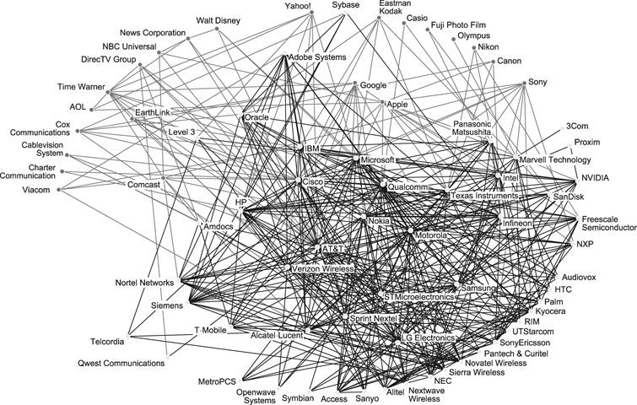
http://www.mobileappstesting.com/getting-started-with-mobile-apps-testing/

Slide 3
Mobile Boot-Camp Objectives:
1. Lecture Theory I: Mobile Ecosystem: Carriers – Networks – Manufactures – Devices – Platforms/OS – Frameworks – Applications – Services
Homework: Exploration & Installation of the Helping Testing Tools
2. Lecture Theory II: How well you know your Devices: current Mobile Trend – next year Trend – demonstration of the new Technology application – What should you know about your Device for daily testing activities – Interview Questions and Answers
Homework: List of Youtube Video to watch for the further Class discussion and exercise
3. Specific of Mobile Testing I: Mobile Testing Approach/Test Planning – Mobile Testing Domains – Mobile Testing Specifics – Manual Mobile Testing Types – Interview Questions and Answers
Homework: Installation of the Eclipse with Android SDK

Slide 4
4. Specific of Mobile Testing II: Android SDK daily testing activities (screenshots and logs) – Emulator/Simulator – RDA Services – Interview Questions and Answers
Homework: installation of the BB/iPhone Simulators, add-on on PC Browser for mobile devices simulation
5. Specific of Mobile Testing Test Cases and Bug report: Full Test Coverage of Manual Mobile Application Testing in Agile – daily activities and responsibilities
Homework: Write 10 Test Cases and 1 Bug report for Mobile Application (HP QC ALM Template)
6. Practicum 1 – Web Mobile Application: Introduction to Web Mobile Application – Web Design and Mobile Testing – Agile daily Environment – specific of Web Mobile Application Testing – Interview Questions and Answers
Homework: Write 20 Test Cases that will provide the Full Test Coverage for the Mobile Web Application

Slide 5
7. Practicum2 – Native Mobile Application: Introduction to Native Mobile Application – Industries and needs in Mobile Native application – specific of Native Mobile Application Testing – Interview Questions and Answers
Homework: Write 30 Test Cases that will provide Full Test Coverage for the Mobile Native Application
8. Practicum3 – Hybrid Mobile Application: Introduction to Hybrid Mobile Application – Technical specifics and examples of Hybrid Mobile application – Testing Coverage for Hybrid Mobile Application – Intro to API Testing
Homework: Write 50 Test Cases that will provide Full Test Coverage for the Mobile Native Application
9. Review of the Class and Practicum Objectives: Interview Questions and Answers
Homework: FINAL EXAM
10. Final Exam review and additional questions

Slide 6
Expectations and Responsibilities:
Student should understand the fast-pacing Nature and unique Environment of Mobile Market that may challenge your previously gained knowledge and experience.
Student must be self-organized and motivated.
Student must make commitment to attend all Classes (the Group Members will rely on each other).
Student MUST BE ON TIME with all Class- and Homework (also if it looks dumb or unnecessary).
Student should REVIEW each of Lecture Presentation in addition to the weekly Homework.
List of Questions submitted to the Teacher’s email is encouraged with exceptions of one list per week/per person after the Student try to find the answers by themselves (and have proof of it).
Student obligated at least to attempt to do all Installation by him/herself
Student should following flexible Instructions during Practicums such as physical relocation within class, verbal and visual reports to the class, and other class activities.

Slide 7

Mobile Ecosystem
Services
Networks
Operators
Applications
Devices
Manufactures
Application Frameworks
Platforms/OS
http://www.mobileburn.com/definitions.jsp

Slide 8
Why I should understand
Mobile Ecosystem?
The Mobile Ecosystem explores the trends, companies, organizations and statistics at the center of mobile marketing.
It let you to be pro-active in AgileTest Planning participation (QA Role in Agile Project – my project)
It let you to gain title of an “Expert” in your company
It let you to understand the nature of the software Defects
It help you to be effective and productive while writing Test Cases
It help you to answer the block of Interview Questions

Slide 9


Operators-Carriers-Providers
They install cellular towers, operate the cellular network, make services (such as the Internet) available for mobile subscribers, and they maintain relationships with the subscribers, handling billing and support, and offering subsidized device sales and a network of retail stores.
The operator’s role in Mobile World is to create and maintain a specific set of wireless services over a reliable cellular network.
In US top four carriers are: Verizon, AT&T, Sprint, T-Mobile

Slide 10
Mobile Ecosystem
Services
Networks
Operators
Applications
Devices
Manufactures
Application Frameworks
Platforms/OS

Slide 11
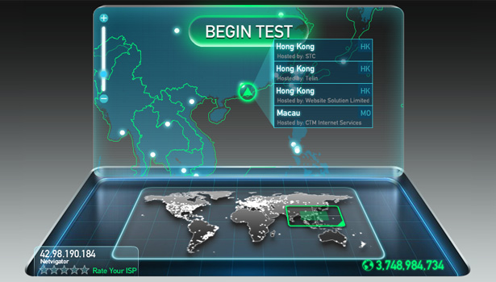
Role of Network in Mobile testing
1. Infrastructure of Network in Test Planning
2.Ability to save and transfer information
3. Speed of the Connection
4. Types Connection and Connectivity testing
5. Mobile Protocol stack testing (using network simulators)
6. Performance – Load - Stress Testing
7. Geo-Location API and services
8. Compatibility Browsing Testing of Web Mobile Application

Slide 12

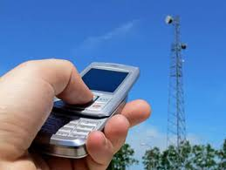
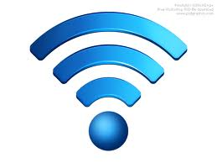
Network: Concept
The cellular technology is just a radio that receives a signal from an antenna.
The types of radio waves and antennas determines the capability of the network and differentiate the services.
The basic networks around the world are the GSM (Global System for Mobile Communications) and CDMA (Code Division Multiple Access)

Slide 13


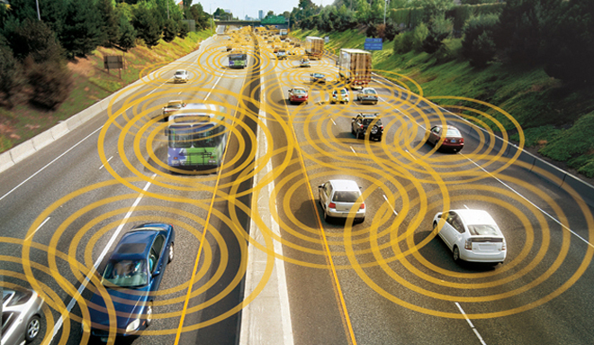

Wi-Fi is a high-speed Internet and network connection without the use of cables or wires — you could use "wireless" as a solid synonym.
The technology uses radio waves to transmit data between your computer and a router.
It found early success in July 1999, when Apple built in Wi-Fi as an option on iBook computers, calling it AirPort. Other computer makers followed suit, and thus offered consistency to consumers.

Slide 14
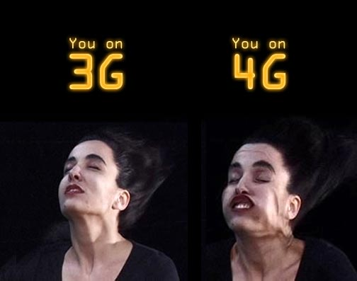
Mobile Network: 1 to 4G – era
The first generation of wireless technology 1G, refers to the analog signal used by cellular towers.
2G technology upgraded the analog signal to digital and allowed the inclusion of sending text messages across the network.
3G technology made use of electromagnetic wavelengths, known as spectrum, to broadcast a wireless broadband signal that allowed users to access the Internet and download applications using a 3G data card or a handheld mobile device such as a Blackberry or iPhone.
4G is called an “ultra-broadband” access for mobile devices. 4G networks are based on an all Internet protocol packet switching instead of circuit-switched technology, and use OFMDA multi-carrier transmission methods or other frequency-domain equalization (FDE) methods instead of spread spectrum radio technology.
Types of 3G broadband include: Enhanced Data GSM Environment (EDGE), EV-DO, and High-Speed Downlink Packet Access (HSDPA).
WiMax and LTE represent 4G broadband.

Slide 15
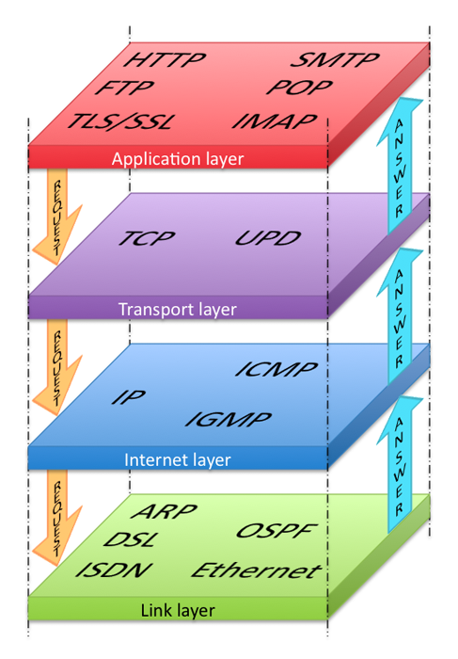
Network stack protocol – part of Mobile Testing
Individual protocols within a suite are often designed with a single purpose in mind.
Because each protocol module usually communicates with two others, they are commonly imagined as layers in a stack of protocols.
The lowest protocol always deals with "low-level", physical interaction of the hardware. Every higher layer adds more features. User applications usually deal only with the topmost layers
Thenewboston: http://www.youtube.com/watch?v=ueVnSz_lXEs&list=SP6gx4Cwl9DGBpuvPW0aHa7mKdn_k9SPKO

Slide 16
Connecting via Mobile Network
Technology | Abbreviation Meaning | Connection Speed
GPRS | General Packet Radio Service (2-3G GSM) | 128 kb/s
EDGE | Enhanced Data for GSM Evolution | Up to 476 kb/s
HSPA | High-Speed Packet Access | Up to 1 Mbit/s
3G | Third Generation | 384 kb/s to 2 Mbit/s
HSDPA (“3.5G”) | High-Speed Downlink Packet Access | 14.4Mbit/s
4G WiMax | Worldwide Interoperability for Microwave Access | 128Mbit/s
4G LTE | Long Term Evolution | 300Mbit/s to 1Gbit/s

Slide 17
Mobile Ecosystem
Services
Networks
Operators
Applications
Devices
Manufactures
Application Frameworks
Platforms/OS

Slide 18

What is depends on Makers/Manufactures in Mobile Testing
Manufacture determines and affects:
1. OS Hardware and Firmware (Software)
2. Mobile Platform
3.Mobile Browsers
4. Devices
5. Ways of future technology
6. The model and approach of Mobile Testing

Slide 19
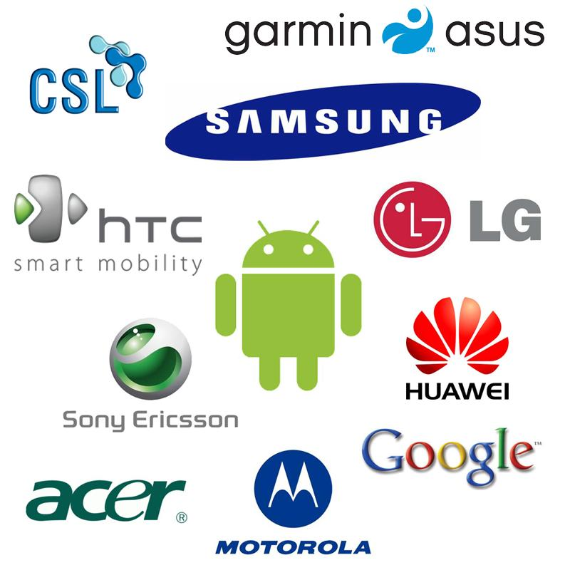
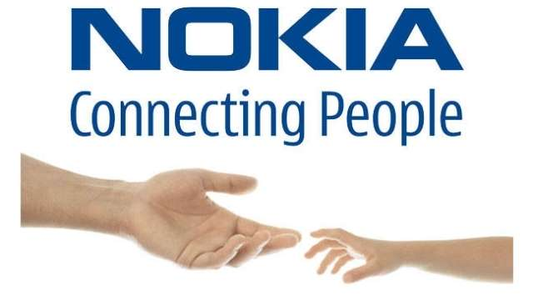

Mobile Phones Makers/Manufactures/Vendors

Slide 20
Mobile Ecosystem
Services
Networks
Operators
Applications
Devices
Manufactures
Application Frameworks
Platforms/OS

Slide 21

What is depends on Mobile
Devices in Mobile Testing
1. Form Factor
2. Hard and Software
3. Features and Options
4. UI
5. Target in Testing Planning

Slide 22
Types of Mobile Devices:
Mobile computers
Pager
Personal Navigation device (PND)
Tablet Computer
Mobile phone
Digital video Camera (DVC)
Digital still camera(DSC)
Wearable Computing

Slide 23
Mobile Computers:
Mobile Internet device
Mobile WEB
Personal Digital Assistant
Calculator
Handheld game console
Mobile Collaboration
Portable media player

Slide 24
Mobile Ecosystem
Services
Networks
Operators
Applications
Devices
Manufactures
Application Frameworks
Platforms/OS

Slide 25
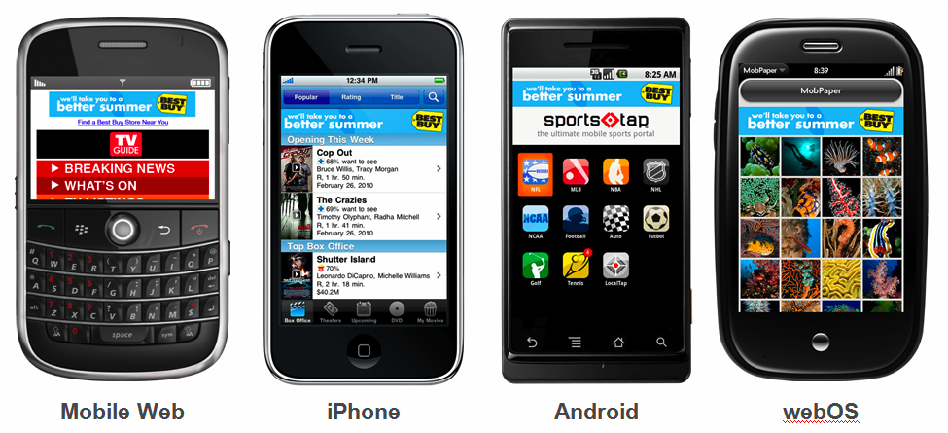
What is depends on Platforms/OS in
Mobile Testing:
  I. Mobile Feature
  1. Software
Standard/Pre-installed Software
GPS
Multi-tasking
Email
Switching between apps
2. Network Connection
3. UI
II. Device settings
III. Tablet or phone
IV. Apps Store:
  Submission requirements
  Development specifications
  User guides
  Number of application

Slide 26
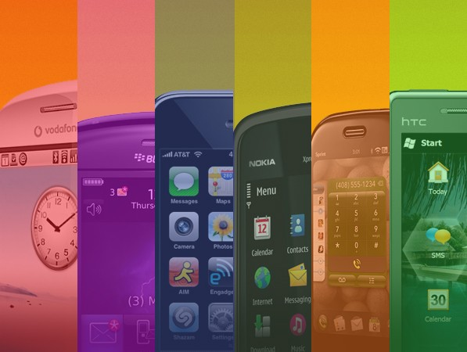
Types Mobile Platforms
Licensed
JME
BREW MP
Proprietary
iOS=OS X+Darwin
Open Source
Android-OHA
LiMo
Tizen
Linux OS
Firefox OS
Windows Phone
BB 10
webOS (LG)

Slide 27


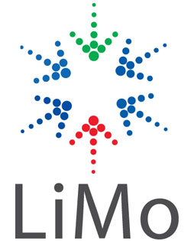
Platforms: Licensed
The major goal of Licensed Platforms was to create a common/standard platform of Application Programming Interfaces (APIs) development that work similarly across multiple devices with the minimum effort required to adapt the device differences.
Licensed platforms are sold to device makers for non-exclusive distribution on devices.
Example: JME - Sun Microsystems/Oracle; Brew MP – HTC Smart Phone or carrier’s firmware, etc

Slide 28

Platforms: Proprietary
Proprietary platform is the “all-under-one-roof” concept where the Device designs, development and marketing are belongs to one company/brand.
Windows is one, OS X is another. You must buy it from them or one of their authorized dealers.
They are not available for use by competing device makers.
Do not confuse proprietary OS with proprietary applications or software. These are programs developed by a specific company for a specific purpose when off the shelf software will not meet their needs.
http://www.ehow.com/info_8366503_advantages-disadvantages-proprietary-operating-system.html

Slide 29

Platforms: Open Source
Open source platforms are practicing the main principle of Open-Source software development: the Peer production by bartering and collaborating with the end-product, source material, “blueprints”, and documentation that available at no cost to the public.
Platforms are freely available for users to download, alter, or edit.

Slide 30
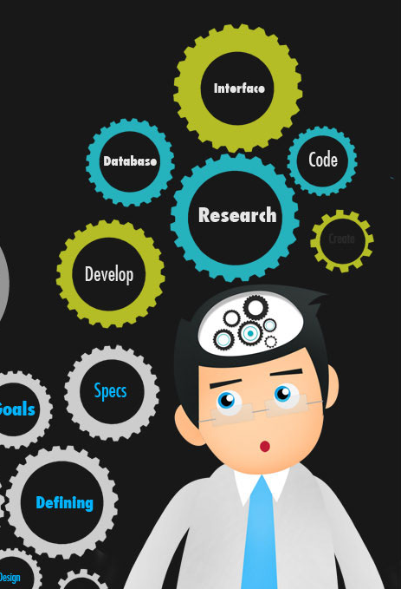
What mobile platforms are you familiar with ?
Android
iOS/OS X
BlackBerry 10
Windows Phone
Tizen
Linux (OS)
BREW MP
Firefox (OS)
webOS(LG)

Slide 31
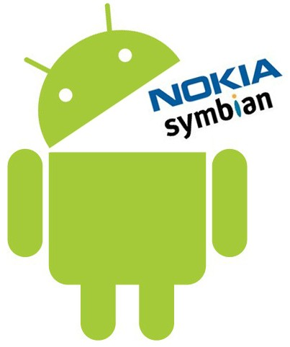
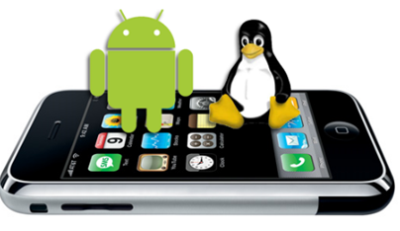

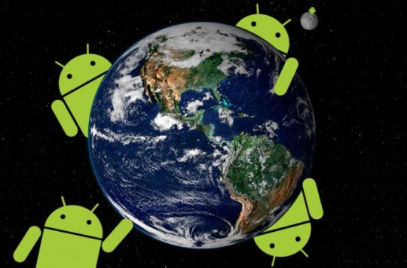
Describe Android OS
Source
Platform
Core Language
OS Architecture
Version History
Updates/Upgrades
Makers
Carriers
Life Battery
Web Browsers

Slide 32

Architecture of Android
Applications
Home
Phone
Application Framework
Package Manager
Telephony Manager
Libraries and Android Runtime
Android Runtime consist:
Contacts
Browser
Content Providers
Location System
Notification System
Dalvik Virtual Machine
Linux Kernel
Drivers Package
Power management
Hardware
Core Java Libraries
Libraries:
Media SurfaceM FreeType
Open GL\ SSL SQLite
WebKit SGL libc
OS
http://www.mindcracker.com/Story/1076/architecture-of-android

Slide 33
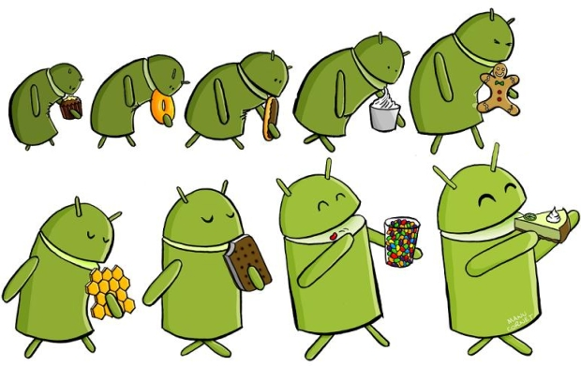
Android Version History
http://www.theverge.com/2011/12/7/2585779/android-history

Slide 34
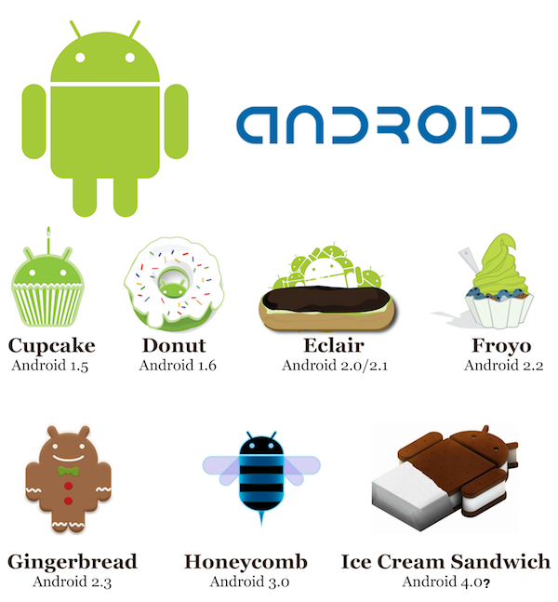
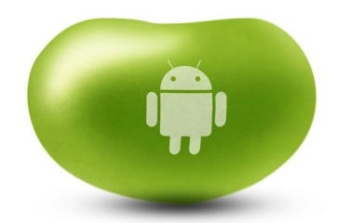
Android Versions History – MUST to KNOW
July 9, 2012
Jelly Bean
Android 4.1
04-2009
09-2009
11-2009
05-2010
Jelly Bean
Android 4.2
November, 2012
12-2010
02-2011
10-2011

Slide 35
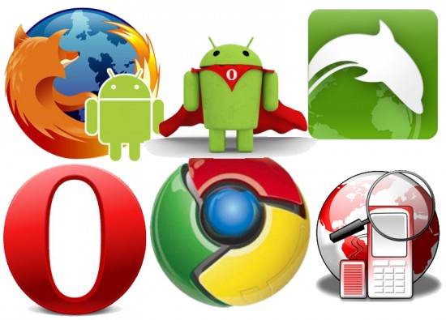
What Android Browsers do you know
SkyFire
Google Chrome
June 28, 2012
Opera Mini 7
Opera
Maxthon
Sleipnir
Dolphin
Mozilla FireFox
xScope
Web Android
http://www.youtube.com/watch?v=reYXAERpdWQ
http://techhamlet.com/2012/06/best-browser-apps-android-device/

Slide 36
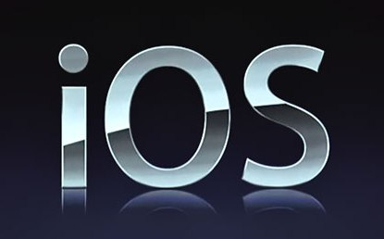
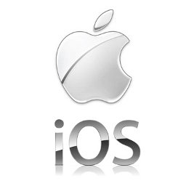
What do you know about iOS/Platform
Source
Platform
Core Language
OS Architecture
Version History
Updates/Upgrades
Makers
Carriers
Life Battery
Web Browsers

Slide 37
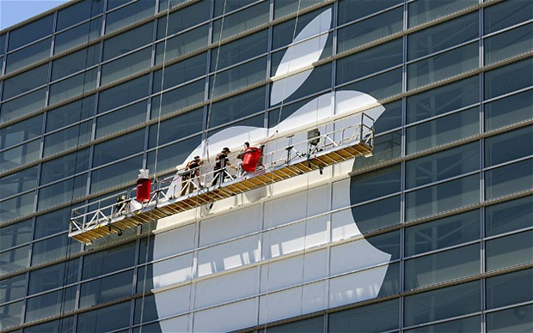
Operating System: iOS
iOS is derived from Mac OS X that shares with the Darwin foundation; and therefore, it is a Unix operating system.
Primary Apple development language is Objective-C; although, it is possible, with some translation work, to port Java code into iPhone.
http://www.techotopia.com/index.php/The_iOS_4_Architecture_and_SDK_Frameworks
http://iosframeworks.com/

Slide 38
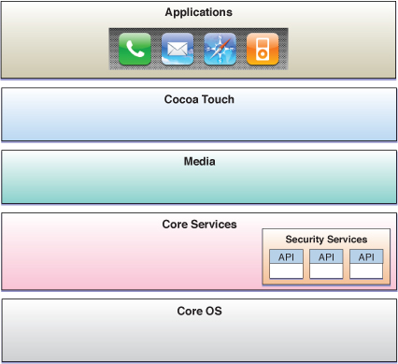
Operating System: iOS
Hardware

Slide 39
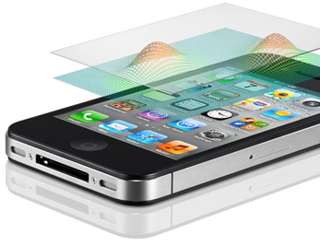
iOS: Cocoa Touch
The Cocoa Touch layer sits at the top of the iOS stack and contains the frameworks that are most commonly used by iPhone application developers.
Cocoa Touch is primarily written in Objective-C, is based on the standard Mac OS X Cocoa API (as found on Apple desktop and laptop computers) and has been extended and modified to meet the needs of mobile technology.
The Cocoa Touch layer provides the following frameworks for iPhone app development:
1 UIKit Framework
2 Map Kit Framework
3 Push Notification Service
4 Message UI Framework
5 Address Book UI Framework
6 Game Kit Framework
7 iAd Framework
8 Event Kit UI Framework
https://developer.apple.com/library/mac/#documentation/Cocoa/Conceptual/CocoaFundamentals/WhatIsCocoa/WhatIsCocoa.html

Slide 40


iOS Version’s History – MUST to KNOW
Version | First Release | Originally create/Highest Version to Upgrade for
3.x (D/C) | February, 2010 | iPhone (original); iPod Touch (1st generation)
4.X (D/C) | June, 2010 | iPhone 4; iPod Touch (2nd generation)
5.0 | October, 2011 | iPhone 4S, iPad 2
5.1 | March, 2012 | iPad (3rd generation)
5.1.1 | May, 2012 | iPod Touch (4th generation)
 | June, 2012 | Apple TV (3rd generation)
6.x | September 2012 | iPhone 3GS, iPhone 4, iPhone 4S, iPod Touch 4, iPad 2, iPad 3, iPad 4, Apple TV 3, nano touch – upgrade iPhone 5,iPod Touch 5 - originally
Apple's iOS did not have an official name until the release of the iPhone software development kit (iPhone SDK) on March 6, 2008.
When introduced, it was named iPhone OS. It was renamed iOS on June 2010, as iPhone was no longer the only device to run iOS.
http://en.wikipedia.org/wiki/IOS_version_history

Slide 41
What iPhone Browsers do you know
Opera Mini
Chrome
Atomic Web
Dolphin
Aquari
Firefox Home
Wide Web
Safari
Incognito
iBrowse2
http://www.youtube.com/watch?v=DlI-K9PgONo
http://www.youtube.com/watch?v=rPPIsqFRPsI
http://lifehacker.com/5922808/lifehacker-faceoff-the-best-web-browsers-for-iphone-and-ipad

Slide 42
Comparison Table: Android vs. iOS
Category | Google Android | Apple iOS
License - Source | Open Source | Close - Proprietary
Company | Open Handset Alliance/Google | Apple
OS Platform | Linux | OS X – Unix (Darwin)
Programming Language | Java | Objective-C
Virtual Machine | Dalvik VM | None
Package Manager | APK – Google Play/Play Store | iTunes (with iOS 6 – iStore)
Carriers | AT&T, Verizon, T-Mobile, Sprint, MetroPCS, Virgin, 96% out of 369 US carriers | Apple Store, AT&T, Verizon, Sprint, Virgin Mobile, Cricket + 10 regional carriers
Life Battery | Moderate | Advance high
Browser Engine | WebKit: Web, Opera Mini 7, Dolphin, Chrome | WebKit: Safari, Opera Mini 7, Atomic Web, Chrome

Slide 43
Mobile Ecosystem
Services
Networks
Operators
Applications
Devices
Manufactures
Application Frameworks
Platforms/OS

Slide 44

Frameworks
Web development is about getting stuff done, not figuring out how to get it done.
Frameworks and libraries help the web developers focus on creating rather than figuring stuff out.
Rather than reinventing the wheel, Developers can use a framework or library to delegate brunt, non-creative and repetitive work, freeing up their time and energy to create the actual website or application.
http://speckyboy.com/2011/03/07/20-new-frameworks-for-web-and-mobile-app-developers/
http://www.rhomobile.com/webinars-old/rhodes-testing-framework/

Slide 45
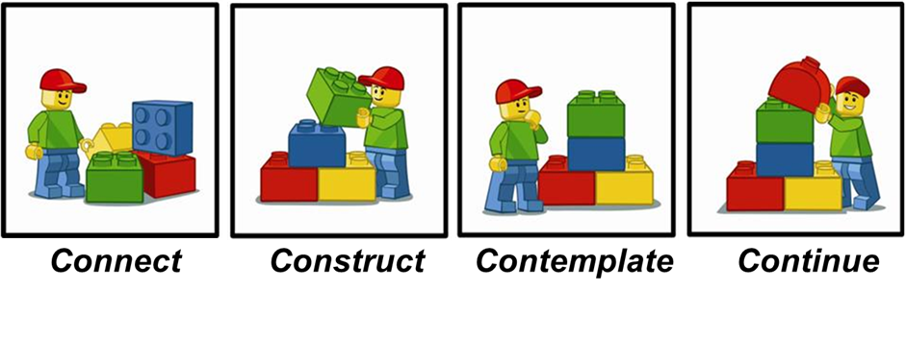
It defines the underlying code structure of the application in advance.
Developers usually use object-oriented programming techniques to implement frameworks such ways that the unique parts of an application can simply inherit from pre-existing classes in the framework

Slide 46
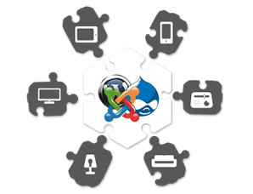
Framework- definition
A software framework is an abstraction in which software providing generic functionality can be selectively changed by additional user written code, thus providing application specific software.
A software framework is a universal, reusable software platform used to develop applications, products and solutions.
Software frameworks include support programs, compilers, code libraries, an application programming interface (API) and tool sets that bring together all the different components to enable development of a project or solution.
For example:
  Platform: Windows CE;
  OS: Windows Phone;
  Framework: .NET
  Platform: OS X;
  OS: iOS;
  Framework: Cocoa Touch
http://en.wikipedia.org/wiki/Comparison_of_web_application_frameworks

Slide 47

What is API?
An Application Programming interface (API) is a set of functions, classes, libraries, or packages (a.k.a. frameworks) that allowing the programmer to access an application’s services by using the programming languages.
An API may include specifications for routines, data structures, object classes, and variables.
Generally speaking, an application programming interface (API) is a specification of how some software components should interact with each other.
API examples: Google Maps, Twitter, Instagram

Slide 48
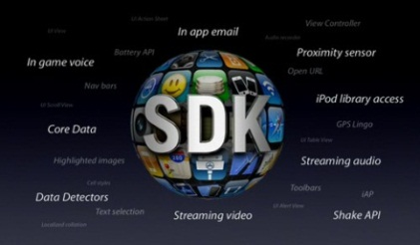
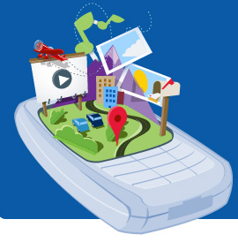
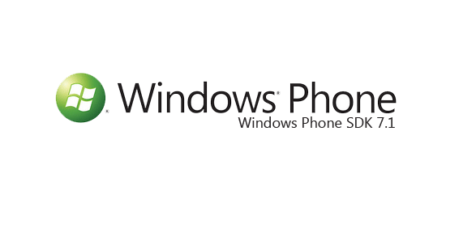
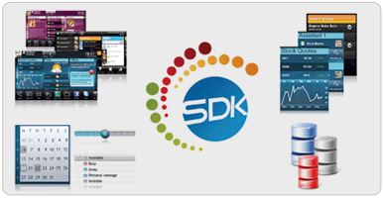
Term to know: SDK
Software Development Kit, is a programming package that enables a programmer to develop applications for a specific platform.
Typically an SDK includes one or more APIs, programming tools, and documentation.
Common tools include debugging aids and other utilities often presented as a part of integrated development environment (IDE).
SDKs also frequently include sample code and supporting technical notes or other supporting documentation to help clarify points from the primary reference material.
                iPhone SDK:
                http://www.morgana.ca/freedev.html
Android SDK:
http://developer.android.com/training/basics/firstapp/index.html
Windows Phone SDK:
http://msdn.microsoft.com/en-us/library/ff402523(v=vs.92).aspx

Slide 49
Mobile Ecosystem
Services
Networks
Operators
Applications
Devices
Manufactures
Application Frameworks
Platforms/OS

Slide 50

What is a Mobile application?
A Mobile app is a software that runs on a handheld device, which can connect to Wi-Fi or wireless carrier networks and has an OS to support standalone software.
Mobile Apps were originally intended for productivity: email, calendar and contact databases, but public demand caused rapid expansion into other areas such as mobile games, location-based services, banking, order-tracking, and ticket purchases.

Slide 51
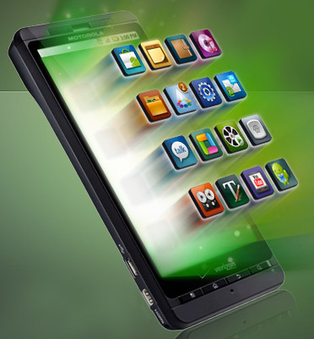
What is a Native Mobile Application?
Native app is the one that is specifically designed to run on a device’s operating system and machine firmware, and typically needs to be adapted for different devices.
Native apps are built for a specific SDK platform, tools and languages, typically provided by the platform vendor (e.g. xCode/Objective-C for iOS, Eclipse/Java for Android, Visual Studio/C# for Windows Phone).
That means you must duplicate them using the appropriate programming language in order to target another mobile platform.
Nearly all games are native apps.

Slide 52
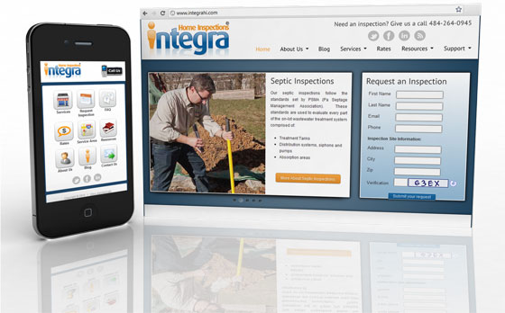

What is a Mobile Web Application?
A Web app, or Browser application, is the Internet-enabled apps that have specific functionality for mobile devices.
The Application or the parts of the software are streams from the Web each time it is run.
They don’t need to be downloaded and installed on the device.
http://www.youtube.com/watch?v=4VUWrZRCtI8

Slide 53
Comparison of Native vs. Web Application
A Web app is built using HTML5 technology that describe the latest generation of Web standards, including HTML, CSS, and JavaScript, along with several dozen other technologies.
As they are not owned by any one corporation, they are universally well supported.
Native apps are built using the preferred technology of one specific platform and operating device, so Apple, Android and BlackBerry devices all have different technologies to work with.
We can compare it to building a train for a particular gauge of track.
Native apps and Web apps differ not just in how they are made but how they are accessed.
An HTML5 app is simply a Website – you visit it in your browser, and you’re done.
A native app must be downloaded and installed on the device, generally through an app store like the Apple App Store or Google’s Android Market. These app stores are controlled by their owner and may apply charges, rules and policies – these are never a constraint with HTML5, distributed purely via the Web.

Slide 54
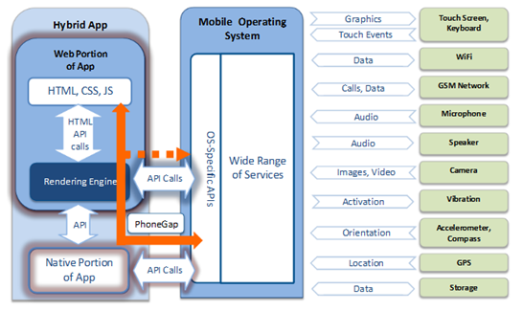
Web + Native= LOVE Hybrid

Slide 55
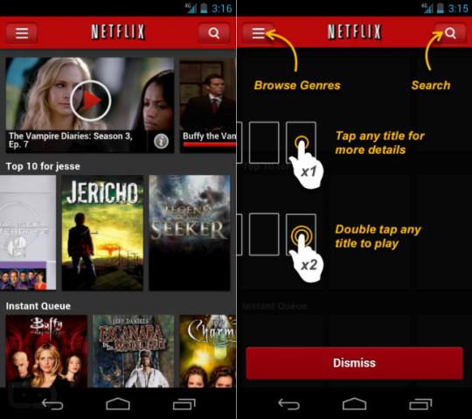
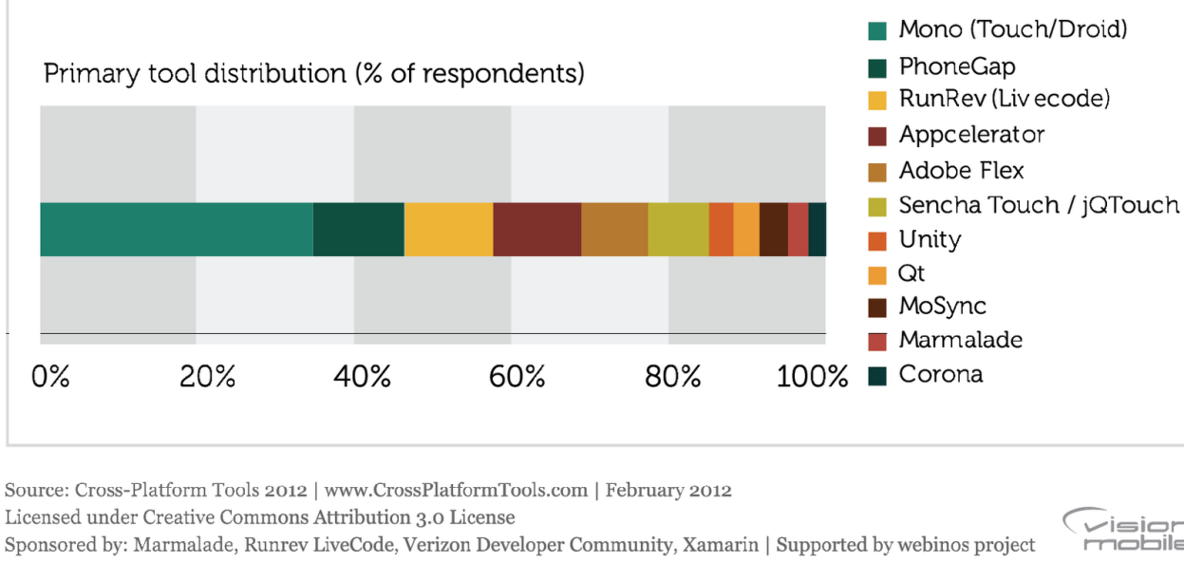
Hybrid apps rely on development frameworks like Sencha, PhoneGap, Titanium, Rhomobile, ParticleCode, Corona, Mosync, Worklight, BkRender…
Examples:Twitter, Yelp, Amazon Cloud Reader, Netflix
http://www.gsmarena.com/glossary.php3?term=accelerometer
http://icenium.com/community/blog/icenium-team-blog/2012/06/14/what-is-a-hybrid-mobile-app-

Slide 56
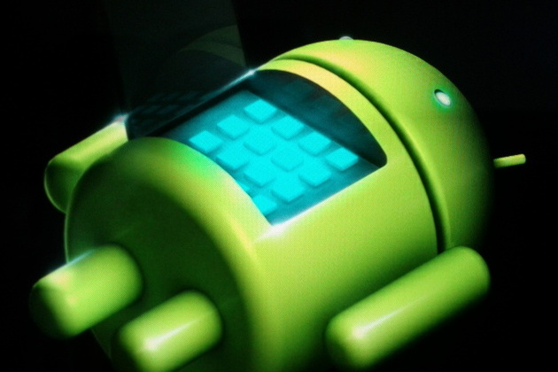
What is the file extensions for Android?
.apk - application package file (APK) is the file format used to distribute and install application software and middleware onto Google's Android operating system.
.dex -Android programs are compiled into .dex (Dalvik Executable) files, which are in turn zipped into a single .apk file on the device.

Slide 57
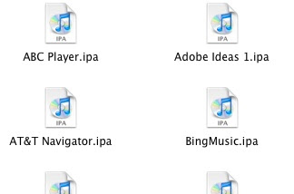
What is the iPhone file extensions?
An .ipa file is an iPhone application archive file which stores an iPhone app.
Each .ipa file is compressed with a binary for the ARM architecture and can only be installed on an iPhone, iPod Touch, or iPad.
Files with the .ipa extension can be uncompressed by changing the extension to .zip and unzipping.
.ipa files cannot be installed on the iPhone Simulator because they do not contain a binary for the x86 architecture.
To run applications on the simulator, we need to open original project files using the Xcode SDK.

Slide 58
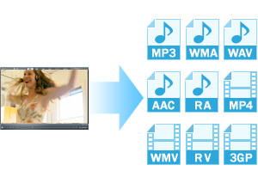
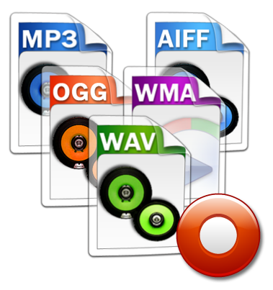
Media File Formats: Audio
.aif Audio Interchange File Format
.iff Interchange File Format
.m3u Media Playlist File
.m4a MPEG-4 Audio File
.mid MIDI File
.mp3 MP3 Audio File
.mpa MPEG-2 Audio File
.ra Real Audio File
.wav WAVE Audio File
.wma Windows Media Audio File
http://www.fileinfo.com/filetypes/common

Slide 59
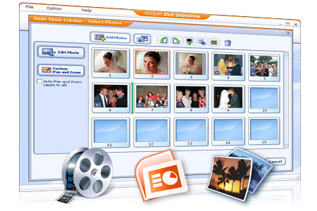
Media File Formats: Video
.3g2 3GPP2 Multimedia File
.3gp 3GPP Multimedia File
.asf Advanced Systems Format File
.asx Microsoft ASF Redirector File
.avi Audio Video Interleave File
.flv Flash Video File
.mov Apple QuickTime Movie
.mp4 MPEG-4 Video File
.mpg MPEG Video File
.rm Real Media File
.srt SubRip Subtitle File
.swf Shockwave Flash Movie
.vob DVD Video Object File
.wmv Windows Media Video File
http://www.fileinfo.com/filetypes/common

Slide 60
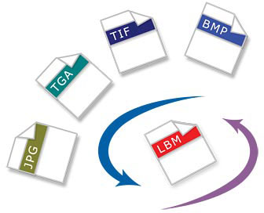
Media File Formats: Image
3-D Images
.3dm Rhino 3D Model
.3ds 3D Studio Scene
.max 3ds Max Scene File
.obj Wavefront 3D Object File
Raster Image Files
.bmp Bitmap Image File
.dds DirectDraw Surface
.gif Graphical Interchange Format File
.jpg JPEG Image
.png Portable Network Graphic
.psd Adobe Photoshop Document
.pspimage PaintShop Pro Image
.tga Targa Graphic
.thm Thumbnail Image File
.tif Tagged Image File
.tiff Tagged Image File Format
.yuv YUV Encoded Image File
http://www.fileinfo.com/filetypes/common

Slide 61
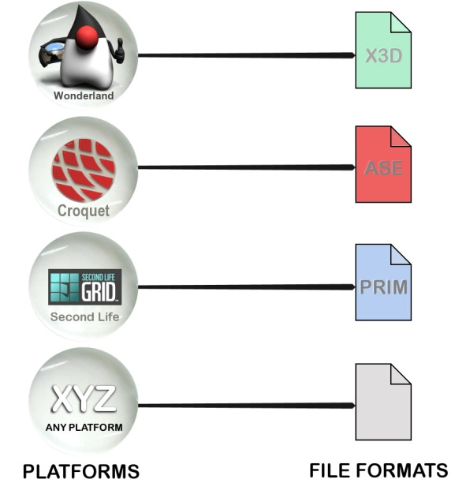


Media File Formats: Game
.dem Video Game Demo File
.gam Saved Game File
.nes Nintendo (NES) ROM File
.rom N64 Game ROM File
.sav Saved Game
http://www.fileinfo.com/filetypes/common

Slide 62

Media File Formats: Executable Files
.apk Android Package File
.app Application file
.bat DOS Batch File
.cgi Common Gateway Interface Script
.com DOS Command File
.exe Windows Executable File
.gadget Windows Gadget
.ipa iPhone archive File
.jar Java Archive File
.pif Program Information File
.vb VBScript File
.wsf Windows Script File
http://www.fileinfo.com/filetypes/common

Slide 63

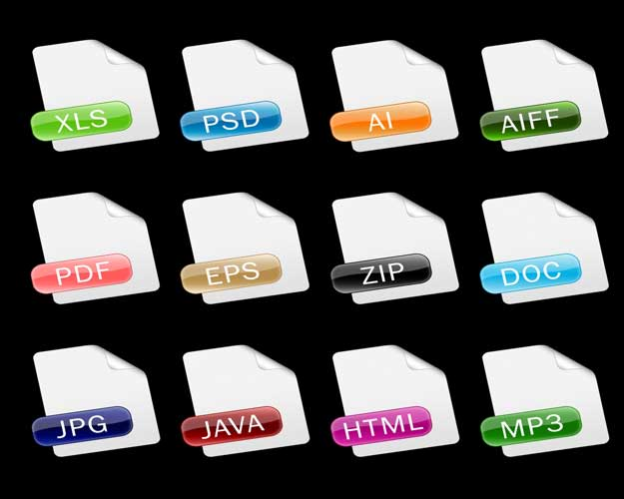
Media File Formats: Web Files
.asp Active Server Page
.aspx Active Server Page Extended File
.cer Internet Security Certificate
.cfm ColdFusion Markup File
.csr Certificate Signing Request File
.css Cascading Style Sheet
.htm Hypertext Markup Language File
.html Hypertext Markup Language File
.js JavaScript File
.jsp Java Server Page
.php PHP Source Code File
.rss Rich Site Summary
.xhtml Extensible Hypertext Markup Language File
http://www.fileinfo.com/filetypes/common

Slide 64
Mobile Ecosystem
Services
Networks
Operators
Applications
Devices
Manufactures
Application Frameworks
Platforms/OS

Slide 65



http://timreview.ca/article/335

Slide 66
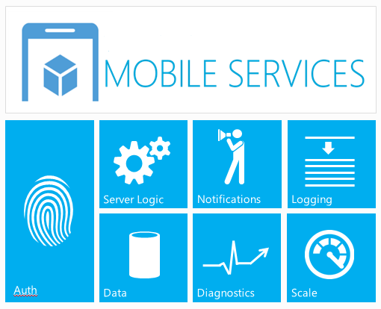

Slide 67
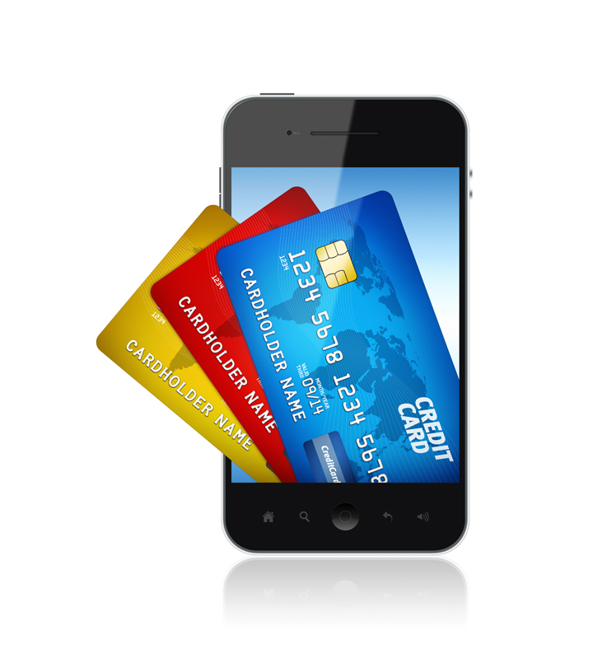

Slide 68
