Slide 1

MoBILE TESTING – survival knowledge – Part VII
Created by Ivette Doss

Slide 2

Objective for Today:
7. Practicum2 – Native Mobile Application: Introduction to Native Mobile Application – Industries and needs in Mobile Native application – specific of Native Mobile Application Testing – Interview Questions and Answers
Homework: Write 30 Test Cases that will provide Full Test Coverage for the Mobile Native Application

Slide 3
Uniqueness of Native App
Native mobile applications run directly on a mobile device's operating system, are fast and have access to all hardware features.
Native applications can operate connected and disconnected from a network. Several of the features that make mobile devices unique (e.g. location awareness) require a network connection.
Native applications offer the most advanced functions, visually rich content and possibly the best user experience.
Native applications that collect data to send to server-based applications and additionally operate in disconnected mode, must synchronize the data periodically with the server-based applications. This requirement adds to the complexity of the mobile application.
You should use a native application when either, (a) you need access to hardware features on the mobile device; or (b) the application needs to run in disconnected mode or use local storage; or (c) communication costs are high.

Slide 4
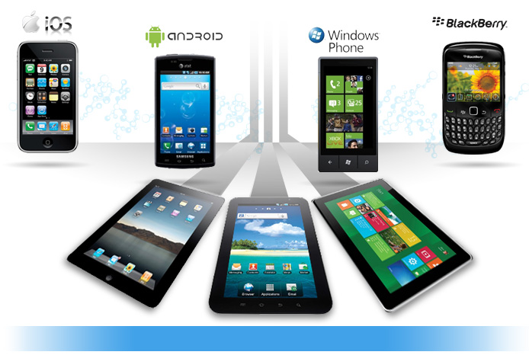
Native Applications
Applications that are most suitable for a native platform include games, social networking, lifestyle and entertainment, technology, gadgets and travel.

Slide 5
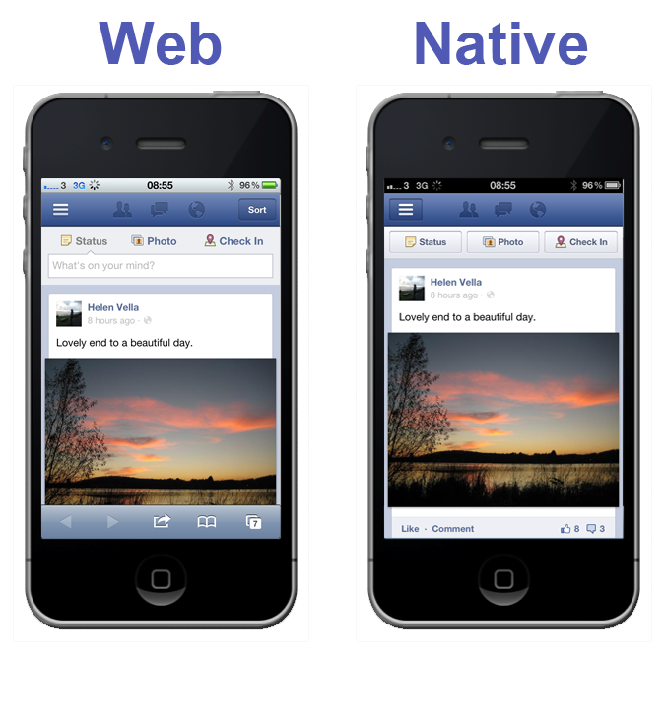

Slide 6
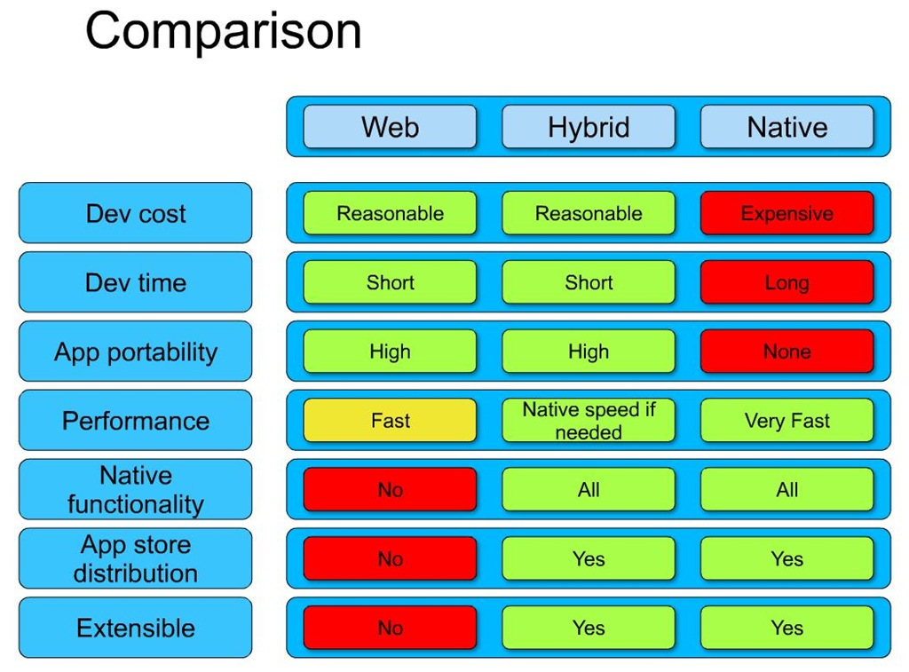

Slide 7
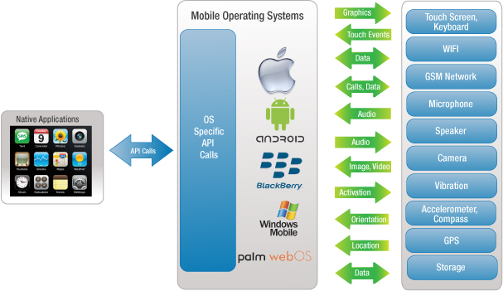
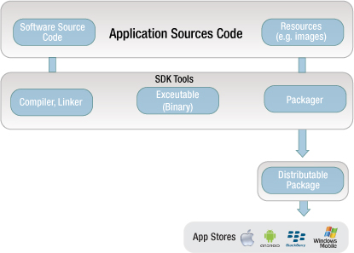
WP
WP

Slide 8
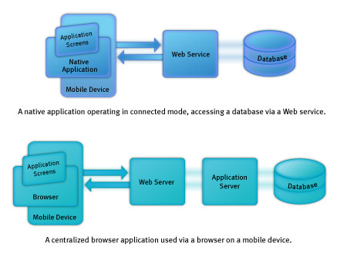

Slide 9
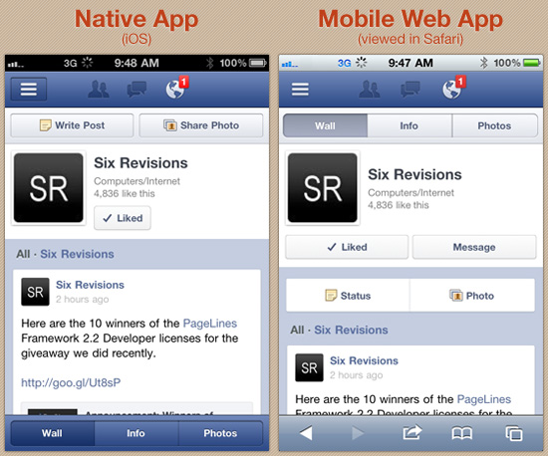
Comparison of Native App vs. Mobile Web App
User Interface
Notice that, in terms of the general look-and-feel, there’s little difference between the two, making for a consistent user experience

Slide 10
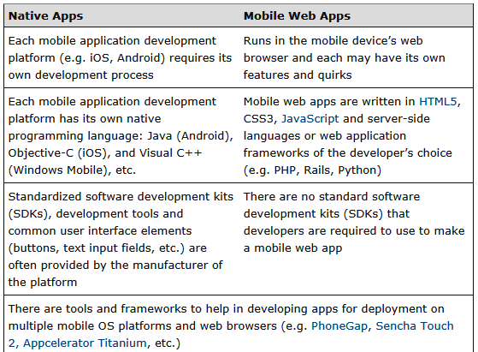
Comparison of Native App vs. Mobile Web App
Development

Slide 11
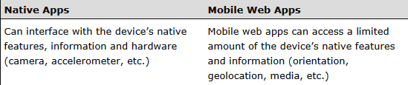
Comparison of Native App vs. Mobile Web App
Capabilities

Slide 12
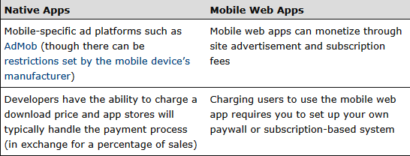
Comparison of Native App vs. Mobile Web App
Monetization

Slide 13
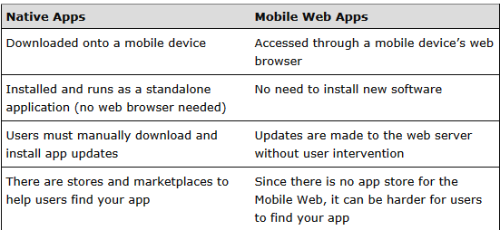
Comparison of Native App vs. Mobile Web App
Method of Delivery

Slide 14
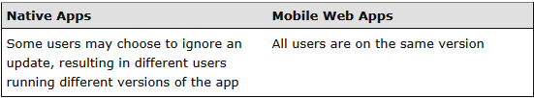
Comparison of Native App vs. Mobile Web App
Versioning of the App

Slide 15
Comparison of Native App vs. Mobile Web App
Versioning of the App

Slide 16
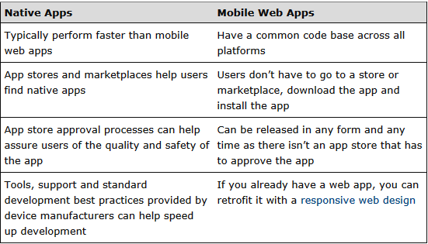
Comparison of Native App vs. Mobile Web App
Strengths

Slide 17
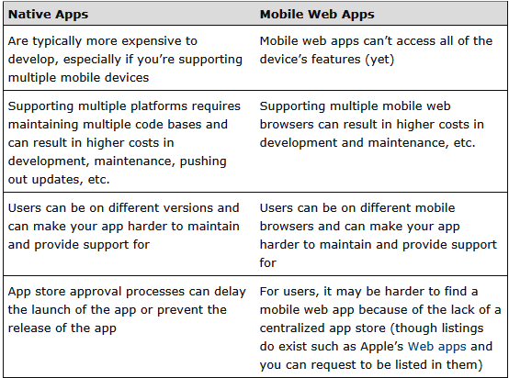
Comparison of Native App vs. Mobile Web App
Weaknesses

Slide 18
Helpful Links
http://www.drdobbs.com/mobile/free-native-mobile-app-performance-monit/240152389
http://www.telerik.com/automated-testing-tools/ios-testing.aspx

Slide 19
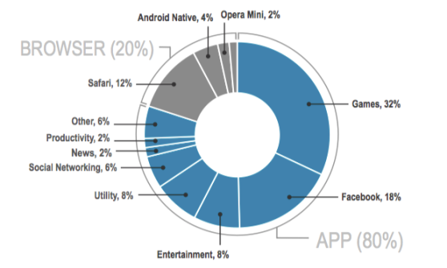

Slide 20
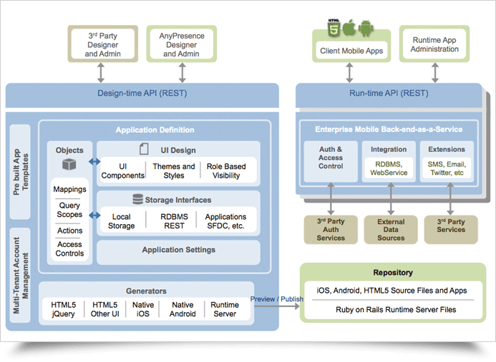

Slide 21
