Slide 1

Mobile Testing –
Survival Knowledge – Part V
Created by Ivette Doss

Slide 2
Objectives Today:
Specific of Mobile Testing:
Android SDK daily testing activities (screenshots and logs)
Emulator/Simulator
RDA Services
Interview Questions and Answers
Homework: installation of the BB/iPhone Simulators, add-on on PC Browser for mobile devices simulation
https://swdownloads.blackberry.com/Downloads/entry.do?code=060AD92489947D410D897474079C1477

Slide 3
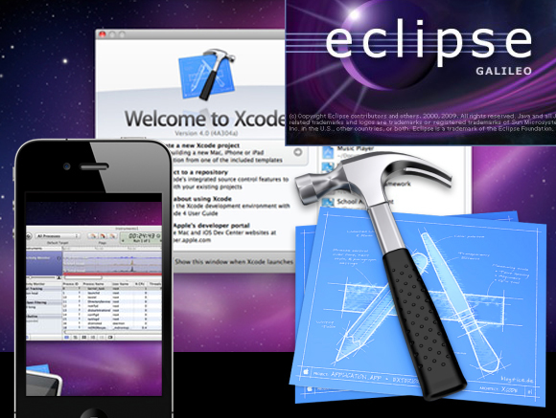
Eclipse vs. Xcode

Slide 4
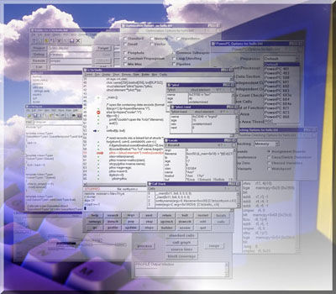
IDE - Integrated Development Environment
A set of programs run from a single user interface.
For example, programming languages often include a text editor, compiler and debugger, which are all activated and function from a common IDE menu.
Eclipse/Android SDK (Android)
Xcode (iPhone/iPad )
NetBeans IDE (Windows, OS X, Linux, Solaris)
Codeanywhere (cloud computing)
Cloud9 IDE (cloud computing)

Slide 5
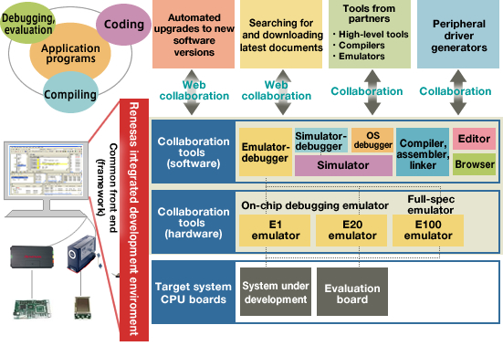
IDE – Integrated Development Environment

Slide 6
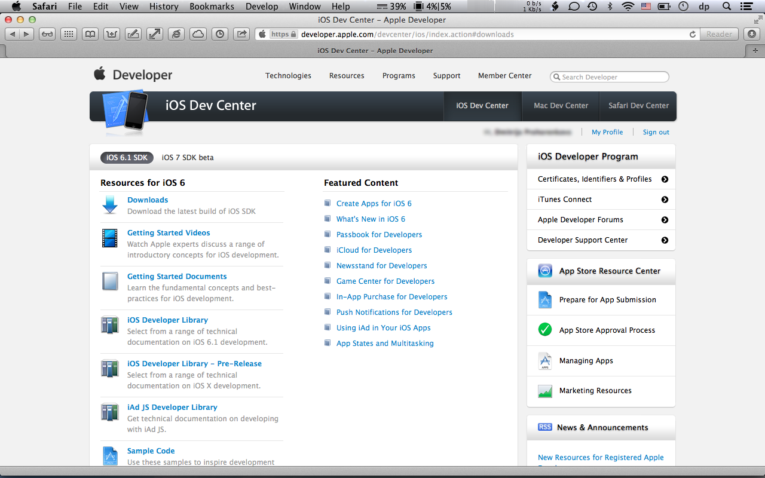
Xcode -Introduction
Developer.apple.com/devcenter/ios/index.action#downloads

Slide 7
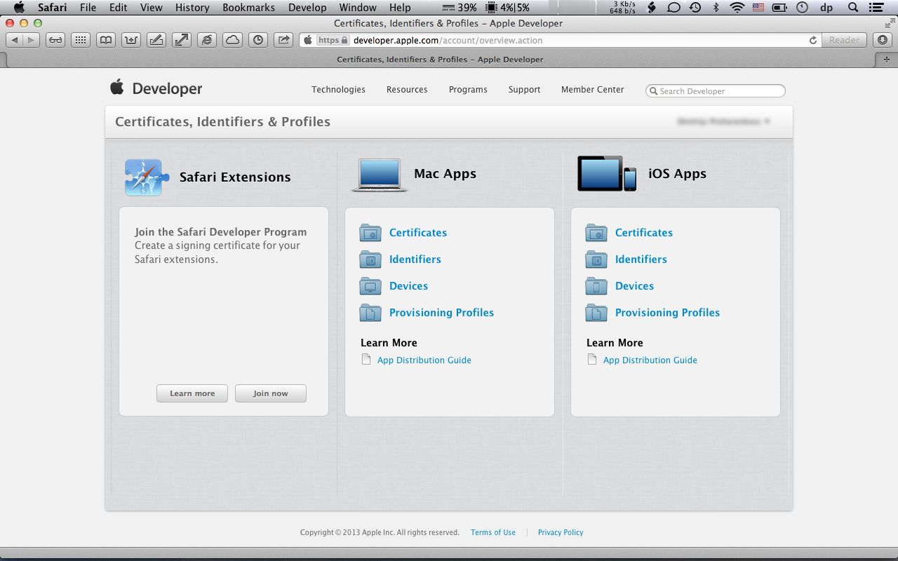
Xcode -Introduction
Device Registration for Individual/Team Developers ($99/year – 200 Devices/year)
Certificate is applied only to registered Devices
Types of Certificates: Developer or Distribution
Only assigned and certified Devices could run Apps
Certificates should be downloaded and placed to the library (auto choice)
6. Each App should be assigned to “Code Signing Identity” to prevent malicious, unauthorized code

Slide 8
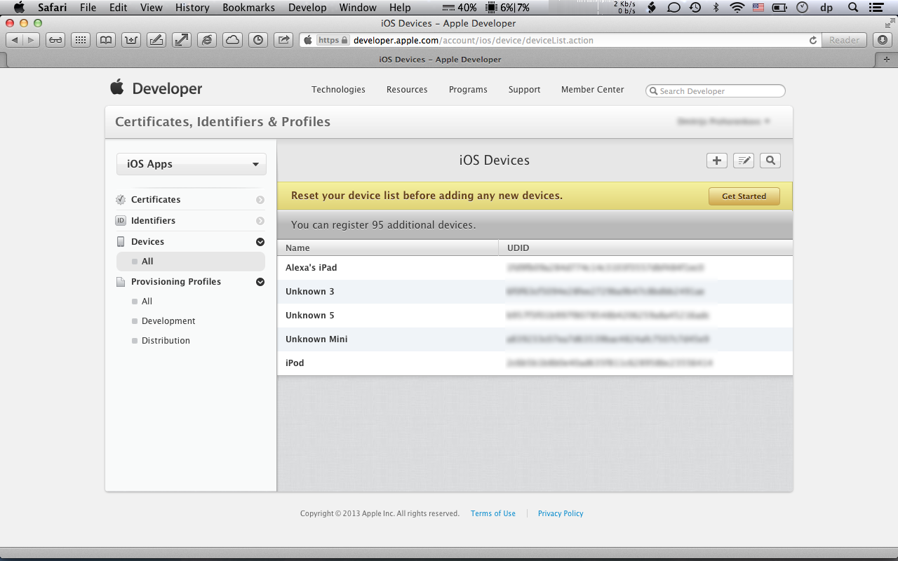
Xcode -Introduction
Summary:
To start working with any app on Xcode professionals should have:
Individual/team Developer License
Xcode Registration
Device Registration
Application Registration

Slide 9
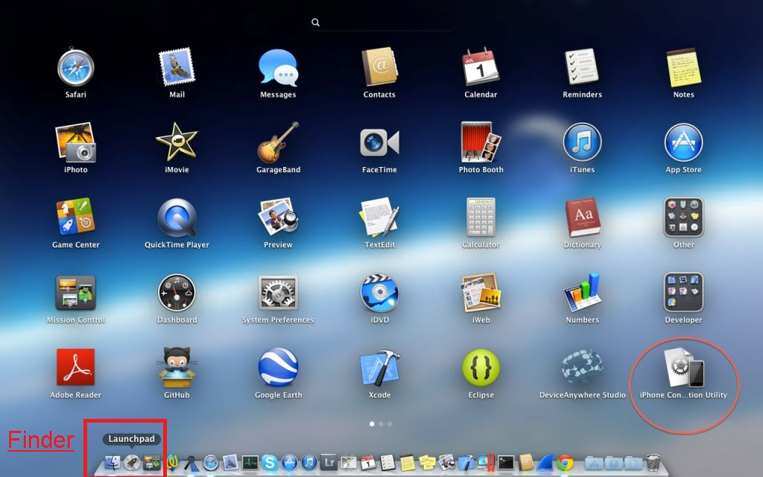
Xcode -Introduction

Slide 10
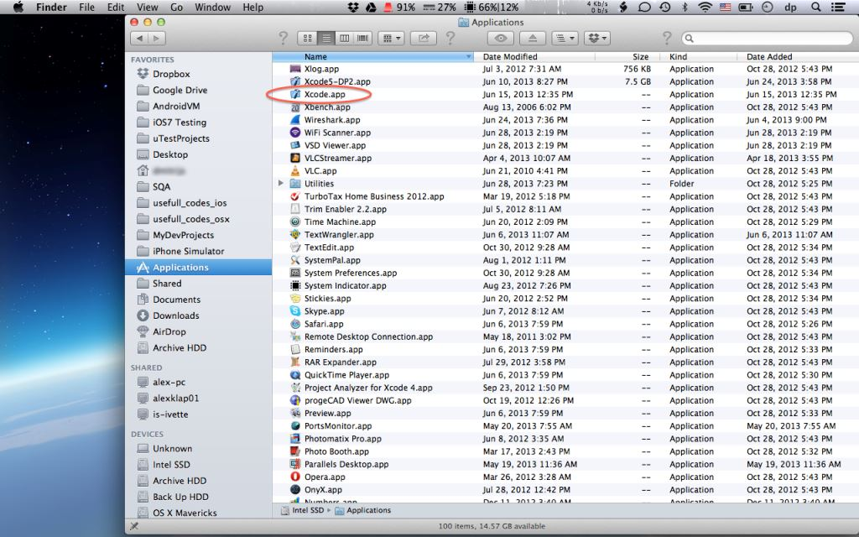
Xcode -Introduction

Slide 11
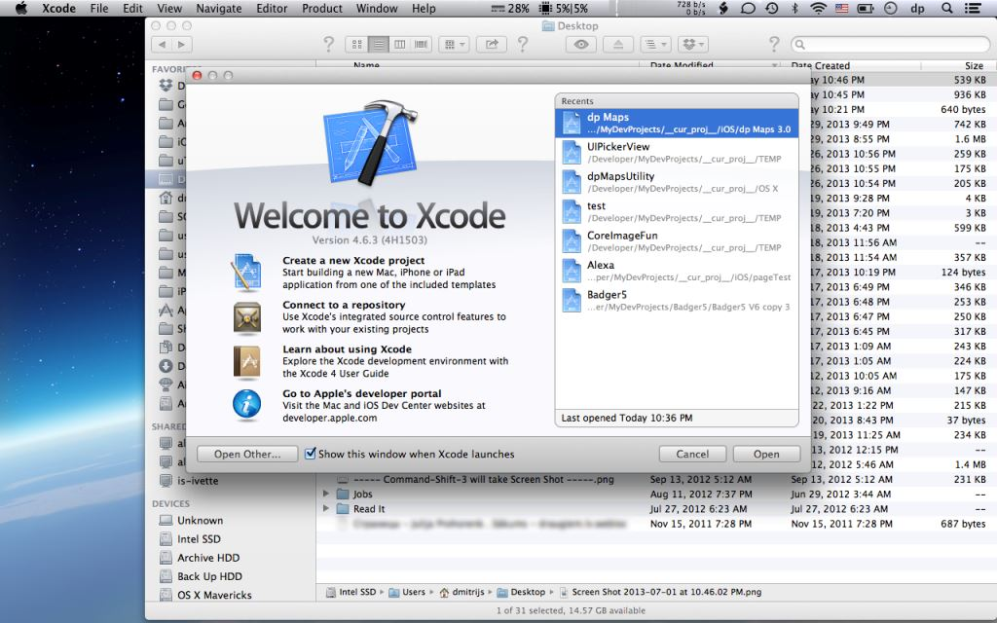
Xcode -Introduction

Slide 12
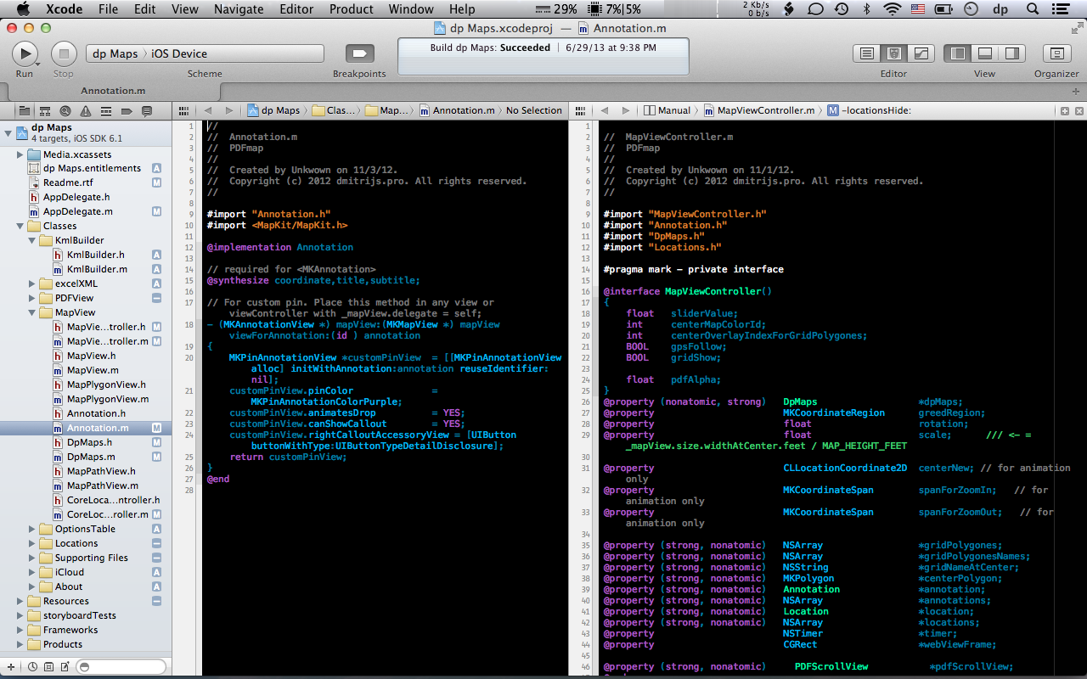
Xcode -Introduction

Slide 13
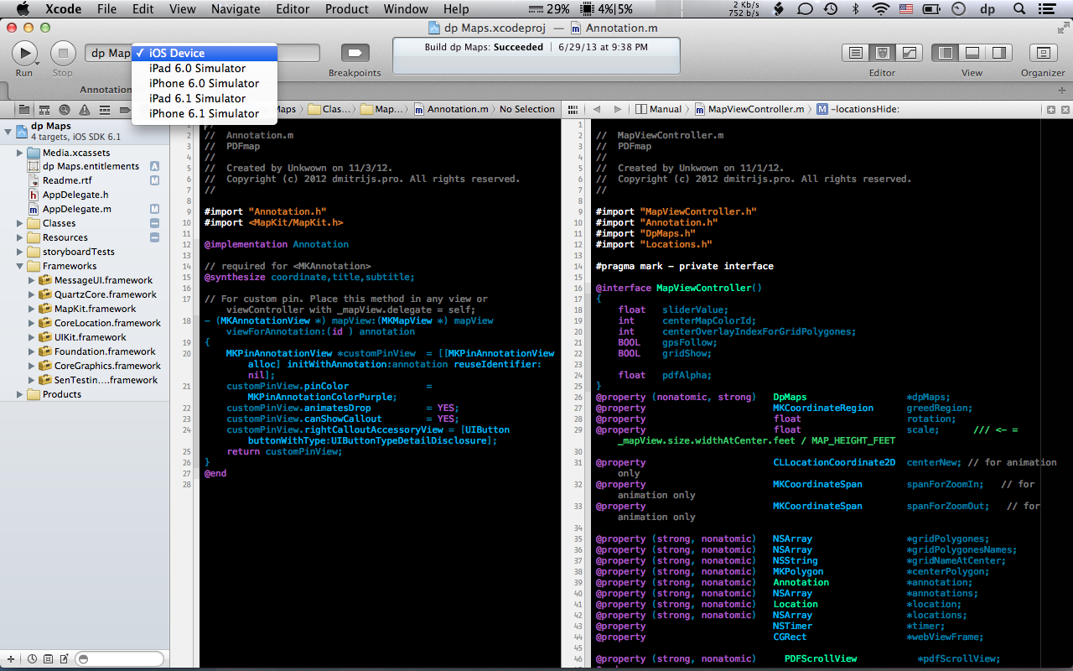
Xcode -Introduction

Slide 14
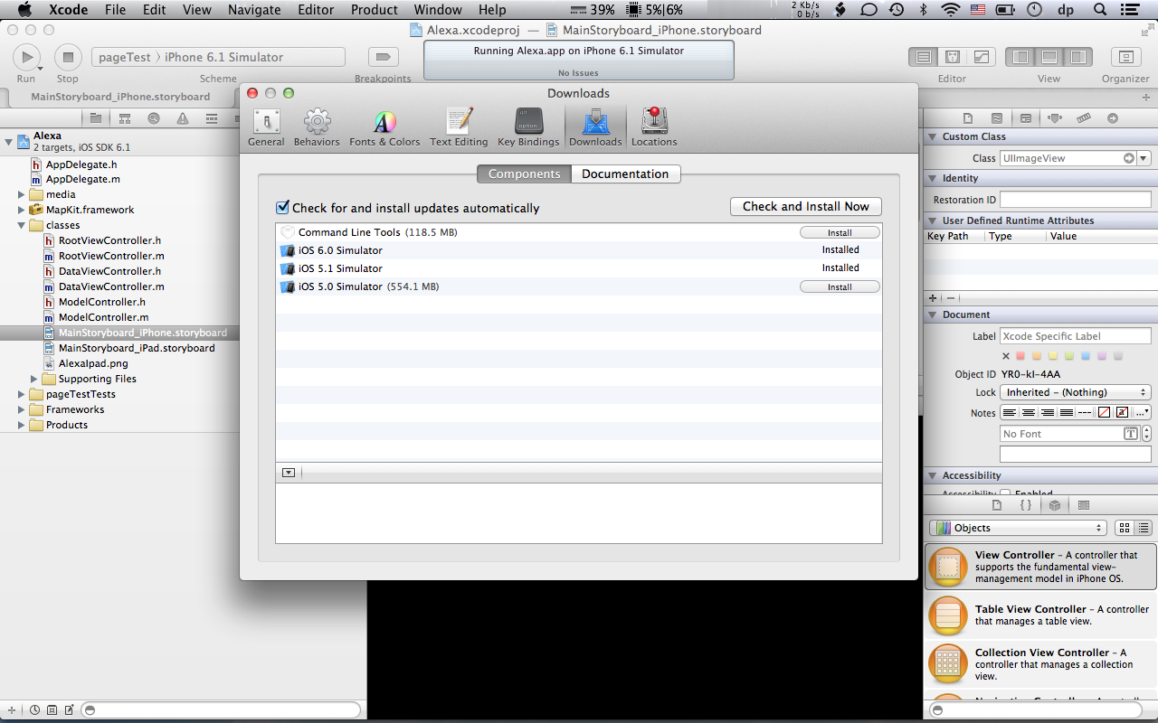
Xcode -Introduction

Slide 15
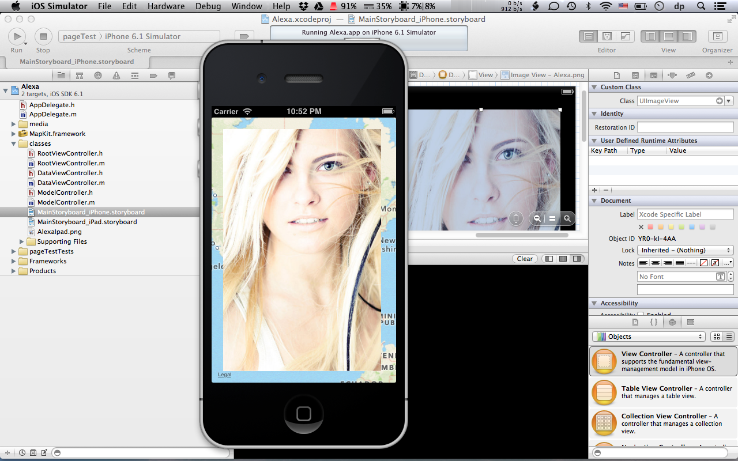
Xcode -Introduction

Slide 16
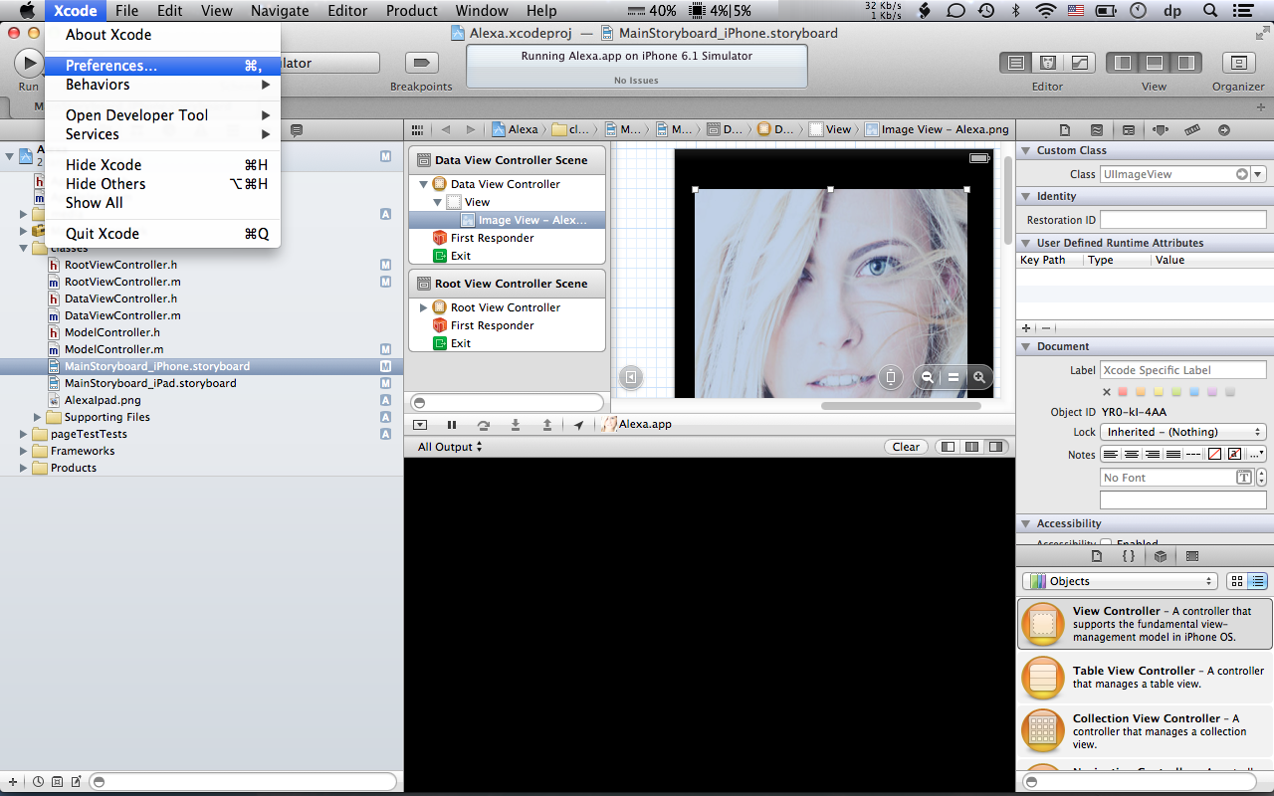
Xcode -Introduction

Slide 17
Xcode -Introduction

Slide 18
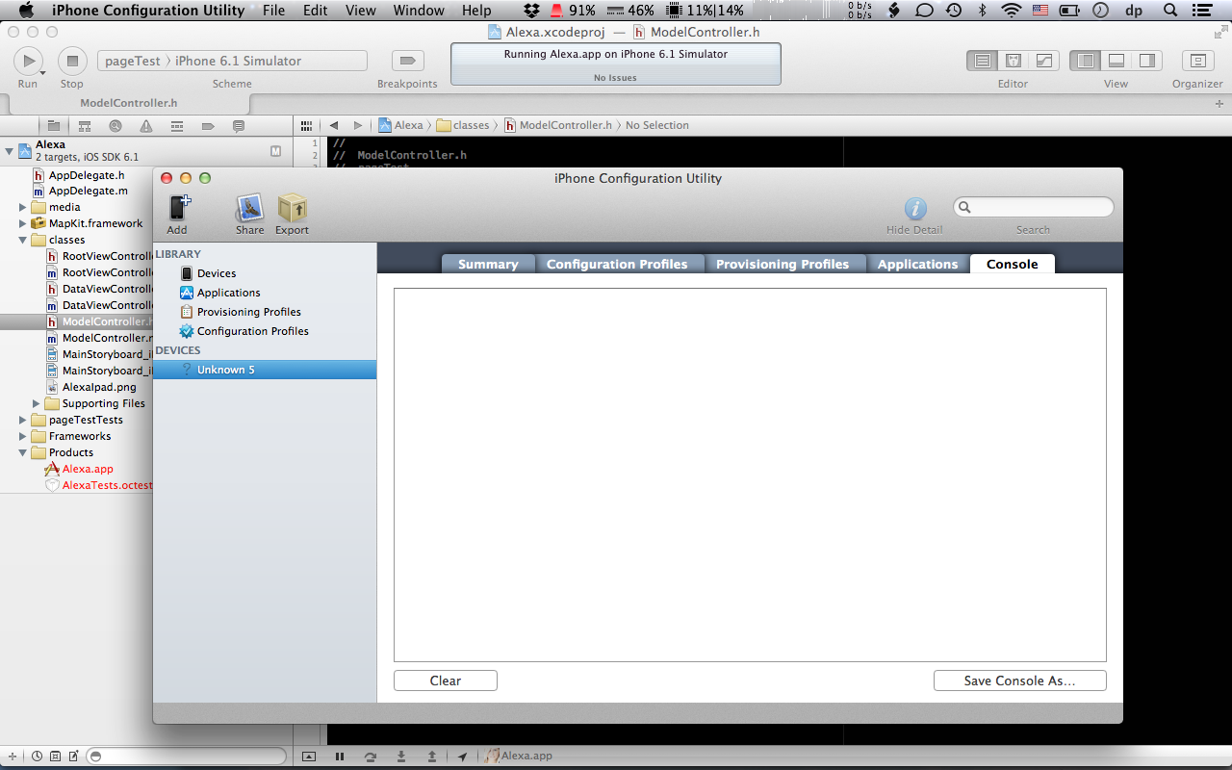
Xcode -Introduction

Slide 19
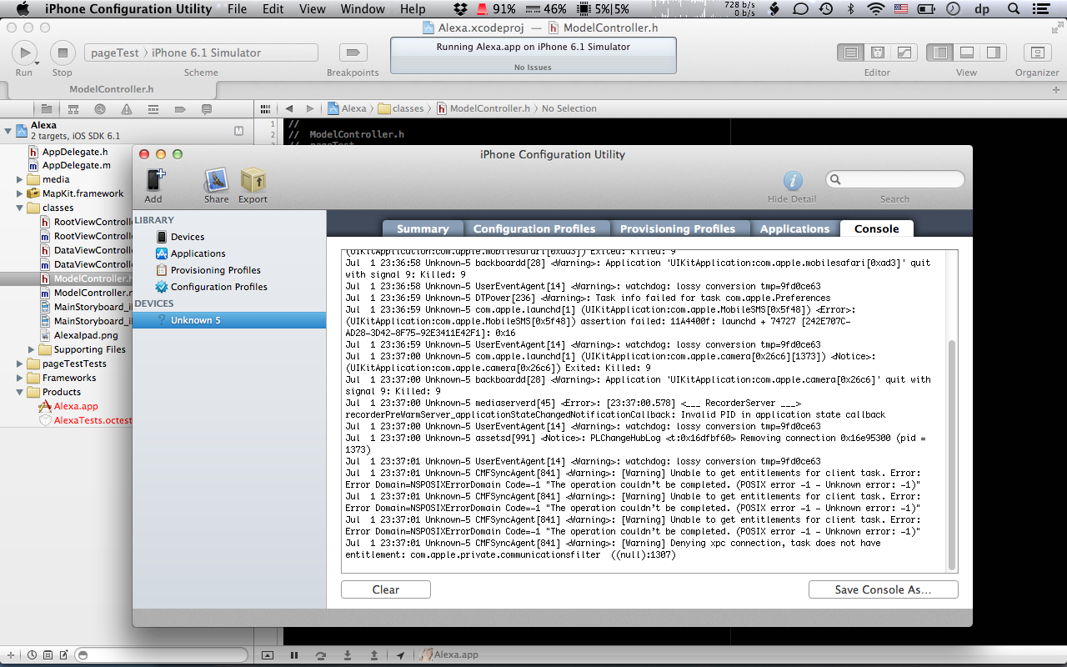
Xcode -Introduction
iPhone Connection Utility:
System LOG
Developer LOG – Debugging Log or Release Log

Slide 20




What Remote Device Access tools do you know?
Device Anywhere
Perfecto Mobile
Nokia RDA
Advantages of RDA:
You don’t need to purchase actual device.
User can select different Carriers e.g. Verizon, T-Mobile, AT & T.
RDAs are more reliable than simulators as they are real devices.
Some RDA Service like Device Anywhere also has automation capabilities.
Disadvantages of RDA:
Since you access devices remotely it takes time for any action or key event.
Sometimes the needed device is not available due to prior reservations.
Higher Service Cost
1.http://www.keynotedeviceanywhere.com/
2. http://www.perfectomobile.com/
3.http://www.developer.nokia.com/Devices/Remote_device_access

Slide 21














Why RDA - Platforms & Networks
Must
Major
Market
Cover major platforms
Diversify Screen sizes, form-factors, OS versions
Consider Networks
Change periodically
Notes:
Use the Triple M “MMM” approach when “thinking platforms”

Slide 22
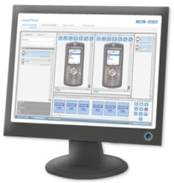
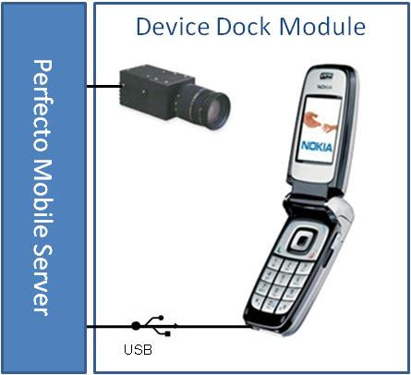
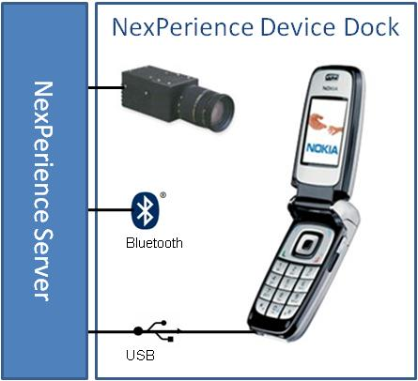
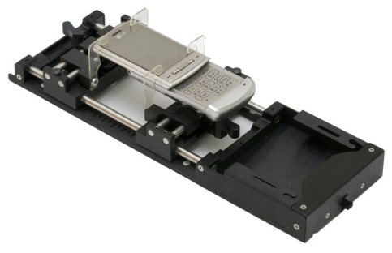
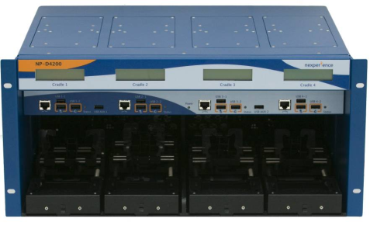
RDA – how it works
RDA Server
Internet
Application Scripting

Slide 23
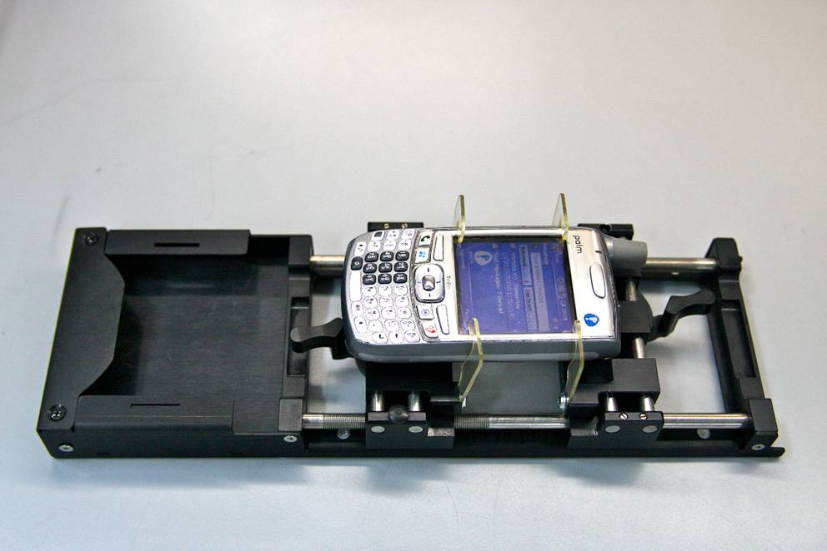
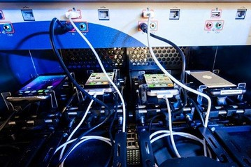
Perfecto Mobile – Cloud Automation Tool

Slide 24
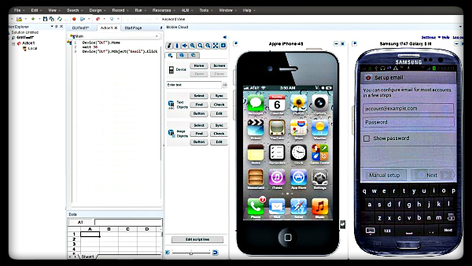
Perfecto Mobile – Homescreen

Slide 25
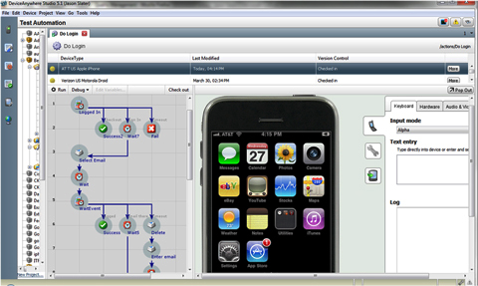
Visual-Graphical Scripting

Slide 26
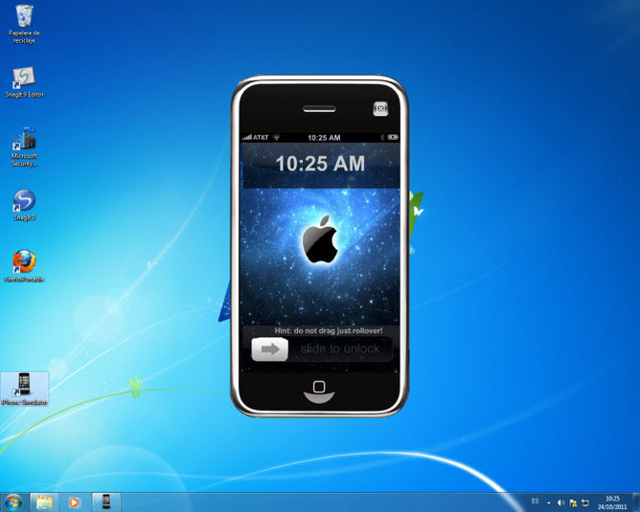
Can you give the view of Testing the Mobile Application on the Emulators/Simulators?

Slide 27
Emulators
An emulator is a hardware replica of an actual mobile device. The emulator simulates the mobile device and enables the tester to test a mobile app on a PC without having to test it on an actual mobile device.
There are three types of emulator:

Slide 28
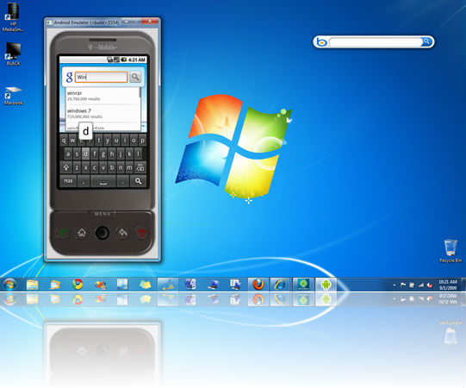
Types of Emulators
▪ Device emulators are generally provided by the device manufacturer. The device emulator is specific to a particular model of a device.
Android

Slide 29
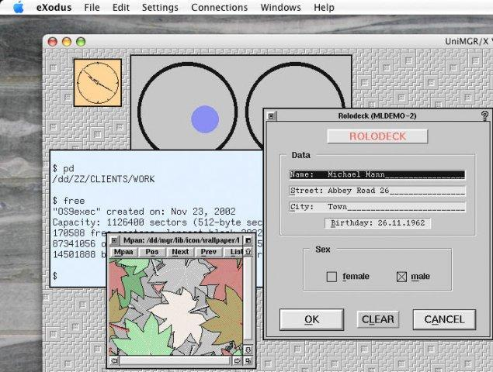
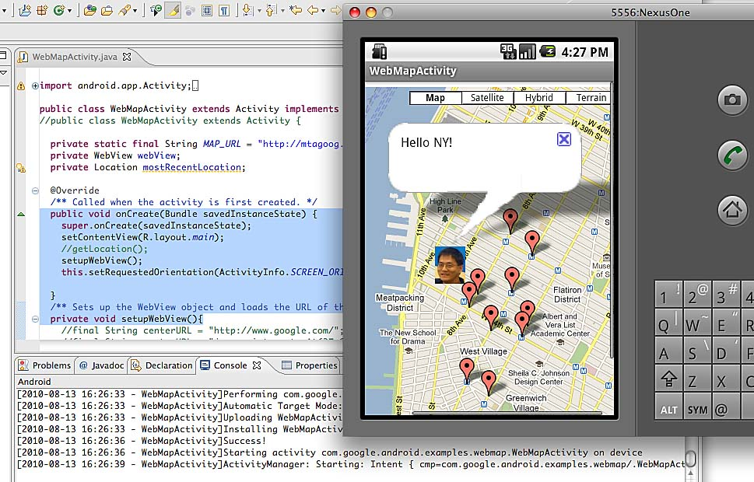
Types of Emulators
Operating System (OS) emulators are provided by Microsoft and Google for their respective operating systems.
An OS emulator mimics the specific operating system for a device and runs on a PC.
OS emulators typically have a dependency on the build tool that is used to emulate the mobile environment; for example, Xcode is a build tool for the iPhone and the Eclipse Emulator is a build tool for the Android.

Slide 30
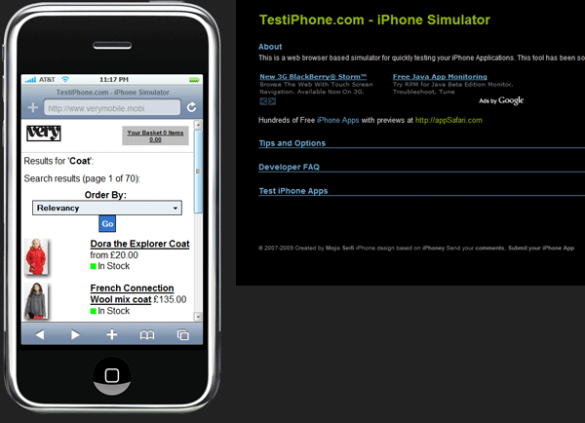
Types of Emulators
Browser emulators are generally available on the respective device web sites; they run on a browser that is not necessarily on a mobile device (i.e. they can run on a PC browser).
There are a great many open source emulators on browsers, such as MobiOne for the iPhone and Android Emulator PC for the Android.
http://mobiforge.com/testing/story/a-guide-mobile-emulators

Slide 31
Emulators Advantages:
An emulator will let you know exactly what is happening “behind” the device LCD, allowing a tester to do a debug and actually open up a screen to see what is happening.
This provides the tester with a great deal of insight into problems and makes it easier for the developer to fix the defects.
The tester can also provide the developer with screenshots, high-level information, and data messages.
Debug - The process of identifying and removing errors from computer hardware or software
http://codebutler.com/2012/10/10/configuring-a-usable-android-emulator/
http://www.jasonconger.com/post/setting-up-an-android-emulator-for-use-with-citrix-xenapp-mobile-application-sdk/

Slide 32
Emulators Advantages:
▪ Emulators tend to be cost-effective because most of them are freeware.
▪ Because the virtual device (emulator) is in control of its own software stack, testers can collect important information on “each component” of a content page. Some examples of this information include inner text and page redirect URLs.
▪ Many types of content compatibility tests – such as verifying image sizes or identifying broken links – can be accurately and quickly performed.

Slide 33
Simulators
Whereas device emulators are hardware replicas of specific devices, simulators mimic the software of the device for testing purposes.
Testers typically use the native browser of a PC for mobile browser simulation. (Note that simulators are used for testing the mobile web, not mobile apps.)
To get a native browser to simulate a mobile browser, testers change the “User Agent” settings in the native browsers. This approach is typically used for automated functional testing.
With simulators, testing can be done quickly and easily without the use of emulators. In addition, simulators are cost-effective because they can be used without purchasing any new software.
For Firefox browsers simulating iPhone and Android, automation is possible with tools like QuickTest Professional.
But this is mainly from the functional rather than look and feel perspective and is primarily used for functional automation testing. To reduce manual effort/cost, one of the popular ways is to go for functional automation.

Slide 34
Disadvantages of Simulator
Simulation errors
Any incorrect key stroke has the potential to alter the results of the simulation and give us wrong results.
Also, Developers are usually programming using theories of the way things work are not often 100% correct. SO, for increase the accuracy and the correctness of simulation we must first run a base line to prove that it works.
In order for the simulation to be accepted in the general community we have to take experimental results and simulate them. If the two data sets compare, then any simulation we do of your own design will have some credibility.
Hardware-Software differences
Another aspect of testing on a simulator is the differences between software and hardware. Simulators do not reflect the specific hardware and software features of each supported device.
Performance
The last important aspect of simulators is where the PC is running. Depending on the processing power of the PC running the simulator and the type of handset or smartphone, with limited CPU and memory, being used for testing, performance on the simulator may be unrealistically good or bad.

