Slide 1
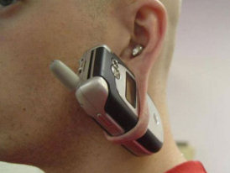
Mobile Testing –
Survival Knowledge – Part IV
Created by Ivette Doss

Slide 2
Objectives for today:
DELAY: 4. Specific of Mobile Testing II: Android SDK daily testing activities (screenshots and logs) – Emulator/Simulator – RDA Services – Interview Questions and Answers
Homework: installation of the BB/iPhone Simulators, add-on on PC Browser for mobile devices simulation
TODAY: 5. Specific of Mobile Testing Test Cases and Bug report: Full Test Coverage of Manual Mobile Application Testing in Agile – daily activities and responsibilities
Homework: Write 10 Test Cases and 1 Bug report for Mobile Application (HP QC ALM Template)

Slide 3
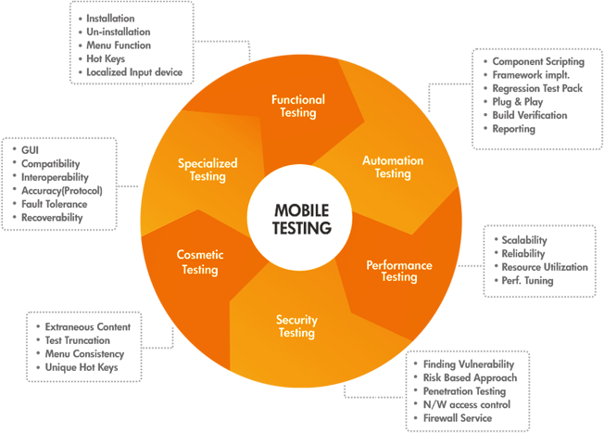
How would you test the mobile app page?
http://msdn.microsoft.com/en-us/library/windows/desktop/bb226821(v=vs.85).aspx#GlossaryA

Slide 4


How would you test the mobile app page?
1. Find and divide page into components/modules
2. Create a list/table of modules and types of testing that should be performed
3. Create a variety of variables and conditions within each module
4. Specify the Expected and leave place for Actual Results (Comments and Attachments columns are desired) for each of the combinations
5. FOR TROUBLESHOUTING: Create a list/table to view ANY problem from different angles/points of view
http://sixrevisions.com/tools/10-excellent-tools-for-testing-your-site-on-mobile-devices/
http://www.mobileappstesting.com/tag/testing-checklist-for-mobile-application/

Slide 5

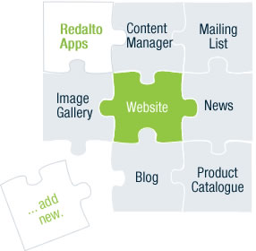
How would you test the mobile app page?
Create a Check List:
1) Functionality Testing
2) Usability testing
3) Interruption testing
4) Connectivity testing
5) Compatibility testing
6) Performance testing
7) Security testing
OR
Get prepared to Interview ‘SMART’ way and print the Mobile Application Checklist (next 8 Slides)
http://www.mobileappstesting.com/tag/testing-checklist-for-mobile-application/
http://sixrevisions.com/tools/10-excellent-tools-for-testing-your-site-on-mobile-devices/

Slide 6
Examples of Major Test Cases for mobile device 1
Test case | Sub-Category | Description | Result
1. Installation |  | Verify that app can be Installed Successfully | App should be able to install Successful
2. Un-installation |  | Verify that app can be Uninstall Successfully | User should be able to uninstall the app successfully
3. Network Test Cases |  | Verify the behavior of app when there is Network problem and user is performing operations for data call | User should get proper error message like “Network error. Please try later”…
 |  | Verify that User is able to establish data call when Network is back in action | User should be able to establish data call when Network is back in action

Slide 7
TC | Sub-Category | Description | Result
4. Voice Call Handling | Call Accept | Verify that User can accept Voice call at the time when app is running and can resume back in app from the same point | User should be able to accept Voice call at the time when app is running and can resume back in app from the same point
 | Call Rejection | Verify that User can reject the Voice call at the time when app is running and can resume back in app from the same point | User should be able to reject the Voice call at the time when app is running and can resume back in app from the same point
 | Call Establish | Verify that User can establish a Voice call in case when app data call is running in background | User should be able to establish a Voice call in case when app data call is running in background

Slide 8
TC | Sub-Category | Description | Result
5. SMS Handling |  | Verify that User can get SMS alert when app is running | User should be able to get SMS alert when app is running
 |  | Verify that User can resume back from the same point after reading the SMS | User should be able to resume back from the same point after reading the SMS
6. Unmapped Keys |  | Verify that unmapped keys are not working on any screen of app | Unmapped key should not work on any screen of app
7. Application Logo |  | Verify that app logo with App Name is present in app manager, on the App screen page, widgets (opt.) and user can select it | Application Logo with App Name should be present in app manager, on the App screen page, widgets (opt.) and User can select it.

Slide 9
TC | Sub-Category | Description | Result
8. Splash Screen |  | Verify that when User selects app Logo in Splash is displayed. Note: Splash do not remain for fore than 3 sec Note: A splash screen is an image that appears while a game or program is loading. | When User selects app, Logo in app Splash should be displayed
9. Low Memory |  | Verify that app displays proper error message when device memory is low and exits gracefully from the situation | App should display proper error message when device memory is low and exits gracefully from the situation
10. Clear/Back Key |  | Verify that Clear key should navigate the User to previous screen | Clear Key should navigate the User to previous screen
11. End/Home Key |  | Verify that End Key should navigate the User to native Device screen | End Key should navigate the User to native Device screen

Slide 10
TC | Sub-Category | Description | Result
12.Visual Feedback |  | Verify that there is visual feedback when response to any action takes more than 3 sec | There should be visual feedback given when response time for any action is longer than 3 sec
13. Continual Keypad Entry |  | Verify that continual key pad entry do not cause any problem. Note: Continual Keypad test consist in a multiple key press, done quickly as possible, in order to load at maximum capacity the handset's memory | Continual key pad entry should not cause any problem in app
14. Exit Application |  | Verify that User is able to exit from app with every form of exit modes such as Flap, Slider, Home Key or Exit option from any point of app | User should be able to exit with every from of exit mode such as Flap, Slider, Home Key or Exit option from any point of app
15. Charger Effect |  | Verify that when app is running then inserting and removing charger do not cause any problem and proper message is displayed when charger is inserted in device | When app is running, then insertion or remove of charger not cause any problem, and proper message displayed .

Slide 11
TC | Sub-Category | Description | Result
16. Low Battery |  | Verify that when app is running and battery is low, then proper message is displayed to the User. | When app is running and battery is low, there should be proper message displayed to the User
17. Removal of Battery |  | Verify that removal of battery at the time of app data call is going on do not cause interruption and data call is completed after battery is inserted back in the device | Removal of battery at the time of app data call is going on should not cause interruption and data call should be completed after battery is inserted back in the device
18. Battery Consumption |  | Verify that app does not consume battery excessively | The app should not consume battery excessively
19. Application Start/Restart |  | Find the app icon and select it. Press tab on the Device to launch the app. Observe the app launch in the timeline defined. | App must not take longer than 25 sec to start

Slide 12
TC | Sub-Category | Description | Result
20. Application Side Effects |  | Make sure that your app is not causing other apps of device to hamper | Installed app should not cause other apps of device to hamper
21. External incoming communication infrared |  | App should gracefully handle the condition when incoming communication is made via InfraRed | When incoming communication enters the device, the app must at least respect one of the following: Go into pause state during InfraRed session and automatically continue from the point it was suspended at after the InfraRed session is done Give a visual or audible notification The app must not crash or hung.

Slide 13
TC | Sub-Category | Description | Result
22. Bluetooth interrupt: |  | When a file transfer is taking place with Bluetooth, the application must be paused and should be resumed from the same point after the transfer is done

Slide 14
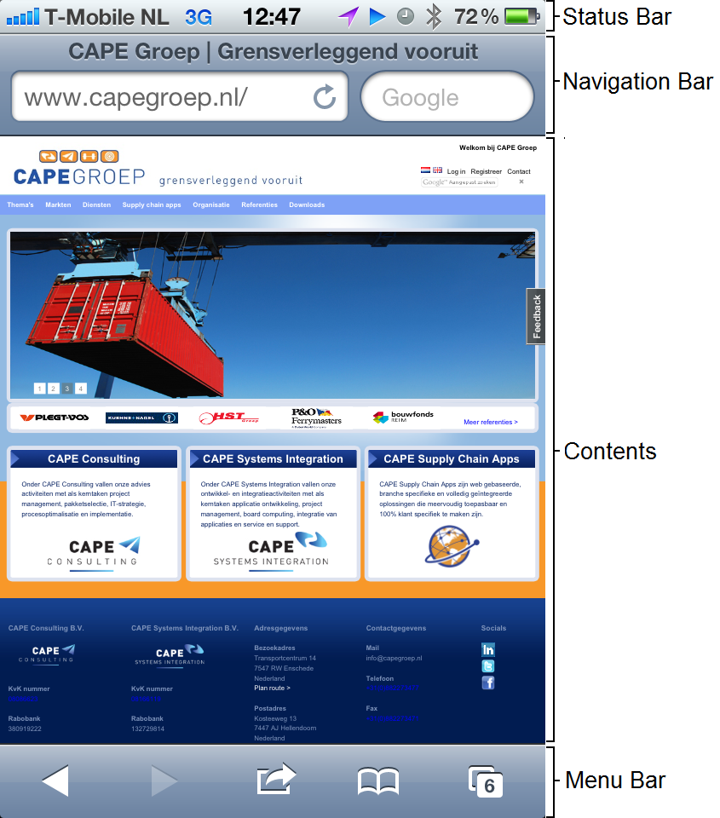
Title Panel
Menu/ Home Panel
Body
Footer
Device Menu Bar

Slide 15
Module/ Components | Functionality | UI | Network/ Connectivity | Interruption | Compatibility
Module 1: Nav. Bar
Module 2: Title Panel
Module 3: Home/Menu Panel
Module 4: Body Content
Module 5: Global Footer

Slide 16
O. Specify Possible Types of Mobile testing to perform
1. Specify Module: Example Homepage
2. Specify Sub-Module – Main Elements/Components of page: Example – Title Bar with Login and Search
3. Specify Sub-Sub-Module - Variables/Conditions: Example – Login valid/invalid, max. char., no char.
Example of TC Title/Name: Module 1 – Homepage – Login – invalid input – validation of error message

Slide 17
Module/ Components | Functionality | UI | Network/ Connectivity | Interruption | Compatibility
Module 1: Nav. Bar – Search Field verification of URL | Launch http://xxx Confirm the correctly installed environment of the application | 1.Launch http://xxx 2. Confirm that URL string is not truncated and hovered

Slide 18
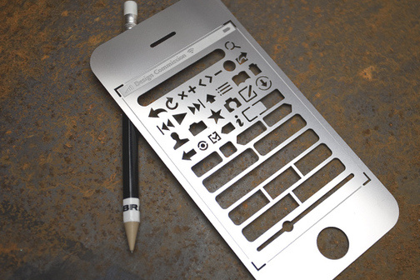
iida A02 infobar
http://www.youtube.com/watch?v=ass2rWIqd8I&feature=player_embedded&list=PLS7azqUNoh8szi0WyRZPE4CSxfxH1L7cF#!

Slide 19
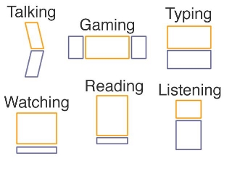
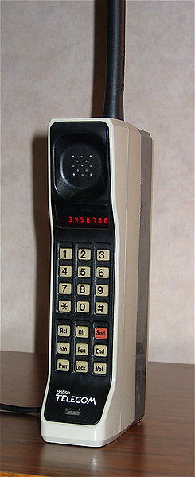
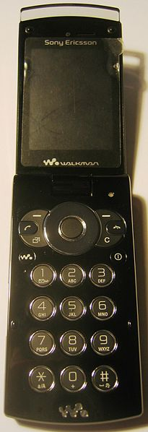
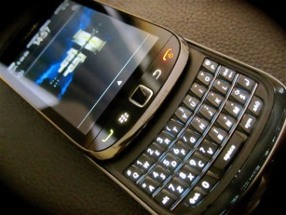
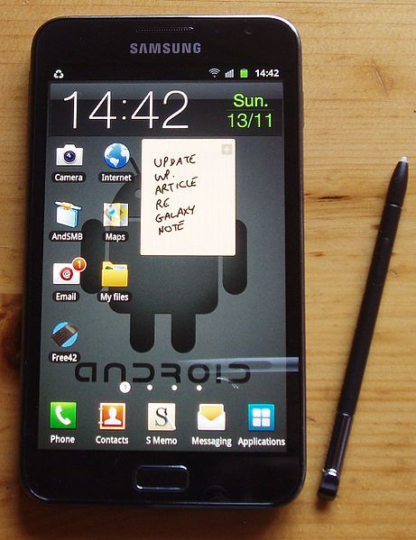
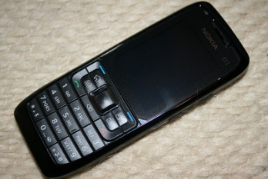
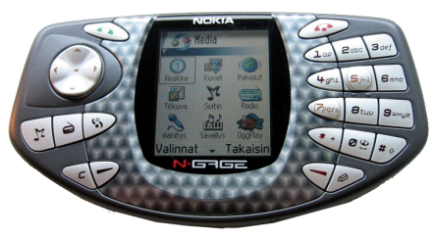
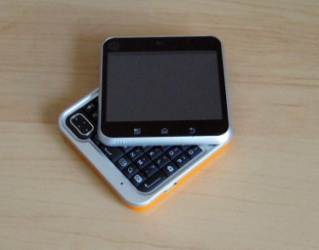
Good to know: Mobile Form Factor
Brick
Bar
Touchscreen
Taco
Flip
Slider
Swivel

Slide 20
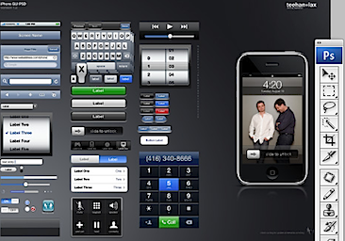
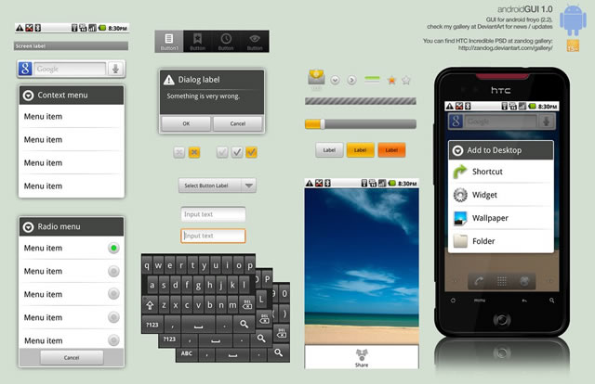
Good to know: different Mobile UI
Self-Learning
ANDROIDs Popular UI:
Android GUI PSD
Stock (Droid 1, Nexus1)
Sense UI (Eris, Incredible, Evo)
Motoblur(*new* Droid X, Droid 2)
Touchwiz(Galaxy S devices)
iPhone Popular UI:
iPhone GUI PSD (Photoshop file)
iPhone GUI stencil for Omnigraffle
Favorites UI Design Walkthrough
Edward Tufte on iPhone interface design
http://mobileorchard.com/7-iphone-ui-user-interface-design-resources/
http://speckyboy.com/2010/10/27/30-fresh-web-ui-mobile-ui-and-wireframe-kits/

Slide 21
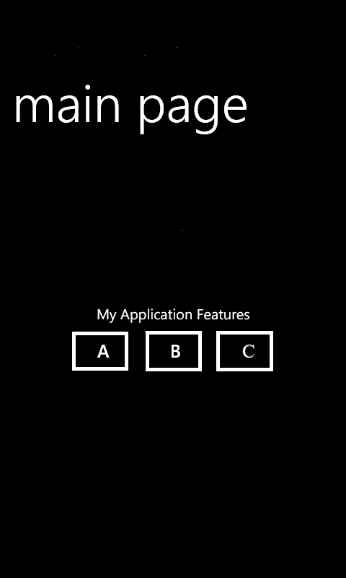
Write as many Test Cases you can for the following: Mobile device, simple app with three buttons (1,2,3) that making the sounds 1
1. Stay with the TC Plan to cover different area of testing:
1) Functionality Testing
2) Usability/UI testing
3) Interruption Testing
4) Connectivity testing
5) Performance/Load testing
Add Media specific Testing
Self-Learning:
http://www.guru99.com/testing-tools.html
http://www.mobileapptesting.com/the-best-tools-for-mobile-app-testing/2011/08/
http://en.wikipedia.org/wiki/Soak_testing

Slide 22

Case Title | Description | Result
Verification of Button A sound/tune | Launch http://xxxxxx Tap and Hold on Button A. Verify the sound /tune of Button A | When button A is pressed the sound /tone specified for button A should be audible
Button B | 1. Launch http://xxxxxx 2. Tap and Hold on Button B. 3. Verify the sound /tune of Button B | When button B is pressed the sound tone B should be audible
Combination of buttons and sounds | 1. Launch http://xxxxxx 2. Tap and Hold on Button AB. 3. Verify that when A,B buttons are pressed consecutively, the priority sound/tune assigned to Button A | When buttons A,B are pressed consecutively, the sound/tune A should be audible by default.
Functional Testing

Slide 23
Case | Description | Result
Panning (sliding horizontally left-right) Swiping (sliding vertically up-down) | Verify that when main Page is panned/swiped, the buttons A,B,C remains in the same order, the same position on the page screen, and do not make sound | The buttons A,B,C, should not loose the order or make any sound during panning/swiping gestural input procedures
Rotation | Verify that when device is rotated, Buttons ABC should not loose it’s order and make any sound | During device’s rotation Buttons ABC should not loose it’s order and make any sound
Zooming | Verify that buttons A,B, C should not loose the order or make any sound during the Zooming gestural procedure | Buttons A,B,C should not loose the order or make and sound during the Zooming procedure
UI Testing

Slide 24
Case | Description | Result
Phone Call Interruption | Verify that when Phone Call is initiate, buttons ABC are in “pause” mode and do not perform assigned sound tunes. | When Phone Call is occurred, the Buttons ABC should be saved in ‘pause” mode and do not perform assigned sound tone.
SMS interruption | Verify that when text notifications/message appears, the main app page will response with safe, end session | When SMS action occurs, proper error message should be displayed and app will be closed gracefully with saved information
TechNews App Notification (w/Ringtone) | Verify that when TechNews Notification with the Ringtone occurs, buttons ABC will pause and perform assigned sound tones after Notification Ringtone is done. | When TechNews Notification (w/Ringtone) occurs the Buttons ABC should be pause until Ringtone tune are done, and continue to perform ABC assigned sound after no more than 3 sec delay.
Interruption Testing

Slide 25
Case | Description | Result
Flight Mode of Mobile Device | Verify that when Device has Flight Mode ON, the Buttons ABC are still active and performing sound | Buttons ABC should be active and perform assigned sounds when Mobile Device is in Offline Mode.
Bluetooth Mode of Mobile Device | Verify that when Device has Bluetooth ON, the Buttons ABC are still active and performing sound | Buttons ABC should be active and perform assigned sounds when Mobile Device is in Bluetooth Mode.
Hopping Mode | Verify that when Device is in Frequently changed “hopping” area the Buttons ABC are still active and performing sound | Buttons ABC should be active and perform assigned sounds when Mobile Device is in the “hopping mode”
Connectivity Testing

Slide 26
Module | Description | Result
Define the maximum amount of load that a system can handle | Verify that when 10,000 Users press A,B,C buttons pressed simultaneously, the designed combination of three sound tone is appeared | When buttons ABC are pressed simultaneously the tune combined of three sounds should appeared
The number of concurrent user that application can handle | Verify that when 10,000 User concurrently press Buttons A, there is not drop in functionality and sound quality. | When 10,000 User concurrently press Button A it should be not affect the functionality or sound quality
Check application scalability | Verify that during the Device OS upgrades application can run without drop in performance | When Device OS upgrades occurs the application runs without significant performance degradation
Performance testing
http://searchdatacenter.techtarget.com/definition/scalability
http://en.wikipedia.org/wiki/Bottleneck

Slide 27
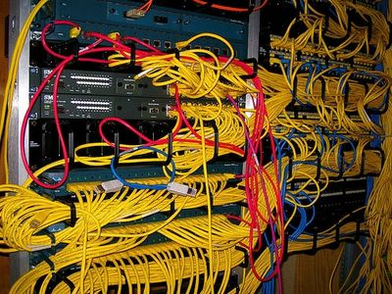

How would you troubleshoot Network on iPhone

Slide 28

Troubleshooting Concept
1. Define the areas that may cause the problem: Example: Device or Carrier
2. Make a list of Troubleshoot Areas/Features and Methods that you can use:
VPN
Short URL at isup.me (Problems With a Specific Website)
Ping itself
Device Wi-Fi connection
Device Bluetooth connection
Device LTE vs. GPRS
3. Start with minimum of variables and conditions

Slide 29
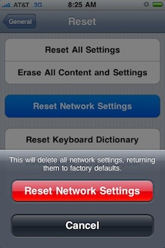
How would you troubleshoot Network on iPhone
1. Home Screen – Settings Tab – General – Network – Wi-FI (On/Off) – Choose Network) – Ask to Join Networks (On/Off)
2. Home Screen – Settings Tab – General – Reset – Reset Network Settings
Note: It will also reset your remembered Wi-Fi access points and their passwords, so be ready to re-enter a bunch of WEP/WPA keys!
3.Connect through the iOS VPN under Setting- General – Network.
It is a “virtual private network” (VPN) configuration for Apple iOS devices: iPad, iPhone, and iPod Touch. The VPN allows users not on the UCSF network (alternative to traditional wired connectivity), access to restricted resources on the UCSF network in the same way as you would from the UCSFwpa wireless network.
http://support.apple.com/kb/HT3204

Slide 30
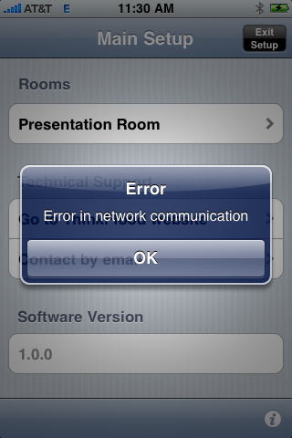
4. If you are experiencing network timeouts when connected to your home Wi-Fi network, please try turning off Bluetooth, as the iPhone’s current Bluetooth drivers sometimes interfere with Wi-Fi.
5. Sometimes the iPhone does not “like” being attached to an ad-hoc network, and will often drop the Wi-Fi network connection and jump over to the cellular network. This problem does not exist for iPod touch devices, as they do not have other network options.
Home Screen – Settings – Airplane Mode ON – WI-FI ON – Select RedEye Network
Note: You will not be able to receive calls on your phone with Airplane Mode ON, so please remember to turn it off when you are finished.

Slide 31
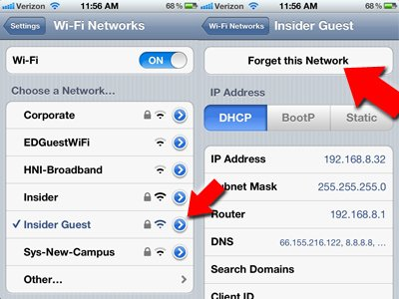
6. I can't connect to my Wi-Fi network anymore
Wi-Fi routers are fickle creatures.
Whether it's a problem on your iPhone or a router problem, one quick trick to "start from scratch" with your Wi-Fi connection is by "forgetting" a network you've joined.
Go to Settings, then Wi-Fi, then tap the blue arrow next to the network you want to forget, then tap "Forget This Network."
Once you've forgotten the network, tap it in your Wi-Fi screen to do a fresh re-connect

Slide 32
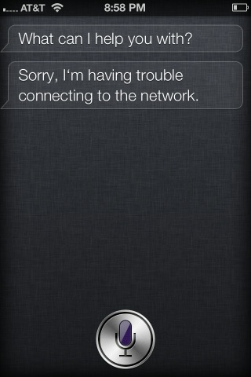
7. Troubleshooting of Siri (4S up)
Go to Settings in your iPhone and go to the Siri tab.
Disable Siri
Turn off the iPhone
Turn on the iPhone
Go to Settings again and enable Siri
The steps are basically about resetting Siri and it would again catch up with the network and the connection would normally happen.
The fix worked for many, but a few couldn’t still resolve the problem, but keep trying and the response from Siri would be back at any point of time.

Slide 33
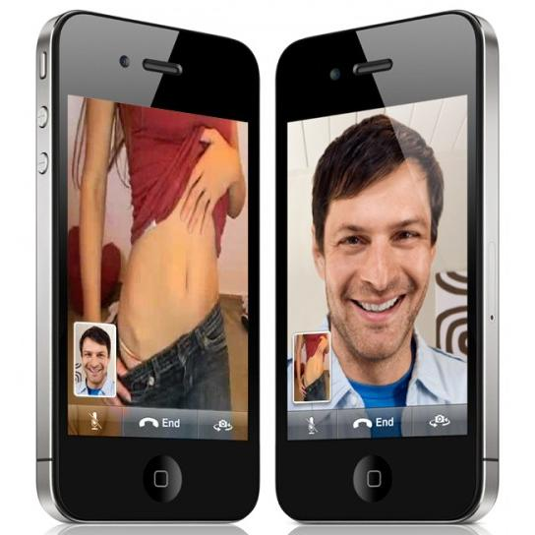
What is your Stress test approach when testing FaceTime on iPhone?
Video Chatting Technology of Apple
Please, see these two Youtube video before proceed
http://www.youtube.com/watch?v=LGzEy3oQ4Co
http://www.youtube.com/watch?v=KRV4FYSMWVM

Slide 34
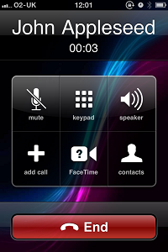
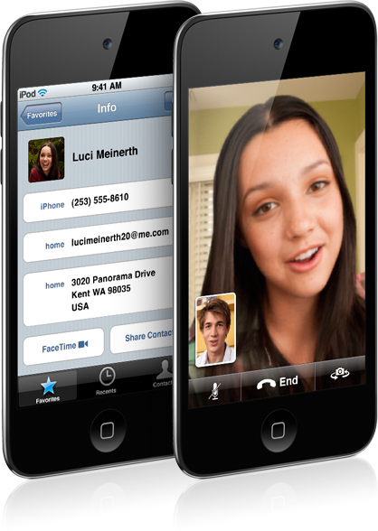
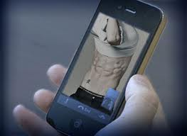
What is the FaceTime general features? What we need to “Stress out”?How we can stressed it?
Activation of FaceTime option on your iPhone/iPad/iPod
New Call begin when the person you’re calling accepts the FaceTime invitation
Video Call
Voice Call
Switching between Front and Back Camera
My own picture/video on the chat -screen

Slide 35
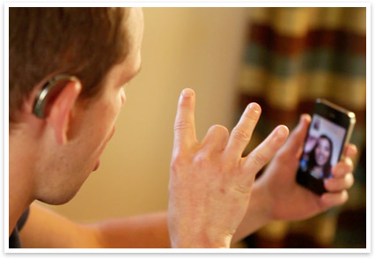
Contacts info invalid
Invitation to Contact send it with the Fake Identity
Try to Edit/Modify/Delete Contact info during a Chat
During a Video Call/Chat:
Initiate multiple calls/video/chats with other FaceTime Contacts
Running Music/Games/Video/Web apps during the Video/Call Chat
Download some big File during the Chat session
Play abusive way with Portrait/Landscape Layout
Play abusive way with the Front/Back Camera
Turn video chatting, still running call session and try to open multiple apps, website, music, video
Use Face Time Session outside, with the street noise, sunlight/nighttime, in the Disco club, etc.

Slide 36

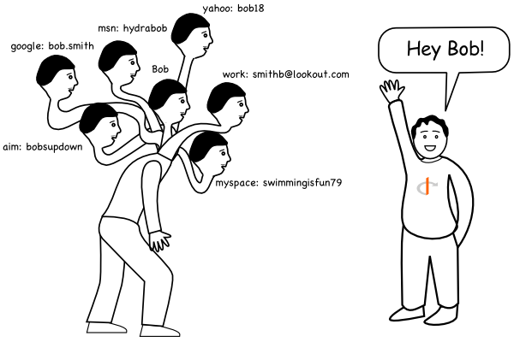
Tell me your opinion on OpenID
An OpenID is a way of identifying yourself no matter which web site you visit.
It's like a driver's license for the entire Internet. But, it's even more than that because you can (if you want) associate information with your OpenID (like your name and your e-mail address), and then you choose how much web sites get to see about you.
This means that web sites that take advantage of OpenID won't bother you for the same information over and over again
http://openidexplained.com/

Slide 37

Thank you for listening
To be continue…

Slide 38
List of cool Mobile apps:
Android
iPhone
QA Interview and Programming Apps
Cheat Sheets (David Ortega Cuadrado)
Linux Cheat Sheet (Conundrum)
Ruby Cheat Sheet (Nakarin Maneerat)
Java Quick reference cards (nadstech.com)
Hackers Reference (Frustration Free Solution)
Cloud Computing Interview Questions
Java QA & Forum
Transcribe Pro
Cloud Tools for Windows Azure
Task Cloud 9
Cooper Egg – Server Monitoring
Synced Tool
Micro Transfer
thoughtbot Learn

Slide 39
List of cool apps: TechNews
Android
iPhone
TheVerge
Appy Geek
TechNews – Riversip (Briox)
TED
inoTechNews (inoapp llc)
The Verge
TED
Appy Geek
Tech News Tube
iNews 24/7
TechWire
MobilityBeat

Slide 40
List of cool apps: Helping Tools
Android
iPhone
Monitor Usage Stats and Tweak System Utilities
Carat
MX Log Collector
RemoteLogCat
Fing
WiFi Analyzer
ADB Wifi
Android Assistant
Battery Dr Saver
System Analyzer
Android Cleaner
UDID
Carat
BattLoad Testing $3.99
Device Log Viewer
WiFi Analyzer
Network Analyzer ($2.99)
System Status ($2.99)
VR Mobile –Vibration Testing
UDID – Ad Hoc Helper
Unit Testing Free for iOhone
Test Studio (Mobile Automation)
Minimal Essential testing Strategy
Performance Test Mobile
http://android.appstorm.net/roundups/utilities-roundups/35-android-apps-to-monitor-usage-stats-and-tweak-system-utilities/

Slide 41
List of cool apps: Helping Tools
Android
iPhone
Monitor Usage Stats and Tweak System Utilities
Audio Kit
iCurlHTTP
ProjQA Audit
AKLite
Agile Estimate
HP ALM Mobile
About My Device
LogPolice
Rest Client
HeadsUp XG
CEH Exam
SMTPtest
G360 Accelerometer

Slide 42
List of cool apps: Helping Tools
Android
iPhone
J-Rest Client
ISTQB Test
CircleCi
API 653 Tmin Calculator
iTester
iLoader.io
SessionLog
HTML source code
Flash Quiz MCAD
Bug Tracker
URLTestr
Defect Logger
YASC
Net Analyzer
Sensor Monitor
System Status

Slide 43
Fun Apps
Android
iPhone
Lie Detector
NC Decibel – Environmental

