Slide 1
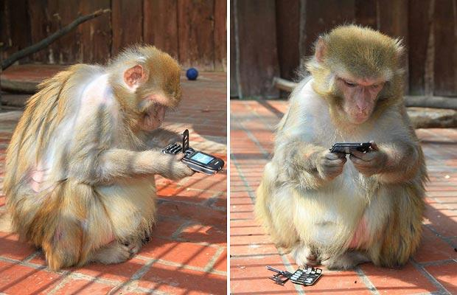
Mobile Testing – Survival Knowledge – Part III
Created by Ivette Doss

Slide 2

Objective for today
3. Specific of Mobile Testing I:
Mobile Testing Approach/Test Planning
Mobile Testing Domains
Mobile Testing Specifics
Manual Mobile Testing Types
Interview Questions and Answers
Homework: Installation of the Eclipse with Android SDK

Slide 3
Specific of Mobile Testing
1. Tell me about Test Plan Specifics that must emphasized while writing TP for Mobile Application
2.What is the difference between Mobile Testing and Mobile Application Testing?
3. Compare Web Application Testing vs. Mobile Application Testing
4. What Type of Mobile Domains you know

Slide 4


Testing Scope
Scope is very much important because there is a large amount of test items available for mobile app testing.
So defining scope like - testing with/without carriers, calls, data calls, WAP, variant of operating systems, etc. is explicitly important while writing a test plan.

Slide 5
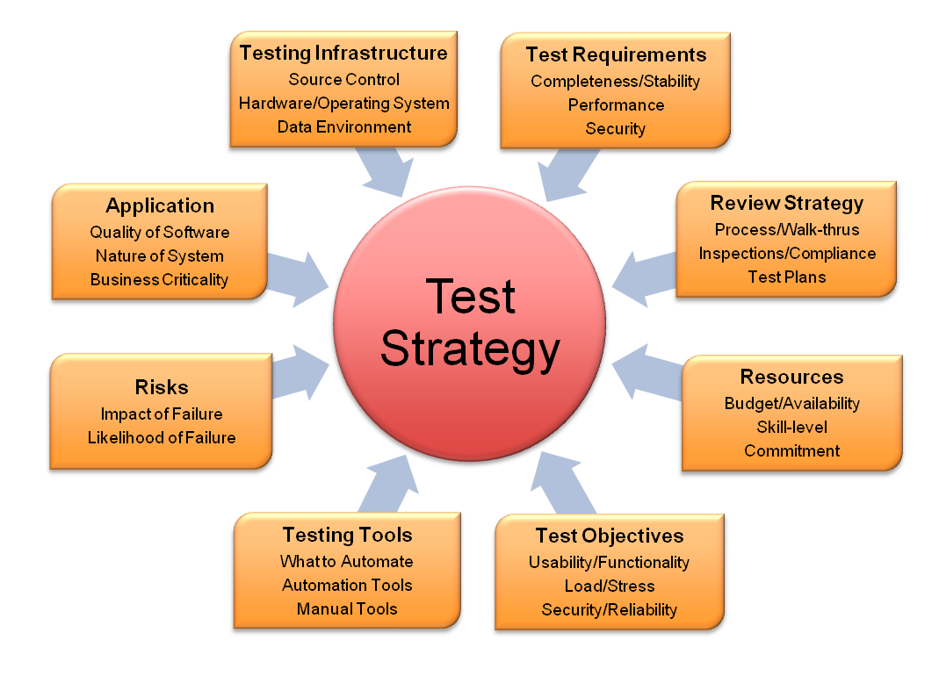
Testing Strategy
The strategy and methodologies for unit testing, system testing, regression testing and pass/fail check-listing:
Few things like - application characteristics, stability, connectivity, launching, UI and application accessing internal resources or user data.

Slide 6
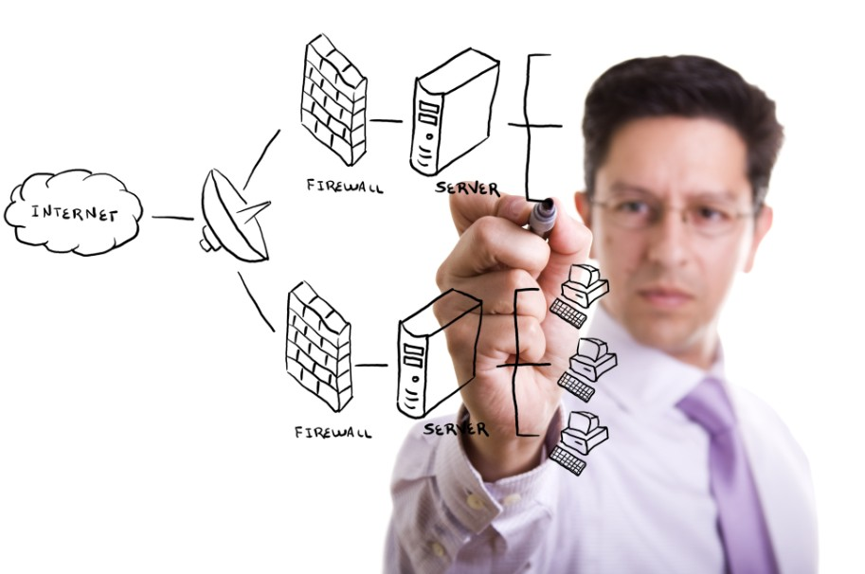
Test Environment Setup
Environment is another big thing for test plan for mobile app:
Which parts of the app will be tested on emulator and which parts will be on real device,
what will be the device versions,
how many variant of the devices will be present while testing,
what will be the possible carriers,
what will be the test locations -- thess questions are needed to be answered in the test plan explicitly.

Slide 7


Control Procedure
How to handle the reports, documentations, change requests while testing is undergone -- should be confirmed from conversation/discussion with the PM and should be listed in the test plan.

Slide 8
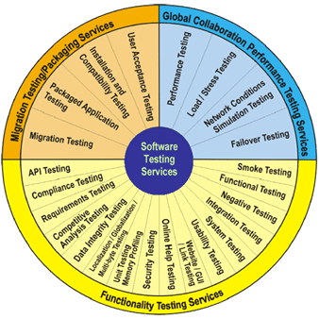

Slide 9

Tell me about Test Plan Specifics that must emphasized while writing Test Plan for Mobile Application
1. Requirements Analysis considering Mobile Factors:
What kinds of media files are going to be supported
If download is going to be on SD Card or internal memory
What if SD card will not be available
What if user changes the SD Card
2. UI Mock Ups:
Ask your client to provide the wire frames or UI mock ups which will help you understand how the application screens will look like. Wire frames can also help you to go through the flow of the application.
3. Study the Architecture and Technology:
By the time developers are busy in developing the architecture or going through requirement analysis, it is very important that a tester should also look in to the technology perspective of the application.
For example, if your client is developing any streaming or media sharing applications, then apart from regular requirement analysis a QA should make sure what kind of streaming technology is going to use.
What are the different APIs will be used in the applications. If the application is related to media, then what are the different kind of media file types this application will support etc.

Slide 10
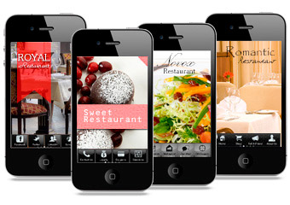
4. Competitors application Analysis:
Download competitors app and verify various features and functionality in this application.
For example some twitter based application. You can take a look on Seesmic, tvider, twitpic.
These all are media sharing app on Twitter and many Features resembles as finally they are
developed based on twitter API’s. By following this practice you can:
  Suggest some new features and improvements in the product your org is going to develop.
  Get some hands-on on the kind of technology and features being used
  Help you being familiar with the app
  Help you to chalk out some important scenarios

Slide 11
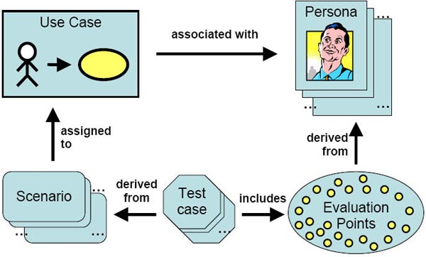
5. Keep in Mind the Target devices:
This will be decided by your client or by your manager that which device they will be targeting the app on. It is very important if you can provide your inputs on that as well. For a testing purpose, make sure you have devices of different screen sizes and resolution. Also some device may support orientation and some may not. So this should also be taken in consideration. We will discuss later on about how to choose a right set of devices. The point here what I am making is we should be in condition to provide our inputs in this front as well.
6. Design Scenarios and Test Cases:
Once Test Planning is done, it is very important to design some test scenarios and Test Cases. You can design a complete Test Suite which will have various modules feature wise.
You may add some tabs dedicated to Performance, system and interruption test cases as well. Make sure you involve these kind of generic test cases as well.
Apart from bulky test suite, you should have a quick checklist which will cover important features in the application. So in case you need a quick round of testing then you can follow this checklist.

Slide 12

7. Analysis on Need of Tools and Utilities:
Make sure to put some efforts on the kind of told you can use later which will help you test the mobile app.
I am not only talking about the Automation Tools but also some small utilities like log capturing tools, screenshot capturing tools, memory consumption by app checking tools etc.
8. Keep performance in Mind:
While testing your application, apart from regular functional testing scenarios, analyze the following:
the application for app size,
behavior of the application in long run
behavior of app if app being used excessively for long time,
application launch time and time to load any screen,
behavior of app when app do not have enough space,
simultaneously running many apps should be considered.

Slide 13
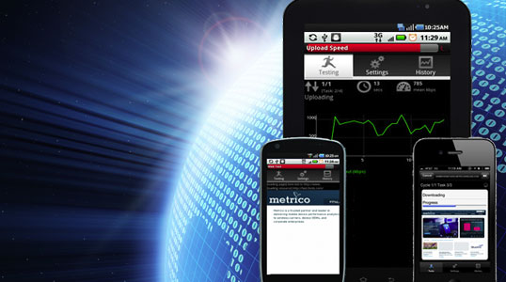
9. Application Submission Related Strategy:
Be sure about the distribution channel for your mobile application. If you are submitting your app to app store then go through the guidelines provided by apple to make sure that you application is getting accepted.
Similarly depending on the application store, go through the application and verify that whether your app satisfies the criteria for that store.
10. Testing Among The Beta Crowd:
Many times testers test the application in order to complete the testing within time as they have challenge to complete the testing within time. In this case sometimes they miss some scenarios that the normal user can encounter.
For example, if movie app is of 1-2 hours then will the tester actually see the complete movie ? Mostly no …he will just fast forward it and will verify the rest of the scenarios. But the actual user will be interested more in watching movies and hence if he finds disturbance in this process then he will just throw this application away.
The probability to see long term impacts of using the application can be dig out more in this kind of testing which is normally not possible.

Slide 14
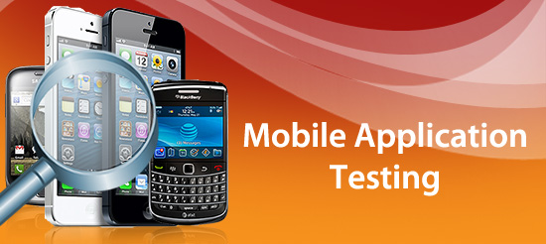
Techniques of Mobile Application Testing
1. Manual Testing
2. Remote-manual Testing (DeviceAnyWhere, Perfecto Mobile)
3. Testing using Emulators
4. Performance Testing (Automated Testing)

Slide 15




What Remote Device Access tools do you know?
Advantages of RDA:
You don’t need to purchase actual device.
User can select different Carriers e.g. Verizon, T-Mobile, AT & T.
RDAs are more reliable than simulators as they are real devices.
Some RDA Service like Device Anywhere also has automation capabilities.
Disadvantages of RDA:
Since you access devices remotely it takes time for any action or key event.
Sometimes the needed device is not available due to prior reservations.
Higher Service Cost
1. http://www.keynotedeviceanywhere.com/
2. http://www.perfectomobile.com/
3. http://www.developer.nokia.com/Devices/Remote_device_access

Slide 16
Have you ever worked on any Mobile Testing automation tool?
TestComplete
http://smartbear.com/products/qa-tools/automated-testing-tools
M-Eux
http://www.jamosolutions.com/
TestQuest-10
http://bsquare.com/testquest-10.aspx
Test Quest Pro
http://www.bsquare.com/testquest-pro.aspx
Robotium
http://code.google.com/p/robotium/wiki/RobotiumTutorials
VNC
http://www.realvnc.com/
Sikuli
http://www.sikuli.org/
FoneMonkey (iPhone)
http://www.gorillalogic.com/book/fonemonkey-ios
Eggplant (iPhone)
http://www.testplant.com/
TestiPhone( For iPhone Mobile Web)
http://www.testiphone.com/

Slide 17
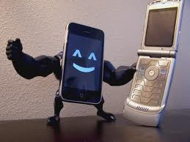
List of Mobile Web Performance Testing Tools
Sandstorm
Neotys
Mobitest
IBM Rational Performance Tester
Rigor
Gomez Mobile RUM
Shunra
HP Loadrunner
Gomez Mobile RUM
SOASTA
Infosys Windtunnel
Jmeter
iOS Instrumentation
Borland Silk Perfomer

Slide 18
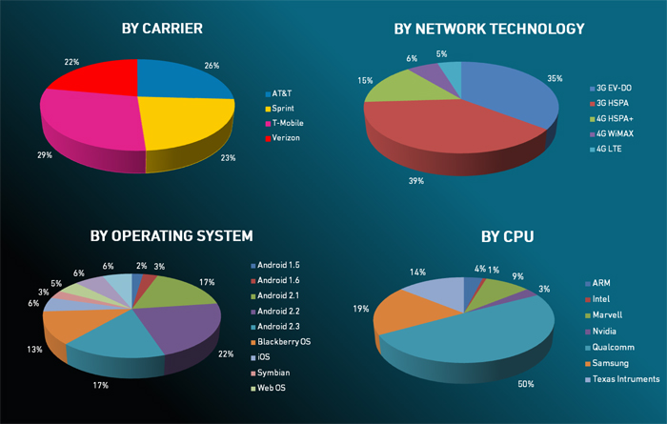
Mobile Testing Approach:
http://www.drdobbs.com/joltawards/jolt-awards-the-best-testing-tools/232901286?pgno=5

Slide 19
Specific of Mobile Testing
Tell me about Test Plan Specifics that must emphasized while writing TP for Mobile Application
What Type of Mobile Domains you know
3.What is the difference between Mobile Testing and Mobile Application Testing?
4. Compare Web Application Testing vs. Mobile Application Testing

Slide 20
Types of Mobile Testing Domains:
1. Downloadable Mobile Application Testing:
A. From End-User Perspective:
Some applications come pre-installed in mobile handset Some mobile applications are downloadable from different mobile application stores (iStore, Google Play, Getjar, Nokia Ovi Store, BB Appworld etc.)
B. From Professional Perspective:
Multi-environment: Developer-version, QA Environment-version of app (some 3web, float.qa, qa, test), Staging- version, Pre-production, Production Environment. Plus, continuous comparison Master Web Site version.
http://www.suncellular.com.ph/faqs_vas_freewap.php

Slide 21
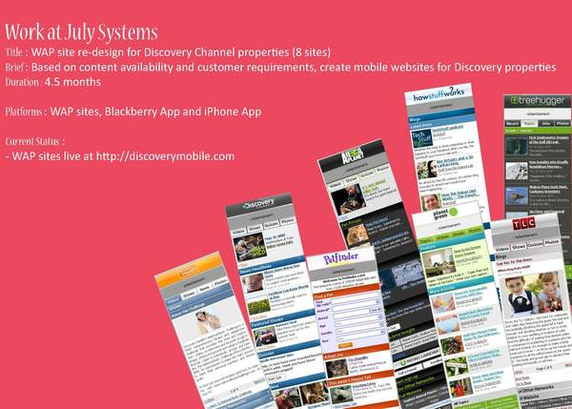
Types of Mobile Testing Domains:
Mobile Website Testing (WAP Sites):
Unlike downloadable mobile applications, mobile websites can be accessed via browser. No download involved.
Testing of Mobile WAP sites has its own challenges. Proper navigation, good user interfaces (design), security, performance and mobile browser compatibility are important areas.
http://msdn.microsoft.com/en-us/library/office/aa140117(v=office.10).aspx
http://discoverymobile.com
http://www.wirelessdevnet.com/channels/printlinks.phtml?category=4
http://surfwap.com/

Slide 22
Types of Mobile Testing Domains:
Mobile Handset Testing:
Similar to Organizations that develop third party downloadable mobile applications, there are many companies that develop complete mobile handset.
A mobile QA need to test native applications or features that are available in the phone. SMS, MMS, Voice Call, Phonebook, Calculator, Bluetooth and other mobile features. It also includes Multimedia (Camera, Video, Media player, ringtones) and Mobile Protocol stack testing.
http://www.edn.com/design/test-and-measurement/4327335/Protocol-stack-testing-for-LTE-technology
http://www.artizanetworks.com/lte_tut_pro_sta.html
http://searchnetworking.techtarget.com/tip/Test-your-TCP-IP-protocol-stack-to-troubleshoot-network-connectivity
http://en.wikipedia.org/wiki/Protocol_stack

Slide 23
Specific of Mobile Testing
Tell me about Test Plan Specifics that must emphasized while writing TP for Mobile Application
What Type of Mobile Domains you know
3.What is the difference between Mobile Testing and Mobile Application Testing?
4. Compare Web Application Testing vs. Mobile Application Testing

Slide 24
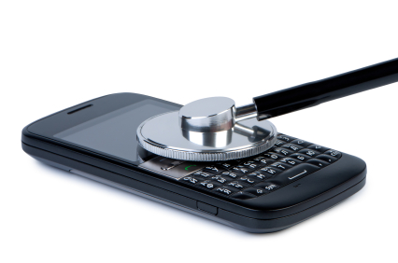
What is the difference between Mobile Testing and Mobile Application Testing?
1. Mobile Protocol stack testing. (using network simulators)
2. Multimedia Testing
3. Feature Testing
Mobile Testing means the complete testing of mobile in System level + Application level
1.Multimedia Testing
2. Feature Testing
Mobile Application testing deals with only the features and multimedia part.
Mobile Testing
Mobile Application Testing

Slide 25
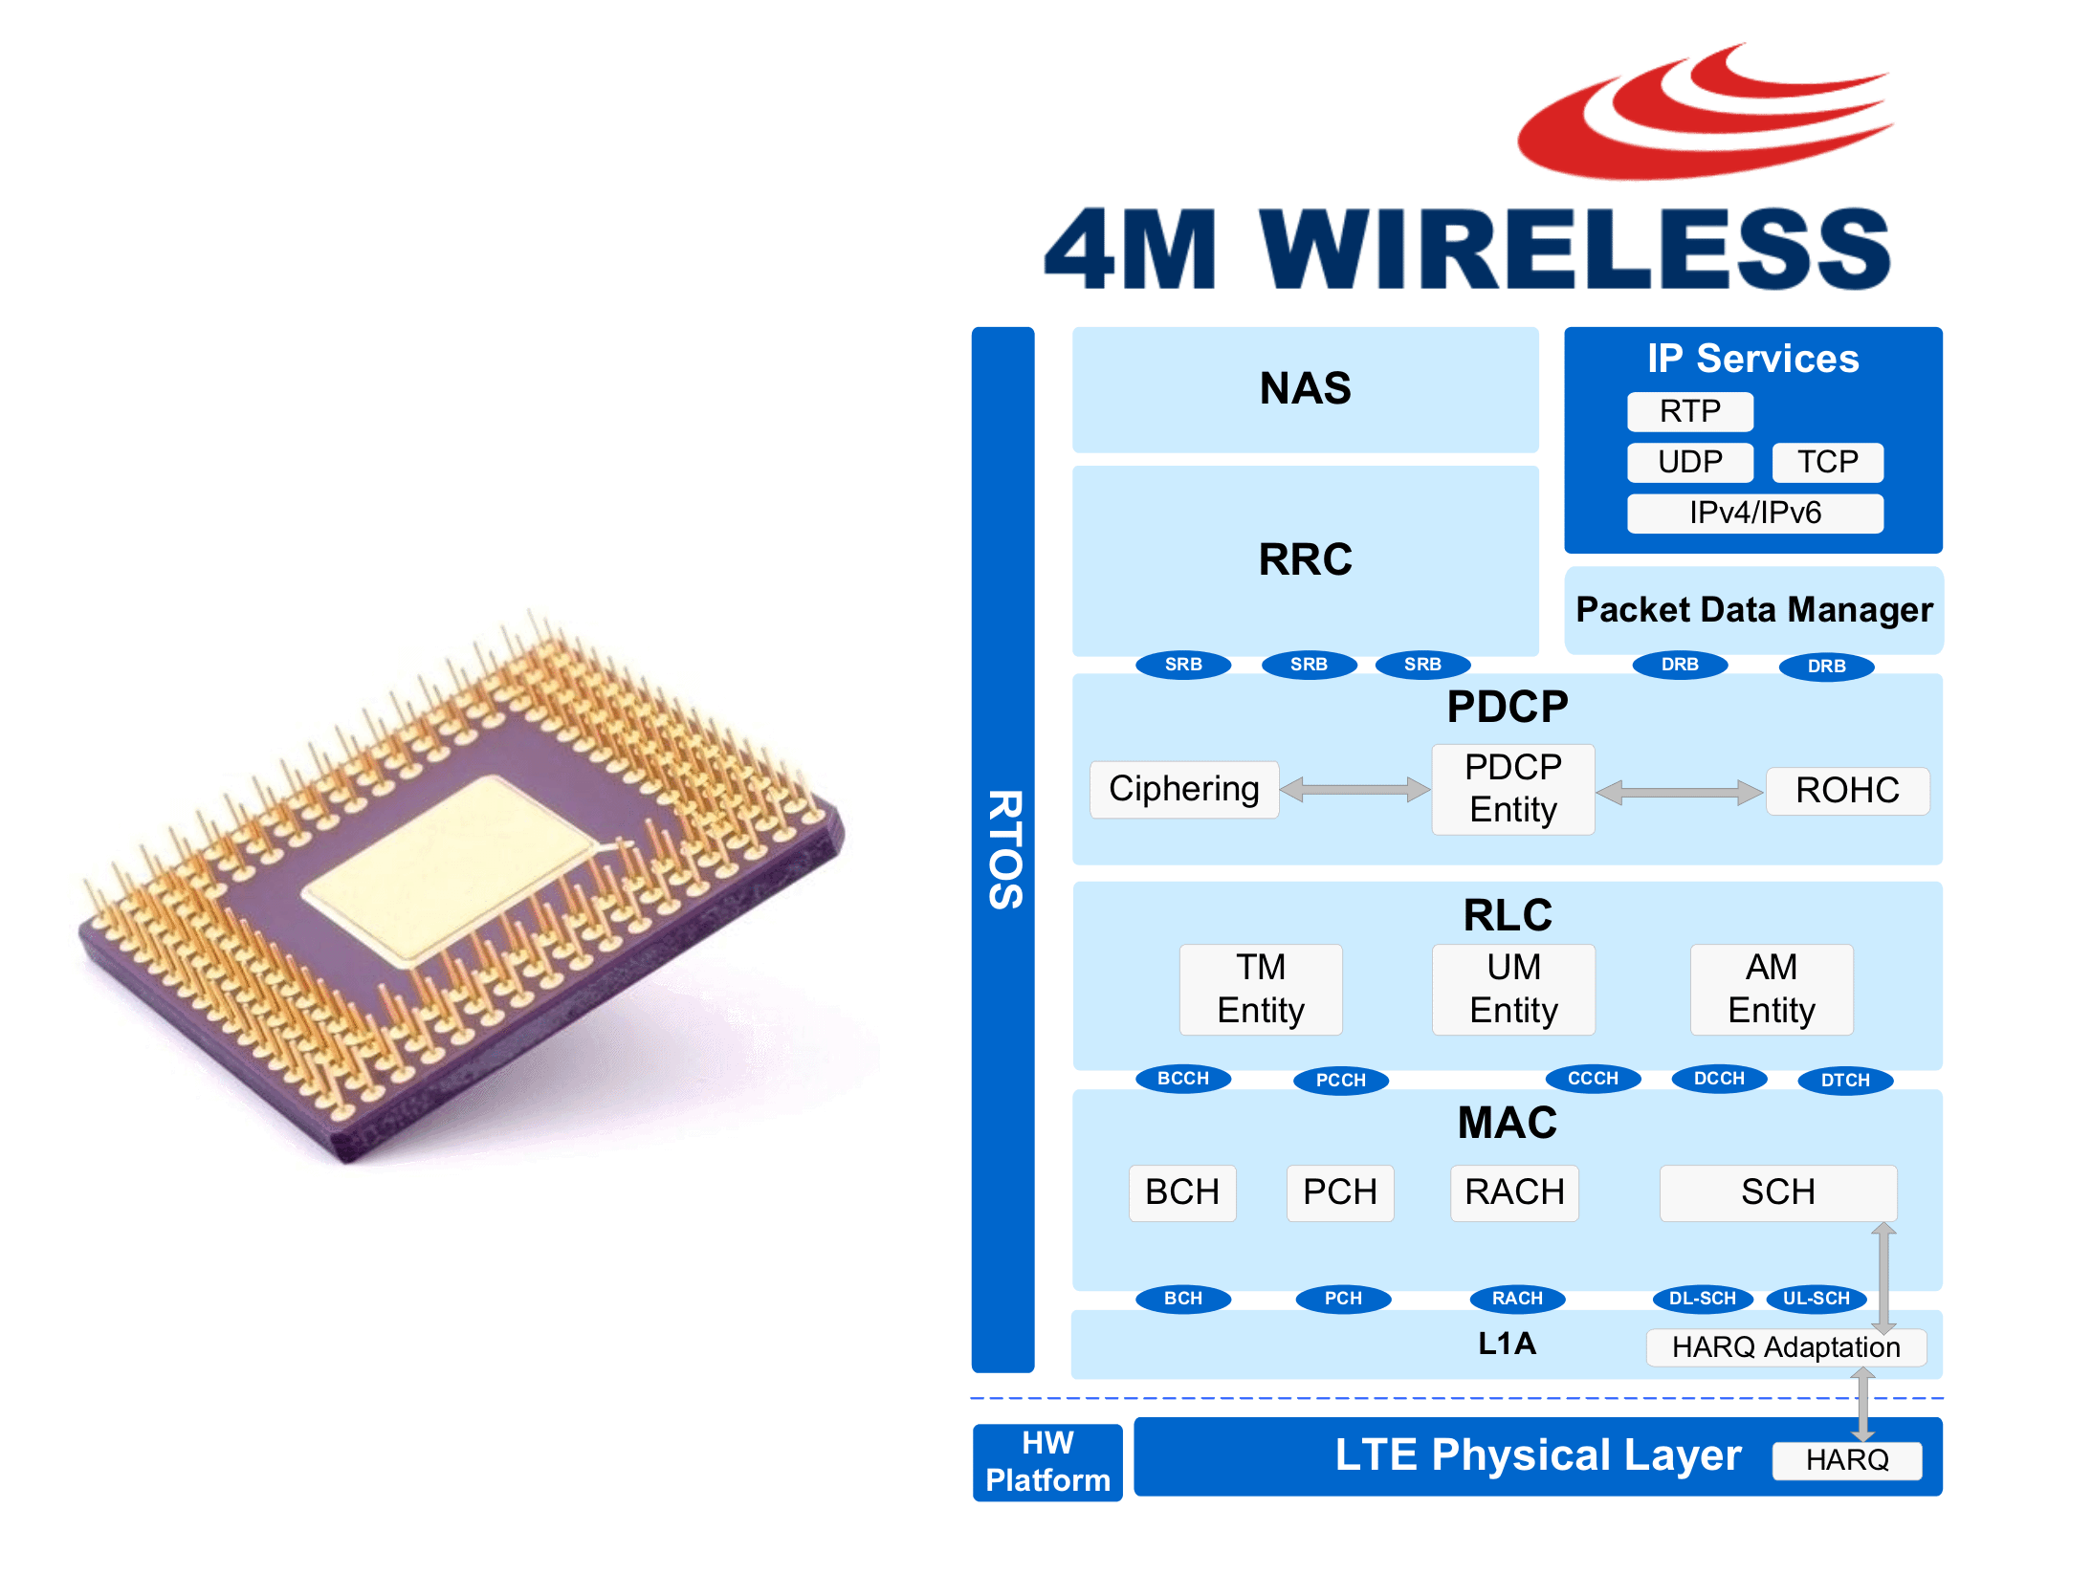
Parts of Mobile Testing: Mobile Protocol Stack
1. Mobile Protocol stack testing. (using network simulators)
few examples are below:
* Stack supports 4 bands EGSM,PGSM,GSM-850,DCS.Mobile originating and mobile terminating call in all those bands.
*cell selection reselection
*cell bar
*All types of handover
*frequency hopping
*Coding schemes etc
handover or handoff refers to the process of transferring an ongoing call or data session from one channel connected to the core network to another.
Frequency-hopping spread spectrum (FHSS) is a method of transmitting radio signals by rapidly switching a carrier among many frequency channels.

Slide 26
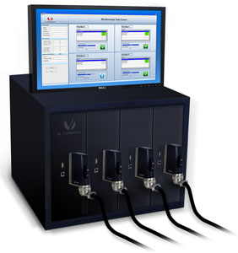
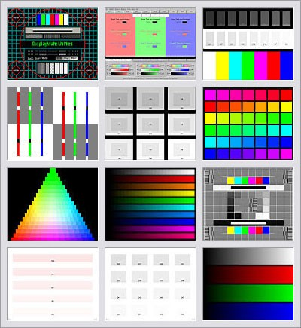
Parts of Mobile Testing: Multimedia Testing
* Midi polyphonic tones ringer and player
* MP3 as ringer and player &other supported formats
* Camera
* Video Conferencing etc

Slide 27
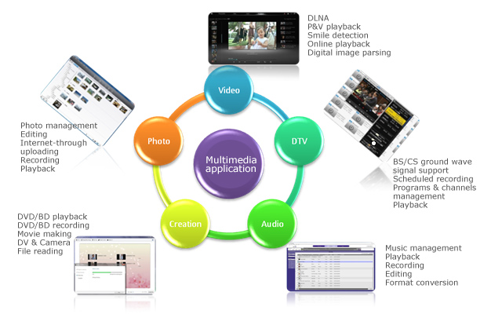
Parts of Mobile Testing: Multimedia Testing

Slide 28
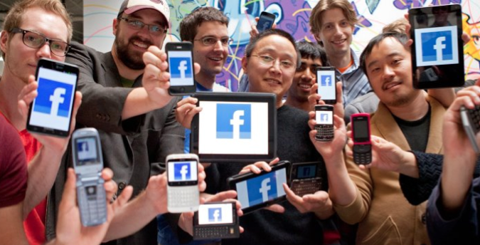
Parts of Mobile Testing: Feature Testing
*Phonebook
*SMS
*Supplementary calls
*Security
*Calculator
*Gaming
*Fast dialing etc

Slide 29
Specific of Mobile Testing
Tell me about Test Plan Specifics that must emphasized while writing TP for Mobile Application
What Type of Mobile Domains you know
3.What is the difference between Mobile Testing and Mobile Application Testing?
4. Compare Web Application Testing vs. Mobile Application Testing

Slide 30

Compare Web Application Testing vs. Mobile Application Testing
Category | Web Application | Mobile Web Application
Device for Testing | PC, Laptop, Server | Huge variety of devices
Platforms | Win, Mac, Linux, Unix, Oracle Solaris, some other server Platforms | Currently, more than 20
Operating System | Win, Mac OS X, Linux | iOS, Android, Windows Phone, BB QNX, Linux, Tizen, + another 5
Browsers | IE, Safari, Chrome, Firefox, Opera | About 100 Web Browsers depends on the region
User Interfaces | One for each OS and Browser | Many for each OS and Browser

Slide 31
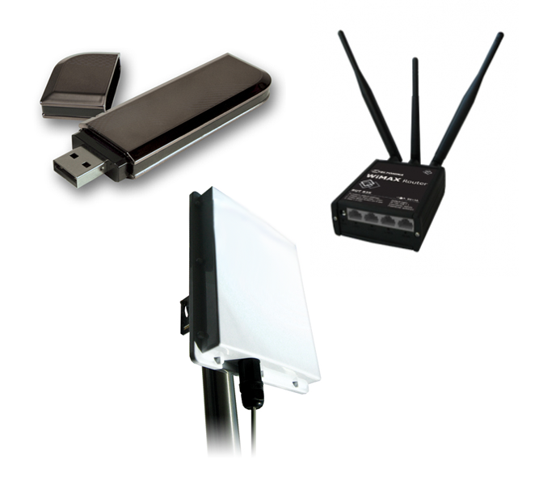
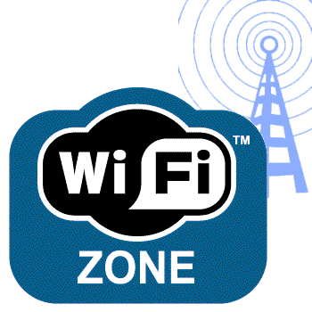
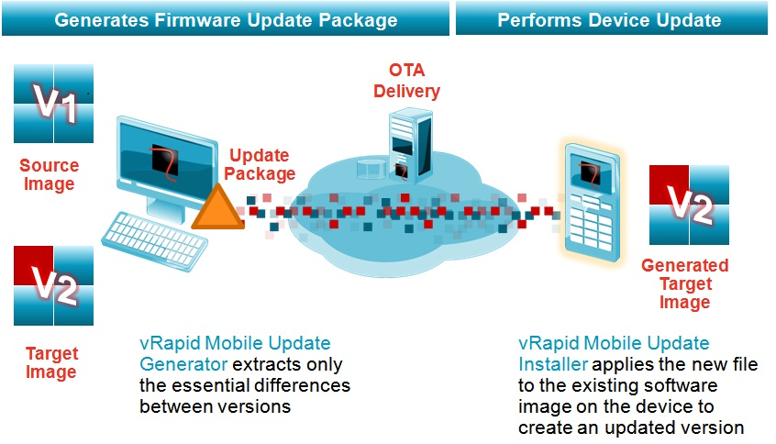

What are the different ways you can install a Mobile Application?
OTA (Over The Air)
2. Wi-Fi
3. Data-cable/USB cable
4. Bluetooth
5. Using third-party App

Slide 32
Different approach to testing mobile Apps
I: INPUTS INTO THE DEVICE
These represent the ways you can interact and control the device. Including:
▪ Built-in keyboard/keypad
▪ Touch screen gestures and typing
▪ Synching with other devices
▪ Peripherals that you can plug in to the device
▪ Hold the device differently when inputting– be creative!
Test the application and try out all the inputs that you can think of. If it is a touch device, make sure you try different combinations with your fingers. Keep a thumb on the edge of the screen and try to type, or tap your fingers on the device while using it.
If it rotates to portrait and landscape modes, make sure you try in different modes. See if the application behaves strangely when you rotate it and try to manipulate with touch gestures or typing on a keyboard.
Even the way devices are held can impact their connectivity and how well they respond to application inputs. Can you hold the device in such a way and interact with it so that it causes the app you are testing to crash or freeze up? What happens if you launch the application in each supported orientation of the device? (Sideways, upside down, straight up)

Slide 33
Different approach to testing mobile Apps
S: Apps STORE
Mobile apps tend to get distributed online through special stores. The most well known are Apple’s App Store and the Google Play. For test ideas, try to find out information about the requirements of application requirements for store submissions. Sometimes finding out what store(s) the app will be submitted to and looking at any public documentation available that outlines guidelines can be a treasure trove of testing ideas.
See if you can find anything that might have been missed by looking for:
Submission specifications
Development guide
User guide for error handling, location services, permissions for user privacy items, accessibility, etc.

Slide 34
Different approach to testing mobile Apps
L: LOCATION
Where you are located can have an impact on what you are testing, particularly if the application requires an internet connection. Applications may be affected by the following:
▪ Geo-location errors
▪ Movement, stopping suddenly
▪ Connection issues due to interference
▪ Moving from one data network to another (eg. wifi to wifi, wifi to wireless broadband, 2G-3G-4G)
Getting up and carrying your device while testing an app is an effective way to find bugs. Can it handle your devices native messages when you change or lose connections? Does it crash or freeze if it loses or changes connections?
Also, your location is often different from where the application is developed. You may speak a different language than the programmers. Is the application compatible with the language and culture where you are located? Are words correctly translated? Are meanings correct and clear? Does the application do something that could be interpreted as funny or offensive? If so, the development team needs to know those issues.

Slide 35
Different approach to testing mobile Apps
I: INTERACTIONS/INTERRUPTION
Mobile applications have far more hardware restrictions when they operate than other computers. They have less memory and less processing power than a PC, for example. As a result, they are susceptible to problems when other applications or operating system functions are running. It’s important to test how the app behaves when other applications running at the same time. Furthermore, any changes made to the device’s preferences can have an effect on your app. See how interaction with other programs, particularly built-in, native applications and the application you are testing interact. On mobile devices, they can cause your app to fail. You have to be very conscious of your memory footprint and how you shut down and clean up.
Are there problems when:
▪ Running multiple applications, utilizing multitasking
▪ Using other applications, then using the application you are testing(email, calendar, texting, note taking, others)
▪ Notifications appear (new emails, phone calls, text messages, other notifications)
▪ Error messages occur (losing connections, notifications, operating system and other errors)

Slide 36
Different approach to testing mobile Apps
Be creative with your device settings. Find out all the ways you can change the settings on your phone, and determine which might have an effect on the application. Spending a couple of hours using the application while changing different settings is worthwhile. Also spend time exploring ways you can force error messages.
Another interesting interaction is with any time-based notification, such as calendars, alarms, and built-in clocks. Applications can behave strangely when they become confused about time, or if they are interrupted by a time-related alert. Even using applications in a certain order, or doing things on certain days (time changes for example) can cause interruptions or interactions that the application may have problems dealing with.

Slide 37
Different approach to testing mobile Apps
C: COMMUNICATION - Compatibility
Smartphones started out primarily as communication devices, but the app we are testing may not handle communication interaction smoothly. Here are some communication examples:
▪ Phone
▪ Texting
▪ Emails
▪ Instant messaging
▪ Voicemail messages
▪ Video
▪ Others
It is interesting to test how an app interacts with communication: texting, emails, telephone, voicemail. There are a lot of combinations to test here: taking calls/texts, rejecting calls/texts, interacting with voicemail. Each of these communication devices take precedence over the app you are testing, so how does it handle these interruptions? There are a lot of scenarios you can try. In some cases, you might be able to use a communication device while using the app you are currently testing.

Slide 38
Different approach to testing mobile Apps
E: ERGONOMICS
If you test mobile apps for any length of time, you will show signs of physical stress. You need to manage this as a tester, by taking breaks and managing your time and physical interaction. However, also think of the end users. They run into the same problems that can make you tired:
▪ Small screens can be hard on the eyes
▪ A small device means there is no ergonomic help from a desk, or chair – you often hunch over to interact with it
▪ It’s not uncommon to get a sore back, fingers, eyes when using a device for any length of time
▪ Use physical strain as points of investigation for usability problems
Use physical cues from your own testing work and analyze whether the application makes interaction worse. Are fonts and colors and sizes too small? Are there too many steps to click through to get through complicated workflows? Does the end user have to type a lot on the small device? Any shortcuts to decrease physical strain, or improvements to display are huge factors with how successful an app is. Highlight and report problem areas that make you struggle – users will have the same kinds of problems if they use the app for any length of time.

Slide 39
Different approach to testing mobile Apps
D: DATA
Anything you can input into the application is processed in some way. Furthermore, any data that is coming from a server or third party can have an effect on the application. Check for:
▪ Types of input – special characters, different languages, etc
▪ Media – see if the app depends on an outside source to play music, videos or anything else.
▪ Size of files – if the application uses outside files, try using different file types
▪ Frequency of updates – some applications require data from a server that is updated periodically to change settings, or to provide new content. Find out the schedule of these updates and see how the application reacts when an update occurs.

Slide 40
Different approach to testing mobile Apps
U: USABILITY
These can be some of the most important bugs to find and log, because they are the issues that often frustrate end users the most.
When you are testing the application, note and log any issues that make you uncomfortable, frustrated, angry, or upset. To find usability issues, look for any actions that are awkward, confusing, or slow.
Listen to your emotions – that’s an important source of usability issues. Instructions can be incomplete or misleading, items can be labeled incorrectly, and there may be workflows that make doing what you want to do difficult.
If there are aspects of the application that you don’t like and frustrate you, log them as usability issues. Sometimes installation, setup or upgrading an app can have complicated steps. Are there any strange configuration interactions with your phone's settings or hardware? Some device updates require switching power off, removing batteries, and other things that may be difficult for non-technical users to do.
Highlight anything cumbersome, frustrating or confusing for the development team.

Slide 41
Different approach to testing mobile Apps
P: PLATFORM
Borrowing the “P” from Bach’s SFDPOT mnemonic, looking at the device that the application needs to run on is important. You may have a device that the programmers do not have access to, and their app may not work at all, or may work poorly. Your unique device is something that they are depending on you to test the application, so careful observation and documentation of problems, large or small is important. Also be aware of changes to your device. You have little control over operating system updates. The provider encourages you to update these, for good reasons. However, new versions can cause an app to fail that worked in a prior version. Be aware that updates (even small ones) can cause an application to stop working. Be sure to find out all the technical information about what device you are using, and what operating system version you have installed when logging a bug.

Slide 42
Different approach to testing mobile Apps
F: FUNCTION
Functional testing is the most common form of testing. It usually involves comparing the specification or requirements for an app, and verifying that the application does what it says it does. This can often be very simplistic: looking for items and ensuring they are there and function the way they are supposed to. To be more creative, generate test ideas by asking these questions:
▪ Can you identify everything that the application does?
▪ Have you worked through all the aspects of the app? Clicked every button? Filled in every form? Have looked into default settings and options that are available to you?.
▪ Try a tour of the product to identify everything it does3. Try to find commonly used features, and the most obscure. Be thorough.
▪ Once you have a good sense of what the product is supposed to do, does it match what the app developers say it does? If it doesn’t, there is a source of problems. If your impression differs from theirs, they need to know that.

Slide 43
Different approach to testing mobile Apps
U: USER SCENARIOS
This is an incredibly powerful method of finding problems. In fact, if I am limited to one type of testing approach in a short period of time, this is often the one I will choose. This is a fun way to use the application: imagine two or three real users that you know, and think what they would do when using the application. Try to think of creative users: I always imagine that one annoying family member who struggles with technology and always wants me to fix their computer or mobile phone. If I pretend to be that person, what kinds of problems would they find? What would they struggle with? I also imagine a more technical user, and someone in between. I try to think of real people and how they would react to using the software. To create scenarios, I identify the following
▪ How is this application supposed to be used?
▪ What problems does it solve for users?
▪ What are the goals of end users that this application helps them solve?
I then create scenarios based on that information. For example, if I think of a busy office worker, I set up a scenario with my phone so that it has a lot of emails, texts and meeting reminders occurring while I use the app. You can get very creative here, with a lot of other application interaction, as well as trying to quickly solve a problem or enjoy an experience with a device under different conditions.

Slide 44
Different approach to testing mobile Apps
N: NETWORK
Mobile apps that require network connectivity such as an internet connection are quite susceptible to problems. Since they aren’t stationary objects like a PC, they have a huge dependence on the availability, performance and reliability of networks. The path from a server to your device can be confusing, complex and circuitous. What this means is that the application may expect connectivity that isn’t available consistently where you are testing. In these cases, the application may fail or crash because of timing issues (it takes too long to get responses) poor connections (lack of signal strength) or moving from one network to another.
▪ Wifi
▪ Wireless broadband
▪ Dead spots
▪ Moving from one data network to another (eg. wifi to wifi, wifi to wireless broadband, wireless broadband to wifi, others)
The network controlled by a service provider and how well it performs is not something we can control. We can find out whether apps work well with the network we are using or not, and let the developers know about the problems you see.

Slide 45
Different approach to testing mobile Apps
GETTING STARTED
I usually start with “FUN” – I look at the functions of the app, starting with the installation and moving from there. I follow any instructions (or lack of) it comes with, and spend time touring the application. I then look at all the settings options of my mobile test device and determine what might interfere with the application. It can take over an hour to delve deeply into the built-in capabilities of the device itself. I then try to think of three different users, and imagine how they would use the application. I map out basic scenarios, and try to move my way through the application the way real users would. As I move through the app, I am careful to note anything that bothers me, and feels unresponsive or awkward. These are usability issues that are important feedback. Then, I investigate my network options, and I try the app out using different connection options. From there, I move on to the rest of the mnemonic: interactions, interruptions, and others. You might be surprised how many bugs you find if you work at trying out as many ideas in each category as you can. Don’t be limited by this though, come up with your own ideas, use this mnemonic as a springboard for your testing thinking.

