Slide 1

Final Exam Review

Slide 2
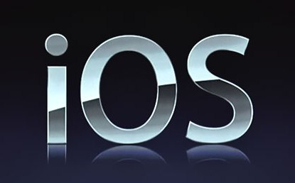
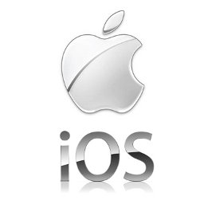
What do you know about iOS/Platform
Source
Platform
Core Language
OS Architecture
Version History
Updates/Upgrades
Makers
Carriers
Life Battery
Web Browsers

Slide 3
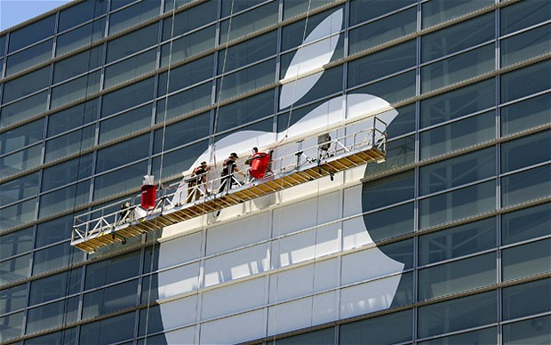
Operating System: iOS
iOS is derived from Mac OS X that shares with the Darwin foundation; and therefore, it is a Unix operating system.
Primary Apple development language is Objective-C; although, it is possible, with some translation work, to port Java code into iPhone.
http://www.techotopia.com/index.php/The_iOS_4_Architecture_and_SDK_Frameworks
http://iosframeworks.com/

Slide 4
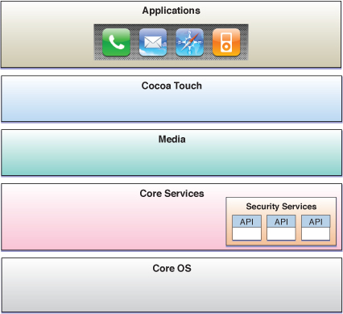
Operating System: iOS
Hardware

Slide 5
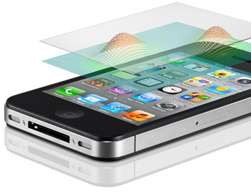
iOS: Cocoa Touch
The Cocoa Touch layer sits at the top of the iOS stack and contains the frameworks that are most commonly used by iPhone application developers.
Cocoa Touch is primarily written in Objective-C, is based on the standard Mac OS X Cocoa API (as found on Apple desktop and laptop computers) and has been extended and modified to meet the needs of mobile technology.
The Cocoa Touch layer provides the following frameworks for iPhone app development:
1 UIKit Framework
2 Map Kit Framework
3 Push Notification Service
4 Message UI Framework
5 Address Book UI Framework
6 Game Kit Framework
7 iAd Framework
8 Event Kit UI Framework
https://developer.apple.com/library/mac/#documentation/Cocoa/Conceptual/CocoaFundamentals/WhatIsCocoa/WhatIsCocoa.html

Slide 6

Application Frameworks
Web development is about getting stuff done, not figuring out how to get it done.
Frameworks and libraries help the web developers focus on creating rather than figuring stuff out.
Rather than reinventing the wheel, Developers can use a framework or library to delegate brunt, non-creative and repetitive work, freeing up their time and energy to create the actual website or application.
http://speckyboy.com/2011/03/07/20-new-frameworks-for-web-and-mobile-app-developers/
http://www.rhomobile.com/webinars-old/rhodes-testing-framework/

Slide 7
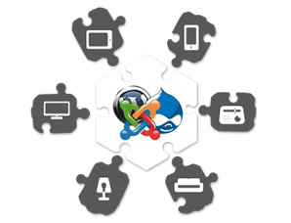
Framework- definition
A software framework is an abstraction in which software providing generic functionality can be selectively changed by additional user written code, thus providing application specific software.
A software framework is a universal, reusable software platform used to develop applications, products and solutions.
Software frameworks include support programs, compilers, code libraries, an application programming interface (API) and tool sets that bring together all the different components to enable development of a project or solution.
For example:
  Platform: Windows CE;
  OS: Windows Phone;
  Framework: .NET
  Platform: OS X;
  OS: iOS;
  Framework: Cocoa Touch
http://en.wikipedia.org/wiki/Comparison_of_web_application_frameworks

Slide 8
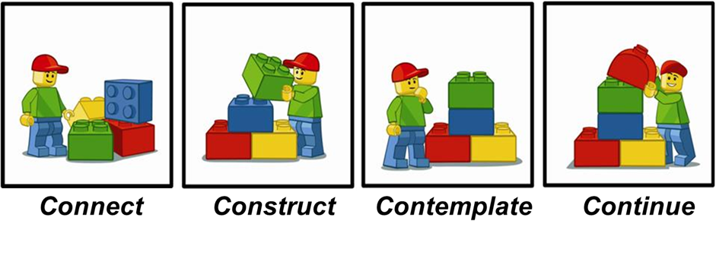
It defines the underlying code structure of the application in advance.
Developers usually use object-oriented programming techniques to implement frameworks such that the unique parts of an application can simply inherit from pre-existing classes in the framework

Slide 9
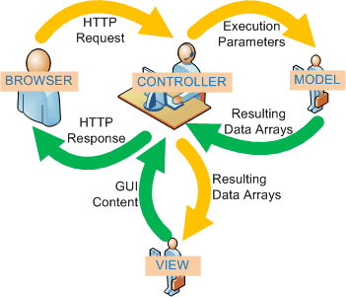
Framework’s type | Short Description
Model–view–controller (MVC) | Many frameworks follow the MVC architectural pattern to separate the data model with business rules from the user interface. This is generally considered a good practice as it modularizes code, promotes code reuse, and allows multiple interfaces to be applied. In web applications, this permits different views to be presented, such as web pages for humans, and web service interfaces for remote applications

Slide 10
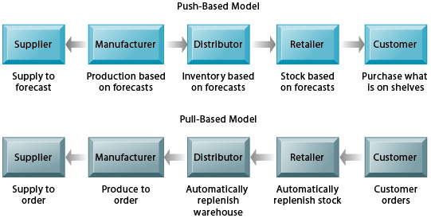
Types of Framework architectures
Framework’s type | Short Description
Push-based vs. pull-based | Most MVC frameworks follow a push-based architecture also called "action-based". These frameworks use actions that do the required processing, and then "push" the data to the view layer to render the results. Struts, Django, Ruby on Rails, Symfony, Yii, Spring MVC, Stripes, Play, CodeIgniter are good examples of this architecture. An alternative to this is pull-based architecture, sometimes also called "component-based". These frameworks start with the view layer, which can then "pull" results from multiple controllers as needed. In this architecture, multiple controllers can be involved with a single view. Lift, Tapestry, JBoss Seam, JavaServer Faces, and Wicket are examples of pull-based architectures.

Slide 11
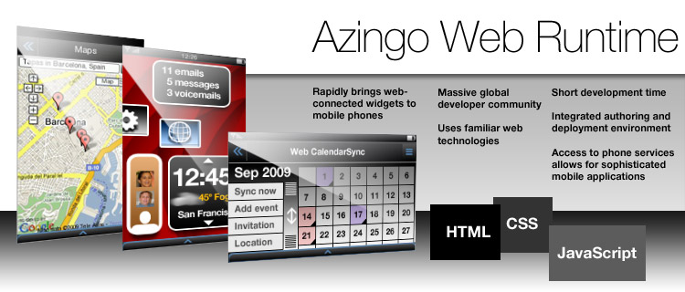
Application Framework – Example
Web Runtimes (WRTs)
Nokia, Opera (Presto), and Yahoo! provide various Web Runtimes, or WRTs.
Those are mini-frameworks, based on web standards, to create mobile widgets.
Both Opera’s and Nokia’s WRTs meet the W3C-recommended specifications for mobile widgets.

Slide 12
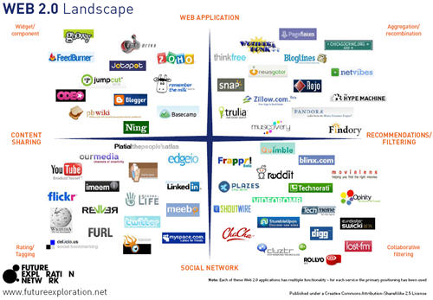
Application Framework: Example
The Web2.0 is the only application framework that virtually works across all devices and all platforms.
Increased demand to offer products and services outside of operator’s control, together with a desire to support more devices in shorter development cycles.

Slide 13
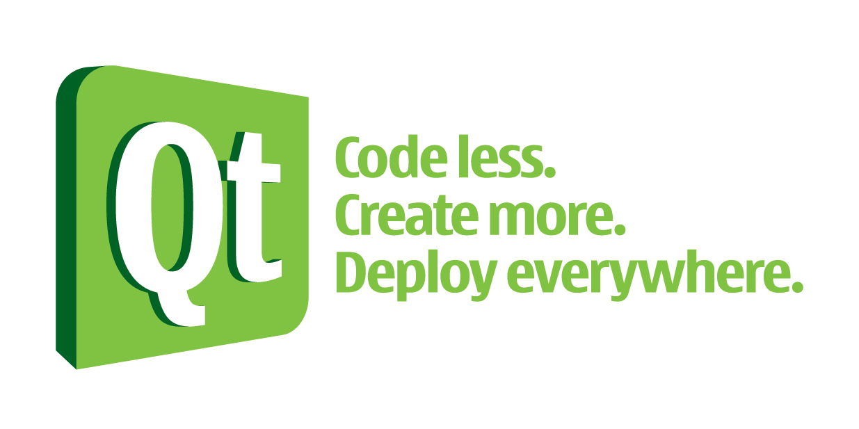


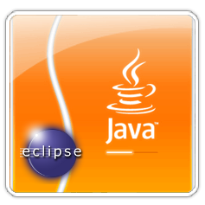
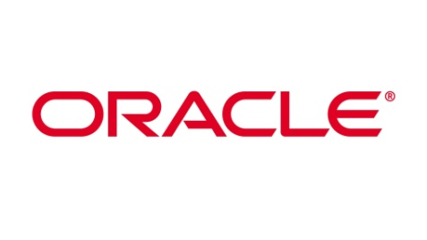
Application Framework: Examples
Free-software frameworks exist as part of the Mozilla, OpenOffice.org, GNOME, KDE, NetBeans and Eclipse projects.
Microsoft markets a framework for developing Windows applications in C++ called the Microsoft Foundation Class Library.
A number of frameworks can build cross-platform applications for Linux, Macintosh, and Windows from the same source code, such as Qt, the widget toolkits wxWidgets, FOX toolkit, or Eclipse RCP.
Oracle Application Development Framework (Oracle ADF) aids in producing Java-oriented systems.

Slide 14
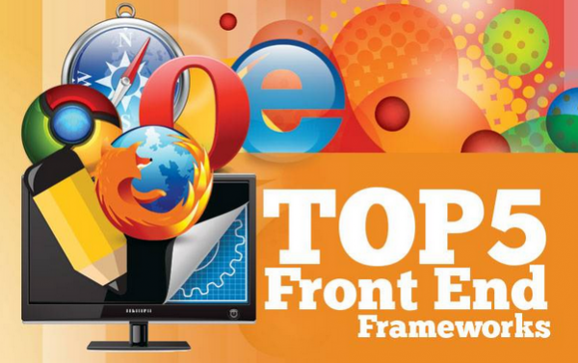
Top Apps Frameworks
jQTouch (Amazon, Mozilla, Google, Twitter, MS, Craiglist, WordPress)
Prototype (Apple, HubPages, AutoTrader, TicketMaster)
Struts (Yell, IRS, TelecomFrance, The ShoppingChannel, One Entry)
Bootstrap (NASA, Read.gov, InEx Finance, Syd PHP, PressAboutUs)
JavaScript MVC (T-Mobile, Grooveshark, Wegener, Mindjet, Kaplan)
http://www.sparkyhub.com/top-5-front-end-frameworks-infographic/

Slide 15
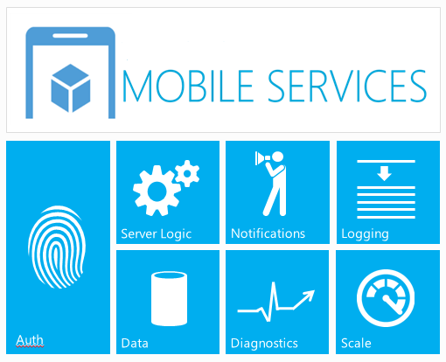

Slide 16
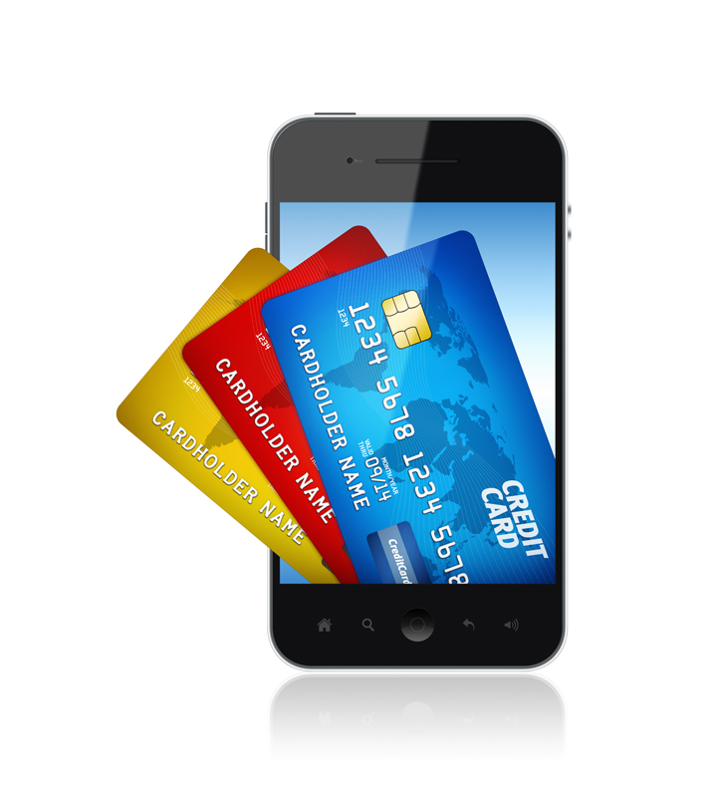

Slide 17

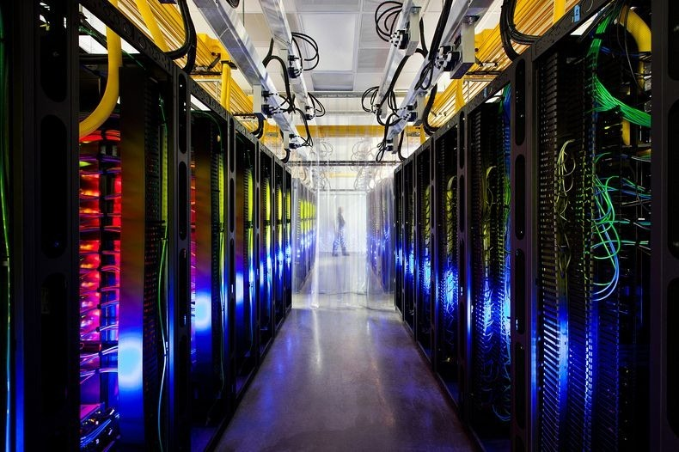

http://timreview.ca/article/335

Slide 18
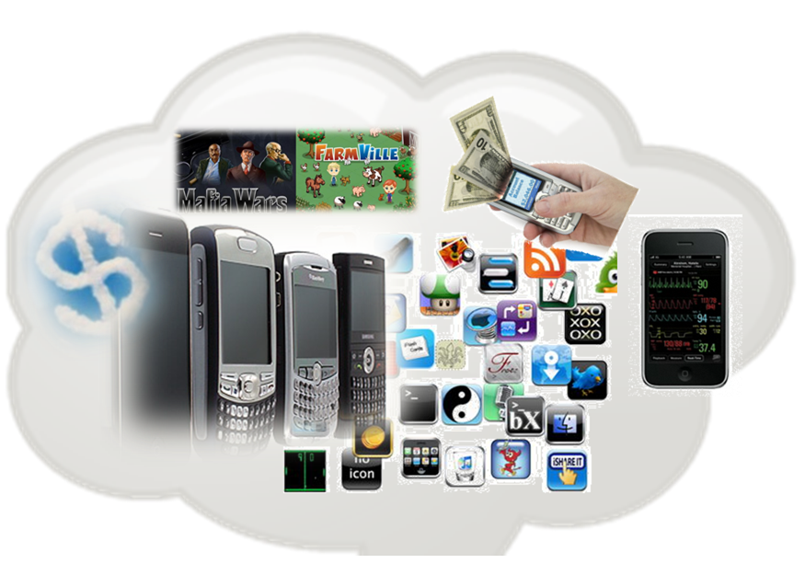
Cloud Services
An updated version of utility computing: basically virtual servers available over the Internet

Slide 19
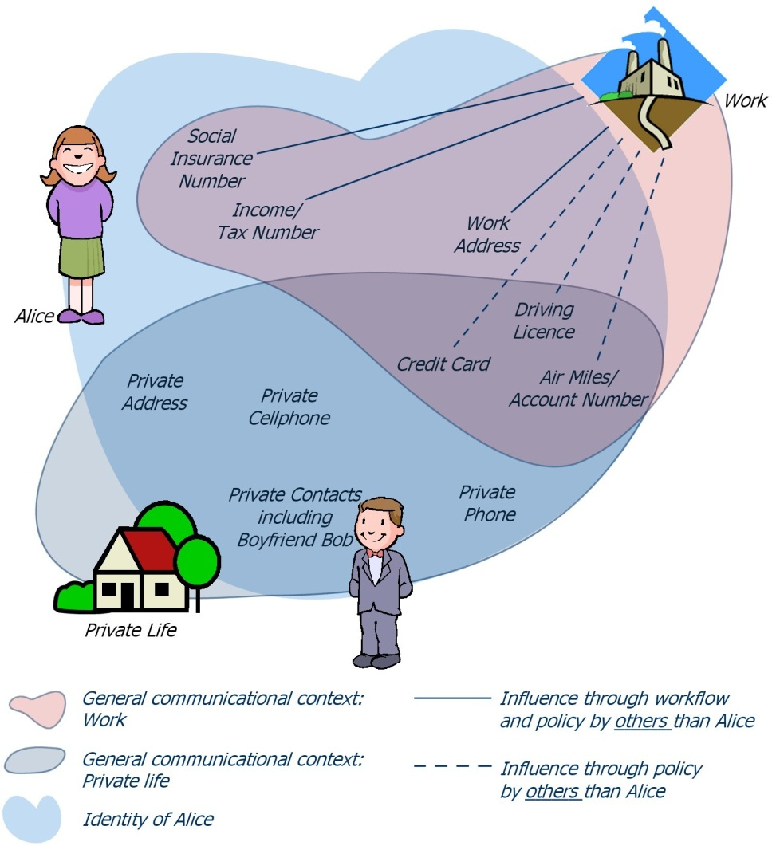
Location Based Services (LBS)
LBS are used in a variety of contexts, such as health, indoor object search, entertainment, work, personal life, etc.
LBS include services to identify a location of a person or object, such as discovering the nearest banking cash machine or the whereabouts of a friend or employee.
LBS include parcel tracking and vehicle tracking services.
LBS can include mobile commerce when taking the form of coupons or advertising directed at customers based on their current location.
They include personalized weather services and even location-based games.
They are an example of telecommunication convergence. Convergence services, such as VoIP, IP-TV, Mobile TV, etc., will replace the old technologies and is a threat to the current service providers

Slide 20
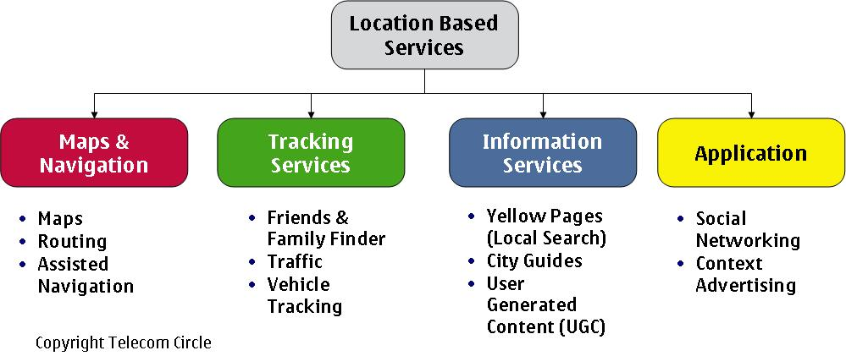

Slide 21

Thank you for listening
To be continue…

Slide 22
List of cool Mobile apps:
Android
iPhone
QA Interview and Programming Apps
Cheat Sheets (David Ortega Cuadrado)
Linux Cheat Sheet (Conundrum)
Ruby Cheat Sheet (Nakarin Maneerat)
Java Quick reference cards (nadstech.com)
Hackers Reference (Frustration Free Solution)
Cloud Computing Interview Questions
Java QA & Forum
Transcribe Pro
Cloud Tools for Windows Azure
Task Cloud 9
Cooper Egg – Server Monitoring
Synced Tool
Micro Transfer
thoughtbot Learn

Slide 23
List of cool apps: TechNews
Android
iPhone
TheVerge
Appy Geek
TechNews – Riversip (Briox)
TED
inoTechNews (inoapp llc)
The Verge
TED
Appy Geek
Tech News Tube
iNews 24/7
TechWire
MobilityBeat

Slide 24
List of cool apps: Helping Tools
Monitor Usage Stats and Tweak System Utilities
Android
iPhone
Carat
MX Log Collector
RemoteLogCat
Fing
WiFi Analyzer
ADB Wifi
Android Assistant
Battery Dr Saver
System Analyzer
Android Cleaner
UDID
Carat
BattLoad Testing $3.99
Device Log Viewer
WiFi Analyzer
Network Analyzer ($2.99)
System Status ($2.99)
VR Mobile –Vibration Testing
UDID – Ad Hoc Helper
Unit Testing Free for iOhone
Test Studio (Mobile Automation)
Minimal Essential testing Strategy
Performance Test Mobile
http://android.appstorm.net/roundups/utilities-roundups/35-android-apps-to-monitor-usage-stats-and-tweak-system-utilities/

Slide 25
List of cool apps: Helping Tools
Android
iPhone
Monitor Usage Stats and Tweak System Utilities
Audio Kit
iCurlHTTP
ProjQA Audit
AKLite
Agile Estimate
HP ALM Mobile
About My Device
LogPolice
Rest Client
HeadsUp XG
CEH Exam
SMTPtest
G360 Accelerometer

Slide 26
List of cool apps: Helping Tools
Android
iPhone
J-Rest Client
ISTQB Test
CircleCi
API 653 Tmin Calculator
iTester
iLoader.io
SessionLog
HTML source code
Flash Quiz MCAD
Bug Tracker
URLTestr
Defect Logger
YASC
Net Analyzer
Sensor Monitor
System Status

Slide 27
Fun Apps
Android
iPhone
Lie Detector
NC Decibel – Environmental

