Slide 1
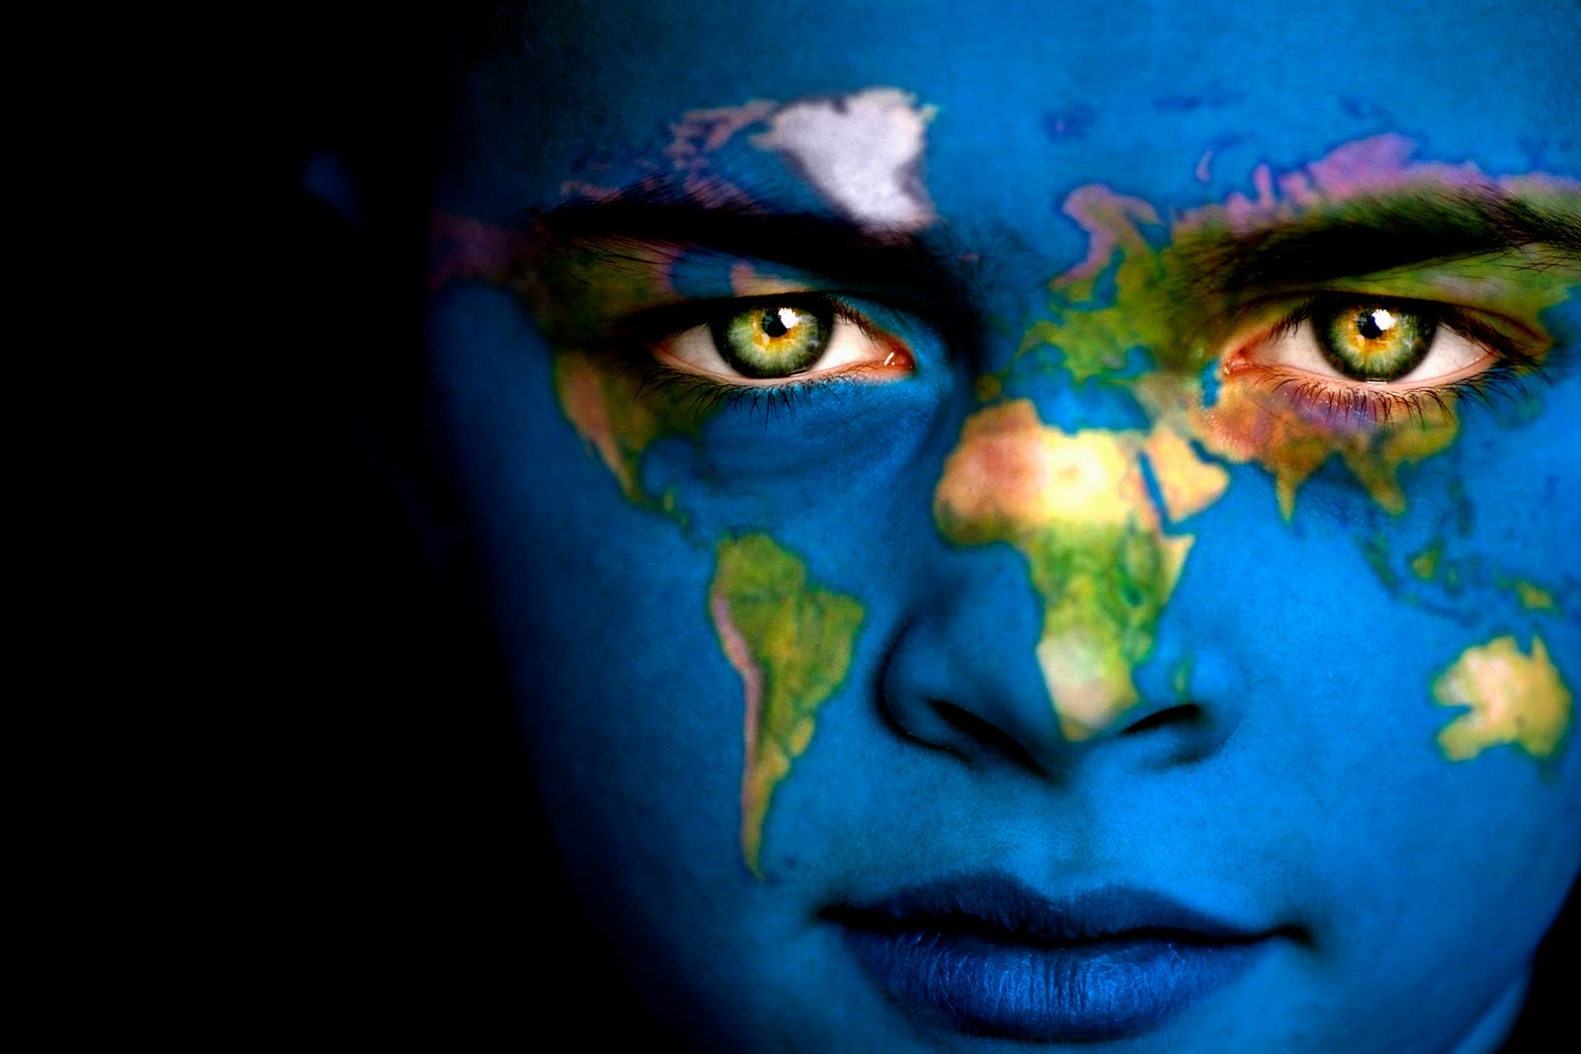
LOCALIZATION

Slide 2
89%
Users are outside US
53%
Users ready to pay for obtaining the content in their native languages
$1 - $ 25
For every Dollar invested in Localization there are $25 return
72%
Users spent most of time searching and obtaining information in their own languages
71.5%
Of the Fortune 500 localized to reach the targeted Customers

Slide 3
GIL – Global/International/Local
Globalization is set of planned design and development methods for product in advance, keeping in mind a multicultural audience, in order to avoid increased costs and quality problems, save a time, and smooth the localizing effort for each region or country.
Internationalization is the process of designing a software application so that it can be adapted to multiple languages and cultural conventions without engineering re-design changes.
Localization is the process of adapting internationalized software’s content to particular cultural and linguistic market.

Slide 4
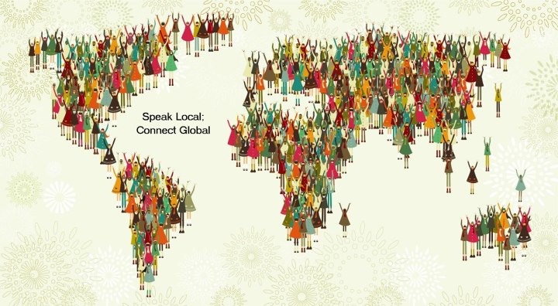
L10n – I18n
The Term L10n is abbreviation of the lengthy word Localization.
The Term I18n is abbreviation of the lengthy word Internationalization.
The L/I and N represent the first and last letters of the word, and 10/18 represents the number of letters in between.

Slide 5
Highlights of Internationalization
Extracting text and other localizable elements from the software code.
Ensuring that the design of the user interface (UI) is flexible and neutral.
Ensuring that the relevant character set is supported (double-byte sets, Unicode).
Ensuring that regional standards are supported.
For Web sites, ensuring that text embedded in graphics is easily localizable.

Slide 6
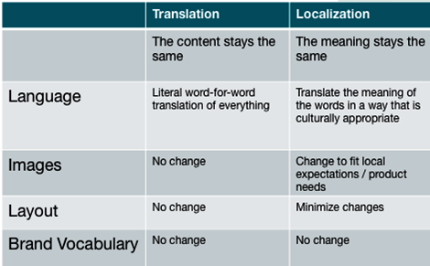
The purpose of the Localization is a creation of User’s native, “locale” experience in variety of ways. P.S. Language localization differs from translation activity, because it involves a comprehensive study of the target culture in order to correctly adapt the product to local needs.
Localization vs. Translation:

Slide 7
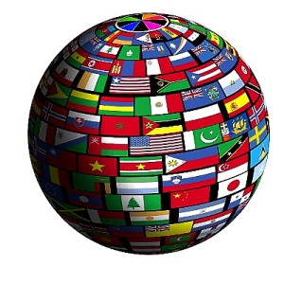
Parts of Localization (L10N)-
Translation: give the proper meaning from a source language.
Locale: user's environment that is dependent on language, country/region, and cultural conventions.
For example, Spain, Colombia and Mexico represent three different locales.

Slide 8
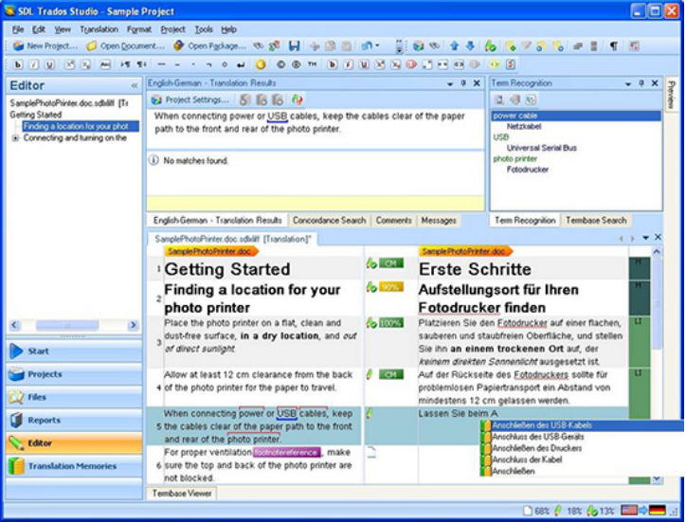
Highlight s of Localization Translation:
Literal translation,
Idiomatic language translation,
Translation of text/image content,
Translation of Software source code,
Translation of Brand web sites,
Translation of Database content.

Slide 9
Highlights of “Locale” Details:
currency,
national regulations and holidays,
visual cultural sensitivities,
product or service names,
gender roles/title,
geographic naming
postal address,
number and date formats,
the sort order,
the fonts and the font size (Asian Language).

Slide 10
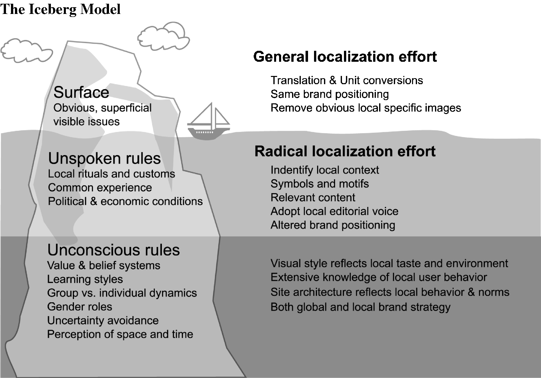

Slide 11
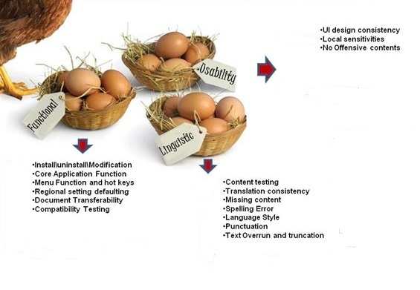
Localization testing coverage:

Slide 12
Language Functional Testing
Install/Uninstall Application Processes
Core Application Function
Menu Function and hot keys
Regional Settings default
Document Transferability (Terms and Policies)
Compatibility Testing
Error Handling

Slide 13
Linguistic/Locale Testing:
Translations for Names and Titles
Translations for territory and country names
Translations for currency names
Translations for weekday, month, era, period of day, in full and abbreviated forms
Translations for time zones and example cities for time zones
Translations for calendar fields
Translations and conversion of the measurements
Patterns for formatting Alphabetical lists of countries and states
Patterns for formatting/parsing words, dates or times of day
Patterns for formatting/parsing Postal Addresses
Patterns for formatting/parsing Phone numbers
Patterns for formatting/parsing numbers
Proof of Unique sets of characters used for writing the language
Rules for language adapted collation (comparison)
Rules for formatting numbers in traditional numeral systems
Rules for spelling numbers as words
Rules for transliteration between scripts (umlaut, accent)

Slide 14
Language Usability Testing
1. Cultural attention in a User Interface setup and design ( navigation, gestures features, and information structure)
Check for alignment, overlap, and truncation Issues that occurs after translation
Check for Orientation adjustments (Portrait vs. Landscape)
Check for the invalid symbols and characters
Check for the cultural meanings of the color
Rules for signs in cultural content
Rules for appropriate visual cultural standards (Maps, flags, icons, clip art, photos, cinematics)

Slide 15
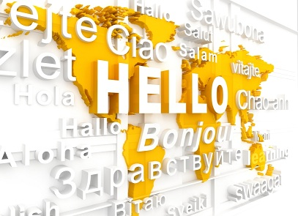
Guide of L10N/I18N Compliance:

Slide 16
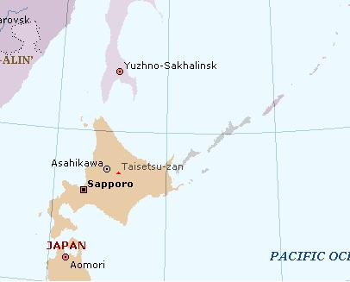
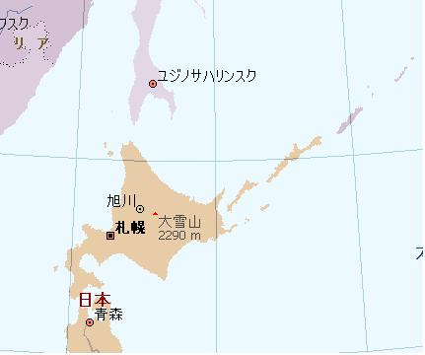
Issues with Maps, con’t.
The southern Kuril Islands required different cartographic symbology based on the language version.
The islands are disputed between Russia and Japan.
Global English version
Japanese version

Slide 17
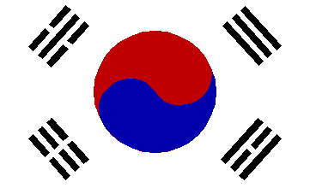
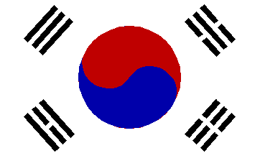
Flag Content as Clip Art
Provision of flags as artwork is reasonable; ensure they are current and presented correctly.
This Korean flag was displayed backwards in an online gallery.
WRONG
CORRECT

Slide 18
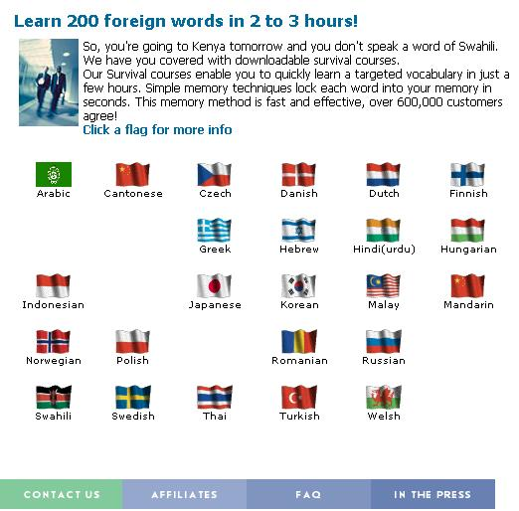
Flag Content as UI Design Elements
Flags are inappropriate indicators of language or locale in a UI:
Requires ongoing maintenance of changes
Inaccurate reflection of language extent – both beyond and within a country’s borders
Sensitive to some cultures.

Slide 19
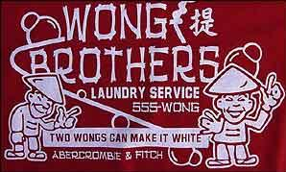
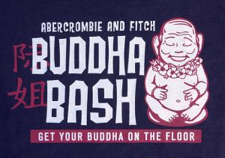
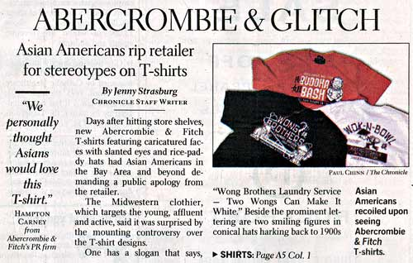
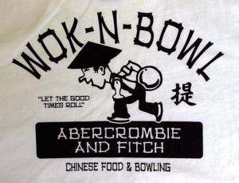
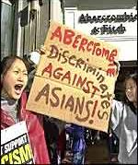
Retail Product Design and Marketing
In 2002, Abercrombie & Fitch t-shirt designs (at left) caused much protest from consumers who found it racially offensive; it was quickly discontinued.

Slide 20
Content-Intensive Game Issues
JFK Reloaded and Grand Theft Auto are good examples of problem game concepts using controversial themes.
JFK is a very sensitive subject in the US; the game was UK-developed.
GTA is very popular but widely criticized for very extreme violence and for modeling and/or contributing to asocial behavior.
Notes:
This font contained offensive Nazi-style (right-facing) swastikas that required removal.
The Star of David was also removed due to redundancy (it’s already present in the Wingdings font).
The font was obtained from a third-party vendor in 2003 in Japan who didn’t perceive the error.
The simple oversight of not reviewing the third-party content led to a Critical Update for Windows.

Slide 21
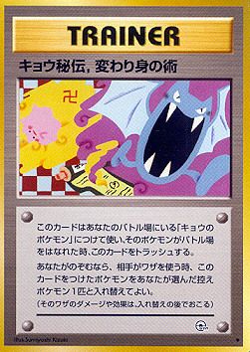
Content-Intensive Game Issues, con’t.
Hearts of Iron was banned by China in 2004 for how it portrayed Taiwan and Tibet during WWII (not as part of the PRC).
The Pokemon card on the right was discontinued after ADL pressure in 1999 for containing a swastika (a manji – a left-facing Buddhist style); some Muslim countries banned Pokemon in 2001 for cards allegedly containing “Zionist” symbols.
Notes:
This font contained offensive Nazi-style (right-facing) swastikas that required removal.
The Star of David was also removed due to redundancy (it’s already present in the Wingdings font).
The font was obtained from a third-party vendor in 2003 in Japan who didn’t perceive the error.
The simple oversight of not reviewing the third-party content led to a Critical Update for Windows.

Slide 22
Issues with Human Representation
Use of 4 fingers with human figures in Japan
Exposed feet is a problem in the Middle East
Gestures are very context-dependent
A bit too revealing for some cultures

Slide 23
The Subtlety of Geopolitical Content Issues
Desktop Image for Indonesia
Flag of The Netherlands
Even something as subtle as a common photographic filter technique can send a strong, negative message to local customers.
Indonesia gained its independence from The Netherlands in 1949.

Slide 24
Usability testing- date notation
Here are the proper date formats for some key locales:
MM DD YYYY - United States
DD MM YYYY - Most European countries, Australia, Canada
YYYY MM DD - South Africa, Japan, Korea, China, Taiwan

Slide 25
Long and Short Date and Time Formats
Some examples below for Long and Short Date and Time Formats
Language/Country | Long Date Format | Short Date Format | Time Format
Dutch-Belgium | maandag 14 april 2010 | 14/04/2010 | 14:34:17
Dutch-Netherlands | maandag 14 april 2010 | 14-4-2010 | 14:34:17
English- United Kingdom | Monday 14 April 2010 | 14/04/2010 | 14:34:17
English - United States | Monday, April 14, 2010 | 04/14/2010 | 2:34:1 7PM

Slide 26
Calendar/Holidays/Start of Week
There are a few aspects regarding calendars that we need to consider when we testing the localized software (if the software contains the calendar). Although the Gregorian calendar is used in almost every country, there are still cases in which a different calendar might be considered.

Slide 27
Calendar/Holidays/Start of Week
These include:
Arabic calendar (Note: In Islamic countries, the date changes at sunset, not midnight)
Jewish calendar
Iranian calendar
Japanese Imperial calendar

Slide 28
Holidays:
When you are testing a localized software and the software contains the calendar that you need to test it is important to know the holidays of the target country. Do not assume that everyone celebrates Christmas. Many non-Christian countries do not have a Christmas holiday. Even new year celebrations may vary.

Slide 29
Holidays
The Chinese New Year - The biggest and most celebrated festival in China and part of east and south east Asia.
Jewish Year 5771
Al-Hijra - 1st Muharramn (Islamic New Year) December 18, 2010
Open a website: http://www.holidays.net/

Slide 30
COLOR
Color has very different meanings around the world and therefore it is a significant element, not just for computer user interfaces, but for all forms of international interaction. Table below shows different meanings of colors for various cultures i.e. color purple represents death in Catholic parts of Europe. Euro Disney should have done their homework well before choosing purple as a signature color.

Slide 31
color
Red
China: Good luck, prosperity, happiness, marriage
Japan: Anger, danger
Middle East: Danger, Evil
India: Purity, life
Egypt: Death
USA and Western Europe: Danger, anger, stop

Slide 32
Color
White
Asia: death, purity
Middle East: purity
India: Death, purity
USA and Western Europe: Purity, virtue
Black
Asia: Evil influences, knowledge, mourning
Middle East: Mystery, evil
USA and Western Europe:
elegance (black dress and
tuxedo), death, evil
Purple
Catholics: Death
Asia: Wealth, glamour
Western Europe: Royalty

Slide 33
Color
Although the strict meanings of colors may be fading across countries, it is still a good practice to test colors carefully. We do not see brightly colored web sites for the Japanese culture; instead, products are usually designed with pastel colors in mind. And if you notice that red color is dominating in Japanese version of software you can file a usability defect saying that red color in Japan means anger, danger.

Slide 34
Encodings, Unicode, all that stuff
Did you ever get an email from your friends in Russia, or India with the subject line "???? ?????? ??? ????"?
I've been dismayed to discover just how many software developers aren't really completely up to speed on the mysterious world of character sets, encodings, Unicode, all that stuff. A couple of years ago, a beta tester was wondering whether Unicode could handle incoming email in Japanese. Japanese? They have email in Japanese? I had no idea.

Slide 35
Graphics
This picture is a part of website that localized in French. What is not right?
If the website will be localize to many languages, the money picture should be generalized.

Slide 36
People in user software
Users had to click on this button to run a computer program.
Many users thought it concerned a person of a particular
race, gender, age, and economic class.
This icon represents a data security in the US version of the software.
In other countries it would mean a symbol of totalitarian oppression

Slide 37
Spelling
2. Spelling: The same language used in different countries can have different spelling rules. Let’s say, you are testing English (UK) version of the product and you see that for example, neighbor spelled as in the United States. In this case you should file a bug, because in UK English this word is spelled as neighbour
English (U.S.) - internationalization –
English (U.K.) internationalisation
English (U.S.) - Program
English (U.K.) - programme
English (U.S.) Color –
English (U.K.) colour
English (U.S.)- center
English (U.K.) - centre

Slide 38
Garbage characters
Question marks (????) appearing instead of displayed text indicates problems in Unicode-to-code-page conversion.
Random characters ( and so on) appearing instead of readable text indicates that the code page-based code is using the wrong code page.
The appearance of default glyphs such as boxes, vertical bars, or tildes () indicates that the selected font cannot display some of the characters.

Slide 39
Usability and L10n
Imagine you buy some educational software for your eight-year-old kid, and you notice that the children in the software program sip a lot of coffee. While many parents in Brazil might find that behavior absolutely natural, most parents in the United States probably will not.
Thus if you want to sell your localized product in the U.S. market, you might want to replace the coffee with some kind of soft drink. However, in a localized version for the European market, soft drinks might not be the best choice either, since many European parents consider coffee and soft drinks to be equally unhealthy for their children.

Slide 40
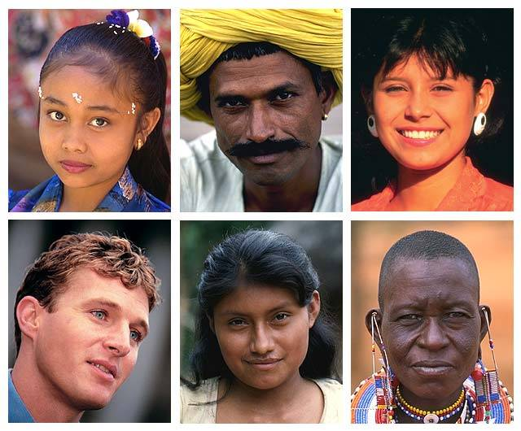

Slide 41
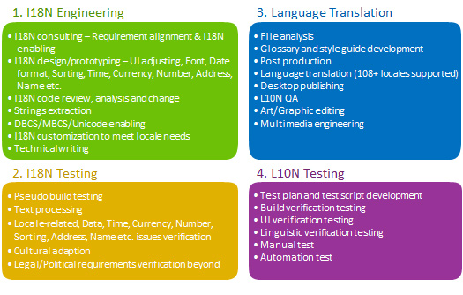
Improve the GIL processes

Slide 42
Technical Resources:
http://wiki.kolmisoft.com/index.php/Localization
http://www.lingobit.com/solutions/win32/mfc_win32_localization.html

Slide 44
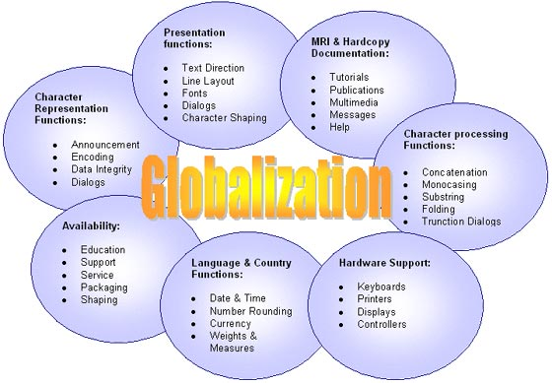

Slide 45
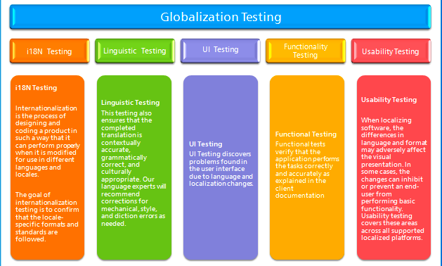

Slide 46
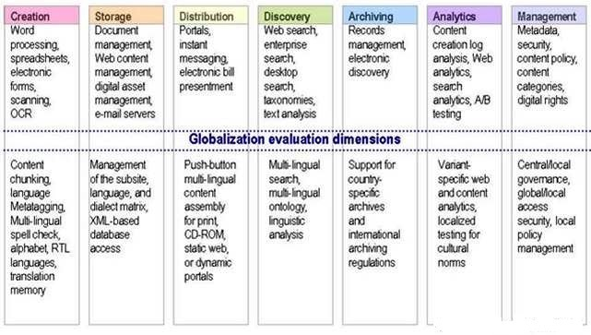

Slide 47
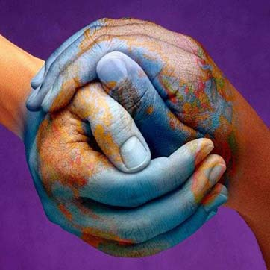
Thank you for viewing

